Slide 1
Analytics and Data Visualization of Baby Name in New York City - Shailendra Khadka Yadav

Slide 2
Outline
Inroduction
Problem Statement
Dataset Descriptions and Source
Pre-processing on data
Technologies
Preferred Analysis
Visualizations
Lessons Learned

Slide 3
1. Introduction
This study includes Analytics and Data Visualization of baby name and birth in New York City, which describes the different visualization on the basis of baby name, county, and gender.
The study focuses on explaining the most popular baby name, birth analysis based on year, county and gender on the different attributes.
The data source is taken from
https://health.data.ny.gov/Health/Baby-Names- Beginning-2007/jxy9-yhdk
Notes:
Based on the above dataset information is inquired, sorted, grouped, and visualized for preferred
analysis.
In this project, I have shown the different visualization based on the statistics for last 9 years (2007~2015) available

Slide 4
2. Problem Statement
The goal is to study the similarities and differences, concerning the naming tendency.
Exploring the naming analogies or differences between counties, in an easy and comprehensive way.
It is also inspired all these young parents who would like to get some ideas in naming their children.
Notes:
There are two primary portals that someone is able to explore baby names, also with the help of visualization tools
-Name Voyager
-Name Trends

Slide 5
3. Dataset Descriptions and Source
The major attributes mentioned in the dataset are
Year (numeric) : In which Year the baby was born
First.Name (string) : First Name of the baby
County (string) : Name of the state
Sex (string) : Gender of the baby
Count (numeric) : Count the baby of that particular first name
Data source:
https://health.data.ny.gov/Health/Baby-Names-Beginning-2007/jxy9-yhdk
Notes:
The input dataset consists of 145,570 rows representing newborn children’s names in the New
York State Baby Names, aggregated by name, gender, year and state or county where the mother
resided as stated on a New York State or New York City (NYC) birth certificate.

Slide 6
4. Pre-processing on data
Since the input dataset consists of 145,570 rows and 5 variables, the same County name is recorded as uppercase and lower case.
For example kings and KINGS seems like two different county.
after pre-processing to the data by converting all County name into uppercase.

Slide 7
5. Technologies
This project is done using R and packages are needed
ggplot2
Ploty
RColorBrewe
Wordcloud

Slide 8
6. Preferred Analysis
I have my preference to analyze the above dataset by different attributes. The major expected visualization are as follows:
Most popular first names for baby (Male and Female)
Which county have highest birth of child?
Year wise birth percentage of baby?
Gender wise baby birth analysis based on Year and county.
Gender wise yearly distribution of baby.
Notes:
I have my preference to analyze the above dataset by different attributes.

Slide 9
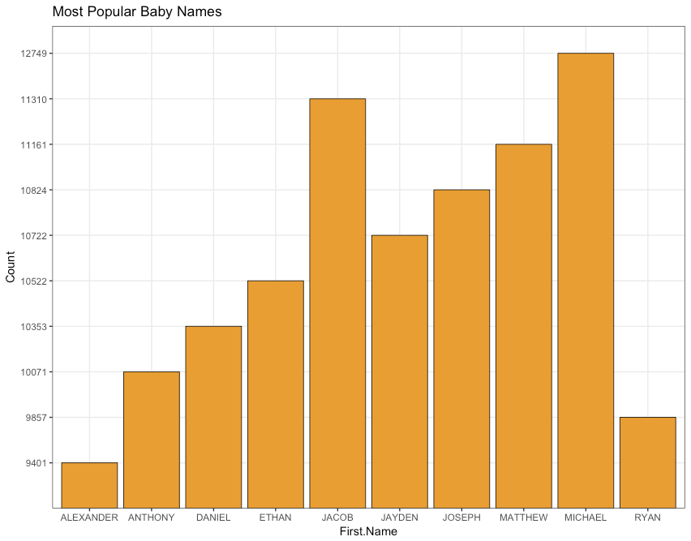
7. Visualizations
Most popular first names for baby (Male and Female)
Notes:
The above Bar graph is shown that the most popular first names for baby (Male and Female) is
“Micheal”. This name is repeated for 12749 times.

Slide 10
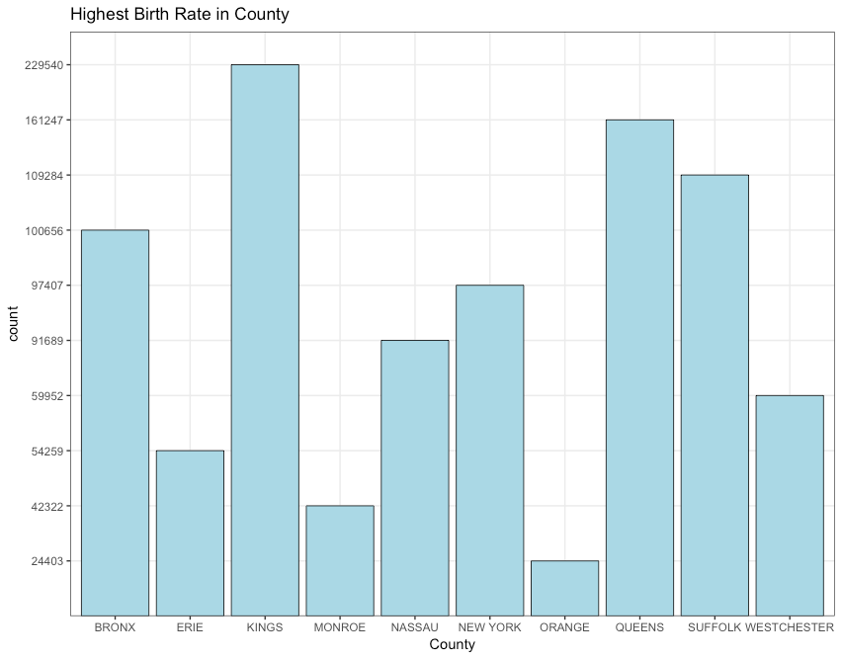
Which County have highest birth of child?
Notes:
The above Bar graph is shown that the County have highest birth of child is “Kings”. This name
is has 229540 counts.

Slide 11
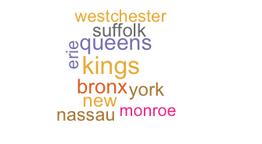
Wordcloud to show the most popular baby county name as KINGS.

Slide 12
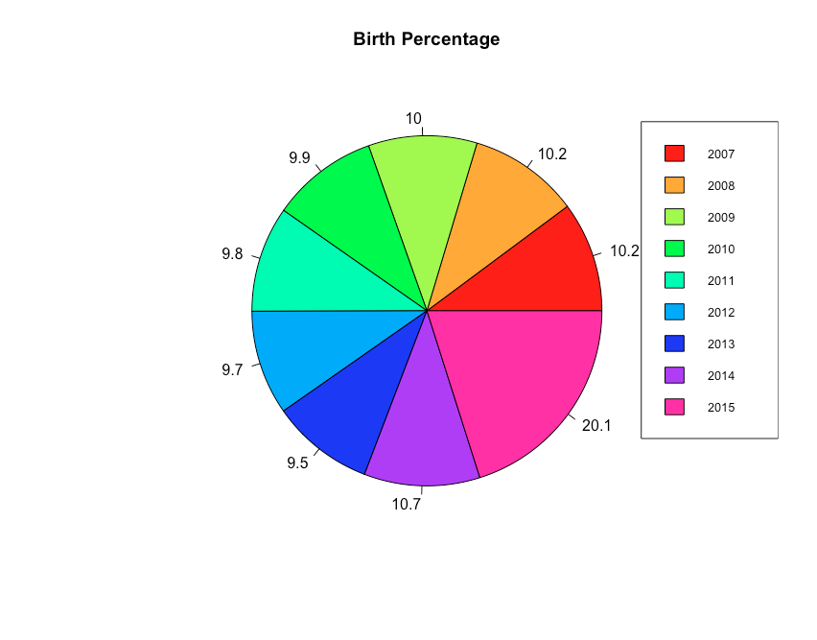
Year wise birth percentage of baby
Notes:
The highest birth percentage rate (21.1%) is in year 2015. Second highest is in 2014 (10.7%) and
the lowest birth percentage rate is in year 2013(9.5%).

Slide 13
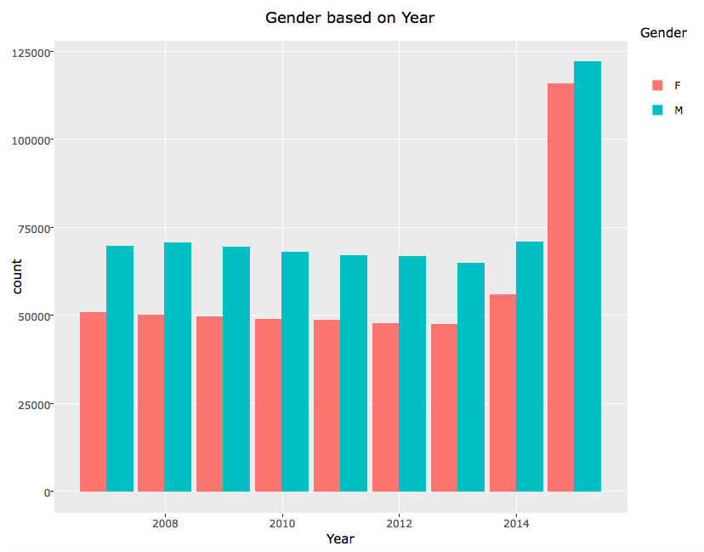
Gender wise baby birth analysis based on Year.
Notes:
The above Bar graph is shown that the Gender wise baby birth analysis based on Year. It is
shown that in year 2015 has the highest.

Slide 14
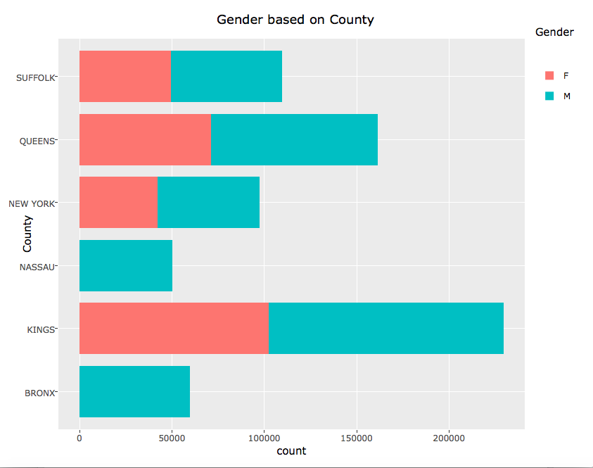
Gender wise baby birth analysis based on County.
Notes:
Bar graph to show the gender wise baby birth analysis based on county highest baby birth is in
Kings County.

Slide 15
7. Lessons Learned
Based on the implementation and observations on the data sets, the data results were sorted, grouped and visualized for interpretations.
Learned how to create different variables in a single graph and how to solve various problems in coding
Worked on wordcloud visualization, which is really exciting for me to get the more idea about visualization
Notes:
-This project has enriched my knowledge on R programming to prepare different visualization.
-learned how to create different variables in a single graph and how to solve various
problems in coding.

Slide 16
References
[1] Magdalena Pöhl, Tsafou Kyriakoula and Michael Oppermann, Baby Names Explorer – Final Report
[2] https://www.dashingd3js.com/the-data-visualization-process
[3] https://health.data.ny.gov/Health/Baby-Names-Beginning-2007/jxy9-yhdk.

Slide 17
Thank you!

