Slide 1
Concrete Compressive Strength Prediction

Slide 2
Objective:
Development of a regression model to predict the compressive strength of concrete. The model will determine what will be the compressive strength of concrete by mixing specific quantities of different components in concrete making process.
Benefits:
Optimize the usage of resources.
More economical use of raw materials.
Time efficient and cost optimization.
Helps in easy flow for managing resources.

Slide 3
Data Sharing Agreement :
Sample file name (ex "cement_strength_08012020_120000.csv")
Length of date stamp(8 digits)
Length of time stamp(6 digits)
Number of Columns (8)
Column names
Column data type

Slide 4
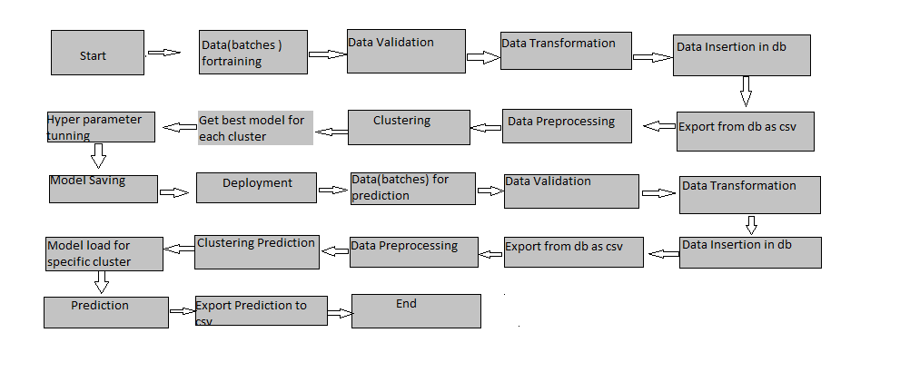
Architecture

Slide 5
Data Validation and Data Transformation :
Name Validation - Validation of files name as per the DSA. We have created a regex pattern for validation. After it checks for date format and time format if these requirements are satisfied, we move such files to to “Good_Raw” folder else move to “Bad_Raw” folder.
Number of Columns – Validation of number of columns present in the files, and if it doesn't match then the file is moved to “Bad_Raw” folder.
Name of Columns - The name of the columns is validated and should be the same as given in the schema file. If not, then the file is moved to “Bad_Raw” folder..
Data type of columns - The data type of columns is given in the schema file. It is validated when we insert the files into Database. If the datatype is wrong, then the file is moved to “Bad_Raw” folder..
Null values in columns - If any of the columns in a file have all the values as NULL or missing, we discard such a file and move it to “Bad_Raw” folder..

Slide 6
Data Insertion in Database:
Table creation :- Table name “Good_Raw_Data" is created in the database for inserting the files. If the table is already present then new files are inserted in the same table.
Insertion of files in the table - All the files in the "Good_Raw" folder are inserted in the above-created table. If any file has invalid data type in any of the columns, the file is not loaded in the table

Slide 7
Model Training:
Data Export from Db :
The accumulated data from db is exported in csv format for model training
Data Preprocessing :
Performing EDA to get insight of data like identifying distribution , outliers, trend among data etc.
Check for null values in the columns. If present impute the null values.
Perform log transformation to the numerical features.
Perform Standard Scalar to scale down the values.

Slide 8
Clustering :
KMeans algorithm is used to create clusters in the preprocessed data. The optimum number of clusters is selected by plotting the elbow plot, and for the dynamic selection of the number of clusters, we are using KneeLocator function. The idea behind clustering is to implement different algorithms on the structured data
The Kmeans model is trained over preprocessed data, and the model is saved for further use in prediction
Model Selection :
After clusters are created, we find the best model for each cluster. We are using two algorithms, "Random forest Regressor" and “Linear Regression”. For each cluster, both the algorithms are passed with the best parameters derived from GridSearch. We calculate the Rsquared scores for both models and select the model with the best score. Similarly, the model is selected for each cluster. All the models for every cluster are saved for use in prediction.

Slide 9
Prediction:
The testing files are shared in the batches and we perform the same Validation operations ,data transformation and data insertion on them.
The accumulated data from db is exported in csv format for prediction
We perform data pre-processing techniques on it.
KMeans model created during training is loaded and clusters for the preprocessed data is predicted
Based on the cluster number respective model is loaded and is used to predict the data for that cluster.
Once the prediction is done for all the clusters. The predictions are saved in csv format and shared.

Slide 10
Q & A:
Q1) What’s the source of data?
The data for training is provided by the client in multiple batches and each batch contain multiple files
Q 2) What was the type of data?
The data was of numerical type.
Q 3) What’s the complete flow you followed in this Project?
Refer slide 5th for better Understanding
Q 4) After the File validation what you do with incompatible file or files which didn’t pass the validation?
Files like these are moved to the Achieve Folder and a list of these files has been
shared with the client and we removed the bad data folder.

Slide 11
Q 5) How logs are managed?
We are using different logs as per the steps that we follow in validation and
modeling like - File validation log , Data Insertion , Model Training log , prediction log
etc.
Q 6) What techniques were you using for data pre-processing?
Removing unwanted attributes
Visualizing relation of independent variables with each other and output variables
Checking and changing Distribution of continuous values
Removing outliers
Cleaning data and imputing if null values are present.
Scaling the data

Slide 12
Q 7) How training was done or what models were used?
Before diving the data in training and validation set we performed clustering to divide the data into clusters.
As per the clusters, the training and validation data were divided.
The scaling was performed over training and validation data
Algorithms like “Random Forest Regressor”, “Linear Regression” were used based on the recall final model was used for each cluster and we saved that model .
Q 8) How Prediction was done?
The testing files are shared by the client .We Perform the same life cycle till the data is clustered .Then on the basis of cluster number, the respective model is loaded and perform prediction.
In the end we get the accumulated data of predictions.

Slide 13
Q 9) What are the different stages of deployment?
When the model is ready we deploy it in google cloud platform.
First we create a flask app in which we define route for prediction.
Then we do all the pre required settings, and deploy our model in GCP.

