Slide 1
AI Adoption Reality Check
Data-Driven Insights for Strategic AI Investment

Slide 2
The Strategic Imperative: Three Critical Actions Required
Agent adoption stalled at 4% penetration despite 4,400+ Copilot users - untapped productivity potential
87% of Agent users stuck in infrequent usage pattern (1-5 days/month) - habit formation crisis
Finance, IT, and Legal show highest unlicensed engagement - immediate license upgrade candidates

Slide 3
The Opportunity Gap

Slide 4
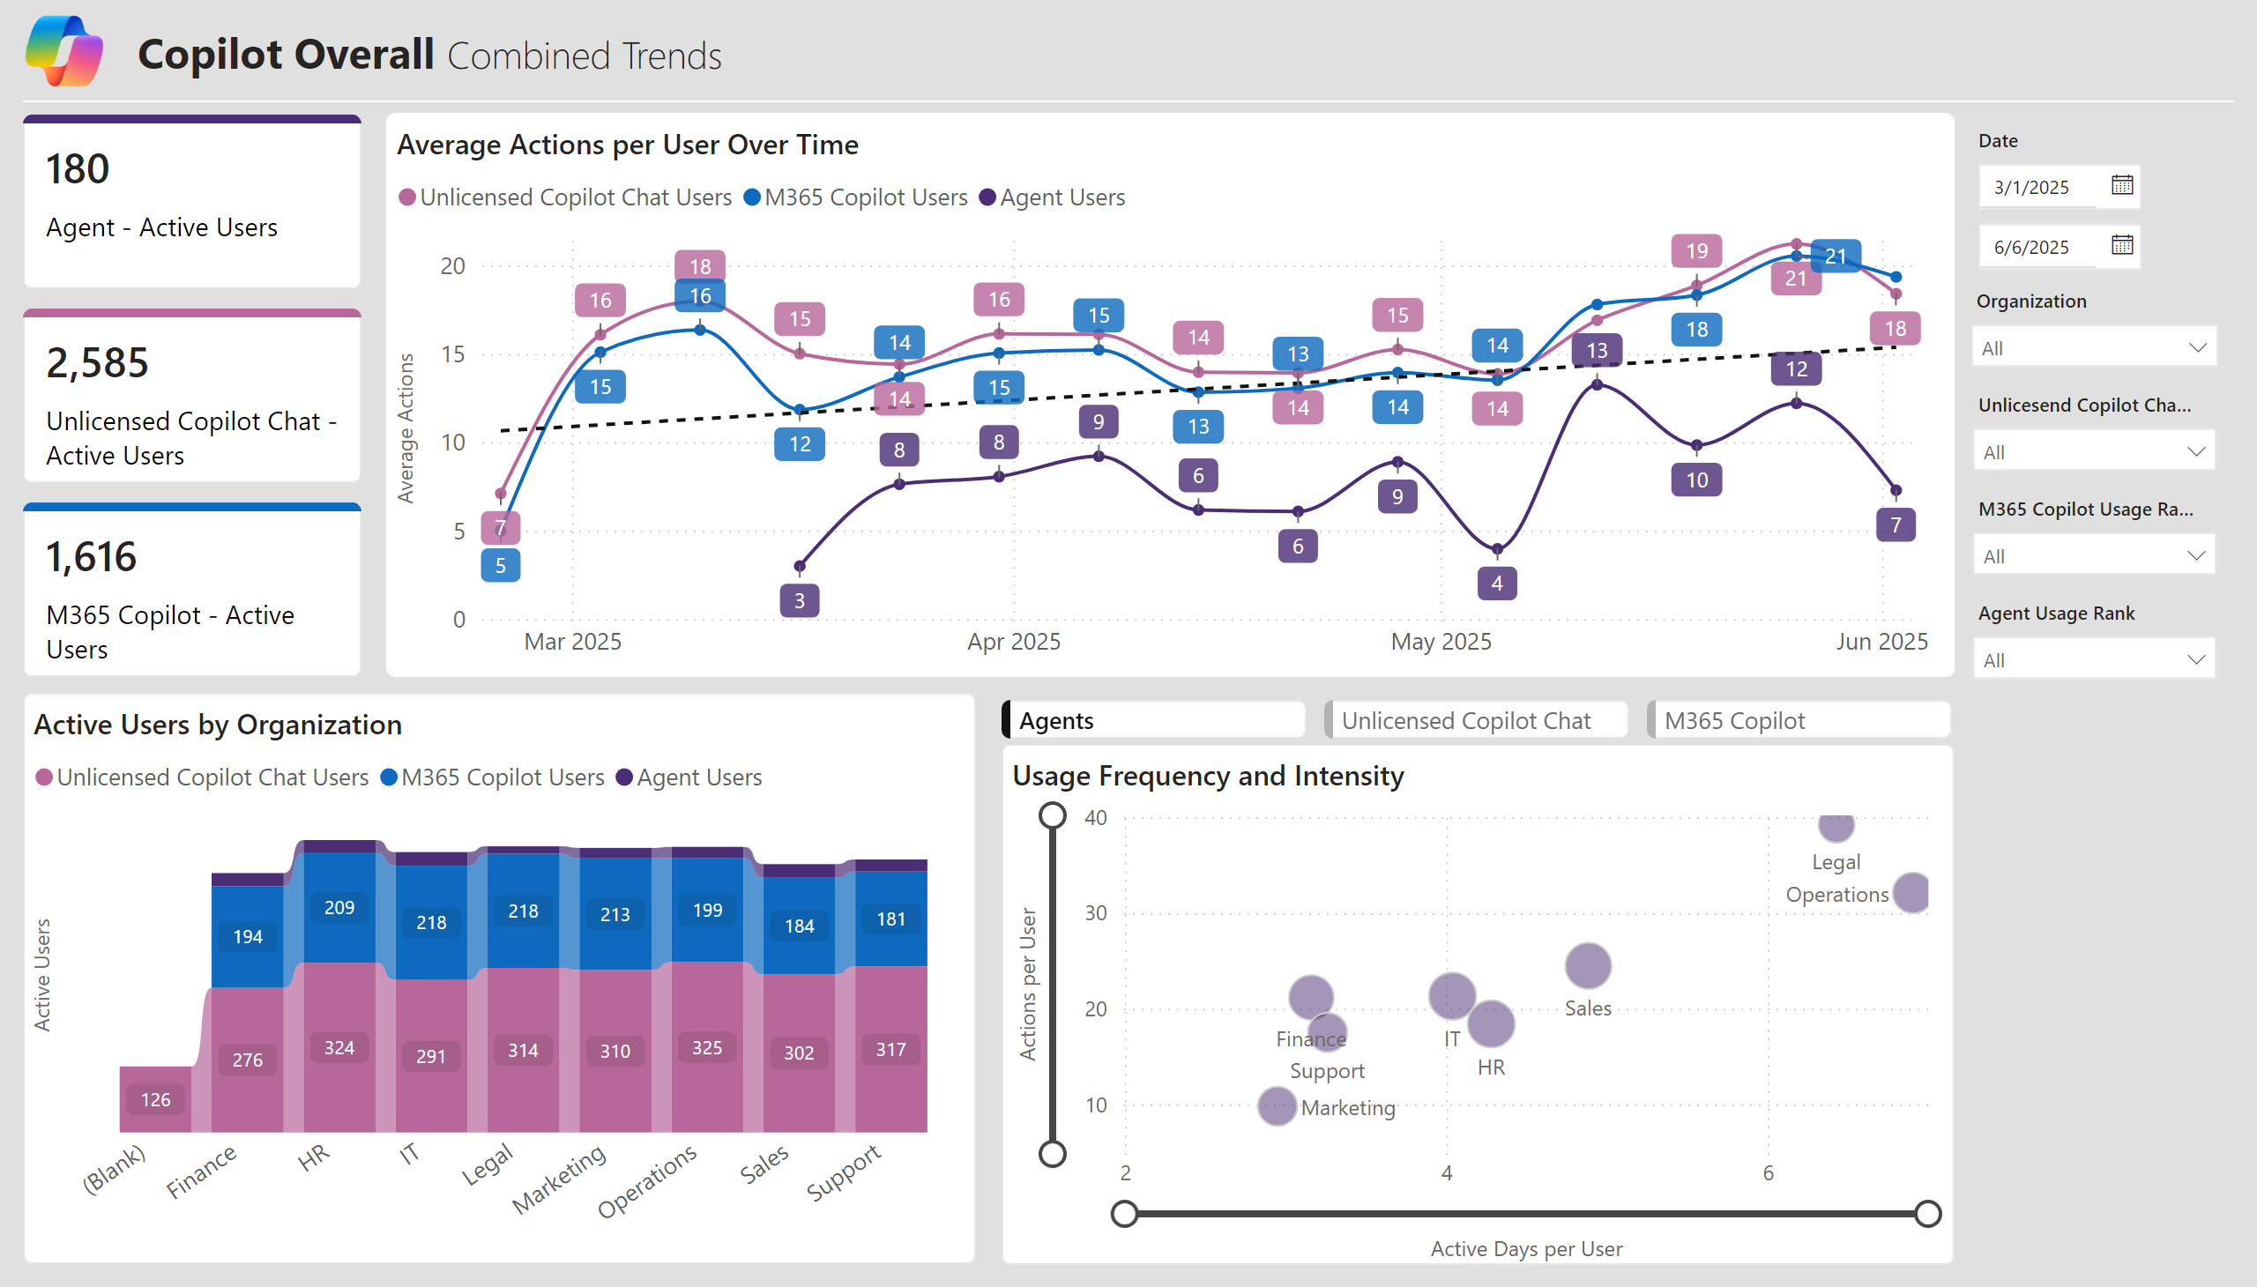
Strong Copilot adoption masks critical Agent engagement gap requiring intervention
4,381 active Copilot users (2,585 unlicensed + 1,616 M365 + 180 agents) demonstrate platform reach
Agent users show 3x growth trajectory (7 to 21 actions/month Mar-Jun) validating capability value
Legal Operations emerged as power user segment (35 actions/user, 6+ active days) - replication opportunity

Slide 5
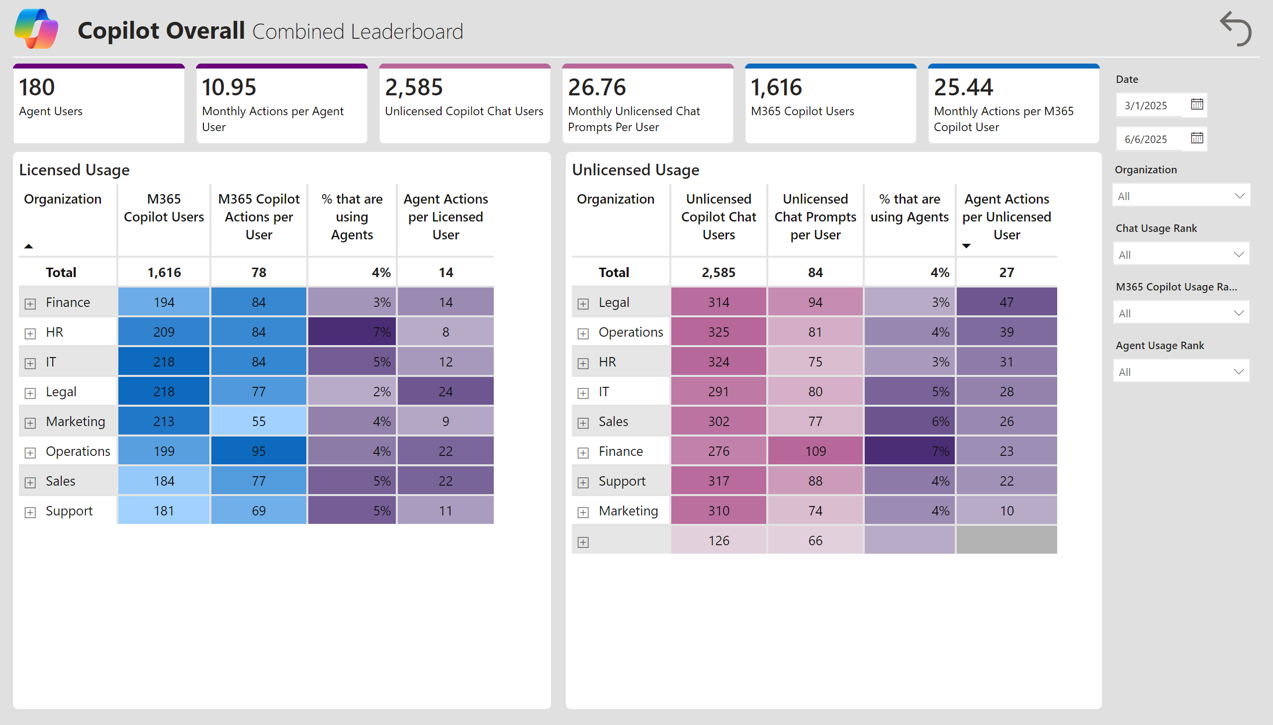
96% of Copilot users have never tried Agents - massive awareness and adoption gap
Only 4% of 4,200+ Copilot users have adopted Agents across both licensed and unlicensed segments
Finance shows 7% agent adoption (highest) at 109 prompts/user - proof point for targeted enablement
Gap represents 4,000+ users unaware of or unmotivated to try agentic capabilities - immediate action required

Slide 6
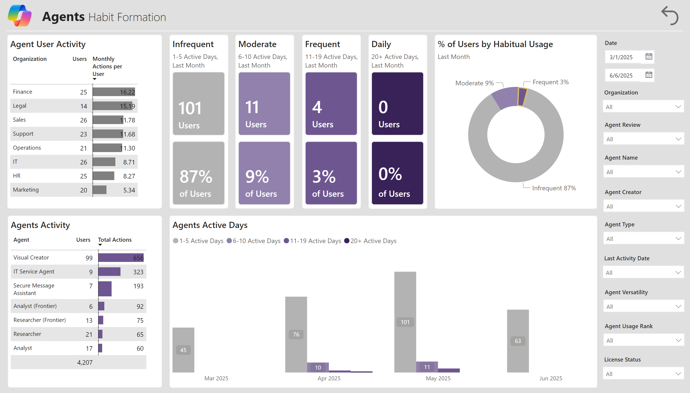
87% of Agent users remain infrequent - usage has not embedded into workflows
Zero daily users (20+ days/month) and only 3% frequent users signals fundamental adoption challenge
Finance and Legal show highest engagement (16 actions/user) yet still infrequent - onboarding gap
Pattern suggests discovery phase stuck - users try once but fail to integrate into daily workflows

Slide 7
Visual Creator captures 99 of 180 users - single use case driving all adoption
55% of Agent users concentrated in Visual Creator (656 actions) while other agents see minimal usage
IT Service Agent (9 users, 323 actions) shows depth potential with high actions per engaged user
Concentration risk: Agent value proposition currently perceived as single-purpose vs. platform capability

Slide 8
License Optimization

Slide 9
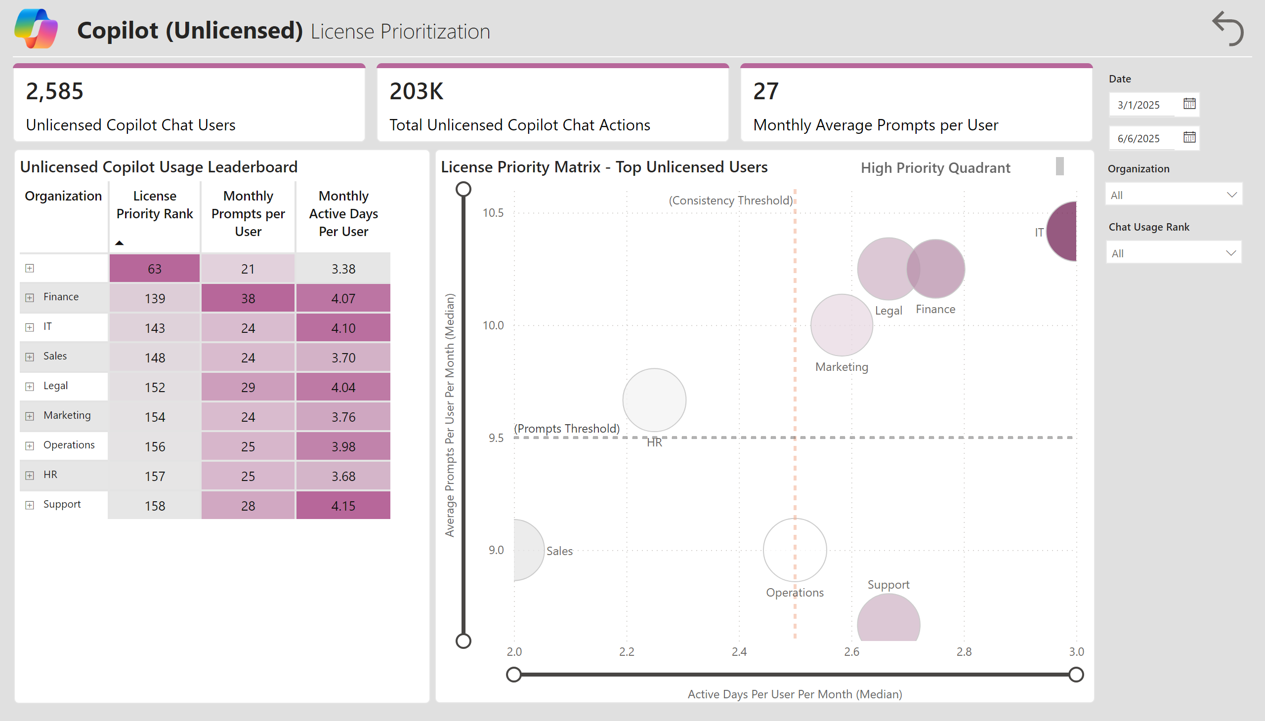
Finance, IT, and Legal unlicensed power users represent immediate ROI upgrade targets
Finance (38 prompts/user), IT (24 prompts), Legal (29 prompts) show sustained high usage in unlicensed tier
Priority matrix identifies these departments in high-value quadrant (usage + consistency above threshold)
Converting these 324 + 291 + 314 = 929 users captures proven high-engagement audience for license revenue

Slide 10
203K unlicensed actions demonstrate platform value but foregone premium feature adoption
2,585 unlicensed users generating 203K actions (27 prompts/user/month avg) validate core value proposition
Activity concentration in Finance, Legal, Operations suggests enterprise use cases ready for M365 integration
License strategy: Target departments with 25+ prompts/user and 4+ active days as conversion priority

Slide 11
Strategic Action Plan

Slide 12
Action 1: Launch targeted Agent awareness campaign to 96% who have never tried
Launch department-specific Agent showcases in Finance and Legal (highest current success)
Deploy Visual Creator quick-start guides to all 2,585 unlicensed users as gateway drug to platform
Establish Agent champions program in departments showing >10 actions/user to evangelize use cases

Slide 13
Action 2: Implement 30-day habit formation program to convert infrequent to frequent users
Design daily use case prompts for Finance (16 actions/user) to push from infrequent to frequent tier
Create workflow integration guides showing how to embed Agent calls into existing business processes
Set target: Move 20% of 101 infrequent users to moderate tier (6-10 days/month) within 90 days

Slide 14
Action 3: Prioritize 900+ Finance/IT/Legal users for M365 license upgrades
Phase 1: Upgrade Finance (324 users, 38 prompts/user) and Legal (314 users, 29 prompts/user) high-value cohort
Target users with >25 monthly prompts and >4 active days as proven engaged audience for M365 features
Expected outcome: Convert proven unlicensed power users to revenue-generating licensed customers

Slide 15
Expected outcomes: 10x Agent adoption, 50% habit formation improvement, 900 license conversions
Agent adoption: From 180 to 1,800+ users (4% to 40% penetration) via awareness campaign and champion network
Habit formation: From 0% daily users to 15% daily users via 30-day integration program in Finance/Legal
License revenue: Convert 900 high-value unlicensed users in Finance/IT/Legal to M365 premium tier

Slide 16
Data reveals adoption paradox: strong platform reach with weak Agent engagement
Current state: 4,381 Copilot users but only 4% trying Agents, 87% infrequent usage, 203K unlicensed actions
Three priorities: Agent awareness blitz, habit formation program, strategic license upgrades (Finance/IT/Legal)
Success metrics: Track Agent penetration, daily user %, and license conversion rate monthly through Q2 2026

