Slide 1
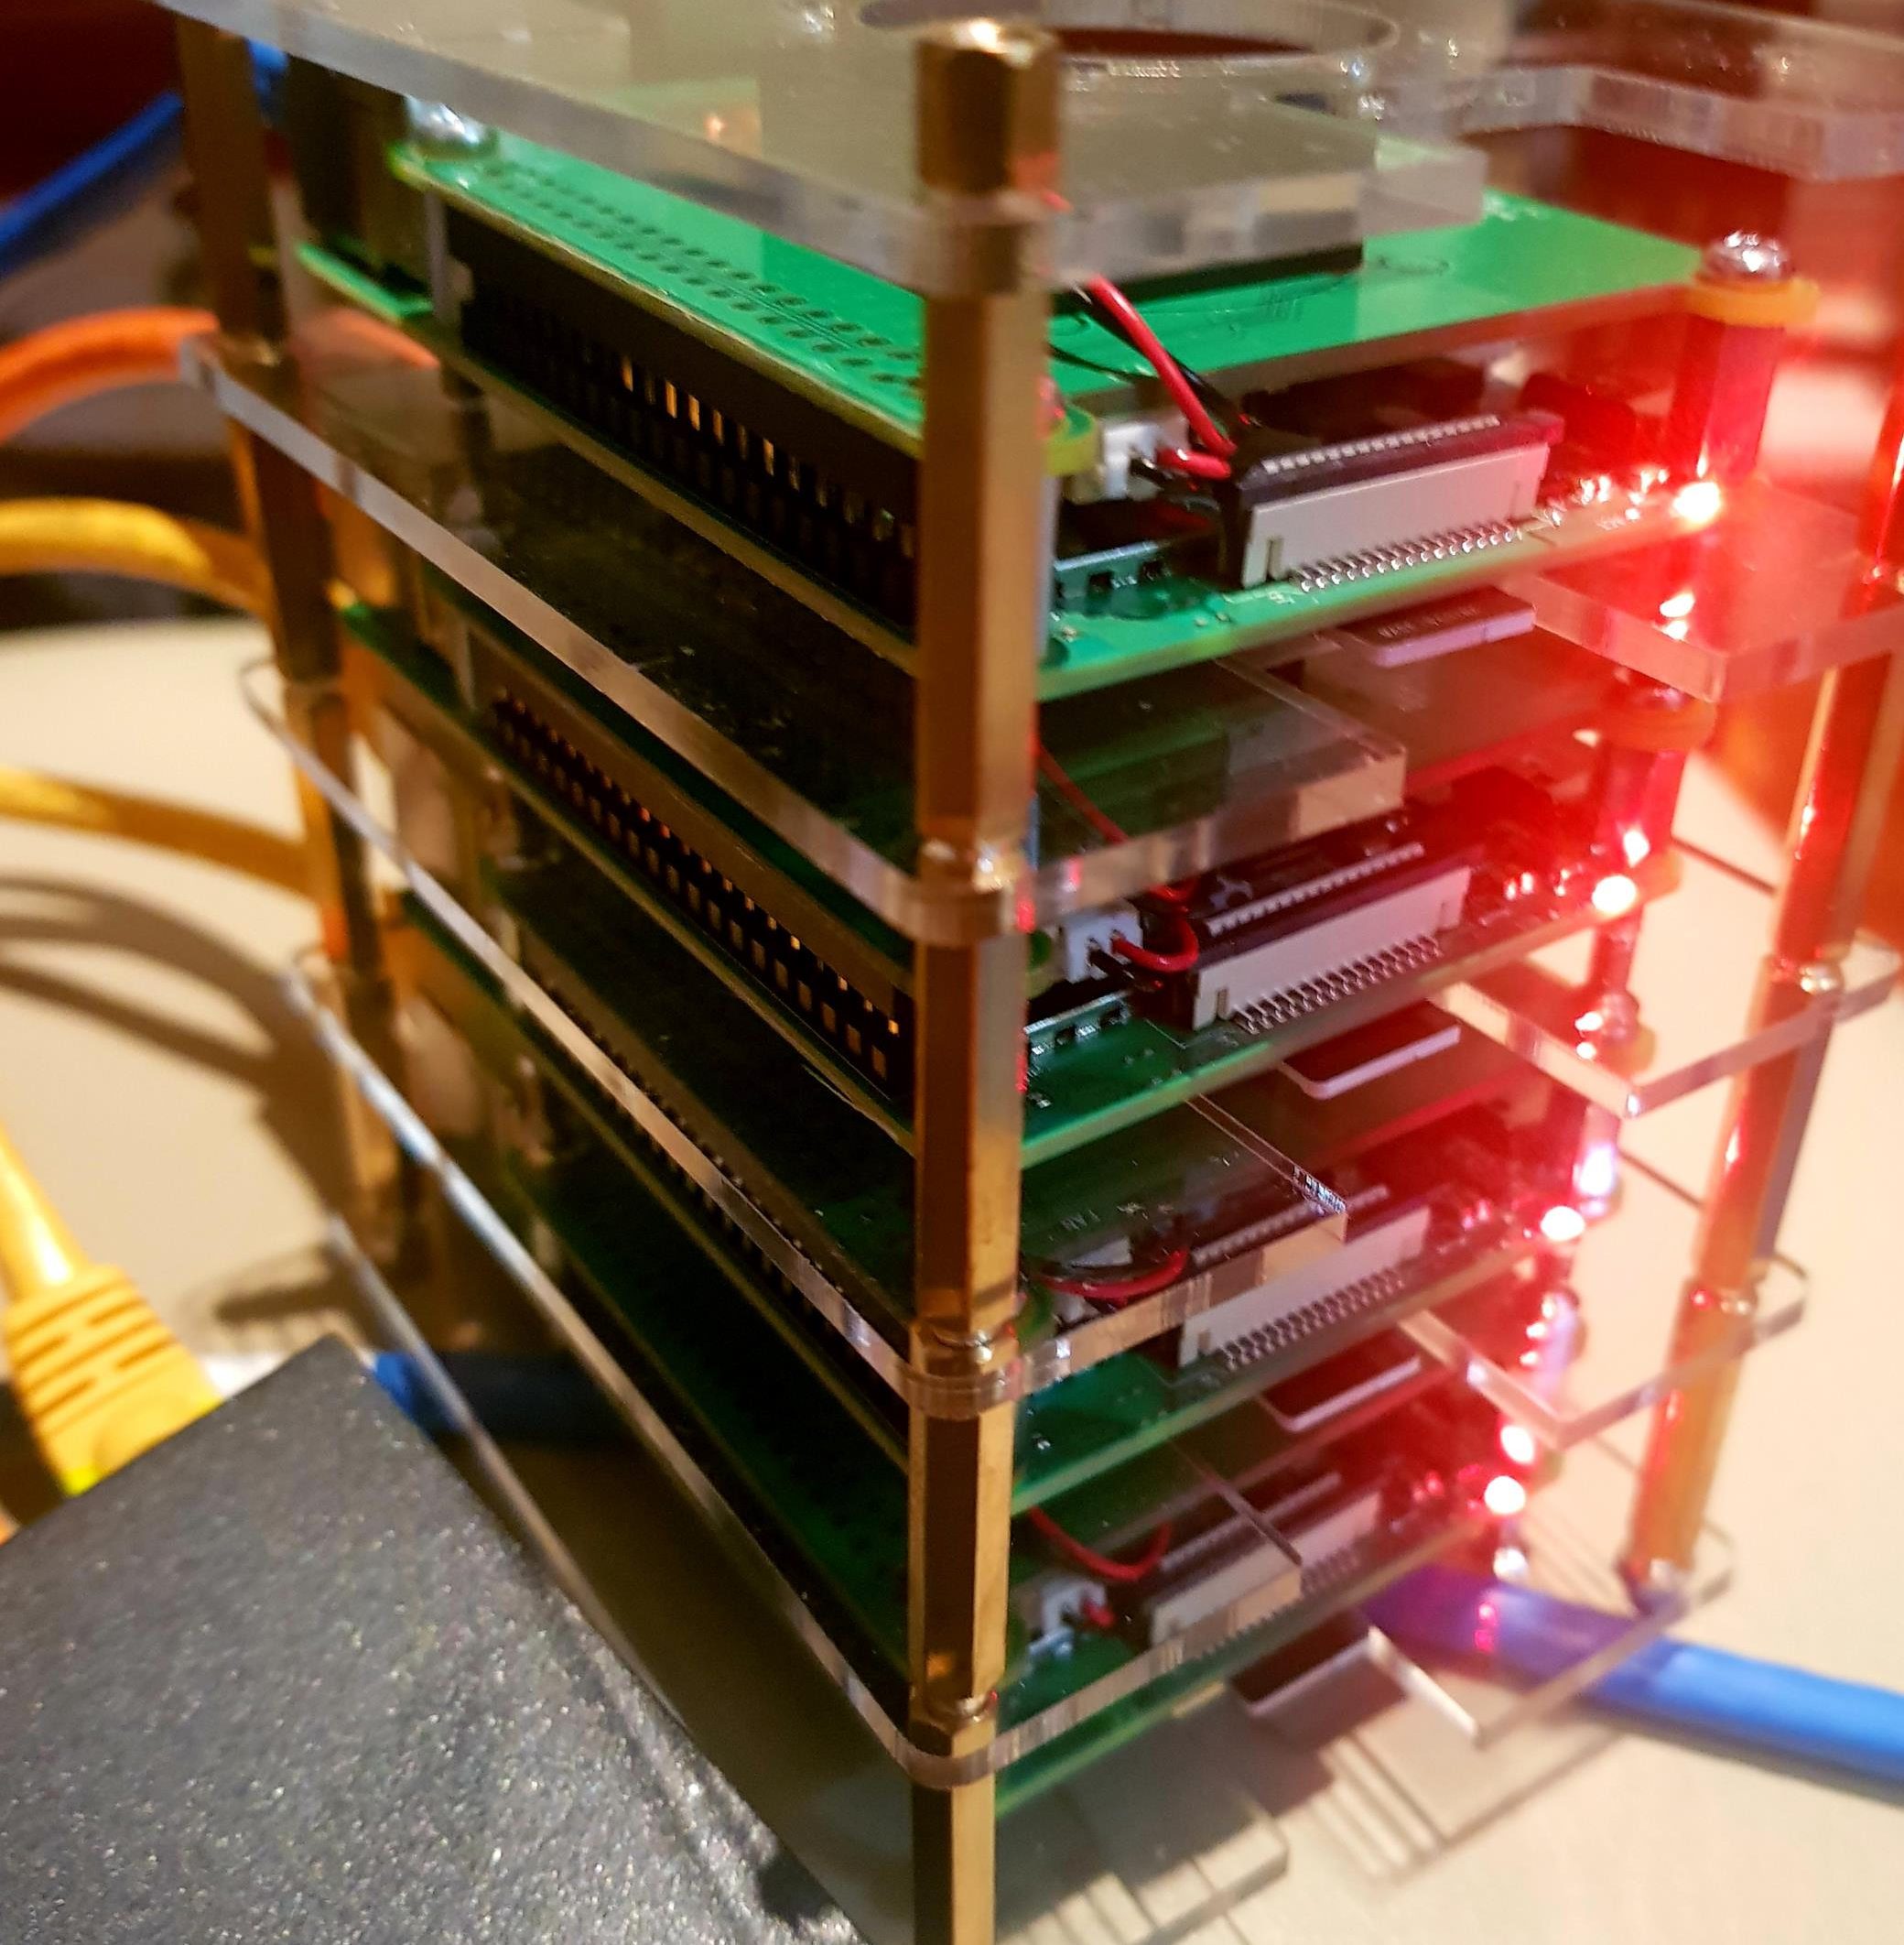
Scaling Services on a Raspberry Pi Microserver Cluster
Components in a Pi cluster
Installation
Creating a Docker Swarm
Enlisting Manager and works
Creating a service
Visualizing workload
Scaling
Fault Tolerence

