Slide 1


Slide 2
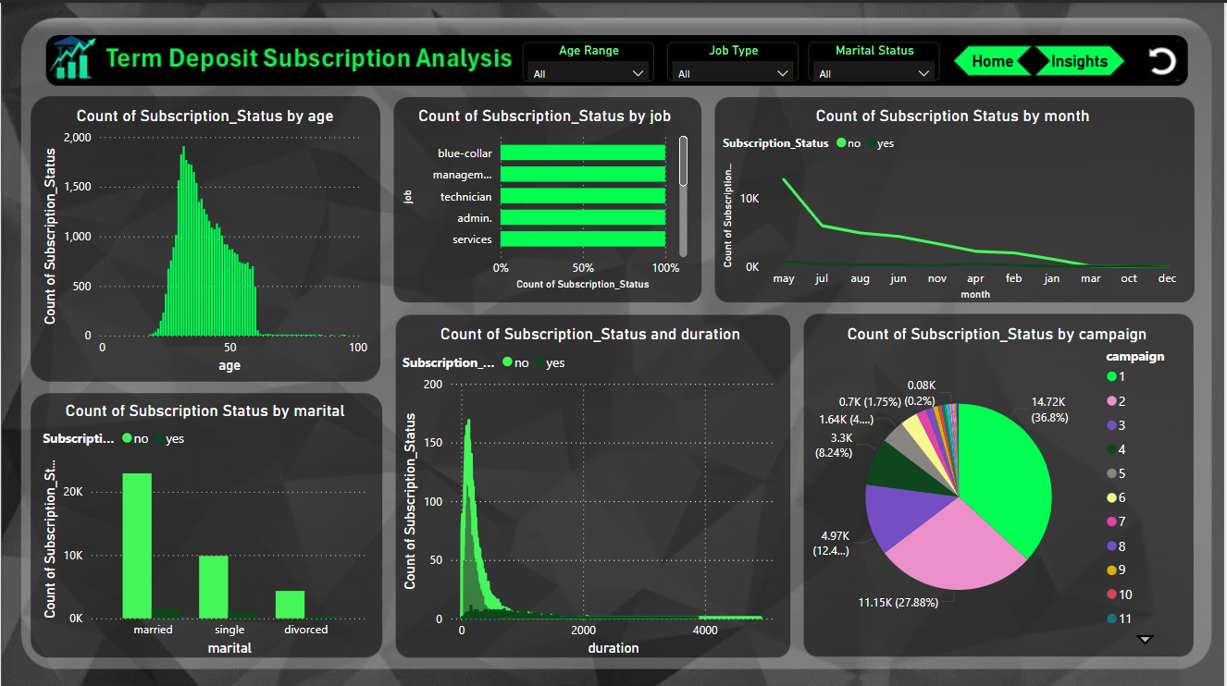

Slide 3
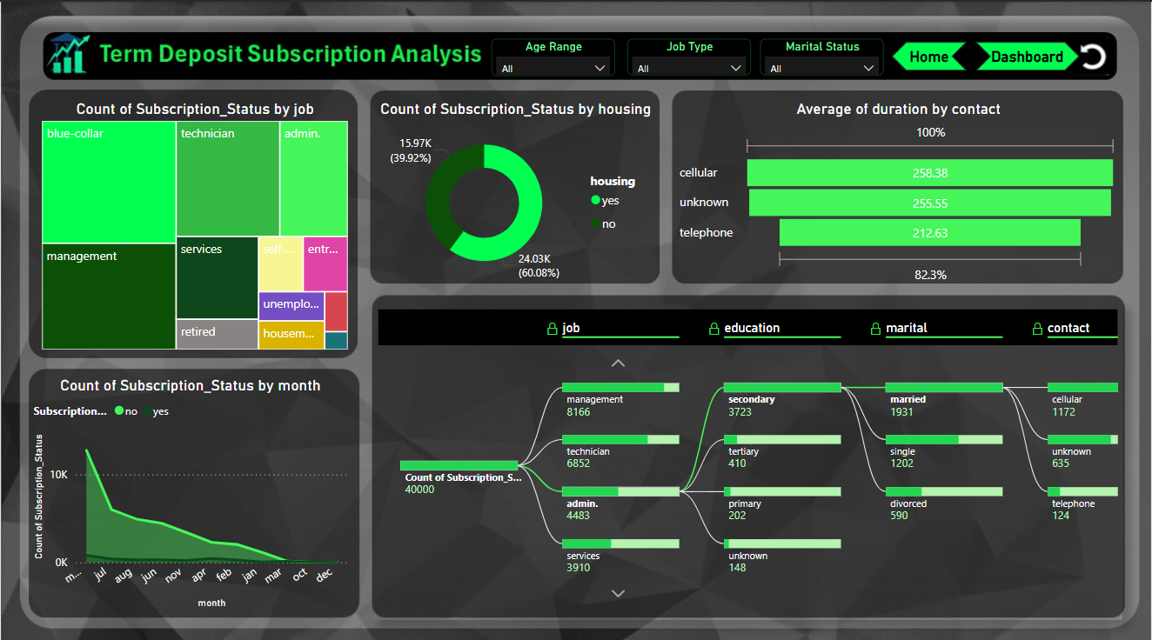

Slide 4




This is the logo and when we click on Logo we will be redirected to the home page.
This is the navigator button and when we click on the buttons we will be redirected to the different pages of powerbi.
This is the clear all slicers button. When we click on the button all the slicers will be cleared.

Slide 5


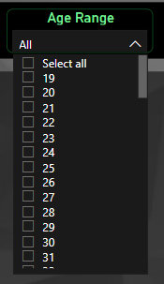
Slicers
Understanding :
The dataset contains information about bank clients, including their demographics (job type, marital status, and age) and details about their financial behaviors. These attributes are crucial for understanding the target audience for the term deposit campaigns.
Approach :
The slicers provide dynamic filtering options for visualizing trends across different subsets of the data based on job type, marital status, and age range.
Understanding
The slicers themselves do not involve a predictive model but enhance the dashboard by allowing users to interactively explore filtered subsets of the data. Enabling users to analyze how specific groups (e.g., married technicians) contribute to campaign success.

Slide 6
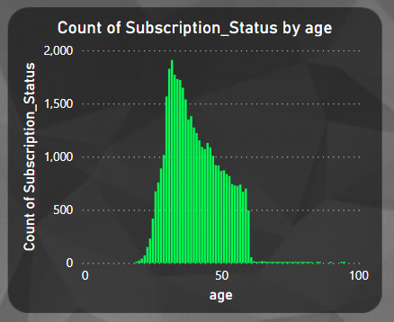
Stacked Column Chart
Understanding :
The dataset includes information about the age of clients and their subscription status for a term deposit. Age: Represents the age of each client. Subscription Status (y): A binary column indicating whether the client subscribed to the term deposit (Yes/No).
Approach :
To analyze how different age groups respond to marketing campaigns and whether they are more likely to subscribe to term deposits.
Understanding
The stacked column chart is a descriptive tool rather than a predictive model.
The proportion of subscriptions and non-subscriptions within each age group.
Comparative trends across age ranges to identify the most responsive demographics.

Slide 7
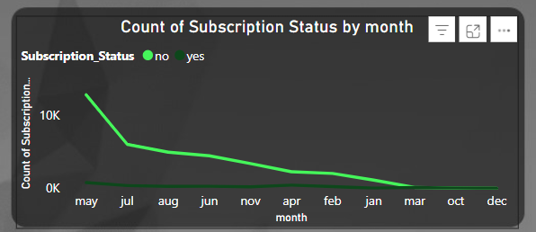
Stacked Column Chart
Understanding :
The dataset includes information about the age of clients and their subscription status for a term deposit. Age: Represents the age of each client. Subscription Status (y): A binary column indicating whether the client subscribed to the term deposit (Yes/No).
Approach :
To analyze how different age groups respond to marketing campaigns and whether they are more likely to subscribe to term deposits.
Understanding
The stacked column chart is a descriptive tool rather than a predictive model.
The proportion of subscriptions and non-subscriptions within each age group.
Comparative trends across age ranges to identify the most responsive demographics.

Slide 8
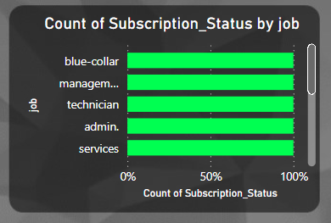
100% Stacked Column Chart
Understanding :
The dataset includes data about clients' job types and their subscription status for term deposits.Job: Categorical variable indicating the type of job (e.g., admin, management, technician, etc.
Approach :
To analyze the relative proportion of subscriptions across different job types and determine which professions are more likely to subscribe.
Understanding
The 100% stacked column chart provides a proportional view of the subscription status within each job category.
It ensures that the comparison focuses on relative differences, irrespective of the total number of clients in each job type.
Useful for identifying trends in job categories with higher or lower subscription likelihoods.

Slide 9
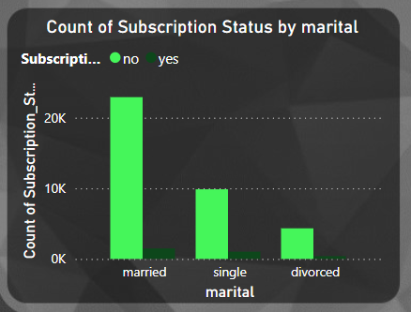
Clustered Column Chart
Understanding :
The dataset includes marital status and subscription status information for clients of the bank. Marital Status: Categorical variable indicating the marital status of the client (e.g., married, single, divorced.
Approach :
To analyze how marital status impacts subscription decisions and identify trends or patterns.
Understanding
The clustered column chart allows direct comparison of subscription counts across different marital groups.
Each marital status is represented by separate clusters, making it easy to compare the number of "Yes" and "No" responses side by side.

Slide 10
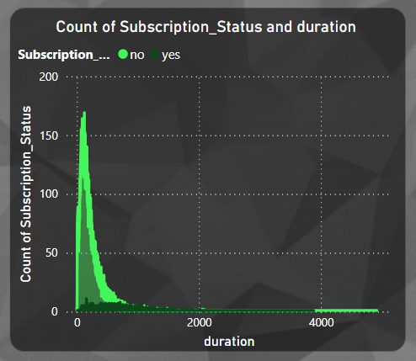
Area Chart
Understanding :
This variable represents the last contact duration (in seconds) during the telephonic marketing campaign.
Approach :
To analyze how the duration of a call influences a client's likelihood to subscribe to the term deposit.
Understanding
The area chart effectively shows the overlap and differences in subscription counts across call durations.
The stacked areas provide a visual representation of how "Yes" and "No" responses contribute to the total count for each duration range.

Slide 11
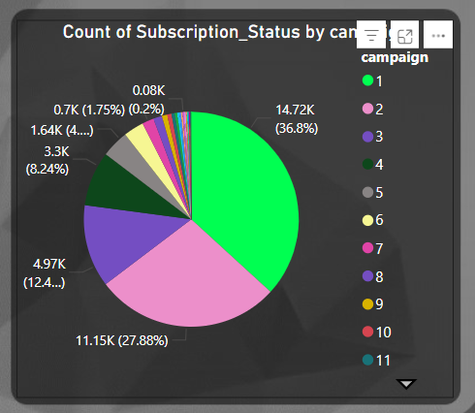
Area Chart
Understanding :
Campaign: Represents the number of contacts made during the current campaign to a client (numeric value).Subscription Status (y): Indicates whether the client subscribed to the term deposit ("Yes" or "No").
Approach :
To analyze how the number of calls in a campaign influences the likelihood of subscription.
Understanding
A pie chart effectively visualizes proportions, making it easier to understand the distribution of campaign efforts across subscription outcomes. It highlights the campaign counts that contribute the most to the overall results.

Slide 12
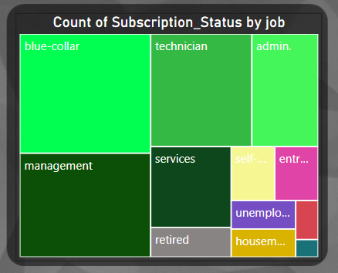
Tree Map
Understanding :
The dataset includes information about the age of clients and their subscription status for a term deposit. Age: Represents the age of each client. Subscription Status (y): A binary column indicating whether the client subscribed to the term deposit (Yes/No).
Approach :
To analyze how different age groups respond to marketing campaigns and whether they are more likely to subscribe to term deposits.
Understanding
The stacked column chart is a descriptive tool rather than a predictive model.
The proportion of subscriptions and non-subscriptions within each age group.
Comparative trends across age ranges to identify the most responsive demographics.

Slide 13
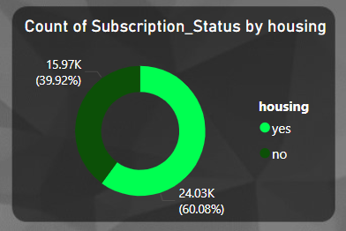
Donut Chart
Understanding :
The dataset includes information about the age of clients and their subscription status for a term deposit. Age: Represents the age of each client. Subscription Status (y): A binary column indicating whether the client subscribed to the term deposit (Yes/No).
Approach :
To analyze how different age groups respond to marketing campaigns and whether they are more likely to subscribe to term deposits.
Understanding
The stacked column chart is a descriptive tool rather than a predictive model.
The proportion of subscriptions and non-subscriptions within each age group.
Comparative trends across age ranges to identify the most responsive demographics.

Slide 14
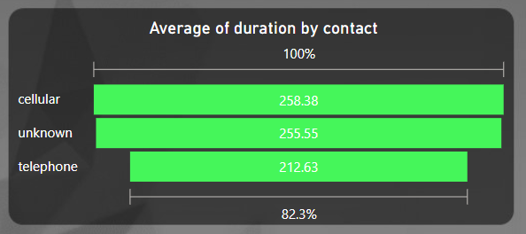
Funnel Chart
Understanding :
The dataset includes information about the age of clients and their subscription status for a term deposit. Age: Represents the age of each client. Subscription Status (y): A binary column indicating whether the client subscribed to the term deposit (Yes/No).
Approach :
To analyze how different age groups respond to marketing campaigns and whether they are more likely to subscribe to term deposits.
Understanding
The stacked column chart is a descriptive tool rather than a predictive model.
The proportion of subscriptions and non-subscriptions within each age group.
Comparative trends across age ranges to identify the most responsive demographics.

Slide 15
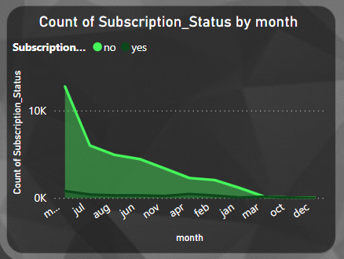
Area Chart
Understanding :
The dataset includes information about the age of clients and their subscription status for a term deposit. Age: Represents the age of each client. Subscription Status (y): A binary column indicating whether the client subscribed to the term deposit (Yes/No).
Approach :
To analyze how different age groups respond to marketing campaigns and whether they are more likely to subscribe to term deposits.
Understanding
The stacked column chart is a descriptive tool rather than a predictive model.
The proportion of subscriptions and non-subscriptions within each age group.
Comparative trends across age ranges to identify the most responsive demographics.

Slide 16
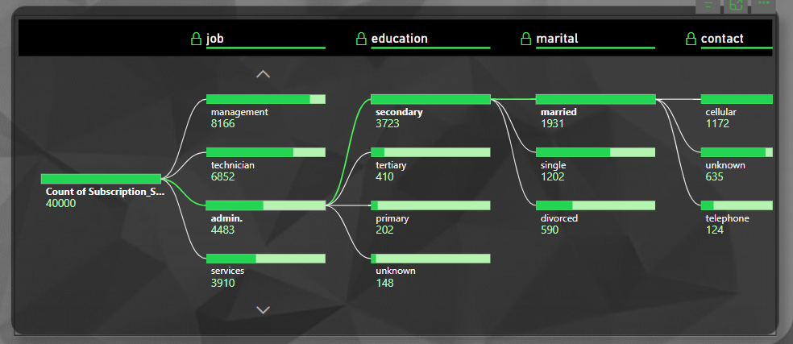
Decomposition Tree
Understanding :
The dataset includes information about the age of clients and their subscription status for a term deposit. Age: Represents the age of each client. Subscription Status (y): A binary column indicating whether the client subscribed to the term deposit (Yes/No).
Approach :
To analyze how different age groups respond to marketing campaigns and whether they are more likely to subscribe to term deposits.
Understanding
The stacked column chart is a descriptive tool rather than a predictive model.
The proportion of subscriptions and non-subscriptions within each age group.
Comparative trends across age ranges to identify the most responsive demographics.

