Slide 1



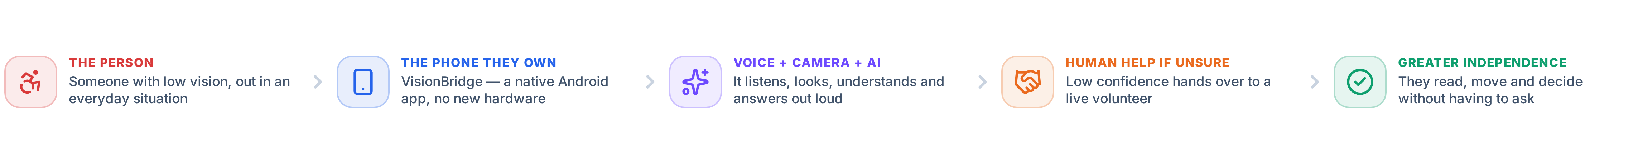
SMART INDIA HACKATHON 2026
TITLE PAGE
VisionBridge
NATIVE ANDROID ACCESSIBILITY COMPANION
An AI-powered Android companion that helps people with low vision read, understand, navigate and stay safe — and hands over to a real volunteer the moment the AI is not sure.
PROBLEM STATEMENT ID
PROBLEM STATEMENT TITLE
26196
Student Innovation
THEME
PS CATEGORY
MedTech / BioTech / HealthTech
Software
TEAM ID
TEAM NAME
—
Prime Innovators
Notes:
Problem statement 26196 · Student Innovation · MedTech/BioTech/HealthTech · Software. VisionBridge is now a native Android app (Kotlin + Jetpack Compose), not a web app.

Slide 2
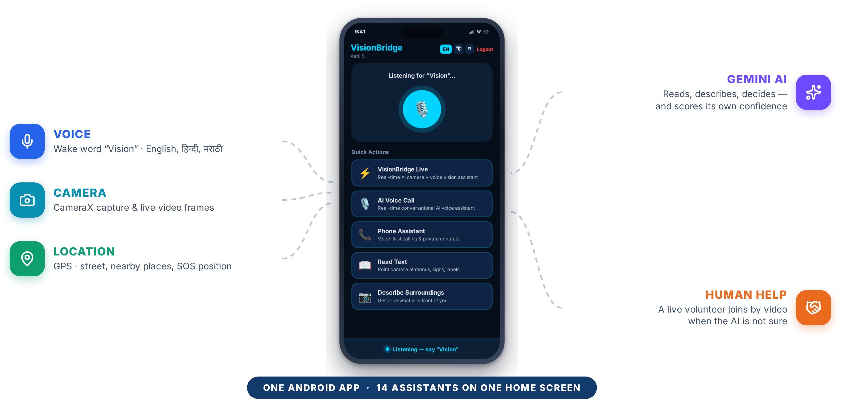


















IDEA / PROPOSED SOLUTION
Prime Innovators
VisionBridge — one Android app that lets a person with low vision read, understand, move and ask for help, using only their voice.
THE PROBLEM · FIVE EVERYDAY MOMENTS
THE SOLUTION · VOICE + CAMERA + AI + LOCATION + PEOPLE
Printed text has no voice
Menus, medicine labels, bills, notices
Transport is guesswork
Which bus is this? Which platform?
Hazards give no warning
A step, a parked scooter, an open drain
“Where am I?”
Street names and nearby places are invisible
Always having to ask
Independence depends on a stranger being free
CONFIDENCE ≥ 0.70
CONFIDENCE < 0.70
AI FIRST.
HUMAN HELP WHEN
AI IS NOT ENOUGH.
The answer is spoken immediately and kept in context, so the next question needs no new photo.
The app refuses to guess. “Shall I connect you to a volunteer?” — one spoken yes opens a live video call.
Notes:
Lead with the problem, then the phone. The confidence gate is the core idea: the app would rather say it is unsure and fetch a human than guess.

Slide 3

























TECHNICAL APPROACH
Prime Innovators
HOW IT WORKS · FROM A SPOKEN SENTENCE TO A SPOKEN ANSWER
USER INPUT
ANDROID APP
SUPABASE BACKEND
GOOGLE GEMINI
ASSISTANCE
Voice — wake word “Vision”
Camera — photo or live video
Touch · GPS location
Kotlin + Jetpack Compose
41 on-device voice rules
Screen + 3-turn memory
20 Deno Edge Functions
Auth · Postgres + RLS
Realtime WebSocket
Vision → JSON + confidence
Live API, native audio
4-model fallback chain
Spoken answer (Android TTS)
High-contrast screen
The right feature opens
HUMAN FALLBACK Below 0.70 confidence the app stops, says so aloud and offers a live volunteer — a WebRTC video call signalled over Supabase Realtime.
THE SAME FOUR STEPS BEHIND EVERY FEATURE
INPUT
UNDERSTAND
DECIDE
ASSIST
The user speaks or points the camera
Gemini reads the words and the image
Route the intent · score the confidence
Speak the answer, or hand to a human
TECHNOLOGIES ACTUALLY USED IN THE CURRENT ANDROID BUILD
Kotlin
Jetpack Compose
CameraX
SpeechRecognizer + TTS
Google Gemini
Gemini Live API
Language · minSdk 24
Material 3 UI · 23 screens
Capture + live frames
Android voice in / out
Vision → JSON + confidence
Native audio over WebSocket
Supabase Auth
Postgres + RLS
Supabase Realtime
Edge Functions (Deno)
WebRTC
Media3 / ExoPlayer
JWT session + refresh
11 tables, row-level policies
Volunteer call signalling
20 server endpoints
Volunteer video calls
Radio, stories, audio games
ALSO IN THE BUILD OkHttp · DataStore · Play Services Location · OpenStreetMap · WhatsApp Cloud API. The Gemini key never leaves the server — Live sessions use ephemeral tokens.
Notes:
Android app → Supabase Edge Functions → Gemini → spoken answer. The Gemini key stays server-side; Live sessions use ephemeral tokens. 41 on-device voice rules mean most commands never touch the network.

Slide 4





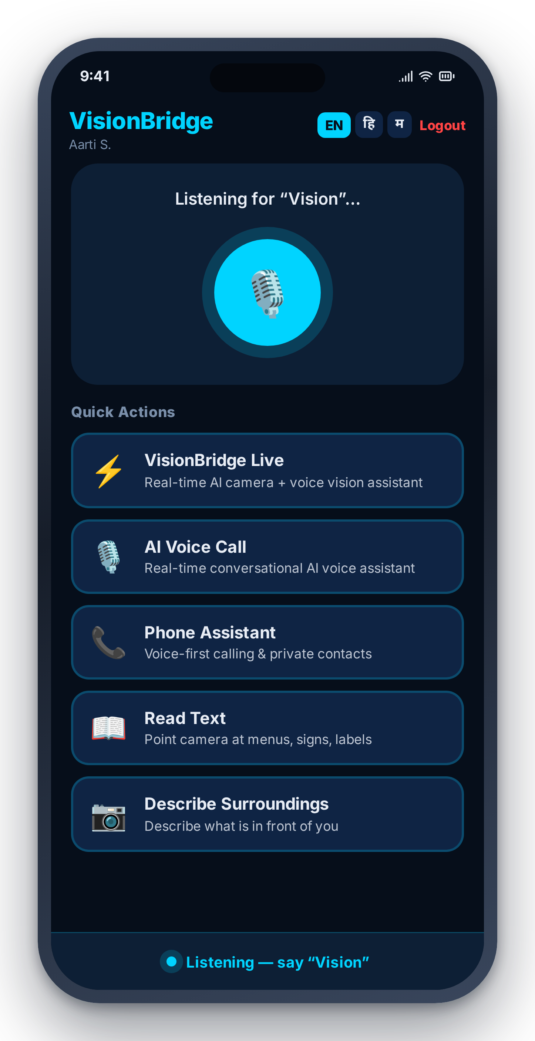
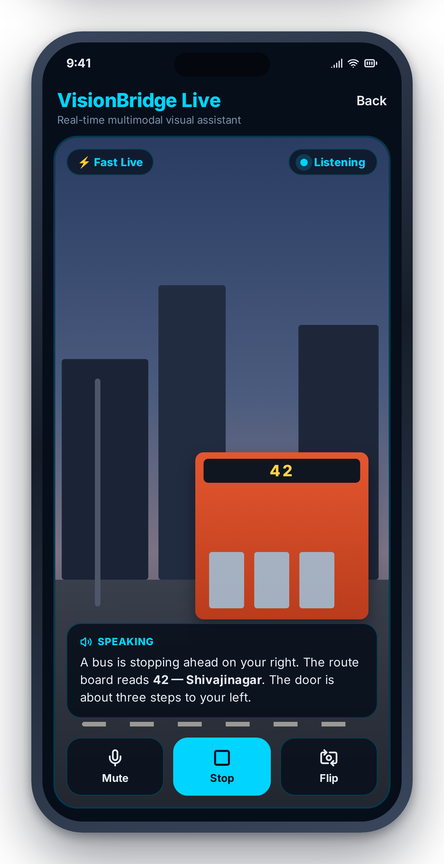
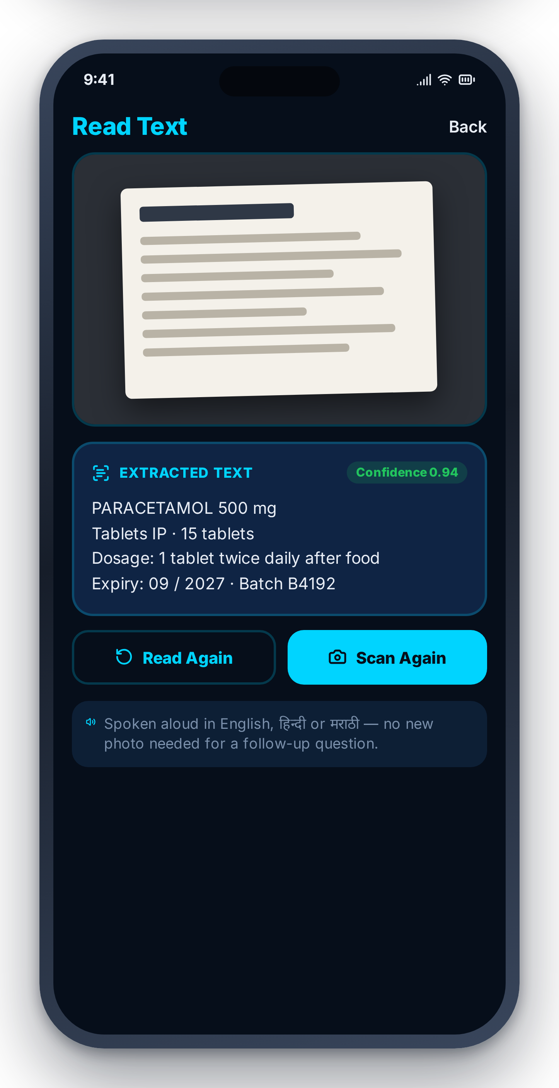




















KEY FEATURES AND INNOVATION
Prime Innovators
IMPLEMENTED TODAY · 14 ASSISTANTS ON ONE HOME SCREEN
INSIDE THE APP
Smart Reading
Surroundings
Currency Reader
Object Finder
Hazard Mode
Menus, labels, notices
What is in front of me
Notes, coins, total
Wallet, keys, bottle
Scans every 5 seconds
Public Transport
Where Am I?
VisionBridge Live
AI Voice Call
Phone Assistant
Routes, platforms, signs
Street + nearby places
Real-time camera + voice
Conversational assistant
Voice-first calling
ALSO BUILT
Volunteer Help
Emergency SOS
Daily News
Entertainment
Volunteer Dashboard
Live sighted helper
WhatsApp alert + GPS
Spoken local briefing
Radio, stories, games
A separate login and screen for the sighted volunteer
Home
VisionBridge Live
Smart Reading
14 assistants, one wake word
Camera + voice in real time
Reads text aloud with a score
WHAT MAKES IT DIFFERENT · FIVE INNOVATIONS, ALL RUNNING TODAY
THE CONFIDENCE GATE
ONE WORD, NO MENUS
LIVE NATIVE AUDIO
TRILINGUAL BY DESIGN
RESILIENT AI LAYER
Every vision answer carries a score. Below 0.70 the app refuses to guess and offers a live volunteer.
“Vision” plus 41 on-device rules route most commands instantly, with no network round-trip.
Gemini Live over WebSocket — camera and voice together, interruptible, on ephemeral tokens.
English, हिन्दी and मराठी across the UI, the wake word, speech and every AI reply.
A four-model Gemini fallback chain keeps a session alive when one model is rate-limited.
Notes:
14 assistants reachable from the home screen and from the wake word. Five innovations, all running in the current build — none of this slide is future scope.

Slide 5



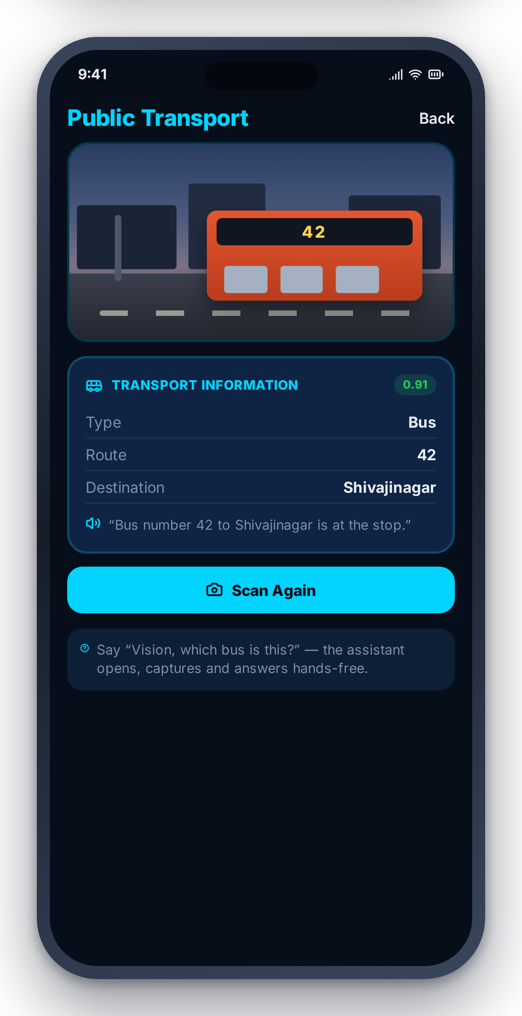












IMPACT AND BENEFITS
Prime Innovators
WHO IT IS FOR People with low vision who already carry an Android phone — and the sighted volunteers who choose to answer when the AI is not sure.
ONE REAL MOMENT · 8 P.M. AT A BUS STOP
BEFORE
WITH VISIONBRIDGE
• A bus pulls in. She cannot read the number.
• She says “Vision, which bus is this?” — no menus, no screen to find.
• She looks for someone to ask — tonight nobody is there.
• The Public Transport assistant opens and the camera captures the board.
• The bus leaves. She waits, and asks the next stranger.
• Gemini reads it and the answer is spoken in her language: route 42.
• A dedicated reading device costs money and is one more thing to carry.
• If the frame is too dark to be sure, the app says so and offers a volunteer.
WHAT CHANGES FOR THE USER
Greater independence
Fewer things to ask
Safer daily movement
Access to information
Affordable by design
A human safety net
Reading a label or finding a bus stops depending on somebody else being free.
Reading, transport, money, objects, location and help sit behind one sentence.
Background hazard scanning interrupts to warn before she reaches an obstacle.
News, stories and radio arrive as speech, not as text she cannot read.
No device to buy or charge — it installs on the Android phone she owns.
A live volunteer takes over instead of a confident wrong answer, in the same app.
WHAT WE DO NOT CLAIM No clinical accuracy, no guaranteed hazard detection, no offline operation, no user numbers — and no replacement for a cane, a guide or a doctor.
One phone. One word. A more independent everyday life.
Notes:
Tell the bus-stop story in one breath. Impact is qualitative on purpose: no invented statistics, and the limits are stated on the slide.

Slide 6












FEASIBILITY, FUTURE SCOPE & REFERENCES
Prime Innovators
WHY IT IS FEASIBLE · NOTHING EXOTIC TO PROCURE, NOTHING TO TRAIN
AN ANDROID PHONE
APIs ALREADY IN ANDROID
MANAGED CLOUD + GEMINI
A PLATFORM THAT SCALES
minSdk 24 reaches almost any phone in use today. Nothing to manufacture, buy or charge.
CameraX, SpeechRecognizer, TextToSpeech, location and Media3 all ship with the platform.
Supabase and the Gemini API are called through official SDKs — no dataset, no GPU, no training.
Each assistant is its own screen, function and prompt, so a new one disturbs nothing else.
RISKS WE ACTUALLY HAVE → AND HOW THE BUILD HANDLES THEM
A confident wrong answer
API quota and rate limits
No offline operation today
Camera, voice and location privacy
Every vision result carries a confidence score; below 0.70 the app stops and offers a volunteer.
A four-model Gemini candidate chain fails over automatically inside one request.
Acknowledged, not hidden. On-device hazard warnings are listed as future scope.
Keys stay in Supabase secrets; Postgres row-level security scopes every row to its owner.
FUTURE SCOPE · NOT YET BUILT
REFERENCES · OFFICIAL DOCUMENTATION FOR WHAT IS BUILT
More Indian languages
Offline hazard warnings
Verified volunteer network
ANDROID · LANGUAGE · MEDIA
AI · BACKEND · SERVICES
Personalised routines
Wider device support
Improved AI reliability
Kotlin · kotlinlang.org/docs
Jetpack Compose · developer.android.com/compose
Navigation Compose · developer.android.com/navigation
CameraX · developer.android.com/camerax
SpeechRecognizer + TTS · developer.android.com
Media3 / ExoPlayer · developer.android.com/media3
Gemini API · ai.google.dev/gemini-api/docs
Gemini Live API + ephemeral tokens · ai.google.dev
Supabase Auth · Postgres · RLS · supabase.com/docs
Supabase Edge Functions · supabase.com/docs/functions
WebRTC · webrtc.org OkHttp · square.github.io
OpenStreetMap Nominatim + Overpass · WhatsApp Cloud API
Clearly separated from everything above, which is implemented and running.
GitHub Repository
Live Demo
Demo Video
github.com/shailesh-pande01/visionbridge-ai
visionbridge-ai.vercel.app
YouTube Demo Video
Every reference above is the official documentation of a component already implemented in the VisionBridge Android app. No external studies, datasets or statistics are cited or claimed.
Notes:
Feasible because everything is a managed service or a platform API — no model training, no dataset, no GPU. Future scope is clearly fenced off from what is built.

