Slide 1








SMART INDIA HACKATHON 2026
TITLE PAGE
VisionBridge
NATIVE ANDROID ACCESSIBILITY COMPANION
Now with VisionBridge MedSafe · accessible medicine-pack reading
An AI companion that helps people with low vision read, understand, move and stay safe — on the Android phone they already own.
When the AI is unsure, it says so and can connect a real person.
Say “Vision…” in English · हिन्दी · मराठी | Android 7.0 and above | no extra hardware
PROBLEM STATEMENT ID
PROBLEM STATEMENT TITLE
26198
Student Innovation
THEME
PS CATEGORY
MedTech / BioTech / HealthTech
Software
TEAM ID
TEAM NAME
135775
Prime Innovators
READ
UNDERSTAND
MOVE
STAY SAFE
HUMAN HELP
Printed text · medicine packs
Scenes · objects · money · live AI
Location · buses · obstacles ahead
SOS alert · medicine reminders
Live video with a volunteer

Slide 2






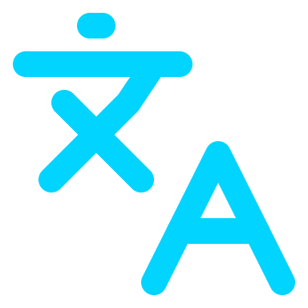
IDEA / PROPOSED SOLUTION
VisionBridge — say “Vision…”, point the phone, hear the answer. When the AI is unsure, a real person can help.
THE PROBLEM · ONE DAY, MANY VISUAL BARRIERS
THE SOLUTION · ONE VOICE-FIRST COMPANION FOR FIVE EVERYDAY JOBS
08:00
Medicine strip
READ
UNDERSTAND
MOVE
STAY SAFE
HUMAN HELP
Name, dose and expiry too small to read
09:30
Bus stop
Hear printed words
Know what is around
Find your way
Get help fast
Reach a real person
Which bus is this? Where is it going?
11:00
Footpath
Smart Reading
Surroundings
Where Am I?
Emergency SOS
Volunteer video
A step or an obstacle just ahead
MedSafe
Object Finder
Public Transport
Medicine reminders
Phone Assistant
15:00
Shop counter
Which note did I get back?
NEW
Reads medicine packs · see slides 3–5
Currency Reader
Obstacle check
Any time
“Where am I?”
VisionBridge Live
Help depends on someone being free
81%
could not access medicine names and doses under simulated moderate vision loss
Merenda et al., 2025 · reference [3]
AI Voice Call
Also on the home screen: radio, audiobooks and audio games · start talking with “Vision”, a two-finger double-tap or a shake (optional)
WHAT IS NEW · WHY IT IS DIFFERENT FROM A GENERIC AI APP
Says “I’m not sure”
A person, one step away
MedSafe for medicine packs
Voice-first, 3 languages
Photo answers are scored; below the threshold the app says it is unsure.
When the AI is unsure, a sighted volunteer can join on live video.
Reads only what is printed on the pack — directions word for word, no medical advice.
English, हिन्दी, मराठी; 50 common commands are matched on the phone.

Slide 3








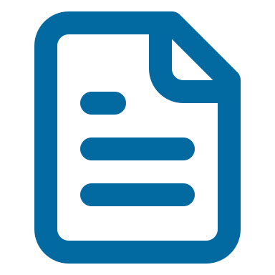


TECHNICAL APPROACH
HOW A PHOTO REQUEST WORKS · FROM A SPOKEN SENTENCE TO A SPOKEN ANSWER
INPUT
ANDROID APP
SUPABASE EDGE
GEMINI AI
CONFIDENCE GATE
OUTPUT
Say “Vision…”, point the camera, share GPS
Kotlin + Compose · 50 on-phone voice rules · 15-min memory
20 serverless functions · the Gemini key stays on the server
Image → structured JSON + confidence · 4-model fallback
High score → answer
Low score → don’t guess,
offer a human helper
MedSafe, Surroundings: 0.70
Speech in EN · HI · MR, high-contrast screen, volunteer video
MEDSAFE · THE STRICTEST GATE, APPLIED TO MEDICINE PACKAGING
CAPTURE
PREPARE
EXTRACT
STRUCTURE
GATE
PASS → SPEAK AND SHOW
CameraX photo at maximum quality
Size check, rotate and compress on the phone
Edge Function asks Gemini to read, never infer
JSON fields + confidence, sanitised server-side
Status CLEAR + name read + confidence ≥ 0.70
“Medicine: … Strength: … The packaging says: …”
High-contrast result cards · read aloud · save · daily reminder
UNSURE → DO NOT GUESS
PRINTED FIELDS IT CAN READ
“I couldn’t confidently read this medicine packaging. I don’t want to guess. You can try another photo or connect to a human helper.”
Buttons: Try another photo · Connect to human helper
Medicine name
Strength
Form
Active ingredients
Printed directions (verbatim)
Expiry date (past dates flagged)
Storage
Printed warnings
Manufacturer
Batch no.
On screen in MedSafe: “Assistive packaging reader only. VisionBridge does not diagnose or prescribe. Always follow your doctor’s or pharmacist’s instructions.”
TECHNOLOGY ACTUALLY USED · CHECKED AGAINST THE CURRENT BUILD
ON THE PHONE
Kotlin
Jetpack Compose
CameraX
SpeechRecognizer
TextToSpeech
Fused Location
Media3 / ExoPlayer
SQLite + AlarmManager
minSdk 24
CLOUD BACKEND
Supabase Auth (JWT + silent refresh)
Postgres + row-level security
Edge Functions (Deno / TypeScript)
Supabase Realtime (call signalling)
AI & CALLS
Gemini API → JSON + confidence
Gemini Live API (ephemeral tokens)
WebRTC video
OpenStreetMap Nominatim + Overpass
WhatsApp Cloud API (SOS)

Slide 4












FEASIBILITY AND VIABILITY
FEASIBLE BECAUSE IT ALREADY RUNS · EVIDENCE FROM THE CURRENT BUILD
93 / 93
PASSED
EN · HI · MR
20
Android 7.0+
unit tests passing — latest local run, 14 Sep 2026
End-to-end MedSafe test on a real phone, live backend + Gemini
570 UI strings each; replies are spoken in the chosen language
Supabase Edge Functions called by the app — AI, SOS, location, audio
minSdk 24 — no extra device to buy, carry or charge
RISKS WE ACTUALLY HAVE → WHAT THE BUILD ALREADY DOES
PRIVACY AND SECURITY ALREADY IN PLACE
Wrong AI answer
Photo results are scored. MedSafe and Surroundings withhold answers below 0.70; Currency and Transport offer a volunteer below 0.65.
Gemini API key kept only in server secrets
Medicine over-trust
Printed text only — no diagnosis, dosing or suitability advice. Disclaimer in 3 languages; expired packs → “consult a pharmacist”.
Gemini Live runs on short-lived ephemeral tokens
AI quota or outage
Four Gemini models are tried in order within one request; the user hears a clear error and can retry.
Row-level security on all 13 tables (44 policies)
Users cannot promote themselves to admin
No internet
Stated limit: AI features need a connection. Saved medicines and reminder alarms are stored on the phone and keep working offline.
Medicine reminders stay private on the lock screen
Volunteer trust
Volunteers self-register today — a verified network is future scope. The video call starts only when a volunteer accepts.
Volunteer sees the user’s camera; theirs stays off
VIABLE: runs on phones people already own · managed, pay-as-you-go cloud · modular — MedSafe was added as its own screens, Edge Function and tables without changing other assistants
IMPLEMENTED TODAY · IN THE ANDROID BUILD
FUTURE SCOPE · NOT BUILT YET
All assistants on slide 2, incl. MedSafe
Confidence gate + volunteer video
Offline obstacle warnings on the phone
Continuous hazard alerts while walking
Gemini Live: real-time camera + voice
Voice and UI in EN · HI · MR
Verified volunteer network
More Indian languages
SOS with WhatsApp location alert
Offline medicine list + reminder alarms
Field study with low-vision users
Pharmacist-reviewed MedSafe accuracy tests

Slide 5












IMPACT AND BENEFITS
WHO BENEFITS
People with low vision or blindness who use Android phones — plus their families, caregivers and the volunteers who help remotely.
2.2 billion+
26.68%
people worldwide have a near or distance vision impairment · WHO, 2026 [1]
of people aged 50+ in India have visual impairment · national survey, 2015–19 [2]
ONE REAL MOMENT · 8:30 PM, AT HOME, A MEDICINE STRIP IN HAND
WITHOUT VISIONBRIDGE
WITH VISIONBRIDGE MEDSAFE
The print is too small to read
Waits for family — or guesses
Expiry and directions stay unknown
Dose times rely on memory or family
1
2
3
4
Asks by voice
Hears the pack
Saves and schedules
Never a guess
“Vision, check my medicine.” MedSafe opens — in English, Hindi or Marathi.
Name, strength, printed directions and expiry are read out; past dates are flagged.
Adds it to My Medicines with a 9:00 PM daily reminder that works offline.
Blurry photo? “I don’t want to guess.” Try again or connect a volunteer.
WHAT CHANGES · SOCIAL, HEALTH, SAFETY, ECONOMIC AND ENVIRONMENTAL BENEFITS
SOCIAL
SOCIAL
HEALTH
SAFETY
ECONOMIC
ENVIRONMENT
Independence
Inclusion
Safer medicine routine
Human safety net
Low cost
No new device
Read, travel and check money without waiting
Voice-first in 3 languages, high-contrast UI
Printed info + reminders — never advice
Volunteer video and SOS with live location
Runs on the Android phone the user already has
Nothing extra to make, charge or throw away
WE DO NOT CLAIM: clinical validation or regulatory approval · diagnosis, prescribing or dosing advice · guaranteed obstacle detection · accuracy or user-count figures · replacing a doctor, pharmacist, cane or guide.
Read what is printed. Don’t guess what isn’t.

Slide 6



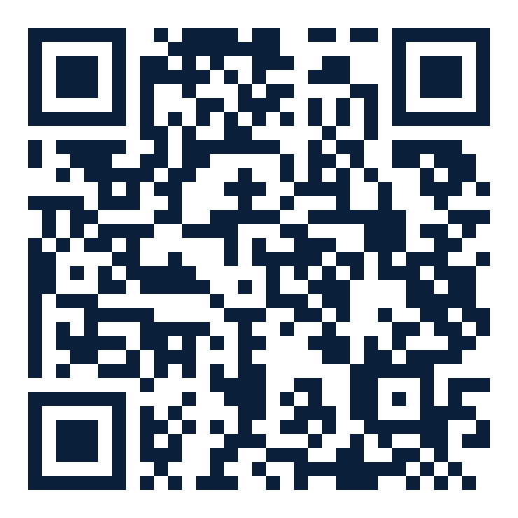
RESEARCH AND REFERENCES
SEE IT · TRY IT · VERIFY IT
VisionBridge · Team Prime Innovators · Team ID 135775 · PS ID 26198
Demo video
Android source code
Earlier web prototype
Scan to watch the demo video
or click the code
Watch VisionBridge in action
Kotlin app + Supabase backend
Browser version built before the Android app
youtu.be/ok7P_i5SeR4
github.com/shailesh-pande01/
visionbridge-app
visionbridge-ai.vercel.app
RESEARCH BEHIND THE IDEA
1
2.2 billion+ people live with a near or distance vision impairment.
World Health Organization — “Blindness and vision impairment” fact sheet, updated 10 Feb 2026.
who.int/news-room/fact-sheets/detail/blindness-and-visual-impairment
2
India, age 50+: visual impairment 26.68%, blindness 1.99%.
Vashist P. et al. National Blindness & Visual Impairment Survey 2015–19. PLOS ONE, 2022.
doi.org/10.1371/journal.pone.0271736
3
Simulated moderate vision loss: 81% could not access medicine names and doses; 75% missed the full expiry date.
Merenda T., Depasse F., Patris S. Explor. Res. Clin. Soc. Pharm. 18:100581, 2025.
doi.org/10.1016/j.rcsop.2025.100581
4
Blindness and low vision are specified disabilities under Indian law.
Rights of Persons with Disabilities Act, 2016 — Dept. of Empowerment of Persons with Disabilities.
depwd.gov.in/en/acts
OFFICIAL DOCUMENTATION FOR THE COMPONENTS USED
All links checked on 16 Sep 2026
ANDROID
GEMINI AI
BACKEND AND SERVICES
CameraX
SpeechRecognizer
Structured JSON output
Supabase row-level security
Edge Functions
TextToSpeech
Jetpack Compose
Live API
Realtime
WebRTC
Scheduling alarms
Ephemeral tokens
Nominatim reverse geocoding
WhatsApp Cloud API

