Slide 1

PROPOSAL
Pension Contribution Processing Automation
Microsoft Power Automate + AI Agent Validation Layer
A practical automation layer that reduces manual load across employer file intake, validation, historical comparison, and pension administration system posting, without rebuilding the existing portal.
PREPARED FOR
PREPARED BY
DATE
Reflections Global
Ratish Nair, CBO
05 June 2026

Slide 2
PENSION CONTRIBUTION PROCESSING AUTOMATION
Contents
Introduction
03
Context, current state, and the shape of the proposed engagement
Objectives
03
Outcomes the build will deliver across the 12-week MVP
Proposed Solution & Flows
04
Two operating flows, mailbox-led and portal-led, sharing one validation layer
Recommended Architecture
05
Orchestration, agent/API layer, validation services, and audit
Scope
06
What is included in the 12-week MVP and what sits outside it
Delivery Plan
07
Indicative 12-week Gantt across discovery, build, UAT, and handover
UAT Summary
08
Short, rolling validation cycles aligned to milestone outcomes
Our Delivery Advantage
09
Why this team, this design, and this delivery model
Commercial Model
10
Two budgetary options, focused build vs. build, manage & operate
Assumptions, Exclusions & Open Items
11
Conditions the estimate is based on and items to close before signature
Signature of Approval
12
Sign-off block for client and Newtuple
NEWTUPLE TECHNOLOGIES · CONFIDENTIAL
02 / 12

Slide 3
PENSION CONTRIBUTION PROCESSING AUTOMATION
01
Introduction
Newtuple proposes a practical automation layer for pension contribution processing. The solution uses Microsoft Power Automate where it fits best, mailbox monitoring, attachment handling, notifications, and a controlled AI agent and validation API where interpretation, comparison, and auditability need stronger ownership.
The client receives monthly contribution files from multiple employers. These files contain employee contributions, new joiners, exits, retirements, and other membership changes. Today, the work depends on manual review of emails, attachments, prior submissions, validation rules, employer comments, and final upload into the pension administration system.
The proposed engagement focuses on removing this manual load without creating a large workflow platform. The design keeps the existing employer portal intact, introduces an API-accessible agent and validation service, and uses Power Automate for mailbox orchestration and process routing.
This proposal is prepared as a budgetary estimate . The final scope, licensing, API behaviour, rule library, and commercial terms should be confirmed during discovery. Estimates carry a ±30% variance until then.
02
Objectives
Outcomes the 12-week MVP will deliver
Automate intake of employer contribution files from designated Microsoft 365 mailboxes.
Capture attachments, email context, and employer instructions as part of the submission record.
Use AI-powered interpretation of employer email commentary for Flow 1, as part of committed scope.
Retrieve previous-month files from Azure or AWS storage as agreed during discovery.
Validate files against configurable technical and business rules.
Compare current submissions with historical files and identify variances.
Return errors to employers by email for mailbox-led submissions.
Return errors to the existing portal for portal-led submissions.
Post validated records to the pension administration system API, where API access is available.
Maintain a complete audit trail across receipt, validation, communication, resubmission, and upload.
TODAY
AFTER MVP
Manual review of emails, attachments, and employer commentary
Cross-checking with prior-month files by hand
Errors caught late, sometimes after PAS upload
No central audit trail across receipt to upload
Mailbox + portal submissions handled through one validation layer
Historical comparison and variance detection automated
Errors returned to the right channel before PAS posting
Full audit ledger across every submission and decision
NEWTUPLE TECHNOLOGIES · CONFIDENTIAL
03 / 12

Slide 4
PENSION CONTRIBUTION PROCESSING AUTOMATION
02
Proposed Solution & Flows
The solution is organized around two operating flows. Both share the same validation and audit layer, but differ in how submissions arrive and how errors are returned to the employer.
FLOW 1
Mailbox, validation, PAS API
Designed for employers who submit by email today
ENTRY
Employer mailbox on Microsoft 365. Submissions arrive as email with attached contribution files.
PATH
Mailbox
›
Power Automate
›
AI email agent
›
Validation core
›
Historical comparison
›
PAS API
RESPONSE
Errors and status updates returned to employers by email.
FRS COVERED
FR-001 · FR-002 · FR-003 · FR-004 · FR-005 · FR-006 · FR-007 · FR-008 · FR-010 · FR-011
FR-003 includes AI-powered interpretation of employer email commentary and natural-language instructions, in committed scope for Flow 1.
FLOW 2
Existing portal, validation, portal
Designed for employers using the existing portal
ENTRY
Existing client portal, untouched. Newtuple exposes an API the portal can call for validation.
PATH
Existing portal
›
Validation core
›
Historical comparison
›
Portal response
RESPONSE
Errors and validation results returned synchronously or asynchronously to the existing portal.
FRS COVERED
Existing portal · FR-004 · FR-005 · FR-006 · FR-007A · FR-011
The portal remains outside Newtuple build scope. Newtuple provides an API for validation invocation and response handling, no portal rebuild, no UX disruption.
NEWTUPLE TECHNOLOGIES · CONFIDENTIAL
04 / 12

Slide 5
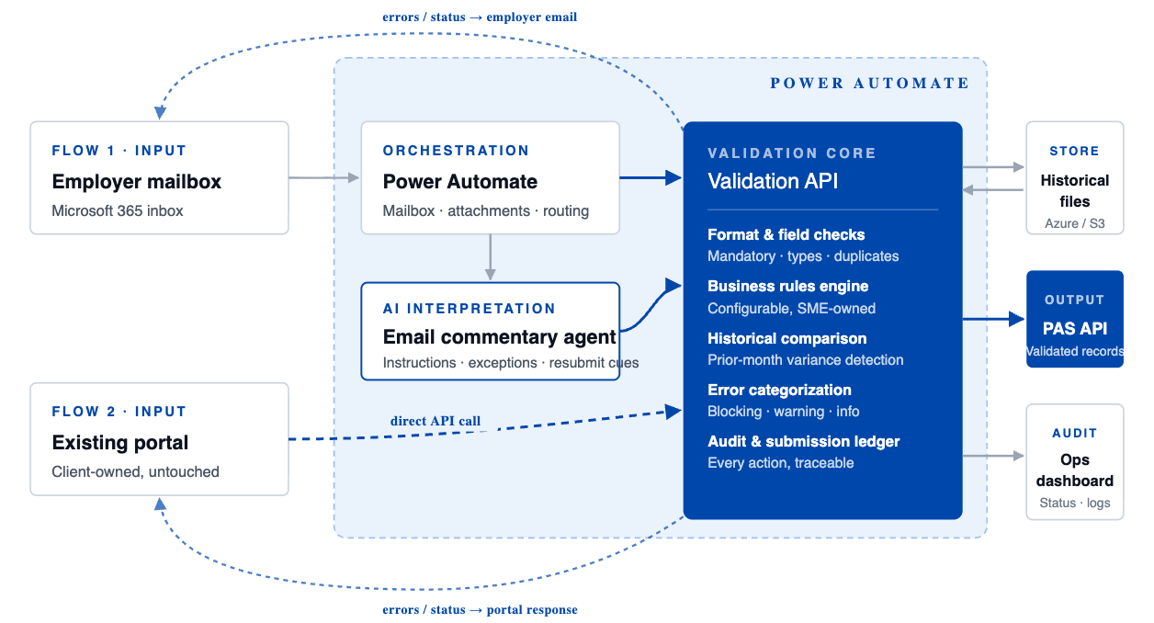
PENSION CONTRIBUTION PROCESSING AUTOMATION
03
Recommended Architecture
Indicative, confirmed in discovery
The architecture separates orchestration, agent interpretation, validation logic, and audit tracking. This keeps Power Automate flows readable while placing business-critical logic in a controlled service layer.
MINIMAL ARCHITECTURE
Two input channels · one validation core · audit-first
Cobalt, Newtuple-built service / decision path
Gray, orchestration & data movement
Dashed, response / feedback channel
Recommended components
LAYER
RECOMMENDATION
Orchestration
Microsoft Power Automate. Client E5 license is noted, but Premium or Process licensing may still be required for premium connectors.
Agent & API layer
RESTful web API to invoke the agent and validation process synchronously or asynchronously.
AI interpretation
Agent-based processing of employer email commentary and natural-language instructions (Flow 1 only).
Validation engine
Configurable technical and business rule execution with comparison to previous submissions.
Storage & history
Historical files retrieved from the agreed cloud storage location during processing.
PAS integration
Validated data posted to the PAS API, subject to API access, contract, and authentication confirmation.
NEWTUPLE TECHNOLOGIES · CONFIDENTIAL
05 / 12

Slide 6
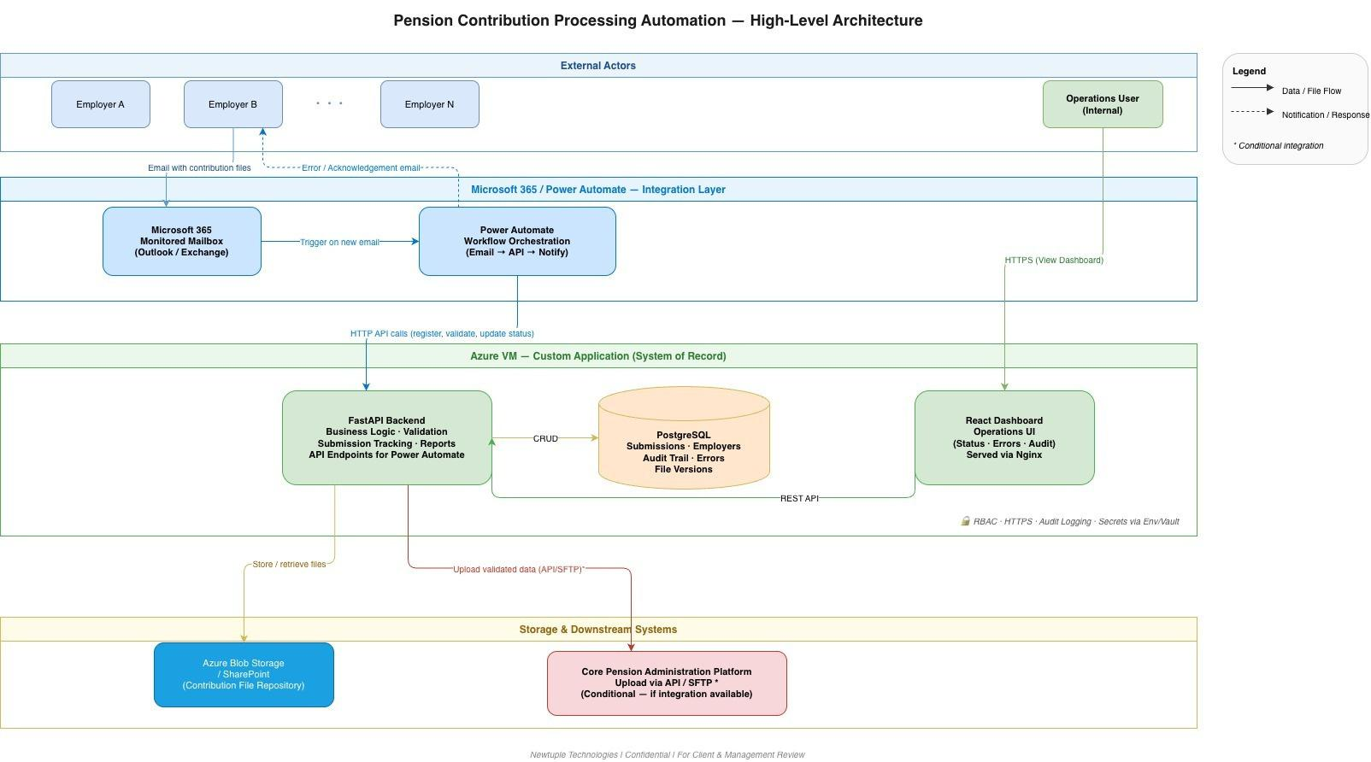
PENSION CONTRIBUTION PROCESSING AUTOMATION
04
Technical Architecture
System view, indicative
This view shows how the logical flow is realised across Microsoft 365, the Power Automate integration layer, the custom application on Azure, and the downstream pension administration platform. All cross-component access is over HTTPS, with audit logging at every hop.
INTEGRATION LAYER
SYSTEM OF RECORD
STORAGE & DOWNSTREAM
Microsoft 365 mailbox monitored by Power Automate. Triggers orchestrate intake, call APIs, and emit status notifications back to employers.
FastAPI backend with business logic and validation. PostgreSQL holds submissions, employers, audit trail, errors, and file versions. React dashboard for operations.
Azure Blob or SharePoint as the contribution file repository. Upload to the pension administration platform via API or SFTP, subject to integration availability.
Security & Operating Controls
Authentication , role-based access across dashboard, validation API, and PAS endpoints.
Secret management , credentials held in environment variables or a managed vault, never in source.
Transport security , HTTPS everywhere including internal API calls.
Hosting , custom application runs on an Azure VM with Nginx fronting the dashboard and API endpoints.
Audit logging , every submission, decision, error, notification, and upload recorded with timestamp and actor.
Conditional integration , PAS posting depends on confirmed API or SFTP availability during discovery.
NEWTUPLE TECHNOLOGIES · CONFIDENTIAL
06 / 12

Slide 7
PENSION CONTRIBUTION PROCESSING AUTOMATION
05
Scope
12-week MVP
IN SCOPE
Capabilities delivered as part of the MVP
SCOPE AREA
INCLUDED CAPABILITIES
Email processing
Mailbox monitoring, submission detection, attachment extraction, email context capture, and AI interpretation of employer comments.
File management
Central file registration, historical file retrieval, current-to-prior association, version tracking, and resubmission handling.
Validation engine
Format checks, mandatory field checks, data type validation, duplicate detection, contribution amount checks, employee status checks, reconciliation, and configurable business rules.
Error management
Validation report generation, error and warning categorization, automated employer notification for Flow 1, portal-facing error response for Flow 2.
Existing portal integration
API support for the existing portal to call validation services and receive synchronous or asynchronous results.
PAS integration
Validated record posting to the PAS API, upload status capture, and audit logging, subject to API readiness.
OUT OF SCOPE
Not included in the 12-week MVP
Building or redesigning the existing employer portal.
Replacing the core pension administration system.
Third-party security audit, certification, or formal compliance attestation.
Historical migration beyond data required for validation, testing, and comparison.
Guaranteed PAS upload automation until PAS API contract, authentication, and payload requirements are confirmed.
Advanced analytics, employer scorecards, and compliance dashboards unless added as a separate work package.
NEWTUPLE TECHNOLOGIES · CONFIDENTIAL
07 / 12

Slide 8
PENSION CONTRIBUTION PROCESSING AUTOMATION
06
Delivery Plan
Indicative 12-week build
The delivery plan is shown as an indicative 12-week build. The sequence may shift after discovery, particularly if licensing, PAS API access, historical storage access, or validation rule confirmation takes longer than expected.
WORKSTREAM
W1
W2
W3
W4
W5
W6
W7
W8
W9
W10
W11
W12
Discovery, access & rule confirmation
Discovery
W1 → W2
Flow 1, Mailbox intake & AI interpretation
Mailbox · attachments · email agent
W2 → W6
Validation engine & historical comparison
Rules · history · variance · reports
W3 → W8
Flow 2, Existing portal API integration
Portal API contract
W5 → W8
PAS API posting & status tracking
PAS handoff · retries
W7 → W10
UAT, hardening & handover
UAT · defects · handover
W9 → W12
MILESTONE 1 · WEEK 2
MILESTONE 2 · WEEK 8
GO-LIVE · WEEK 12
Discovery sign-off, requirements, licenses, PAS API contract, storage access, and validation rules confirmed.
Validation core stable, Flow 1 & Flow 2 both running against a working rules engine and historical comparison.
MVP ready for controlled production use, with UAT signed off and a handover document delivered.
Plan prioritises a working end-to-end flow early, then adds validation depth, portal integration, PAS posting, and audit hardening.
NEWTUPLE TECHNOLOGIES · CONFIDENTIAL
08 / 12

Slide 9
PENSION CONTRIBUTION PROCESSING AUTOMATION
07
UAT Summary
UAT runs in short cycles across the engagement rather than waiting until the end. This is important because validation behaviour depends on real employer files, historical comparisons, and client-specific business rules.
CYCLE
TIMING
FOCUS
Cycle 1
End of Week 5
Mailbox intake, attachment capture, submission registration, and AI interpretation of email commentary.
Cycle 2
End of Week 8
Validation rules, historical comparison, error reporting, and portal-facing validation response.
Cycle 3
Weeks 10 → 12
PAS posting, retry and status handling, audit trail, operational reports, and handover readiness.
08
Our Delivery Advantage
Newtuple's advantage in this engagement is practical delivery discipline. The proposed design avoids over-engineering, keeps the client's existing portal intact, and puts the highest-risk logic in a service layer that can be tested, audited, and changed without rewriting process flows.
Clear separation between workflow orchestration and business validation logic.
Agent-based interpretation only where it matters, employer comments and instructions in mailbox-led submissions.
A reusable validation API that serves both mailbox and portal flows.
Audit-first processing so every file, decision, error, notification, and upload status can be traced.
A delivery model sized for a budgetary decision now, with discovery used to confirm the final build path.
A controlled MVP that can expand later into dashboards, employer analytics, exception recommendations, or richer self-service workflows.
WHY NEWTUPLE
OPERATING STYLE
AFTER GO-LIVE
Deep GenAI & data engineering practice. Two dozen production-grade AI builds across finance, compliance, and enterprise automation.
Senior practitioners on every engagement. Weekly demos, sprint discipline, and code in your environment from day one.
A clean handover, or a turnkey operate model under Option B, whichever suits your team's bandwidth.
NEWTUPLE TECHNOLOGIES · CONFIDENTIAL
09 / 12

Slide 10
PENSION CONTRIBUTION PROCESSING AUTOMATION
09
Commercial Model
Indicative, ±30%
The figures below are budgetary estimates based on the current requirement notes and partner clarification. They should be treated as ±30% until discovery confirms validation complexity, licensing, integration access, PAS API behaviour, and client-side dependencies.
RECOMMENDED
OPTION A
OPTION B
3-month build engagement
6-month build, manage & operate
USD 36,000 ^{±30%}
USD 5,000 ^{/ month}
Best fit when the client wants a focused MVP build and handover.
Best fit when the client wants a lower monthly run-rate and ongoing operational support within agreed monthly capacity.
Duration · 3 months
Monthly fee · USD 12,000
Model · Build & handover
Post-go-live bug-fix window · 2 weeks
Duration · 6 months
Monthly fee · USD 5,000, paid in advance
Model · Build, manage & operate
Support · Standard IST business hours
What's included in both options
BUILD
QUALITY & UAT
HANDOVER
Senior delivery team, weekly demos, code in your environment from day one, and a working MVP across both flows.
Three rolling UAT cycles, defect triage, validated against representative employer files and the agreed rule catalogue.
Architecture notes, runbook, rule configuration guide, and a walkthrough with the client operations team.
Commercial Notes
Power Automate Premium or Process licensing may be required even if the client has Microsoft E5.
Cloud hosting, Microsoft licensing, PAS API charges, storage charges, and third-party service costs are not included unless explicitly agreed.
Final commercials should be confirmed after discovery validates integration complexity and the final rule catalogue.
Quote validity should be confirmed before client submission.
NEWTUPLE TECHNOLOGIES · CONFIDENTIAL
10 / 12

Slide 11
PENSION CONTRIBUTION PROCESSING AUTOMATION
10
Assumptions, Exclusions & Open Items
ASSUMPTIONS
EXCLUSIONS
The client will provide representative employer files, previous-month files, validation rules, and expected outputs during discovery.
Required access to Microsoft 365, Power Automate, cloud storage, PAS API documentation, and test environments will be available on time.
The existing portal team will expose the integration point or consume Newtuple's validation API as agreed.
PAS API posting is subject to confirmed endpoint availability, authentication, payload schema, error handling, and rate limits.
The client will nominate business users for weekly review, UAT feedback, and rule confirmation.
Portal rebuild, new portal UX, or employer identity management changes.
Large-scale historical data migration or cleansing outside validation test needs.
Formal security certification, penetration testing, or regulatory attestation.
Long-term managed service beyond the selected commercial option.
Enhancements outside the agreed MVP backlog unless approved through change control.
Open Items Before Final Submission
OPEN ITEM
OWNER GROUP
WHY IT MATTERS
Client name and signatory details
Sales
Needed for cover page, signature block, and final quote validity.
PAS API contract and authentication model
Product / client technical team
Determines whether automated upload can be committed in the MVP.
Power Automate licensing position
Client IT / Microsoft admin
May affect implementation cost and process design.
Final validation rule catalogue
Client operations / SME
Controls scope, test cases, and estimate confidence.
Historical storage location and access pattern
Client IT
Required for previous-month comparison and data retrieval timing.
Decision on Option A vs. Option B
Sales / commercial
Needed before presenting a final commercial recommendation.
Commercial Conditions
Prices are in USD and exclusive of taxes, GST, duties, and statutory charges.
Invoices are payable within 15 days of invoice date.
Infrastructure, Power Automate licensing, connector costs, API usage, and third-party software costs are borne by the client.
Travel, if required, will be billed at actuals.
Work will be performed during standard IST business hours.
Scope extensions will be handled through a mutually agreed change request.
NEWTUPLE TECHNOLOGIES · CONFIDENTIAL
11 / 12

Slide 12
PENSION CONTRIBUTION PROCESSING AUTOMATION
11
Signature of Approval
This section will be finalized once the client legal name, authorized signatory, selected commercial option, and quote validity are confirmed.
FOR CLIENT
FOR NEWTUPLE TECHNOLOGIES PRIVATE LIMITED
Name
Name
Dhiraj Nambiar
Title
Title
Founder
Date
Date
On signature, Newtuple will schedule a discovery kickoff within 5 business days, share the proposed delivery team and weekly cadence, and confirm access requirements across Microsoft 365, Power Automate, cloud storage, and PAS API documentation.
NEWTUPLE TECHNOLOGIES · CONFIDENTIAL
12 / 12

