Slide 1

WHAT CHANGED IN AI
Claude Fable 5 dropped.
Here is what actually changed.
Anthropic's first Mythos-class model for general use. The capabilities, the safeguards, and the memory result - explained.
01 / 08
› › ›

Slide 2
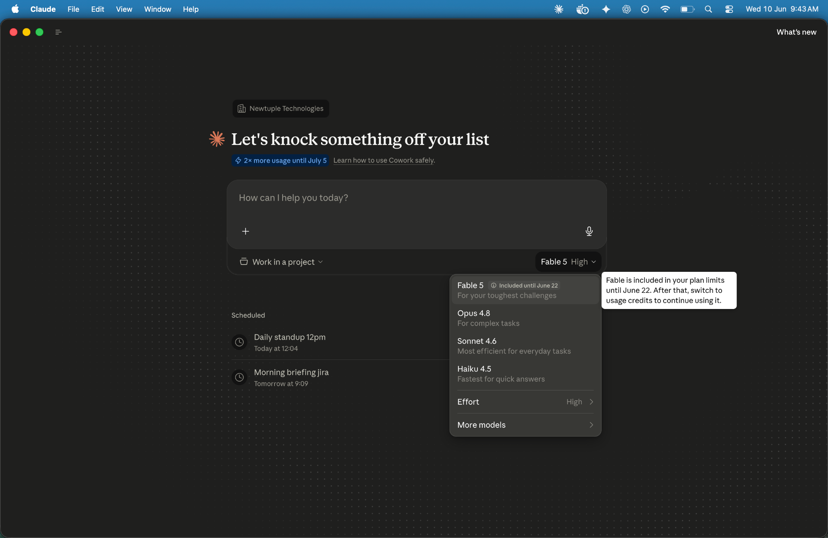

Slide 3
THE CONTEXT
A new model tier above Opus.
It shipped yesterday.
Anthropic has publicly named a model class above Opus for the first time. Fable 5 is a Mythos-class model made safe for general use - the same class as Mythos Preview (April 2026), which was restricted to cyber defenders only.
MYTHOS-CLASS
FABLE 5
A new tier above Opus. First public use: Mythos Preview (April 2026, restricted).
Same Mythos-class model, with safety classifiers for general use. Available to everyone from 9 June.
02 / 08
› › ›

Slide 4

SOFTWARE ENGINEERING
Stripe migrated 50 million lines of Ruby.
In one day. A task that would have taken a full team over two months.
2 months
1 day
#1
What it would have taken the engineering team by hand
What Fable 5 took to complete the same migration
FrontierCode score — hardest long-horizon production coding eval
Fable 5 also scores highest on FrontierCode at medium effort - meaning fewer tokens, not just better output. Token efficiency matters for agentic cost models.
03 / 08
› › ›

Slide 5
LONG-HORIZON TASKS
The longer the task,
the larger the gap.
When given access to persistent file-based memory in a long-running task, Fable 5 improved three times more than Opus 4.8 under the same condition. This is the result most relevant to enterprise agentic deployments.
3×
MEMORY IMPROVEMENT MULTIPLIER
Fable 5 vs Opus 4.8 under identical persistent memory conditions, in Anthropic's Slay the Spire long-horizon evaluation. Fable also reached the final act 3× more often.
04 / 08
› › ›

Slide 6
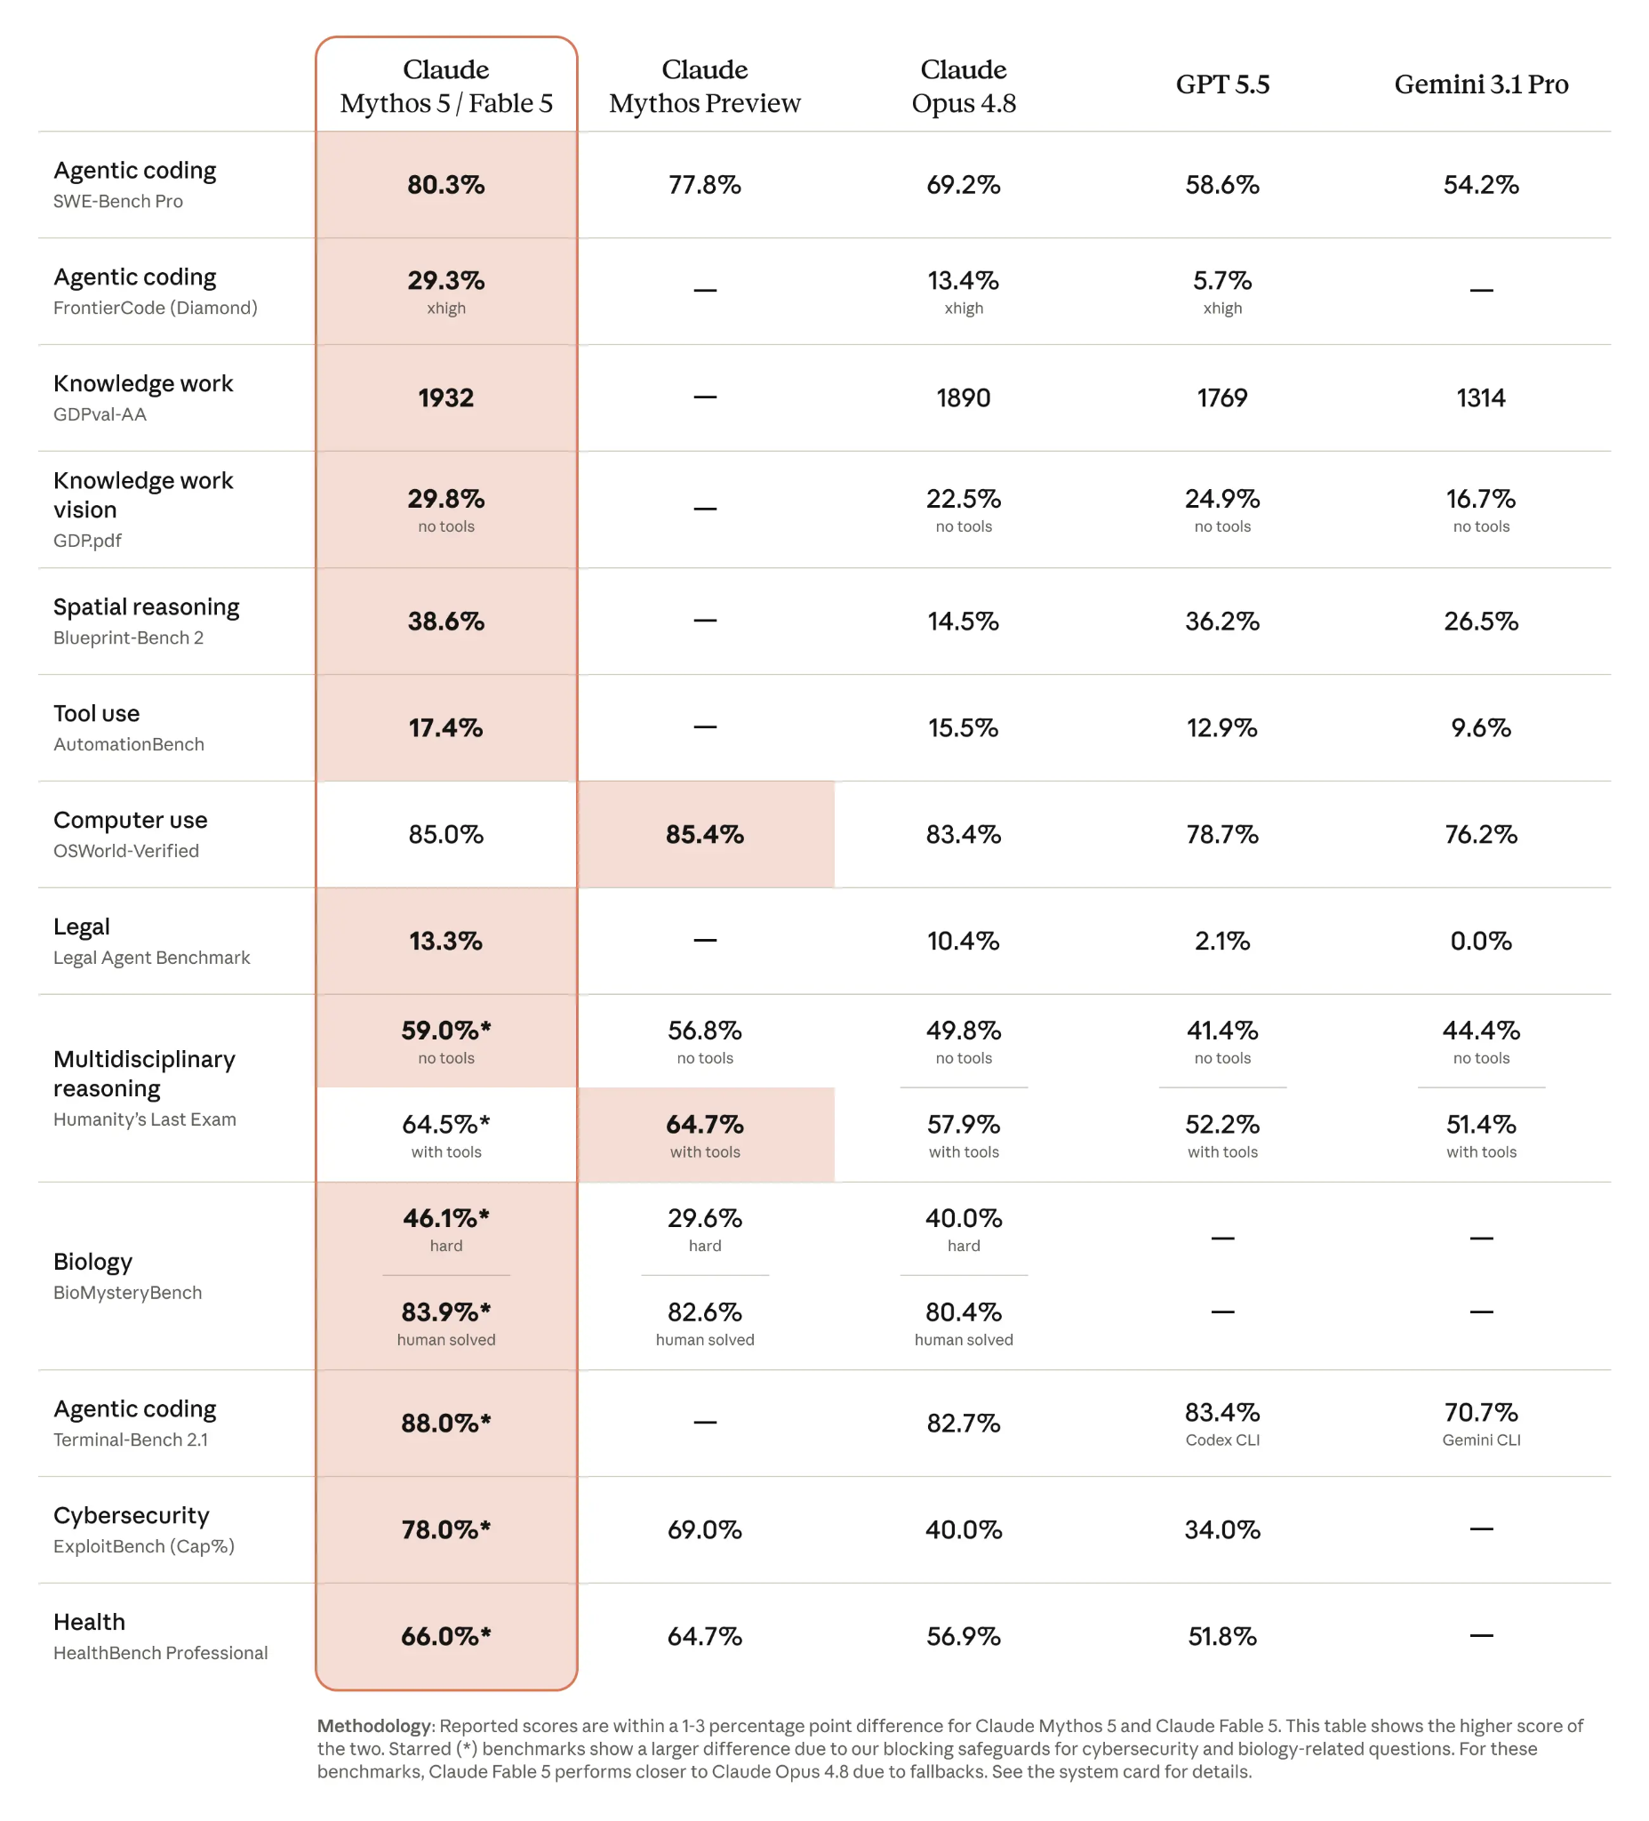
Source: Anthropic, 'Claude Fable 5 and Mythos 5,' June 9, 2026. anthropic.com/news/claude-fable-5-mythos-5

Slide 7
KNOWLEDGE WORK & VISION
Benchmarks worth flagging.
Finance, document reasoning, and vision, all state-of-the-art.
KNOWLEDGE WORK
VISION
#1
Vision-
only
Hebbia Finance Benchmark
Pokémon FireRed, no aids
Highest score among all models tested on senior-level analytical reasoning, document-based reasoning, and chart interpretation.
Completed the game with a minimal, vision-only harness — no maps, navigation aids, or game-state info. Previous models needed a complex helper harness to manage it.
05 / 08
› › ›

Slide 8
BENCHMARKS
NEWTUPLE
Agentic coding
Claude Fable 5
Claude Opus 4.8
GPT-5.5
100
35
80.3
30
29.3
80
69.2
25
60
58.6
Success rate (%)
Success rate (%)
20
40
15
13.4
10
20
5.7
5
0
0
SWE-Bench Pro
FrontierCode
Source: Anthropic, 'Claude Fable 5 and Mythos 5,' June 9, 2026. anthropic.com/news/claude-fable-5-mythos-5

Slide 9
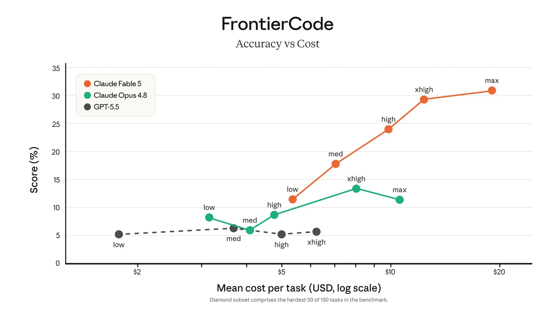
Source: Anthropic, 'Claude Fable 5 and Mythos 5,' June 9, 2026. anthropic.com/news/claude-fable-5-mythos-5

Slide 10
THE SAFEGUARDS
How Anthropic shipped it safely.
Classifiers are now part of the model
When a flagged query is detected, Fable routes silently to Opus 4.8 and notifies the user. This happens in fewer than 5% of sessions. The classifiers cover three domains:
Cybersecurity
01
Offensive cyber tasks, exploit development, agentic hacking. Myhos 5 (restricted) has these lifted for Project Glasswing partners.
Biology & Chemistry
02
Broad coverage while safeguards are refined. Will narrow over time as a trusted access programme for biomedical research is introduced.
Distillation
03
Queries flagged as attempts to extract Fable's capabilities for training competing models, particularly from authoritarian-country actors.
06 / 08
› › ›

Slide 11
THE ENTERPRISE SIGNAL
What this means for your team's workflows.
If you've been designing around Opus 4.8's limits, some of those constraints have moved - the longer the task, the bigger the gap.
01
The memory result is the most underreported detail. Extended autonomous workflows that run across sessions now perform materially differently.
02
Pricing at $10/$50 per million tokens is less than half of Mythos Preview. The cost model for Mythos-class capability has changed significantly.
03
07 / 08
› › ›

Slide 12
FRONTIER MODEL PRICING
NEWTUPLE
What frontier capability costs.
API pricing per million tokens as of June 2026. Standard tier, no caching.
MODEL
PROVIDER
INPUT ($/1M)
OUTPUT ($/1M)
Claude Fable 5
Anthropic
$10.00
$50.00
GPT-5.5
OpenAI
$5.00
$30.00
Gemini 3.1 Pro
Google
$2.00
$12.00
All three models are from the same generation used in Anthropic's official June 2026 benchmark comparison. Fable 5 and Mythos 5 are priced identically. Gemini 3.1 Pro pricing shown for standard prompts under 200k tokens. Cached input pricing available at reduced rates for all three providers.
Sources: Anthropic (anthropic.com/news/claude-fable-5-mythos-5), OpenAI (openai.com/api/pricing), Google (ai.google.dev/gemini-api/docs/pricing). June 2026.

Slide 13
THE CONSTRAINTS HAVE MOVED.
Which ones matter for the work your team is actually doing?
We help enterprise teams map where capability improvements change the architecture decisions they have already made.
newtuple.com ↗
or DM us directly
08 / 08

