Slide 1
Clustering Algorithm Along with Lloyd & k-means ++
Shailesh Pratap Singh
00001402507

Slide 2
Iris – Dataset Attribute Information
IRIS DATASET
Prediction: Class of Iris plant.
▸ This dataset clusters Iris plant based on the following attributes:
▸ Number of Attributes = 4
▸ Sepal length in cm
▸ Sepal width in cm
▸ Petal length in cm
▸ Petal width in cm
▸ Result (Iris Setosa, Iris Versicolour, Iris Virginica)
▸ Number of Instances = 150

Slide 3
Iris Dataset Values
SEPAL LENGTH | SEPAL WIDTH | PETAL LENGTH | PETAL WIDTH | CLASS (RESULT)
5.1 | 3.5 | 1.4 | 0.2 | Iris-setosa
4.9 | 3 | 1.4 | 0.2 | Iris-setosa
4.7 | 3.2 | 1.3 | 0.2 | Iris-setosa
4.6 | 3.1 | 1.5 | 0.2 | Iris-setosa
5 | 3.6 | 1.4 | 0.2 | Iris-setosa
5.4 | 3.9 | 1.7 | 0.4 | Iris-setosa
4.6 | 3.4 | 1.4 | 0.3 | Iris-setosa
5 | 3.4 | 1.5 | 0.2 | Iris-setosa
4.4 | 2.9 | 1.4 | 0.2 | Iris-setosa
4.9 | 3.1 | 1.5 | 0.1 | Iris-setosa
5.4 | 3.7 | 1.5 | 0.2 | Iris-setosa
4.8 | 3.4 | 1.6 | 0.2 | Iris-setosa
4.8 | 3 | 1.4 | 0.1 | Iris-setosa
4.3 | 3 | 1.1 | 0.1 | Iris-setosa
5.8 | 4 | 1.2 | 0.2 | Iris-setosa
5.7 | 4.4 | 1.5 | 0.4 | Iris-setosa
5.4 | 3.9 | 1.3 | 0.4 | Iris-setosa
5.1 | 3.5 | 1.4 | 0.3 | Iris-setosa
5.7 | 3.8 | 1.7 | 0.3 | Iris-setosa
5.1 | 3.8 | 1.5 | 0.3 | Iris-setosa

Slide 4
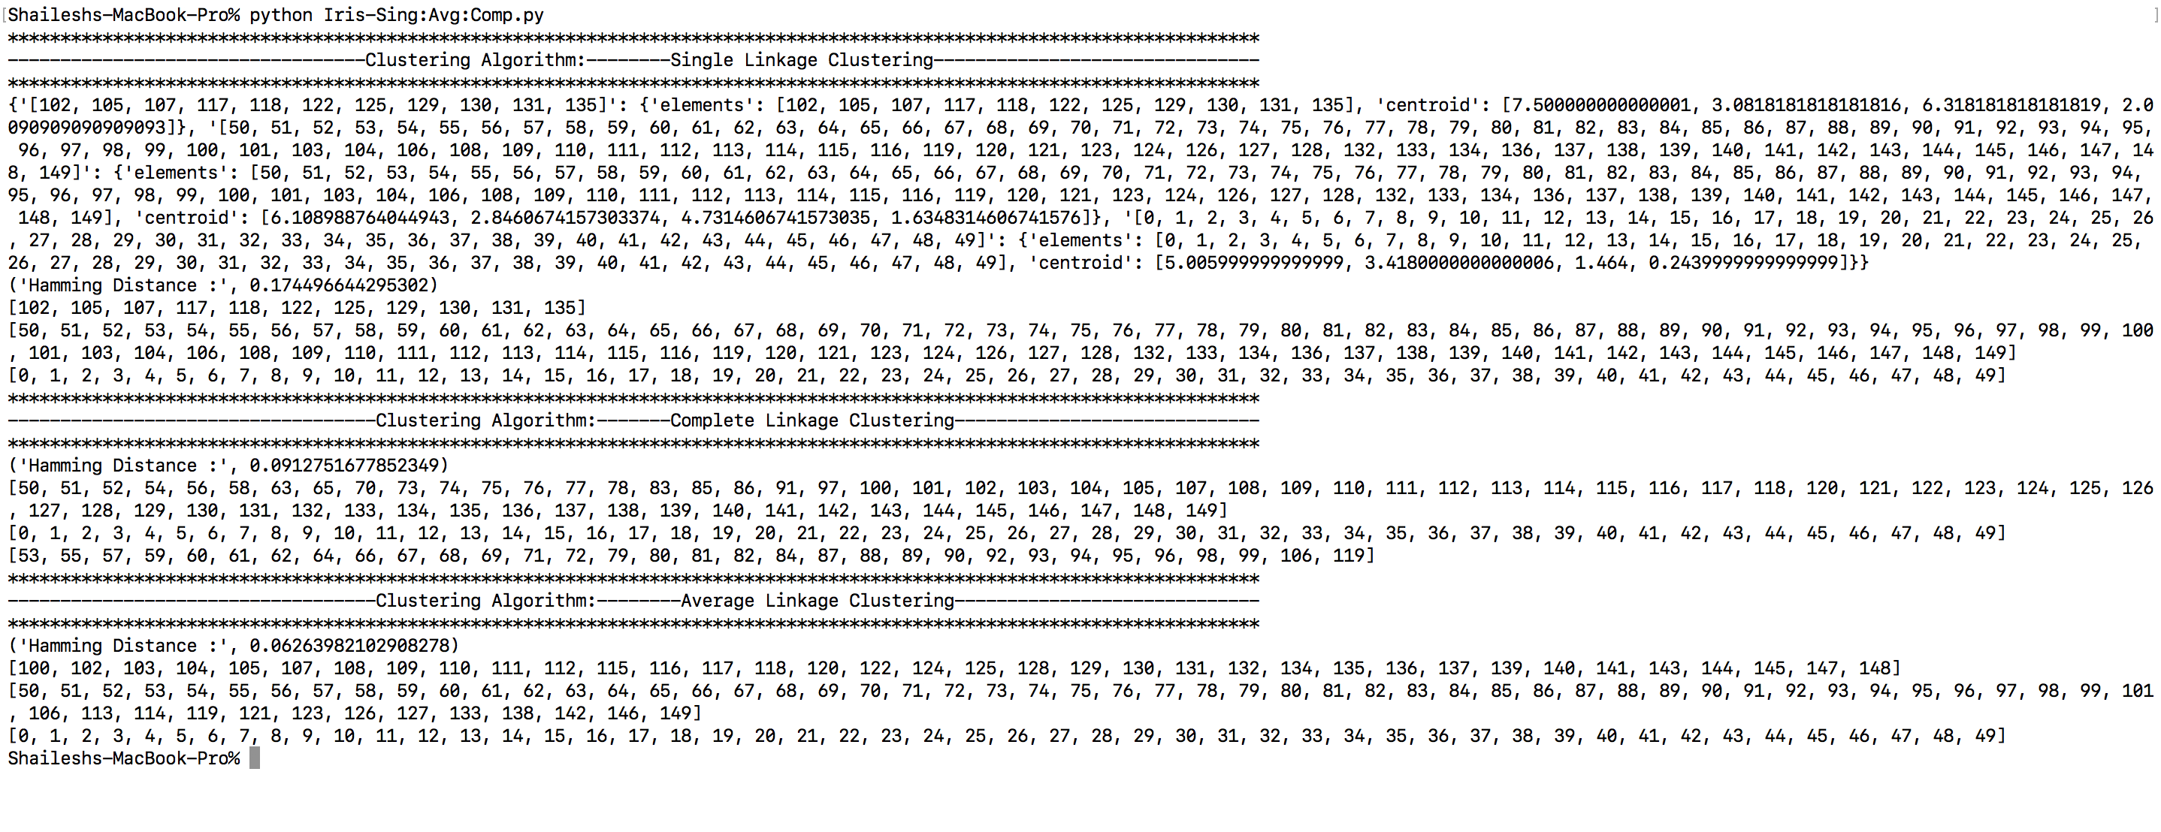
IRIS – SINGLE - COMPLETE - AVERAGE LINKAGE ALGORITHM

Slide 5
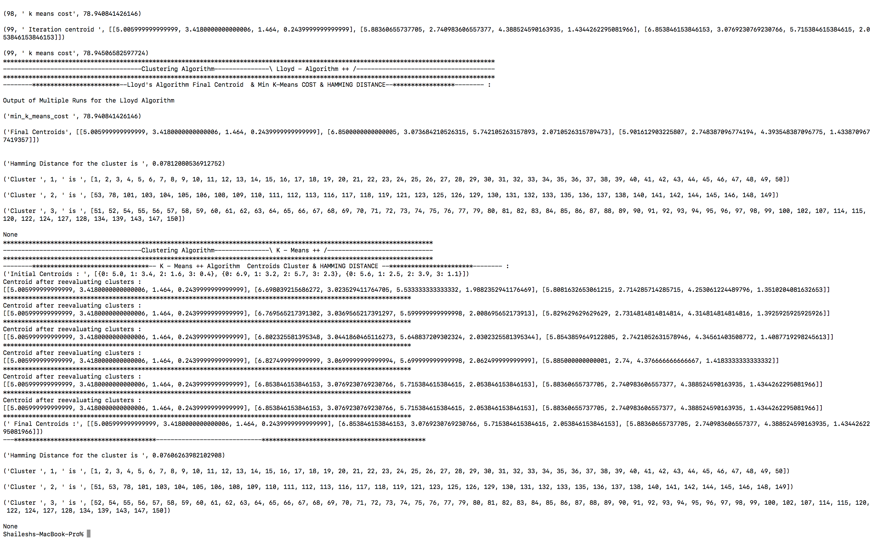
IRIS – Lloyd- /K-Means ++

Slide 6
Balance - Scale DataSet Attribute Information
ABSTRACT: --- Balance scale weight & distance database
Prediction: Balance scale tip to the right, tip to the left, or be balanced.
Number of Attributes = 5
Number of Instances =196
Left-Weight: 5 (1, 2, 3, 4, 5)
Left-Distance: 5 (1, 2, 3, 4, 5)
Right-Weight: 5 (1, 2, 3, 4, 5)
Right-Distance: 5 (1, 2, 3, 4, 5)
Class Name: 3 (L, B, R)
Class is determined by the greater value of (left-distance * left-weight) and (right-distance * right-weight). If they are equal, it is balanced.

Slide 7
Balance – Scale Dataset Values
Left-Weight | Left-Distance | Right-Weight: | Right-Distance | Class Name
1 | 3 | 5 | 4 | R
1 | 3 | 5 | 5 | R
5 | 4 | 1 | 1 | L
1 | 4 | 1 | 2 | L
2 | 4 | 1 | 3 | L
3 | 4 | 1 | 4 | B
1 | 4 | 1 | 5 | R
2 | 4 | 2 | 1 | L
1 | 4 | 2 | 2 | B
2 | 4 | 2 | 3 | R
1 | 4 | 2 | 4 | R
5 | 1 | 3 | 4 | R
5 | 1 | 3 | 5 | R
5 | 1 | 4 | 1 | L
4 | 1 | 4 | 2 | R
3 | 1 | 4 | 3 | R
5 | 1 | 4 | 4 | R
2 | 1 | 4 | 5 | R
5 | 1 | 5 | 1 | B

Slide 8
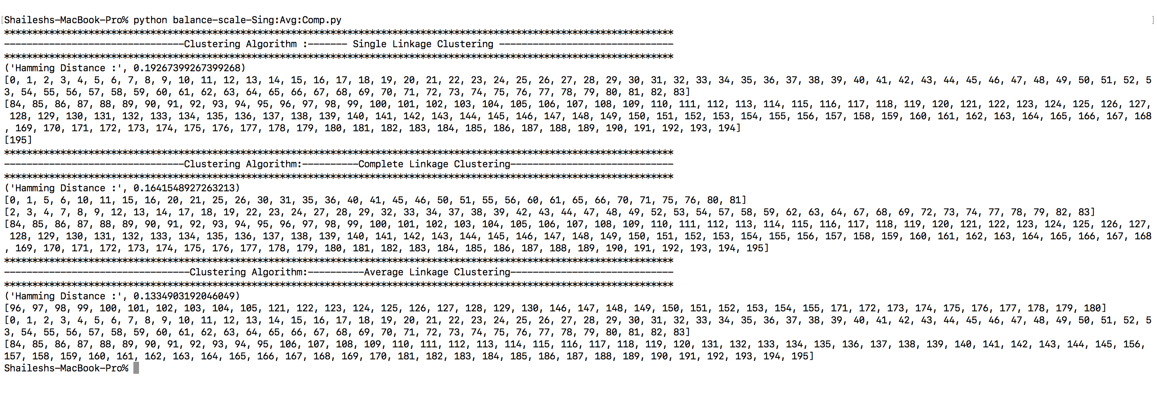
Balance - scale – SINGLE - COMPLETE - AVERAGE LINKAGE ALGORITHM

Slide 9
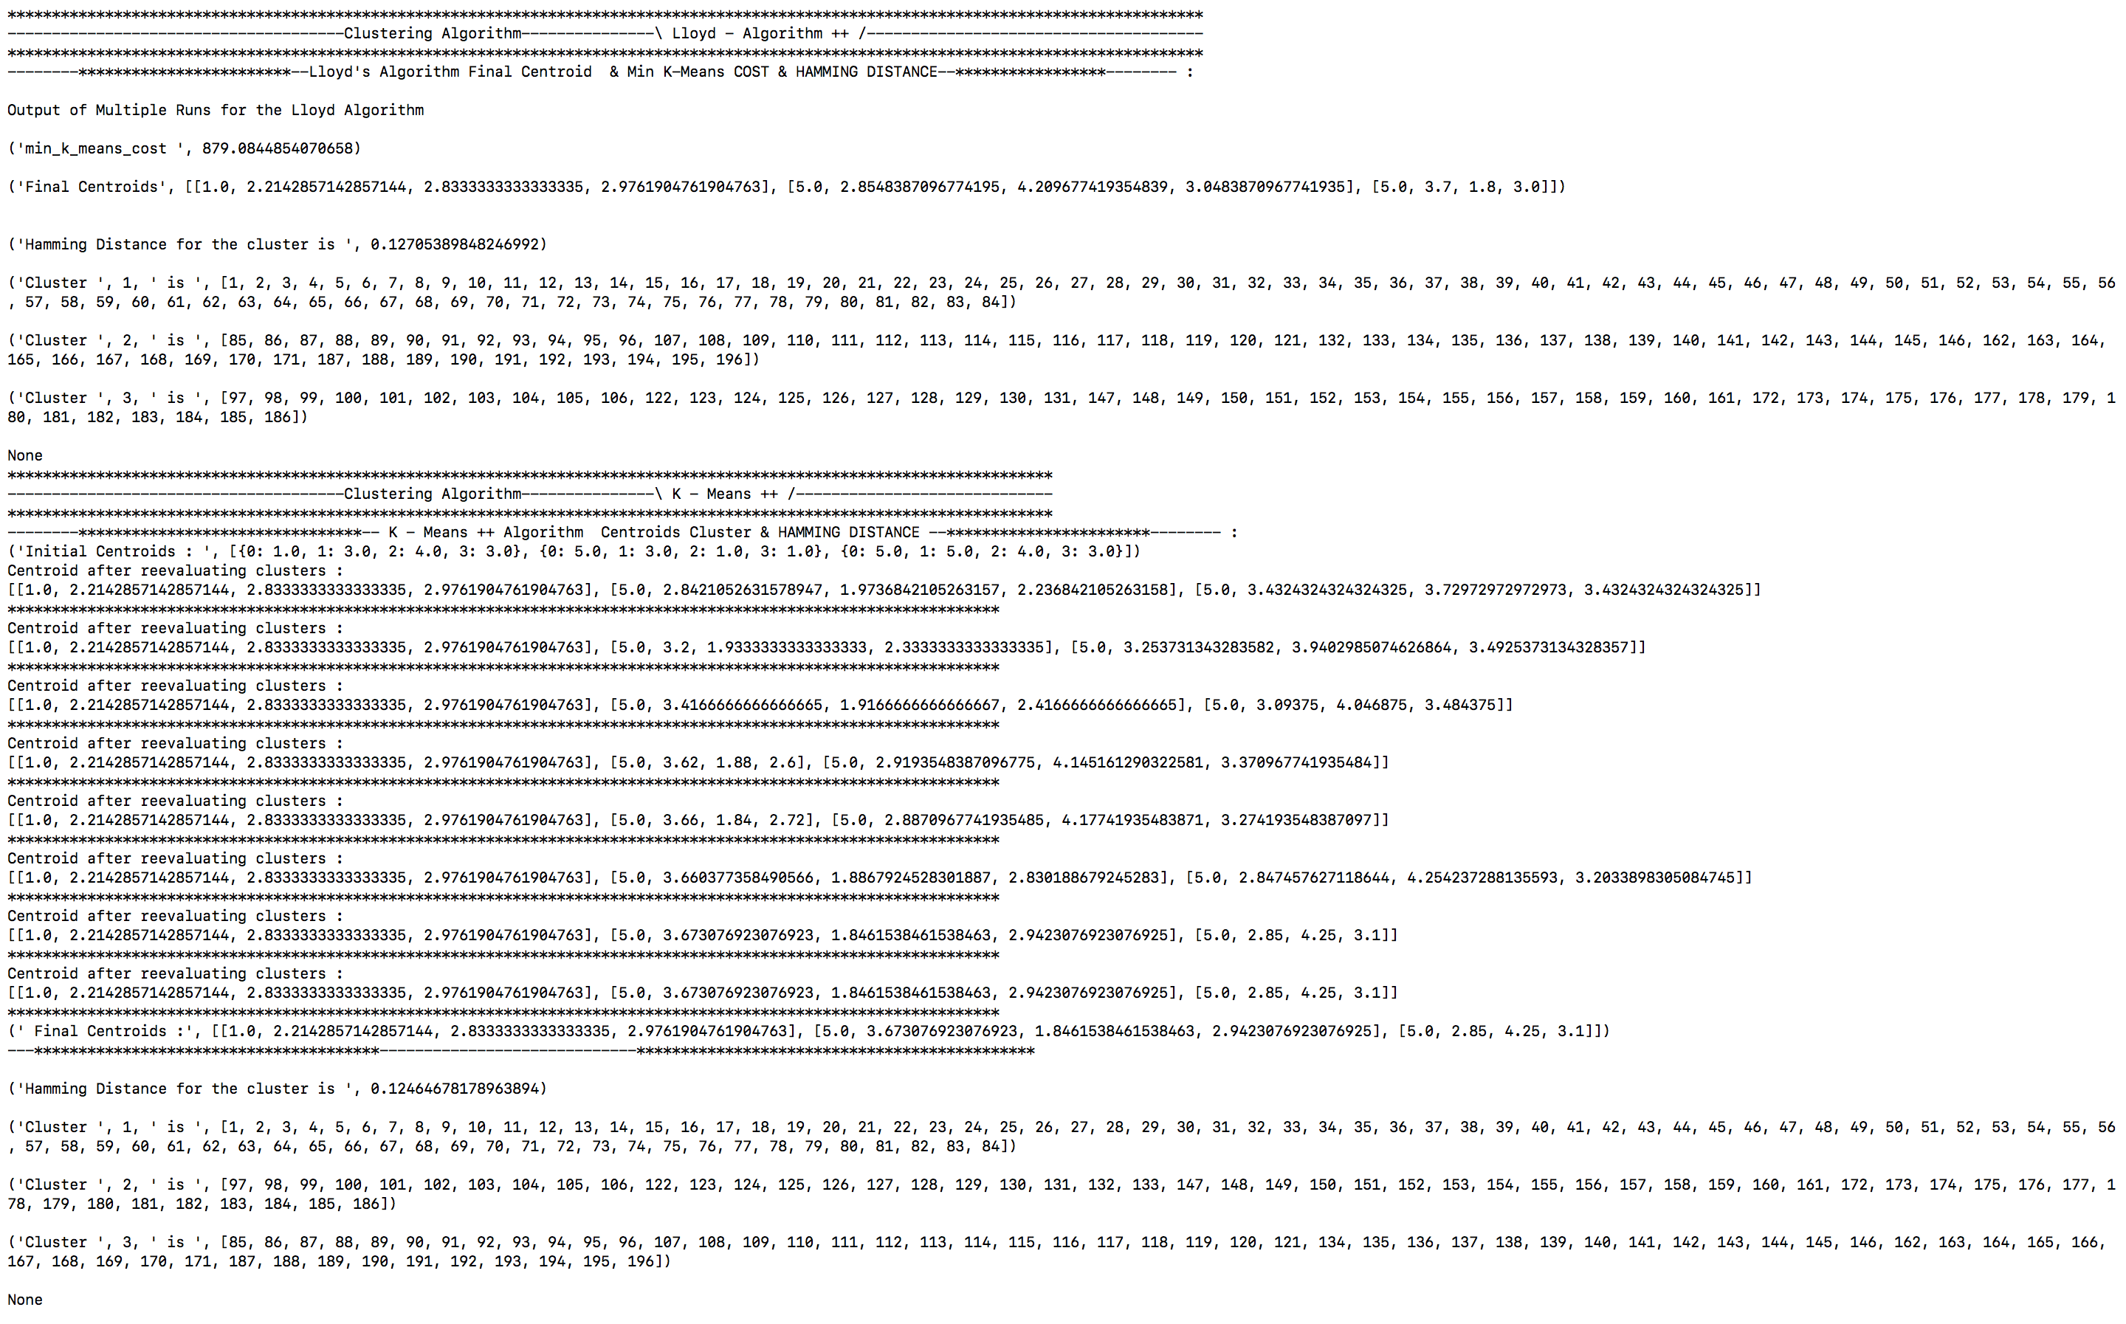
Balance - scale – lloyd /K-Means ++

Slide 10
Comparison B/w Algorithms
CLUSTERING ALGORITHM | IRIS DataSet | BALANCE – SCALE DataSet
SINGLE LINKAGE ALGORITHM | 0.1744 | 0.1926
COMPLETE LINKAGE ALGORITHM | 0.0912 | 0.1641
AVERAGE LINKAGE ALGORITHM | 0.0626 | 0.1334
LlOYD – ALGORITHM | 0.0781 | 0.1270
K – MEANS ++ ALGORITHM | 0.0760 | 0.1246

