Slide 1

SkillSphere Nexus
Integrated Employee Skill, Learning, Certification & Career Management Platform
Team Members · Shailesh, Gowtham, Rohan, Kodur Prashanth
Guide: Vijay Vasanth Sir

Slide 2

INTRODUCTION
What Is SkillSphere Nexus?
A centralized platform unifying employee skills, learning, certifications, career growth, and internal opportunities — helping employees, HR teams, training managers, and administrators understand, develop, validate, and grow talent.
Understand
Map employee skills and competencies
Develop
Deliver targeted learning and training
Validate
Track certifications and credentials
Grow
Support career planning and internal mobility

Slide 3
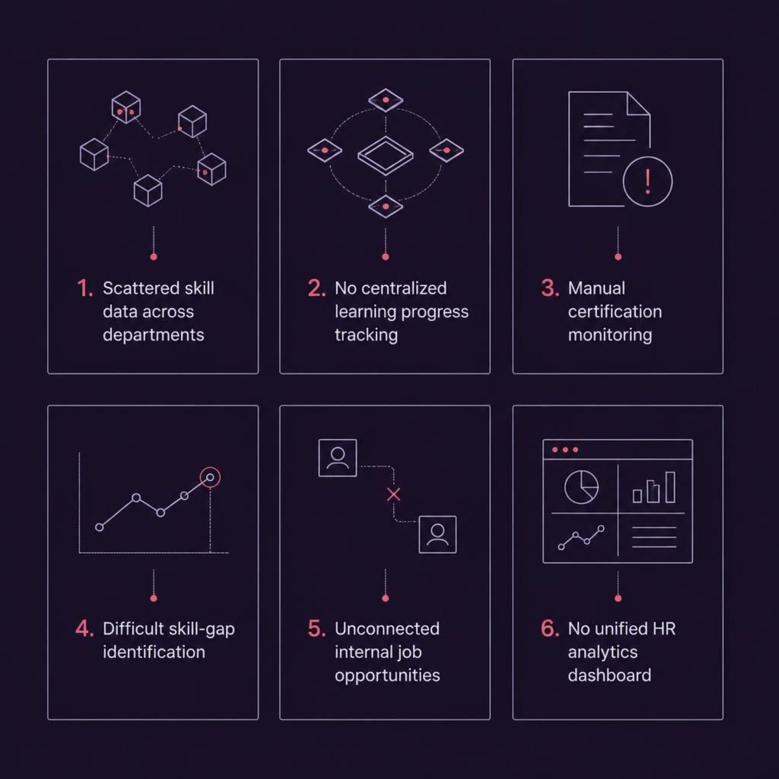
PROBLEM STATEMENT
The Challenge With Traditional Systems
Organizations struggle to connect employee skills with learning, certifications, and career opportunities — creating visibility gaps and inefficient talent development.
Core motivation: HR teams lack a unified system to track, develop,
and grow their workforce effectively.

Slide 4
OBJECTIVES
Project Objectives
Employee Profiles & Skills
Learning Management
Certification Tracking
Manage courses, learning paths, enrollment, progress tracking, and certificate generation.
Register professional certifications, track expiry dates, and manage renewals.
Maintain profiles, skill catalogs, proficiency levels, and competency gap analysis.
Career & Analytics
Secure Access
Support career planning, promotion readiness, internal job matching, and HR dashboards.
Role-based access control via Keycloak for HR, Training Managers, Admins, and Employees.

Slide 5
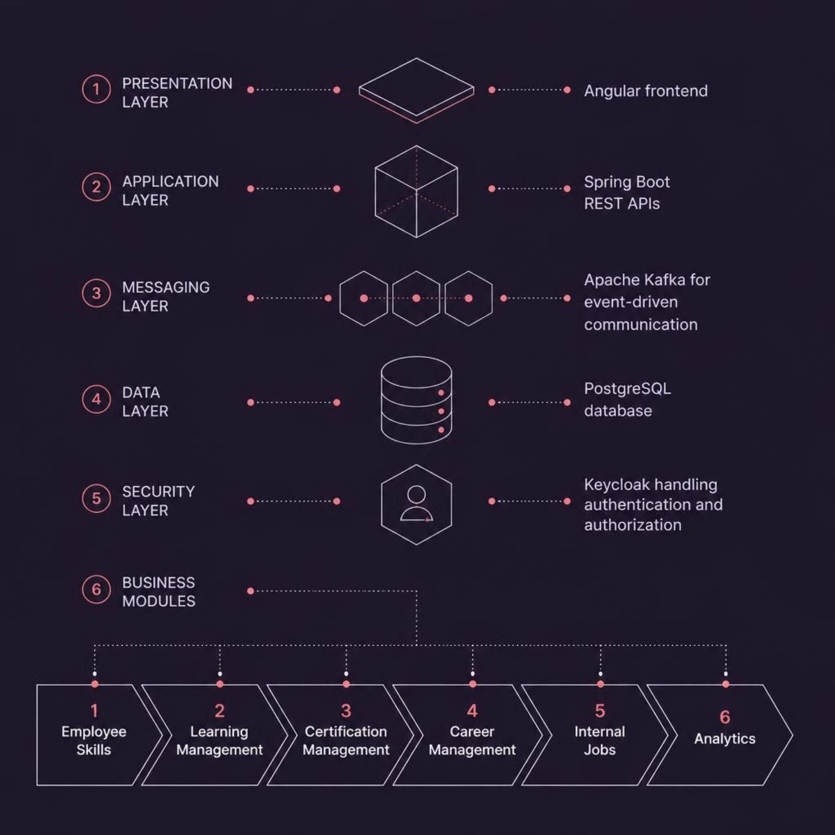
ARCHITECTURE
Technology Stack & System Architecture
Technology Stack
Frontend: Angular — responsive, component-driven UI
Backend: Spring Boot + REST APIs — modular microservices
Database: PostgreSQL — relational data persistence
Auth: Keycloak — OAuth2, and RBAC
Messaging: Apache Kafka — async event-driven communication
The platform follows a modular, integrated architecture — each milestone operates independently while sharing a unified data layer.

Slide 6




ROADMAP
Four-Milestone Project Roadmap
Milestone 1
Milestone 2
Employee Skill Management
Understand the employee — profiles, skill catalogs, and gap analysis
Learning Management
Develop the employee — courses, paths, and certificates
Milestone 3
Milestone 4
Certification Management
Validate the employee — credentials, expiry, and renewals
Career & Analytics
Grow the employee — career plans, internal jobs, and dashboards
Each milestone builds on the previous, forming a fully connected employee development lifecycle.

Slide 7
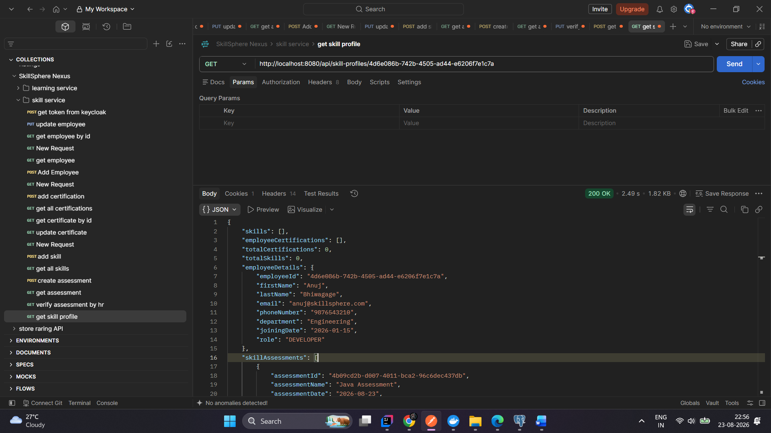
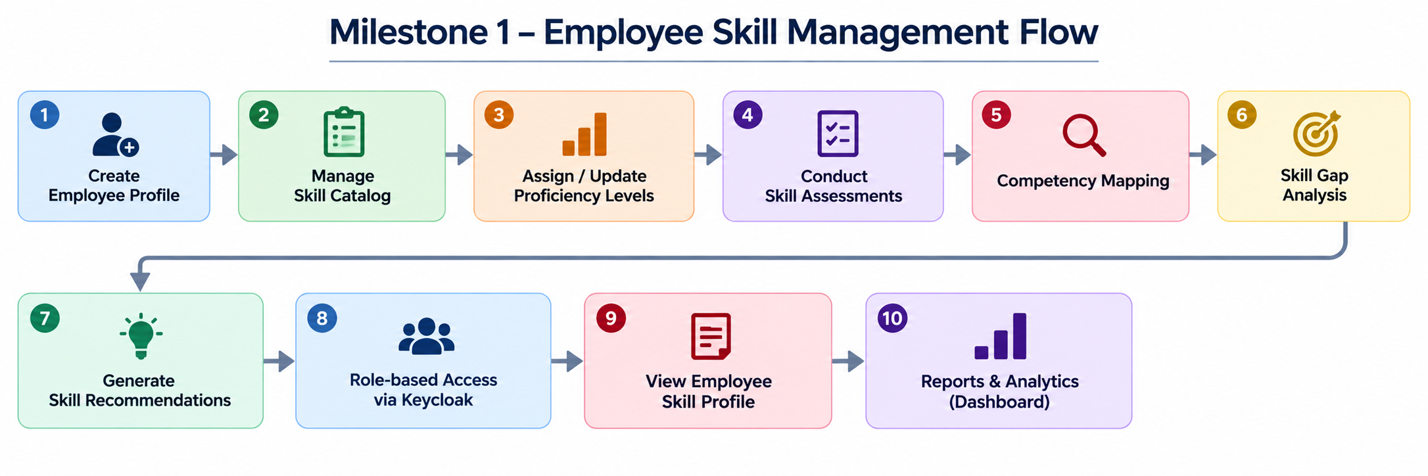
MILESTONE 1
Skill Management
Milestone 1 — Employee Skills
Employee profile & skill catalog management
Proficiency-level tracking and skill assessments
Competency mapping and skill-gap analysis
Role-based access via Keycloak
System compares current proficiency with role requirements to identify gaps.

Slide 8
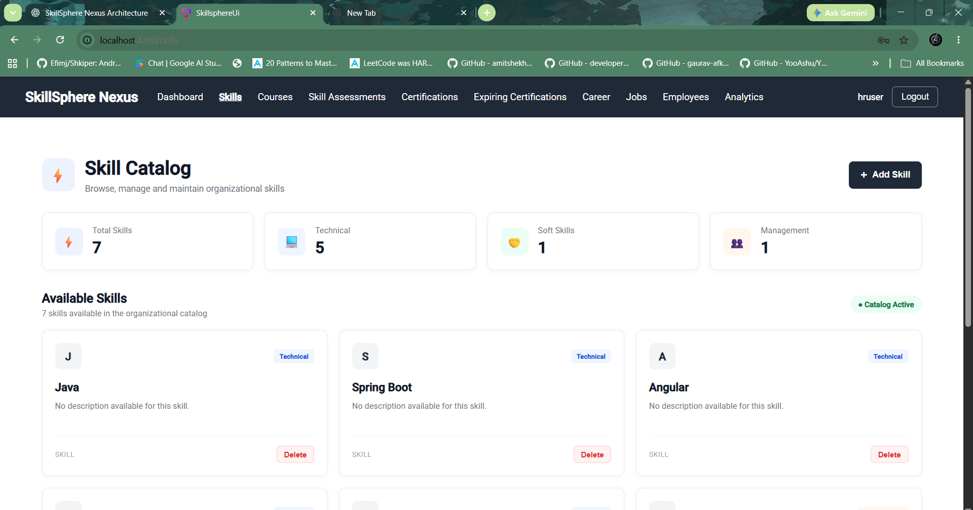
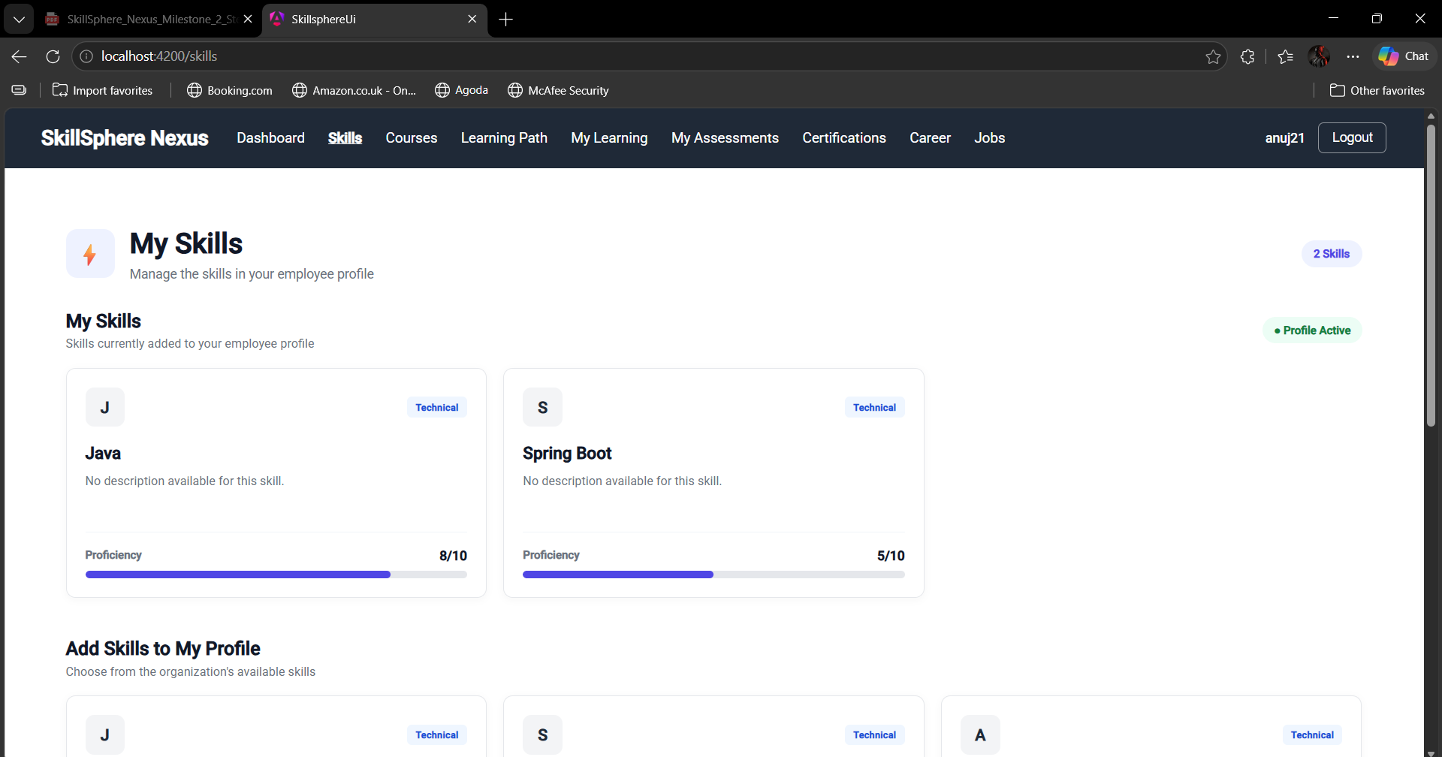
MILESTONE 1 • UI WALKTHROUGH
Employee Skill Management — Catalog & Profile
The screenshots show the organizational skill catalog and an employee’s current skill profile, including proficiency levels.
Skill Catalog
My Skills
Organizational skill catalog showing 7 skills: 5 Technical, 1 Soft Skill, and 1 Management skill. The page supports browsing and adding skills.
Employee skill profile showing 2 assigned skills — Java (8/10) and Spring Boot (5/10) — with proficiency bars and options to add more skills.

Slide 9
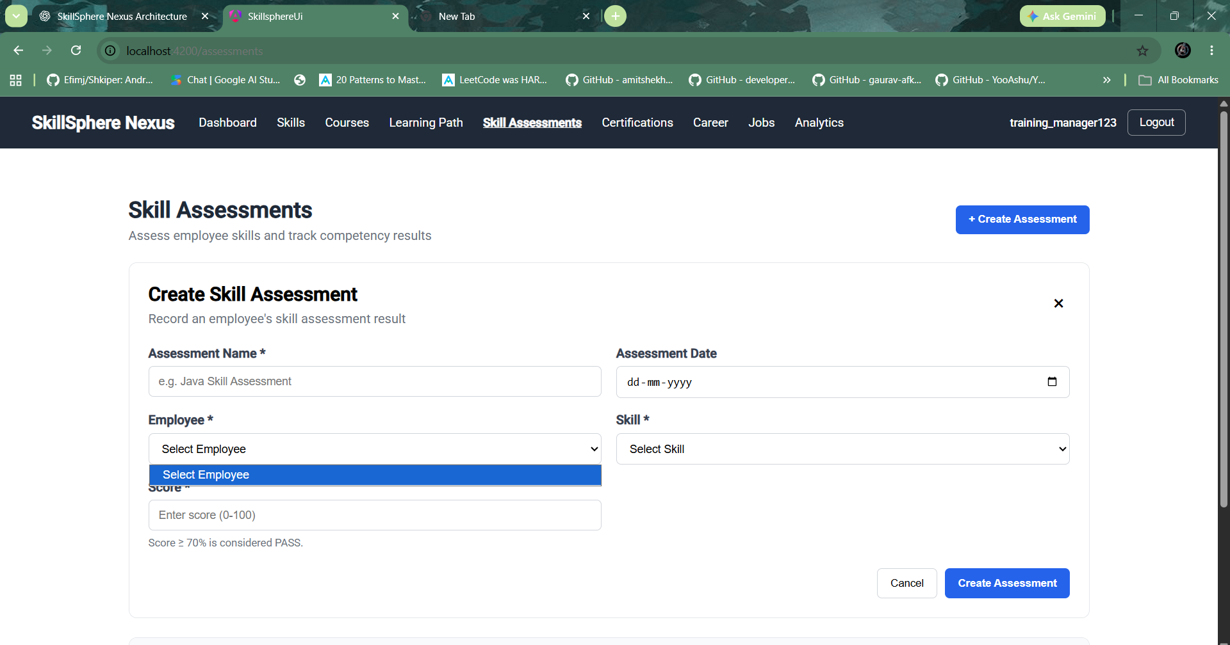
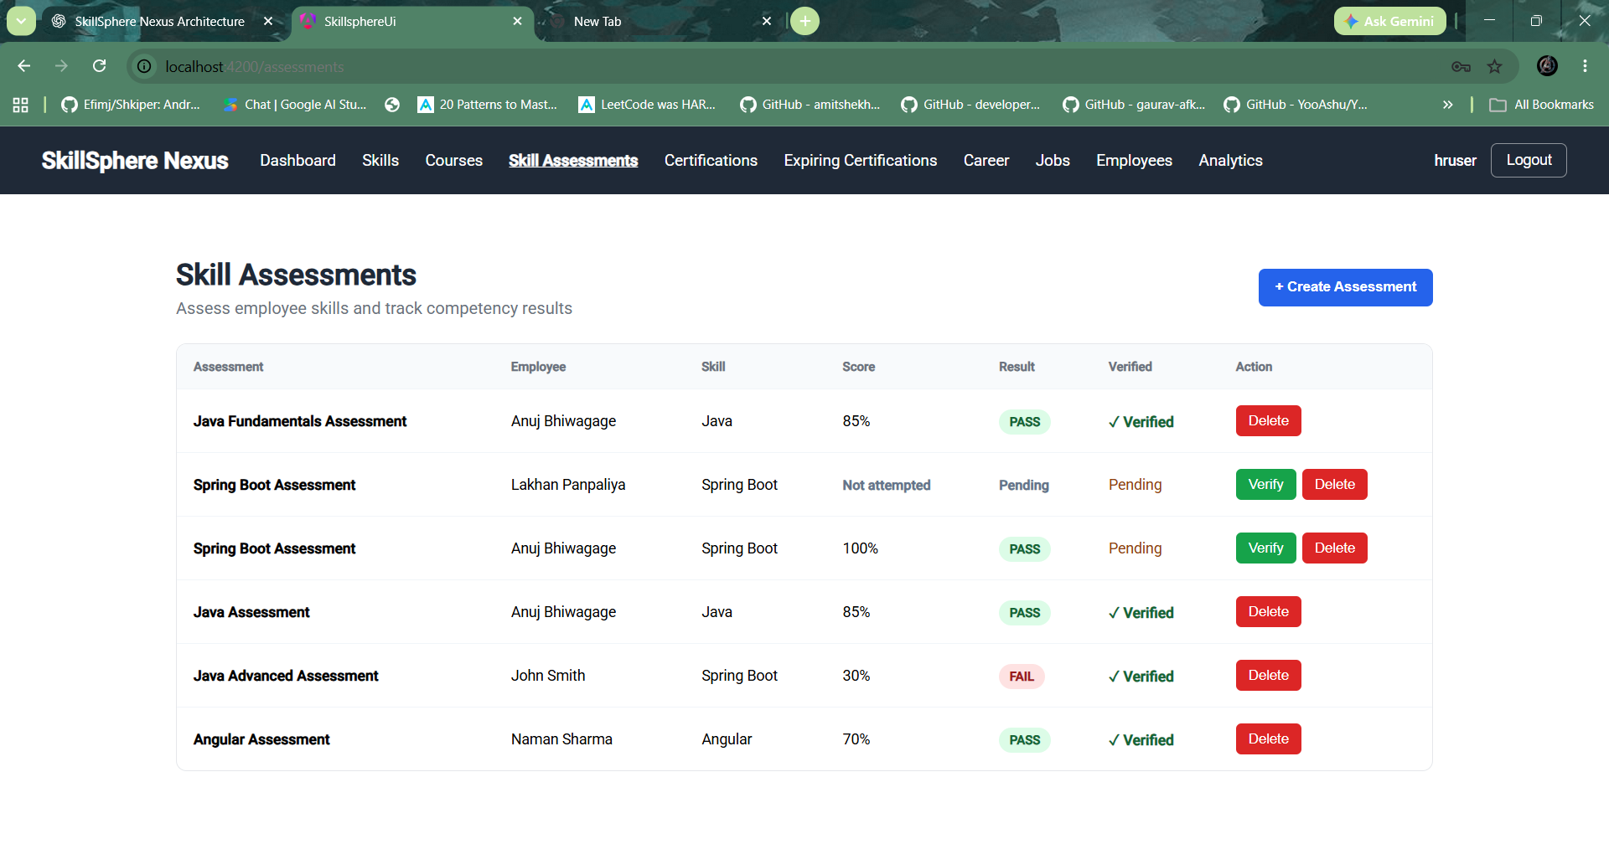
MILESTONE 1 • UI WALKTHROUGH
Skill Assessment — Creation & Results
The screenshots show assessment creation for managers and the resulting assessment list with scores, results, and verification status.
Create Skill Assessment
Skill Assessment Results
Create Skill Assessment lets a manager enter the assessment name and date, select an employee and skill, and record a score from 0–100. Scores of 70% or above are marked PASS.
Assessment results show the assessment name, employee, skill, score, PASS/FAIL result, verification status, and actions such as Verify and Delete.

Slide 10
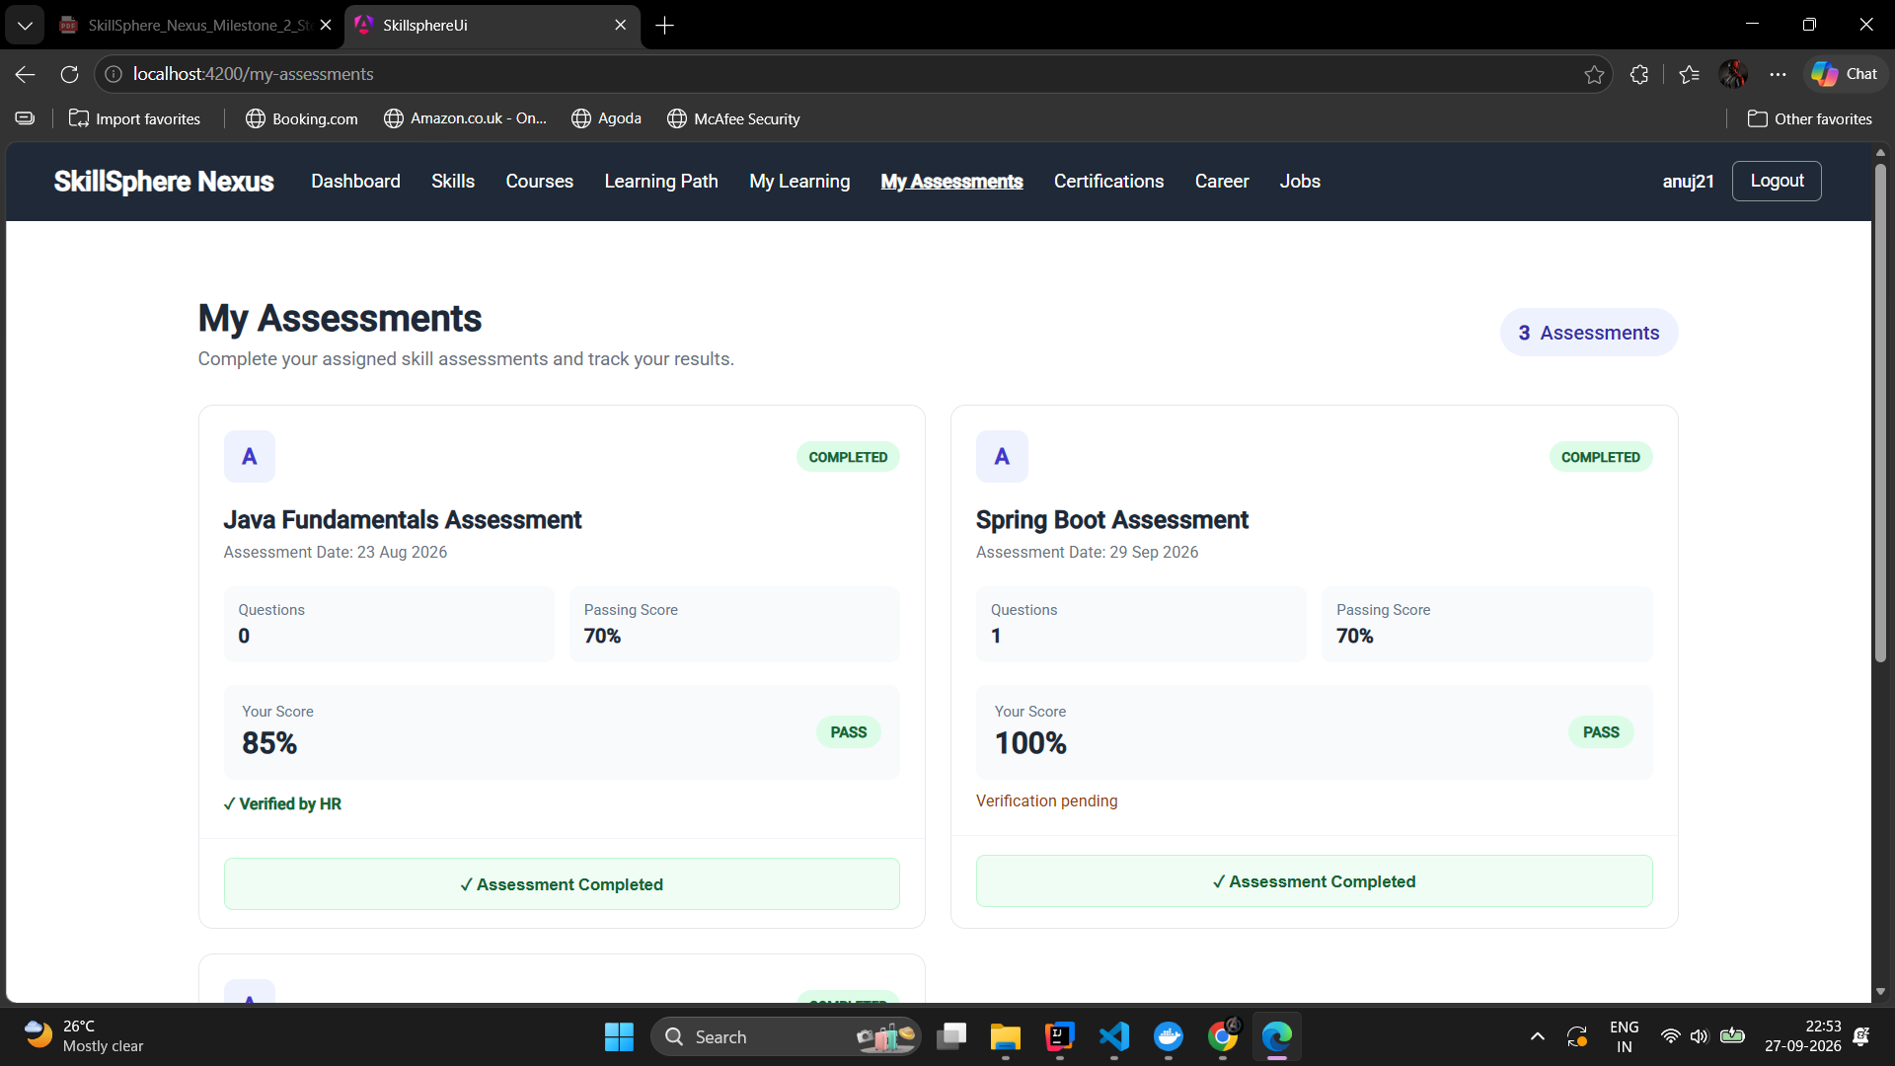
MILESTONE 1 • UI WALKTHROUGH
My Assessments
Employee-facing assessment screen showing assigned assessments, completion status, scores, and HR verification.
Assessment Overview
The screenshot shows 3 assessments. Completed cards display the assessment date, question count, passing score, employee score, PASS result, and verification status; Java Fundamentals is verified by HR while Spring Boot shows verification pending.

Slide 11
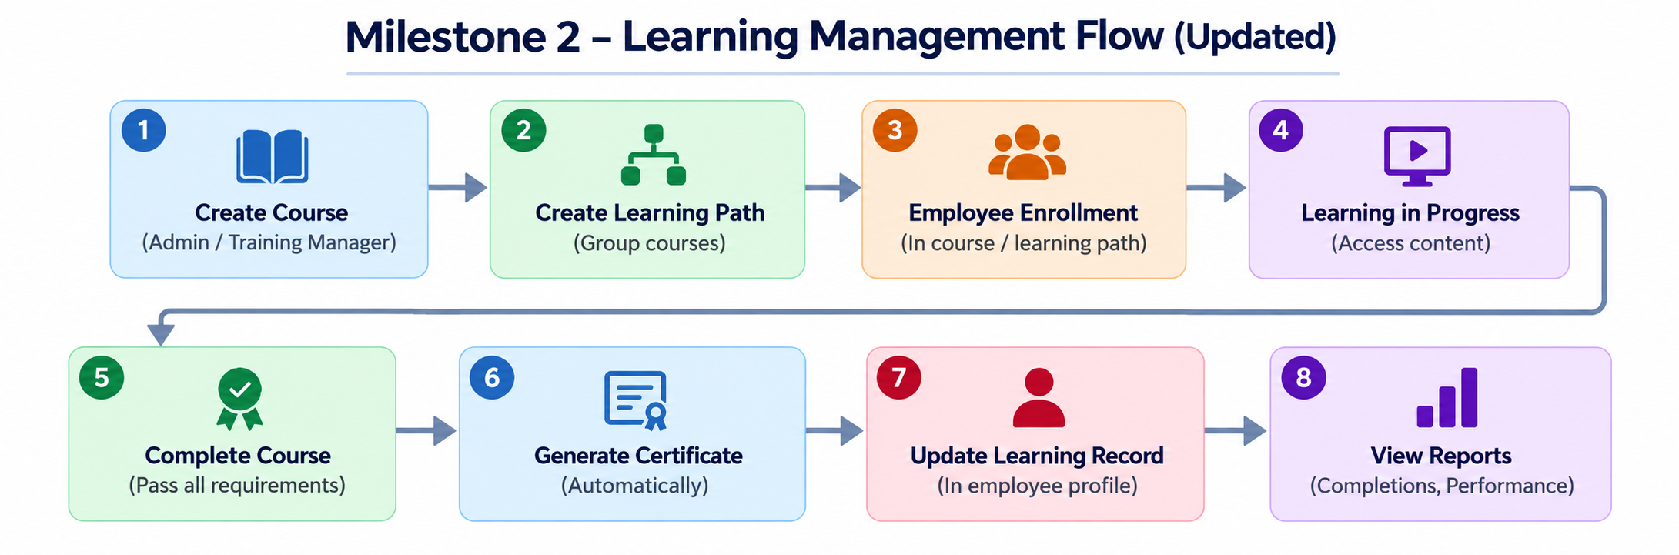
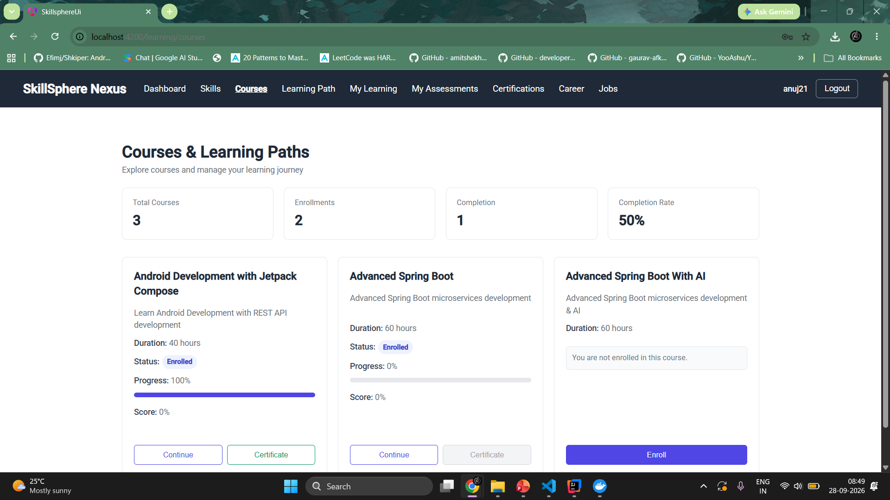
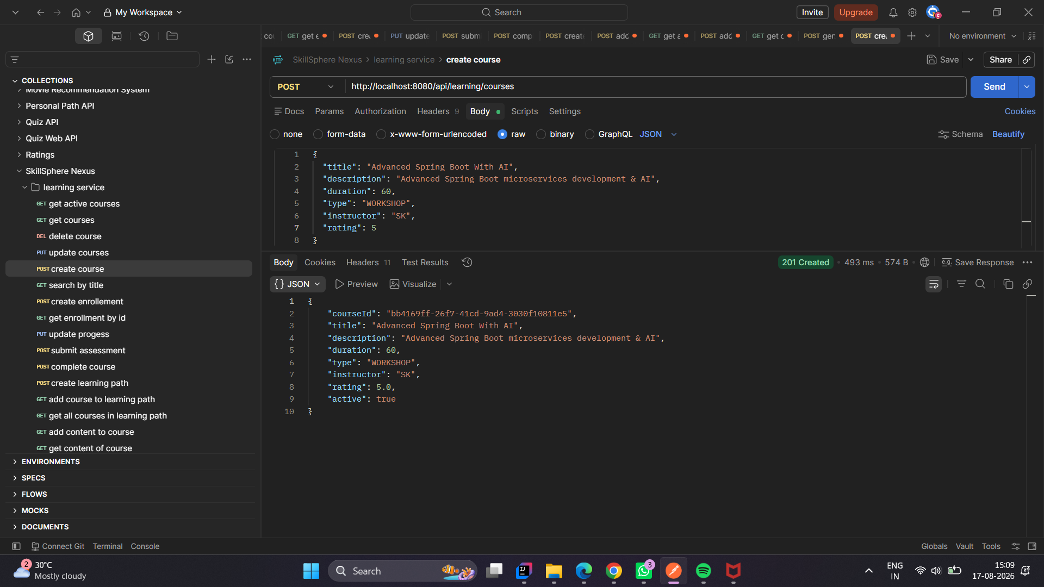
MILESTONES 2
Learning Management
Milestone 2 — Learning Management
Course and learning path creation
Employee enrollment and progress tracking
Course completion and certificate actions
Learning records and performance reporting
Snapshot: 3 courses • 2 enrollments • 1 completion • 50% completion rate

Slide 12
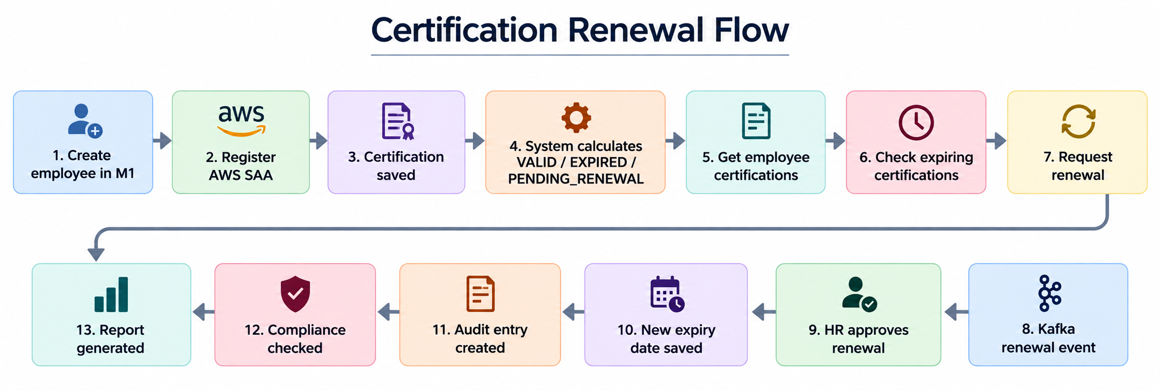
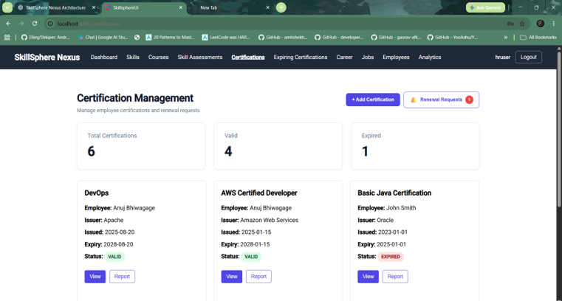
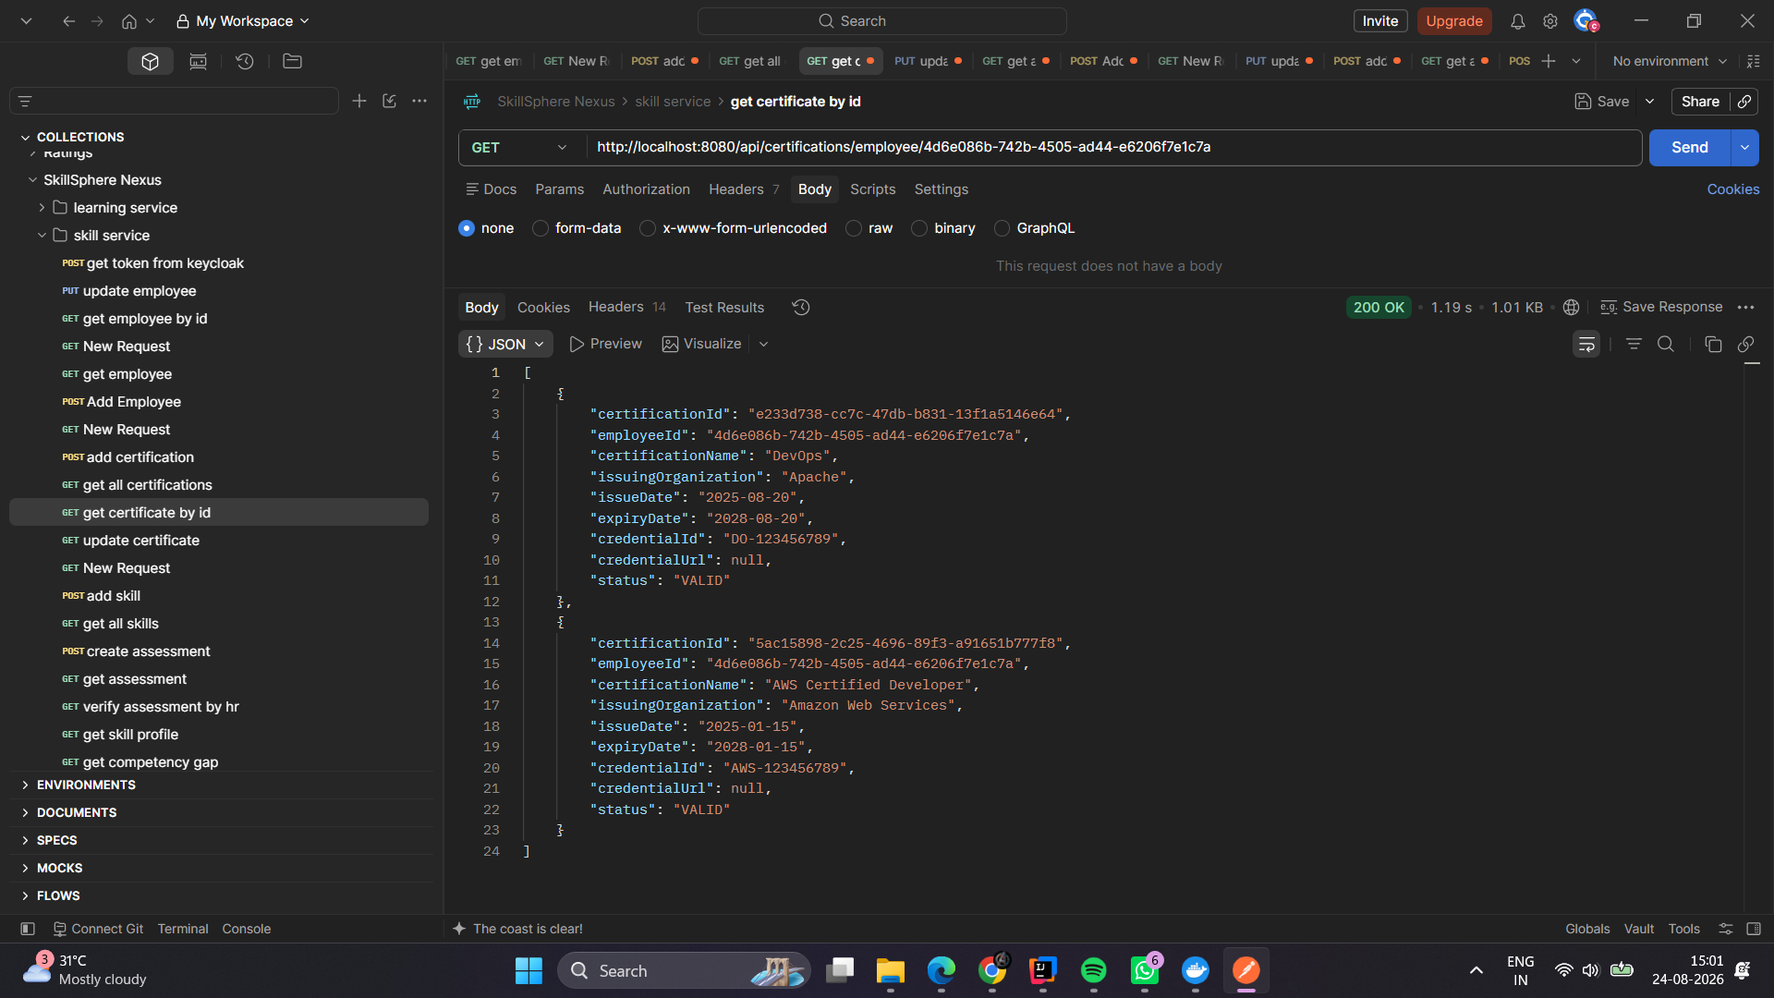
MILESTONES 3
Certification Management
Milestone 3 — Certification Management
Professional certification registration and updates
Dashboard: 6 total · 4 valid · 1 expired
Statuses: VALID, EXPIRED, PENDING_RENEWAL
Renewal warnings, requests, approvals, and audit trail

Slide 13
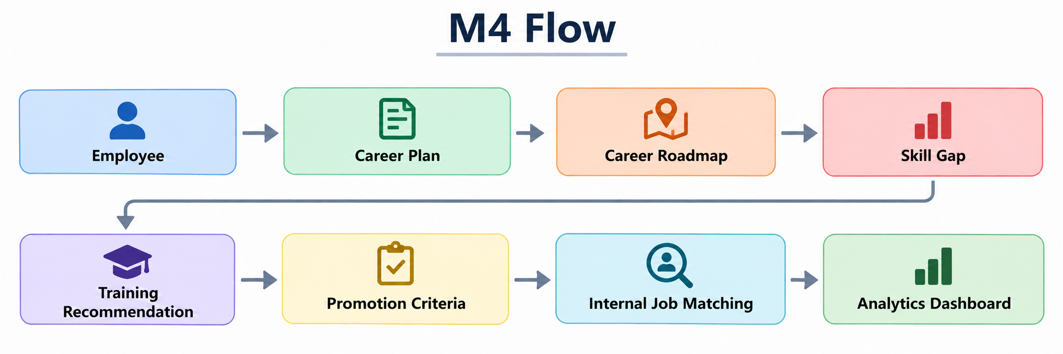
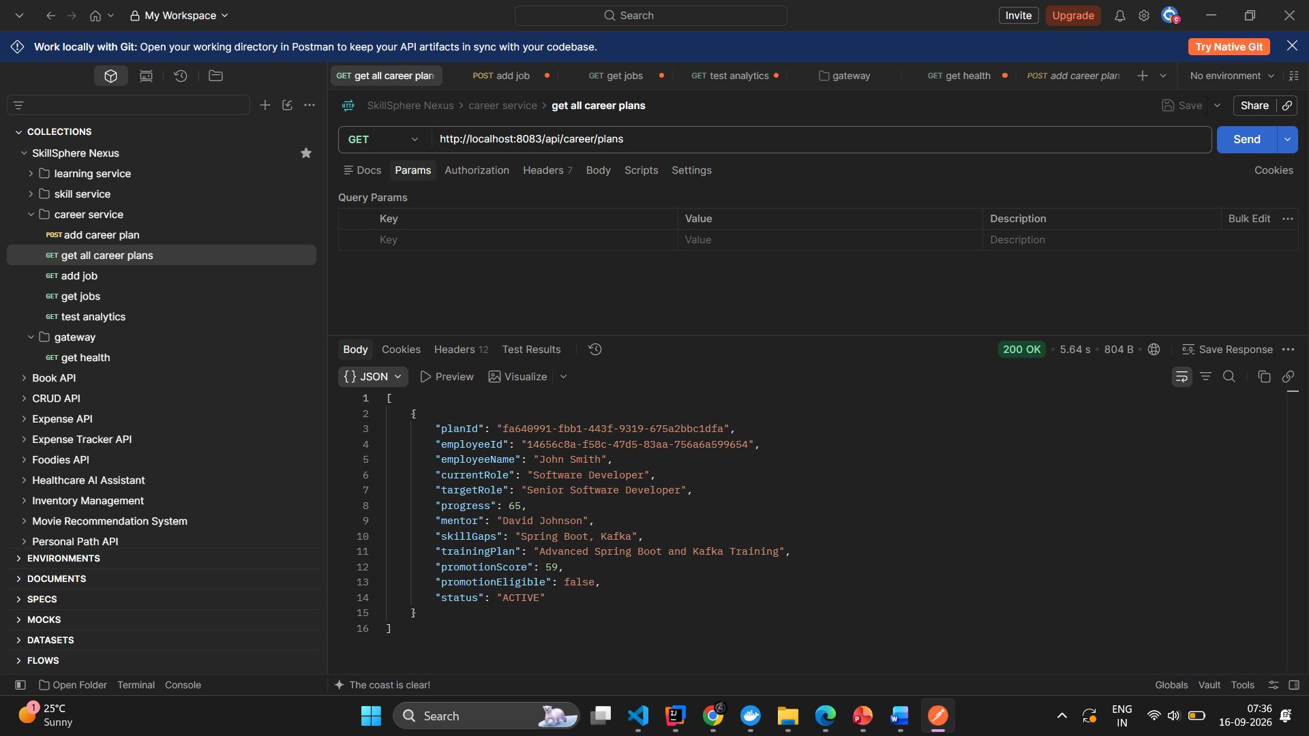
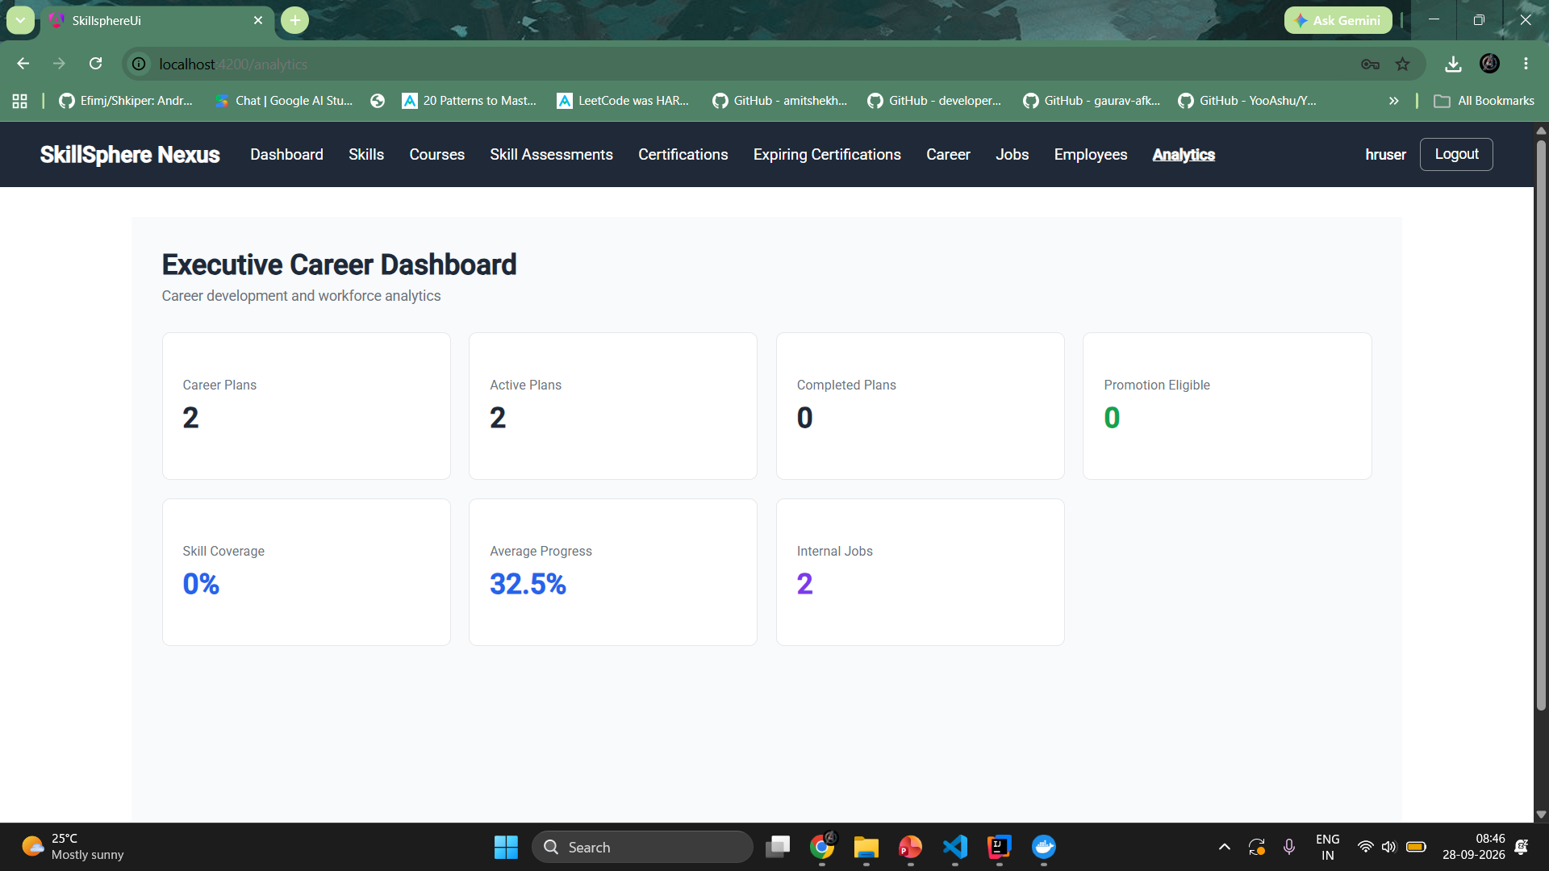
MILESTONES 4
Career Growth
Milestone 4 — Career & Analytics
Career plans with current and target roles
Mentor assignment and personalized training plans
Promotion readiness and criteria mapping
Skill-based internal job matching
Dashboard: 2 plans · 2 active · 32.5% average progress · 2 internal jobs

Slide 14
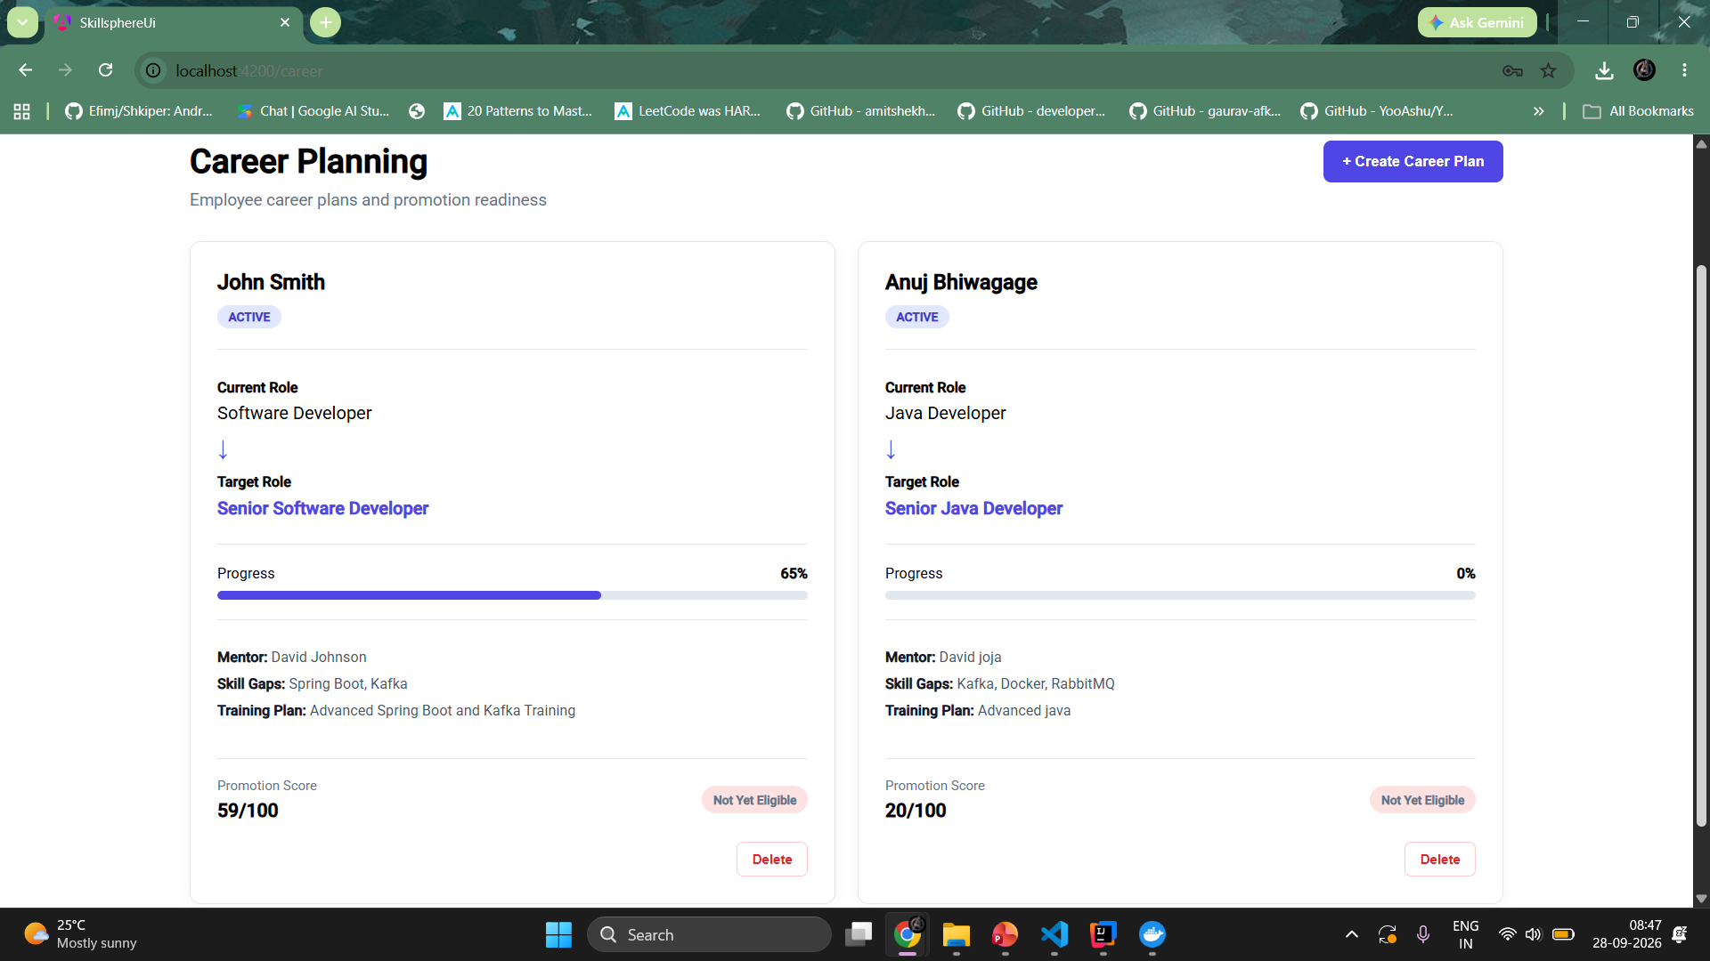
MILESTONE 4 • UI WALKTHROUGH
Career Planning
Career planning gives employees visibility into current and target roles, progress, mentors, training plans, and promotion readiness.
Career Planning Dashboard
The screenshot shows career plans for employees with current and target roles, progress bars, mentor assignments, training plans, and actions such as setting a target role or deleting a plan.
This UI supports career planning, progress tracking, mentoring, and preparation for future internal opportunities.

Slide 15
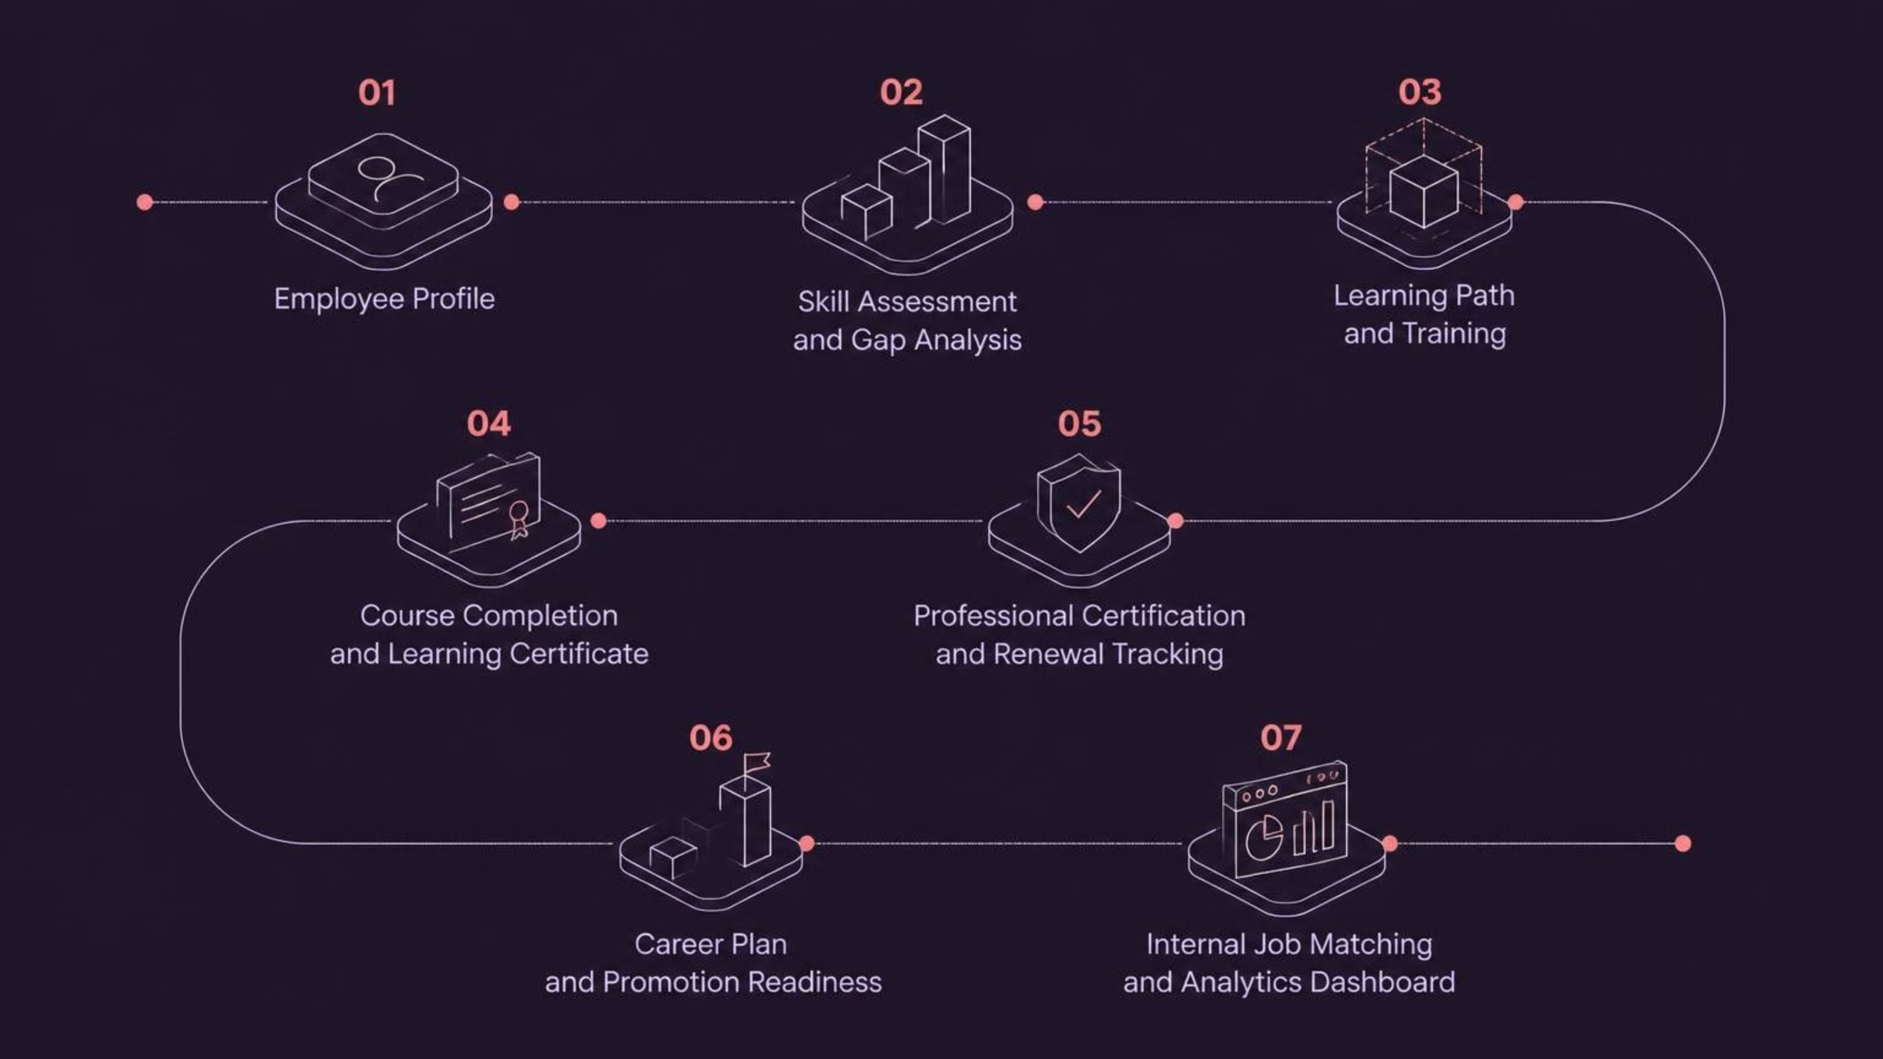
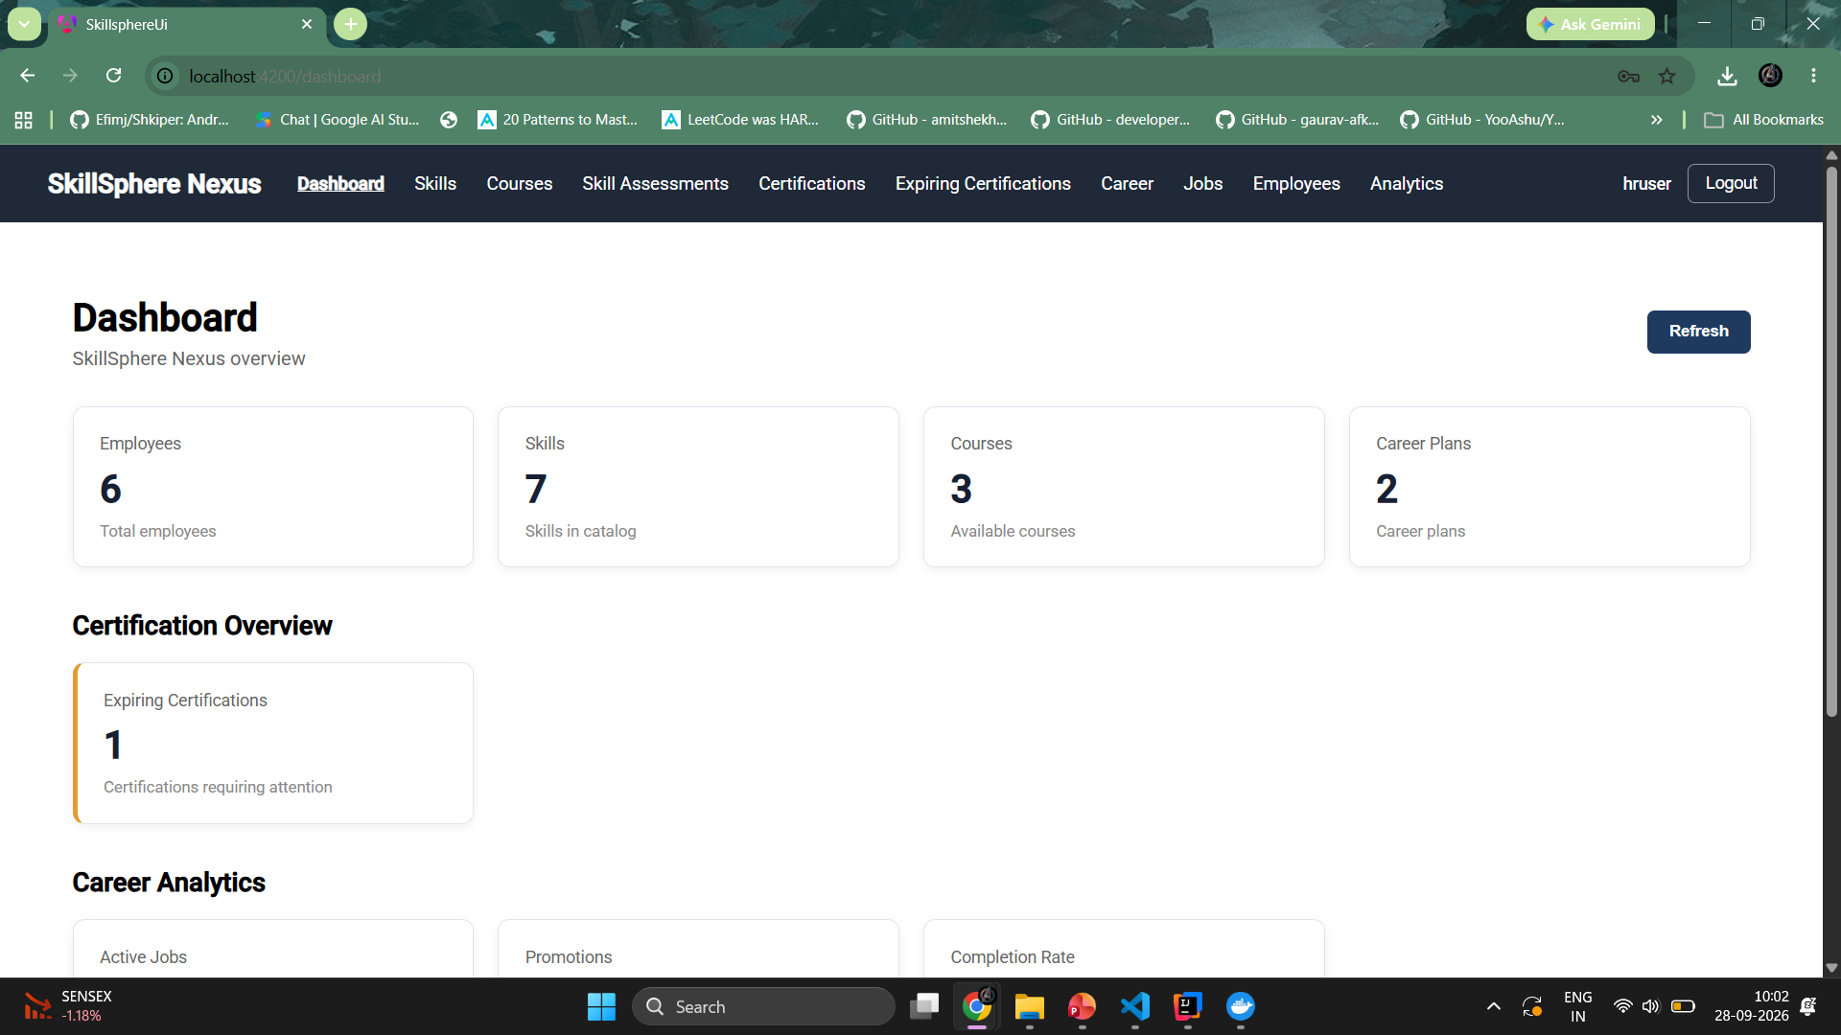
INTEGRATION & DASHBOARD
End-to-End Integration & User Experience
Unified Platform
Dashboard Highlights
All four milestones operate as one connected system. Data flows seamlessly from skill assessment through learning, certification, and career progression — visible through a single centralized dashboard.
Clickable module sections for each domain
Role-based access: HR, Training Manager, Admin, Employee
Clear progress indicators and status badges
Integrated view of skills, learning, certifications, and careers
Easy navigation with consistent UI patterns

Slide 16
SECURITY & FUTURE
Security, Future Enhancements & Conclusion
Security & Validation
Proposed Future Enhancements
Keycloak-based authentication with OAuth2 and SSO
Role-based access: HR, Training Manager, Admin, Employee
REST API validation across all modules
Secure, validated access to analytics dashboard
AI-based Skill and Course Recommendations: Suggest personalized learning paths based on employee skills and career goals.Intelligent
Intelligent Employee-Job Matching: Match employees with suitable internal job opportunities based on their skills and experience.
Gamification & Rewards: Award EXP points for completing courses and certifications, which users can redeem for rewards and incentives.

Slide 17
Conclusion
SkillSphere Nexus unifies employee development — from skills and learning to certifications and growth — improving visibility, planning, and progression across the career organization.
Thank You

