Slide 1



BHARATRATNA DR. BABASAHEB AMBEDKAR LAW COLLEGE
Submitted by:
Guide by:
Roll no.
Subject:
Topic:
Contact no.
Email:
College:

Slide 2

Indexation
Sr. no. | Particulars | Page
1 | Meaning of jurisprudence | 3
2 | Division in school of jurisprudence | 4
3 | Explanation on sociological school of jurisprudence | 5
4 | Meaning of Sociological school of Jurisprudence | 6
5 | Legal and Sociological aspect of sati | 8
6 | Sociology of law | 9

Slide 3

JURISPRUDENCE
Jurisprudence, or legal theory, is the theoretical study of law. Scholars of jurisprudence seek to explain the nature of law in its most general form and provide a deeper understanding of legal reasoning, legal systems, legal institutions, and the role of law in society. Modern jurisprudence began in the 18th century and was focused on the first principles of natural law, civil law, and the law of nations. General jurisprudence can be divided into categories both by the type of question scholars seek to answer and by the theories of jurisprudence, or schools of thought, regarding how those questions are best answered. Contemporary philosophy of law, which deals with general jurisprudence, addresses problems internal to law and legal systems and problems of law as a social institution that relates to the larger political and social context in which it exists. This article addresses three distinct branches of thought in general jurisprudence. Ancient natural law is the idea that there are rational objective limits to the power of legislative rulers. The foundations of law are accessible through reason, and it is from these laws of nature that human laws gain whatever force they have. Analytic jurisprudence (Clarificatory jurisprudence) rejects natural law's fusing of what law is and what it ought to be. It espouses the use of a neutral point of view and descriptive language when referring to aspects of legal systems. It encompasses such theories of jurisprudence as "legal positivism", which holds that there is no necessary connection between law and morality and that the force of law comes from basic social facts; and "legal realism", which argues that the real-world practice of law determines what law is, the law having the force that it does because of what legislators, lawyers, and judges do with it. Normative jurisprudence is concerned with "evaluative" theories of law. It deals with what the goal or purpose of law is, or what moral or political theories provide a foundation for the law.

Slide 4
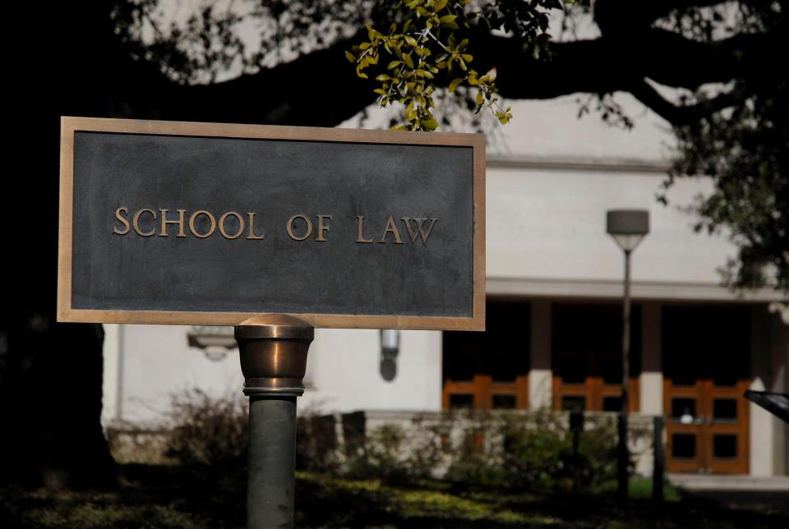
There are four main divisions in schools of jurisprudence, namely:
The Philosophical school of jurisprudence
The Analytical (including the comparative) school of jurisprudence
The Historical school of jurisprudence
The Sociological school of jurisprudence
SCHOOLS OF JURISPRUDENCE

Slide 5
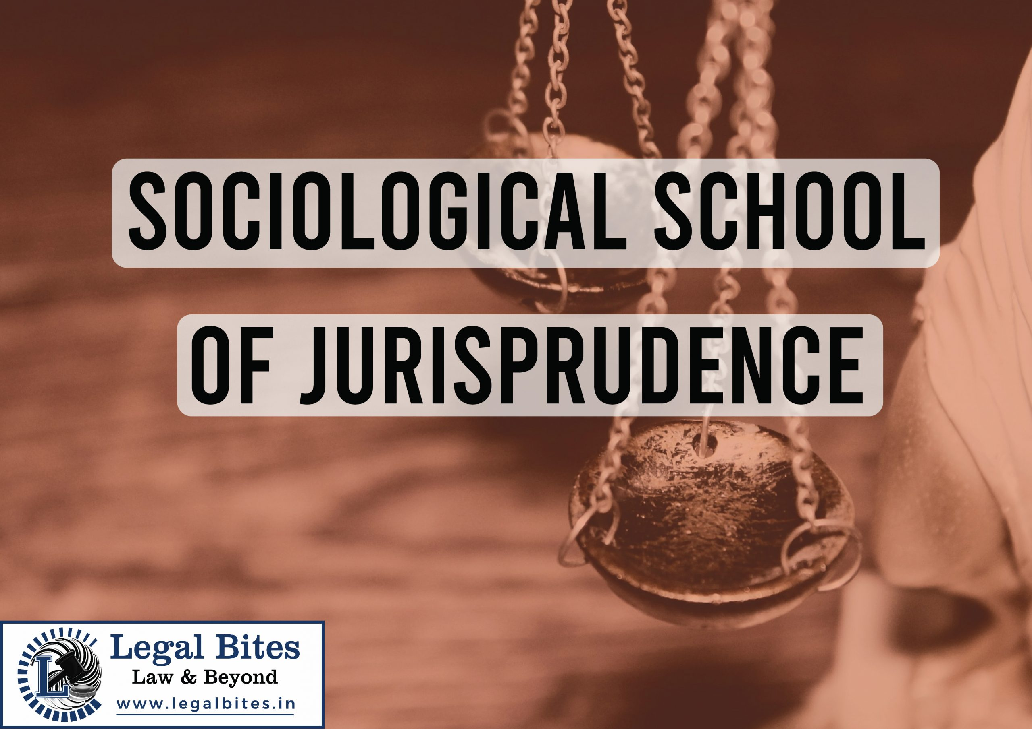
THE SOCIOLOGICAL SCHOOL OF JURISPRUDENCE
Sociology of law is defined in many ways, but its main difference from functional jurisprudence is that it attempts to create a science of social life as a whole and to cover a great part of general sociology and political science. The emphasis of the study is on society and law as a mere manifestation, whereas Pound rather concentrates on law and considers society in relation to it. Huntington Cairns also attempt to create a legal science with a dominant emphasis on sociology. He considers that modern jurisprudence is a meaningless and fruitless pursuit of a goal incapable of achievement.’ Jurisprudence is really an applied science, and no technology has ever succeeded unless it was based on the findings of a pure science. No universal propositions can be laid down concerning legal concepts or rules because they differ from race to race. If jurisprudence wishes to become scientific, it must create a science of society. The basis must be human behavior as influenced by, and in relation to, disorder. It is impossible to discover how law operates unless we have greater knowledge of the factors that cause change in society and govern its evolution.
When this is understood, jurisprudence as a technology can apply these rules to reach useful results. At present jurists are attempting to build a house before the foundations have been laid. Montesquieu laid the seeds of the sociological method in jurisprudence. In his “Esprit des Lois” (Spirit of the laws), published in 1748, Montesquieu used the historical method. Montesquieu researched into the laws and institutions of all kinds of human society. He considered that law should be based on historical observations, and not merely on reason or belief.

Slide 6

Meaning of Sociological school of Jurisprudence
The idea of Sociological School is to establish a relation between the Law and society. This school laid more emphasis on the legal perspective of every problem and every change that take place in society. Law is a social phenomenon and law has some direct or indirect relation to society. Sociological School of Jurisprudence focuses on balancing the welfare of state and individual was realized.
In the words of Ehrlich, “At the present as well as at any their time, the center of gravity of legal development lies not in legislation, nor in the juristic decision, but in society itself. ”
Sociological School of Jurisprudence studies the relationship between the law and sociology. Every problem or concept has two different aspects. One is sociological view and other is a legal aspect. For example, Sati.
Legal and Sociological aspect of Sati
Sati was the ancient Indian practice of burning the widow on her husband’s funeral pyre.
The legal aspect:
Sati Paratha was first abolished in Calcutta in 1798. A territory that fell under the British jurisdiction. A ban on Sati was imposed in 1829 in the British territories in India. In today’s time, the practice of Sati is banned under the Prevention Of Sati Act (1987) which makes it illegal to force or encourage anyone to commit Sati.
The sociological aspect
In today’s era of escalating feminism and focus on equality and human rights, it is difficult and amiss to digest the ruthless Hindu practice of Sati. Indeed, the practice is outlawed and illegal in today’s India.

Slide 7
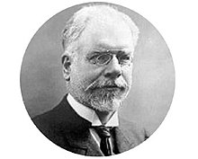
The French jurist Leon Duguit was a professor of constitution law in the University of Bordeaux in France. He made substantial contribution to the sociological jurisprudence in early twentieth century. Dugit carried forward the belief that scientific progress can be accelerated by individual behavior in order to satisfy common social needs and interests. Dugit was inspired by Durkheim who himself had taken inspiration from Comte. Durkheim’s main point, on which Dugit built upon, was that he made a distinction between two kinds of needs of men in society. Firstly, there are common needs of individuals which are satisfied by mutual assistance and secondly, there are diverse needs of individuals which are satisfied by the exchange of services. Therefore, the division of labor was pre-eminent factor of social cohesion as an indisputable fact beyond ideology, beyond religious or metaphysical speculation…. The constant realization of social fact which is simply inter-dependence of individuals could at least replace ideological quarrels by observable facts. Dugit attacked traditional concepts of state, sovereignty and law and sought to fashion a new approach to these matters from the angle of society. Dugit was much influenced by Augste Comets ‘Theory of law as a fact” which denounced individual rights of man and subordinated them to social interest. Completed that “the only right which man can possess is the right always to do his duty.” This formed the basis of Dugit’s legal theory.
Leon Duguit

Slide 8

Sociology of law
Sociology of law studies sociology from the legal point of view. In India, Sociology of law is a recent field of inquiry. Indian advocates of Sociological jurisprudence are P.B Gajendragakhar, and Upendra Baxi views society from the legal point of view.
The Sociology of law is the interdisciplinary approach or sub-discipline of sociology. It views the society from the legal side. And explains the interdependence of Society and law. Sociology law explains the interdependence of the law and society. Podgorecki has listed the following functions of the sociology of law:
(1) The sociology of law aims at grasping law in its working;
(2) it is to provide expert advice for social engineering;
(3) the sociology of law tries to shape its studies to make them useful for practical applications; and
(4) the sociology of law struggles with reality.
Thus, the sociology of law aims at the understanding of legal and social phenomena, whereas the main concern of the traditional approach to jurisprudence is to undertake analytical-linguistic studies.
Conclusion
Sociological School of Jurisprudence studies the relationship between and society. It explains the interdependence of law and society. One can’t formulate better and effective law without looking and studying the need and structure of society. For the betterment and harmonious society, we need better and effective laws.

Slide 9

Jurisprudence and Sociology
The objective of sociology is to study human actions in a social environment. It studies humans as members of social groups. Law is an important element of society. Therefore, sociologists must understand law in order to understand society. However, a sociologist would not look at law in the same way as a lawyer. While a lawyer is concerned with the law itself, a sociologist is concerned with the impact of the law upon society. There is a separate branch of jurisprudence which comprises of sociological of sociological theories of law. Not only sociologists but lawyers too have to understand the society in order to understand the law. For instance, crime is essentially an act of social deviance and to understand the law of crimes, a basic understanding of the society is required. Earlier, the judges used to decide punishments based on popular opinion. However, now the process has become more technical and professional in nature with the opinions and studies of criminologists being taken into consideration. According to Paton, it is essential to understand the relationship between law and social interests since such a study would lead to a better understanding of the evolution of law. The human factor in law cannot be entirely neglected. The ideas of jurists like Keeton asserting the necessity of studying law as devoid of any social interests is, indeed, compelling but appears to be quite impractical.

Slide 10

Thank you

