Slide 1
Online Chinese Character Handwriting Recognition for Linux
Presenter: Ran CHENG (Kelvin)

Slide 2
Content
Background
Introduction
Related material
  Smart Common Input Method (SCIM) and Linux input framework
  Hidden Markov Model (HMM) and Dynamic Programming (DP)
  Chinese character processing
Research Plan

Slide 3
Background
Why?
  Why handwriting?
    One of most important input methods
  Why Chinese character?
    Large market
    One of the I18N goals
  Why online?
    Only feasible runtime Input method
    Frequently used
  Why Linux?
    Fast developing OS
Who?
  Who is the sponsor?
    Redhat Linux

Slide 4
Background (Continues)
What?
  What will be the deliverables?
    One handwriting software prototype
    A new handwriting recognition algorithm
How?
  C++
  GTK+
  Linux input framework

Slide 5
Introduction
Handwriting types
  Online
  Offline
  Signature
The current online Chinese handwriting market
  Most are commercial, not open source
  Some existing open source, but not Chinese

Slide 6
Introduction (Continues)
Aim:
  Online Handwriting recognition and recognition accuracy
  Recognition for Chinese Character
  Implementation of handwriting recognition algorithm using SCIM under Linux
Related Project and Useful Techniques
  SCIM
  HMM and DP
  Some Chinese character processing techniques

Slide 7
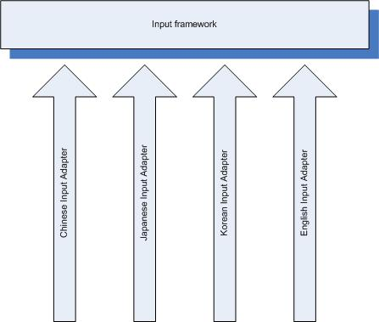
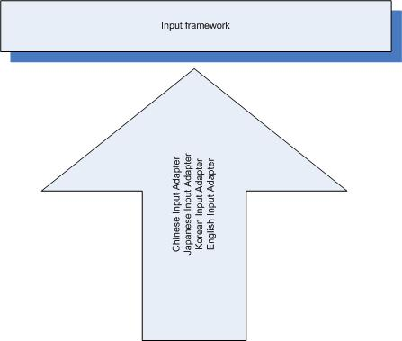
SCIM and Linux Input framework
Smart Common Input Method (SCIM) is a new generation input mechanism under Linux OS.

Slide 8
HMM and DP
What is HMM?
  Markov process with unknown parameters
  challenge is to determine the hidden parameters from the observable parameters
Example
  Two people in difference city {Bob, Smith}
  Talk through the phone
  Weather and activities
    {Sunny, Rainy, Cloudy} {Walk, Shopping, Cleaning}

Slide 9
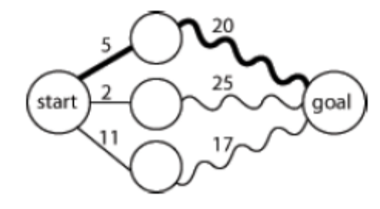
HMM and DP (Continues)
What is DP?
  a method for reducing the runtime of algorithms exhibiting the properties of overlapping subproblems and optimal substructure, described below
Example
  Two stage
  Find the shortest path in stage
  Find the optimal path

Slide 10
Chinese character processing
Character segmentation
Pre-processing
Pattern Representation
Classification
Context processing

Slide 11
Research Plan
Research Methodology
  Scientistic method
    Observation:
      Speech recognition using HMM and DP
      Some Japanese Handwriting recognition using SCIM
    Prediction:
      Handwriting can use HMM and DP
      Chinese handwriting recognition can be adopted by SCIM

Slide 12
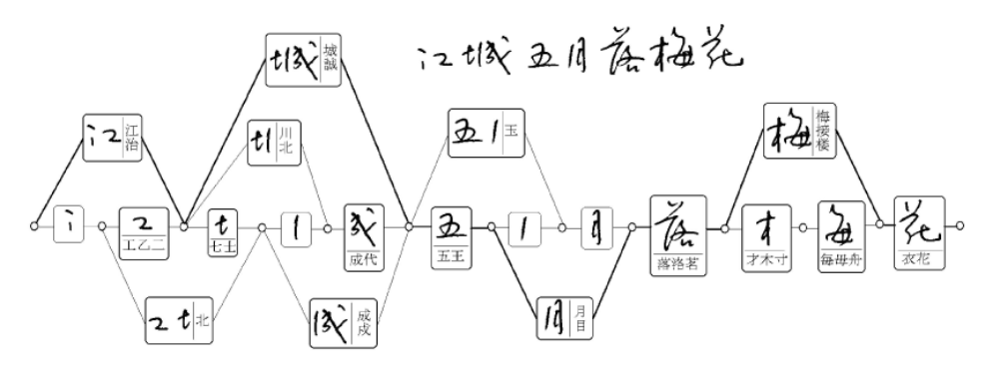
Research Plan (Continues)
Apply HMM
  Hidden parameters: characters
  Observable parameters: strokes
Apply DP

Slide 13
Questions?

