Slide 1

Digital Rights Search Engine

Slide 2
Content
Background
Introduction
XML
Creative Commons
ODRL (Open Digital Rights Language)
ODRL Creative Commons
NIKKY License Packager
XML Creation
IMS Content Packaging
Search Engine
Findings and Future work

Slide 3
Background
Why?
  In recently year, Internet has become the biggest resource library over the traditional mediums. Internet can do the same job as the traditional mediums do, and much better.
  Problem raised: Keeping the advantages of Internet, how can we protect the copyrights of products (like audio, video, images an so on)?
  To balance the advantages of Internet and copyrights issue, Digital Rights Search Engine project was established.

Slide 4
Background (Continues)
How?
  Using XML
    Has been widely used for data representation and exchange over Internet
  Using Java
    Platform independency
    Has Java Swing, which can be used to develop user-friendly GUI.
What?
  Two Java Applications, one is Profession Version, one is Reader Version
    Profession Version let Right Holder Generate or Modify Licenses
    Reader Version let End User Read the Licenses

Slide 5
Introduction
What is a Copyright?
  Copyright is a protection that covers published and unpublished literary, scientific and artistic works, whatever the form of expression, provided such works are fixed in a tangible or material form.
How is the current Copyright Protection on the Internet?
  Optimistic Answer: Hopefully, getting better.
  Pessimistic Answer: Can’t be any worse.
  Piracy - Direct http or ftp download, P2P software, and so on.

Slide 6
Introduction (Continues)
Aim:
  Develop a mechanism to protect copyright on the Internet.
  Develop a user-friendly software to let everyone be able to publish their work with copyright protection.
Related Project and Useful Techniques
  XML
  Creative Commons
  ODRL
  IMS Content Packaging

Slide 7
XML
XML Stand for Extensible Markup Language
XML is a Semi-Structured language - no separate description of the type or structure of data
XML schema language – DTD and XSD
XML categories: ill-formed, well-formed, and valid XML documents
XML Document Object Model

Slide 8
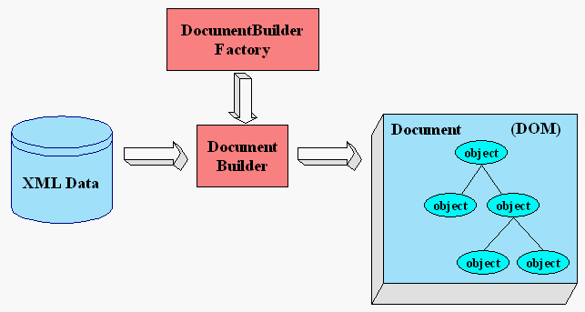
XML (Continues)
Picture from http://java.sun.com/webservices/jaxp/dist/1.1/docs/tutorial/overview/3_apis.html, The Document Object Model (DOM) APIs , 06/02/2006

Slide 9
Creative Commons
Definition:
  A non-profit organisation founded on the notion that some authors may not want to exercise all of the intellectual property rights the law affords them. Creative Commons has developed a set of free public licences to enable authors to share their work with others
    - http://www.jisc.ac.uk/index.cfm?name=fairsynthesis_glossary 06/02/2006
Licence type:
  Permission, Prohibition and Requirement
Licence Names:
  Attribute, Attribute-NoDerivs, Attribute-NonCommercial-NoDerivs, Attribution-NonCommercial, Attribute-NonCommercial-ShareAlike, Music Sharing License, Sampling, Sampling Plus, Noncommercial Sampling Plus, Developing Nations, GNU GPL and GNU LGPL

Slide 10
Creative Commons (Continues)
Example:
  Attribution. You let others copy, distribute, display, and perform your copyrighted work — and derivative works based upon it — but only if they give credit the way you request.
  Noncommercial. You let others copy, distribute, display, and perform your work — and derivative works based upon it — but for noncommercial purposes only
      http://creativecommons.org/about/licenses/ , Choosing a License, 06/02/2006

Slide 11
ODRL
Definition:
  ODRL (Open Digital Rights Language) is an XML-based standard Rights Expression Language (REL) used in Digital Rights Management systems and open content management systems. ODRL is managed by an open organization that's open to public participation.
      http://www.google.com.au/search?hl=en&hs=71F&lr=&client=firefox-a&rls=org.mozilla:en-US:official&oi=defmore&defl=en&q=define:ODRL 06/02/2006

Slide 12
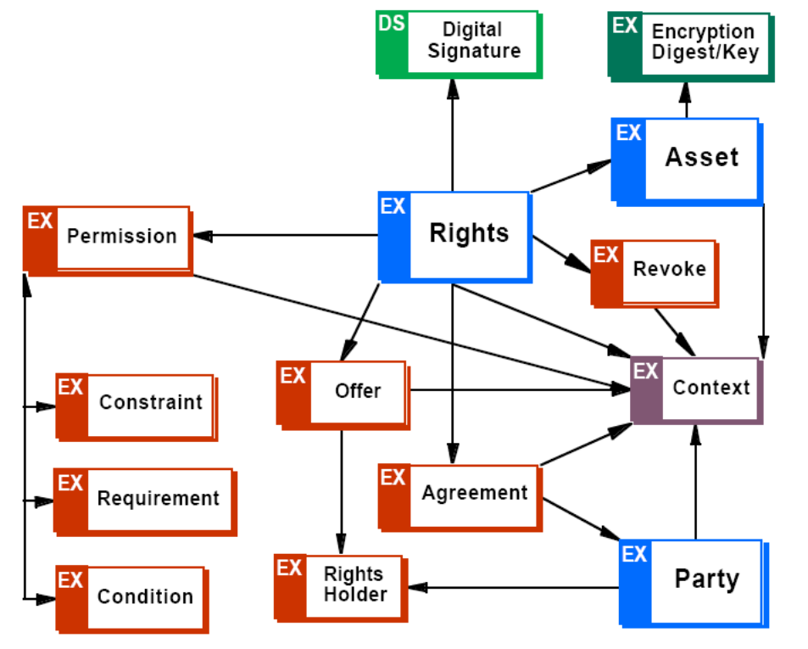
ODRL (Continues)
ODRL Foundation Model:
    -- ODRL/Creative Commons Profile Specification, Renato Iannella

Slide 13
ODRL Creative Commons
Objective:
  Using ODRL Rights Expression Language to express CC licenses
  Keeping CC license semantics
  Giving people more advanced REL features
Keep 13 types of CC licenses
Extend three new constraints:
  Territory
  Sector
  Time period

Slide 14
NIKKY License Packager
Objective:
  Embed a licence to a file or files
  Let rights holder customize the licences using advanced REL mechanism
  Generate package Interchange File (PIF)
  Search and retrieve licence information from PIF
Develop tool:
  JavaTM 2 Platform Standard Edition Development Kit 5.0

Slide 15
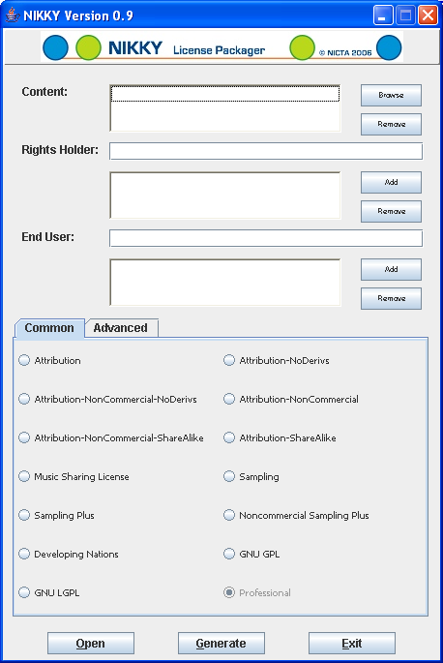
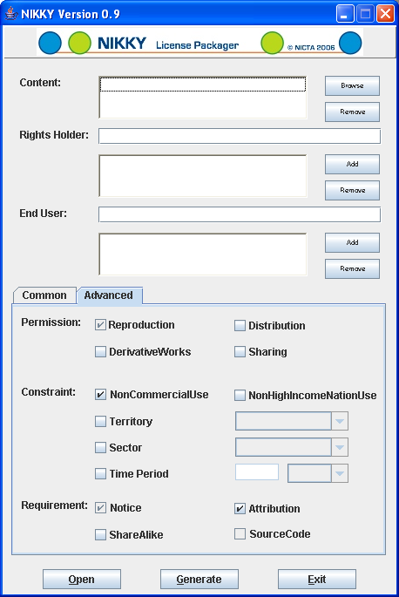
NIKKY License Packager (Continues)
GUI:

Slide 16
NIKKY License Packager (Continues)
Content – container for the shared files
  Browse button: adding files
    No file filter, support any types of files
    Support multi-selection
  Remove: remove selected file
Rights Holder – container for rights holder’s name
  Support multiple rights holders
End User – container for user who use the shared files
  Support multiple users

Slide 17
NIKKY License Packager (Continues)
Common Tab:
  13 types of CC licenses
  Professional license: any type not in 13 CC license
Advanced Tab:
  Contains Permissions, Constraints, and Requirements which can be customized by the rights holders
  Contains data source to be used in creating XML license description file

Slide 18
XML Creation :
Check whether it is standard CC license
  By checking whether the “Professional” option is selected
  For standard CC license, a CC version reference will be added.
Check whether it is a offer or agreement
  By checking whether the “End User” exist
  A corresponding tag will be added
Scan all the license options
  When if option selected, a corresponding tag will be added

Slide 19
IMS Content Packaging
Content Packaging:
  For efficient aggregation, distribution, management and deployment
  Author use tools and technologies available to create content
  Software vendor distribute and manage the content
  Learner retrieve and use content by deployment and delivery tools
IMS – one of the Content Packaging specification
  Two major elements:
    IMS Manifest file: a XML file describing the content organization and resources in Package.
    Resource File: file resources being described by the XML

Slide 20
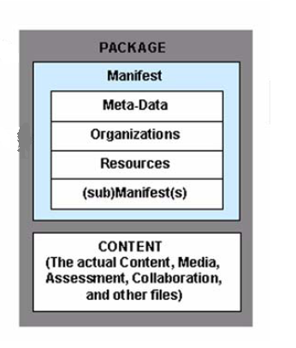
IMS Content Packaging (Continues)
Manifest:
  Meta-data section: an XML element describing a manifest as a whole
  Resources section: an XML element containing referencing to all of the actual resources and media elements needed for a manifest.
Content:
  The location to store the actual files.
IMS Content Packaging Scope

Slide 21
IMS Content Packaging (Continues)
Relation with this project
  Insert license XML description file into top level manifest
  Store the shared file into the Content
  Put all them together into a PIF

Slide 22
Package Interchange File Creation and Retrieve
Definition:
  Package Interchange File - a single file, (e.g., '.zip', '.jar', '.cab') which includes a top-level manifest file named "imsmanifest.xml" and all other files as identified by the Manifest.
PIF format:
  Zip file
Compressing and Decompressing Engine:
  The java.util.zip Package
Compressing Procedures:
  Creating a ZipOutputStream object, to which we write output
  Creating a FileInputStream object, from which we read input
  Creating a ZipEntry object, which just is a copy of our shared file

Slide 23
(Continues)
Decompressing Procedures:
  Creating a ZipIntputStream object, to which we read input
  Creating a FileOutputStream object, from which we write output
  Creating a copy of ZipEntry one by one

Slide 24
ODRL Search Engine
Principle:
  Using XML search engine to recognize the ODRL license tags in the license description XML file.
XML Search Engine:
  javax.xml.parsers
  org.w3c.dom
Exception Hander:
  org.xml.sax.SAXException
  org.xml.sax.SAXParseException;

Slide 25
ODRL Search Engine (Continues)
Searching Procedures:
  Creating DocumentBuilderFactory instance
  Creating DocumentBuilder instance
  Getting a Parser and Parse the File
  Finding the element tag by using XPath
  Verifying the XPath, make sure the element is the one we search for (duplicate may exist in one xml)
  Retrieving the content of element

Slide 26
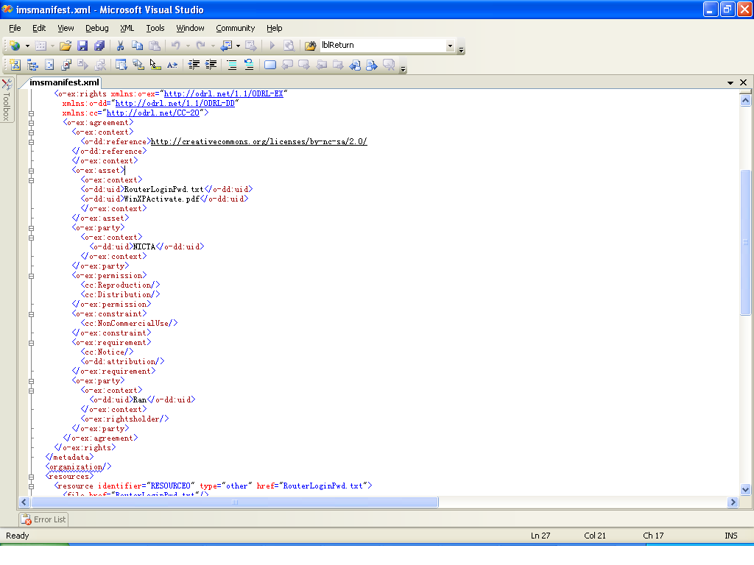
Output Example - Common

Slide 27
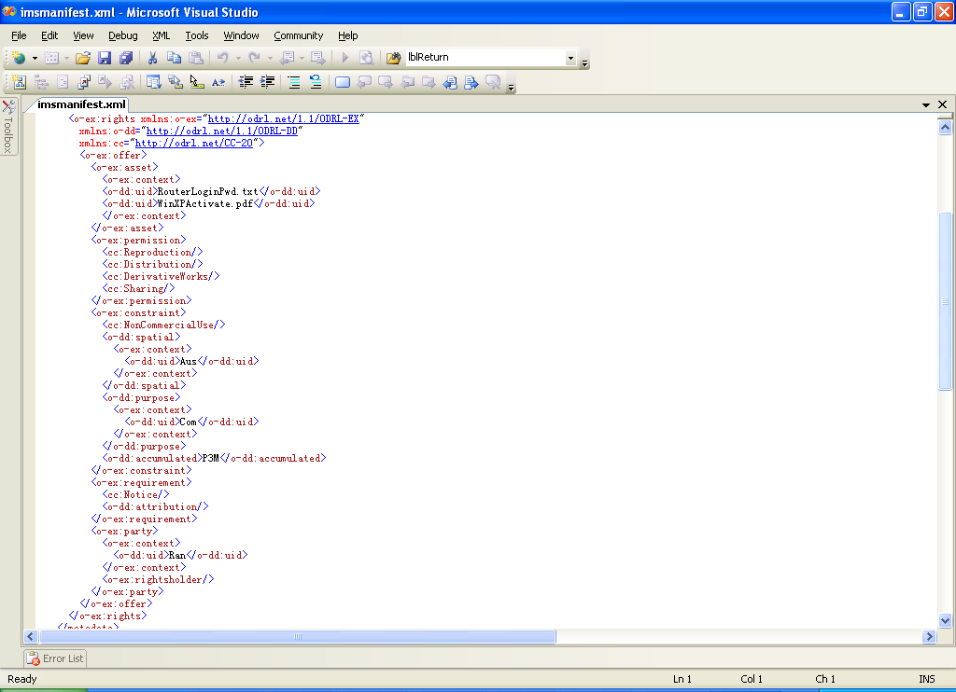
Advanced

Slide 28
Findings and Future work:
Findings:
  CC License names don’t express the license well
  Within 13 CC licenses, some of them have different names but have same permission, constraint and requirement
Future work:
  Making Individual content not be able to isolated from the package
  Using XML generation engine to generate license description file
  Adding a little viewer or player into the Nikky to let the user review the content.

Slide 29
Reference:
ODRL Creative Commons Profile Specification: 6 July 2005
Open Digital Rights Language (ODRL) full specification, Version: 1.1 Date: 2002-08-08
http://java.sun.com/webservices/jaxp/dist/1.1/docs/tutorial/overview/3_apis.html, The Document Object Model (DOM) APIs , 06/02/2006
http://www.jisc.ac.uk/index.cfm?name=fairsynthesis_glossary 06/02/2006
http://creativecommons.org/about/licenses/ , Choosing a License, 06/02/2006
http://www.google.com.au/search?hl=en&hs=71F&lr=&client=firefox-a&rls=org.mozilla:en-US:official&oi=defmore&defl=en&q=define:ODRL 06/02/2006
http://java.sun.com/developer/technicalArticles/Programming/compression/ Compressing and Decompressing Data using Java 06/02/2006
http://java.sun.com/webservices/jaxp/dist/1.1/docs/tutorial/dom/index.html XML and the Document Object Model (DOM) 06/02/2006

