Slide 1

IIT-Delhi-Artificial Intelligence and Machine Learning For Industry- Batch02
Face Recognition System
Project By:
Shailesh Belose
Date: 24th August 2024

Slide 2
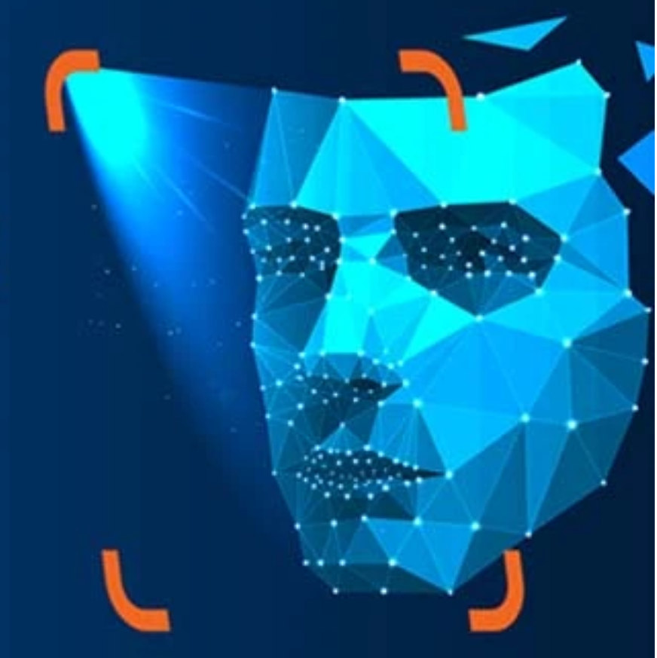
Overview:
Face recognition:
It is a technology that can identify or verify a person by analyzing and comparing patterns based on the person's facial features. It works by capturing an image of a face, then measuring various aspects of the face—such as the distance between the eyes, the shape of the nose, or the contour of the jawline.
Training and testing dataset:
LFW is a widely used benchmark dataset for face recognition and verification tasks. It contains over 13,000 images of faces, each labeled with the identity of the person in the image. These images were collected from the web, ensuring a diverse set of conditions and appearances. Ref: https://vis-www.cs.umass.edu/lfw/index.html

Slide 3
Tools Used:
TensorFlow for model creation.
Flask for building the REST API.
Postman for testing the API.
Numpy, CV2 for numerical operations and image processing.
OS, Json, sklearn
Project Flow:
Data Preparation using Labeled Faces in the Wild. Ref: https://vis-www.cs.umass.edu/lfw/
Model Training
REST API Development
API Testing using Postman

Slide 4
Design:
Face Image Processor
haarcascade_frontalface_default.xml
LFW Cropped
LFW RAW
REST API (flask serer)
“image”
POSTMAN Client
MODEL
“load_model()”
“{
"matching_score": 0.5771670937538147,
"predicted_class": "Abdel_Nasser_Assidi"
}
”
Class_Names.json
“json.load()”

Slide 5
Model Creation
Data Preparation:
Used cropped face images for training.
Images were resized and normalized.
Model Architecture:
Convolutional Neural Network (CNN) with multiple Conv2D and MaxPooling layers.
Softmax activation for classification.
Training Process:
40 epochs, accuracy improvements over epochs.
Challenges faced: Limited data, overfitting issues.

Slide 6
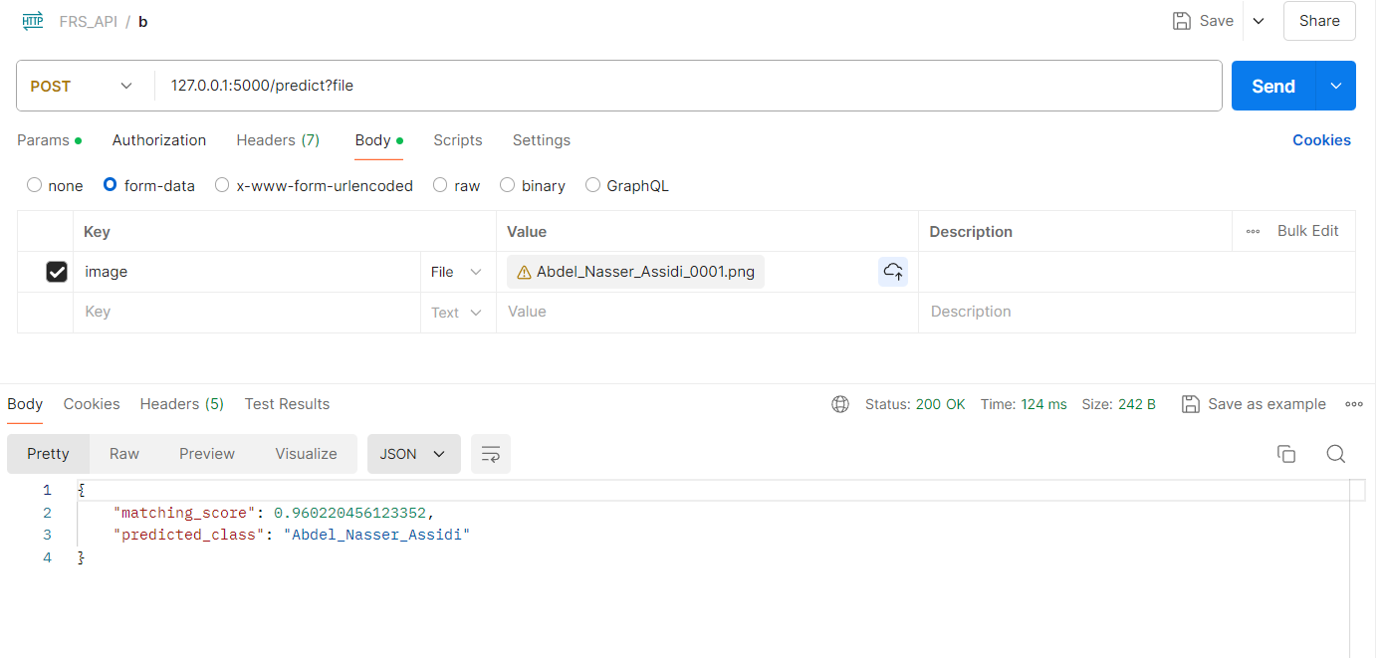
Sample API Testing with Postman:

Slide 7
Future Work:
Improve model accuracy.
Optimize API response time.
Large dataset for training.
Use Case:
Public place surveillance system like schools, colleges, government offices
Forensic department police use case for riots, rally's, festivals etc

Slide 8
Thank you …

