Slide 1
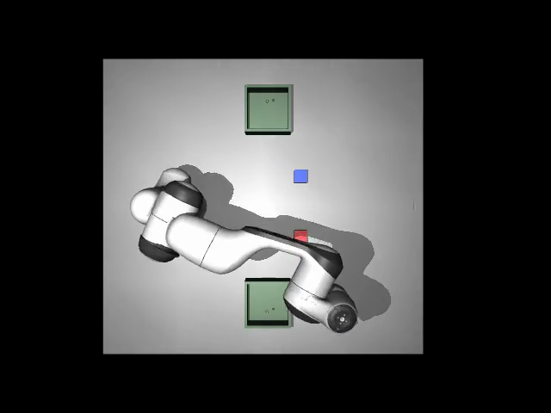
SimToReal
Agent
Test before you touch.
Robot plan testing with AMD inference
Visionary Creators
Anish Jaiswal and Shailesh
AMD Developer Hackathon: ACT III
01
Notes:
0:00–0:25
Hello, we are Visionary Creators. SimToReal Agent helps an operator test AI-generated robot plans in simulation before approving an export. Our starting point is a simple factory task: put a part in a bin. The language model can propose a valid-looking plan, but physics determines whether that plan actually works.
Sources: project README, docs/benchmarks.md, docs/day4_day5_ui.md and saved results for 20261016-133954, 20261016-134119, 20261016-134420. Repository: https://github.com/anish-01/simtoreal-agent

Slide 2
The operator’s problem
A valid JSON plan can still drop a part
Factory operators need evidence before accepting an AI-generated motion plan.
Our prototype tests each candidate in a Panda simulation and explains why it passes or fails.
02
Notes:
0:25–1:00
The intended user is an operator or robotics engineer testing small pick-and-place tasks. A plan may use the right action names and still fail during execution. In our live runs, some generated plans dropped a part. We built a way to catch those failures before export, show understandable reasons, and let a person inspect the evidence. The business hypothesis is less trial and error when configuring robot tasks. We have not measured factory savings.
Sources: project README, docs/benchmarks.md, docs/day4_day5_ui.md and saved results for 20261016-133954, 20261016-134119, 20261016-134420. Repository: https://github.com/anish-01/simtoreal-agent

Slide 3
The operator workflow
01
Describe the task
AMD Token Factory generates eight JSON candidates.
02
Test independent scenes
Local MuJoCo workers execute the plans and record evidence.
03
Reject failures, then rank
Measured checks cover task success, table collisions and drops.
04
Review and approve
A camera check flags uncertainty. The operator approves export.
03
Notes:
1:00–1:40
The operator enters a task. AMD Token Factory extracts goals and generates eight candidate plans. Each plan gets its own simulation state. The backend checks goal placement, arm-table collisions, dropped parts and failed actions. It rejects failures first and ranks the remaining candidates by task success, simulated duration and step count. A vision model checks the final image. The operator reviews the video and approves a JSON and readable-step export. This prototype exports files and does not command a physical robot.
Sources: project README, docs/benchmarks.md, docs/day4_day5_ui.md and saved results for 20261016-133954, 20261016-134119, 20261016-134420. Repository: https://github.com/anish-01/simtoreal-agent

Slide 4
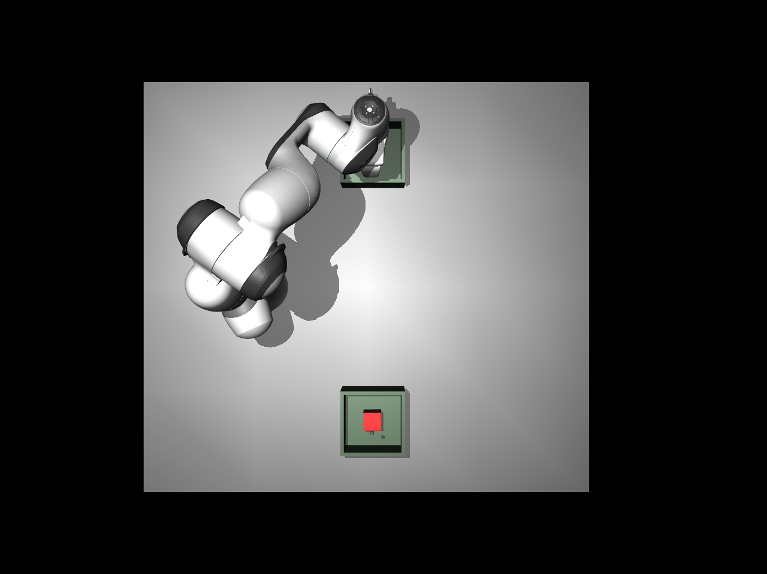
Demo: sorting parts and rejecting failures
“Sort both parts by color”
6 of 8 candidates passed simulation
2 candidates dropped a part
Unreachable task: 8 of 8 rejected
No plan available for approval
04
Notes:
1:40–2:40
Play demo-video.mp4 now. The video uses recorded outputs from our live AMD runs. Let the narration explain: AMD proposes candidates, the local simulation tests a successful placement, another candidate drops a part, and the unreachable task produces no approved candidate. Point out that the results shown here come from saved runs, while a fresh live request uses the current service and quota. If the presentation cannot switch windows, use the static result shown on this slide.
Presenter action: play the 60-second demo-video.mp4 beside this deck, then return to slide 5. Video has captions and synthesized narration. Let it play without speaking over it.
Sources: project README, docs/benchmarks.md, docs/day4_day5_ui.md and saved results for 20261016-133954, 20261016-134119, 20261016-134420. Repository: https://github.com/anish-01/simtoreal-agent

Slide 5
Results from three live AMD runs
Task | Passed / 8 | Rejected | Total wall time
Red part to bin A | 6 | 2 dropped parts | 20.570 s
Sort both parts | 6 | 2 dropped parts | 115.485 s
Blue part out of reach | 0 | 8 unreachable | 9.786 s
24 candidates tested. 12 passed simulation. 12 rejected.
Single runs, October 16, 2026. Client wall times include service delays.
Simulation ran locally on macOS. Sorting vision check took 97.555 s.
05
Notes:
2:40–3:20
Across three live requests, the models generated twenty-four candidates. Twelve passed the measured simulation checks and twelve failed. The unreachable task rejected all eight, with no best plan. These are small demonstrations, not a general safety certification. Total client wall time was about twenty-one seconds for the red task, one hundred fifteen seconds for sorting and ten seconds for the unreachable task. The sorting vision request alone took about ninety-eight seconds. We do not hide that service latency.
Sources: project README, docs/benchmarks.md, docs/day4_day5_ui.md and saved results for 20261016-133954, 20261016-134119, 20261016-134420. Repository: https://github.com/anish-01/simtoreal-agent

Slide 6
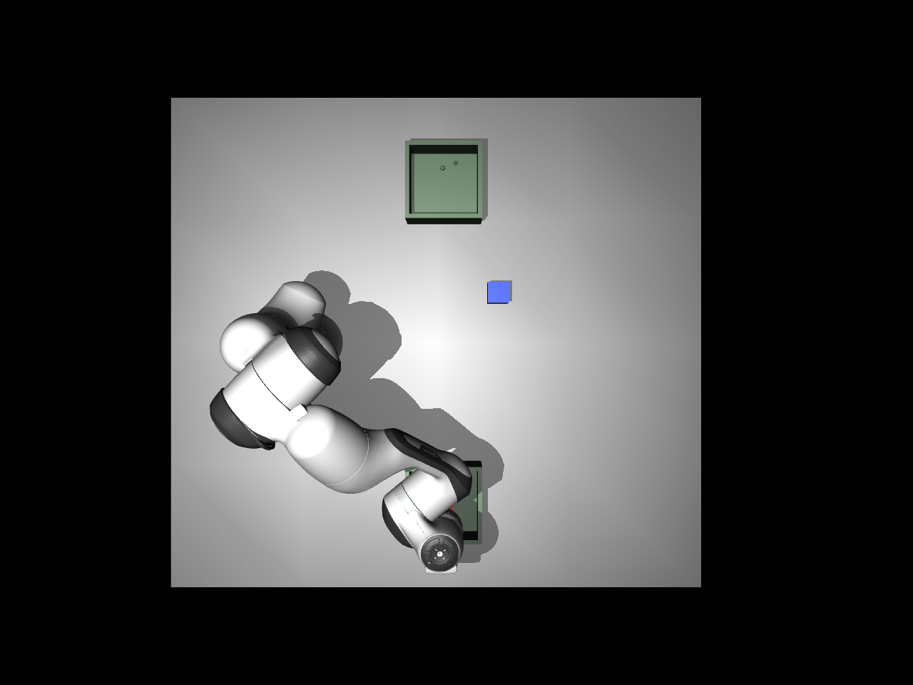
Camera uncertainty requires human review
Geometry: placement passed
Camera model: “no”
The arm obscures the part.
Both successful live tasks
required human review.
The operator must inspect the evidence and acknowledge review before export.
06
Notes:
3:20–3:55
The camera checks disagreed with the geometry checks in both successful live tasks. The overhead view can hide a part behind the robot arm. Both image responses said no with high confidence, so the application required human review. We treat model confidence as a reported output, not proof of correctness. An operator must inspect the video and image, acknowledge review and then approve an export. Rejected simulation plans cannot pass through that approval step.
Sources: project README, docs/benchmarks.md, docs/day4_day5_ui.md and saved results for 20261016-133954, 20261016-134119, 20261016-134420. Repository: https://github.com/anish-01/simtoreal-agent

Slide 7
AMD powers planning and image review
AMD Token Factory
Planner: DeepSeek-V4-Flash
Image review: DeepSeek-V4.1-Flash
Local execution
MuJoCo physics, four simulation workers and a Gradio operator page
The shared API does not report GPU SKU or ROCm version.
07
Notes:
3:55–4:25
AMD is part of the working product. We used AMD Token Factory for planning and final-image review, with the tested DeepSeek model IDs shown here. Physics and video rendering ran locally on macOS with four workers. The shared gateway does not report its GPU model or ROCm version. We therefore claim hosted AMD inference, and we do not claim measured MI300X performance or an AMD simulation speedup. Our code and setup instructions are public.
Sources: project README, docs/benchmarks.md, docs/day4_day5_ui.md and saved results for 20261016-133954, 20261016-134119, 20261016-134420. Repository: https://github.com/anish-01/simtoreal-agent

Slide 8
Next step: a factory pilot
Test before you touch.
Today: a working simulation and approval prototype
Next: clearer camera views, broader collision checks and calibrated hardware trials
Visionary Creators
github.com/anish-01/simtoreal-agent
08
Notes:
4:25–5:00
Today we have a working simulation, review and export prototype, backed by one hundred eleven passing tests. The next step is a pilot with robotics engineers: measure operator time, improve camera visibility and expand collision coverage. Physical deployment would require scene calibration, hardware validation and robot-specific integration. Our contribution is the evidence and approval layer between language-model plans and an operator decision. We are Visionary Creators. Thank you.
Sources: project README, docs/benchmarks.md, docs/day4_day5_ui.md and saved results for 20261016-133954, 20261016-134119, 20261016-134420. Repository: https://github.com/anish-01/simtoreal-agent

