Slide 1









Influencer Profiling System Using Machine Learning and Deep Learning Techniques
Team Members:
Shailesh Singh (A004)
Mrunal Ghadigaonkar (A005)
Sailee Shedge (A006)
Parth Walawalkar (A021)
Anushka Sawant (A022)
Mentor:
Professor Shraddha Sarode
Notes:
1.7.2013
‹#›

Slide 2








Table of Contents
01
Introduction
05
Machine Learning Approach
02
Data Description
06
Deep Learning Approach
03
Data Preprocessing
07
Comparison
04
Embedding Generation
08
Conclusion
Notes:
1.7.2013
‹#›

Slide 3





Introduction
Influencer marketing is one of the fastest-growing areas in digital media, expected to grow by 25–30% every year till 2025
About 71% of marketers plan to increase their influencer marketing budget and 26% of brands spend over 40% of their marketing money on influencers
The project proposes an automated influencer profiling framework using data-driven models
Notes:
1.7.2013
‹#›

Slide 4




Objectives
To develop an automated framework for classifying social media influencers using textual and visual data.
To assist brands in identifying suitable influencers for targeted marketing campaigns.
Notes:
1.7.2013
‹#›

Slide 5

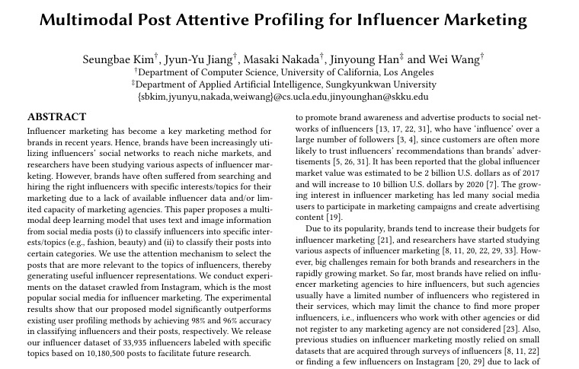
Research Paper
Title: Multimodal Post Attentive Profiling for Influencer Marketing
Authors: Seungbae Kim, Jyuy-Yu Jiang, Masaki Nakada, Jinyoung Han and Wei Wang
Notes:
1.7.2013
‹#›

Slide 6



Data Description
Post-Level Data
Each record represents an individual post made by an influencer.
Includes:
PostID – Unique identifier for each post.
Caption(s) – Text description written by the influencer.
Image(s) – One or multiple images linked to the post.
Captures the content and context of each post.
Influencer-Level Data
Represents overall influencer profile details.
Includes:
Username – Influencer’s Instagram handle.
Followers / Followees count – Social reach metrics.
Post Count – Total number of posts by influencer.
Category – Type of influencer (e.g., Fashion, Food, Fitness, etc.).
Enables analysis at user level beyond individual posts.
Notes:
1.7.2013
‹#›

Slide 7





Data Preprocessing
Text (Captions) | Images
Removal of URLs, hyperlinks, extra spaces, punctuation and special symbols. | Resizing all images to 299×299 pixels.
Conversion of emojis into text form (e.g., 😊 → “smiley face”). | Normalizing pixel values for model compatibility
Tokenization of text for model input. | Filtering out corrupted or blank images
Notes:
1.7.2013
‹#›

Slide 8





Embedding Generation
BERT (Text Embedding
Generation)
Inception V3 (Image Embedding Generation)
Input: Cleaned post captions.
Output: Each token → 768-D text embedding.
Input: Resized images (299x299x3).
Output: Each image → 1024-D image embedding.
Input
Text
Input Image
Convolution
+ ReLU Layers
Inception Modules
Tokenization
Transformer Encoder
Fully
Connected
Layer
Pooling
Layers
768-D
Output
Contextualized Embedding
1024-D
Output
Notes:
1.7.2013
‹#›

Slide 9


Concatenation
Grouping
TEXT
IMAGE
Grouping key: Influencer Username
P_{i}^{T}
P_{i}^{I}
Influencer_{k}​={x_{1​},x₂​,...,x_{n}​}
Bert
Text Encoder
Inception-v3
Image Encoder
Each x_{i​} = embedding of post i
X_{i}^{T} (768 D)
X_{i}^{I} (1024 D)
Concatenation
1792 D
Notes:
1.7.2013
‹#›

Slide 10







Machine learning approach
Averaged Embedding per Influencer
For each influencer:
20 posts → 20 caption/image embeddings.
Compute the average embedding vector to represent that influencer
Results in 1 Username 1 Averaged Embedding, 1 Category
Machine learning models
Support Vector Machine (SVM)
Random Forest (RF)
K-Nearest Neighbors (KNN)
Naive Bayes
Notes:
1.7.2013
‹#›

Slide 11

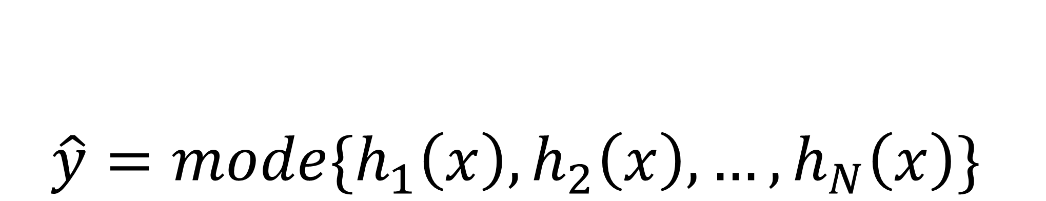

Random Forest
Overview:
Random Forest is an ensemble of decision trees that vote together to decide the influencer’s category.
How It Works :
Each influencer is represented by a feature vector (the fused image + caption embedding).
Multiple decision trees learn patterns in the embeddings (e.g., clusters of fashion vs. travel influencers).
Each tree predicts a category, and the forest takes the majority vote.
Prediction :
Hyperparameters :
n_estimators = 200
max_depth = 20
min_sample_leaf = 5
Notes:
1.7.2013
‹#›

Slide 12




Support Vector Machine
Overview:
SVM finds the optimal hyperplane that separates influencers of different categories in the embedding space
How It Works :
Each influencer embedding is a high-dimensional point.
SVM seeks a boundary that maximizes the margin between categories
If categories are not linearly separable, kernel functions (e.g., RBF) project embeddings into higher dimensions.
Key Formula:
Optimization Objective :
Decision Function :
Hyperparameters :
kernal = 'rbf'
C = 10
Notes:
1.7.2013
‹#›

Slide 13
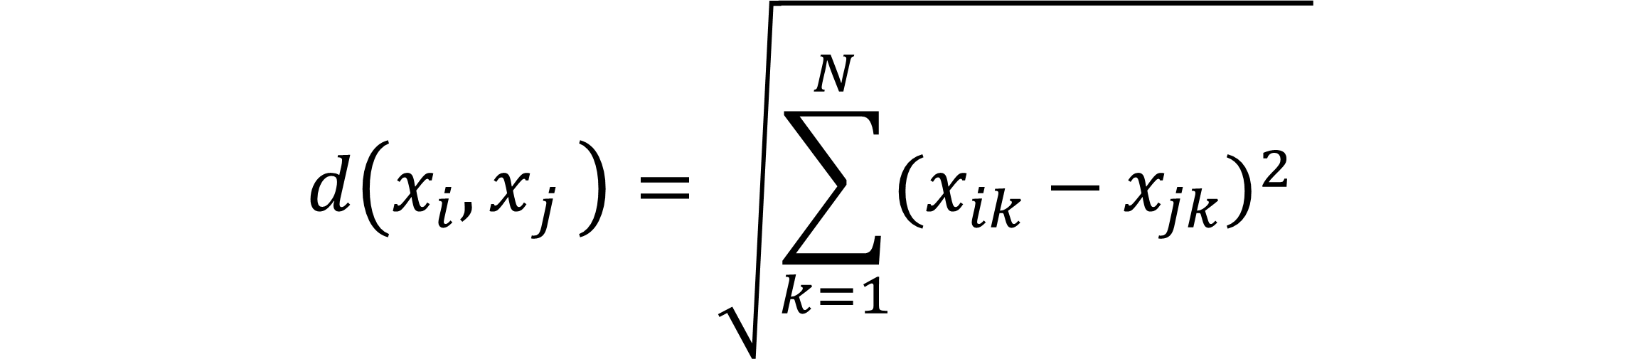
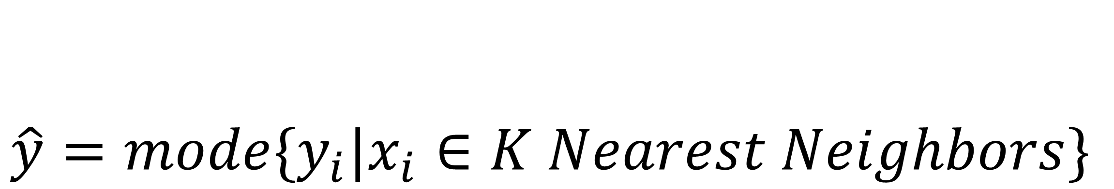
K Nearest Neighbors
Overview:
KNN classifies an influencer by comparing their embedding to other influencers’ embeddings and finding the k closest.
How It Works :
Each influencer’s embedding (image + text) represents their content style
KNN finds the most similar embeddings using a distance metric
The influencer’s category is determined by the majority label among their nearest neighbors
Key Formulas:
Distance :
Prediction :
Hyperparameters :
n_neighbors = 11
weights = 'distance'
Notes:
1.7.2013
‹#›

Slide 14
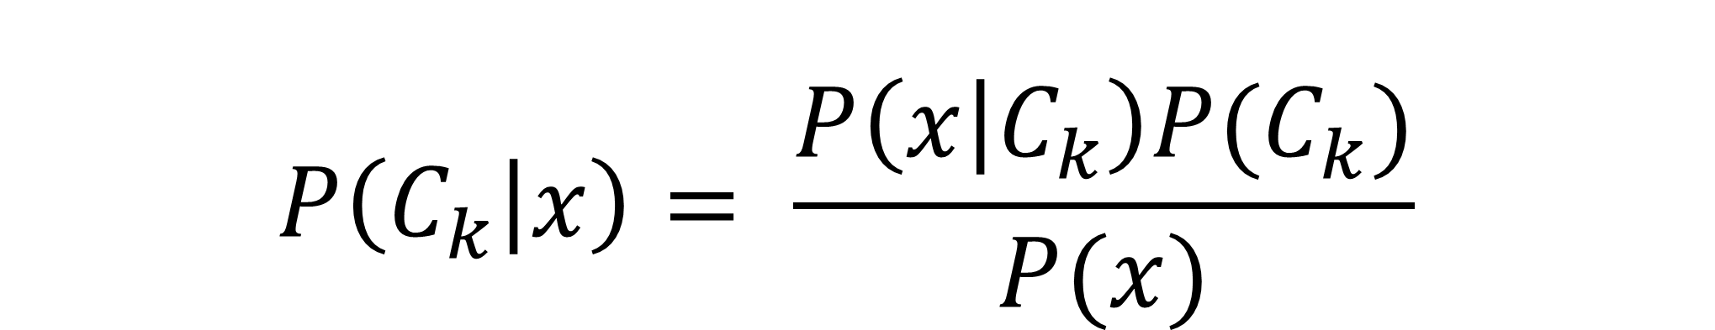
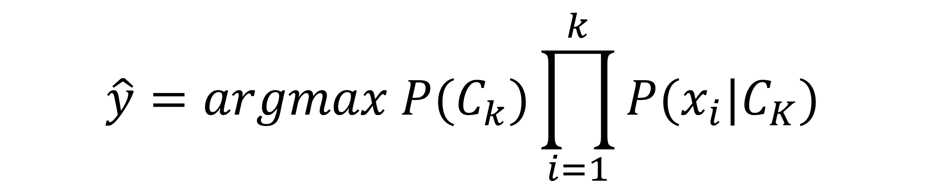
Naive Bayes
Overview:
Naive Bayes is a probabilistic classifier that predicts influencer categories based on conditional probabilities of features (here, embedding dimensions).
How It Works :
Treats each dimension in the embedding vector as a feature.
Estimates the probability of an embedding belonging to each influencer category.
Chooses the class with the highest posterior probability.
Key Formula :
Prediction :
Hyperparameters :
var_smoothing = 1e-6
Notes:
1.7.2013
‹#›

Slide 15



Deep Learning Approach
Learns features automatically from large multimodal data (text + images).
Eliminates manual feature engineering through hierarchical neural layers.
Combines semantic (text) and visual (image) information for influencer prediction.
Uses an attention mechanism to focus on the most relevant posts per influencer.
Captures complex, nonlinear patterns for robust and generalizable classification.
Notes:
1.7.2013
‹#›

Slide 16


Attention Mechanism
Input layer
FC layer
FC layer
Context vector
X_{i​} ε ℝ^{1792×1}
W₁ ε ℝ^{256×1792}
W₂ ε ℝ^{512×256}
r_{c} ε ℝ^{512×1}
b₁ ε ℝ^{256×1}
b₂ ε ℝ^{512×1}
x₁
r₁′
V₁′
x₂
r₂′
V₂′
α_{i}= Softmax(S_{i})
r_{c}
α_{i}
Attention Score
V₂₅₆′
X₁₇₉₂
r₅₁₂′
V_{i} = W_{1​}X_{i​}+b₁​
r_{i} = W₂V_{i}′+b₂​
Raw Attention Score
V_{i}′​=ReLU(V_{i​})
r_{i}′​=Tanh(r_{i}​)
S_{i} = r_{i}^{T} . r_{c}
Notes:
1.7.2013
‹#›

Slide 17
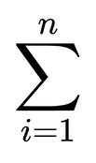
Influencer Level Representation
x1
r1′
x2
V1′
r2′
α₁
Influencer Level Vector
P₁
V₁'​
V2′
rc
Si
αi
Attention Score
V256′
x1792
r512′
x1
r1′
V_{j} =
α_{i} .V_{i}′
P₂
V₂'​
x2
V1′
r2′
α₂
V2′
rc
Si
αi
Attention Score
V256′
x1792
r512′
Where :
V_{i}′ ε ℝ^{256×1} (output from first FC layer + ReLU per post)
α_{i} = Scalar attention score
n = 20 (posts per influencer)
x1
r1′
x2
V1′
r2′
V2′
rc
Si
αi
Attention Score
V256′
x1792
r512′
x1
r1′
x2
V1′
r2′
α₂₀
P₂₀
V₂₀'​
V2′
rc
Si
αi
Attention Score
V256′
x1792
r512′
Notes:
1.7.2013
‹#›

Slide 18
Post Attention Classifier Head
Input layer
FC layer
Final output layer
V_{j} ε ℝ^{256×1}
W₃ ε ℝ^{512×256}
W₄ ε ℝ^{9×512}
b₃ ε ℝ^{512×1}
b₄ ε ℝ^{9×1}
α_{i} = Dropout(Z_{i}′)
Z₁′
Softmax(Y₁)
Y₁
P(Category 1)
V₁
Softmax(Y₂)
Z₂′
Y₂
P(Category 2)
V₂
V₂₅₆
Softmax(Y₉)
Z₅₁₂′
Y₉
P(Category 9)
Z_{i} = W₃V_{i​}+b₃​
Y_{i} = W₄ α_{i} + b₄
Z_{i}′​=ReLU(Z_{i​})
Raw logits
Notes:
1.7.2013
‹#›

Slide 19

Results
Models | Input | Accuracy
Random Forest | Text Image Text + Image | 45 % 73.33 % 75 %
K-Nearest Neighbors | Text Image Text + Image | 39 % 58 % 74 %
Support Vector Machine | Text Image Text + Image | 51 % 78 % 83 %
Gaussian Naive Bayes | Text Image Text + Image | 27.67 % 65 % 76.33 %
Neural Classifier | Text Image Text + Image | 56 % 79 % 85 %
Notes:
1.7.2013
‹#›

Slide 20
Conclusion
Implemented a Multimodal Post Attentive Profiling System combining textual and visual cues from influencer posts.
Used BERT for textual understanding and Inception-v3 for visual feature extraction.
Features are fused through a Post-Attention Layer that emphasizes the most relevant posts per influencer.
Achieved outstanding performance:
85 % accuracy in Influencer Classification
Outperformed traditional baseline models:
Random Forest, SVC, KNN, GaussianNB.
Attention mechanism improved model interpretability by assigning higher weights to posts most representative of influencer interests.
Notes:
1.7.2013
‹#›

Slide 21
Conclusion
Model Implications and Real-World Value
The project demonstrates how AI-driven influencer profiling can assist brands and marketers in:
Identifying the most relevant influencers for targeted campaigns.
Understanding influencer content strategies and follower engagement patterns.
Automating influencer categorization, reducing manual tagging efforts.
Notes:
1.7.2013
‹#›

Slide 22


Limitations and Future Scope
Limitations
Future Scope
Multimodal fusion using unified transformer models like CLIP or ViLT.
Dynamic post sampling to better capture influencer diversity.
Integration of engagement metrics (likes, comments, shares).
Develop a real-time influencer recommendation system for brands.
Targeted Text Modeling i.e. use specialized NLP techniques to extract more meaningful insights from sparse caption text.
Limited to influencers with ≥20 posts and >50K followers.
Resource-Intensive Training
Partial Caption Embedding
Notes:
1.7.2013
‹#›

Slide 23


THANK YOU !
Notes:
1.7.2013
‹#›

