Slide 1

Movie Recommendation System
Group 3:
Ruchika Yejare
Nasir Thanedar
Aaqib Rashid Mir
Ananta Bijay
Yesh Yadav
Shailesh Sharma
Shivam Singh
Mukunda

Slide 2
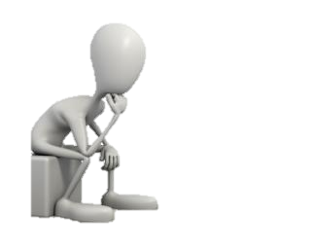
Problem Statement
Aim: Build a movie recommendation system based on Movies dataset.
We wish to integrate the aspects of personalization of user with the overall features of movie such as genre, rating etc.

Slide 3
Project Flow
Data Collection
Exploratory Data Analysis
Pre-processing
Data visualization
Deployment
Model Building

Slide 4

DataSet
TMDB Dataset
Ratings: 3M
Movies: 4802
Genre: Action, Adventure, Comedy, Crime, Drama, showdown, suspicion of murder, boxer, suspension, organized crime, shootout, car chase, Detroit, drug addict, one against many, megalomaniac, maverick cop, framed for murder, bar fight, exploding boat, action hero
Budgets
Revenue
Release Date
Platforms and Programming Languages Used
Backend: Python Data Manipulation- Pandas, Numpy, Seaborn, Natural Language Toolkit(Stemming) Machine Learning Modelling- CountVectorizer, Cosine Similarity, Fuzzy wuzzy
Data Visualization: Power bi
Deployment: Streamlit, TMDB API

Slide 5

Exploratory Data Analysis
Data-Pre-processing Extracting the important features for our data manipulation
Dropping the null values
Our list is in the string format, and we are applying the ast libraries to convert it in list

Slide 6
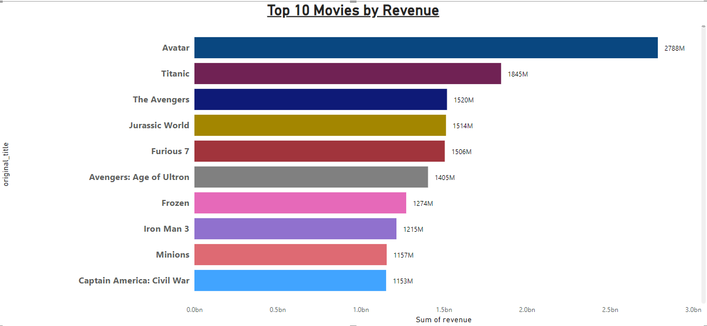
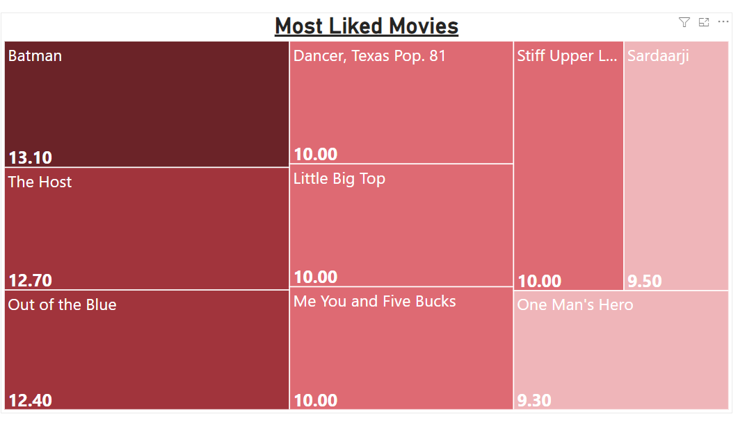
Data Visualization

Slide 7
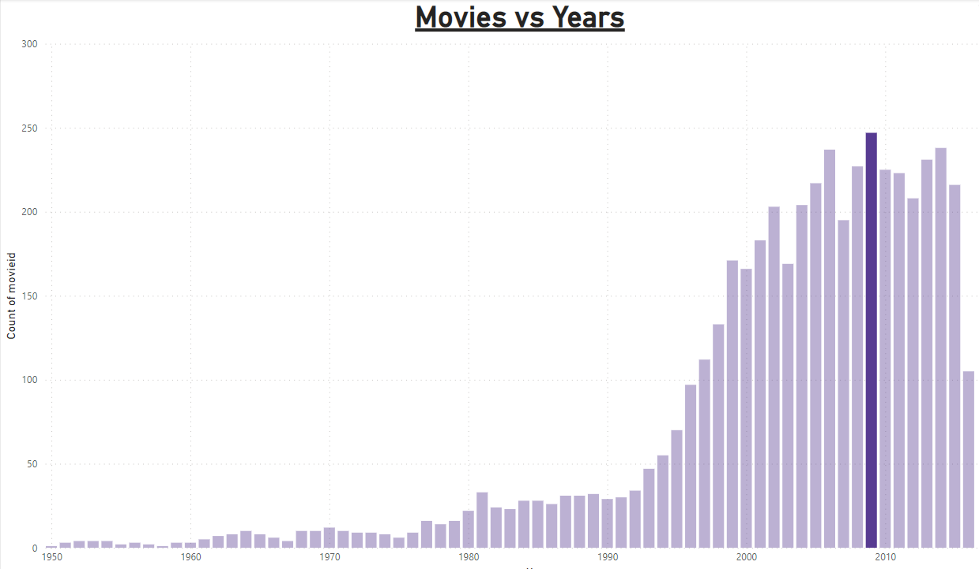

Slide 8
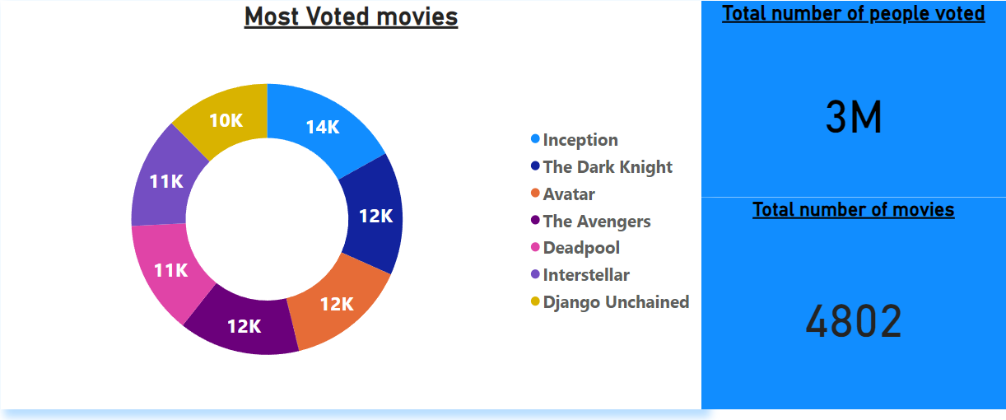
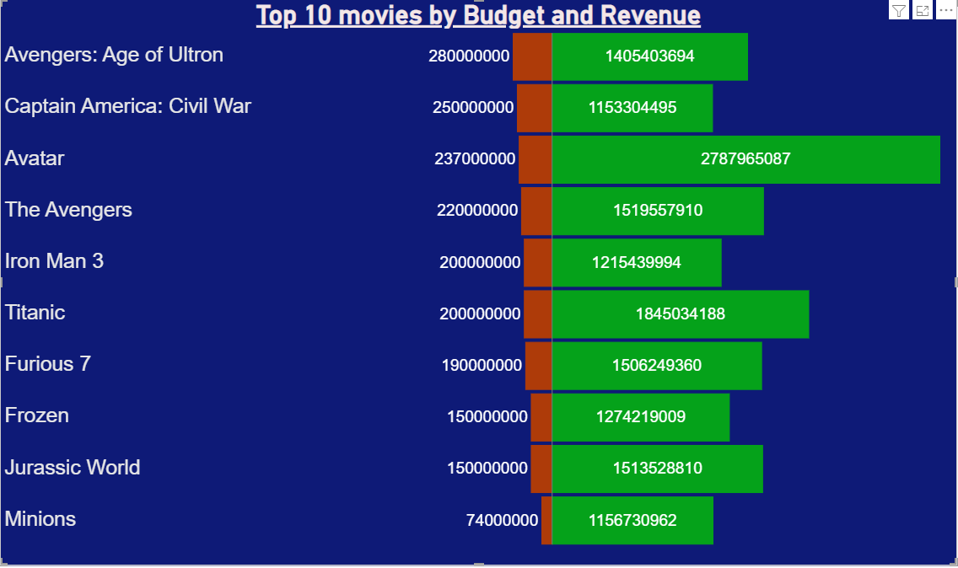

Slide 9
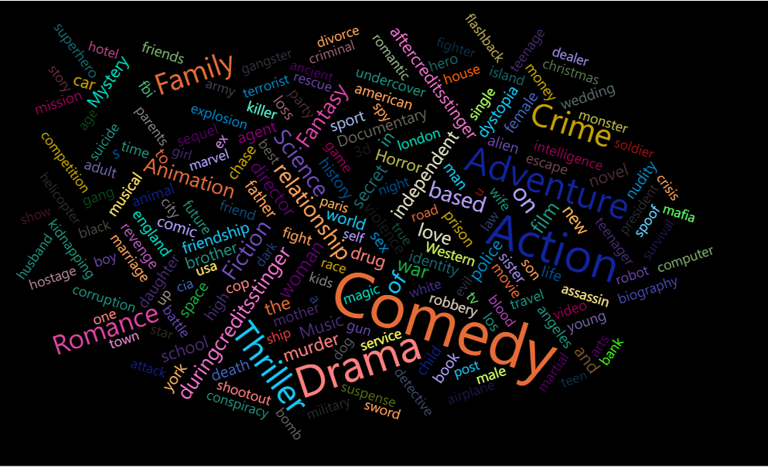

Slide 10
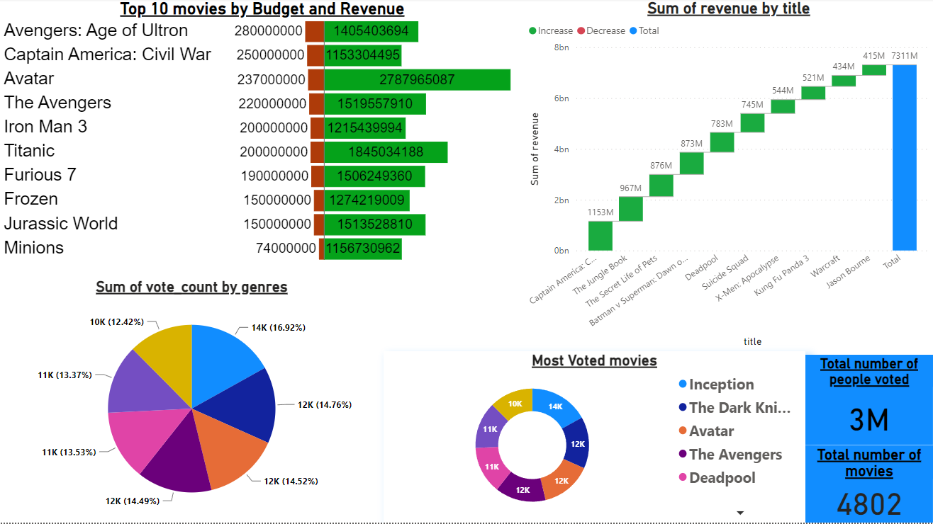

Slide 11
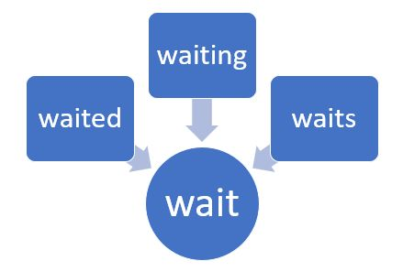

Stemming|Stopwords

Slide 12
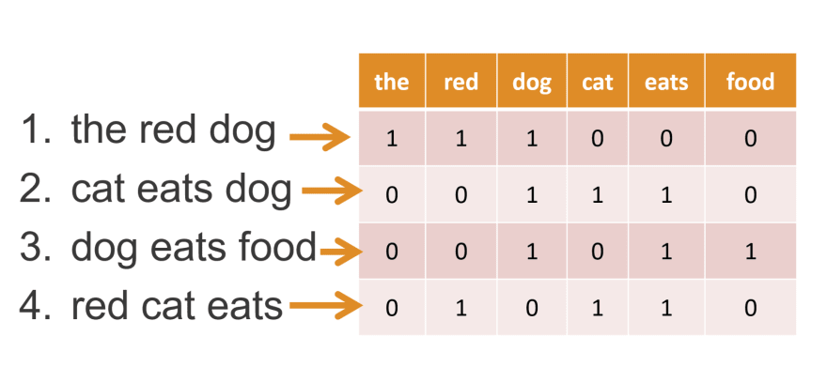
Count Vectorizer
It is used to convert the text into the numerical vector

Slide 13
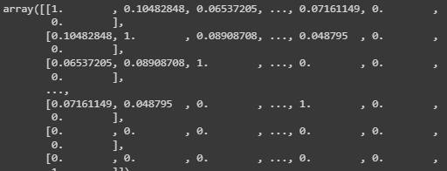
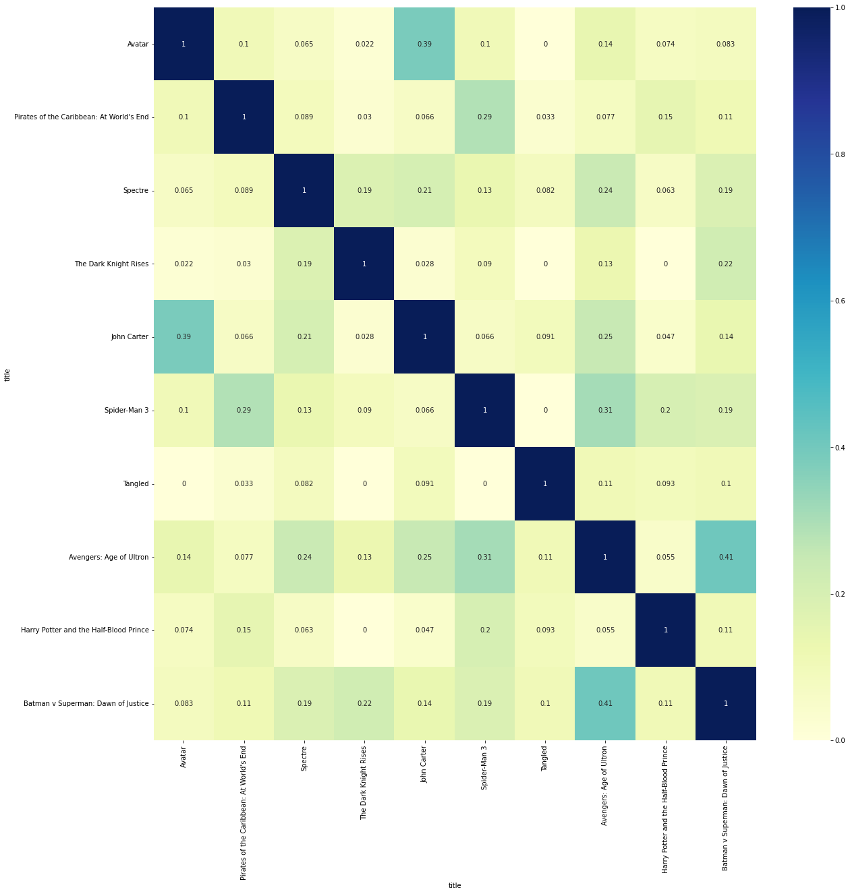
Cosine Similarity
Here we are introducing cosine similarity to
compare the similarity between the records of features
It is basically gives the correlation with respect to cosine angle

Slide 14

Fuzzy Wuzzy
FuzzyWuzzy is a library of Python which is used for string matching.
Fuzzy string matching is the process of finding strings that match a given pattern
For example :
If we enter ‘aple’ it will automatically
detect its available match like ‘apple’

Slide 15
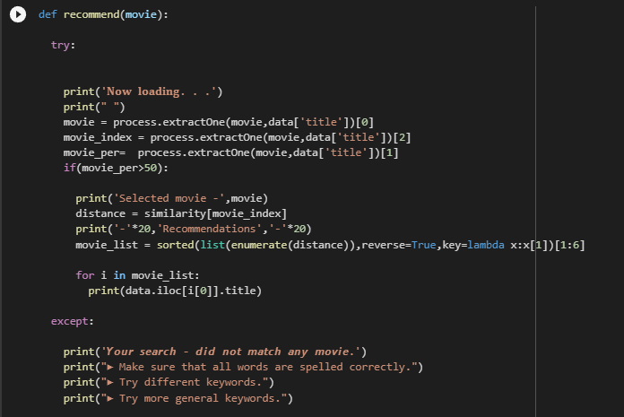
Model Function

Slide 16
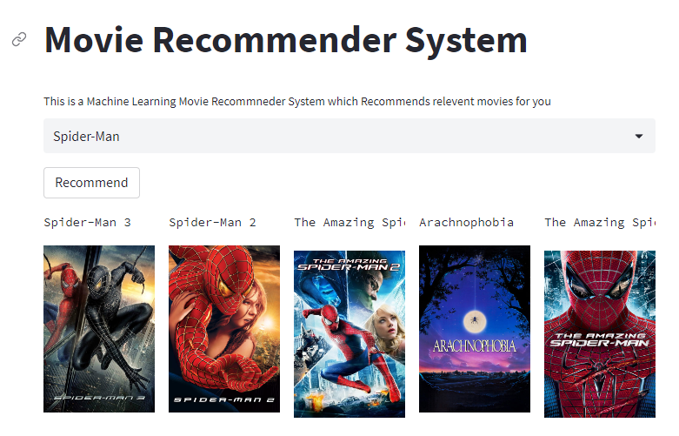
Deployment
Website link: https://huggingface.co/spaces/miraaqib704/moviereccoms-ss

Slide 17

THANK YOU

