Slide 1
Bayesian Modeling of Recommender System
Shailesh Vedula
Course: IOE 591
Date: December 8, 2016

Slide 2
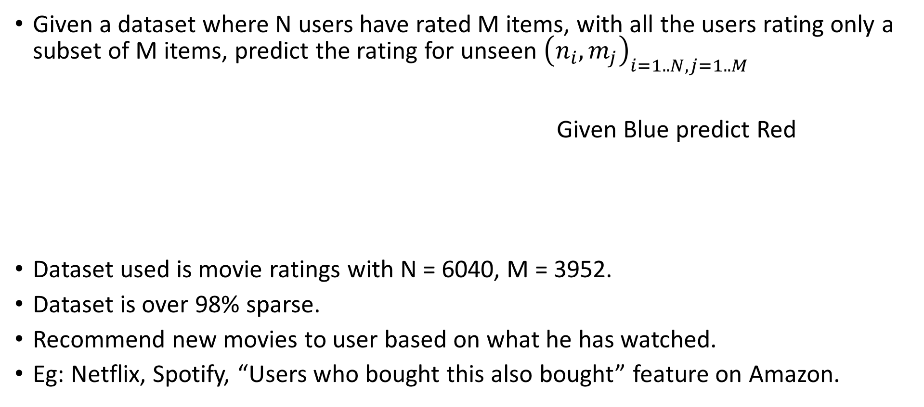
Objective
Given a dataset where N users have rated M items, with all the users rating only a subset of M items, predict the rating for unseen ${\left(n_{i},m_{j}\right)}_{i=1..N, j=1..M}$
Given Blue predict Red
Dataset used is movie ratings with N = 6040, M = 3952.
Dataset is over 98% sparse.
Recommend new movies to user based on what he has watched.
Eg: Netflix, Spotify, “Users who bought this also bought” feature on Amazon.
 | 1 | 2 | .. | 4000
1 | X | X | X | X
2 | X | X | X | X
3 | X | X | X | X

Slide 3
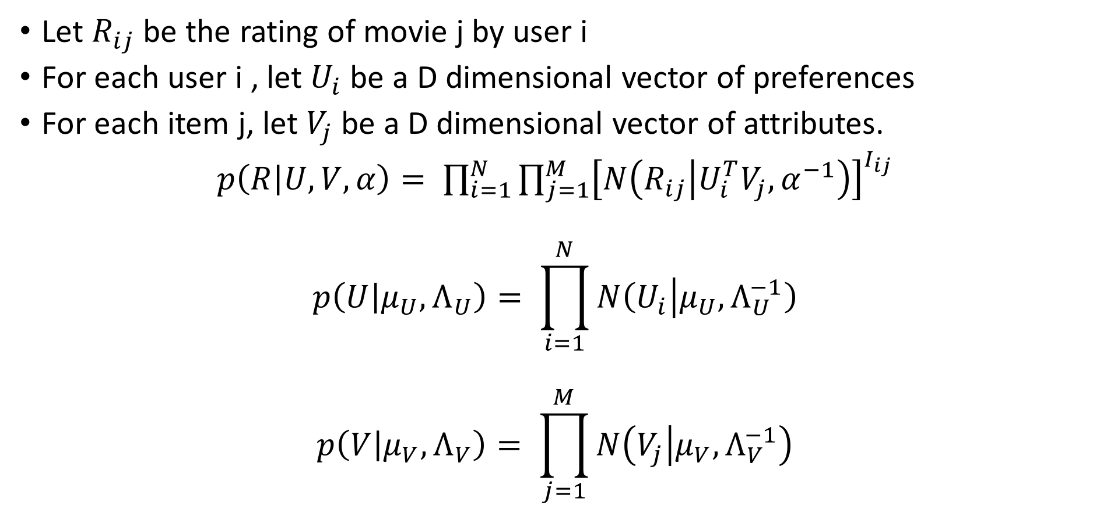
Sampling Model
Let $R_{ij}$ be the rating of movie j by user i
For each user i , let $U_{i}$ be a D dimensional vector of preferences
For each item j, let $V_{j}$ be a D dimensional vector of attributes.
$p\left(R | U,V,α\right)= \prod_{i=1}^{N}{{\prod_{j=1}^{M}{\left[N\left(R_{ij} | U_{i}^{T}V_{j}, α^{−1}\right)\right]}}^{I_{ij}}}$
$$p\left(U | μ_{U},Λ_{U}\right)= \prod_{i=1}^{N}{N\left(U_{i} | μ_{U}, Λ_{U}^{−1}\right)}$$
$$p\left(V | μ_{V},Λ_{V}\right)= \prod_{j=1}^{M}{N\left(V_{j} | μ_{V}, Λ_{V}^{−1}\right)}$$

Slide 4
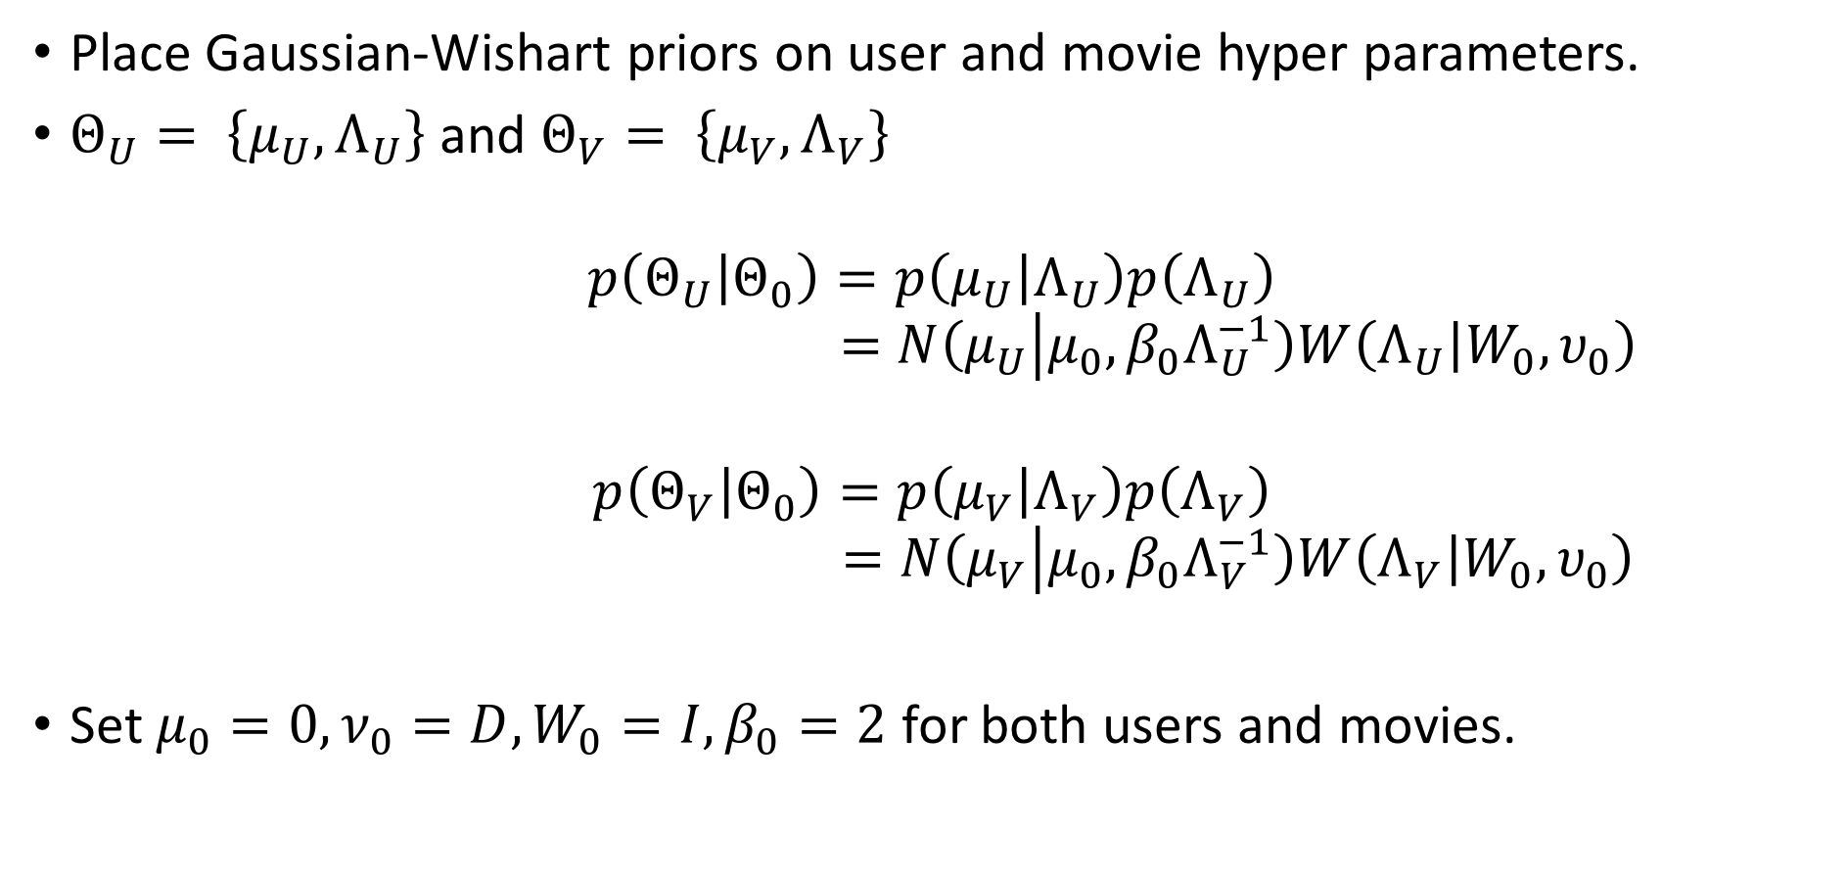
Sampling Model
Place Gaussian-Wishart priors on user and movie hyper parameters.
$Θ_{U}= \left\{μ_{U}, Λ_{U}\right\}$ and $Θ_{V}= \left\{μ_{V}, Λ_{V}\right\}$
$$p\left(Θ_{U} | Θ_{0}\right)=p\left(μ_{U} | Λ_{U}\right)p\left(Λ_{U}\right)$$
$$=N\left(μ_{U} | μ_{0}, {β_{0}Λ}_{U}^{−1}\right)W\left(Λ_{U} | W_{0},υ_{0}\right)$$
$$p\left(Θ_{V} | Θ_{0}\right)=p\left(μ_{V} | Λ_{V}\right)p\left(Λ_{V}\right)$$
$$=N\left(μ_{V} | μ_{0}, {β_{0}Λ}_{V}^{−1}\right)W\left(Λ_{V} | W_{0},υ_{0}\right)$$
Set $μ_{0}=0, ν_{0}=D, W_{0}=I, β_{0}=2$ for both users and movies.

Slide 5
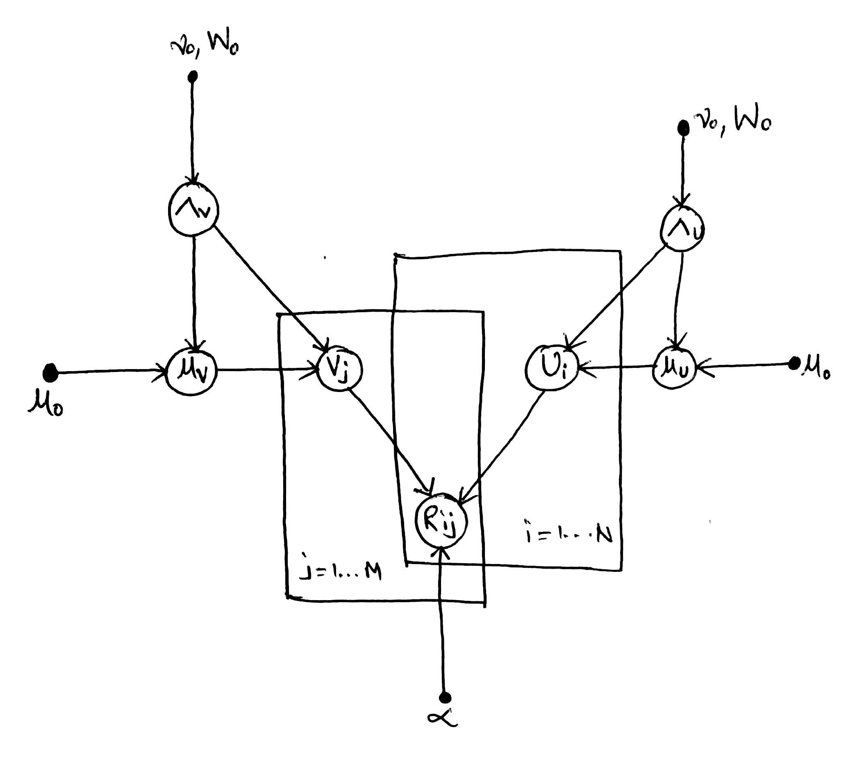
Graphical Model

Slide 6
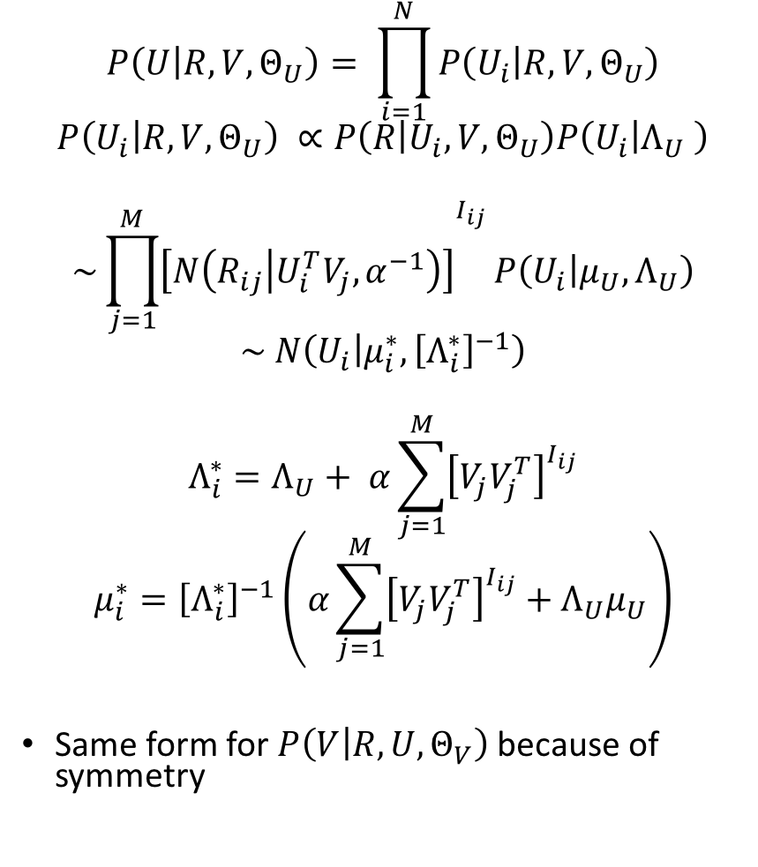

Full Conditionals
$$P\left(U | R,V,Θ_{U}\right)= \prod_{i=1}^{N}{P\left(U_{i} | R,V,Θ_{U}\right)}$$
$$P\left(U_{i} | R,V,Θ_{U}\right) ∝P\left(R | U_{i},V,Θ_{U}\right)P\left(U_{i} | Λ_{U} \right)$$
$$\sim {\prod_{j=1}^{M}{\left[N\left(R_{ij} | U_{i}^{T}V_{j}, α^{−1}\right)\right]}}^{I_{ij}}P\left(U_{i} | μ_{U},Λ_{U}\right)$$
$$\sim N\left(U_{i} | μ_{i}^{∗}, {\left[Λ_{i}^{∗}\right]}^{−1}\right)$$
$$Λ_{i}^{∗}=Λ_{U}+ α\sum_{j=1}^{M}{{\left[V_{j}V_{j}^{T}\right]}^{I_{ij}}}$$
$$μ_{i}^{∗}={\left[Λ_{i}^{∗}\right]}^{−1}\left(α\sum_{j=1}^{M}{{\left[V_{j}V_{j}^{T}\right]}^{I_{ij}}}+Λ_{U}μ_{U}\right)$$
Same form for $P\left(V | R,U,Θ_{V}\right)$ because of symmetry
$$p\left(μ_{U},Λ_{U} | U,Θ_{0}\right) \sim N\left(μ_{U} | μ_{0}^{∗}, {\left(β_{0}^{∗}Λ_{U}\right)}^{−1}\right)W\left(Λ_{U} | W_{0}^{∗},ν_{0}^{∗}\right)$$
$$μ_{0}^{∗}= \frac{β_{0}μ_{0}+N\overline{U}}{β_{0}+N}$$
$β_{0}^{∗}= β_{0}+N$
$ν_{0}^{∗}= ν_{0}+N$
$${\left[W_{0}^{∗}\right]}^{−1}={\left[W_{0}\right]}^{−1}+N\overline{S}+\frac{β_{0}N}{β_{0}+N}\left(μ_{0}−\overline{U}\right)\left({μ_{0}−\overline{U}}^{T}\right)$$
$$\overline{U}= \frac{1}{N}\sum_{i=1}^{N}{U_{i}}$$
$$\overline{S}= \frac{1}{N}\sum_{i=1}^{N}{U_{i}}{U_{i}}^{T}$$

Slide 7
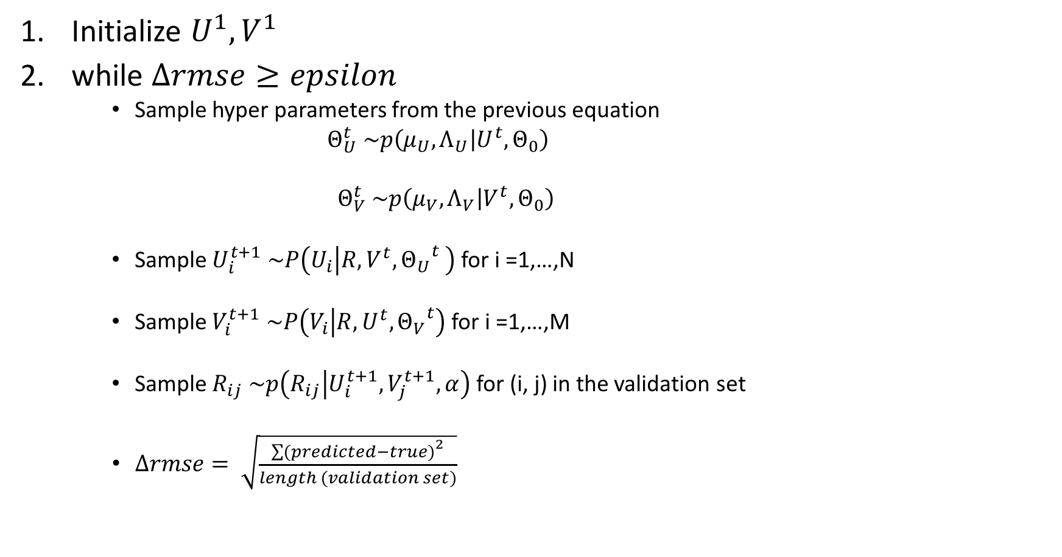
Gibbs Sampling
Initialize $U^{1},V^{1}$
while $Δrmse≥epsilon$
Sample hyper parameters from the previous equation
$Θ_{U}^{t} \sim p\left(μ_{U},Λ_{U} | U^{t},Θ_{0}\right)$
$Θ_{V}^{t} \sim p\left(μ_{V},Λ_{V} | V^{t},Θ_{0}\right)$
Sample $U_{i}^{t+1} \sim P\left(U_{i} | R,V^{t},{Θ_{U}}^{t} \right)$ for i =1,…,N
Sample $V_{i}^{t+1} \sim P\left(V_{i} | R,U^{t},{Θ_{V}}^{t}\right)$ for i =1,…,M
Sample $R_{ij} \sim p\left(R_{ij} | U_{i}^{t+1},V_{j}^{t+1},α\right)$ for (i, j) in the validation set
$∆rmse= \sqrt{\frac{{\sum{(predicted−true)}}^{2}}{length (validation set)}}$

Slide 8
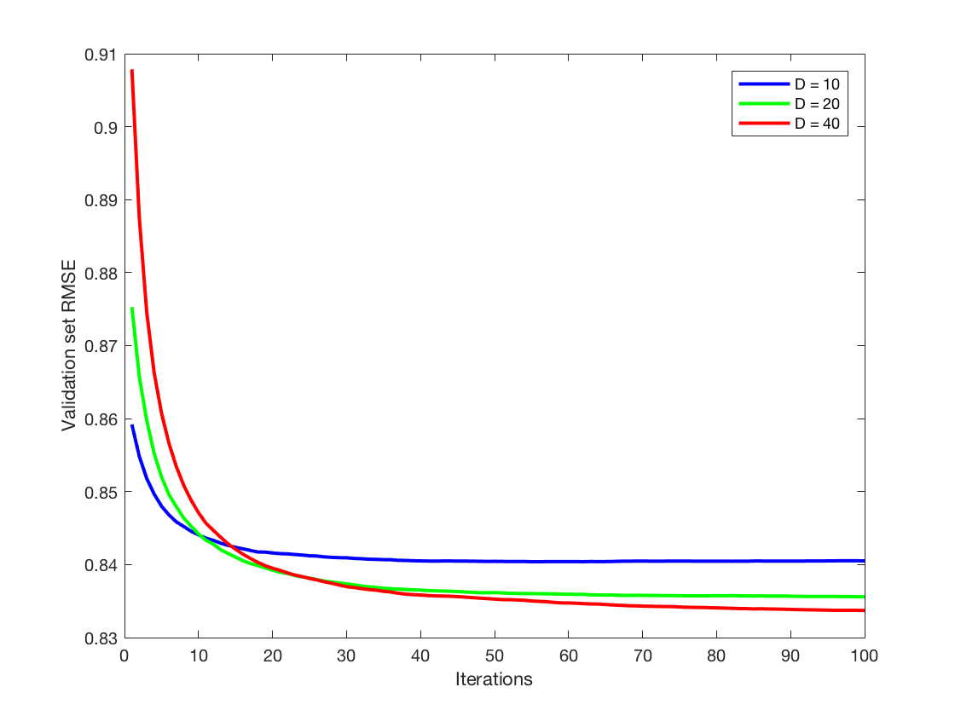
Results

Slide 9
Results
User 1 User 12 User 157
The Hurricane
Watched | Recommended
Toy Story | Whatever it takes
Pocahontas | Hand that rocks the cradle
Apollo 13 | The Hurricane
Star Wars-Episode IV | Fatal Attraction
Schindler’s List | Few good men
Secret Garden | Without Limits
Snow White and the 7 dwarfs | Firelight
Fargo | Titanic
James and the giant peach | Some Mother’s son
Wallace and Gromit | Jaws
A close shave | 2 or 3 things I know about her
Hunchback of Notre Dame | Top Gun
My fair lady | Swiss Family Robinson
Watched | Recommended
Silence of the lambs | Laurel and Hardy
Larger than life | Hungarian Fairy tale
The Godfather | My sweet murder
Wizard of Oz | Window to Paris
Citizen Kane | Airplane
Father of the bride | The Exocrcist
2 days in the valley | Face in the crowd
One flew over the cuckoos nest | Naked gun
Raiders of the lost arc | Young Frankenstein
GodFather Part2 | Bad Lietenant
Das Boot | Aparajito
The graduate | Once upon a time in the west
Chinatown | Prince of central Park
F
Watched | Recommended
Toy Story | Lamerica
Golden Eye | Some mother’s son
Mallrats | Salut cousin
Clerks | I am cuba
Kids in the hall | Some folks call it sling blade
Crow: city of angels | Godfather part 2
Monty Python | 6 ways to sunday
The Princesses Brid | 2 or 3 things I know abt her
Stand by me | schizopolis
Cool Hand luke | The Godfather
Young Frankenstein | Chambermaid on titanic
Grasse Point blank | Just the ticket
Titanic | Mille bole blu
Half Baked | Cotton Mary

Slide 10
Conclusion
Bayesian modeling of movies recommender system was attempted
The presented model gives results to satisfactory degree.
This method is not scalable to very large datasets like the Netflix data or the Yahoo music dataset.
Softmax can be used to keep the rating to discrete numbers.
On the Netflix dataset naïve MCMC methods with D=60 have been reported to take 16 days for convergence.
Variational inference algorithms are used for large datasets.
D=300 on Netflix dataset is possible with variational inference methods.

Slide 11
References
Gopalan, Prem, et al. "Bayesian Nonparametric Poisson Factorization for Recommendation Systems." AISTATS. 2014.
Gopalan, Prem, Jake M. Hofman, and David M. Blei. "Scalable recommendation with poisson factorization." arXiv preprint arXiv:1311.1704(2013).
Salakhutdinov, Ruslan, and Andriy Mnih. "Bayesian probabilistic matrix factorization using Markov chain Monte Carlo." Proceedings of the 25th international conference on Machine learning. ACM, 2008.
Jordan, Michael I., et al. "An introduction to variational methods for graphical models." Machine learning 37.2 (1999): 183-233.
Blei, David M., Andrew Y. Ng, and Michael I. Jordan. "Latent dirichlet allocation." Journal of machine Learning research 3.Jan (2003): 993-1022.
F. Maxwell Harper and Joseph A. Konstan. 2015. The MovieLens Datasets: History and Context. ACM Transactions on Interactive Intelligent Systems (TiiS) 5, 4, Article 19 (December 2015), 19 pages. DOI=http://dx.doi.org/10.1145/2827872

