Slide 1
Today – real Neural Networks!
Using colab for the GPU.
Basics of pytorch neural networks:
Creating models
Adding layers
Next week we’ll do more on data and tuning.
Need to do some exercises and try it out…
Versioning and PyTorch notes:
I’ll do most of the work in Colab – so what you’ll get is identical.
If running on your computer, details may vary (largely around name/imports)

Slide 2
Some reading
Deep learning with Pytorch:
1 – Intro (pretty simple and basic)
2 – Neural network example/basic intro.
3/4 - Tensors and datasets. (~next week)
5 – Pytorch model and training details. (~today)
6 – Extending from 5, more pytorch details. (~next week)
You want to read all of this stuff over the next ~2 weeks, but it isn’t super urgent.
Overall, the book is written to explain ML and NN simultaneously.
You can gloss over or skip the parts there are old news for us.
You do want to read it, the depth is good, this is kind of hard to full grasp solely from doing.

Slide 3
Neural Networks with PyTorch

Slide 4
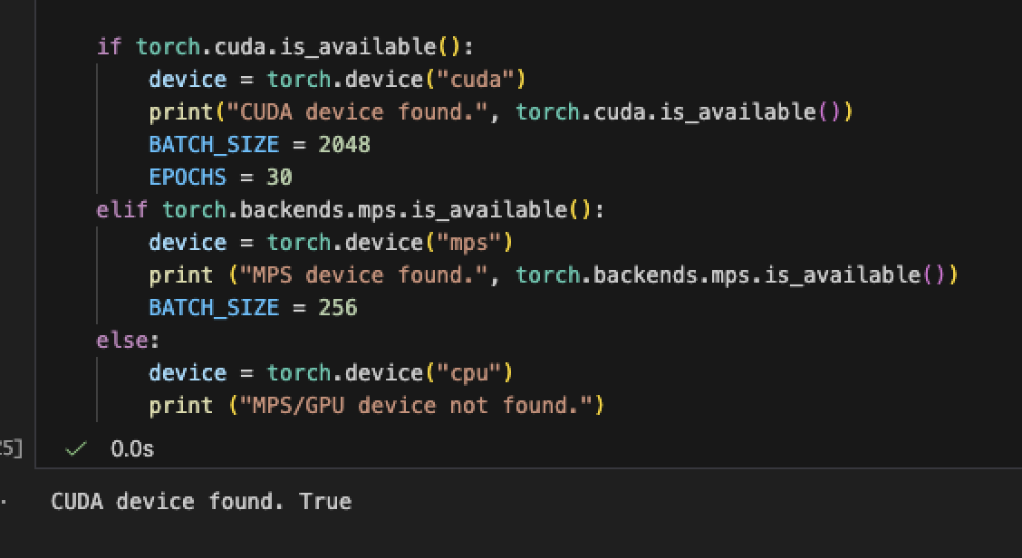
Where to run things
We can control where things are processed directly – GPU or CPU.
If you have a GPU, you want to set this up locally.
There a pip command for a GPU accelerated pytorch install.
Mine is an Apple M2, this shows that it’ll use the GPU.
It can be much, much faster.
We can manually send things to GPU as desired.
Generally, the batch that we are using.
Note: code run on remote systems don’t have disk access.
We semi regularly need to move things to/from gpu.

Slide 5
Neural Network Libraries
Neural networks have libraries similar to sklearn, but there are some new concerns.
GPU acceleration – the big matrix math that is needed in neural networks is done much (much, much…) faster by GPUs (video cards) than by CPUs (regular processors).
To do any serious neural network training, we need a GPU of some sort.
nVidia GPUs are the king, and far beyond anything else, largely due to CUDA (next).
Apple silicon macs have tensorflow acceleration that you can enable.
Colab (or other online workbooks) offer GPU access, Colab is the easiest/cheapest solution.
Other GPUs like Radeons or Intel usually have something, but it tends to suck.
You typically install some variation of TensorFlow and get GPU friendly output.
The GPU operations utilize some faster set of commands than ‘normal’ operations. (CUDA)

Slide 6
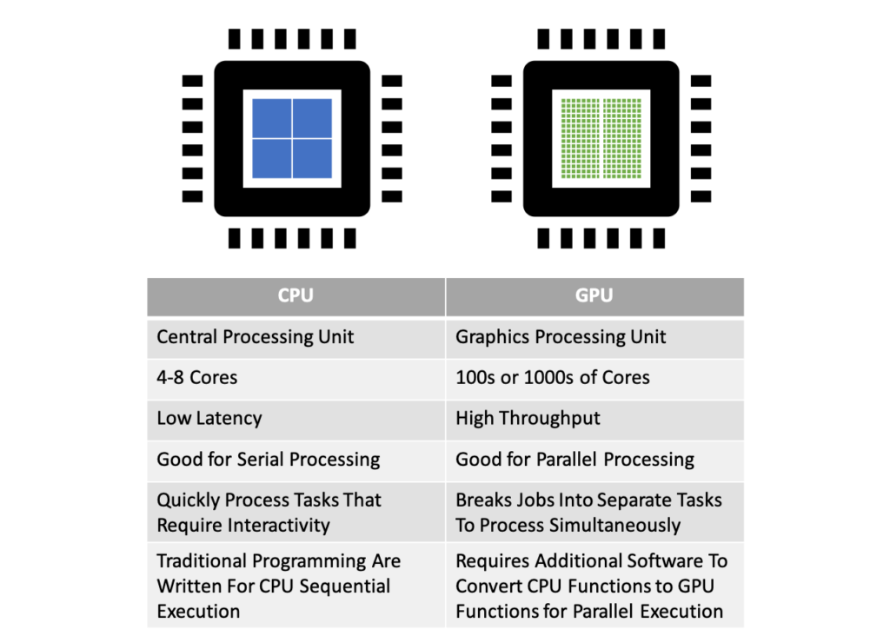
GPWho?
GPUs are graphical processors – video card.
Really good at 3d video.
Also really good at machine learning.
GPUs are good at many parallel calculations.
In graphics, things like objects, interactions, light, shading, position, etc…
In neural networks, these are all the matrix and gradient calculations that we do.
For ‘real’ NN we need to use GPUs (or equiv)

Slide 7
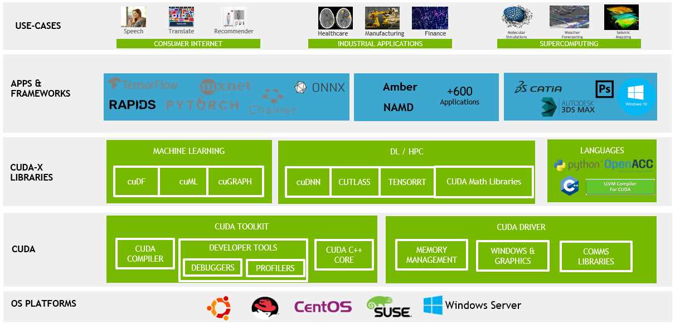

Slide 8
If this is something you want to do, what Hardware do you want?
The best overall solution (IMO) is a macbook pro/air + Colab or similar for big stuff.
Macbooks are accelerated enough for (most) trials, then you can use cloud for training.
Another GPU + Colab will probably work, thought support may vary.
If you want to train lots of stuff from scratch, get an nVidia GPU.
Look up speeds, there’s pytorch benchmark pages out there.
There’s no (effective) replacement for CUDA, so even fast hardware tends to lose out.
If you’re doing lots of stuff, having your own might be cheaper (though I’d hesitate unless you want the GPU for other stuff too, Colab is really fast, and upgrades things.)
There are hard limits for running models – they must fit in GPU memory.
Laptop GPUs will work but are much slower, so unless you want it to game, it isn’t worth it.
There are colab competitors out there, some give free time, some cost less, etc…

Slide 9
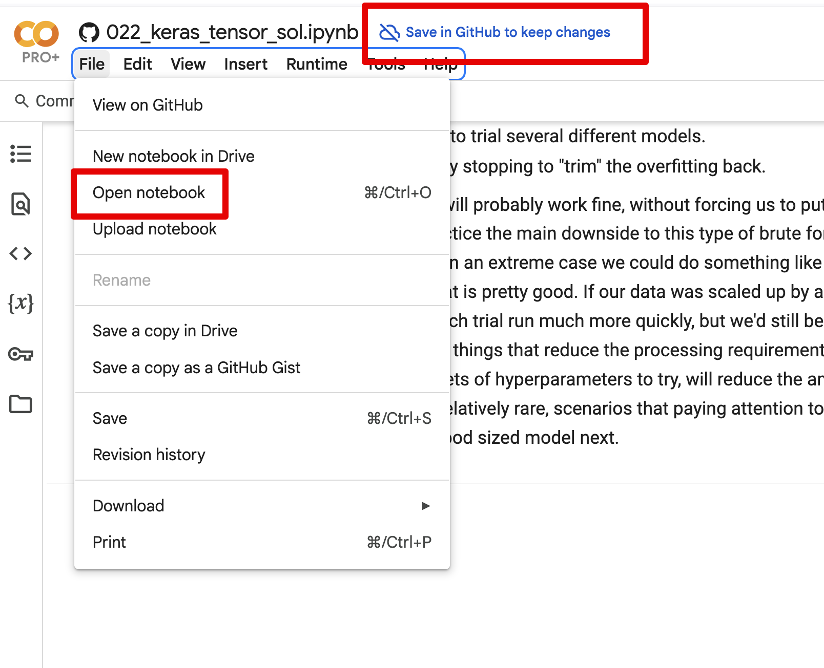
Coding in Colab
For me (and I assume most) we can use Colab for the NN stuff.
We can use things from GitHub and VSCode relatively easily.
I generally prefer to:
Code and run small tests locally. (Ifs for ‘in colab’ may help).
Push to my repository.
Open in Colab and run for real.
On Colab, use GPU runtimes for speed.
Acceleration – runtime -> change runtime type for GPU.
For now, what they give free is fine.

Slide 10
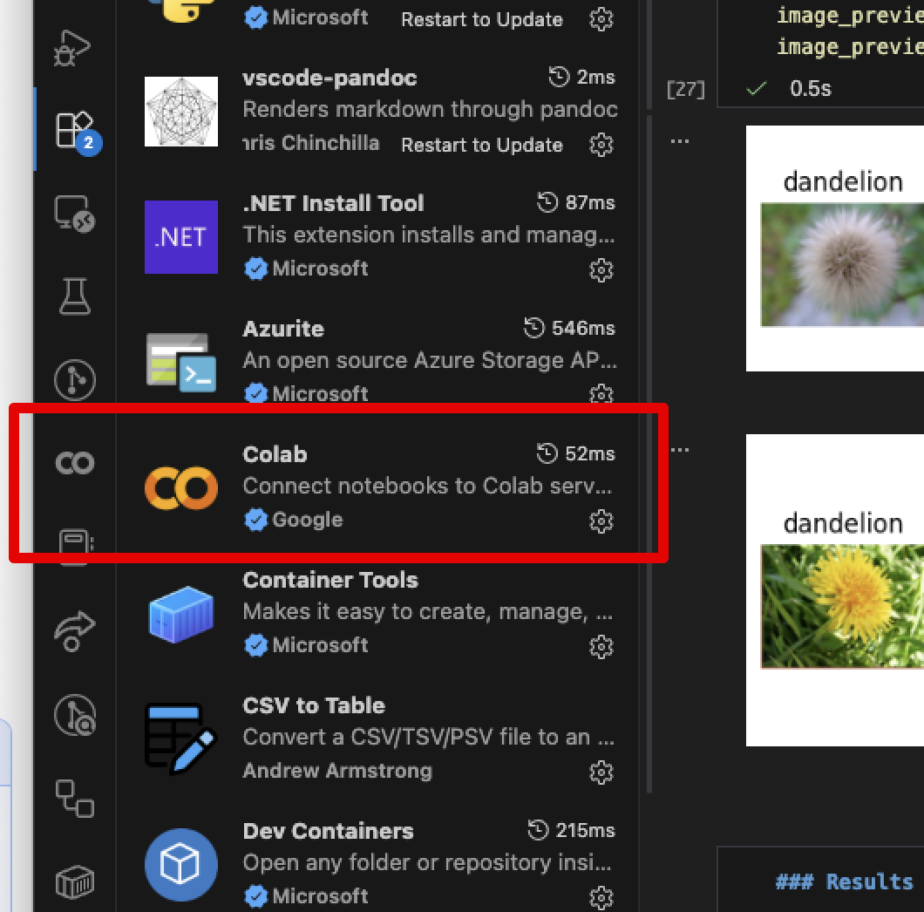
And in VS Code
We can also add a plugin to vscode to let it use Colab runtimes.
Run code on local editor.
Execution is all done remotely.
I usually use this.
Don’t have local files with remote kernel.

Slide 11

What is PyTorch?
Pytorch is a library that provides neural network models and tools.
Similar to how we use sklearn for statistical models.
Made by Facebook, in Zuckerberg’s pre-alpha bro, skinny and weak nerd, stage. Thanks, Zuck!
There was a brief moment in time where big tech maybe, kinda did some good things on occasion.
Provides prebuilt functionality to do the majority of neural networks.
We don’t need to manually do matrix math and similar details.
We can focus on layers, loss, etc… at a higher level.
On a personal note, I think PyTorch still has way too much low level code.

Slide 12
Neural Network Libraries
PyTorch is currently one of the two big NN libraries, with tensorflow/keras.
They do basically the same thing, syntax and details are different.
PyTorch tends to be more common on new/public stuff, tf is older and kind of more est.
There’s some messy and confusing stuff with backends, combining keras/torch, etc…
Ignore all this, unless you really care, it doesn’t matter much for learning.

Slide 13
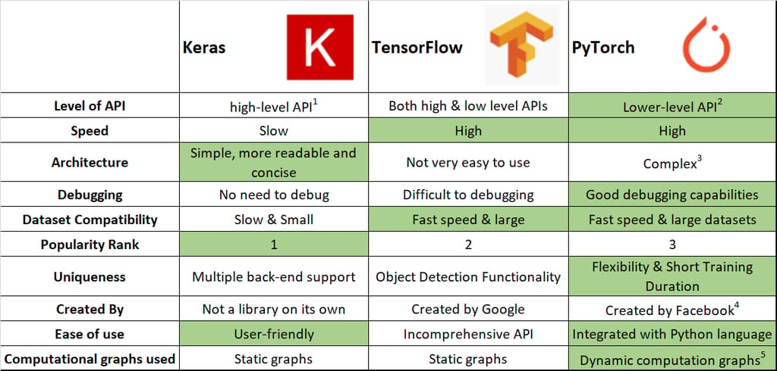

Slide 14
Our Usage…
PyTorch is much easier to use than doing it by hand, but not the simplest.
There’s still some boilerplate code and some details we need to manage.
Our main projects when making pytorch models will be:
Mange the data – similar to before, though now we make special torch specific data objects.
Construct the model – make a model object (actually build it) with the layers and such.
Configure training – define loss and optimization (gd algorithm).
Make train/test loops – define what happens when we train (similar to manual version).
The data and model are scenario specific, the loops are pretty boilerplate.
Note: there’s a condensed/simplified interface called lightning, we might touch it later.

Slide 15
Support and Resources
Generally, these models will have more custom code than sklearn projects.
#1 hint – build/test incrementally. Can I load one record, one set of records, train a model, test it, add layers, change optimizer, etc… Test one thing at a time if struggling.
The documentation is very substantial and mostly good.
PyTorch documentation is decent and has some examples.
The text gives pretty good explanations and examples that can be adapted.
There is a near infinite amount of resources and examples online – beware of version used.
I find it is easy to find answers, but you need to know what specifically you’re looking for.
E.g. “this model doesn’t work” is hard to answer, “this model gives this error when adding an LSTM layer” is probably pretty simple.

Slide 16
Creating a PyTorch Model
To make a model we need to do a bit more work than sklearn:
Create the model object, with the layers and structure defined.
Create datasets from the data or location of data on disk/db/network.
Define the configuration – loss and optimizer.
Define the loops – what to do each training and testing round.
Running it all!
Datasets and preprocessing is also quite different here.
Data is often/usually too big for memory.
Data loaders will manage pulling data off disk as needed.
Pipeline steps to preprocess data are normally applied to the data loader.

Slide 17
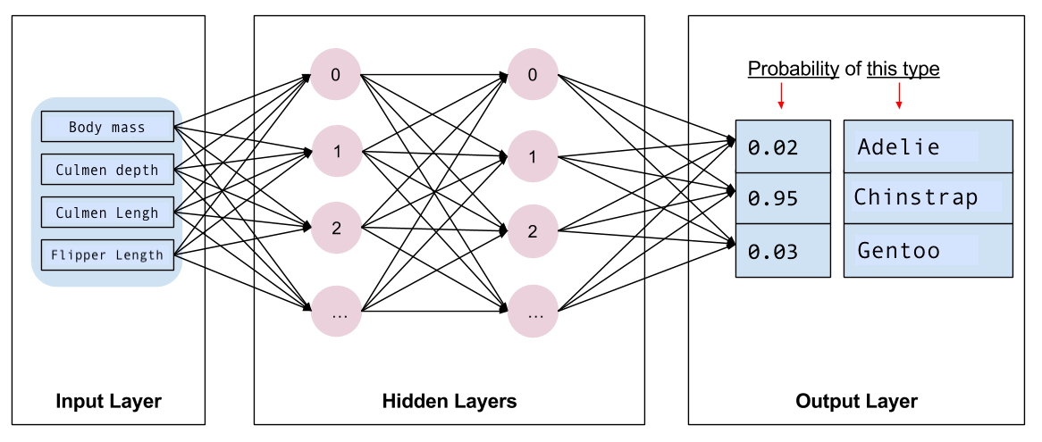
Pytorch Model Structure
The network itself is made of layers.
There are many types (later).
Layers types are premade*.
Input – handle data in its original shape.
Hidden – do the learning.
Output – translate learned values to prediction.
There are assorted other layers - normalization, reshaping, etc…

Slide 18
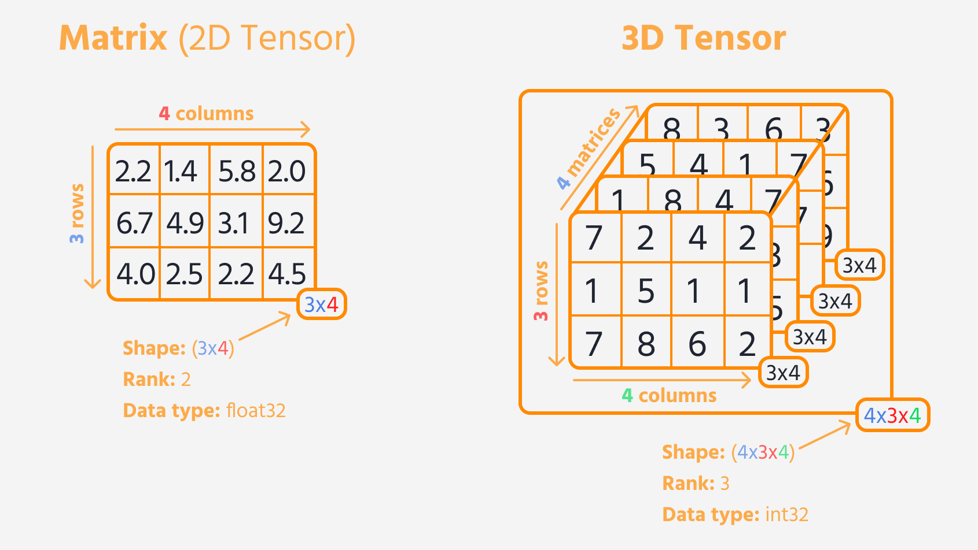
Dealing with Data
Data, when fed to the model, needs to be in a tensor.
A tensor is a 3+ dimension array.
This structure is part of what lets neural networks be good at unstructured stuff.
We can capture 3 or 4D data (images, video, etc…) in its ‘actual’ shape.
We can have very complex (high dimensional) representations of meaning.

Slide 19
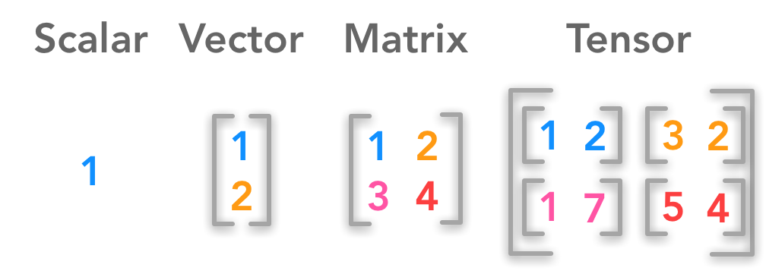
Tensors and Input Layer
Data can be in multiple dimensions.
The input layer defines the shape to expect.
For now, we’ll use something like (18,) which means just flat 18 features.
Later, like with images, we’ll specify the shape of each image, and the batch size in here.

Slide 20
Data Prep Pipes and Neural Nets
We can theoretically use/make a layer for most things that a pipeline does.
Encode, normalize, scale, etc…
Where and how this is actually done varies.
In simple examples, it is all over the place, often ad-hoc.
We can, later, create datasets that can manage large data and process steps.
These can handle large amounts of data easily – out of memory data.
We can plan for processing times to maximize resource utilization.
Tl;dr – we don’t care much about preprocessing details now, it’ll change with datasets.
You need to do it, just pick a spot – usually just before the modelling part.

Slide 21
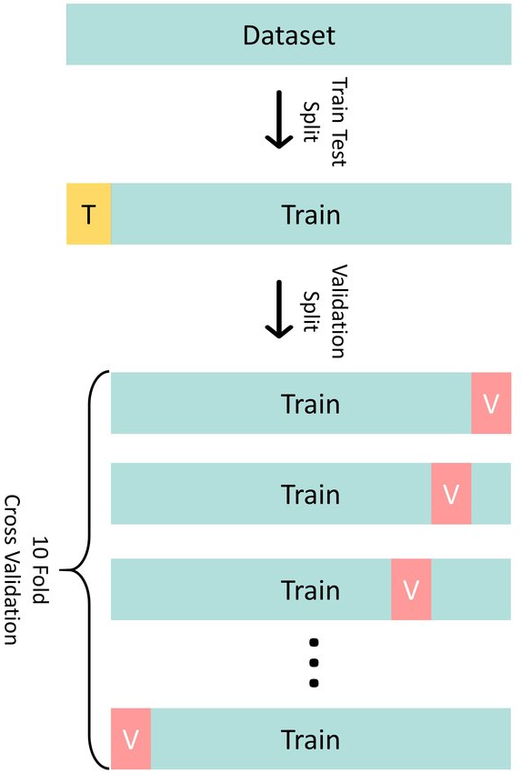
Validate my Validation!
With neural networks we use/refer to the validation set more.
The test set is held entirely aside, to evaluate performance.
This is the correct way to evaluate, tough usually should be similar.
Internally, the model uses the training data:
Split for cross validation similar to before.
We can specify that split, 20% is a reasonable start.
Small validation sets can lead to ’jumpy’ results.
As data gets bigger, percent needed for val/test shrinks.
We generally look to the validation whilst training.

Slide 22
Using Data
We’ll do more data details next week.
Data works with two types of objects:
PyTorch Datasets – responsible for accessing data and providing an item on demand.
DataLoaders – uses a dataset to provide model-ready data in batches.
Like most other things, these can be premade or custom.
NN data is often/usually big – we can’t load it in memory.
The Dataset needs to get one ‘chunk’ of data at a time and load it from disk.
There’s not a pipeline (though we could use it if we made one), prep steps are often provided in a transformation argument in the dataset. (more next week).

Slide 24
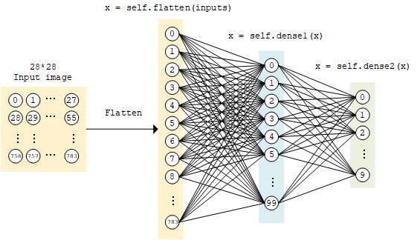
Add Layers

Slide 25
How to Create a Model
We can use a few different methods to create a model.
They are all equivalent, but offer different amounts of flexibility.
Sequential constructor – make a model as an object by providing layers.
Sequential class – use the sequential constructor, but wrap in a class.
Custom class – create a model directly from scratch.
In practice this isn’t too confusing.
We construct the model by adding layers in order*.
This step create the layers.

Slide 26
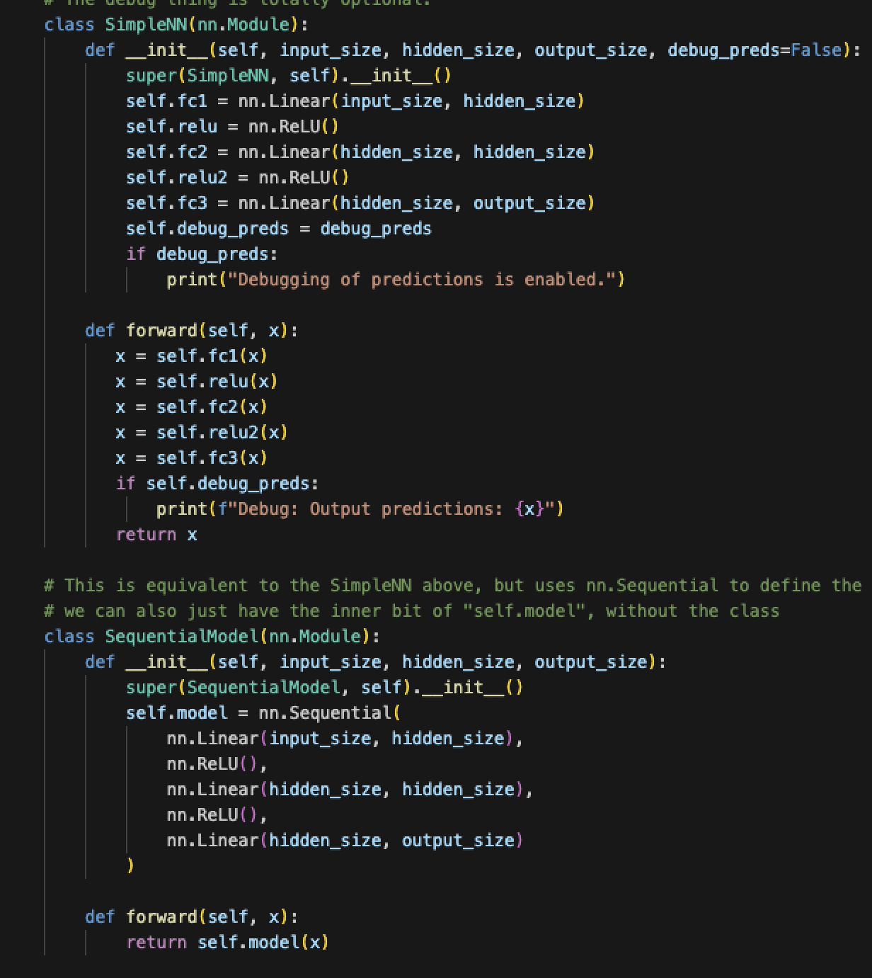
Adding and Connecting Layers
There are many layer types, each an object in the library.
Generally, specify things like number of neurons as arguments.
‘Normal’ dense layers, activation layers, tuning ones like normalization, special types for image, time series, etc…
In sequential models, things flow top to bottom.
Connections are automatic.
In a custom model, we need to define ‘forward’:
Normally a chain of layers like the one shown.
Can add custom stuff, like that debug step.

Slide 27
Assorted Layers
There are many other layer types, we’ll look at some later.
There are different types of ’main’ layers for different model types.
E.g. layers that deal with data in 2D directly without flattening.
There’s layers for prep stuff – encode, normalize, etc…
There’s layers for tuning stuff – dropouts, regularization….
There’s layers for activation functions.
You can make custom ones, if you want to.
We won’t really do this, but as long as your layer accepts/returns the right structure, it works.

Slide 28
Layers, For Now
Adding layers is one of the biggest things we can do to tune.
For now, don’t worry too much:
We need some first layer that can deal with the input shape.
May be something like flatten, or a regular layer with the size set.
We need an output layer that generates the predictions we want.
In between, we have hidden layers, where the magic happens.
A basic regression is 0 hidden layers, can’t do non-linear relationships.
Each layer adds “flexibility” in the relationships the model can handle.

Slide 29
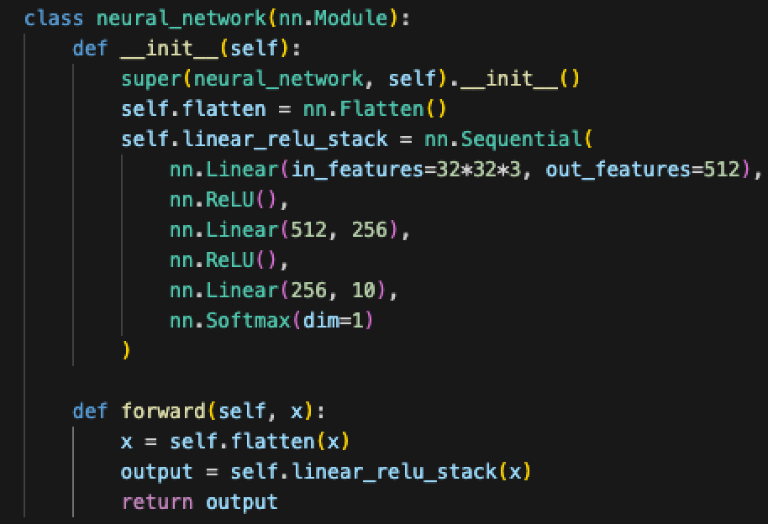
Make a pass at a Model
We also need to define the forward pass.
Start with an input.
Pass that input through the entire model.
Capture the prediction (output) at the end.
In practice, this is just using the layers we made.
For us, this is simple, it isn’t always in other cases.
We use fully connected layers.
Other models can have different structure.
Layers can be skipped, looped, etc…
PyTorch will figure out the backwards pass.

Slide 30
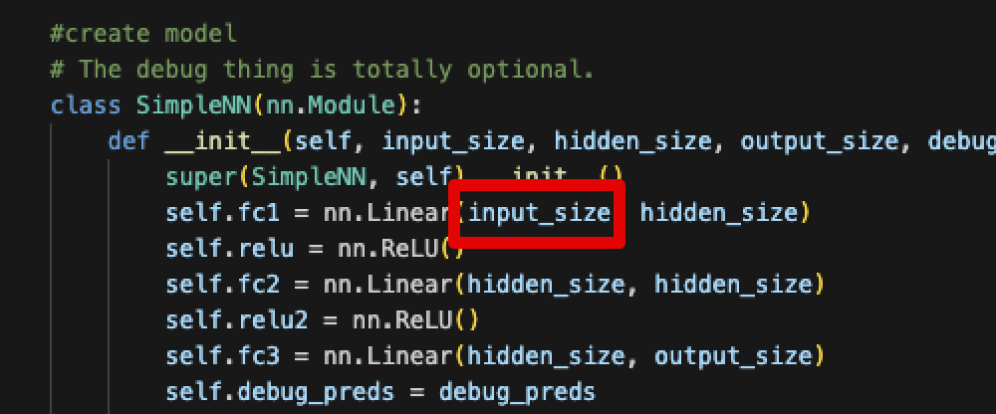
Input Layer(s)
The initial layer of a neural network needs to ‘handle’ the data’s shape.
Depending on scenario, this may involve reshaping.
The first layer must take in the features in their shape.

Slide 31
Output Layer
The output layer translates from internal values to prediction.
Equivalent* to how a sigmoid translates logits to probability predictions.
Depending on what is being predicted, output layers vary.
Regression – none/linear.
Binary classification – sigmoid.
Multiway classification – softmax*.
This is defined by the type of prediction, the model attached doesn’t matter.
*In practice, we can usually use CrossEntropyLoss, which has built-in softmax.

Slide 33

Hidden Layers
Hidden layers are those between input and output.
We can have any number of hidden layers, a reasonable number to test is 2-3.
The number of neurons in the hidden layers is also very flexible:
Commonly see flat sizes until the output layer.
Also common to “funnel down” the sizes.
Exact setup is not deterministic, we’ll look at it more next week.
We’ll usually use “relu” for activation, we’ll look at these more later as well.
Reasonable approaches:
Set # of neurons for all layers to input size. Start with 1 hidden layer, add until overfit.
Lean towards a larger model and use regularization techniques and early stopping.

Slide 34
Go Deep!
The term deep learning refers to the number of layers.
Each layer effectively sees a different representation of data.
Each of those representations is learned, according to what helps most.
In unstructured problems (image, voice, NLP, etc…) this works very well.
Something like facial recognition is not the simplest problem.
Some layers may ‘capture’ head shape, some may ‘capture’ facial feature position, etc…
Classical ML -> features have direct-ish relationship to target.
Deep NN -> features (can) have complex relationship to target. (Combinations of features, combinations of transformations, combinations of different levels…)
It is kind of similar (concept, not math) to a repeated series of PCAs, it keeps trying to extract the ‘information’ each time the data goes through a layer.

Slide 35
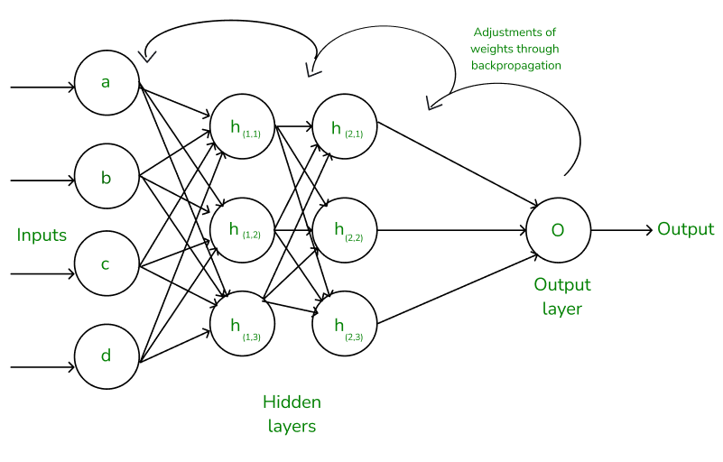
HoW models Learn
The neural network is complex if we examine the math, but the idea is simpler.
Think about it backwards, from the output layer back to the inputs.
The output layer generates predictions, which gives error.
Backpropagation effectively says, “the error here comes from these nodes, adjust bad ones”.
This is the gradient bit, error is attributed to terms and the weights are adjusted to get better.
The output layer ‘teaches’ the previous layer what it needs to be accurate.
This process repeats layer by layer – what does it need to have a more accurate output.
We can have a massive number of weights, that gives NNs their capability.
The earlier layers can be thought of as smart feature constructors.

Slide 37
How Models Learn
Each layer is a different ‘view’ on the data, it gets transformed as it goes through.
At each layer, the useful stuff is kept, the useless stuff is ditched.
This is the weight adjustment part.
Parts of the model that pass data that results in errors gets changed.
Parts of the model that pass low-error stuff get kept as is.
The model (kinda) selects info from each representation (layer) to make a final prediction.
Terms with little error don’t get adjusted in the backpropagation.
This makes them so good at things like images – relationships that are complex can be captured.
The parts aren’t independent, so each change will impact other parts.

Slide 38
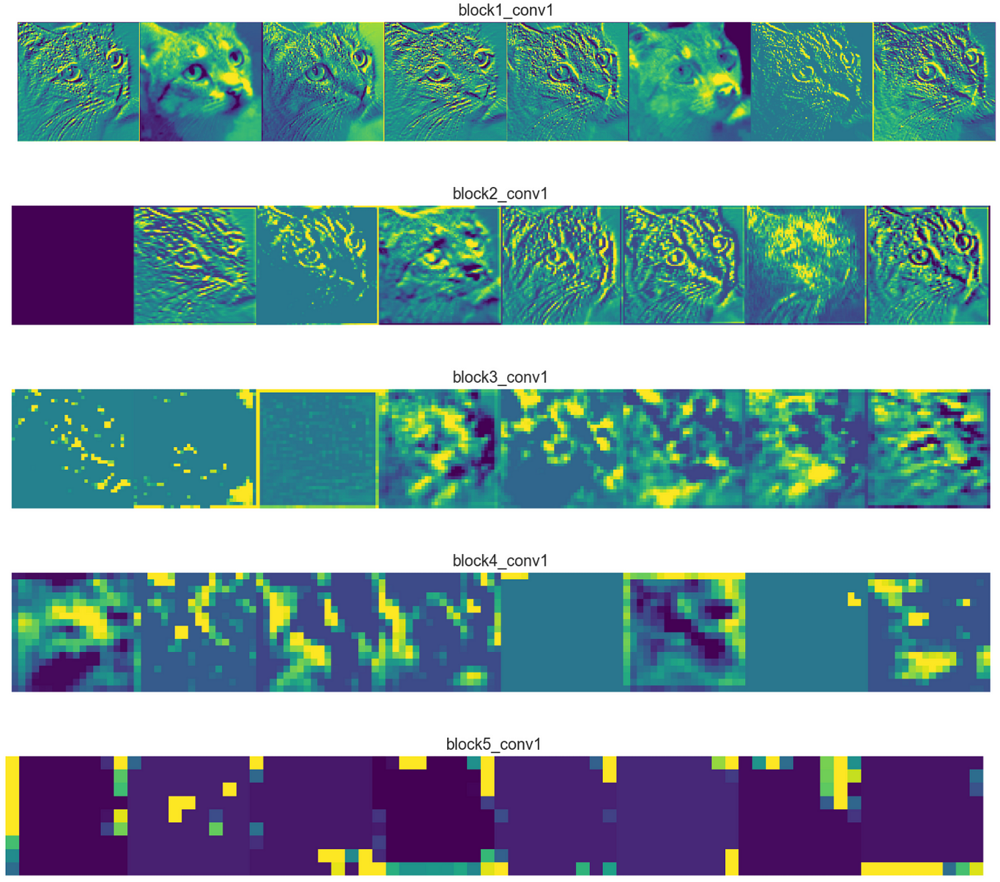
Why Hide your Layers?
Hidden layers allow (with activation) models to be adaptable.
A 0 hidden layer network is a logistic regression – linear only!
Adding hidden layers allows the model to ‘see’ different representations of the data.
Input of each layer is a transformation of the previous layer’s input.
That transformation is discovered as the weights are learned.
Each layer becomes roughly “if we look at the data like this, what helps us predict?”
Deep (lots of hidden) models tend to perform best for unstructured data.
The layers allow for models to learn very complex relationships.

Slide 39
Training and Testing Loops
We need to define the loop that will train (and test) our model.
The loop is largely boilerplate, walking the model through the steps:
Batch data, make predictions, get loss.
In testing – batch data, make predictions, calculate error.
We can define whatever monitoring we want or need.
Print results periodically in training/testing.
Send results to logging/monitoring location (later).
This part is kind of dumb, I think we should have a simple “fit()” option.
This ‘write a loop’ approach does allow you to log/report custom stuff more easily.

Slide 40
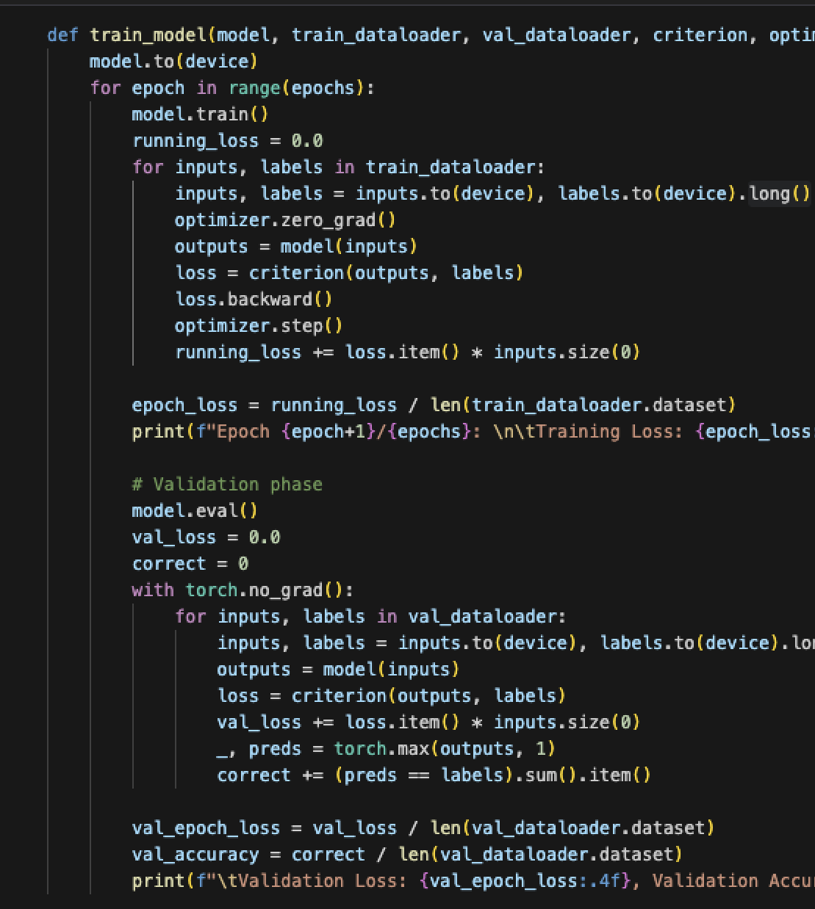
Simple Loops
This is a simple set of loops.
Most of this can be copy/pasted with only a few adaptations for us.
Read through it, and try to make sense of it…
The ‘backpropagation’ bit does most of the work
The test function just measures loss.
No_grad means it won’t do g.d.
Loops can vary a lot, but they need the basics.
Can add more metrics, logging, printouts, etc…

Slide 41
Core Steps in Training
Send models and data to the device (GPU) before calculating on them.
Set model to training mode.
Loop over desired number of epochs, in each epoch loop over each batch.
For each epoch, track the desired metrics.
For each batch:
Get predictions and calculate loss from them.
Use zero_grad to reset gradient calculatiuons.
Call .backward() on the loss to do backpropagation.
Call .step() on the optimizer to step (update optimizer settings).
When getting predictions (e.g. validation), run under “no_grad()” to stop calculations.

Slide 42
Tuning Neural Networks
Tuning a neural network is more variable than a statistical model.
There are many interconnected things to change:
Structure – depth, width, layer types.
Regularization, normalization, other stuff like dropouts.
GD related – optimizer, batches, learning rate, etc…
Models can ‘learn around’ lots of settings and changes.
If we have enough data and enough model capacity, results will tend to converge.
Models are always adjusting to lower loss, lots of models can deliver similar results.
Trials can be a substantial cost – potentially literally.
Estimates of new LLMs are that they may take up to $1billion to train – trial runs are out!

Slide 43
Fighting Fit
Some techniques we can use to improve fit in a model are:
Regularization – we can enable L2/L1 regularization in layers.
Dropout – remove nodes on the fly. Similar in concept to bootstrapping in forests – parts of the model are removed each batch, preventing them from having excess influence. It forces the other parts of the model to learn.
Early stopping – stop the model’s training before it overfits. Also makes our lives easier, since our model will stop when done, even if we’re out at the club.
For now, make it 1-3 or so hidden layers, add regularization, use early stopping.
We’ll do more tuning soon, just ballpark it for now.
Neural networks will usually try to overfit everything, main concern is limiting that.

Slide 44
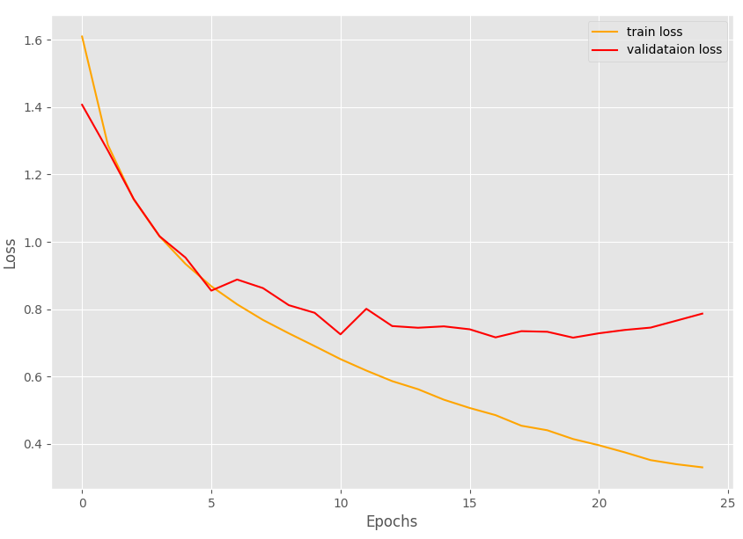
Verbosity and Outputs
We control the train/test loops, so we can define the output we want.
Normally want train/test loss printout every epoch or N epochs (if many).
Post training, we look at a training/validation loss plot.
We can use the loss plot as the main initial tool to tune our models.
Want the point where validation loss is minimized.
Gap between lines is roughly the amount of overfit – reduce with regularization/less capacity.
Similar lines indicate we can probably add more capacity.
If things are still improving, keep training.
This is highly variable, performance literally may vary model to model (esp. w/ small data).

Slide 45
Us verses Reality
In our usage we’ll use notebooks, look at the output, and do interactive stuff.
The notebooks are for exploration and learning, they aren’t really infrastructure grade.
This doesn’t really matter to us, but I always found CS gave us little context to the theory….
In ‘real’ usage, we wouldn’t use the notebooks, we’d have a regular program.
We’d probably experiment on a notebook, decide an approach, then run that for real.
May be a desire to rewrite some in other language, but most time is inside optimized torch stuff.
It should usually be pretty easy to extract our code to a .py file we could run.
Some planning can make it very easy (manage output, wrap code into functions, parameterize, etc…).
Run the training, save the output logs, save weights/models. Another file/api to predict, etc…
This would be combined with some infrastructure code – grab data, schedule, feed prediction data…

Slide 46
Lightning
There’s a higher level wrapper for PyTorch called Lightning.
It basically simplifies/condenses some things and reduces boilerplate code.
It also aims to make things more modular and things like distributed training easier.
Many people use it, potentially with other tools, to make trials/tests more efficient.
It isn’t that different from standard pytorch, and it is pretty common.
Be aware if you’re looking at examples online to avoid confusion.
We may touch on it later, depending on time and how you all feel.
Note: Keras can also use pytorch to some degree, this is part of the mess mentioned.

Slide 47
Using Pytorch
Overall, using pytorch models isn’t conceptually different, just more manual.
Instead of loading a model object with HP we must create it.
Instead of simple dataframe data manipulation, we need to make datasets.
Instead of fit(), we need to define the training process.

Slide 48
Using Pytorch
Pytorch is not the most user-friendly interface to start with.
It isn’t awful, but i don’t think it is all that intuitive, personally – lots of boiler plate.
There’s boilerplate code, lots of stuff is manual/custom, we are ‘in the weeds’, etc…
It does get much easier once you are comfortable with the theory.
Figuring out how NN work while figuring out the code is more challenging at first.
Print statements, example records, shapes, and counts are useful tools.
Once kind of comfortable, you have lots of flexibility to what you want to do.
Most changes are easy to do – we have all the details already in our existing code.

Slide 49
Conclusion
At a high level, pytorch models are used just like any other model.
In practice, most of the details of those parts are changed a bit.
Data: from dataframe to data loader.
Preprocessing: from pipeline to transformations.
Model: from new object to defining new class.
Hyperparameters: from arguments to ‘separate arguments’.
Training: from fit() to a custom loop that fits.
This takes a bit of practice to get used to, try a few as needed.
Q+A and troubleshooting become much, much easier with a little familiarity.
Play with structure, layers, options, and observe – we’ll worry about tuning later, experiment.

