Slide 1
We Get to Machine Learn again!!!!
Intro – logistics, overview, etc…
Assignment 1, Part 1 – easy EDA warm up project.
Trees
Classification trees and tree theory.
Tree loss – entropy, gini, purity, and discrimination.
Hyperparameters and impact on tree models.
Basics of over/underfitting.
Regularization with ccp-alpha.
Next week:
Column transformers, imputation, and custom transformers (project).

Slide 2
Trees

Slide 3
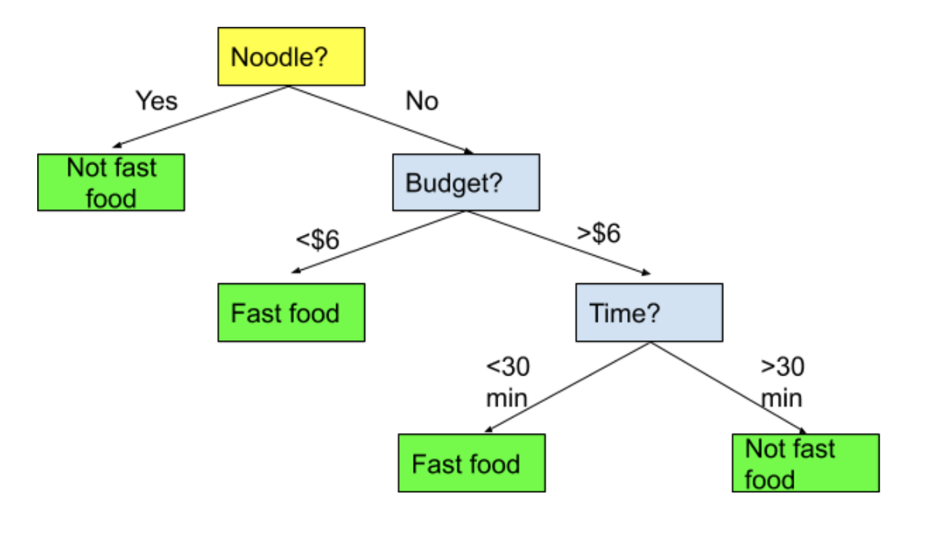
Trees
Trees are one of the simplest to understand models in machine learning.
A tree is just a series of if statements, until a decision is reached.
Once the tree is made, making a prediction is dead simple, just follow the tree and make decisions.
We’ll look at classification trees first, regression are similar once we understand classification.

Slide 4
See the Forest for the Trees
A tree is a fundamentally different type of model from a regression based one.
There’s no equation like y=mx+b to make a prediction.
There’s no linear relationship, as seen in that equation.
The process of creating the model is quite different from gradient descent.
The end result is interchangeable.
All models predict Target given Features.
The only thing that changes is how it learns to do so.

Slide 5
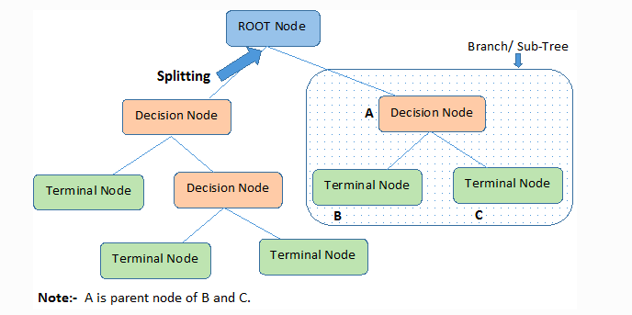
Tree Parts
The parts of a tree are simple and tree like:
Node– each point.
Decision – node where a split is made.
Terminal/leaf – node where a value is determined.
Brach/Sub-Tree – a segment of a larger tree.
Depth – how many layers the tree has.
Samples – number of items in that node.

Slide 6
Building the Tree
The decisions and the cutoffs are created by looking at the features for the criteria that will do the “best job of deciding” – or that will split the group most sharply.
For example:
You are classifying people as horse jockeys or basketball players.
You know their height and hair color.
Height does a better job of splitting the records.
Those >6ft are almost all bball playters.
Those <6ft are almost all jockeys.
Your choice would be to divide the data based on height.
The algorithm finds the decisions that maximize this separation.

Slide 7
Criteria
The criteria for how good the separation can be defined by different metrics.
Gini.
Entropy.
The math behind each is different, the idea is the same.
There is rarely a substantial difference between the two.
Gini is the default.

Slide 8
Scenario
If we have 4 red gumballs and 0 blue gumballs, that group of 4 is 100% pure.
If we have 2 red and 2 blue, that group is 100% impure.
If we have 3 red and 1 blue, that group is either 75% or 81% pure, if we use Gini or Entropy respectively.
As with most post-COVID political movements, trees want to discriminate.

Slide 9
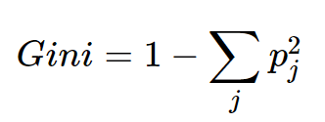
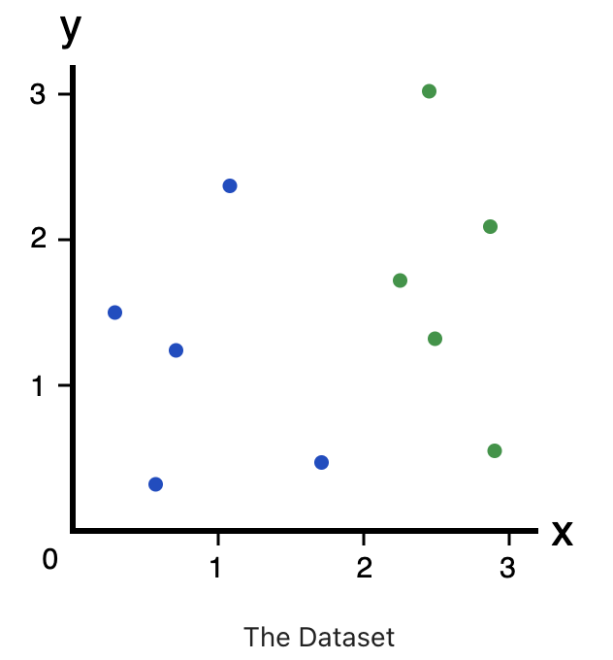
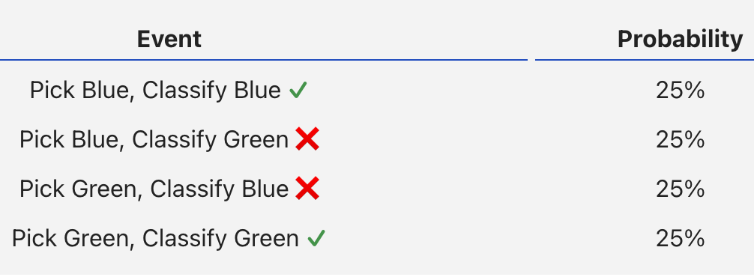
Gini
Gini measures how often a randomly chosen element from the set would be incorrectly labeled.

Slide 10
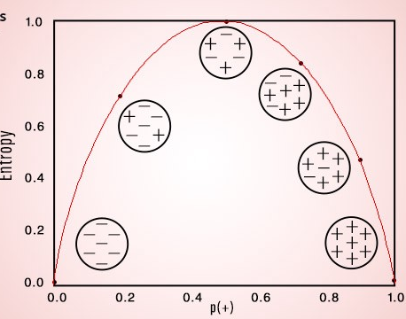
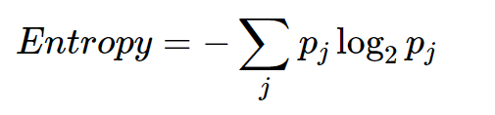
Entropy
Entropy is similar to Gini – a measure of impurity.
Created to convey the idea of information – the lower the entropy the more “information” it conveys.

Slide 11
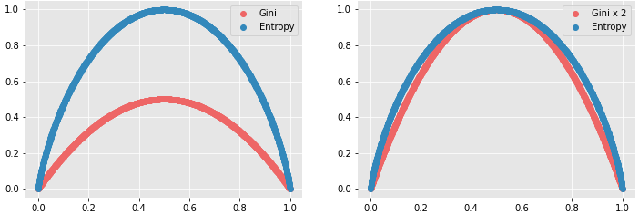
Splitting Decision
The algorithm looks for the decision that maximizes information gain or purity.
Gain = Gini/ENT before the split – Gini/ENT after the split
The split is the one that makes the tree more pure after.
Maximize discrimination with the division.
The series of the decisions makes the tree sequence of decisions.
In practice Gini and Entropy will usually give close to the same results

Slide 12
MoRe Splitting Decisions
When there is a numeric feature, the tree decides to split at some point.
E.g. Age < 35 one way, >= 35 the other.
Where the cutoff number is set is something the algorithm decides internally.
There are several ways that the tree can pick a point.
E.g. Try every value in the dataset, pick the best.
This isn’t really that important for us, we can ignore it.

Slide 13
Woody Goodness
Tree benefits:
Simple, understandable, and mirrors human decision making.
Handles non-linear relationships.
Non-parametric – there is no assumption of what the data is, such as normal.
Explainable – we can follow the exact logic of the decisions.
Data prep is minimal – no need to encode or scale data.
Generally computationally efficient with large datasets when making decisions.
Can be acceptable in scenarios (finance, insurance, etc…) where a black box model isn’t.
You can show how a decision is made in human language.

Slide 14
Barky Badness
Trees have some disadvantages:
Non-robust – small changes in training data can generate wildly different trees.
I.e. a small difference in train-test split can yield different split points, which can then lead to a very different tree. Even if the end results perform almost identically.
What might we try that could mitigate this?
Prone to overfitting (though we can combat that when we code them).
Training with large datasets can be time consuming, especially when attempting to limit overfitting.

Slide 15
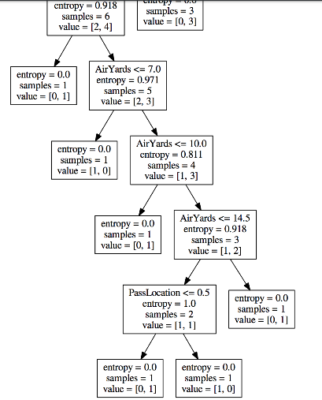
Trees are Too Smart!
One thing we see with trees is that they try to be perfect.
If there is a node with 1 T and 1 F, it’ll try to split.
This is something called overfitting.
The model is too tailored to the training data.
Model changes its performance too much to make sure it is 100%
This can hurt the model’s performance with new data.
The model is perfect with what it knows, but bad on new examples.
We want something tailored to data, but still general enough.
We need to constrain the learning of the model to improve!

Slide 16
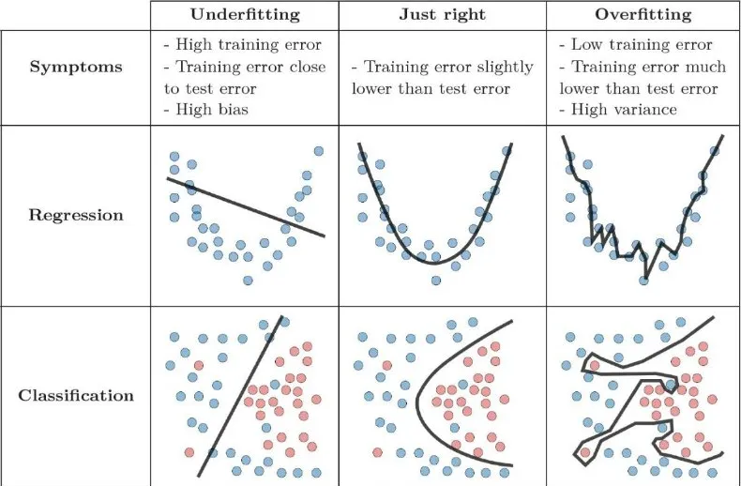
Fits
When we train a model it learns from the training data.
A model can learn too much, or too little from that data.
The training data is a sample of reality.
Model should perfrom well with it.
New data is similar, but different.
This balance is overfitting vs underfitting.
How customized to training data is model?

Slide 17
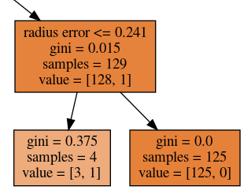
Overfitting A tree
Trees make the overfitting really explicit and clear.
The tree decides, at each step, the best split to improve accuracy.
Eventually, the good splits are used up – some impurity, no easy improvements.
E.g. Suppose you are predicting who will pass a class.
Initial splits based on attendance, doing the work, taking notes, etc… are good.
Eventually you’ll have nodes with people with similar ‘big’ habits, who both passed and failed.
The tree will use anything it has in data to divide the group, even if not really generalizable.
Paid tuition, address, birth month, id number, etc… Anything that happens to split node better here.
These really specific splits likely aren’t broad rules that work in most cases.
We need to stop the model from learning this stuff that doesn’t transfer. But How?

Slide 18
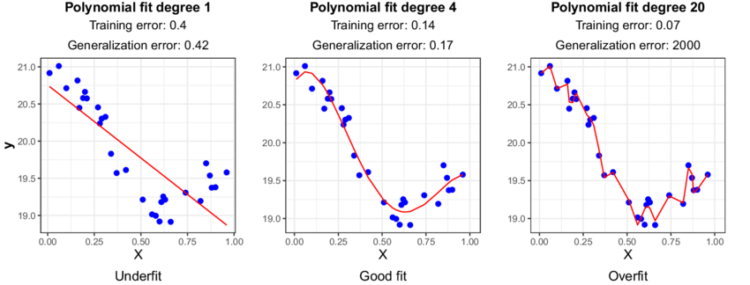
Variance Error – Tree that is Overfitted

Slide 19

How can we Make Sure Models Fit Well?

Slide 20
Making Better Trees - Hyperparameters
Hyperparameters are basically the settings that the algorithm uses while making a model.
Each algorithm has a different family of hyperparameters.
The algorithm makes a model from data, using the HPs as its settings to do so.
We can create different models with different HPs.
These models may perform very differently.
Tree hyperparameters can help us tailor our tree models:
Maximum number of levels in the tree.
Gini vs entropy for splits.
Minimum number of samples in a node to allow it to split.
Maximum total number of leaves.

Slide 21
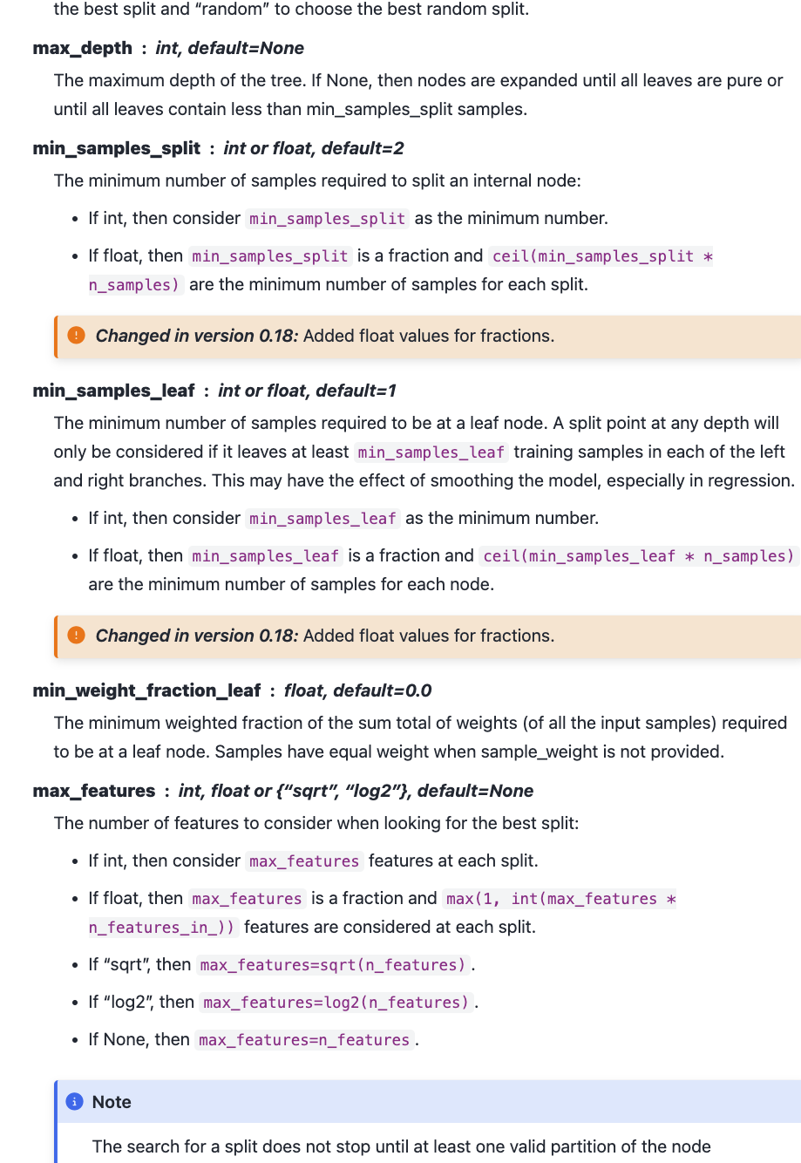
HP Options
Every model has different hyperparameters.
For a tree, they mainly relate to limits on growth:
Max number of levels.
Minimum items in a leaf to allow a split.
Maximum number of features to use.
This is something we want to get used to looking up in documentation.

Slide 22
So Many Parameters!
Parameters are the things that the model learns internally while training.
In a tree – split criteria.
In other models – weights, values, centers, etc… (This will make more sense later)
Hyperparameters are the things the model is told from the developer.
The rules on how the training process can run.
Settings for how it does its job.
Creating a model will require [model type + HP choices + Data].
We often want to compare different HP sets against each other.
Soon we’ll look at tools to automate testing and comparing HP settings.
Can use HP settings to mitigate over/under fitting in a model.

Slide 23
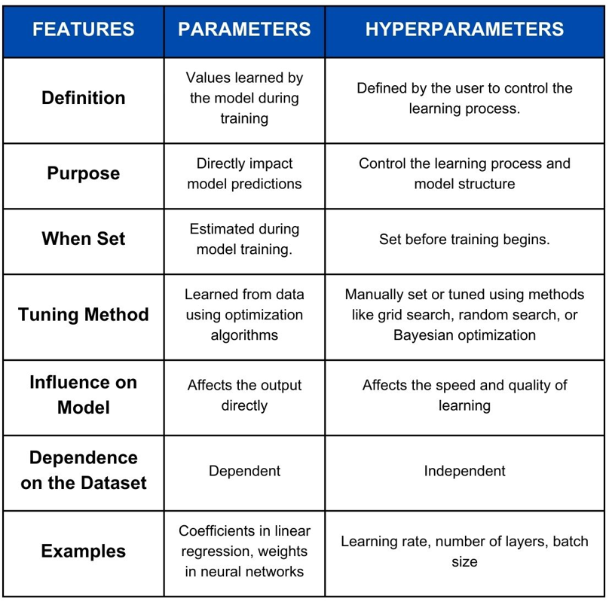
Parameter world
Hyperparameters:
Us
Control training.
Parameters:
Algorithm.
Control predictions.

Slide 24
Tuning the Model with Hyperparameters
We want our model to:
Learn the data well, so it can make accurate predictions.
Not become overly customized to the specifics, so it can make good predictions on new data.
We want to balance overfitting and underfitting.
Trees can tend to overfit if we don’t constrain their growth.
E.g. if a node has a T and F, just split so each node is perfect.
We want to let our tree fit to data, but limit how far it can go.
The model can get to 100% in training, we want to constrain that growth.
The most common thing we’ll do with tuning is limiting overfitting.

Slide 25
Getting lost in the Trees
Trees will always overfit – try to get to 100% on training data, even if it is “too much”.
Trees start with the most impactful decisions near the top (by definition).
If we have a node farther down that still has impurity, tree will still try to split…
The tree has already used all of the ‘useful’ splits to get to this point.
Tree will resort to any value that can differentiate, even if silly.
E.g two people have the same job, income, net worth, and age – one paid loan, one didn’t.
Model will likely sort those two to same node, as they “look the same”.
If tree still tries to split them, it’ll find something that is different, no matter relevance.
Tiny difference in income, age, or credit score, some tangential feature, etc…
We don’t want these forced splits – we only want to divide things in a way that applies to others.

Slide 26
Fighting the Overfit
We can use hyperparameters to combat this tendency.
HPs are effectively the configuration/settings for the algorithm.
Provide HPs as arguments when creating the model object.
For trees, most hyperparameters are limits on growth.
Max depth, min number in a node, etc…
By limiting the ability of the tree to grow, we force it to make broader decisions.
i.e. it still minimizes loss (gini/ent.), but must do it with fewer decisions.
The model must use broadly applicable splits to lower the loss.
Different HPs yield different models, sometimes impacts are massive.

Slide 27
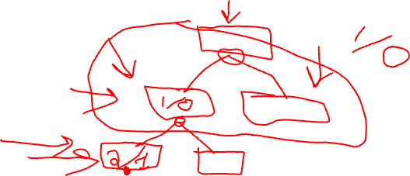
Housekeeping
More trees:
Regularization.
More pipelines.
Imputation.
Column transformers.
Custom pipeline steps (for project class).
I did push some stuff to workbook 003 for this a couple of days ago, pull if you haven’t.
Probably mostly theory, we’ll see with timing.

Slide 28
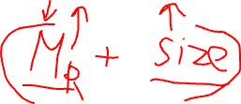
Regularization
Another concept that can combat overfitting is regularization.
Regularization modifies the loss (or equiv) function to penalize growth of the model:
Loss being minimized is the goal, the algorithm only tries to do that.
Normally more accuracy means less loss, so the model wants to overfit.
Regularization changes the loss to a combination of [loss + penalty]
The penalty is a value that gets bigger the mode the model ‘grows’ (or adapts).
Learning reduces error, but increases the penalty.
The model can only get more complex, or grow, if the increase in accuracy ‘outweighs’ the penalty of that growth.
The strength of regularization allows us to control the amount of learning.

Slide 29
Regularized
No regularization.
There is a loss metric that tracks error (cross ent, gini, mse,etc..).
The algorithm changes the models parameters (weights, decision points) to minimize loss.
Regularization.
There is a loss metric that is a combination of error and size of model.
The algorithm changes the models parameters (weights, decision points) to minimize loss.
Regularization changes the target that the algorithm optimizes for.
Instead of only wanting low error, it wants low [error + size] instead.
Process doesn’t change, still do gd or the tree algorithm (cart).

Slide 30

Cost Complexity Pruning
Cost complexity pruning is a way to reduce the complexity of a tree after it is made.
CCP finds the leaves that are least beneficial.
The complexity parameter is used to define the cost-complexity measure, Rα(T) of a given tree (or branch of a tree) T:
Rα(T)=R(T)+α|T|
Where |T| is the number of terminal nodes in T and
R(T) is traditionally defined as the total misclassification rate of the terminal nodes.
This can be gini or entropy, it’s the same either way.
Parts of the tree that were least helpful are pruned.
Acts to limit tree size like hyperparameter limits, but dynamically based on the tree.

Slide 31
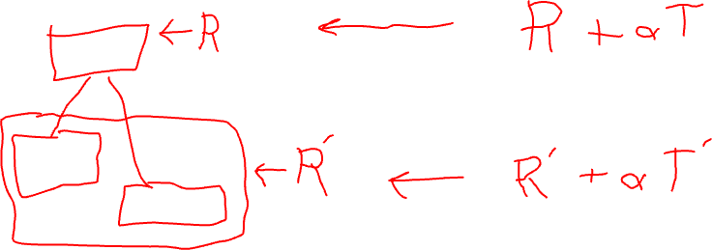
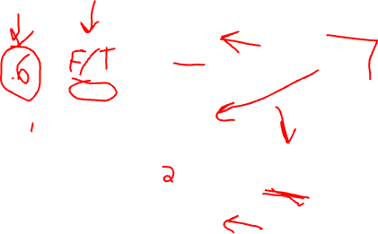
Normal:
R is the loss, what the algo minimizes.
R is misclassification pre split.
R’ is misclassification post split.
If R’ < R then tree splits.
Loss metric is improved.
The specific decision is whichever causes this improvement to be largest.

Slide 32
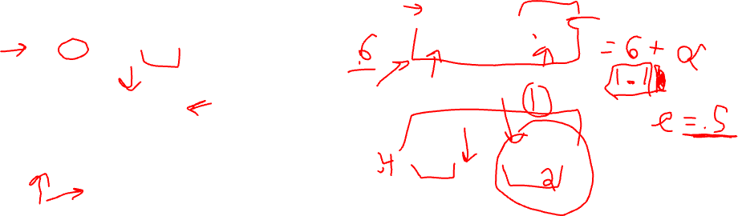
Loss has two sources:
Errors (unchanged).
Size of model (new).
Total loss is minimized.
Pruned:
R+a*T is the new loss.
R is still misclassification.
Alpha is a HP we set.
T is the number of term. nodes (size of tree).
If R’+a*T < R+a*T then tree splits.
Loss still needs to be improved, however…
Loss will improve if we reduce misclassifications.
Loss will get worse if we make tree bigger.
For a split to improve loss, the gain from acc must outweigh the penalty from growth.
Normal:
R is the loss, what the algo minimizes.
R is misclassification pre split.
R’ is misclassification post split.
If R’ < R then tree splits.
Loss metric is improved.

Slide 33
3 True, 4 False Gini: .48
Size: .125 * 2 (1 leaf)
Loss: .71 + .125 = .835
Gini: .37*(4/7) + 0*(3/7)
Size: .125 * 2 (2 leaves)
Loss: .37 + .25 = .62
3 True, 1 False
0 True, 3 False

Slide 34


Be More Alpha
In the CCP equation Rα(T)=R(T)+α|T| the alpha-t is a penalty.
The larger the number of terminal nodes gets, the larger the penalty.
The larger alpha gets, the larger the penalty.
Effectively removes things that have many terminal leaves.
Larger trees will generate larger penalties in branches.
Tends to limit overfitting, as it stops large branches from being developed.
Adding a penalty to “size” is a common strategy.
If a split is going to happen, it needs to “overcome” the penalty incurred by increasing the number of terminal nodes ( |T| increases ).
R(T) needs to decrease, or more accuracy, to overcome alpha-T increase.

Slide 35
Keep it Regular(ized)
This type of constraint on growth, regularization, is quite common.
Easy to implement – just change the loss function.
Can work anywhere with loss (and a size metric).
‘Automatic’ – growth can be limited throughout training*.
On the downside, we need to provide alpha as a hyperparameter.
Instead of targeting “most accurate model” we target “most accurate considering size”.
Big trees have great accuracy, but the size will cause their loss to be large.
If the tree can’t get big, it can’t overfit much.

Slide 36
Use some Trees
Trees are one of the most approachable model types to understand:
We can visualize the entire process and walk through decisions in English.
Trees tend to be greedy, so we need ways to limit the overfitting.
Tuning the settings of hyperparameters and regularization.
Tree creation algorithms seek purity – each node is uniform.
Trees do the same thing as regression, but in a totally different mathematical way.
Linear models assume a linear relationship, trees are non-parametric.
Different data may work better with one or the other (or some other type).
Many of the best non neural network models use some trees in different ways…

Slide 37
General Notes
Sklearn has gotten much better in the recent version in handling dataframes natively.
Many/most of the examples have a step to convert to array before the model part.
I.e. do prep stuff with data in dataframe, convert to array, feed to pipeline/model/gridsearch.
You can avoid this more easily now and sklearn will (more often) handle it ok.
I generally like the conversion step when learning, it’s a clear delineation.
All the prep work is done on the dataframe, we make the conversion when done.
The array conversion doesn’t really change anything in functionality.
The results are the same, and the process is only different in that one or two lines.
The algorithm does a conversion internally and just obscures it from you.
When we do neural networks we’ll need to do that conversion (often) again.

Slide 38
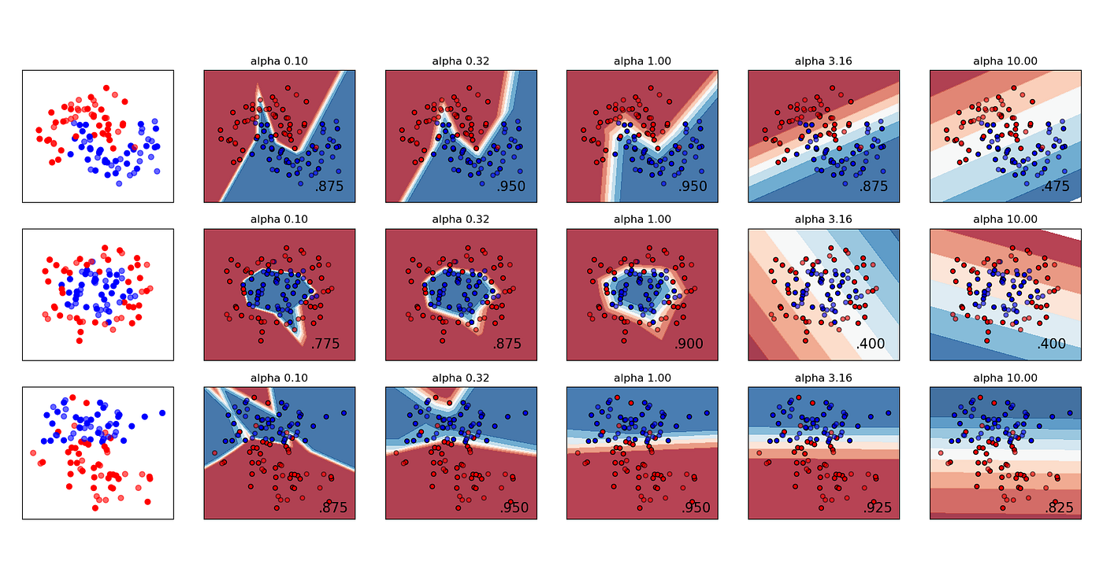

Slide 39
Start the Semester off with a BanG!
Review:
Statistics, particularly for EDA. Sklearn basics. Error and model quality.
Today:
Tree theory.
Underfitting, hyperparameters, regularization basics.
Next week:
Really useful pipeline tools – column transformers, imputation.
More pipeline – simple custom transformers for project purposes.
Using trees in a more ‘realistic’ scenario – the c.t. and imputation allow us to handle most data.

Slide 40
EDA and Classes

Slide 41
EDA and Classes – DataFrame Class Object
Methods:
Head
Info
Attributes:
Data
Columns
Size

Slide 42
Using a Class - Dataframe
When we create a DF we instantiate, or create an object of, that class.
Df = pd.read_csv(“some_data.csv”)
That object, df, has all the stuff in the previous image – the data, attributes, and functions.
Df.columns:
Give me the value of that attribute.
Df.head():
Run this function on the object

Slide 43
We can Make A Class – for EDA
We can try to make our own class, to help with EDA, what should it contain?
Attributes:
A dataframe. (An object in an object).
Some other helpful stuff? E.g. a list of categorical variables.
Functions:
Generate histograms.
Print EDA stuff.
Use:
Create an “EDA” object by loading the dataframe we are using.
Call the “give me EDA” function to get it all spit out for us.
We can reuse this by creating an EDA object for each df, then we can just call the EDA function.
Note: We can also extend classes – or basically make a “dataframe+” adding what we want. We’ll do this later for transformations.

Slide 44
EDA and Classes – DataFrame Class Object
Methods:
Make_EDA
Attributes:
Dataframe

