Slide 1
Housekeeping
Gridsearch and model tuning (Intro to ML.. In chapter 5):
Grid search for hp tuning.
Cross validation.
If we have time, forest and ensemble models (we should be able to):
“Ensembles of Decision Trees” in chapter 2, but just bagging – we’ll do boosting later.
Pretty easy idea – let me know honestly how you guys feel with pace of concepts.
Assignment 1, part 2 and making a tree-based model.
You can do it now.
You may want to use a forest (probably later today), but that switch is easy in your pipeline.
A few imputation details.

Slide 2
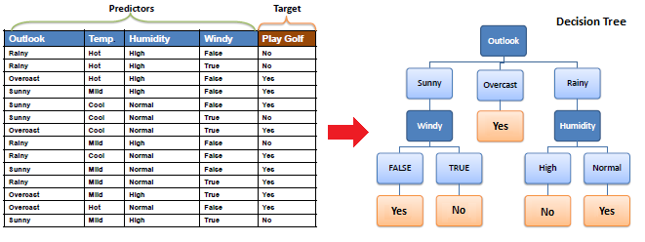
Tree Review
Remember trees - created by playing plinko with the data:
At each node, choose whichever feature can split data the best.
Gini/entropy measure of purity.
Repeat splitting whatever data is in that node until perfect or a limit is hit.

Slide 3
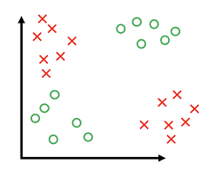
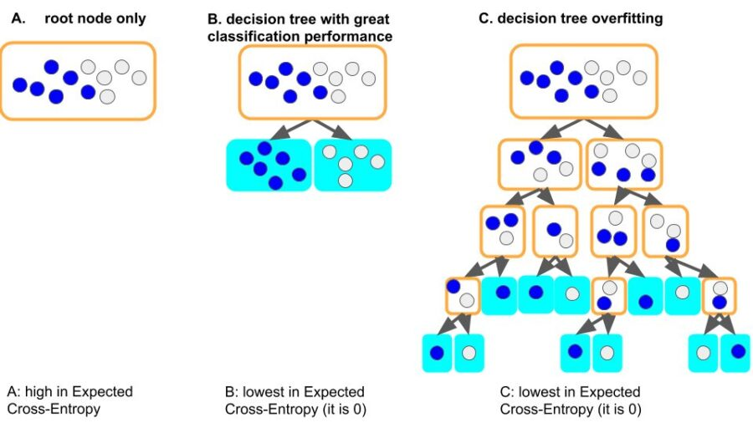
Trees
Not inherently linear, like regression models.
Can better capture non-linear relationships.
Simple and comprehensible by a human, able to be displayed visually.
Quick to predict (can be slow to train).
Very strong tendency to be high variance in error:
Will always overfit, to perfection if possible, if we don’t limit growth.
We need to use HPs or regularization to prevent the model from learning too much.
E.g. both trees here have the same purity (gini/ent.) score.

Slide 4
Tuning the Tree
To make a tree model that work well (not overfitted) we need to tune it.
Hyperparameters:
Settings for the model training process, such as max depth, min items in a leaf, criterion, etc…
We can set limits to (mainly) constrain growth, then the tree must optimize within that.
Regularization (Cost Complexity Pruning):
Regularization is the concept of adding a penalty to the growth of a model.
In order to overfit the data, the model must grow, so this combats that.
Requires each split to improve overall purity by at least some (adjustable by hp) amount.
Done after the tree is made, but is seamless to us.

Slide 5
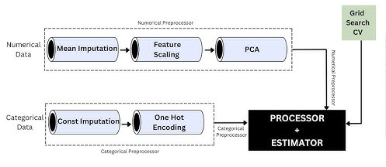
Shove a Column Transformer up Your Pipe
Column transformers are another pipeline item.
CTs are basically a pipeline with branching:
We can treat a CT like any other transformer object in connecting them.
Inside a CT we can specify different paths (pipelines), and which features go down them.
The output of the CT is just like a pipeline, it’ll recombine the data for us.
Mainly needed for mixed data types (cat/num).
All pipe-ish things can be combined in any way.
They accept/output an array(-like) dataset.

Slide 6
Imputation
Imputation allows us to keep data despite having missing values.
Gnerally can’t process data with blank spaces.
Suppose we are doing the long-form census and some respondents leave INCOME blank.
We can’t redo it.
Removing the entire row costs us valuable other data.
But, we’re literally inventing fake data to fill the blanks – seems risky.
Doing quality imputation is a scenario/specific task.
We need to combine judgment and results.

Slide 7
Real Imputation – Why is it missing?
First concept – if it is missing, why? A.k.a. can we predict if a value is missing?
Missing completely at random (MCAR).
One dude’s census form got a drop of water on it in the mail and the income is illegible.
There’s no reason this one is missing, totally random.
Missing at random (MAR).
The probability a value is missing has some correlation to the other features collected.
Media consumed by certain professions encourages leaving income field blank.
Missing not at random (MNAR).
The probability a value is missing depends on its value.
Higher income people tend to leave income blank.

Slide 8
Imputation depends on Cause
Remember, the perfect imputation will generate the exact correct value.
Different missing causes will tend towards different patterns of what’s missing.
MCAR – Easiest. Simple methods, imputation or deletion, are usable here.
Simple imputer as we’ve been using thus far.
MAR – Harder. Multiple imputation – use other features to predict imputed one.
E.g. if income is missing, use location, career, and age to predict it. (E.g. kNN imputer).
Basically, a small regression/classification model to predict the feature.
MNAR – Hardest. Statistical analysis of whatever the topic is needed. Sensitivity analysis.
Need to project the incomes of the missing people, but how much is the dist. shifted?

Slide 9
Don’t Dispute your Impute
Imputation is a domain specific thing, each problem is different.
Each model uses a feature differently, so impacts of imputation vary.
Each method will change the data, we need judgment to evaluate the best.
As data grows, details of imputation tend to matter less.
The biggest imputation concerns are ‘small data’ – surveys, medical data, census.
Where data collection costs money or is impossible, keeping data matters.
SME big in decisions. If income is missing, how to best estimate? Not just a stats answer.
We don’t worry too much about imputation.
In your project class, that might be a good chance to dig deeper.
I put a link to an online text in the resources on bright space, if you’re curious.

Slide 10
Hot-deck imputation uses the answers from another record of the same survey, referred to as the donor, to answer the question (or set of questions) that needs imputation. The donor can be randomly selected from a pool of donors with the same set of predetermined characteristics. For example, if a questionnaire has been returned with the yearly income missing, then we could determine donor characteristics as records with the same province, same occupation and same amount of experience as the respondent from the survey requiring imputation. A list of possible donors matching these criteria is created and one of them is randomly selected. Once a donor is found, the donor response (in this case, the yearly income) replaces the missing or invalid response.
Cold-deck imputation is similar to hot-deck imputation. The difference is that hot-deck imputation uses donors from the same survey, while cold-deck imputation uses donors from another source, such as historical data from an earlier iteration of the same survey or from administrative data.
Mean value imputation is to replace the missing or inconsistent value by the mean value calculated from the responding units with the same set of predetermined characteristics. For example, if a record is missing a total number for an individual’s yearly income, then we could impute the observed average income in that individual’s province for the same occupation with the same level of experience as the respondent. One drawback of mean imputation is that it destroys distribution and the relationships between variables by creating an artificial spike at the group mean. This artificially lowers the estimated sampling variance of the final estimates if conventional formulas for the sampling variance are used.
Nearest neighbor imputation is another type of donor imputation. In this case, some sort of criteria must be developed to determine the responding unit the most similar to the unit with the missing value in accordance with the predetermined characteristics. The closest unit to the missing value is then used as the donor.

Slide 11
So we should be able to…
At this point, with some refreshment of last year, you should feel ok to:
Load, explore, and clean data prior to use.
Do train-test split and format data for training.
Decide on classification/regression model, set target and features.
Create a pipeline to process the data (now with CT branching and mixed data).
Impute, scale, encode should be usable and make sense.
Make models with different hyperparameters and evaluate accuracy metrics.
Tune a model (a bit) to get better performance.

Slide 12
Grids and Pipes

Slide 13
Hyperparameters
We looked at using hyperparameters to make accurate models.
Each algorithm has different hyperparameters.
Hyperparameters are variables set ahead of time that control the training process.
Parameters are what the model learns. In a tree, the split points and order.
We can’t evaluate optimal HP ahead of time, we need to set them and see the results.
With many hyperparameters, they tend not to be independent.
Trial and error!

Slide 14
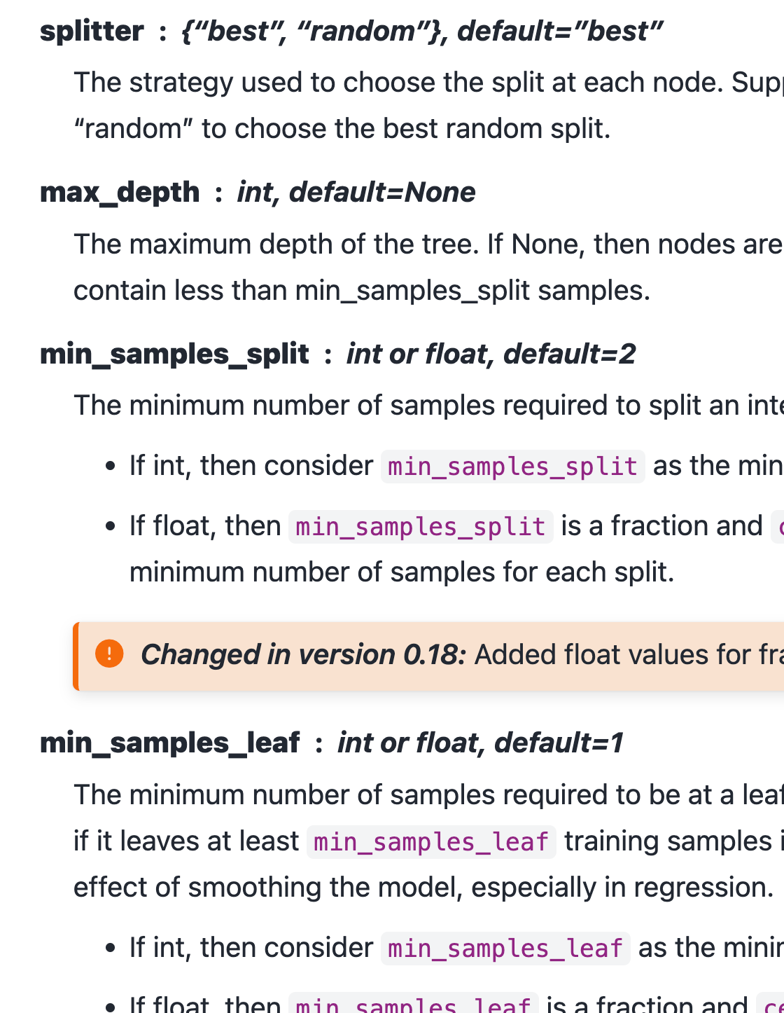
Tuning a model
When we make a model, we need to make it to see how good it is.
With hyperparameters we often don’t really have a good idea what to pick.
However, making a bunch of trials and comparing the results is boring.
Programmers are lazy!
Loops work, but they are repetitive and annoying to do.
We can automate this, test several trials, and just pick the best result.
Repeat the exact same training and evaluation process.
On each repetition, try a different selection of hyperparameters.
Process is always the same, or template-able, so we can automate.

Slide 15
Grid Search
We could loop through different combinations of HPs and collect scores.
Complex and clumsy – multiple nested loops.
Sklearn provides a simplification – GridSearchCV.
Grid search takes a list of HP values we want to try, checks every combination, and returns the best model.
Same result of looping through each value.
Also a randomized version – for when we have no idea what HP values may work.
Concept of searching HP values is common, there are several approaches.
CV = cross validation….

Slide 16
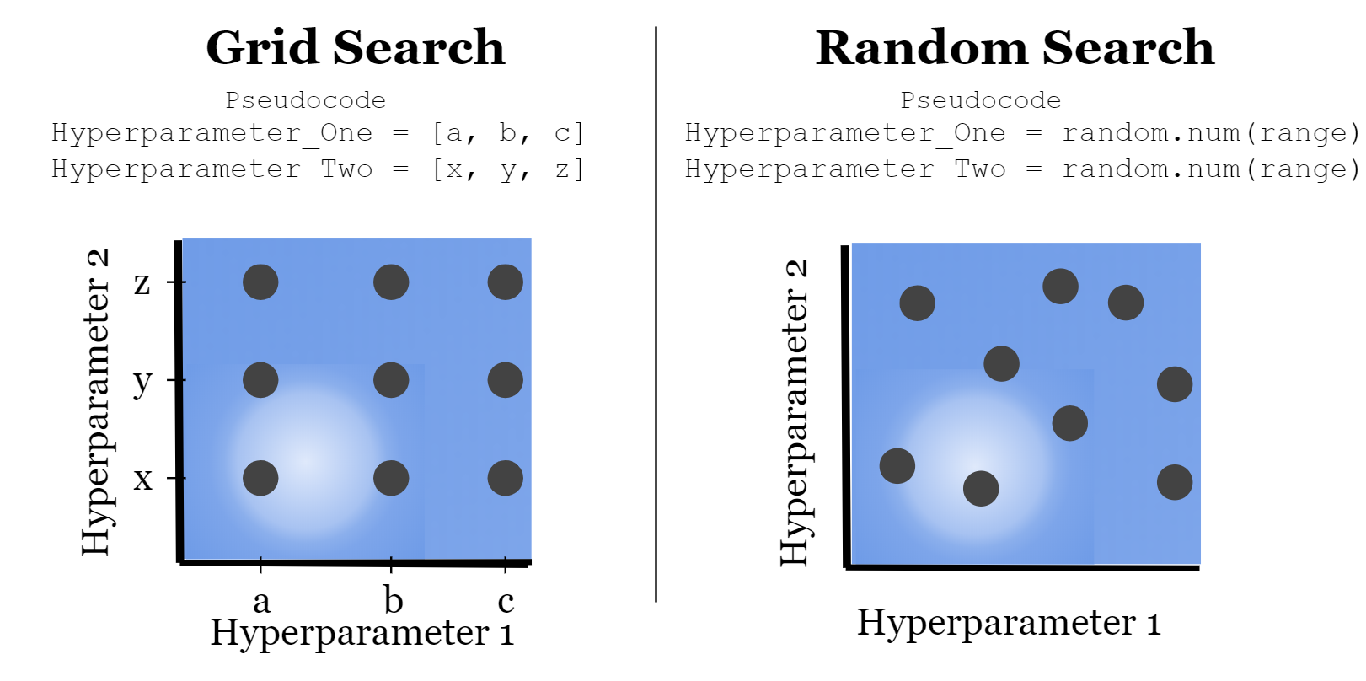

Slide 17
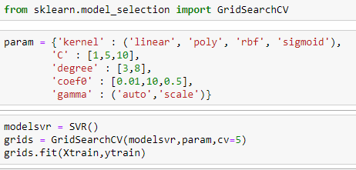
Hyperparameters
The grid search takes in a list of values to try for each parameter you want to change.
A model is made for each combination of parameters that you provide.
Can become a time issue with large sets.
Every model has different possible HP choices.
The GSCV object works just like a pipe in code.
Results in the best performing model of those tried.
We can specify a scoring metric, or take default.

Slide 18
Grid Usage
The grid search will automate the trials that we’d have to do manually.
We get the best model of all possibilities.
We are still limited by providing a non-massive good set of options, which isn’t always clear.
There are other approaches to this automated testing process that can be smarter.
Some things have large numbers of possible options, or wide ranges for numerical HPs.
We generally don’t know exactly what a good set of things to try is.
For numerical values, dialing into an exact value is even more challenging.
Randomized search will try random values – good if we have no real idea.
Halving grid search in sklearn uses a smarter approach to find good combinations.
We can get information out of the GSCV after training by grabbing its attributes.

Slide 19
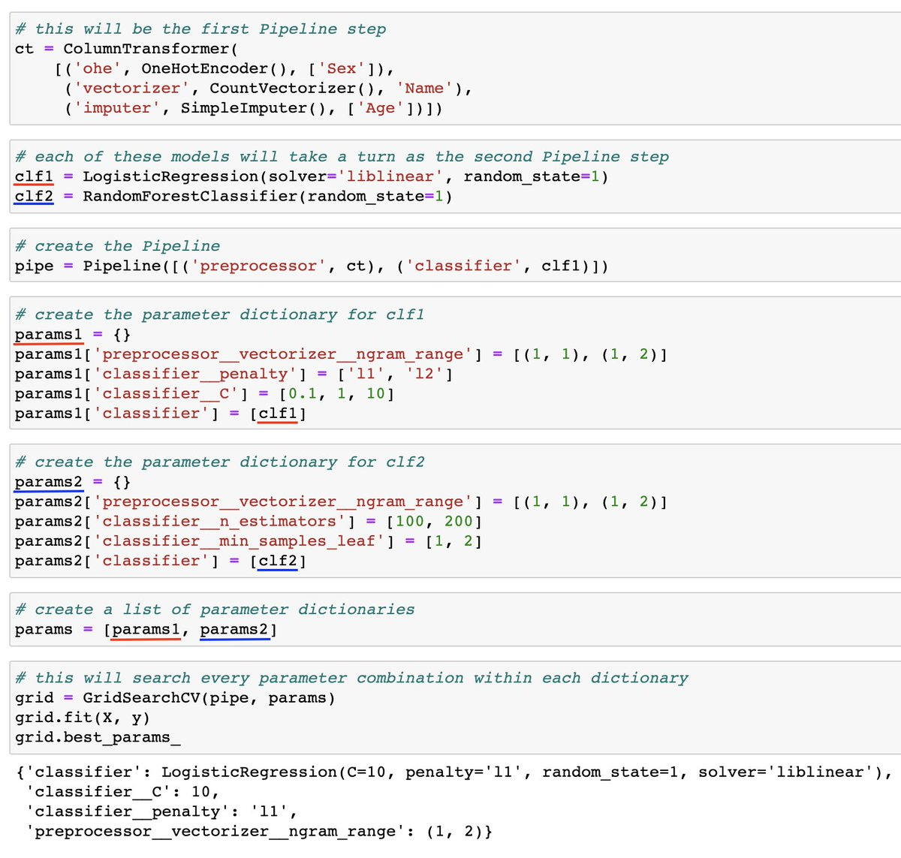
Grids and Pipes
This example is a (too) complex one.
Important:
We can refer to items by name.
Each ‘layer’ is separated by a double underscore.
We can access any hyperparameter this way.
This can be any # of layers deep, each layer just adds a double underscore.
We can also tell the grid search to use different error metrics – f1, recall, etc…

Slide 20
Measuring Results
The grid search will build each model that you specify and capture the results.
The results are tabulated from the test data.
We have several trials of each model, to ensure accuracy…
We can get the model directly from the gridsearch.
Could also get hp values, or other info.

Slide 21
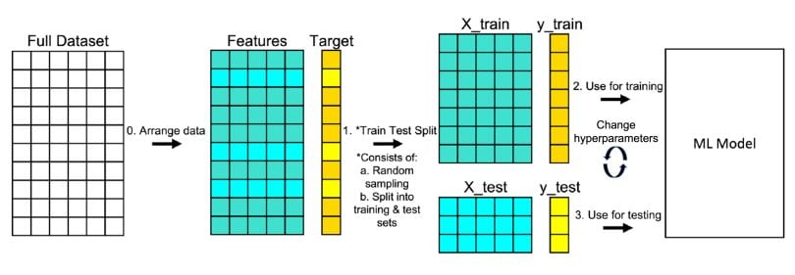
Train-Test Split
We are used to splitting data when building models:
Training data (~75%) used to create the predictive model.
Testing data (~25%) used to evaluate the accuracy of the model.
This split allows us to accurately assess the accuracy on “new” data.
As we can see with trees, training accuracy isn’t the best metric.
The split amounts can change, generally bigger data = smaller test data split.
Problem – random splits in the data can lead to variance in results:
Think of drastically different trees we get when data is split differently.
We hate variance, we’re too OCD!

Slide 22
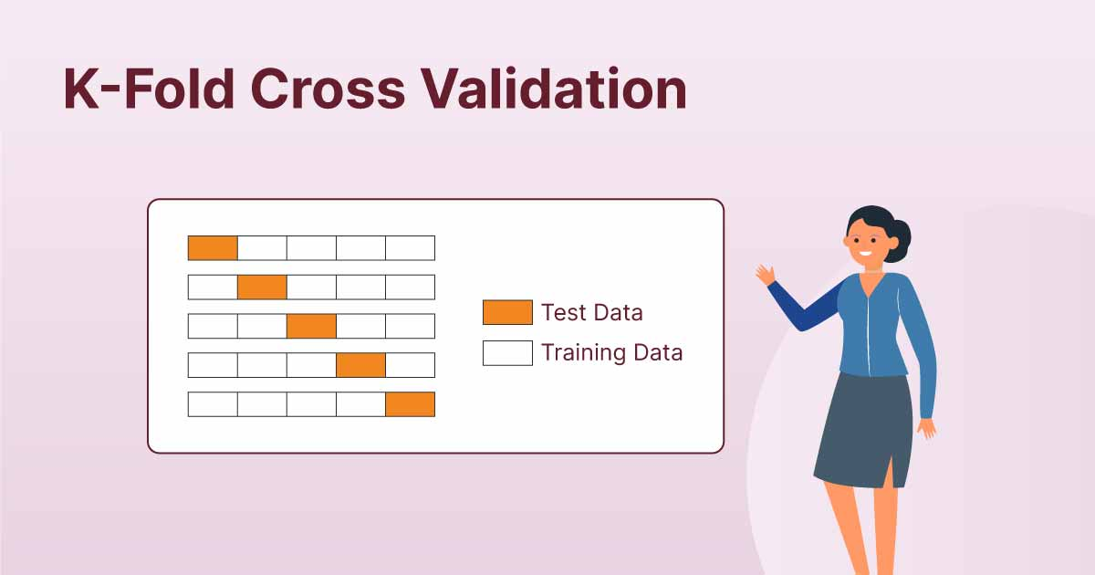

Slide 23
Cross Validation
Cross validation addresses this problem by repeating the split concept repeatedly.
K-fold Cross Validation:
Randomly split the data into K subsets.
Use k-1 set for training data.
Use the other set for validation data.
Repeat for all K subsets.
Average results together.
Mitigates variation from data randomly in one set or the other.
K of 5 to 10 is typical (for smaller sets – as data grows, this can be limited by time).

Slide 24
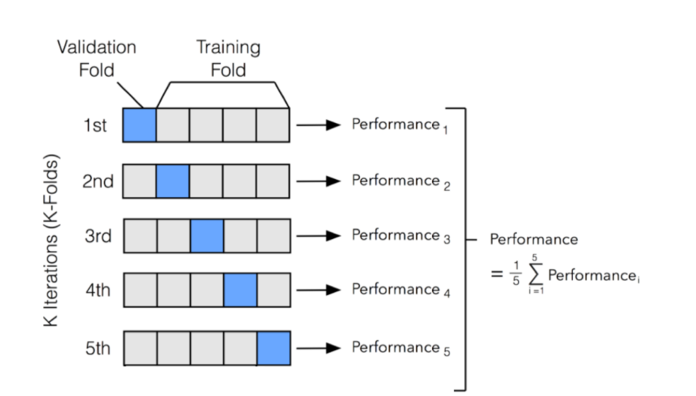

Slide 25
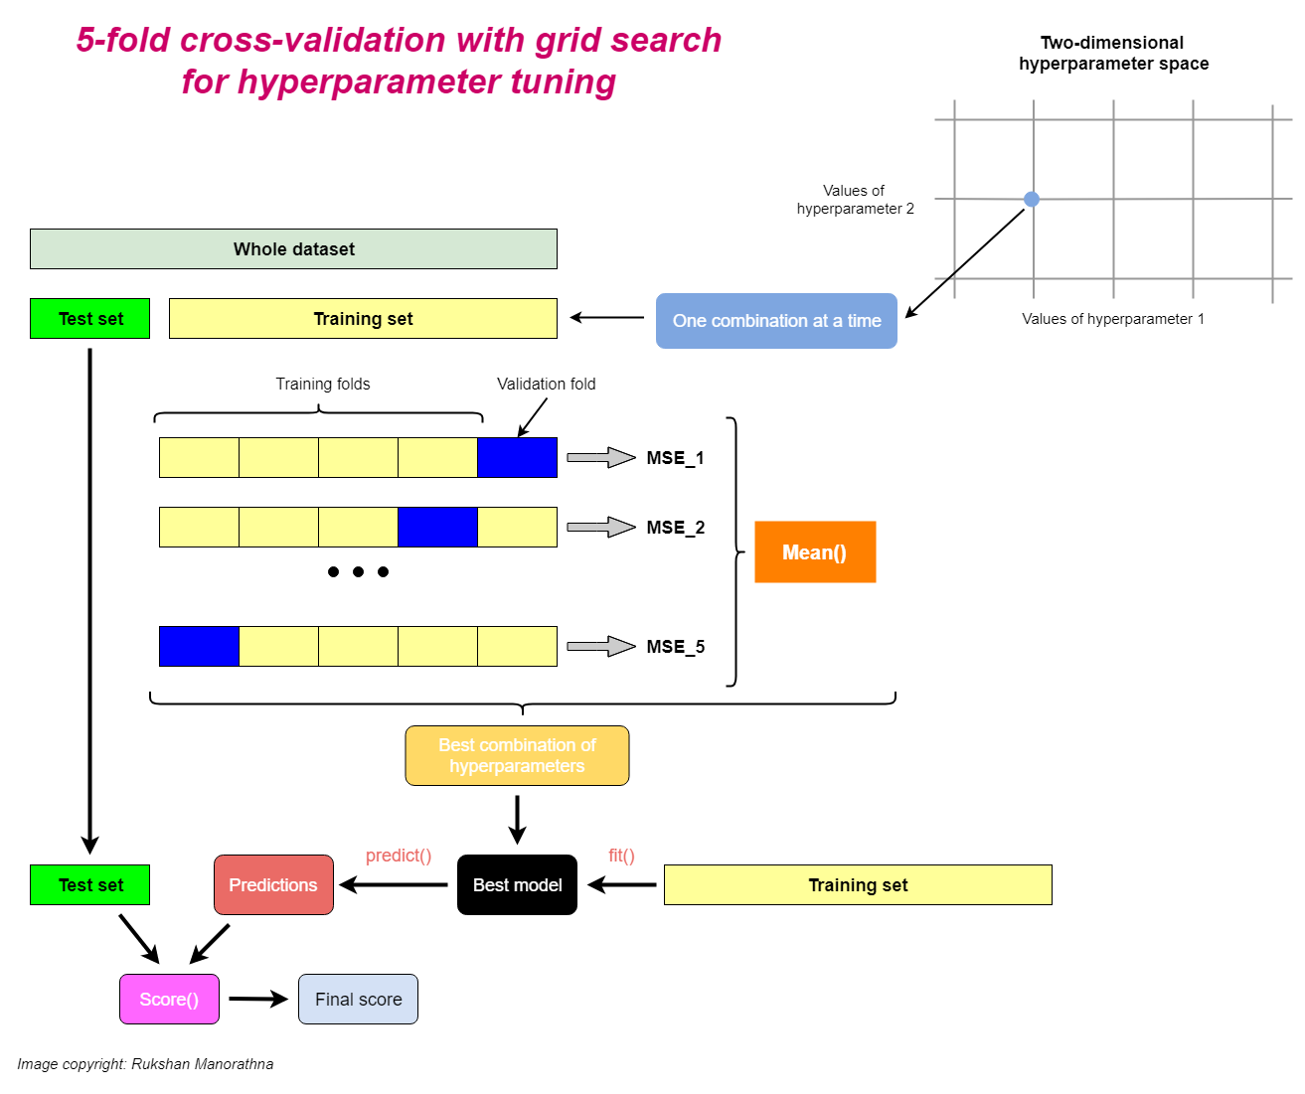

Slide 26
Grid Search CV
Grid Search CV combines these two into one simple call.
Test every HP combination.
Use cross validation to calculate scores.
Identify best model.
In place of one “normal” score we get the cross-validated score, and best HP combo.
Need to specify choices for HP in the grid (or use smart/random chooser).
This will give us an easy way to get the best model, within the range we define.
This may take a long time, so we still need to be kind of selective.

Slide 27
In Practice…
Grid search can be used to easily choose a good set of HP for your model.
Setup a grid of potential choices for HP:
This isn’t generally something we can know ahead of time, need to guess and test.
If we have the data and/or this is important, use explicit test set.
Allow grid search to test and generate the best model.
Use this model for actual predictions.
Concerns:
Time - larger data, more CV rounds lead to better results, but can be slow.
Bad choices for the grid can lead to poor results. (“Smart” grid algorithms can help this).

Slide 28
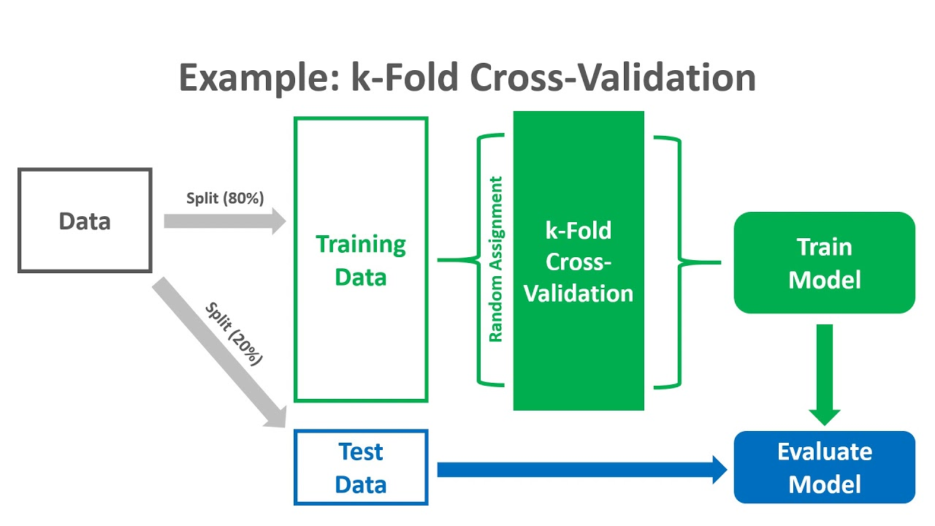
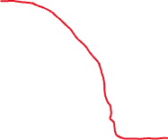
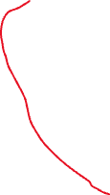
Explicit test set is ‘correct’ way to do things, but we can skip it for less critical things (especially with small data).

