Slide 1
Stuff
Please do the github username survey if you haven’t yet.
Feature selection basics (chapter 4)
I added a review of multicollinearity to it, if you have old version, pull.
Mostly mechanics of different ways to select features.
This part is pretty straightforward, again make sure the general ‘make a pipe’ stuff is OK.
And then… Next time, support vector machines (maybe some this time, if you’re fast).
Dimensionality and visualizing data.
Margins and hinge loss.
Then Natural Language Processing (NLP) – our first really cool topic.
The dimensionality bit is important for understanding here.

Slide 2
Review – Multiclass classification and Image data in Logistic Regression
We saw logistic regression with a couple of twists:
Regularization can be applied to the model internally, and is by default.
The ‘solver’ controls the math behind the scenes, some work better in some scenarios.
Image (or other) data can be used – but must* be made tabular (flat, one record per row).
We can classify into several classes, not just two.
Image data in models (and any unstructured data).
Original data is not usable – 2/3D matrix of pixels.
Need a process to transform image->flat data – this process can vary depending on intent.
Accuracy depends both on model, and quality of this representation.
Once ‘flat’, the process is the same as we’re used to.

Slide 3
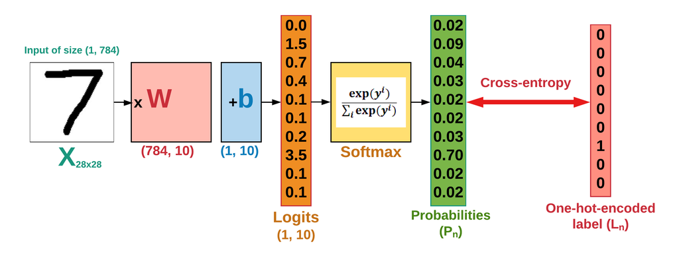




Softmax and Multiple classes
Classifying things into several classes is easy! Depending on model:
Some like trees and bayes can handle 3+ classes by default. (Depends on implementation.)
Can use workaround of multiple models – 1v1 or 1vR.
Main approach – softmax – replace sigmoid with new (activation) function.
Softmax is roughly equivalent to a sigmoid, except.
Takes in logits (from regression) for each output.
Produces probabilities* for each output.

Slide 4
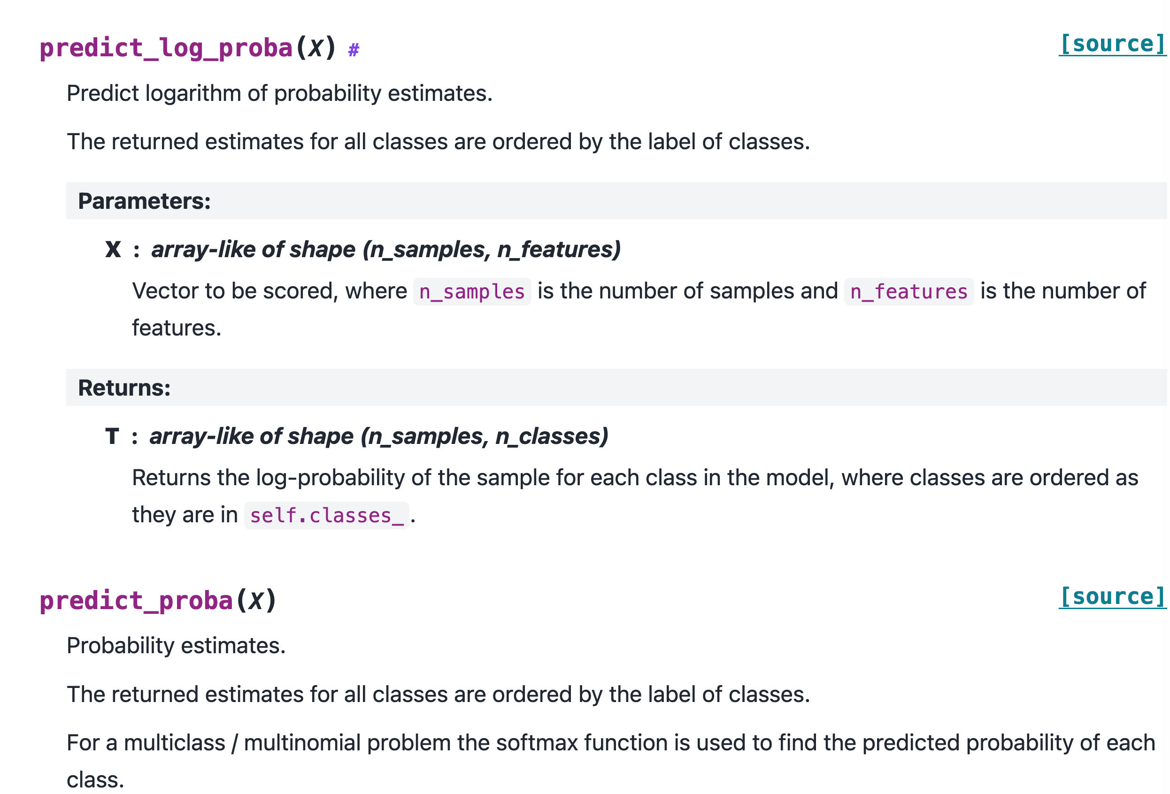
Labels and Softmax and Sklearn and You
In softmax, the way it works is that it:
Receives a tensor of logits, one for each output class.
Creates a tensor of probabilities, one per output class.
In sklearn, they’ve done some simplifying.
Sklearn can provide those individual probabilities if asked.
The main interface allows us to use label encoded data.
In sklearn we don’t need to worry about array of probs.
In sklearn, they handle this translation invisibly.
We can interact with 7 instead of [0,0,0,0,0,0,0,1,0,0].

Slide 5
Feature Selection

Slide 6
Detour – Sparse vs Dense
One thing that is mentioned regularly is a sparse or dense matrix.
Sparse matrices are mostly 0, dense matrices are not.
E.g. one hot encoded data with many classes makes a very sparse matrix.
The difference is in how they are treated (sometimes) in code.
Sparse matrices can be represented differently in storage:
Storage space can be more efficient.
Processing speed can be quicker.
We don’t really need to think about it much, it is a concern with large amounts of data.
E.g. Sklearn data needs to fit in RAM.

Slide 7
Feature Selection
Until now, we haven’t worried too much about feature selection.
Outside of things like L1 regularization built into algorithms.
We’ve seen some pretty wide (high dimension) data, with lots of features.
E.g. images once flattened.
We can select some features to help our models.
We can build this selection into pipelines to make things slick.

Slide 8
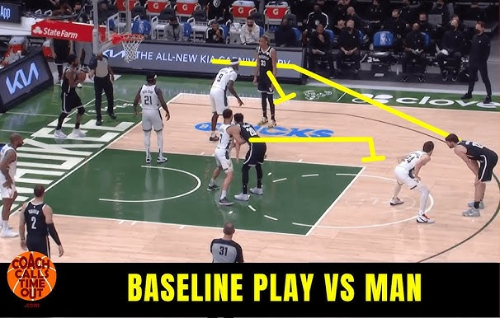
But First, Baselining
One idea that is helpful while tuning models is baselining.
Get a ‘baseline’ level of performance in ‘stock’ model.
Before trying most tuning stuff, but with cleaning.
E.g. Model with all features and default hyperparameters.
If doing tuning outside of a gridsearch, it is more useful.
Grid will just get the best, so if all searching is within there, it is still ‘good’, but doesn’t matter all that much.
E.g. different model types. (This can be in a grid search, but you need to manually make the transformer – not super hard, but somewhat annoying due to different HPs.)

Slide 9
Feature Selection Basics
In general, selecting features won’t improve a model’s overall performance very often.
Feature selection allows us to have simpler models:
Fewer features can make for less data, quicker execution, lower cost, or more transparency.
We want to include the things helpful to an accurate prediction, exclude those not.
The metric for helpful can change:
Basic statistics or inspection – does this value vary enough or is it clearly useless?
Correlation-ish measures.
Model determinations from internal measures, such as tree feature importance.
Performance of the actual model with/without.
All feature selection is basically different methods of calculating and testing this.

Slide 10
It’s Hip to be (R) Square(d).

Slide 11
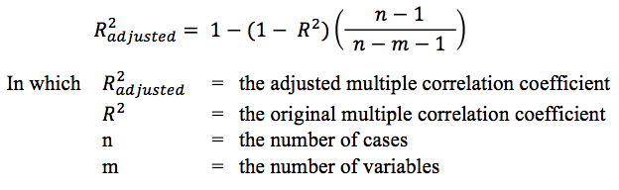
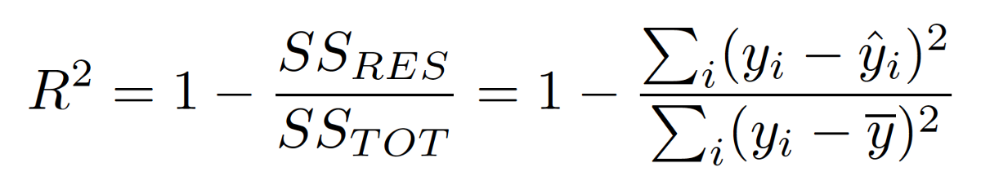
Feature Selection Impacts
Models will internally already have some aspect of weighting feature impacts.
Trees choose to use different features, regression coefficients can shrink (maybe to 0).
Removing a useless feature won’t really make performance jump, since it’s already deemphasized.
Remember R2 – the proportion of variance explained by the model:
R2 of 1 is perfect correlation and perfect predictions, x tells us y. 0 is no correlation.
Added features rarely have absolutely no correlation with the target, so they contribute something.
Could add many bad features to a few good ones to get a higher R2.
Think of multicorrelation examples – we can remove redundant features and r2 is basically unchanged.
Adjusted R2 measures the correlation, adjusted for size of data and # of features.
Similar concept to regularization – there’s a penalty (to overcome) for making the model larger.

Slide 12
The Human Touch (Maybe it’ll Touch You In That Project class…)
The first point of feature selection is human judgement of what matters.
Requires some domain knowledge – what is actually relevant?
This is something much more critical in real life than in learning machine learning.
In examples/exercises, we typically use preformed datasets.
These datasets were made/curated for machine learning, so set up for that.
Even if data is very dirty, it is usually more or less what you need.
The data is already assembled – many/most real life things will need joins.
E.g. there’s probably only relevant-ish stuff in the dataset to begin with, it is curated.
Real life data is more annoying, we need to judge what matters as humans.

Slide 13
With Real Life Data
In a more realistic scenario, you often have lots of data, often spread about.
If your company has a data warehouse, you may have everything.
E.g. if predicting what Amazon customers will buy, you probably have lots of features…
Flitering “what is actually relevant to this prediction” is a human activity you need.
Can’t really score feature importance by adding 100,000 random features effectively.
Your real estate thing is similar, in many ways.
There are lots of features, but depending on what you’re doing, only some matter.
The features you have may be better transformed into new features. (Hint: be aggressive).
You can do feature selection, but you need a starting point smaller than ‘everything’.

Slide 14
Get a Clue!
Suppose you’re in charge of determining who did a crime. Classification model.
Each feature will give some information as to who did it.
Important – security camera footage, fingerprints, dna, ect…
Less Important – people’s journals, alibi witnesses, etc…
Each feature, as long as it is actually relevant gives us some info to help pick the criminal.
E.g. knowing that a waitress saw a suspect an hour after the estimated time of death may give some info, but not all that much. A security camera on the victim’s front door may have lots.
The more we consider, the more complex the decision becomes.
We want to focus on the important features, add others as needed.
The more evidence we have, the higher the ‘ceiling’ is for predictions, but it becomes harder.
Lots of less useful features don’t ‘ruin’ the good info, but make it harder to process.

Slide 15

Ways to select Features

Slide 16
How to do Selection
There are several methods to evaluate how good a feature is, each different.
They may agree, but they may not – it can vary, somewhat unpredictably.
If several methods say a feature is less important, it probably is.
If several methods say a feature is more important, it probably is.
There are a few complications to this:
Relationships, in complex data, might not be so simple – e.g. combo of features to target.
Multicollinearity – multiple features containing the same information. Algorithm can’t weight importance of each feature since the important info could be sourced from multiple features.

Slide 17
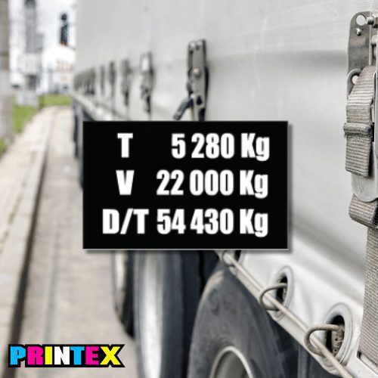
Relative Importance in Multicollinearity
Multicollinearity, or having several features that convey the same information, can mess with feature importance.
Think about predicting MPG for semi-trucks:
Weight may be a factor – tare, gross, other (?)
These are different, but convey similar info – weight.
Bigger trucks likely have both increase, so they mirror e/o.
If a model can ‘get’ weight from 2+ values, which matters?
This doesn’t make the model worse, but tuning features becomes much less clear – which feature matters?

Slide 18
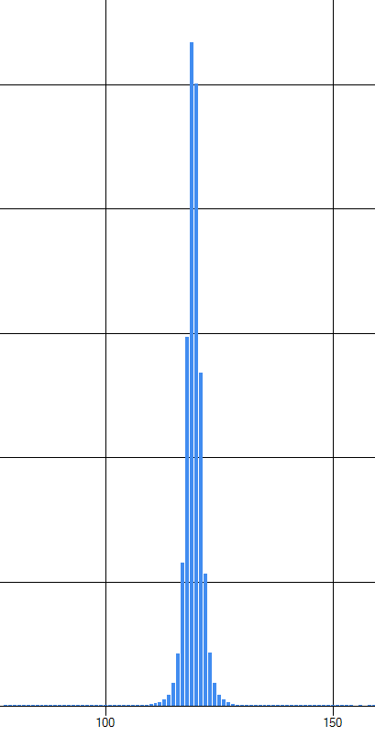
Variance Based Selection
If all of the rows of a feature have the same value, it won’t be helpful in distinguishing.
If the target changes, but this feature doesn’t, it can’t really be helping much.
For example:
Suppose you try to predict US Supreme Court predictions and the ”college type attended” for each judge is a feature. 8/9 attended an Ivy League (Harvard or Yale). Knowing that a justice attended Ivy League won’t help distinguish predictions, since they all did.
This matters much more with small datasets, to reduce dimensionality.
Assuming you have enough data, the low variance feature might matter a bunch, but only in a few scenarios, so keeping it would be better.

Slide 19
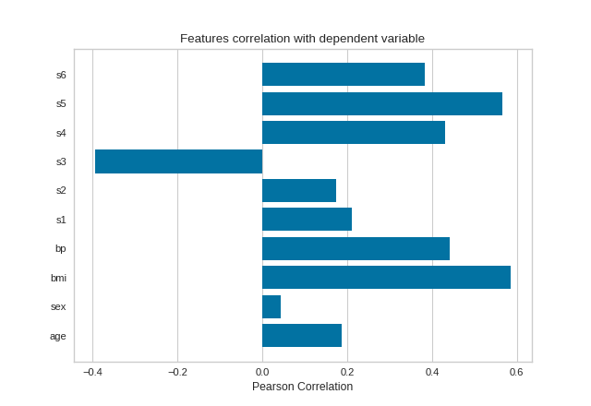
Univariate Selection
Univariate selection looks at the characteristics of one variable (and target) at a time.
Based on correlation or a correlation-y metric – the more a feature is correlated with the target, the more likely it is to be predictive.
The more X tells us about Y, the better the feature is.
Regression:
F_regression (correlation)
Mutual_info_regression (information gain)
Classification:
F_classif (ANOVA)
Chi2 (~correlation)
Mutual_info_classif (information gain)

Slide 20
Univariate Implementation
Select k best: select the best k features based on the metric.
Select percentile: select the best percentage of features based on the metric.
Note – relationships in data don’t have to be one-to-one with target:
I.e. a combination of factors can have a relationship, as a unit, with the target.
The best model is not necessarily the X most correlated features.
For high-dimensional data, the relative importance of any single feature becomes harder to know.
The more complex the relationships, the more complex a model is needed (and more data).

Slide 21
Internal Selection
One type of feature selection we have used is the “built in” selection in models.
Trees and Lasso regression both select out less important features.
Select from Model:
Select from model lets us “borrow” the feature selection of algorithms and apply it as a filter.
E.g. we can use a tree’s feature importance as a step to select features, then pass that dataset to a different model to predict.
Filtered Dataset
Data
Feature Importance Model (Lasso/Tree)
Prediction Model

Slide 22
Recursive Elimination
Recursive elimination does what it says, removes features one at a time.
The entire feature set is modeled.
The least important feature is booted.
Rinse and repeat until the criteria for # of features is reached.
RFECV – Implements a “grid search” with cross validation to choose number of features:
Recursive Feature Elimination with Cross Validation.
Will choose number of features with the best score.
Good for pipelines! Auto-select the best set of features.

Slide 23
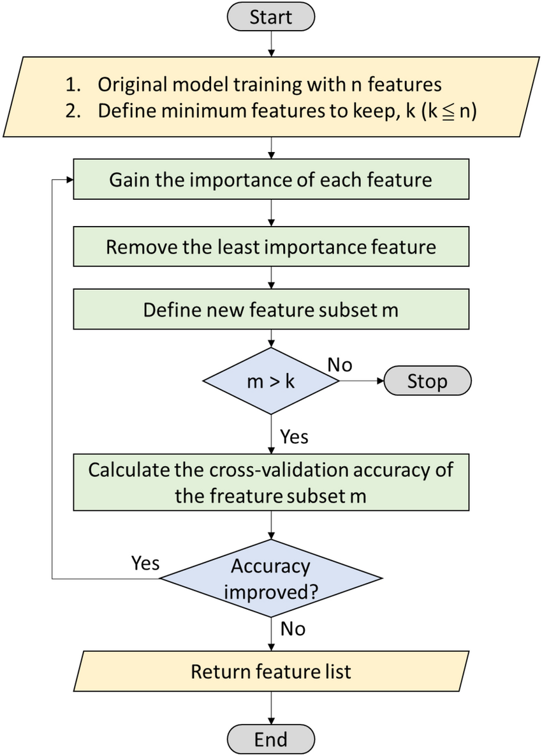

Slide 24
Weirder Stuff
There’s a handful of other ways to select features that are less common.
Don’t memorize this stuff.
Permutation Importance - calculated after a model has been fitted.
Randomly shuffle a single column of the validation data, leaving the target and all other columns in place, and then measure the performance of the model with the new data against the performance of the model with the original data. The drop in model performance measures the importance of the variable you just shuffled.
Target mean performance – a convoluted process someone published in a competition (http://proceedings.mlr.press/v7/miller09/miller09.pdf)

Slide 25

Where we’re going, we don’t need Feature Selection

Slide 26
Do we Select?
As noted, removing features makes the model more ‘efficient’ but doesn’t normally raise the ceiling.
Selecting features makes the most sense when:
There’s some substantial domain knowledge where you know something about importance.
In our scenarios, the features are kind of random values, in reality they’re measurements of actual real stuff.
The process needs to be somewhat understandable or explainable.
The training data is limited, as a too high wide/tall ratio will tend to overfitting. If data is limited, it matters.
Simple is (usually) better for most cases in practice.
Feature selection will make more of an impact with smaller, simpler models and data.
Can unlock better performance on large models by allowing quicker trials.
In many real-life scenarios, bias error might not be the worst. E.g. a bank will default to ‘generalizing’.
Work ‘up’ in complexity – there’s no use getting 2% better from a model that is 20x larger (usually).

Slide 27
So…
Performing feature selection will rarely, if ever, make large accuracy differences.
That requires ensuring a model that fits well.
More features are theoretically better for peak accuracy, as long as they are relevant.
To ‘use’ the info in larger numbers of features we need more complex models.
To constrain overfitting with complex models, we need lots of data.
We’re mostly doing things for learning/experience, so we tend to pursue accuracy.
In reality, many/most scenarios we want the simplest thing that does the job.
The degree of accuracy that matters might not be the maximum, if there’s tradeoffs.

Slide 28
Feature Selection’s Buddies
PCA – extracts portions of the “value” from each feature, composed into new features.
Not feature selection as none of the features actually goes away in the same sense.
Can provide many of the same benefits, or better. E.g. example with pixels.
Bigger/better models – large models, like NNs, learn feature selection given enough data.
Complex scenarios may allow the model to learn this better than is possible with this stuff.
The model can learn the importance of features, and even different representations of them.
In high-dimension things (generative, image rec., NLP, etc…) each feature tends to not have a specific value that someone can evaluate manually – a pixel or part of a sound wave doesn’t have the relationship to a target that “income” or “age” do. A large model with large data is basically able to figure these complex relationships out – we can’t really do it up front.

Slide 29
Feature Construction
We can also create new features out of the original data.
PCA is one example of this we’ll see soon.
Neural networks kind of do this, though not as an explicit step.
In reality, this is pretty common:
A retailer may calculate people in area, or within walking distance, or # of similar stores…
A marketer may construct features to look back at recent advertising.
Infection tracing looking for number of contacts.
What we can need and what we can measure may not always align.
When we are in realistic scenarios, this is another thing needing domain knowledge.

Slide 30
Real Life Feature Construction
In reality, we don’t really have “all” the relevant inputs like we do with examples.
We typically have the data in whatever format it could be collected it.
We likely need to make features from what we collected and use those.
For example:
Spatial (location) – distance from things, time from thing, density of things.
Time series – time since, frequency.
Other – aggregates (sum/avg) instead of raw value, ranking, ratios, etc…
The data we start with might be good for predictions, it might not.
This definitely requires some domain knowledge to do well.

Slide 31
Other Changes
Grouping and “other” groups for categories with many options.
Recategorizing or merging groups – e.g. café, coffee shop, and dinner grouped.
Categorizing some continuous data.
E.g. credit scores are generally used as buckets, not specific numbers.
Truncating values – are there outliers where “high” is good enough.
Combining or splitting columns.
Sometimes feature-info may not be 1-to-1, e.g. address to city, province. Lat/lon to point.
Constructed features like BMI (or advanced sports statistics).
The performance is the ultimate decider – want to provide good predictors of target.

Slide 32
Conclusion
In most real situations, you probably want to do something like:
Make a baseline model with minimal prep & use domain knowledge & metrics to trim the feature set.
Continue trimming to see where/if there’s a dropoff in performance. (e.g. 10f = 90%, 9f = 81%)
Make a model with whatever set of features ‘matter’, evaluate if this is sufficient.
This is for tabular ‘real-life’ data (like ours), with a human-manageable number of features.
But, if you want complex data & maximal performance, then big models keeping most/all is good.
You need a large model capable of learning complex relationships, and enough data to allow it.
These scenarios are often unstructured data, building off of what works is smart.
Shrinking models can also allow for other devices (phones, watches, rpi, etc…) to run things.
For us, we can use metrics, and be reasonable – we don’t have the domain know/constraints.

