Slide 1
Today:
Today – more text processing and NLP.
Chapter 7 in ItMLwP.
Dimension reduction and latent data with tsvd.
Embeddings and word2vec.

Slide 2
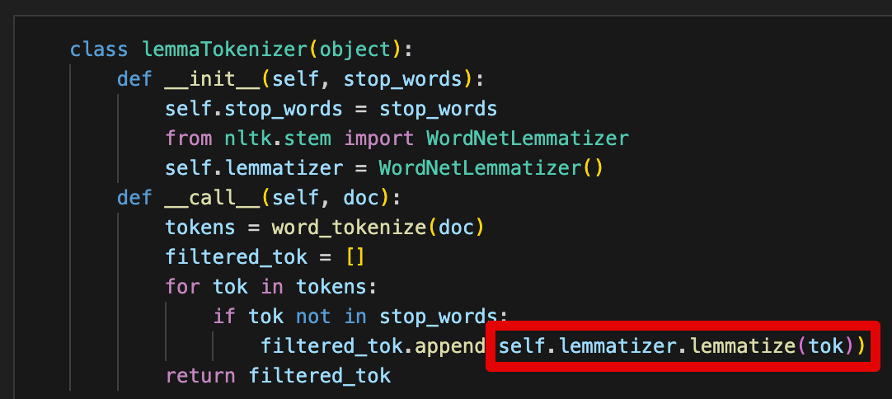
Stems/Lemms and Other languages
Someone asked last time if the stemming/lemmatization would handle infixes in other languages.
I looked into it, my tentative yes is correct.
When doing the cleaning, we rely on premade rules:
The term is checked in a ~dictionary.
If there’s a preferred root, swap it out for that root.
This would rely on someone defining that correctly.
Non-English languages are generally worse in AI, for reasons like this – people build with English in mind.

Slide 3
Quick LLM Note (Just FYI)
If you’re thinking of (or cheating with) some LLMs, they’re a bit different.
The main difference is the setup of the data/targets:
The target is the next token (word).
The features is the text before that.
It just keeps predicting “the next word”.
For us, things are “normal” – target is some external thing, features are text.
Details vary, but that’s the basic concept.

Slide 4
NLP Part 2

Slide 5
Natural Language Processing Review
We can use text as a feature set to do predictive modelling (sentiment/spam/etc).
X is our feature set – the text after its processing.
Y is our target – something external. E.g. positive/negative review, spam/not spam.
We end up with a ‘normal’ array of data, that we can then TTS, predict, etc…
NLP uses some specific terms:
Corpus – all the text that we are using.
Document – one ‘piece’ of text. Normally a sentence or line.
Vocabulary – all the tokens (words/terms) that is in our corpus.
Creating the feature set from the text involves some preparation.
Text is first tokenized – transformed into individual ‘terms’ (words or n-grams).

Slide 6
Processing Text
Last time we saw the basics of using free text as feature data.
Key step is vectorization – transforming the text into a numeric representation.
Saw two methods, count and tf-idf vectorization.
Once we have a “row of values” representing each document, we can use it like any data.
Process aims to extract as much information from the text and represent that in data.
Inherently lossy – we aren’t ever capturing all of the information from the text.
Pretty hard, there’s not really a simple language->number translation for us.
Kind of akin to lat/lon – there is information embedded in it, but not in the raw format.

Slide 7
Vectorization
Turning the text into numbers – vectorization.
We translate the free text into a numerical representation of that text.
Simple vectorization is based on counts of words in that piece of text.
More elaborate vectorization calculates a value based on frequency (tf-idf).
Result is a set of numbers (a vector) that represents the document we started with.
Text-y data preparation tools are also involved:
Removing stop words – get rid of ‘a’, ’the’, ‘it’, etc… as they don’t really change meaning.
Stemming – chopping words down to their root. E.g. Skiing -> ski.
Lemmatization – reducing words down to their root meaning. Chuckling -> laugh.
The goal is to have a vector that “means” the same as the original text.

Slide 8
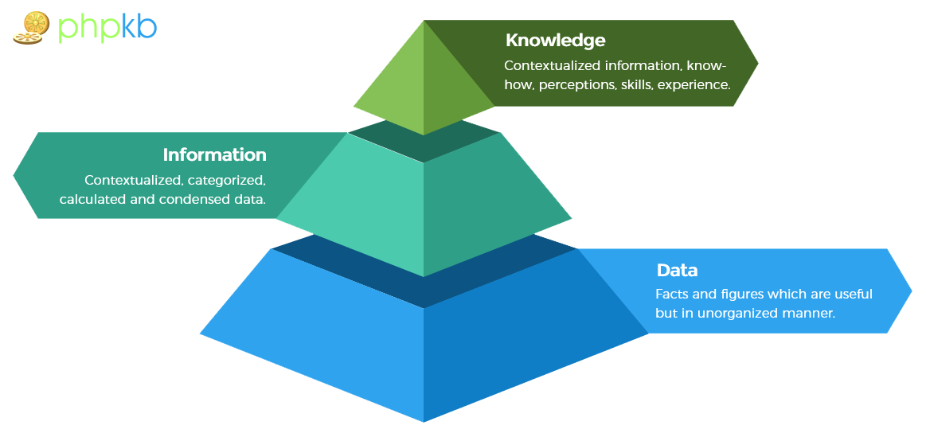
Remember the Dik Pyramid

Slide 9
Represent!
The representation of information from language matters.
Our two methods so far are both count-ish.
“He killed it” vs “it killed him”.
Word count probably doesn’t capture the full meaning of language.
That’s hard.
What we want/need will vary depending on scenario.
There’s no simple way, there’s not even a “flatten” equivalent.
Other methods aim to capture more meaning in a numerical value.
How can we capture more “meaning” in the features we can use?

Slide 10
Dealing With dimensions
Our vectorization processes have a weak spot – vocabulary size.
Each token becomes one column in the feature set.
Can limit with stem/lem./stop words/hard limits, but that loses information.
Smart models can use this size, but we need large volumes of data.
Wide data pushes towards overfitting.
With classification (spam, sentiment, etc…) we likely want to lean towards bias error.
I.e. we want a model to react on general trends, not adapt to specifics – language has specifics.

Slide 11
Too many Words! Dimension Reduction
Feature sets for text can get massive! Probably excessively so:
# of features is often > # of rows -> trends towards overfitting.
Common sense – only subset of words really define meaning.
Processing time can grow to be unreasonable.
Result is sparse – mostly a table of zeros.
Can be hard to fit, especially with limited data.
Some caps can be placed on size during vectorization:
Limit max features, stopwords, lem/stem.
There has to be a better way!

Slide 12
Truncated SVD and LSA
LSA is latent semantic analysis. LSA attempts to:
Extract meaning from large amounts of text, using more advanced frequency calculations.
LSA follows a couple of assumptions:
Meaning of Sentences or Documents is a sum of the meaning of all words occurring in it. Overall, the meaning of a certain word is an average across all the documents it occurs in.
Semantic associations between words are present not explicitly, but only latently in the large sample of language.
Latent Semantic Analysis (LSA) comprises of certain mathematical operation to get insight on a document. This algorithm forms the basis of Topic Modeling. The core idea is to take a matrix of what we have — documents and terms — and decompose it into a separate document-topic matrix and a topic-term matrix.

Slide 13
What’s Going on…
The process is an attempt at dimensional reduction.
Store the same amount of information in a smaller matrix.
Original is unreasonably large and also sparse, can we condense it?
The process does some linear algebra calculations to generate the topics and strengths.
We’ll look at PCA soon, which does a similar thing. (Math isn’t that important now).
PCA has math that is more clear and easy to understand.
We, fortunately, aren’t linear algebra enthusiasts.
We want the key info (var. of target), contained in as few features as possible.
The ‘ideal’ scenario is one feature with an R2 of 1, how close can we get?

Slide 14
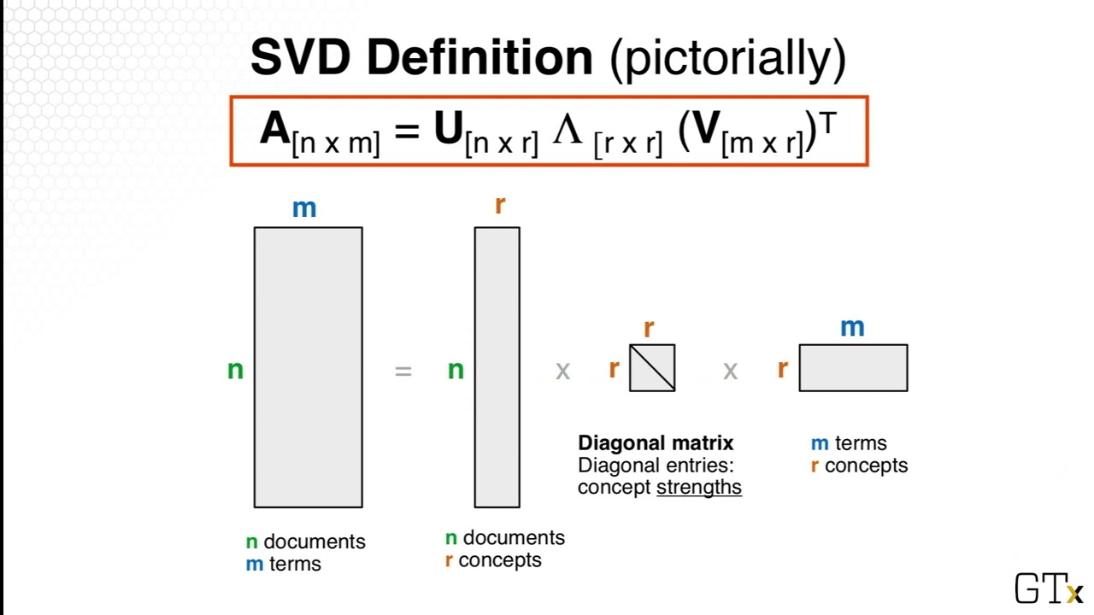
Truncated SVD – Singular Value Decomposition
Truncated SVD is the mathematical mechanics used for LSA.
SVD breaks the original data into 3:
Documents x concepts.
Strength of concepts.
Concepts x terms.
Concepts are represented as patterns of words that usually appear together in documents. For example “leash”, “treat”, and “obey” might usually appear in documents about dog training.

Slide 15
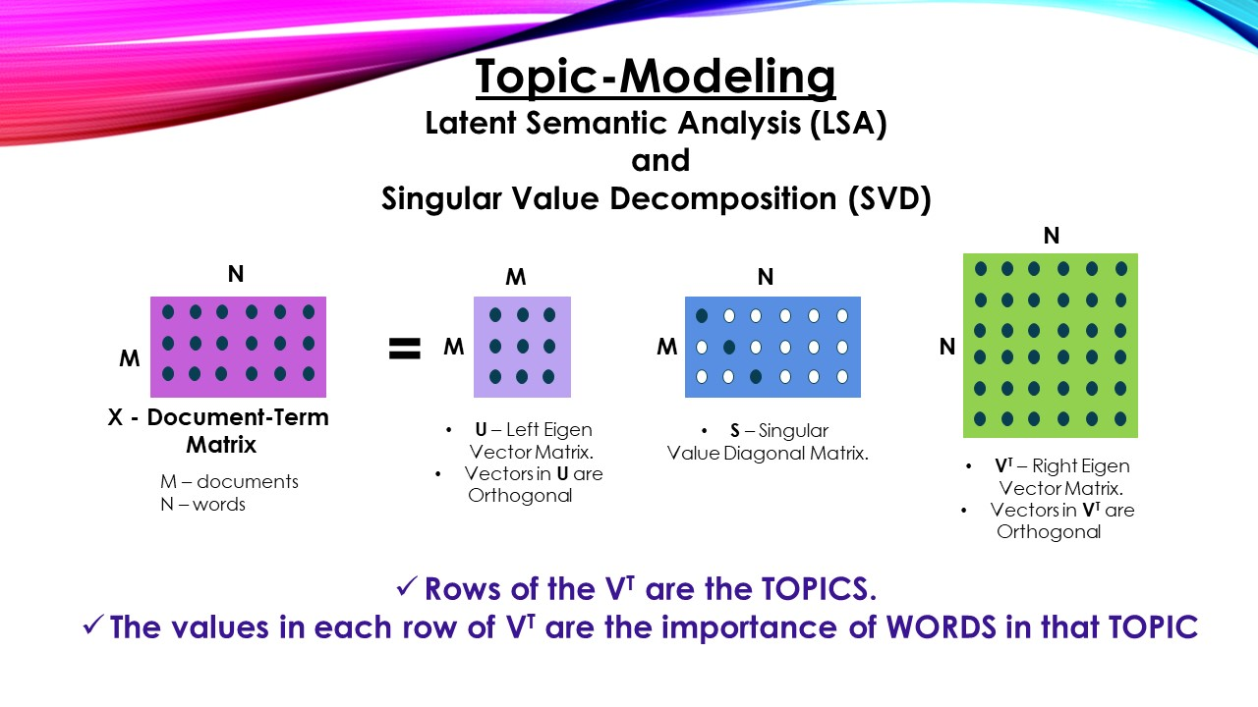

Slide 16
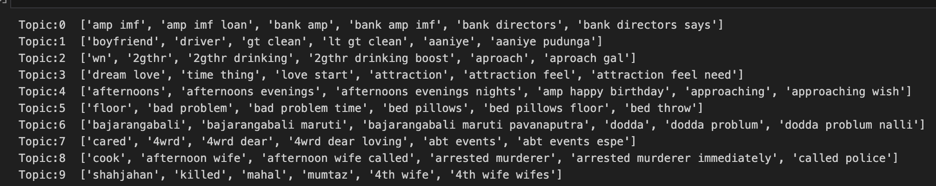
TSVD Results
This is an example of the ‘topics’ detected from tsvd.
The topics are internally similar, as far as the model is concerned.
These topics aren’t defined from outside, the process learns them. (More data impacts this a lot).
The process has no understanding of meaning here, it’s just math.
1 is bank-y things, 3 is love, 8 is a future Netflix documentary. More data, better results.
For meaning predictions – knowing the topic is likely better than the exact token.
Inconsistency in meaning will require more data or worsen results. E.g. bad can be bad or good.

Slide 17
Truncated SVD - Results
SVD aims to capture the maximum meaning with the minimum amount of data.
Each topic is assembled from commonly repeating tokens.
Each document (record) is scored on topics instead of individual tokens.
Assuming the topics are ‘better’ than the tokens at capturing meaning, this is better.
Only the strongest concepts are kept.
Similar to how PCA reconstructs features into more meaningful components.
Feature set can be massively reduced. (Less data, less overfit, etc…)
We don’t know a good number of components going in – we need to tune it.
Downside - Can’t reliably separate different meanings of one word.

Slide 18
Note - Unsupervised Data Preparation
This is an example of data preparation using some unsupervised learning.
The topics are something the tsvd process discovers on its own.
Patterns in the data, not abstract human concepts.
This kind of approach isn’t uncommon:
Data is messy initially.
Use some technique to transform original data.
Predict based on that.

Slide 19
TSVD Feature Set
Out the other end, we get documents scored on each topic.

Slide 20
Slight Detour – Remember R2?
One of the key metrics we use in regression is the coefficient of determination – R2.
R2 tells us the proportion of variance in the target that is explained by our model.
i.e. an R2 of .8 for predicting lifespan means that our model accounts for 80% of the value of the target, while stuff not captured by our model is the other 20%.
When we do dimensional reduction, we can think of it like R2. (Conceptually, not literally).
Our original M features (as a whole) capture K% of the meaning of the document.
After reduction, we have <M features, but hopefully capture ~K of the meaning.
Each of our features captures more useful data, while we discard the non-useful parts.
Kind of (even more conceptually) like multicollinearity – capture meaning in fewer features.

Slide 21
Numbers from Words
Every tool aims to generate some numeric representation of the text – needed for model.
Count vectorization does it with simple arithmetic.
TF-IDF does it with some algebra.
Truncated SVD does it with some linear algebra.
Other tools do it with predictive models.
Generally, we call the result of the models' embeddings (others do too, but term is less common):
This embedding space is multi-dimensional – each term is represented by K numbers.
The larger K gets, the more accurate our representation can be, given we have the data.

Slide 22
Embedding Generating Tools
LSA aims to better extract meaning from text.
Text is transformed into topics.
Scores on those topics, not specific tokens, are used as features.
LSA is still count based, just more sophisticated.
What if we need to capture deeper meaning?
Smarter models with access to more data.
Generative text where more than just meaning matters.

Slide 23
“meaning” of Text
When used for prediction, the meaning of the vector determines model quality.
We need to generate a vector that accurately captures the underlying meaning in text.
In larger scenarios this is called creating embeddings.
Take in some free text.
Evaluate the meaning of that text, using some complex model.
Return a set of values that ‘capture the meaning’ in n-dimensional space.
“Real” models can have an embedding space that is 1000s or more dimensions.
The ‘meaning’ of a word is its position in 1000-dimensional space.
The distance between words shows their similarity in meaning.

Slide 24
Dimensionality and Embeddings
The meaning captured with real embedding processes are more sophisticated.
Use massive amounts of text to learn meaning from seeing tokens over and over.
The larger and more complex the embedding space, the higher the celling.
The amount of data needed to generate it also increases.
For smarter NLP-ish models, we want to represent the meaning of docs as accurately as possible.
Counting occurrences of terms captures some meaning, but it is rudimentary.
We can use other processing tools to extract meaning from the text, and use the values on those “meaning” metrics as our feature set.
Note: this isn’t dealing with generating text, that requires models that capture sequence.

Slide 25
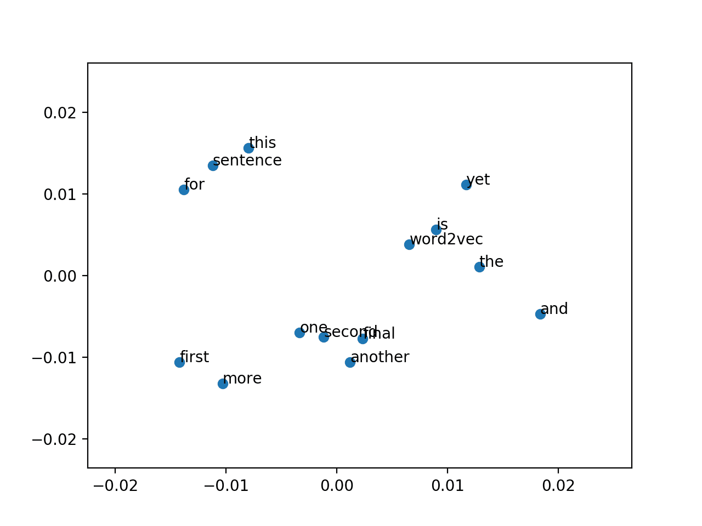
This, but in 5000 Dimensions

Slide 26
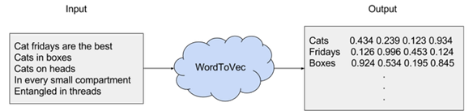
Embeddings
Each word is defined by a 100/200/2000/big number dimension vector of values.
Those dimensions are learned when the model is trained.
Each word is “placed” in that N-dim space, and it “sits” in an area of similar words.
Large embeddings basically plot tokens in large D, the distance to other tokens is the similarity.
E.g. Man, dude, guy, brochacho, will all have similar values in nearly all dimensions.
The ones where they differ will (very roughly) measure things like formality. (This is rough, not pre-def.)

Slide 27
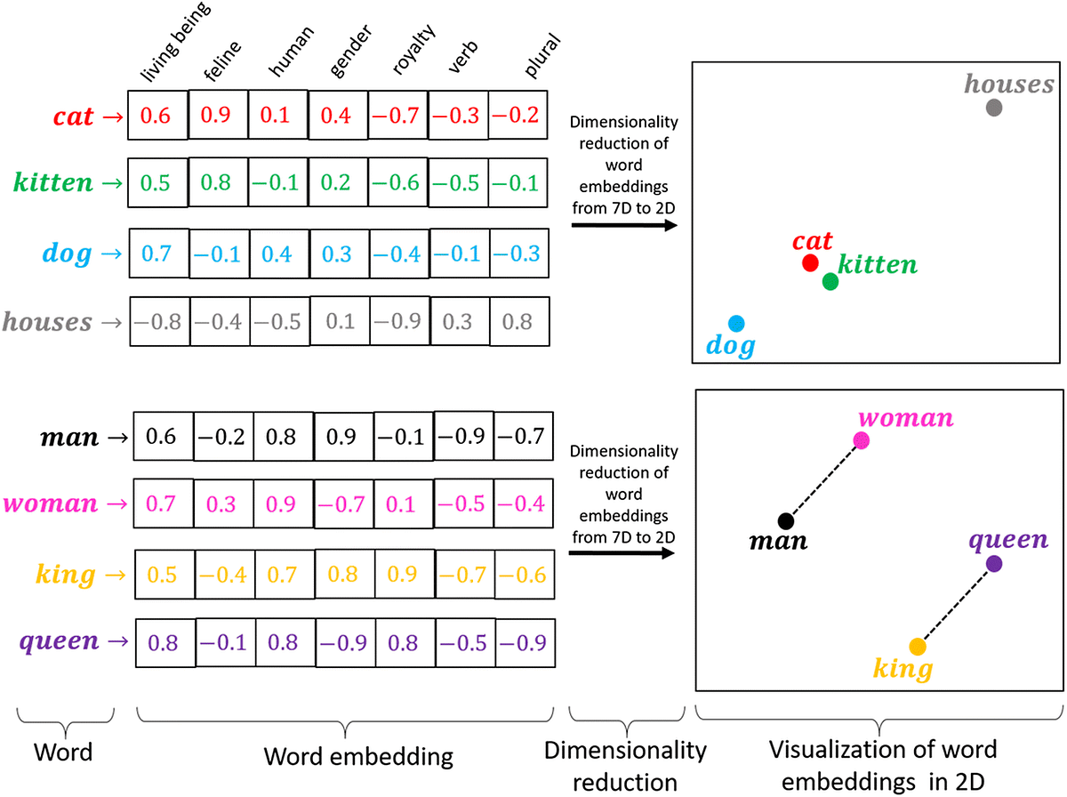
Embeddings Visualized
Each token is represented in K dimensions.
Larger k, more complex representation.
Data needs scale rapidly.
Those dimensions aren’t predefined as they are here, that’s what the embedding system learns.
They aren’t human dims, they’re machine dims.
The accuracy of this embedding determines how well the model handles the meaning of each word.
LLMs are in the thousands.

Slide 28
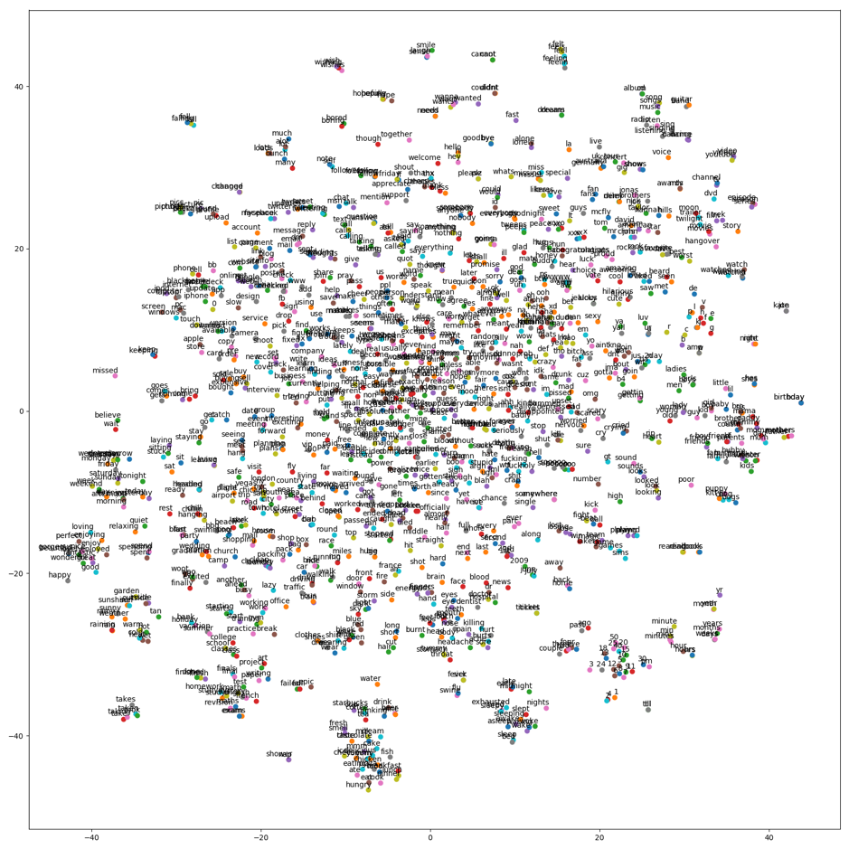
Visualizations map from M-dim down to 2D to visualize the embedding space.

Slide 29
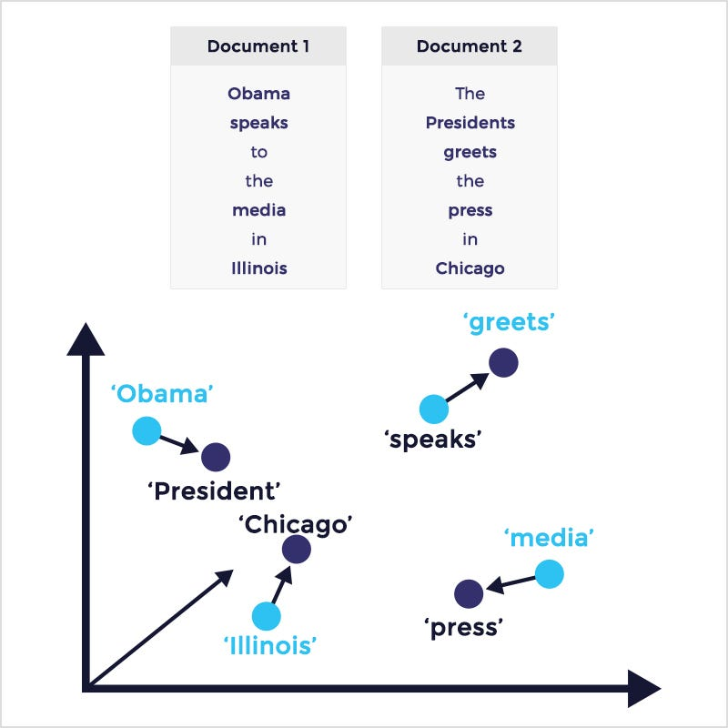
Similarity
Closeness in N dimensions means that vectors are similar.
We can use this to evaluate the similarity of text.
Individual words or pieces of text.
Two measures of similarity:
Lexical – the words are the same.
Semantic – the meaning is the same. Even if words aren’t.
Assuming our embeddings capture meaning, this can work well.
I used something like this to filter cheaters in a 2nd year class.

Slide 30
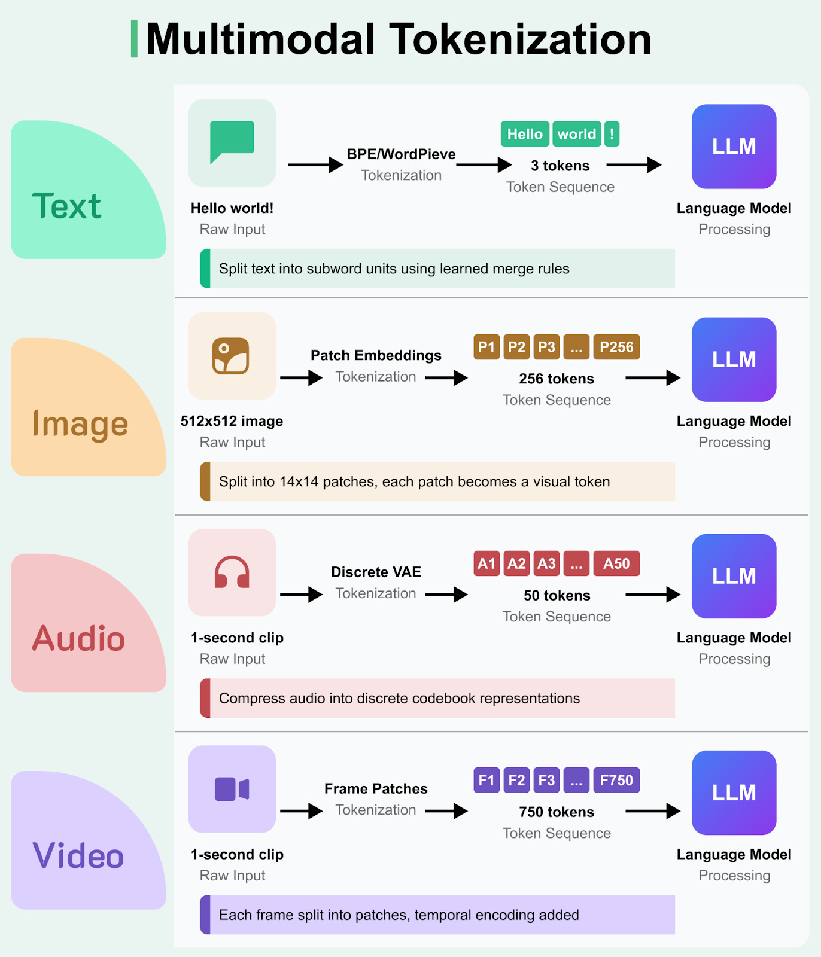
Detour – MultiModal Models
Many of the generative models are multi-modal, i.e. they deal with different types of content like text, images, video, etc…
This works by generating embeddings for each type of media, to a shared space.
E.g. a picture labeled “horse.jpg” tells the model that a horse is X in text and Y in image.
When someone asks for a horse, it “looks up” the image representations and gens…

Slide 31
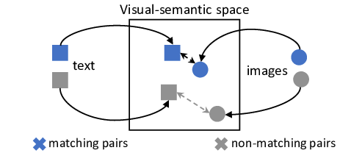
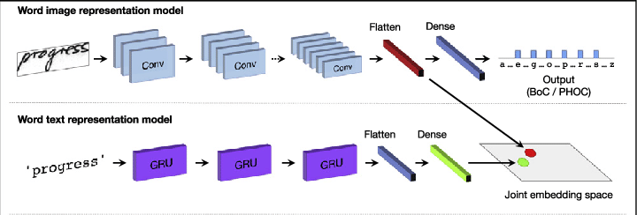
Detour – MultiModal Models
Many generative models are multi-modal, i.e. they deal with different content like text, images, video…
This works by generating embeddings for each type of media, to a shared space.
E.g. a picture labeled “horse.jpg” tells the model that a horse is X in text and Y in image.
Both sets of embeddings ‘end up’ close to each other.
When someone asks for a horse, it “looks up” the ‘horse’ embedding, then finds image embedding that are close in M-dim space, meaning they are similar.

Slide 32
Word2Vec and Alternate encodings
There are lots of other NLP libraries out there that take different approaches to dealing with text.
One library we can use is Word2Vec, originally developed by Google.
Word2Vec transforms words into vector representations using a neural network.
Embbeddign dimension is the
Word2Vec looks at words and their surroundings in sentences (documents) to generate the encoding.
Each word gets a vector of values that encodes it, in M-dimensions.

Slide 33
Embedding Systems
Tools that create embeddings such as word2vec are critical in NLP models.
Models only use and predict numbers, no matter the complexity.
The embedding is what defines the text -> numbers relationship.
The better the embedding is (the closer its representations matches the ‘real’ meaning), the more accurate (with respect to actual use, not model statistics) the results will be.
Real tools use massive text sets to learn word meaning / embedding space.
Larger dimensionality can yield better results, but requires more data/time.
Key – the model learns the dimensions to use, they aren’t defined going in.
E.g. there’s no “plural” axis, or “masculine” axis – the model learns the dimensions needed and they don’t need to correspond to the metrics that we’d use to “measure” a word.

Slide 34
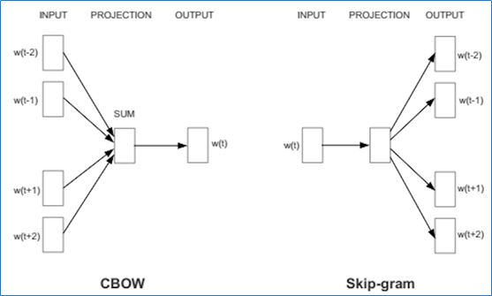
Word2Vec - SkipGram and CBOW

Slide 36
Differences
Skip Gram
Often better with low frequency words and maintains sequence information.
Can be computationally slow and perform worse with non-diverse datasets.
Better for semantic relationships (meaning) and text generation.
CBOW
Faster and often better where words are frequent and order is less important.
Often worse with low-frequency words and loses order.
Common in classification and recommendations – ‘vibes’ over details.
How well the embedding matches the text meaning and use will determine performance.

Slide 37
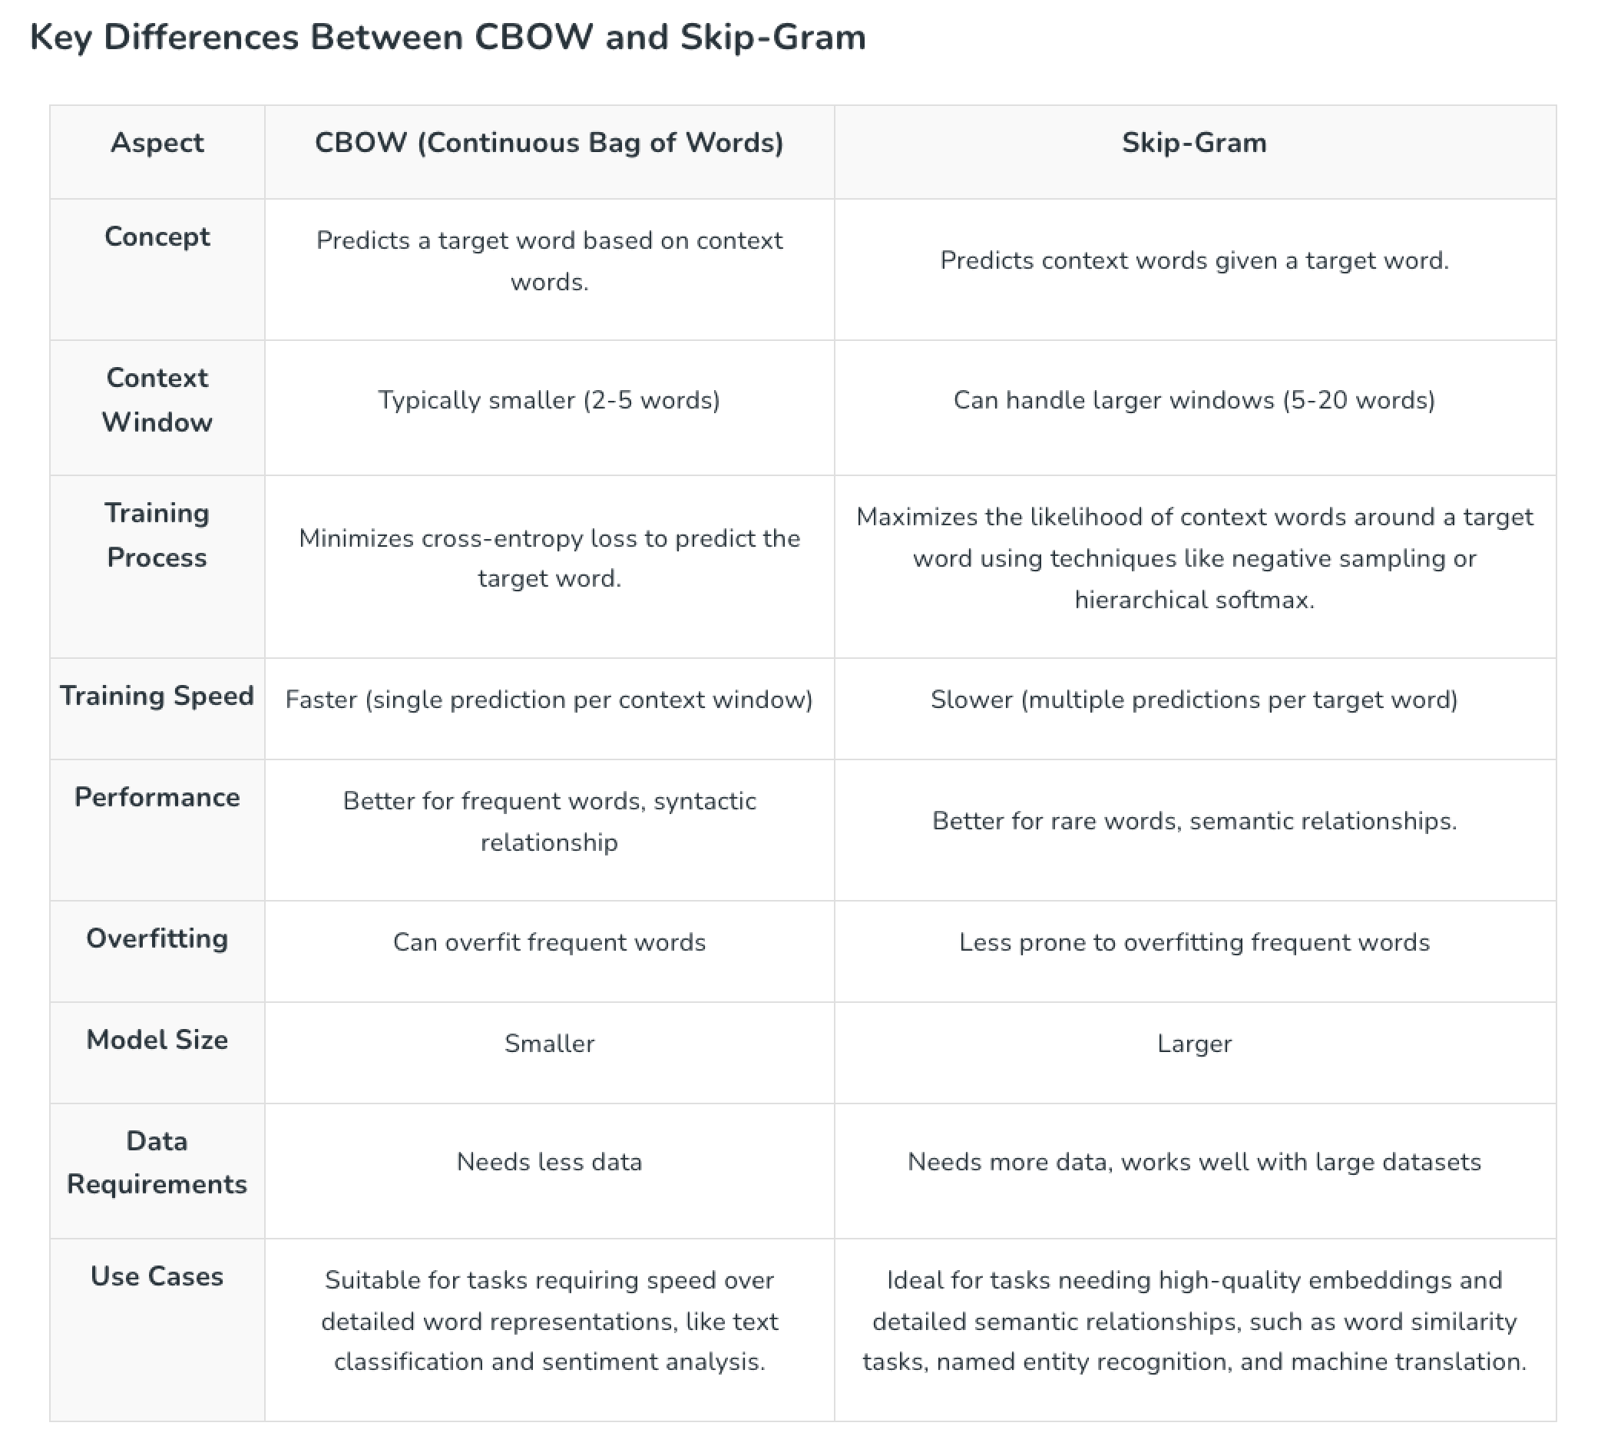

Slide 38
Big Note For us right now
We can/will use embeddings, but we must collapse them to 1 dimension.
Each feature needs 1 value, not 200 values.
This is a simplification for our simple models that must have 1D data.
In neural network models we don’t do this, we can keep 2D data.
Feature x embedding dimensions.
The process doesn’t really change all that much, the we can just use the embedding as is.
This loses the ‘magic’ of fancy embedding, so we can expect much better results with this approach only if we use a bigger model to take advantage of them.
I.e. when flattening all this data to a single value, we shouldn’t expect things to be great.

Slide 39
Using embeddings
The embeddings basically transform each token into a M-dimension vector value.
The closeness in this space determines the similarity of tokens.
E.g. “Guy” and “dude” are probably pretty close in most dimensions.
These models are trained, their target is embeddings and we provide text.
This benefits from very, very, large amounts of data.
E.g. can a model disambiguate all the meanings of “hit”, “cool”, etc…
We can use embedding spaces defined by others or make our own.
If we have specialized language, our own might be better, otherwise likely not.

Slide 40
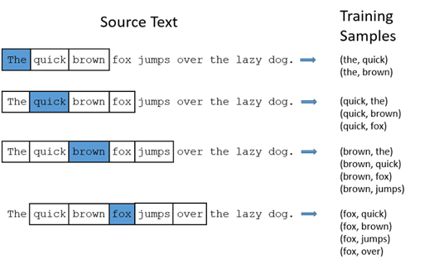
Temporal Awareness
Text isn’t just a bag-o-words, order matters.
”Dumps like a truck” and “likes dump trucks” are verry different.
NLP can benefit from learning from order.
In NN, we’ll look at order more explicitly.
The order will (hopefully) help capture meaning from text better.
LLM and similar models capture information on sequence as part of their process.

Slide 41
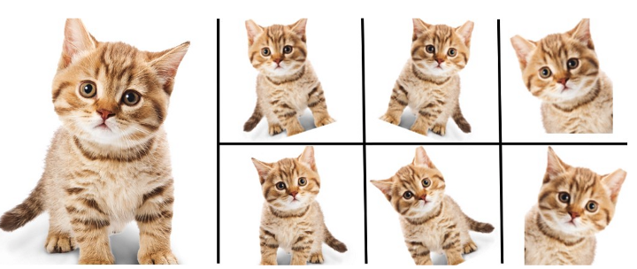
Be More Aware…
“He killed it” vs
“It killed him”
With images, we flattened the data and that looses spatial awareness.
The relationship of pixels that are close to each other is important.
A face is the same in the top left or bottom right, we don’t capture that in our features.
With text, we transform the data into a ~count of words, this looses temporal awareness.
The relationship of tokens to things before/after them matters.
Where words are in text matters and can change meaning, our features don’t capture that.
Each of these is an example of how classical models don’t fit unstructured data well.
One of the things we need to make accurate predictions isn’t capturable by our methods.
We can get some information from text into our model, but not (near?) all.
There’s model structures that specialize in capturing different types of relationships.

Slide 42
Using Embeddings
For us, for now, we’ll collapse the embedding values down.
Later, with neural networks, we’ll look at how we can use them sans collapse.
Our models can only handle a 2D grid of data.
Overall, any representation could work.
In our examples, we’ll collapse multi-D embeddings down to 1 D.
We could keep the multiple dimensions, and have a 3D dataset (later).
We could do any other flattening – we’d have to test to see what works well.

Slide 43
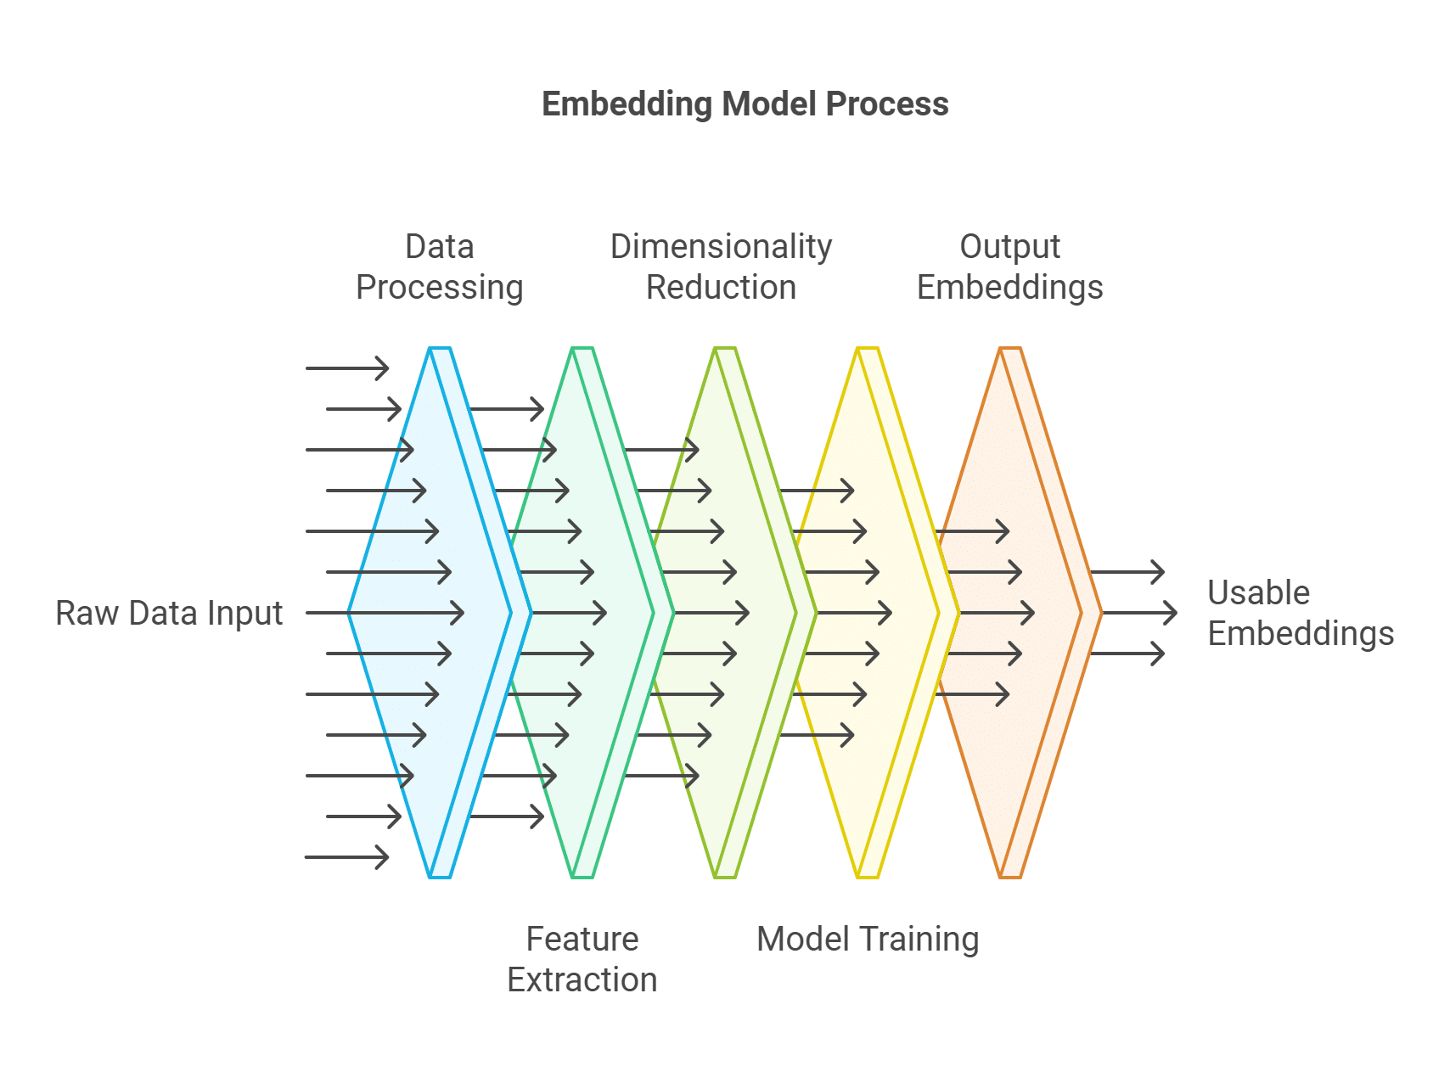
Embedding Results
No matter the process, we end up with (hopefully) usable features to feed a model.
If these features capture good meaning varies.
Different tasks need different meaning.
Elaborate systems can capture ‘deeper’ meaning.
Current sota uses embeddings of several thousand dimensions.
Byte-pair tokenization (splits ing/er/non…)
Massive data needs to train embeddings.

Slide 44
NLP in Practice
NLP is an area that is very quickly developing.
More data makes a big difference!
Language has subtleties, massive datasets allow those subtleties to become patterns.
Models may have kind of stalled, where is there more human text to use to train?
Preprocessing choices can make massive differences:
Stemming, lemmatization, stop words, and n-gram size all vary widely depending on context.
The embedding space quality matters as much or more than the predictor.
Like images, we must represent text as numbers – how well we do this is critical.
This is a source of irreducible error for the predictive model.
E.g. the word “lit” has a different lemma on Twitter, in a college English dept, or for wildfires.

Slide 45
More advanced NLP
Many NLP tools are used in concert with neural networks.
We’ll revisit some later on towards the end.
NNs are well suited to the challenge of extracting patterns from large datasets.
Complex relationships, huge data, large models.
Recurrent neural networks and transformers (March) are model types that are good at NLP.
Good at capturing sequence of tokens – important for actual language.
These tools enable text generation – predict the next word, and generate it.
I.e. what value (in N-dim) should the next word have? Choose a word that is embedded close to that ‘correct’ word.
Precursor to the types of models that are used for modern text generation, transformers.

Slide 46
NLP Conclusion, Part 2
Text is a very complex thing – we can express the same thing in many ways, and different things in similar ways.
Performance of our models is very context dependent:
Different parts of text matter depending on the goal (e.g. generation vs classification).
There are several moving parts – cleaning, processing, embedding, model….
In general:
For classification/regression – simplify the problem as much as is reasonable/works.
Meaning matters, text detail doesn’t. We want to limit variance errors.
For generation/advanced stuff – complex model, embedding, large data.
The relationships are complex, so we need a large model to be able to capture it.
Data needs can explode – need to be able to disambiguate all uses of each token.

