Slide 1
Housekeeping
Today (pull for updates).
PyTorch data processing.
Computation graph basics.
Imbalanced data in a neural network.
Depending on time, theory of convolutional models (image models).
Next week – tuning models and monitoring training.
*The mechanics are mostly in chapter 5 and 6, you want to read those first and after.

Slide 2
Thus Far in Neural Networking…
Self check – you get a dataset, can you predict it?
Any of the samples – MINST, flowers, CIFAR, etc…
You all generally seem to be ok with things.
PyTorch has lots of specific details (which is annoying), is that manageable?
Do the larger concepts (model, train loop, gd, etc…) mostly make sense?
The code is more variable, is that manageable?
Is this doable, slow and boring, or too fast?

Slide 3
Memorize Stuff, Or Don’t
The PyTorch content has a pretty large amount of “required stuff”.
Training loops, gradient calculations, dataset structure, etc…
Don’t focus on memorizing each bit, it is hard and not that useful.
Focus on the concepts, we can look up the details.
What are our data and labels?
What is the model structure?
What do we need/want to do to train it?
Zero gradients, get loss, backwards propagate, step optimizer, repeat.

Slide 4
Fun Project Idea!
For the real estate thing, you have image URLs.
Grab the images, create a dataset to process and prepare them, and use them as some features to make a model.
This will require a bit of thinking to plan a good way and order to do it.
We’ll cover the image specific bits by next time.
This isn’t all that hard, but it is not trivial – there will be odd issues to resolve.
I’d also try separate features for year and season, as well as something for “momentum”, interest rates/lending costs, relative status in hood (cheapest house on best street), distance from stuff, etc….
You probably don’t have a great set of predictors by default, you likely need to build.

Slide 5
PyTorch Data

Slide 6
Bonus – Gradient Tracking
One (possibly annoying) thing about pytorch is that we must manage if gradients are tracked.
If training, the model needs to calculate gradients to learn.
If evaluating the model doesn’t, we just need predictions.
In code, we normally have two things to do to separate train/not train:
Use set_grad_enabled or no_grad to manage if gradient tracking is on.
Set the model to train or eval mode to tell layers like dropouts if they should work.
This is mostly for context – you should understand it to some degree, but the deeper knowledge of this stuff is for more complex work (i.e. something other than stock layers).
I think everything defaults to “on”, and will work by default, but don’t quote me.

Slide 7
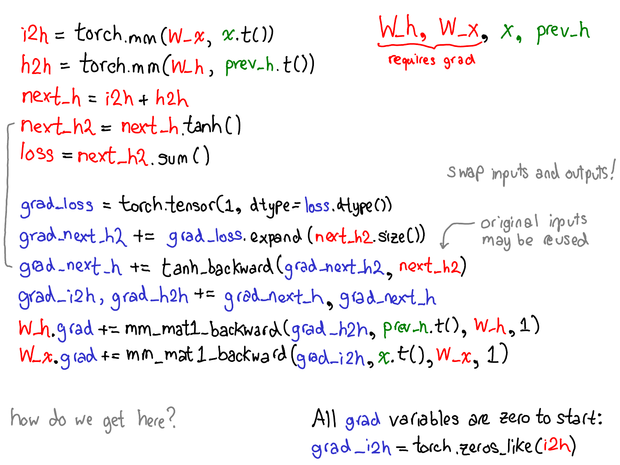
AutoGrad
Autograd is part of PyTorch that, well, automatically calculates gradients.
This saves work from us, we don’t need to do calculus.
Recall in the scratch example, we needed to provide pre-differentiated functions and do gradient calculations.
Each calculation had an opposite operation.
E.g. diff loss functions.
In this pic, the red is what needs to be done.
The blue is the set of calculations in the backwards pass that are the opposite of the initial steps.

Slide 8
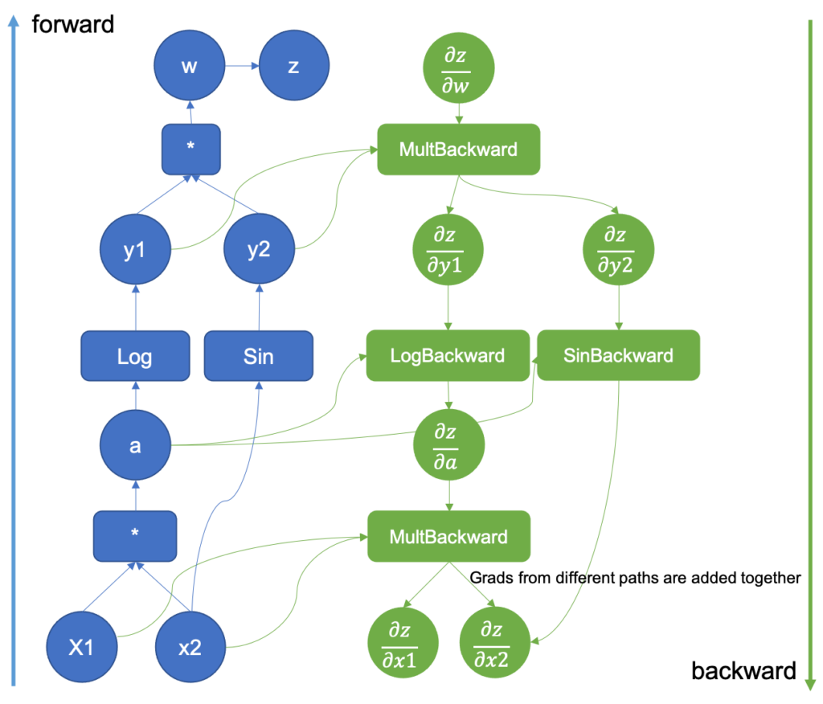
Graph
Internally, PyTorch builds a graph of the executions and tensors in the model.
As it goes forward, inverse opps are added.
PyTorch does this dynamically (tf doesn’t).
This is one of PyTorch’s big things.
Allows for changes to model structure.
More flexible and easier to debug.
Below our level of focus.

Slide 9
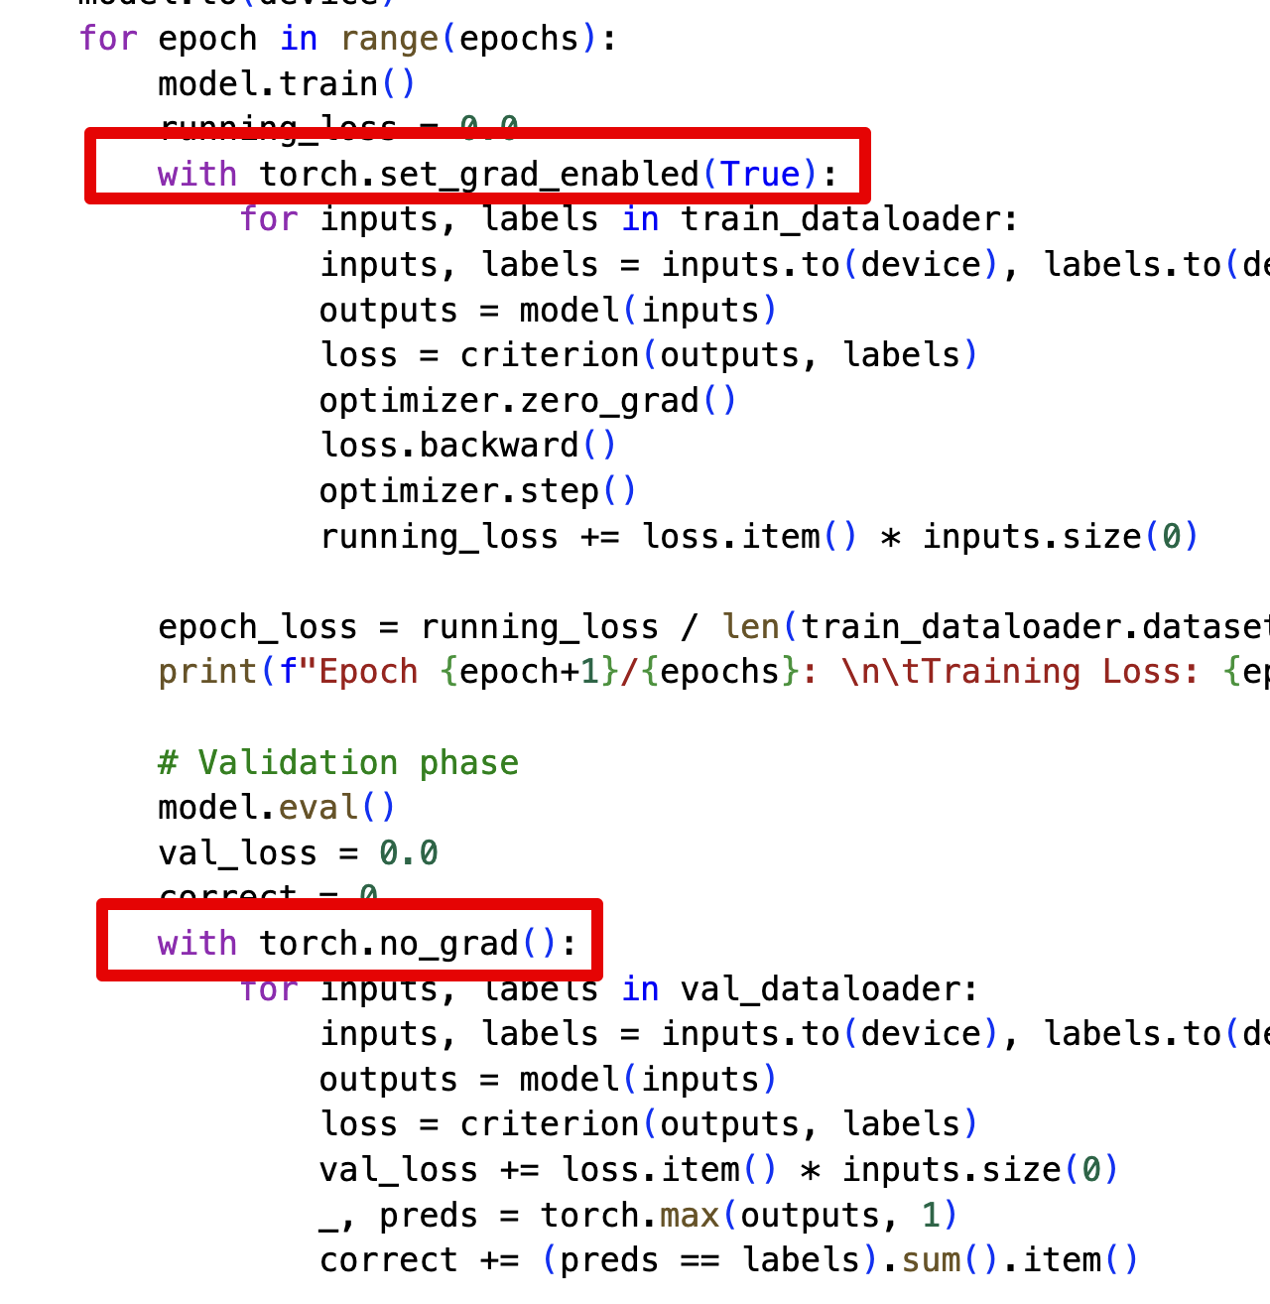
Doing it with Grads
We can use these commands to control gradient tracking.
The set_grad_enabled can be used with False as well, that’s the same as the no_grad call.
Not calculating gradients is faster for inference.
Also inference mode which is even less “learny”.
Can also be used to fine tune.
Control which weights can be updated.
Transfer one model to different data.

Slide 10
Graph Building
This graph is generated at run time.
This means things can be changed in code.
Sizes and shapes can be changed*.
For specialized models, this allows flexibility.
NLP – length of a document.
CNN – image size.
Some other condition…
The steps that are constructed are navigated in reverse automatically.

Slide 11
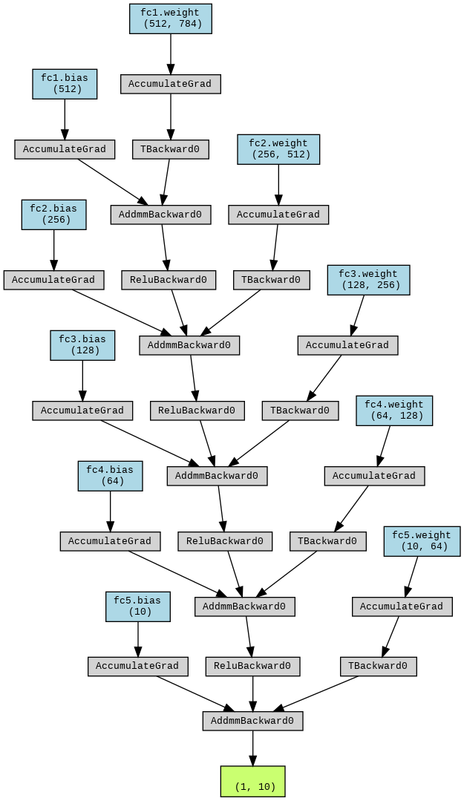

Slide 12
Heads up!
In PyTorch, we almost always have several ways to do things:
Write ’raw’ code to do math on tensors directly.
Use simplified defaults like the “sequential” model.
Create custom classes to implement parts of the code.
Older ways to do things.
These are generally interchangeable.
There’s not one specific way to do stuff, you’ll see examples that all differ.
Flexibility is useful, but it makes it harder when starting.

Slide 13
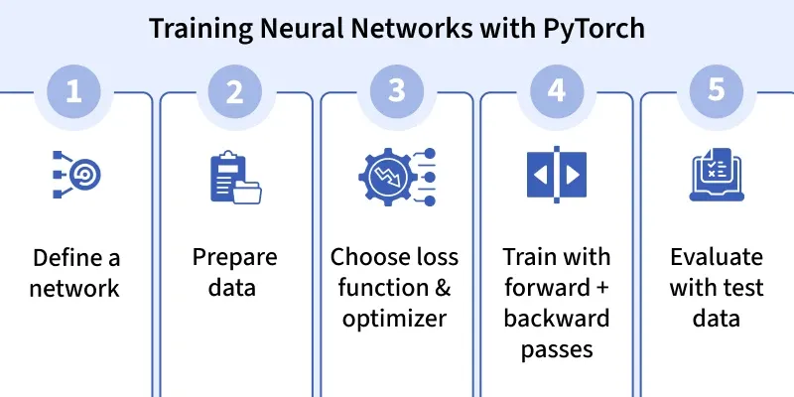
Prepare some Data!

Slide 14
Data in Neural Networks
We can feed our pytorch models data in the same way as sklearn models.
Targets and features are the exact same as before.
However…
Neural networks are mainly targeted at unstructured data, while sklearn at tabular.
We often deal with large amounts of data, maybe more than we can fit in memory.
We usually have batches, or subsets of the data that we use one at a time.
Preparation steps can be ‘moved around’ for performance reasons.
Managing the data in a NN model can involve much more work than we are used to.

Slide 15
Datasets for Neural Networks
Before we feed data into our neural network we construct some helpers:
Datasets – ‘holds’ the actual data and labels.
Dataloaders – manages the data loading process, doing things like batches.
Instead of handling a raw dataframe, we use our data to create these objects.
The ‘holding’ bit can be a little variable:
The dataset can hold the data in memory, like we are used to.
It doesn’t need to, and is often impossible when we have more data than memory.
The dataset is just responsible for providing data when asked.
That data may be saved on disk, and loaded bit by bit.

Slide 16
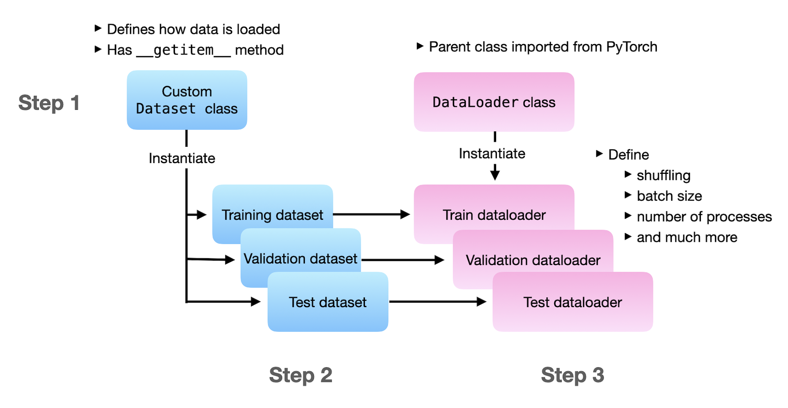
Data Thingys
Datasets must provide:
Length and get item.
Do transformation.
Make it a tensor.
Dataloaders manage:
Packaging items into batches.
Datasets are often custom.
Loaders can be, but less required.
Each data item is separate, they aren’t remixed like in CV.

Slide 17
Datasets
Datasets have 3 mandatory parts:
Len – returns the number of items in the dataset.
Init – sets up the data initially – pass in the data or aim at the location of data.
Getitem – returns an item from the dataset.
In a dataset we don’t look at the entire data and address/select specific items.
If we want data, we need to request a sample, then manipulate that.
For built-in/public datasets, we generally can use the dataset time they’ve made.
We can also build in preparation steps such as transformations.
With more complex data, this can be a big step.

Slide 18
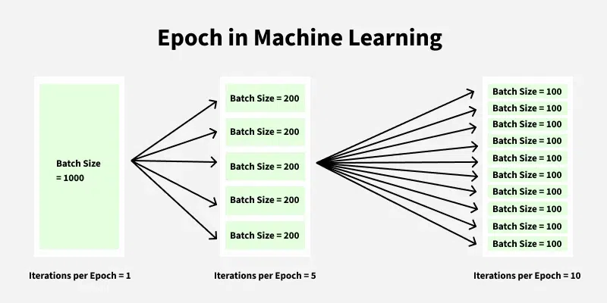

Slide 19
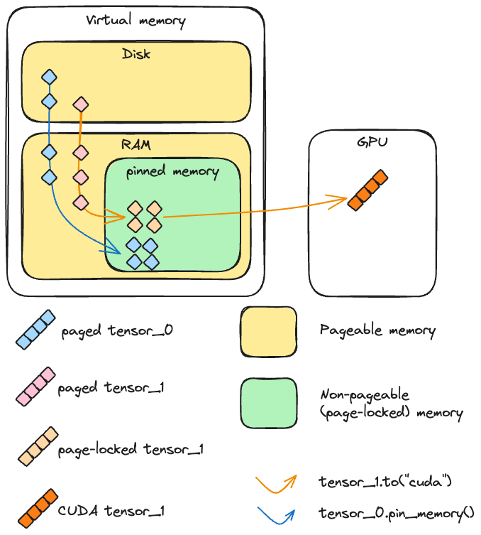
Out OF memory
Datasets allow for us to handle data out of memory.
E.g. more data than we have RAM.
With a df, we load the df, it is all in memory.
With a dataset, we only load a batch (or so), rest is on disk.
Key differences:
Dataset can be any size, since only a protion is used at a time.
Access speed differs – the batch in mem is fast, rest is slow.
From perspective of model, it just sees data – as normal.
How to access disk data is on us.

Slide 20
Dataloaders
The dataloader takes in the dataset and provides data in a model friendly way.
A dataset provides one item at a time with getitem.
The dataloader can be set to provide one batch at a time.
We can also tell it to do things like shuffle the data.
There are several other things we can do, mostly related to performance.
The dataloader is provided to the model to train.
It will provide a batch of data at a time to the training loop.
The dataloader is a middle-man between dataset and model, they don’t interact.

Slide 21
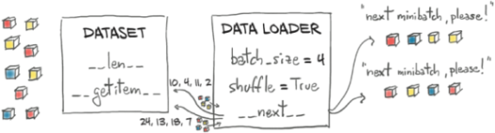
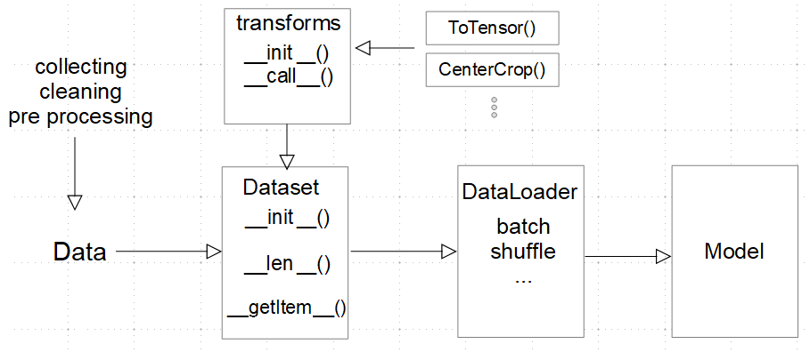
Get a Load of this Data!
Dataloaders manage the “get the data ready for a model” part of the pipeline.
Uses its dataset to get data, combines with other settings.
Batching – set size, each ask for data gets a batch.
Shuffle – we normally want to shuffle training data.
Num workers – allow for parallel processes.
Pin memory – forces loader into special “non-paging” memory area that allows for faster data transfer.

Slide 22
Data Preparation

Slide 23
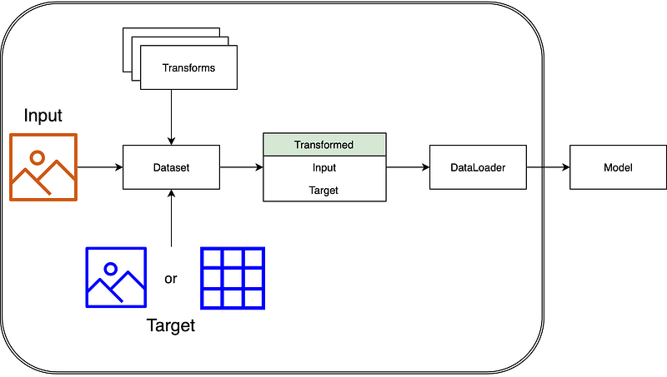
The Pipeline
The dataset/loader can do most pipeline stuff.
The dataset interacts with actual data/labels.
It can apply transformations to data.
The dataloader takes that prepared data and manages providing it as needed.
The model still sees a batch at a time.
More backend work organizes that batch.

Slide 24
Transformations
Transformations are normally applied in the dataset.
Either as it is created or as a batch is produced.
With a custom dataset, we can do anything.
For images, we generally do things like normalize and resize.
For tabular data, we do things like encode or scale.
There’s less of a standardized process like an sklearn pipeline.
Things tend to vary more, so are more open eneded.
When things are done is open – preprocessing, dataset creation, batch creation, in model…
Performance is a cocern, and we can move prep steps if we need to.

Slide 25
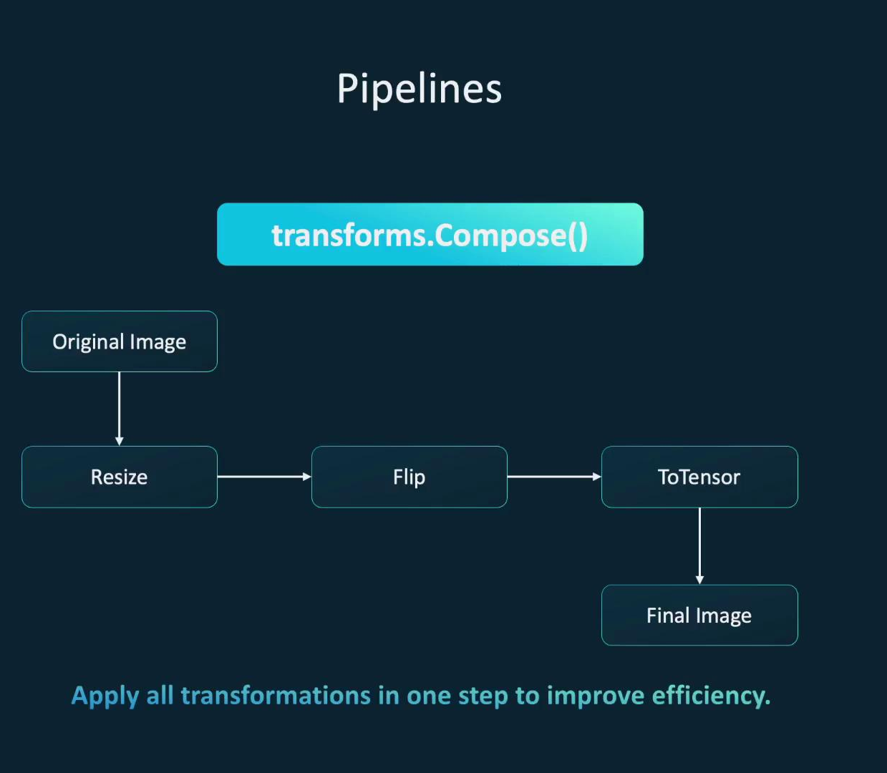
Compose
Compose is roughly equivalent to a column transformer in sklearn.
If there are 2+ transformations, Compose combines them.
Compose is generally more efficient than separately.
Normally ends with toTensor() to make whatever our data is into a tensor for the model.

Slide 26
Data and Performance
For smaller datasets, the performance of all this doesn’t really matter.
With very large data and complex models, that changes.
Each ‘step’ takes a while to both setup and perform.
Our limiting factor is usually the speed of our GPU, and we can’t change it w/o $$$$.
Controlling where/when prep runs, we can keep the GPU busy almost all the time.
E.g. while the GPU is working on one batch, the next can have transformations done by CPU.
Faster training means more trials means more chances at best model.
Training is often paid by the hour, so maximizing output makes sense.

Slide 27
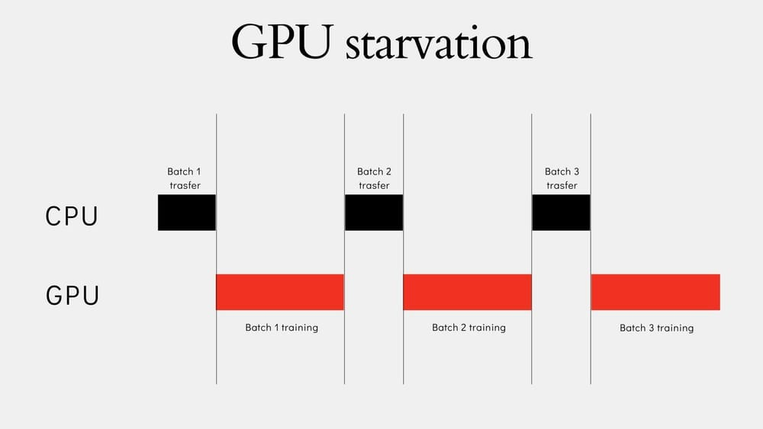
We don’t want this…
Our GPUs are precious jewls.
Should not be left idle.
We’ll look at this in more detail after we cover tensorboard.
A tool to monitor training.

Slide 28
Dataloader Performance
There are several things we can do to manage performance.
We’ll do more detail later, with tensorboard.
Some performance things:
Num_workers – allow more processes to load data (Multithreading) instead of current.
Pin_memory – force the dataloader into non-paging memory (faster).
Work location – constructor, getitem, vs layer, preprocess step, etc…
Device used – is it on the cpu or the gpu?

Slide 29
I lost my Balance!!
There are a couple of simple things we can add to address a class imbalance.
Weighting:
Can add weight to loss function to increase impact of less common classes.
Stratification:
Change training record selection to increase minority.
Can feed dataloader a new sampler.
The sampler gives a non-random selection, to favor minority class.
In my personal observation on examples in this class, the most common improvement is to prevent any class's performance from being “too bad”.

Slide 30
In Pytorch….
In PyTorch, we get our data from a few different sources, slightly differently.
Premade PyTorch datasets.
Premade other datasets (huggingface, Kaggle, tensorflow, etc..).
Custom data datasets.
Customized classes.
“Specialized” dataset creators. (Depricated).
Once we get to the data loader level, the layers beneath it can be ignored.

Slide 31
Monitoring Performance
For basic stuff, we can just have some print statements in our training loop.
Loss, epoch, batch, etc…
For serious management, we want something better.
Training can take a long time, weeks even. We don’t want to sit there for it.
If doing trials, being able to compare is nice.
Our computer that is training may live in a data center somewhere.
One option is to use Tensorboard – a webpage based monitor package.
We write logs with updates on progress to disk.
Tensorboard takes the logs and makes them into a nice webpage.

Slide 32
Tensorboard
Tensorboard originally came from tensorflow, the other NN package.
It has many features and can be customized a fair bit.
Some things that it is useful for are:
Monitoring the loss curves as training progresses.
Showing example data/predictions.
Help tune hyperparameters.
Tensorboard runs on your computer, you can then access it through a browser.
In a big-data environment, training is on a server, you can access this via the web.

Slide 33
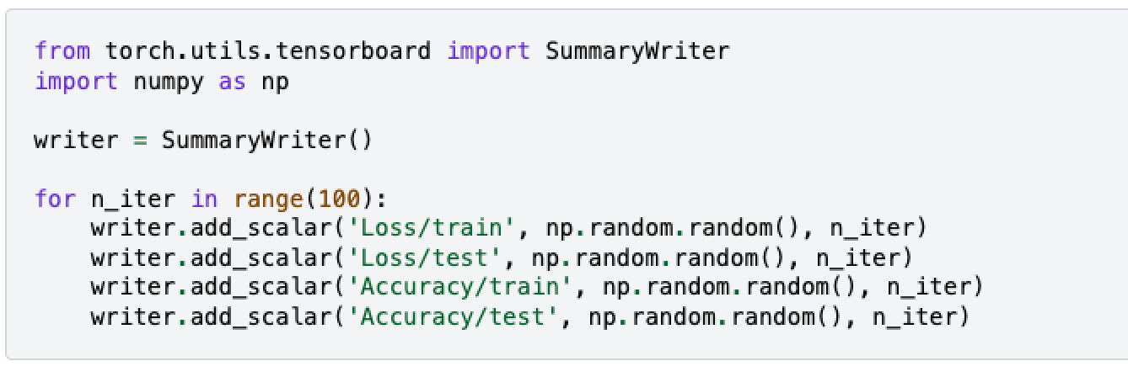
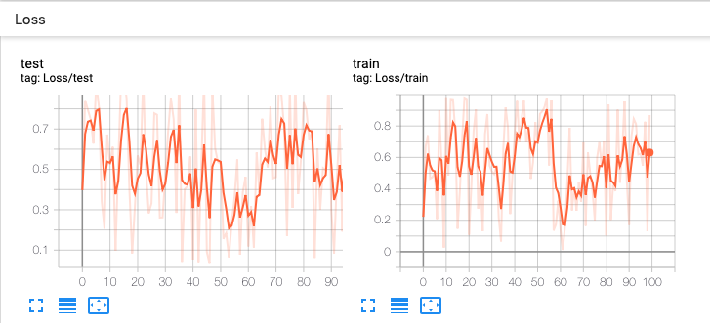
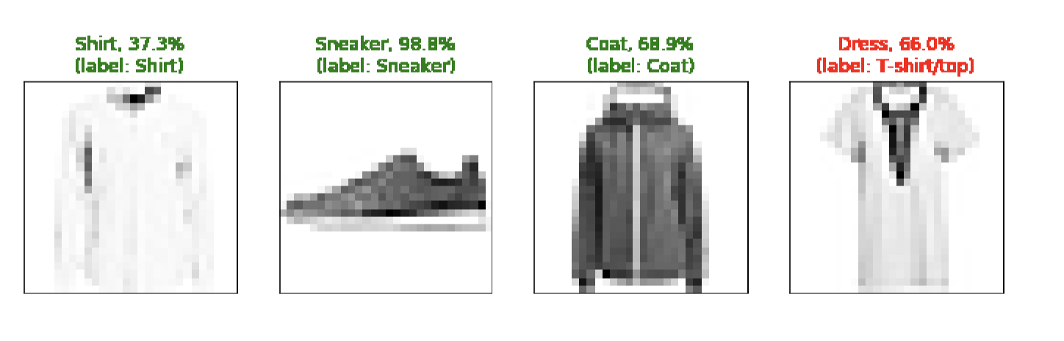
Tensoring your Boards
For simple stuff, tensorboard does most of the heavy lifting.
We just need to write log values, it’ll pick them up and make the GUI.
We use a writer object to do the logging.
Create the object, aimed at the desired logging location.
Add stuff (what you want logged) to the writer.
Functions for different data – numbers, images, charts, etc…
Usually, you want to add an entry every K batches/epochs to the log.
Usually scalars – loss and accuracy.
Parameters – Label, value, step (x-axis on chart).

Slide 35
Hyperparameter Tuning
As with classical models, we want to modify hyperparameters to tune a model.
Unfortunately, a grid search won’t work here.
With pytorch models we want to do the same thing, but it is structured differently.
Setup the set of choices for HPs.
Train the model, with modifications to do some logging.

