Slide 1
Housekeeping
Generative models. (pull please, I updated this earlier today)
Today:
Text generation with LSTMs.
Data preparation for generation – mostly manually.
Text padding.
Temperature.

Slide 2
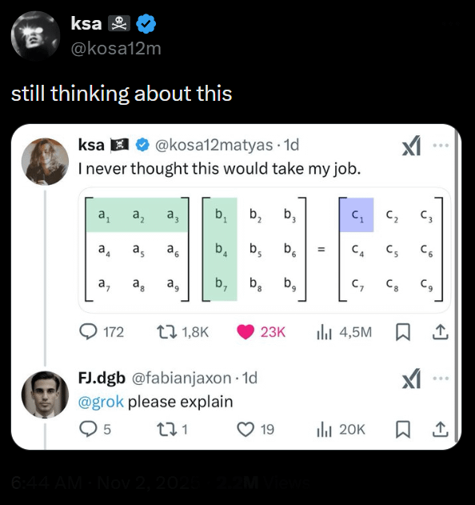
A little Data science Humor

Slide 3
Text Generation

Slide 4
LSTM
LSTM models are excellent in dealing with temporal relationships in data.
The recurrence allows the model to maintain a ‘memory’ of what came before.
LSTM models are good because they are able to do several things:
Maintain a long-term memory.
Maintain a short-term memory.
Combine these with new data to make predictions.
Be selective about updating the memories with new data.
Each of the LSTM units has several gates to process all of this.

Slide 5
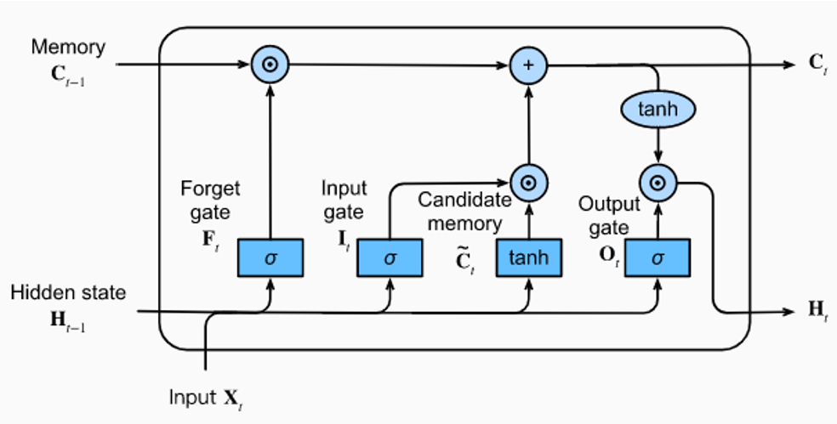

Slide 6
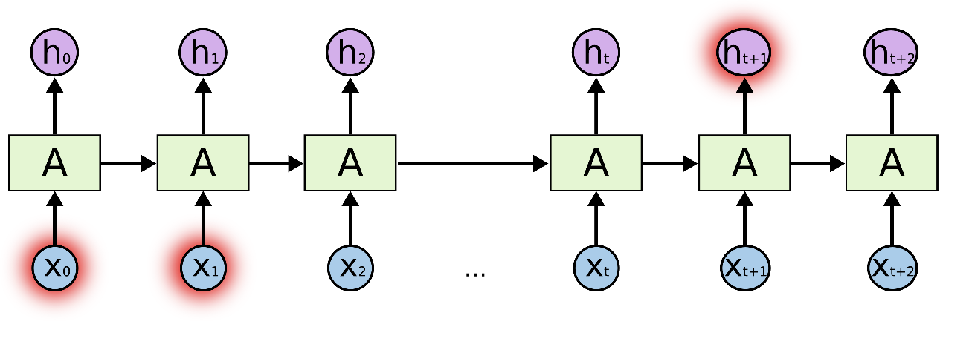

Why does this help and matter?
Predicting the next item is what time series models do.
Natural language is kind of a special application of that.
In a sentence, different parts impact other parts, e.g.
“The dancer is backing that ass up” vs “the donkey trainer is backing that ass up”.
The subject of the sentence totally changes meaning.
The states of the LSTM (hopefully) help the model know this.
What from the previous info should impact next prediction.

Slide 7
Notes
We’ll look at this in some level of detail:
Constructing datasets.
Padding
Shape
Etc…
In many/most applications we’d automate some of this through loaders.
It is common for us to need to define preprocessing.
E.g. provide a preprocessor to map.

Slide 8
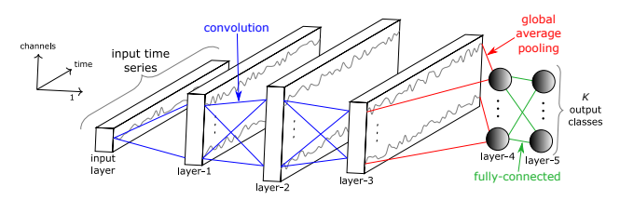
Key Idea – Here and Elsewhere
One key thing here is that anything can predict, we need to choose the best interpretation.
Any model that can calculate loss and adjust weights will ‘work’ with gradient descent.
In images, CNNs capture spatial data, and that tends to be a good feature set.
In time series (and now text), RNNs capture temporal data, that tends to work well here.
This representation is flexible – and can vary.
Some models can combine different parts to generate features.
Image models can use RNN parts, time-series can use CNN parts.
For time series in particular, the hierarchical representations seem to work well.
We basically just want the best features for the dense bit – CNN, statistical, RNN, NN, etc…

Slide 9
Predicting Text
Text is one of the things that has temporal relationships in the data.
The order of words matter, as does what came earlier in the sequence.
We can use a model to predict the next word, or set of words.
Input – previous tokens.
Output – next token(s).
A piece of text is a weird time-series of words.
We can make a model that predicts the next word, then the next, etc…
Eventually, we’ll basically have Siri.

Slide 10
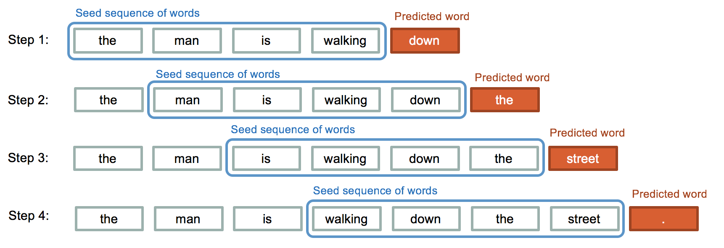

Slide 11
Forget predicting, what about Generating Text?
We can apply these LSTM models to predict the next word.
We can then tell it to generate that word!
ChatGPT, watch out!
We just need to setup the data properly:
The input is the previous set of words.
The output is the next word.

Slide 12
Text Generation Training Data

Slide 13
Features and Targets
Text generation data is a little different than normal, but mostly like a time series.
We have “some” previous tokens as features, the next token is the target.
That some can vary:
You need to predict the second word in a response as well as the 2,456th word.
Can make a sliding window, like a time series (easier with big text chunks).
Can also do a similar thing within each small document (row).
Like the picture.
Details kind of don’t matter, we want the model to learn to predict the next word. The exact subset of data it sees can vary a lot, as long as it is representative.
E.g. under time constraints, is predicting every word of that sentence important, or seeing more…

Slide 14
Data Configuration
Our data again needs to be processed and reshaped.
We need to strip and tokenize the data. (This changes with ‘good’ models as they predict things like commas).
We need to shape the data.
X – previous M tokens.
T – next N tokens.
We need to pad the data, or make every record the same length.
Models need fixed size data, but sentences are any length.
We add blanks to either end to standardize the length.

Slide 15
Dataset Construction
Our dataset will be a bunch of these items:
Previous next features.
Next token target.

Slide 16
Data Preparation

Slide 17
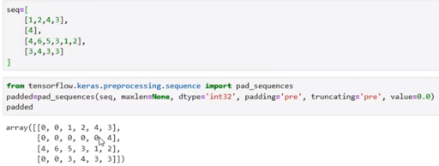
Padding
Padding makes each tokenized text record into a set length.
Padding adds 0s either at the end or at the beginning of the text to fill it.
For generation, we want to pad at the beginning, as we want the ‘next’ item.

Slide 18
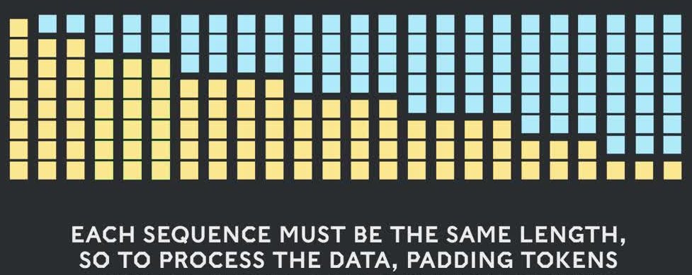
Post Padding
After (left) padding, we have a usable dataset.
Each X value will be a fixed number of tokens before the current word.
The target is the next token, we can train. (Blue is data)

Slide 19
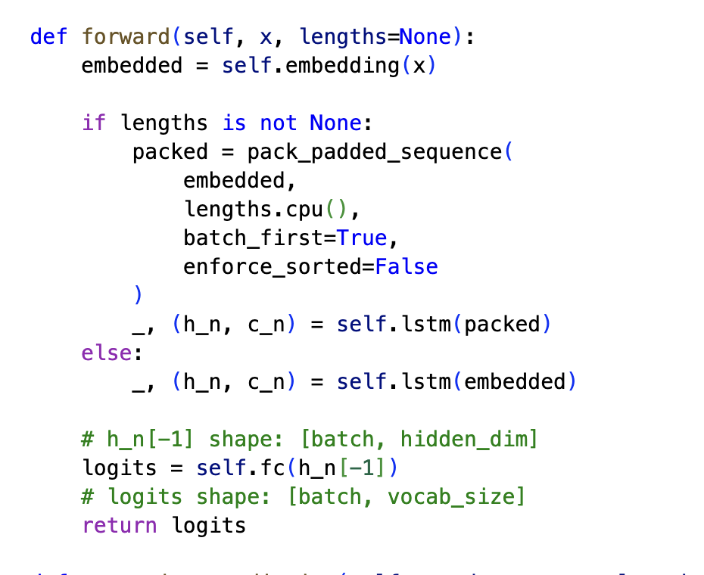
Sequences and Packing
In pytorch, we probably want packed sequences for efficiency.
Directs model to ignore the padded bits and save time.
We just feed the function padded sequences.
The prediction is the next value.

Slide 20
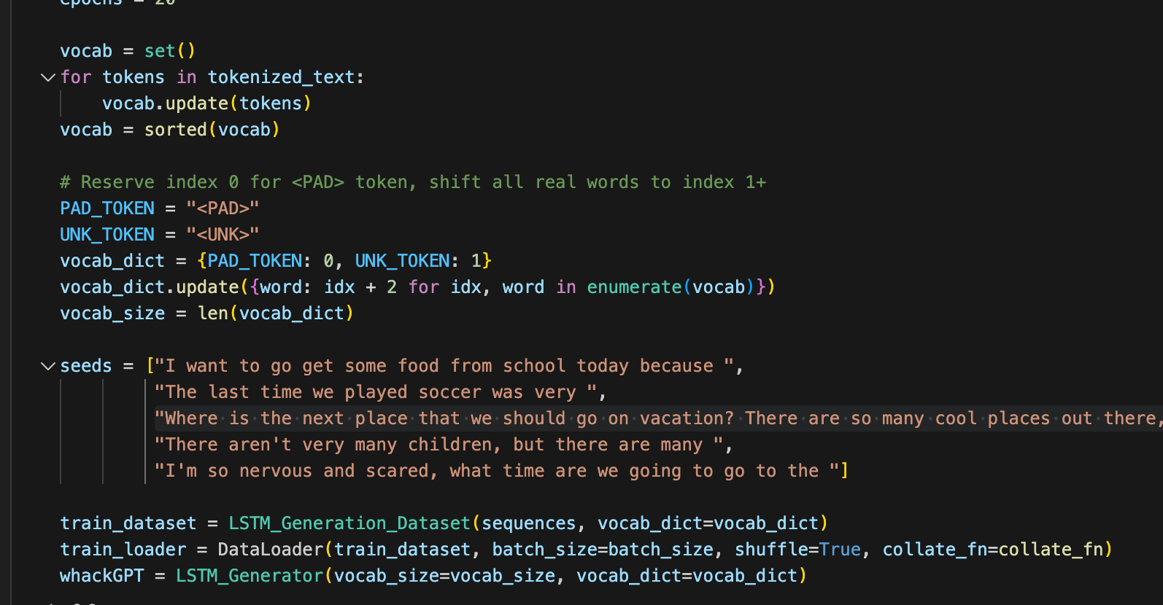
Dataset Construction
In addition to the data, we need some other info to train.
Padding and unknown tokens – these are designated placeholders, so model doesn’t choke on new stuff.
Vocabulary – mapping of token number to word. We need this anywhere we translate.
Vocab size – how many output neurons do we need.

Slide 21
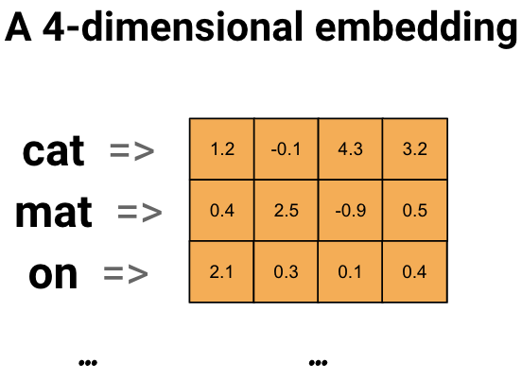
Embedding
To make things useful, we need to generate embeddings for the tokens.
This can be done in any way – we’ll use an embedding layer.
Can download and use embedding space pre-made, such as word2vec.
There are several options, they can be extended for customization.
Most important thing is the number of dimensions:
Higher dimension, better representation, slower, more data needed.
We can use ‘tens’ as a start, real LLMs can use thousands.

Slide 23
Language Model Notes
This is very simple processing for text, for a simple model.
In larger models, the data preparation is (or can be) different.
Construction of the datasets is potentially a lot of work.
Specific applications like chatbots may need to restructure data into prompt-response.
Other models are commonly used to help process the massive amount of data.
The dataset is massive, and may only have one or two epochs.
Tokens are often sub-word length, as models need to handle suffix/prefix etc…
Large/smart models also have an assortment of things done to make them faster and better – reinforcement, specialized ‘sub-models’ (mixture of experts), etc…

Slide 24
Training a Text Generator
Training the model is the same, once the data is setup.
To use it to chat, we need to ‘wrap’ some generation logic around it.
Predict the next word, add it to the input, then that’s the input for predicting the next…
Recursive predictions from time series things.
The prediction is a token value, so we need to make it a word.
We can make a couple of simple functions to do this with our model.
When generating text, we need to provide some prompt that is the original X data.
How does the model ‘sound’? We can tune the temperature.

Slide 25
Temperature
The model will normally select the most likely token as a prediction.
This usually makes sense, but for speech it really doesn’t.
A novelist isn’t trying to always choose the optimum/most likely word...
Temperature inserts random variation of the prediction.
Instead of just taking the most likely next token as the prediction, we will randomly select a token that is ‘in that area’.
The ‘correct’ next word is most likely, but we’ll vary our selection of similar words.
With large/complex models, this allows for synonyms or different structure to be used.
This makes generated text sound more normal, as it will vary word choice more.

Slide 26
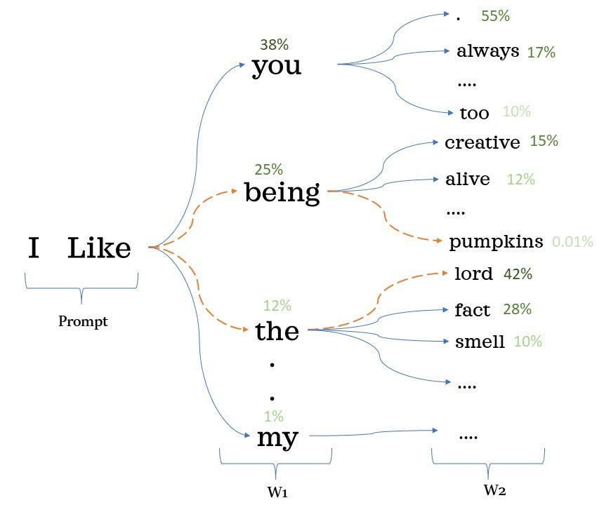
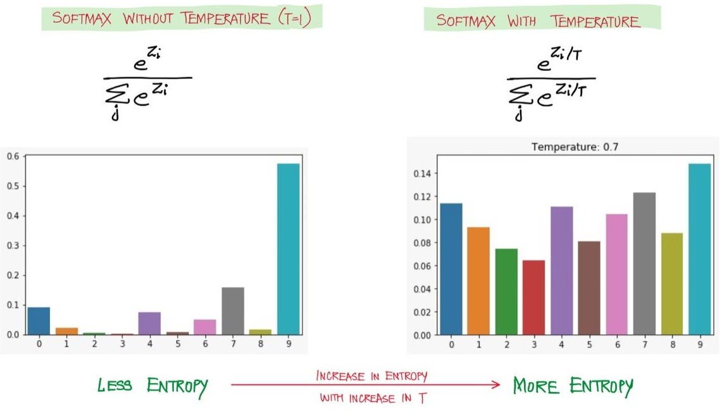
Temperature introduces Randomness

Slide 27
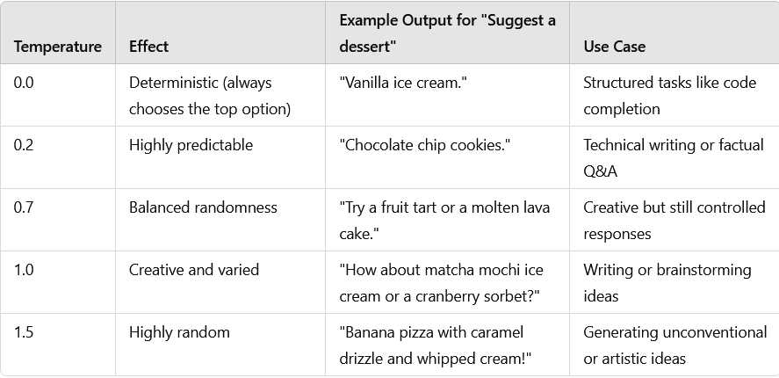
Tune that Temp!
Temperature can also be used to tune a model for different uses.
Variations from “most correct” make different amounts of sense.
There are other sampling methods as well.
Top-k: pick most likely, then select.
Could be anything.

Slide 28
Response Selection
In real usage, there are several strategies for this.

Slide 29
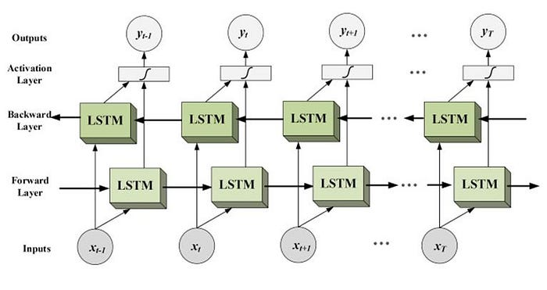
Lastly, Let’s Go Bi
We can also add LSTM layers that are bidirectional.
This is common in sentiment analysis, but transformers have largely surpassed this there as well.
These layers feed the data through the LSTM units in both directions.
This can allow the model to get context from before as well as after the word.
I.e. if a word in the future helps give context to something earlier.
“Server can you bring me this dish” vs. “He crashed the server” – meaning of ‘sever’ is better captured.
By processing it in reverse, model can capture relationships bef/aft.

Slide 30
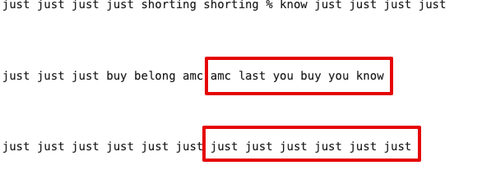
Lower your Expectations…
Lower your expectations, even lower than the normally are here.
Good text generation is hard, and we aren’t making a great attempt.
Language is diverse - need large embedding space and model to capture it.
That requires massive datasets and time.
Those mean it takes ages to train one – we aren’t even at a fraction of that.
E.g. this example from training – real-ish flipping to ‘junk’.
The model is ‘stuck’ and every prediction falls on ‘just’.
The model can (maybe) learn its way out of this, but may take time…
The temperature helps with randomness here.

Slide 31
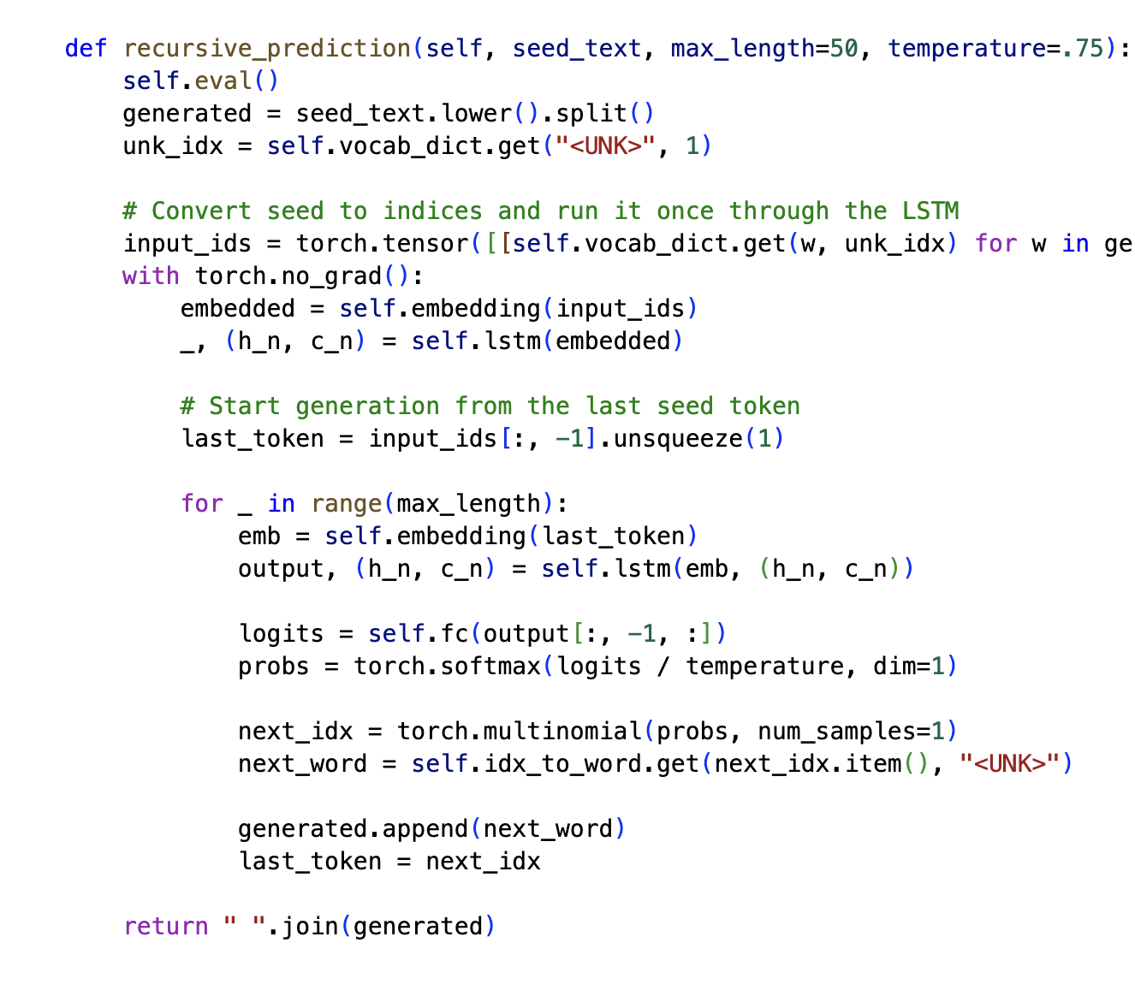
Chatbotification
Our model is a text generator, but not usable for normal interactions yet.
Need to wrap model in interface.
This does that (a little more efficiently):
Generate an output.
Stack the next prediction on top.
Generate a new prediction.
Send this a seed, get back a response.
A chat “tool” would call this to get responses.
<UNK> is the default, if a token is unknown.

Slide 32
But I want to have a good Model!
Training a real LLM is an industrial scale effort, we really can’t do it.
Language is complex, and models are massive.
Really need to distribute it to many systems for large models.
E.g. Facebook’s llama models.
Gen 2 reportedly required nearly 2 million GPU hours.
Gen 4 (current) has over 5x as many parameters to train.
Smaller shortcuts for speed can really add up here (optimizers, vectorizing code, moving calculations to/from GPU, mathematical shortcuts like matrix calculus for gradients…)
Estimates of training data needs range between 10s and 1000s of tokens/param.
Costs can run into hundreds of millions for large models.
Some GPUs available on colab have 40 or 80gb of GPU ram, no consumer machine matches.

Slide 33
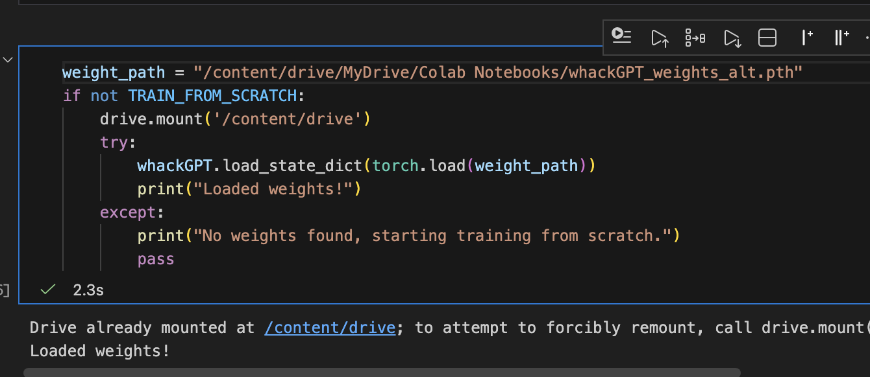
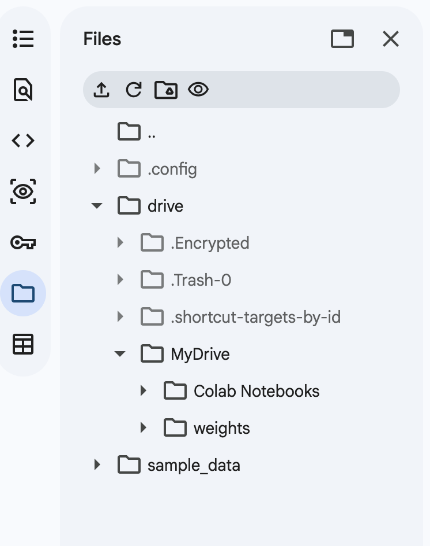
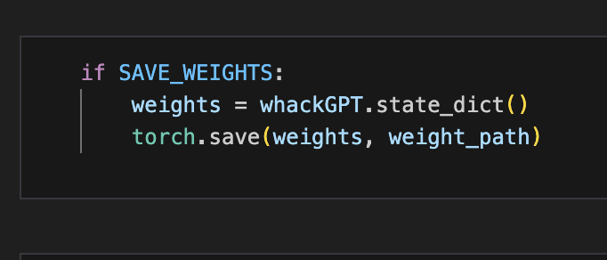
Save that Weight
Training a semi-ok generative model (or other big stuff) takes a while.
Things can also crash or be disconnected.
It is a good idea to save weights.
Training can be restored by loading weights and starting training loop.
Example shows connection to google drive.
Put it in with early stopping!

Slide 34
In Real Usage…
This is the basis of generating text in most cases.
Real applications add some other tactics:
Custom prompt/response framing – e.g. a chatbot is setup so a question is an input and their response is a prediction.
Reinforcement – feedback is provided by a human for good/bad, or better response. This helps tune the model. This can also be done live, e.g. do you accept or reject a response.
Token variation – LLMs can use tokens that are smaller than a word. This helps since they need to understand sub-word things like a prefix.

Slide 35
conclusion
LSTM text generation works well, but transformers have surpassed it.
Transformers are better able to track what matters and what doesn’t in context.
Most of the other mechanics, like dealing with data, are similar.
We can train a simple, though awful, text generation model.
Actual generative models require lots of training – time and data – ours will be bad.
I heard a podcast where an ex-Open AI guy said the next generation would cost $1billion+ to train.

Slide 36
Do some Summer Stuff
This isn’t generally the best time for hiring, but its also not very stable.
The best thing is probably to have some accomplishment/solution:
Sample workbooks doing default stuff (is it CC fraud?) is ok, but not really useful.
Something that is either real or unique and realistic is good.
Real things are best, but they are kind of hard to come by. If you can, do it.
Things are are unique or interesting are the best thing you can definitely do.
I’d make 1 or 2 example workbooks on some topic I know, and make them nice. (RE?)
Focus on presentation – no one is searching for answers like I’m obligated to ☺
Look for contracts, mat. leaves, as well as BI/rpt. jobs (ideally w/ other connection)
For DS - Some agent-y examples are likely good use AI apis to do something else.

