Slide 1
Keep The House
Today – Recurrent Neural Networks (ch5).
Recurrence
Long-short term memory models.
Time-series like datasets.
Bidirectional layers.
There’s a test next time, yay!
Generative models next week, then school’s out forever!

Slide 2
Some RecurrEnt Notes
Using RNNs is the most annoying and easy to mess up thing yet.
Data semi-regularly needs to be reshaped in multiple dimensions.
Things are dependent – future preds rely on current data.
PyTorch (imho) makes this needlessly annoying to deal with, things could be abstracted.
Focus on concepts, build incrementally, and examine/print status.
If you understand what the data is and what you want, you can look up details bit by bit.
We’ll go over it now, let me know what doesn’t make sense, and we can build some more in-depth exploration of those parts next time or next week.

Slide 3
Recurrent Neural Networks

Slide 4
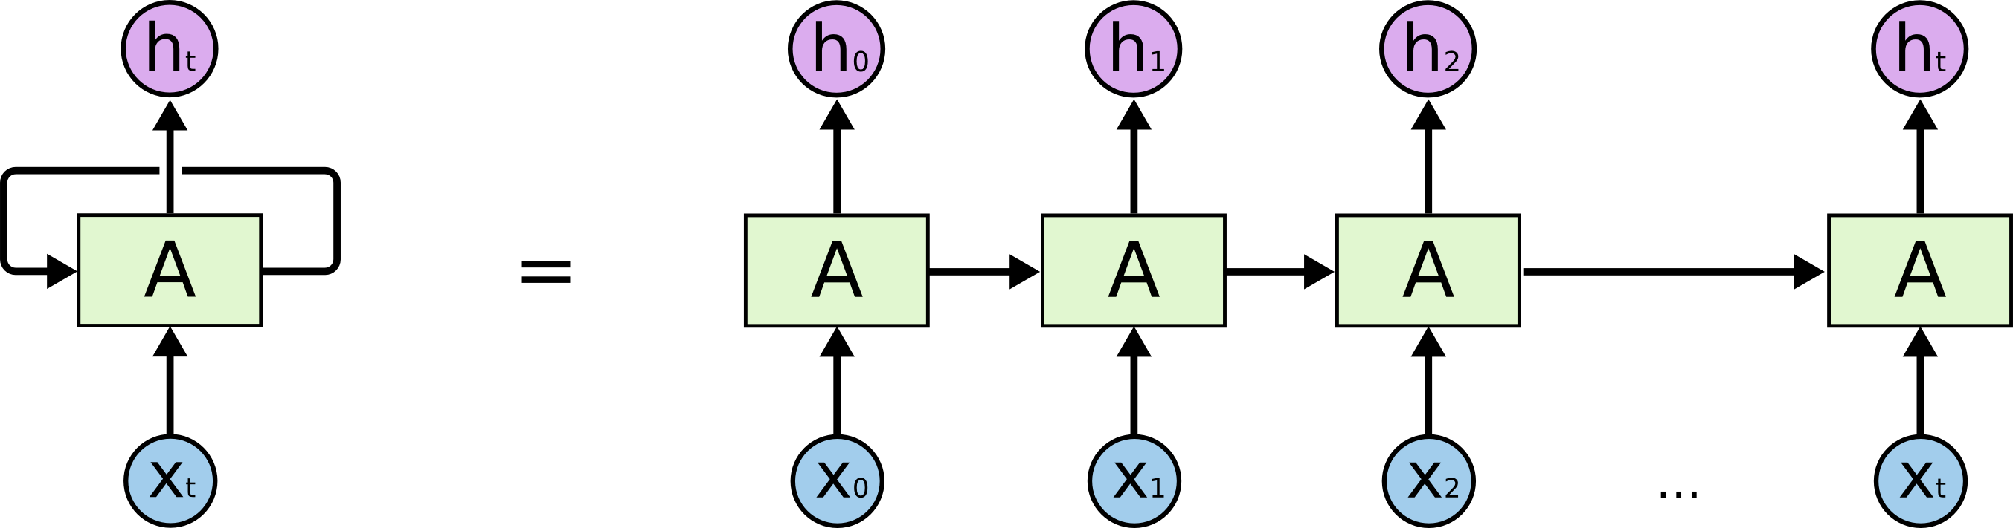
RNN Basics
In looking at a CNN we saw a neural network that can deal with spatial relationships.
RNNs can handle temporal relationships – looking through time.
Time-series and text are well suited to this structure of model.

Slide 5
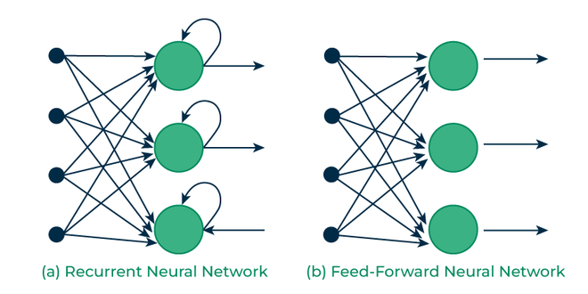
Big Difference – ‘Looping’
RNN models have some looping in their structure.
Allows the model to ‘know’ something about previous records.
Regular models are 1 at a time.
We often refer to this as memory.

Slide 6
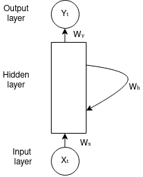
Recurrent Neural Networks
RNNs are able to ”save” some information from earlier steps.
There are several different varieties of RNN models. (We’ll look at a couple).
RNNs maintain a memory by keeping the output of one step as part of the input to another.
This allows things at different time steps to be considered at once.
A ‘regular’ model would have each time step as independent rows.
Output contains both prediction and feature for future predictions.
Each prediction isn’t independent of each other.

Slide 7
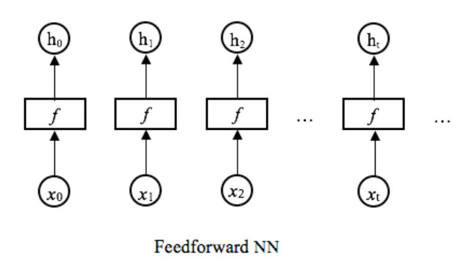
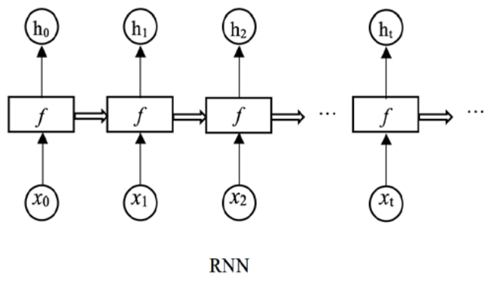
RNN Depiction
We can picture this by contrasting to a regular (feed forward) network.
In a normal network, each prediction is independent.
In a RNN, each informs the next.
If dealing with time series data, this makes sense.
We have the concept of ‘state’.
The model has an understanding of current status.
Predictions aren’t just made based on the current record.

Slide 8
RNN Implementation

Slide 9
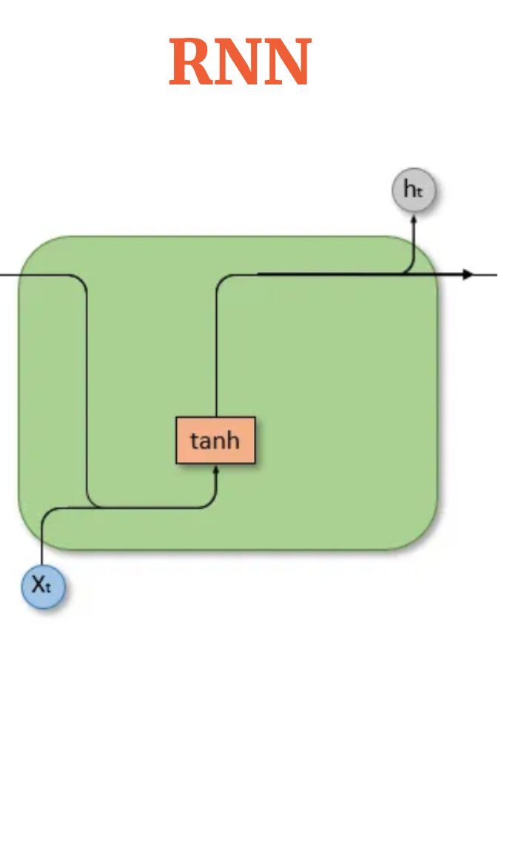
RNN Basic Structure
The basic idea of an RNN is that there is some sort of State that holds memory.
The network can have information from earlier held in its state.
The new record can bring in its features (as normal).
The model can use both to make a prediction.
We refer to this as a ‘unit’ in a RNN layer.
Roughly equivalent to a neuron, though more complex and we have fewer.
The top line is the state, that is what is passed on from before.
The bottom line is the feature set for this record.
Each prediction is based on “X + memory of previous predictions”.

Slide 10
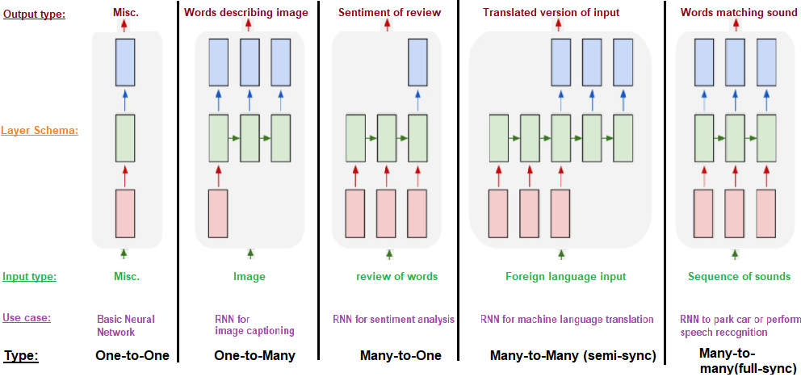
Applications
The ability to keep state allows for RNNs to excel any time we have a sequence.
Time series data and NLP are the big ones.
We can have arbitrary number of input and output lengths.

Slide 12
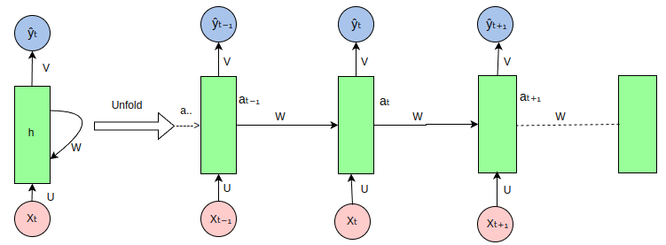

Slide 13
Rnn Basic Concepts
RNN models keep a memory of past action.
These predictions combine with a record to make a new prediction.
This means RNN models make predictions based on now and ‘the past’.
Often better suited for anything sequential – time series, audio, NLP…
Note: transformer based models (another NN structure) have surpassed RNNs for most text stuff.
ChatGPT et al are transformers.
We’ll see a bit of it next week.
They are better at managing ‘relevance’ of one thing to another in a sequence.

Slide 14
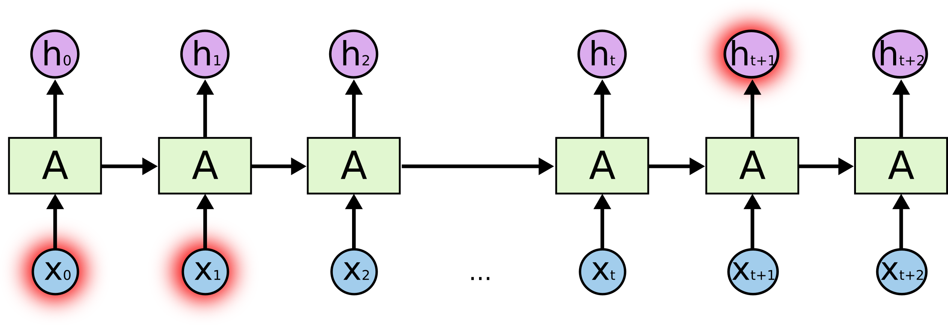
Mo’ Gradients, Mo’ Problems
RNNs can run into issues with the gradients getting too large or too small.
Exploding or vanishing gradients.
Vanishing gradients commonly occur with deeper models.
The longer the memory, the more risk of vanishing.
How much of an impact can the memory of 20 steps ago be?
E.g. Change in this prediction w.r.t. x many steps ago.
E.g. a really long, complex joke with a callback – can it remember?
As gradients get extremely small, learning updates stop.
Solution – Long Short-Term Memory

Slide 15
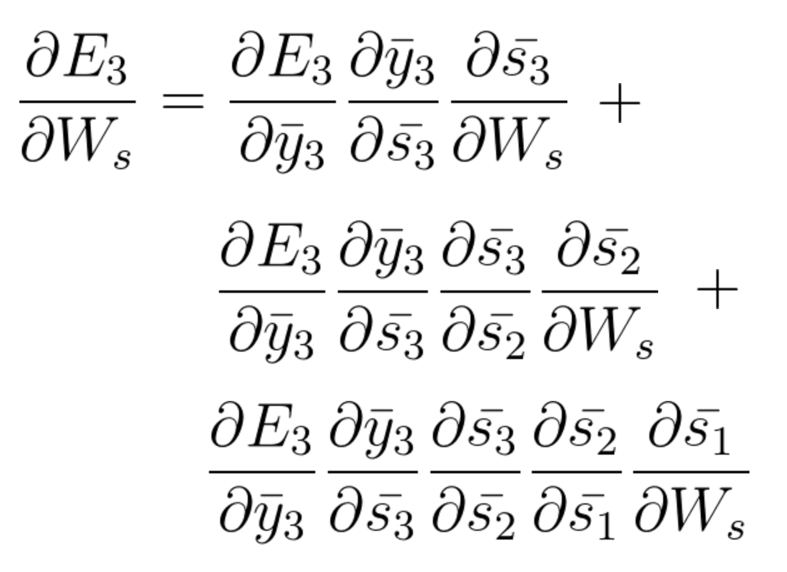
Training a RNN and Issues
RNNs are trained using an algorithm called BPTT – back propagation through time.
Mathematically this is the same as ‘normal’, but with transformations on the model structure.
Image shows gradient calculations at step 3.
Adjustment for this step depends on steps 1 and 2.
As steps grow, this equation grows, and values can get minute.
We lose the gradient, or indication of how to adjust weight.

Slide 16
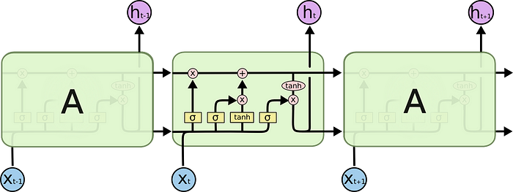
Enter Long-Short Term Memory…

Slide 17
Long Short-Term Memory
LSTM models are a commonly used type of RNN.
LSTMs can mitigate the gradient issues.
LSTMs retain a bunch of data – their long memory.
“Look back” period of N previous records.
At a basic level, the output of an LSTM at a particular point in time is dependent on three things:
The current long-term memory of the network — known as the cell state.
The output at the previous point in time — known as the previous hidden state.
The input data at the current time step.
https://towardsdatascience.com/illustrated-guide-to-lstms-and-gru-s-a-step-by-step-explanation-44e9eb85bf21

Slide 18
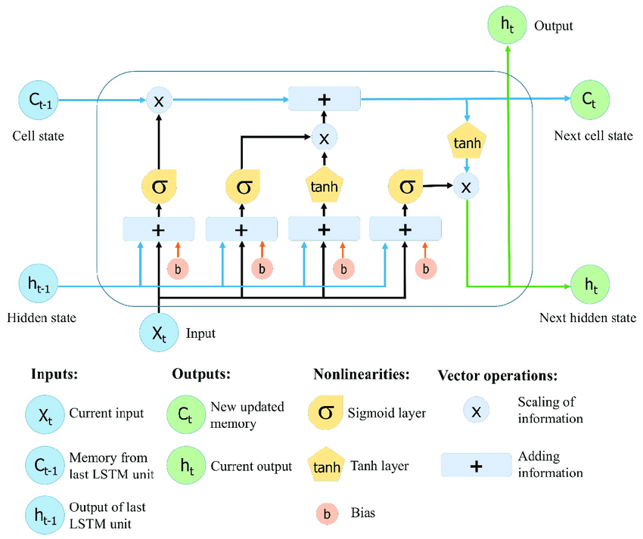
It’s simpler than it looks…
The activation functions are referred to as ‘gates’.
Each gate ‘decides’ what to keep and what to discard.
The node (roughly):
Takes in X, hidden, and cell states.
Weighs what parts to keep/ditch.
Creates a prediction.
Passes pred and state forward.

Slide 19
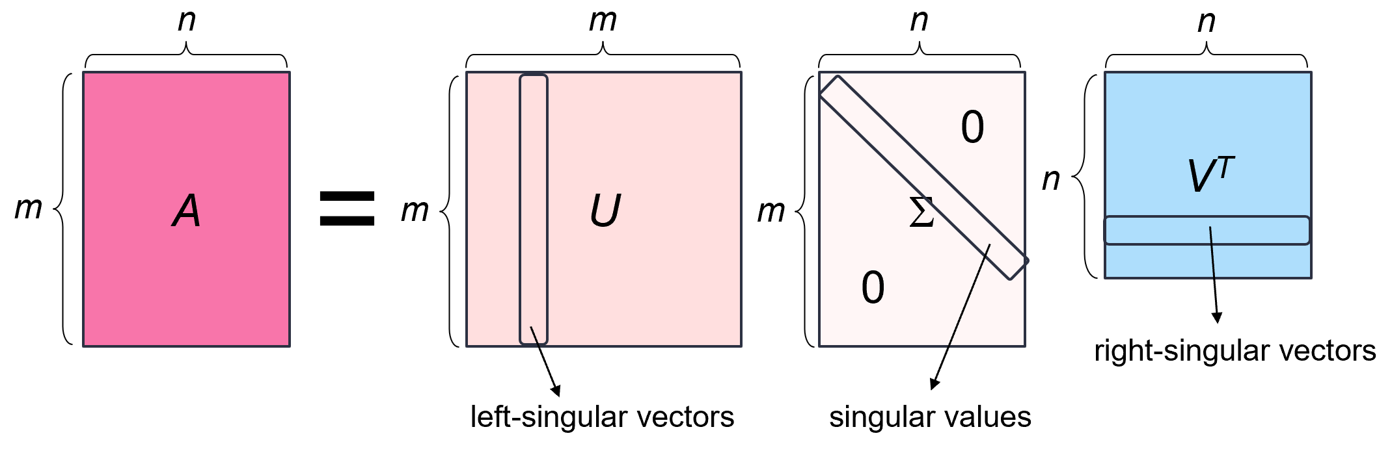
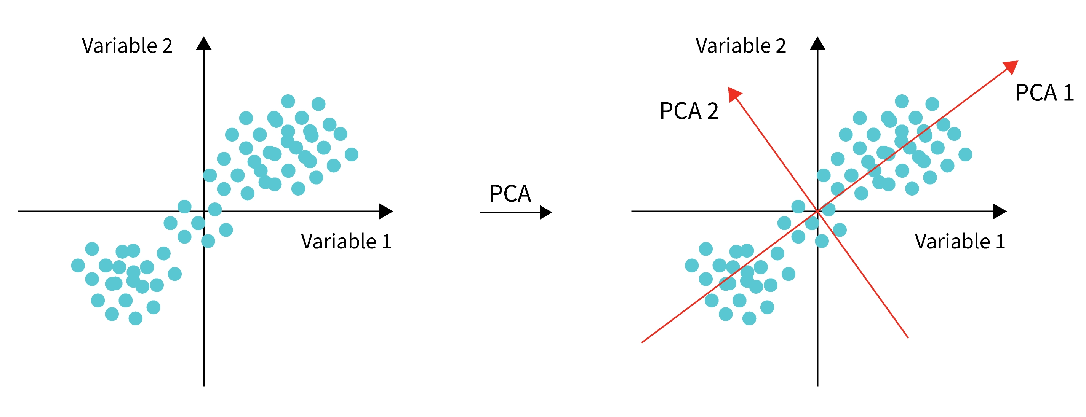
Remember the Magic of Linear Algebra…
Linear algebra can determine relevance of data in a matrix…

Slide 20
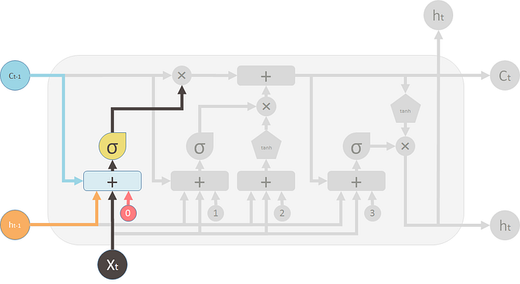
Forget Gate
The forget gate decides what information should be thrown away or kept.
Information from the previous hidden state and information from the current input is passed through the sigmoid function.
Values come out between 0 and 1. The closer to 0 means to forget, and the closer to 1 means to keep.

Slide 21
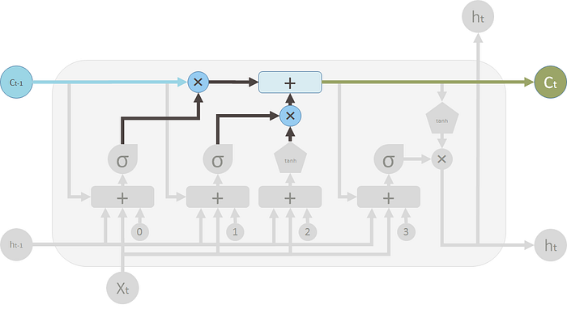
Cell State
The forget and input results are combined to generate a current state.

Slide 22
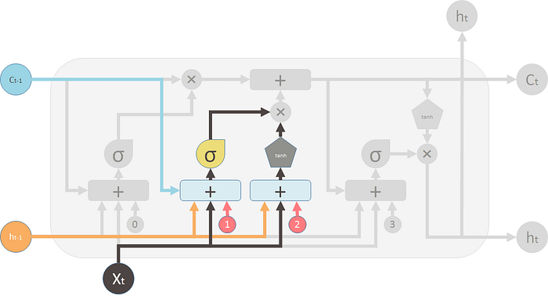
Input Gate
To update the cell state, we have the input gate.
We pass the previous hidden state and current input into a sigmoid function.
Decides which values will be updated by transforming the values to be between 0 and 1.
Also pass the hidden state and current input into the tanh function to squish values between -1 and 1 to help regulate the network.
Multiply the tanh output with the sigmoid output. The sigmoid output will decide which information is important to keep from the tanh output.

Slide 23
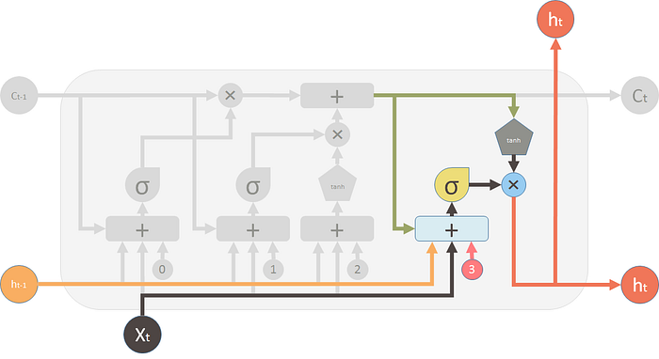
Output Gate
Output gate decides what the next hidden state should be.
Pass the previous hidden state and the current input into a sigmoid function.
Pass the newly modified cell state to the tanh function.
Multiply the tanh output with the sigmoid output to decide what information the hidden state should carry.
The output is the hidden state.

Slide 24
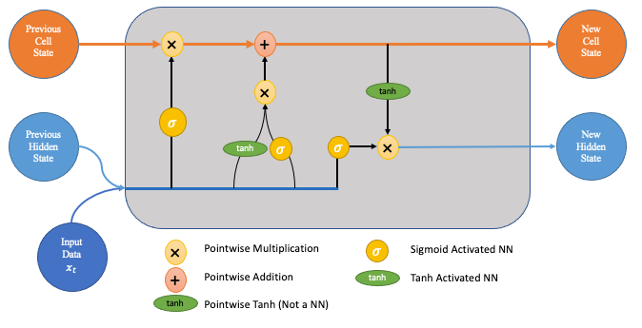
State it Clearly
The LSTM units have two different lanes for state – cell and hidden.
The hidden state acts as a short-term memory – more impacted by recent events.
The cell state acts as long-term memory – more able to hold things from earlier.
The cell state flows from itself, and new stuff is only added after passing a gate.
The hidden state flows from the last prediction and the new input.

Slide 25
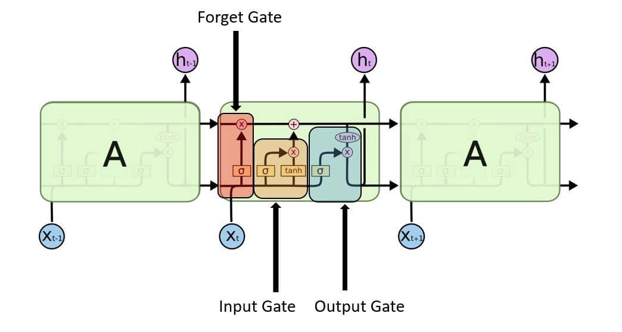
Data flows through, in order…

Slide 26
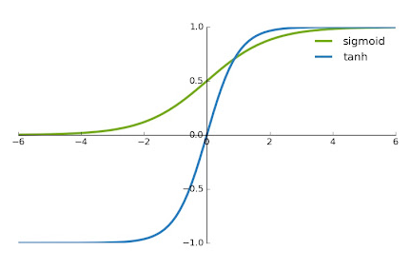
Training and Activation
LSTM models us 2 activations – sigmoid and tanh.
Sigmoid is bounded [0,1] – keep/forget here.
Tanh is bounded [-1,1] – emphasize/deemphasize.
Tanh has a steeper gradient, it helps to not vanish.
As the weights are set in training, they learn this.
What to keep in each subset of data/states.
What to ditch.
These can differ because of the ‘multiple memories’.

Slide 27
LSTM in Parts
The LSTM layers use this design to better deal with sequential data.
The state (top) part of the model remembers information from previously.
The forget/memory gates try to keep the important stuff in the memory.
The output provides a prediction, as normal.
Each of those predictions depends on two things:
The new data in this record - this is exactly what we are used to.
The data from the state, what the model remembers – this is the new part.
The ‘features’ extracted in the top layers are made by combining info from different steps.
Just as the ‘features’ extracted in a CNN are made by combining different pixels.

Slide 28
LSTM In Effect
LSTM can “hold” information from the past.
During training, the model keeps things that are useful and forgets things less useful.
Important previous information is held.
Temporal awareness!
LSTMs are very good at many scenarios:
Time series applications.
Speech and NLP applications – e.g. translation, Google’s phone answer AI, chatbots.
Generative models (think GMM) – creating text from a model.
Transformers have often surpassed these in practice – better able to manage state over time.

Slide 29
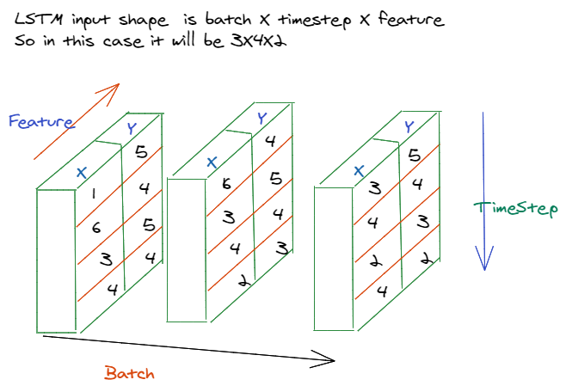

Slide 30
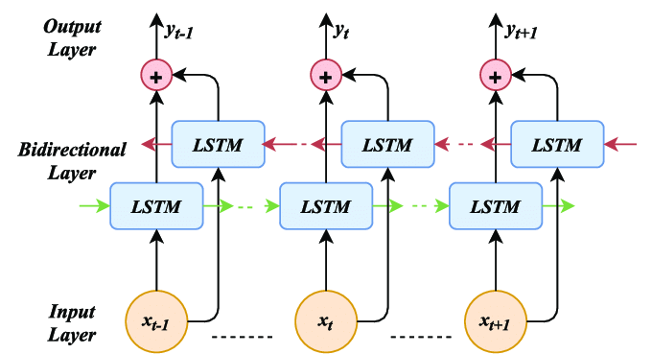
Let’s Go Bi
There are LSTM variations like bidirectional.
Bidirectional models have a ‘backwards’ layer.
Data is fed through here in reverse.
Helps capture longer dependencies.
For/back are merged with some math (option).
Can help performance in many cases.
Can be much slower.
Data requirements increase.

Slide 31
Recall Word2Vec…
In the top example, the model has no idea what happens after Teddy.
In the bottom example, the backwards part of the model sees Roosevelt, so it can capture that relationship.
Parts of speech are often not one word after another.
Can understand the sequence in both directions.
“If I know this thing is coming, what do I expect to see before it” vs. ”If I know what happened before, what do I expect next.”

Slide 32
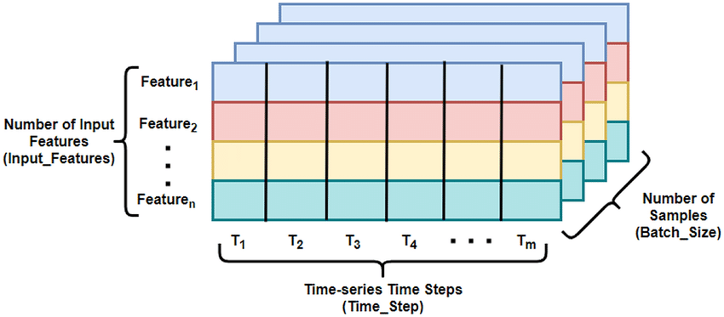
Building LSTM Data

Slide 33
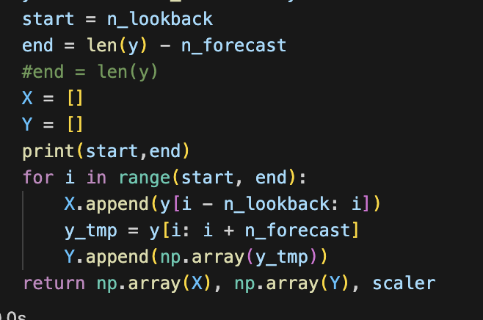
LSTM Data
Using an LSTM model requires that we deal with some complex shapes in our data.
Using “normal models”, each instance is one row of data.
In an LSTM, each instance contains several past features and several future inputs.
The shape of the data going into the model will generally be:
X data - (Batch_size, length_of_lookback, number_of_features).
Y data – prediction.
For most data, we’ll need to construct a dataset to look like this.
We’ll probably need a function to take our data, loop through the rows, and assemble all values from different rows into multi-dimensional data for us.
This can be a bit annoying and easy to make a mistake on – be careful.

Slide 34
The Data Can be Annoying
Managing the data and making datasets is the most annoying part of RNNs.
Data generally isn’t in a ready to use format, like regression/class.
Usually need to do some “reconstruction” like the lookback part.
It is likely annoying to think of the entire operation in one step.
Work incrementally - can you construct one valid sample.
Once you can make one, can you make a function to do that.
Once you have that, can the function increment to make the next.
Once you have that, will it assemble the data into a series of records.

Slide 35
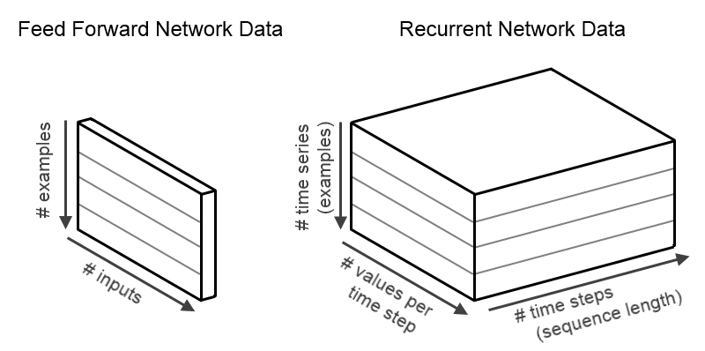

Slide 36
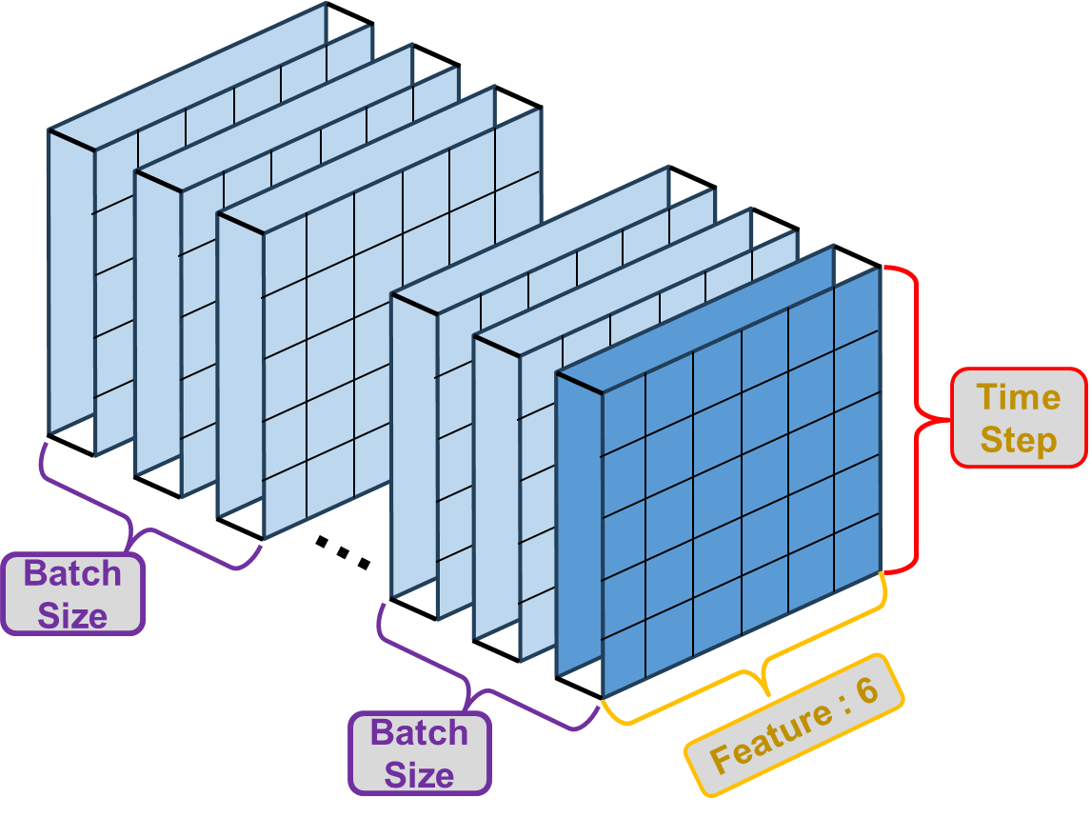

Slide 37
Time Series Data
Data usually needs to be reshaped to be useful.
The shape of our output can differ here.
One node is the next prediction – the next day/week/year etc…
We can create a multiple node output for several predictions at once.
I’d generally recommend deciding the data size and making a function to construct it from your data – if you have changes, set things like #records to be parameters.
Keep it as a separate goal form the modelling bits, and check it independently.

Slide 38
LSTM in Keras
LSTM (or RNN) layers can be added just like any other layer.
The nodes param is roughly like the filters in a CNN model – layers have many.
When there’s more than one LSTM layer, we need to enable ‘return_sequences’.
The output layer normally has one node per prediction, no activation.
Making multiple predictions into the future is one place where custom loss is useful.
Could weight the value of errors for the next prediction vs the one 10 instances later.
Differing considerations could make accuracy at different time steps matter more.
LSTM layers are often/usually paired with a dropout (and/or regular regularization).
We can add it as a parameter to the layer directly.

Slide 39
LSTM in Pytorch

Slide 40
Tuning LSTM Models
Like other models, we generally want to have a larger model for a larger problem.
Estimate - Units = samples in training data / ((# input neurons + # output neurons) * alpha)
Unstructured problems are more likely to benefit from more layers, each with fewer units.
Structured problems (sales or stock prices) may benefit from fewer, larger layers.
Hyperparameter tuning is back on the menu, boys!
LSTM models often employ a dropout for regularization, it performs well.
Large numbers of epochs are often helpful, possibly with small batches (~8-96).
Think – update model every day vs every 100 days.

Slide 41
Layin’ Down Layers
LSTM layers do all of the internal of gates and states on their own.
Hyperparameters will add features such as regularization:
Layers, dropouts, bidirectionality, and more can be done via parameter.
The between layer stuff will automatically be inserted, we treat it like one layer.

Slide 42
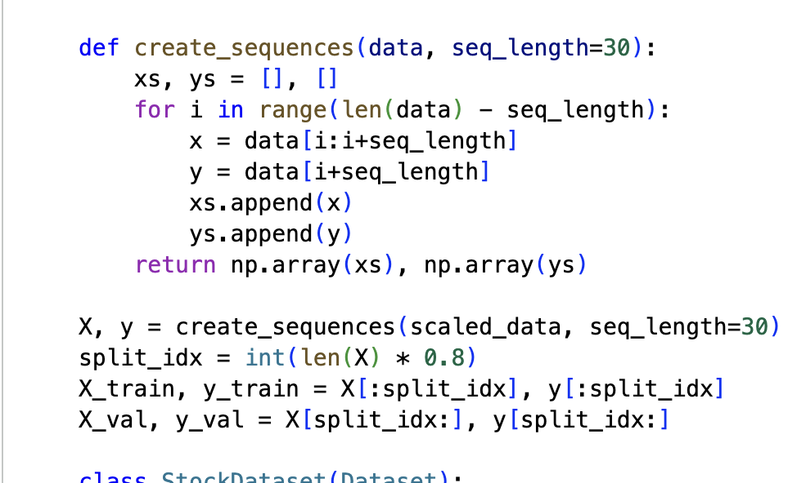
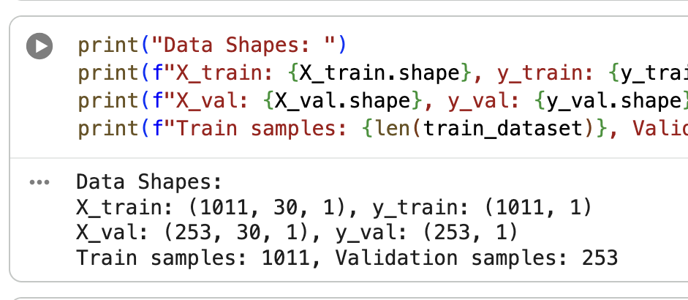
Datasets
Datasets are more complex in shape.
Generally, we can use something like this example.
Generally easier to do pre-dataset.
Each sequence contains:
Target (y) – at t = 1 (‘current’ record).
Features (x) – of [t – lookback, t-1] (previous K records).
Each sequence steps forward by one interval.
Target progresses by one time step.
The last feature record is dropped off the end.
Note: these assume “batch_first”.

Slide 43
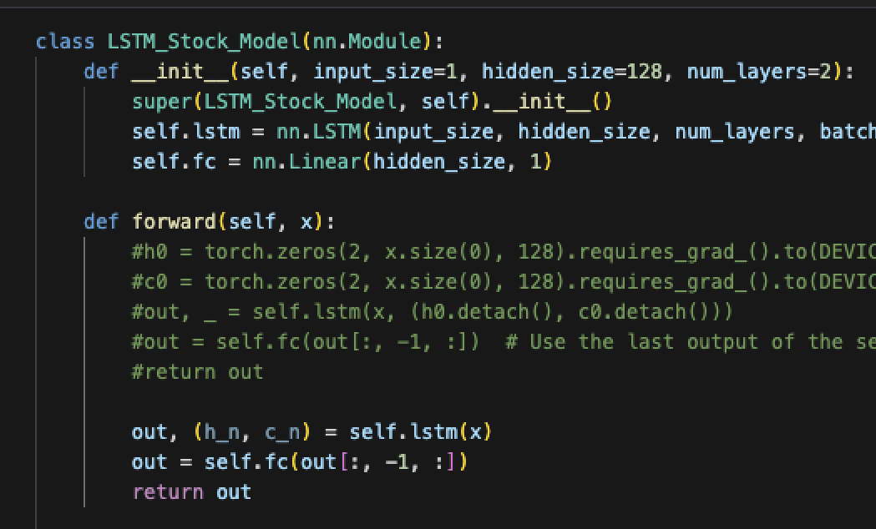
Structure
The structure of the network is slightly more complex.
Internal RNN/LSTM complexity is mostly abstracted away.
Outputs of the model are more complex.
LSTM = output, hidden, cell states.
We need to manipulate this to get the right output.
Note: many examples have the zero thing for initialization, it isn’t needed.

Slide 44
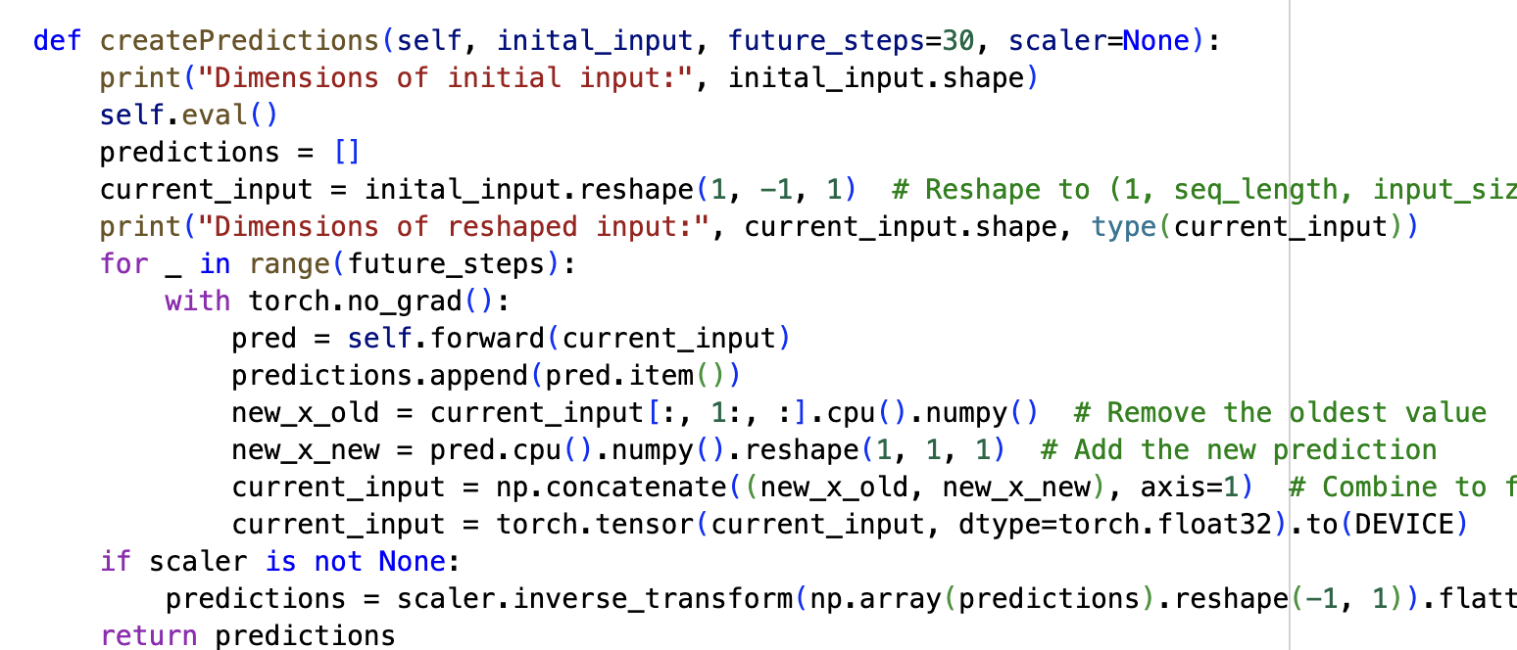
Further Predictions
With a time series, we likely want to predict more than one time step into the future.
However, predicting the future is hard.
Change a prediction from one time step to many – dataset, model, and error calc.
“Step” the predictions using each prediction as a feature going forward.
Example uses a prediction as the next feature.
You don’t have anything in the future as an input.
We’ll do the later, it is probably better.
The farther in the future, the worse things will get.

Slide 45
Text Notes
RNN based models are often used for text/NLP problems.
We need to generate embeddings to represent the value of the tokens.
Recall – count, tf-idf, and their tsvd outputs are ‘simple’ ways to represent tokens.
Word2Vec generated embeddings for tokens – multi-dimensional vectors to convey meaning.
In neural networks we can use an embedding layer to do it for us.
If in the model, this would be done on GPU (this is what the examples do).
You could also map it as part of the pipeline to get it on CPU.
This could be a slow step if data is big – real NLP embedding spaces are massive and vocabs are larger.
In general, NN will perform well with massive data and large embedding spaces – NNs win with complexity.

Slide 46
Being BI is in… if it Performs better
Bidirectional LSTM layers feed the previous sequence bot forwards and backwards.
Common in NLP applications.

Slide 47
Generative Models
LSTMs can be used to generate things, like text.
Text generation is simpler than it sounds at first glance.
Train a model to be able to predict the next word (or token) from text.
Generate text by taking in the previous text, and predict the next word.
The ‘previous text’ + ‘predicted word’ is then the source for the next prediction.
We can treat it as 1 word tokens, large LLMs may have different splits – it varies.
E.g. predict a root word, then the correct suffix: run to running or runner.
2+ grams for thinks like ‘downhill skiing’ and ‘oven glove’.

Slide 48
Got the Right Temperature
Generative models usually utilize a parameter called temperature.
Temperature basically introduces randomness to a prediction.
A model will default to try to predict the correct (most likely) next token.
People don’t really speak like that, especially if writing one piece of prose.
Normal sounding text will use synonyms an alternate terms to avoid sounding robotic.
Temperature makes the actual prediction probabilistic.
The ‘correct’ answer is most likely, but we are choosing from all likely predictions.
Sometimes we want to return a word that is not optimal, but reasonably likely.
The higher the temperature is, the more likely we are to choose an imperfect option.
Multiple implementations of this idea can exist.

Slide 49
Conclusion
Sequential problems are common – prices of anything traded, weather, “life stuff”, etc…
Highlight an example of real-world challenge for analysts – defining the type of solution.
Classification/regression are relatively simple in their structure, or they can be.
We have a target to predict, features we can use, and we can make a model to predict y from X.
Sequential models bring ambiguity to the forefront more – how far in advance can we predict? Should we use any other features? Can we use our predictions to feed other predictions?
Many time series (esp. long term) problems inherently involve ‘features’ we (likely) don’t have.
Commodity prices, climate trends, or product sales are often highly impacted by things like laws, regulations, or decisions from other actors that are hard or impossible to capture in data.
Large and complex models can ‘learn around’ this, but with limits. ‘More data’ often not as useful.

Slide 50
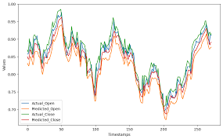
Review – Time My Series
A time series is a dataset that has:
A target value.
Repeated over many time steps.
There might be other features, or not.
Time series forecasting carries the time series target into the future.
Based on patterns in the target value’s movement.

Slide 51
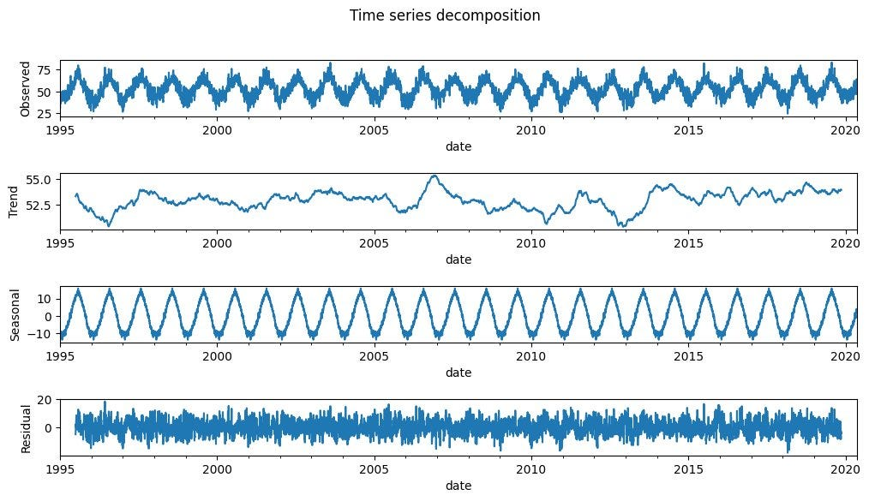
Old School
‘Classical’ (statistical) models:
All attempt to capture non-stationary aspects of data – mean/std should be constant.
Moving average models – trend, cyclicality, add/mult of each.
ARIMA – p,d,q to handle seasonality, trend, differencing, autoregressiveness.
These classical models are relatively simple.
Generally not great for highly complex scenarios.
Variance error is less likely.

Slide 52
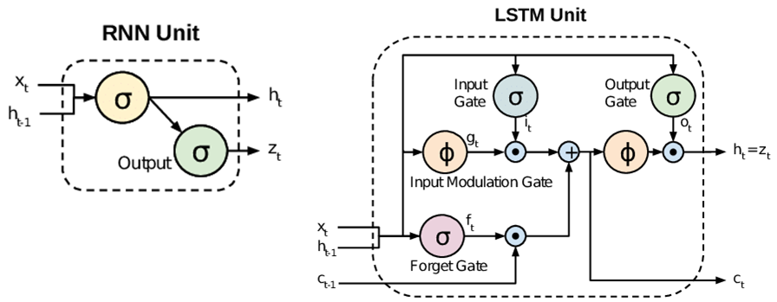
New Hotness
Complex time series models can utilize neural networks.
Facebook prophet: premade, easy to use, time-series library.
Custom Recursive Neural Networks – nn able to capture temporal relationships.
Neural networks for time series.
RNNs attempt to retain a memory, or keep early data to help with later steps.
Use gates (activiation functions + lin. Alg.) to calculate what to keep/drop.
State attributes are the model’s memory.
There are a few varieties of RNNs:
RNN, GRU (we’ll ignore), LSTM.

Slide 53
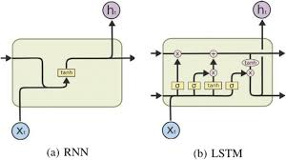
RNN
Basic RNNs implement recurrence with a state.
The state is combined with the input at each time step.
I.e. predictions are based on a combo of old info and new time step.
Can run into issues with vanishing/exploding gradients over time.
The backwards propagation goes back through all the cells to update.
The change w.r.t. initial time steps can flatten – changes in x don’t change y.
Long sequences are hard for RNNs to maintain performance.

Slide 54
LSTM
LSTM models help address this weakness.
Maintain two sets of state, each working differently.
Hidden state, short term, like the RNN state.
Cell state, long term, this is new.
The gates aim to use linear algebra decompositions to keep important parts.
Forget gate – what info should be removed from state.
Input gate – what info is added from the new stuff (h+x).
Output gate – what information should make the pred.

Slide 55
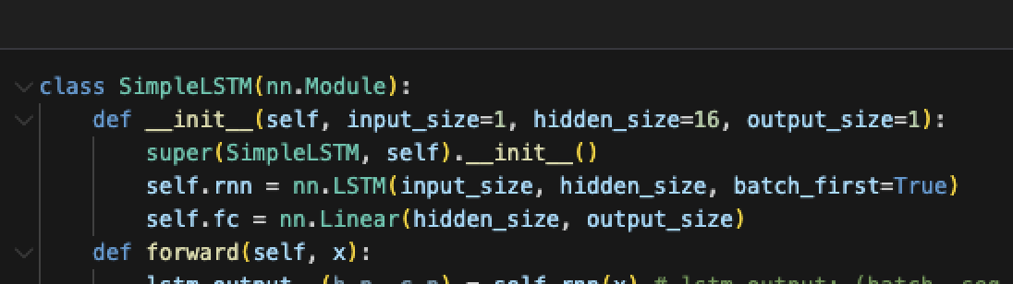
Cell Management
The cell details are invisible.
PyTorch gives us a powerful layer.
Add one layer, and specify number of internal layers.
Change most tuning with hyperparameter changes.
We generally need a simple NN.

Slide 56
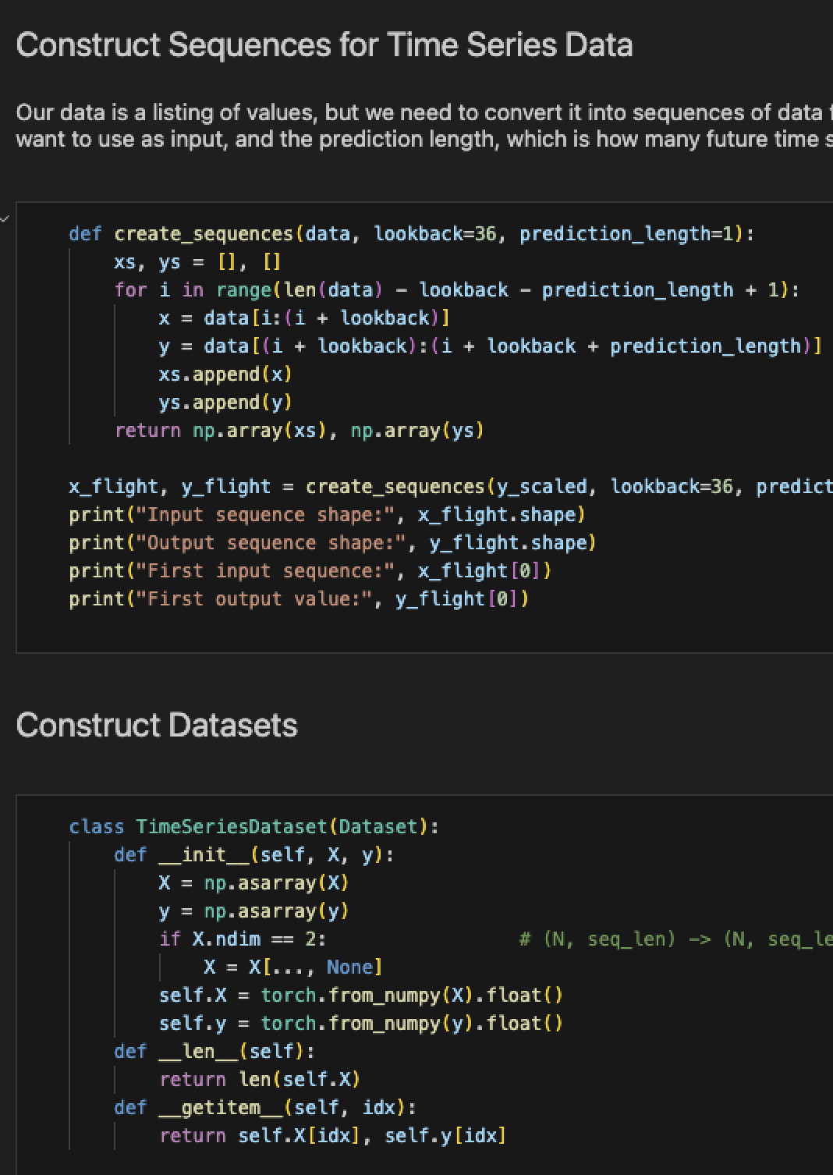
Data for RNNs
Data in RNNs is usually quite different than a flat network.
Each record provides several time steps: t is predicted, t-1 and back are X features.
This will usually require some type of sequence creation loop.
Final shape* is (batch, number_of_observations, features).
This can be change with the batch_first parameter, so be aware.
We can’t randomize, order matters here, so normal cv is out.
Generally, hold some data at the end as a test set.

Slide 57
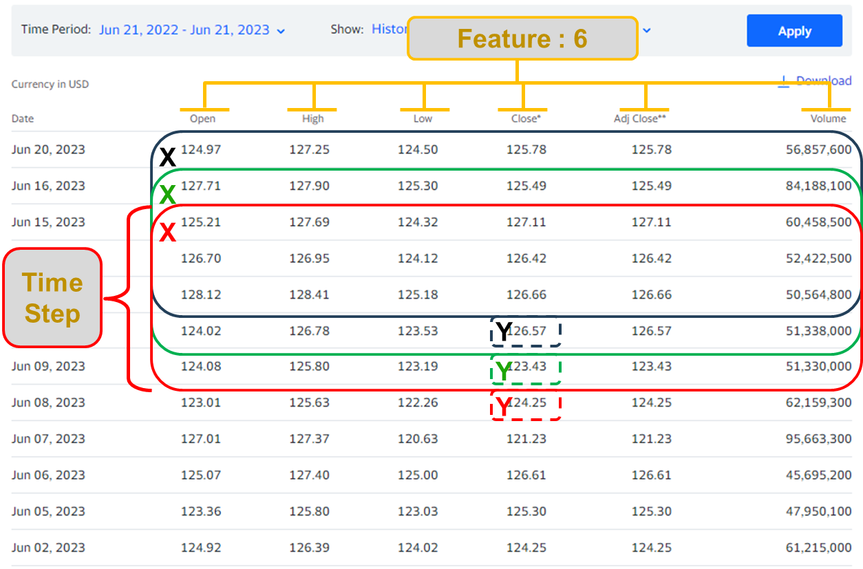
Data Can be Annoying
It can be a little annoying to manage shape of data if complex.
Recommendation:
Build from one record up.
Use frequent shape/example printouts.

Slide 58
Code it up – Simple Start
I added a new workbook that has a simple version of data/models.
There is a little description of the key parts of the models.
Otherwise, it is a pretty barebones example.
The main workbook is a little larger and more complex.
I really recommend you all try one, end-to-end, on your own.
Stock data with any other symbol. Can add volume for more features.
Sktime has other built-in datasets.

Slide 59
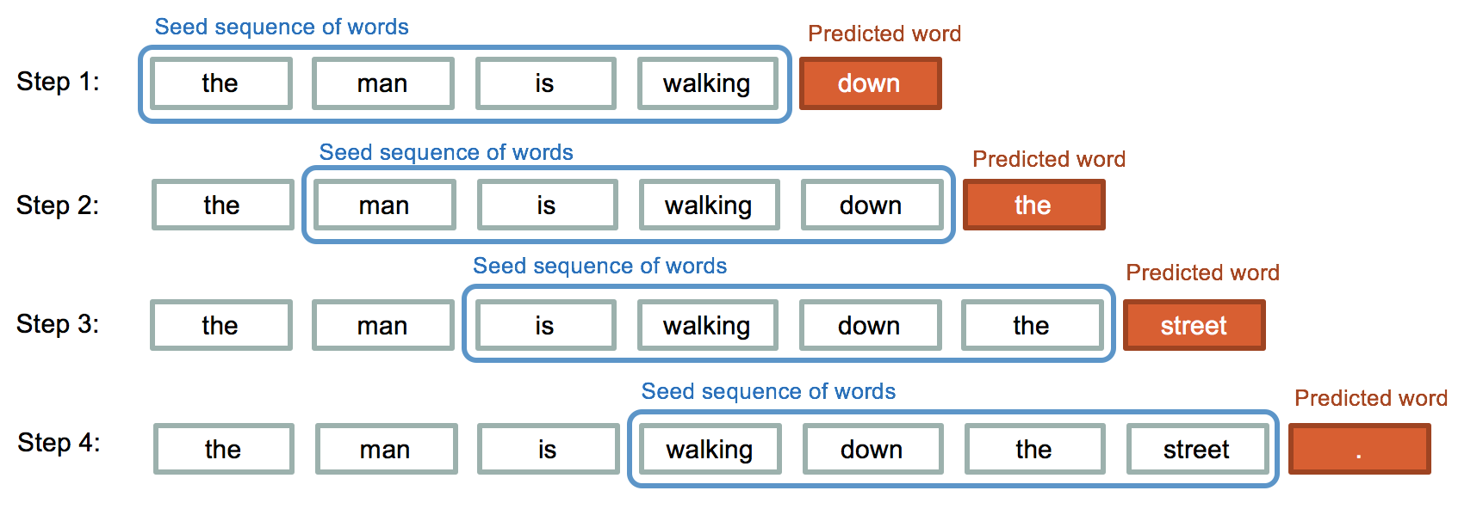
Going Forward…
Next week we’ll revisit NLP with RNNs.
We can handle 2+D data, so the embeddings are now useful.
The RNN should be able to capture and remember info on early tokens in the state(s).
If this is easy for you… (this isn’t all that hard, but we’ll do it next).
Try to do a classification on text with an LSTM.
Data can be text messages from assignment, newgroup from old example, or other.
The embedding layer will do much of the work – what else do you need to do? (“sequences”).
This will lead us to some generative models.
Text is a time-series of tokens: given these tokens, predict the next one(s).
Depending on time and interest, maybe we’ll get to transformers (what real LLMs use now).

