Slide 1
Document Verification
Shailja 19bce1454
Aditya 19bce1402
Pankaj 19bce1642

Slide 2
Literature review

Slide 3
1.3D-LIDAR Based Object Detection and Tracking on the Edge of IoT for Railway Level Crossing
an edge IoT HW platform implementation capable of detecting and tracking objects in a railway level crossing scenario is proposed. The response of the system has to be calculated and sent from the proposed IoT platform to the train, so as to trigger a warning action to avoid a possible collision. The system uses a low-resolution 3D 16-channel LIDAR as a sensor that provides an accurate point cloud map with a large amount of data. The element used to process the information is a custom embedded edge platform with low computing resources and low-power consumption. This processing element is located as close as possible to the sensor, where data is generated to improve latency, privacy, and avoid bandwidth limitations, compared to performing processing in the cloud. Additionally, lightweight object detection and tracking algorithm is proposed in this work to process a large amount of information provided by the LIDAR, allowing to reach real-time specifications.

Slide 4
2.OCR with the Deep CNN Model for Ligature Script-Based Languages like Manchu
Deep CNN model to recognize the text and then build a Manchu recognition system is proposed. A deep CNN model uses four convolution layers to mine different image features. In the Manchu recognition system, the sliding window method is used to identify the same characters in the database.

Slide 5
3.A Gans-Based Deep Learning Framework for Automatic Subsurface Object Recognition From Ground Penetrating Radar Data
This work proposes a Generative Adversarial Nets (GANs)-based deep learning framework, which generates new training data to address the scarcity of GPR data, automatically learns features and detects subsurface objects (via hyperbola) through an end-to-end solution.

Slide 6
4.A Single Neural Network for Mixed Style License Plate Detection and Recognition
This article proposes a single neural network called ALPRNet for detection and recognition of mixed style LPs. In ALPRNet, two fully convolutional one-stage object detectors are used to detect and classify LPs and characters simultaneously, which are followed by an assembly module to output the LP strings. ALPRNet treats LP and character equally, object detectors directly output bounding boxes of LPs and characters with corresponding labels, so they avoid the recurrent neural network (RNN) branches of optical character recognition (OCR) of the existing recognition approaches.

Slide 7
5.Arabic Documents Information Retrieval for Printed, Handwritten, and Calligraphy Image
This paper presents a new computational backend model that supports Arabic document information retrieval (ADIR) as a dataset and OCR services. the proposed work can provide accessing different methods of document layout analysis with a platform where they can share and handle such methods (services) without any setup requirements. One of the used datasets composed from 16,800 Arabic letters written by 60 writers. Each writer wrote each letter from Alif to Ya 10 times in two forms. The forms were scanned at 300 DPI resolution and are segmented in two sets: training set with 13,440 letters for 48 images per class label, and testing set with 3,360 letters to 120 images per class label Convolutional neural network (CNN) is used and adapted for Arabic handwritten letters classification

Slide 8
6.CNN-Based Object Recognition and Tracking System to Assist Visually Impaired People
The application uses MobileNet architecture due to its low computational complexity to run on low-power end devices. To assess the efficacy of the proposed system, six pilot studies have been performed that reflected satisfactory results. For object detection and recognition, a deep Convolution Neural Network (CNN) model is employed with an accuracy of 83.3%, whereas the dataset contains more than 1000 categories

Slide 9
7.Keeping Children Safe Online With Limited Resources: Analyzing What is Seen and Heard
The authors propose a highly modular framework of analyzing content in its final form at the user interface, or Human Computer Interaction (HCI) layer, as it appears before the child: on the screen and through the speakers. Our approach is to produce Children’s Agents for Secure and Privacy Enhanced Reaction (CASPER), which analyzes screen captures and audio signals in real time in order to make a decision based on all of the information at its disposal, with limited hardware capabilities. We employ a collection of deep learning techniques for image, audio and text processing in order to categorize visual content as pornographic or neutral, and textual content as cyberbullying or neutral. We additionally contribute a custom dataset that offers a wide spectrum of objectionable content for evaluation and training purposes.

Slide 10
8.MMU-OCR-21: Towards End-to-End Urdu Text Recognition Using Deep Learning
The researchers have proposed a very large Multi-level and Multi-script Urdu corpus (MMU-OCR-21). It is the largest-ever Urdu corpus of printed text that is effectively suitable to work with deep learning techniques. In total, the corpus is composed of over 602,472 images, including text-line and word images in three prominent fonts, and their respective ground truth. Also, we have performed experiments using multiple state-of-the-art deep learning techniques for text-line and word level images.

Slide 11
9. Multichannel Object Detection for Detecting Suspected Trees With Pine Wilt Disease Using Multispectral Drone Imagery
In this article, a multichannel convolutional neural network (CNN) based object detection was used to detect suspected trees of pine wilt disease after acquiring aerial photographs through a rotorcraft drone equipped with a multispectral camera. The acquired multispectral aerial photographs consist of RGB, green, red, NIR, and red edge spectral bands per shooting point. The aerial photographs for each band performed image calibration to correct radiation distortion, image alignment to correct the distance error of the lenses of a multispectral camera, and image enhancement to edge enhancement to highlight the features of objects in the image. After that, a large amount of data obtained through data augmentation were put into multichannel CNN-based object detection for training and test.

Slide 12
10. YOLO-FIRI: Improved YOLOv5 for Infrared Image Object Detection
The researchers propose a region-free object detector named YOLO-FIR for infrared (IR) images with YOLOv5 core by compressing channels, optimizing parameters, etc. An improved infrared image object detection network, YOLO-FIRI, is further developed. Specifically, while designing the feature extraction network, the cross-stage-partial-connections (CSP) module in the shallow layer is expanded and iterated to maximize the use of shallow features. In addition, an improved attention module is introduced in residual blocks to focus on objects and suppress background. Moreover, multiscale detection is added to improve small object detection accuracy

Slide 13
Our approach
We will be using OCR tools.The AI-OCR tool automatically captures, extracts, and creates an editable and searchable copy of the student data for an efficient verificaton.
AI-OCR tool is very apt for the Document Verification process as it performs operation on extracted text using OCR and performs verification and Validation check.
In this Project, I will take the example VIT ID for document verification.

Slide 14
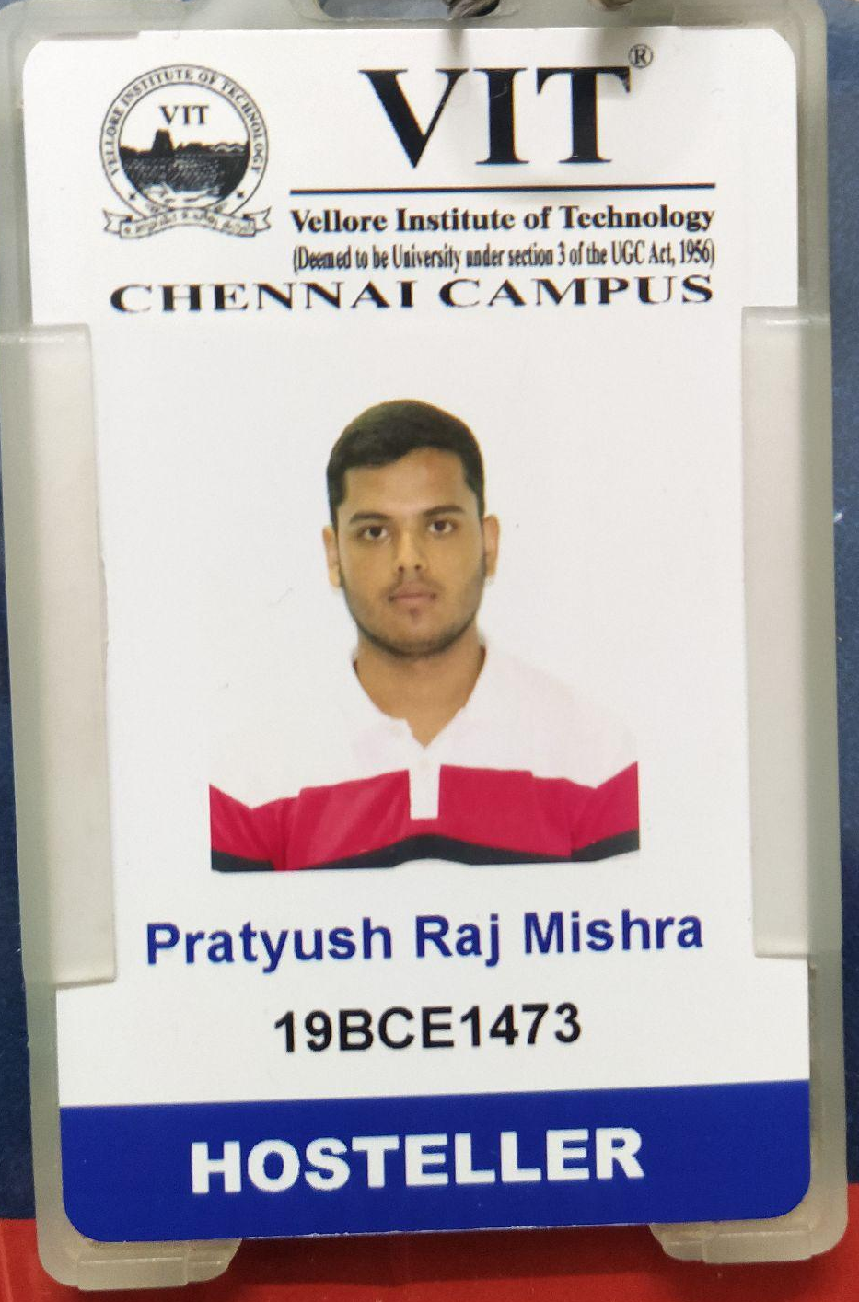
Unique Features of VIT ID card
Every document has some unique features which make it different from others
VIT ID card has these unique features -:
VIT logo
Student Registration number
Student Name
Accommodation detail (weather a hosteller or a day scholar)
Campus Name

Slide 15
METHODOLOGY
STEP 1: Extracting Region of Interest
STEP 2: Training a Object Detection Model
STEP 3: Verification of Document
STEP 4: Extracting Data using OCR
STEP 5: Validation of Data extracted using OCR

Slide 16
STEP 1: Extracting Region of Interest
After extracting the Region of Interest, feature extraction, and object recognition technology will be applied, and features specific to the ID card will be detected and marked.

Slide 17
STEP 2: Training a Object Detection Model
Step I: Collect a comprehensive dataset concerning the ID card.
Step II: After creating a dataset, we need to label it.
Step III: Now, all prerequisites are ready we will train our model

Slide 18
STEP 3: Verification of Document
The trained model will be used to verify whether the input document is a valid ID Card or not if it is, we will proceed to the next step, or else the document will be declared invalid and the process will end.

Slide 19
STEP 4: Extracting Data using OCR
After it is verified that the submitted document is an ID card then information present on ID will be extracted by the means of Optical Character Recognition (OCR). This information will contain
Registration number :- XXXXXXXXX
Accommodation detail :- XXXXXXXX

Slide 20
STEP 5: Validation of Data extracted using OCR
This information will be processed and validated by using an existing database. Name, Registration number, Accommodation detail, Campus Name will be verified by comparing it with customer records available in the database which we will create.

Slide 21
THANK YOU

