Slide 1

iProjectX · Illustrated sales story
Stop flying blind.
Give the board one truth — then walk every feature in the product.
Notes:
Open on the title. Do not rush. Ask: “When did you last walk into a steering committee without a second spreadsheet?” Pause. Then: this story is why iProjectX exists.

Slide 2
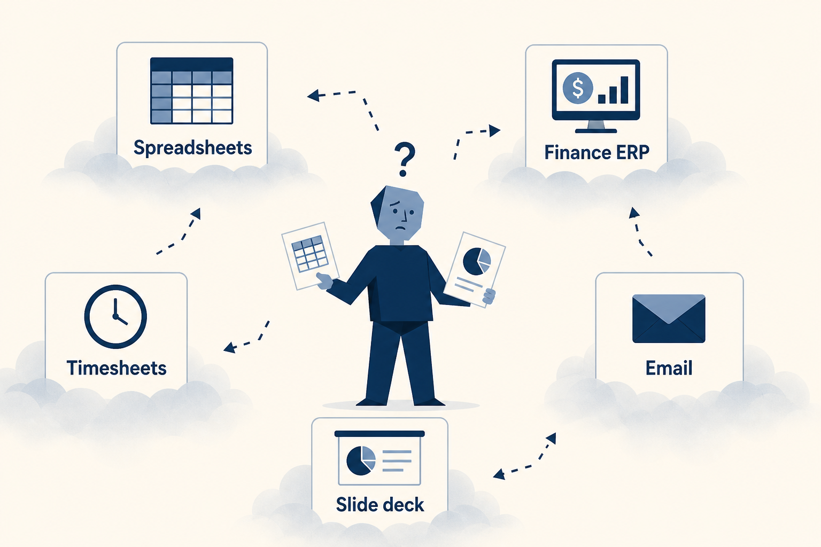
Flying blind looks like this: five systems, one story that never matches.
iProjectX · Stop Flying Blind · Confidential
2 / 28
Notes:
Point at each box. Ask which one they live in this week. Spreadsheets, ERP, timesheets, email, and the slide deck are the usual five. None of them share a formula.

Slide 3
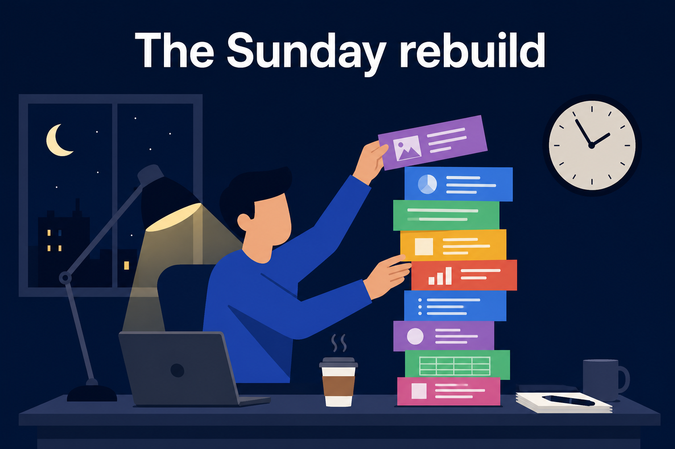
Someone rebuilds the pack on Sunday. By Monday the numbers have already moved.
iProjectX · Stop Flying Blind · Confidential
3 / 28
Notes:
This is the human cost. Do not invent hours saved. Ask what that Sunday is worth to them. The product’s answer is a live pack — Executive Reports — not another rebuild.

Slide 4
WHAT “FLYING BLIND” MEANS IN THE ROOM
Four questions nobody can answer from one screen.
PMO
Is this RAG real — or did someone type the colour?
CFO
Does the forecast match the invoice and the timesheet?
CIO
Is there one system of record for the change portfolio?
CISO
If audit asks, can we replay who saw what?
iProjectX · Stop Flying Blind · Confidential
4 / 28
Notes:
Read the four questions slowly. The rest of the deck is how iProjectX answers each one.

Slide 5

iProjectX is the cockpit: health, money, people, and the calendar on one picture.
iProjectX · Stop Flying Blind · Confidential
5 / 28
Notes:
This is the turn in the story. From here we walk the product — not a brochure of modules, a journey from idea to board pack.

Slide 6

The whole product is four verbs: See. Explain. Govern. Trust.
iProjectX · Stop Flying Blind · Confidential
6 / 28
Notes:
See = Pulse, Cockpit, Dashboard, Infographic, Timeline. Explain = Health Engine + Explain chips on RAG and money. Govern = gates, RAID, decisions, reports. Trust = MFA, RLS, optional SSO/BYOD, audit.

Slide 7
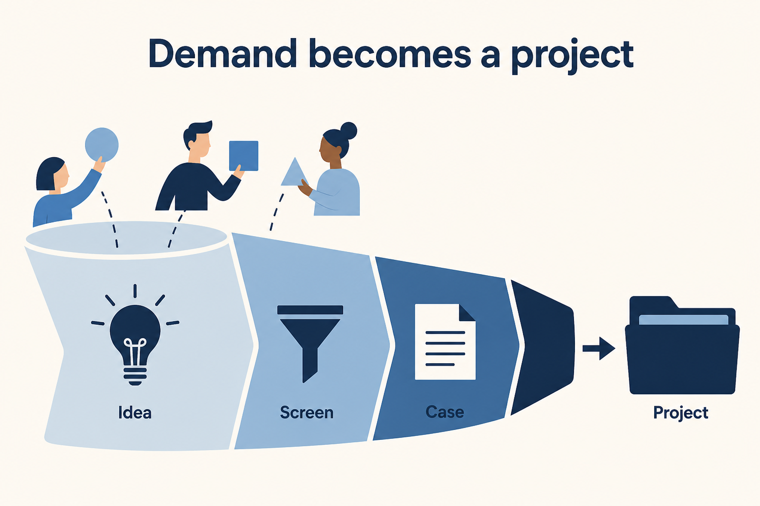
The story starts before the project exists — an idea enters Demand.
iProjectX · Stop Flying Blind · Confidential
7 / 28
Notes:
Demand Pipeline stages: Idea → Screening → Business Case → Approved / Rejected / On Hold. Admin can convert an approved case into a project. Jira and a signed webhook can drop work into Demand or Work Items.

Slide 8
THE STORY · PORTFOLIO
From idea to a living register
Every item below is a real page in the product.
Demand Pipeline
New Project Wizard
Project Register
Idea, screening, case, approve / reject / hold.
Seven steps: project, streams, gates, FY, work, governance, review.
The inventory. Filters, KPIs, charts. One code per project.
Project workspace
Programs
Project Infographic
Overview, streams, decisions, work, RAID, finance — one record.
Roll-up health and money across a programme.
One-page visual brief. PDF and PPT export.
Segmentation
Prioritisation
Movements
Cluster the portfolio — budget × value, not a flat list.
Rank by ROI, priority, benefits, and funding pressure.
Gate slip and change-request movement this period.
Portfolio Scenarios
Business Units
Home + My Work
Include / exclude projects under a funding cap.
The org shape the register reports against.
Role-aware start. Your approvals and assigned work.
iProjectX · Stop Flying Blind · Confidential
8 / 28
Notes:
Do not tour every page. Pick Demand → one project → Infographic. The rest is “and the register already has…”

Slide 9
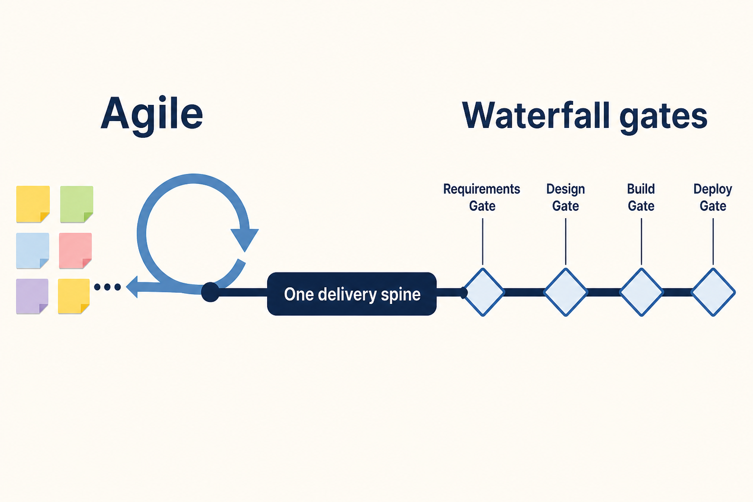
Agile sprints and Waterfall gates share one spine. No second system.
iProjectX · Stop Flying Blind · Confidential
9 / 28
Notes:
Delivery Methods & Gates lets the org configure Waterfall (default 9 gates) and Agile (default 6). Work Items link to a gate or a sprint. Work Board is the kanban. Agile page shows velocity. One project can be hybrid.

Slide 10

A gate can say no. The checklist must be complete before Approve.
iProjectX · Stop Flying Blind · Confidential
10 / 28
Notes:
Stage Gates: approve / hold / reject. Checklists are enforced. Roadmap × Governance overlays the plan on the gate flow. Governance Channels name the forum and the decision rights. This is govern — not a status meeting.

Slide 11
THE STORY · DELIVERY
How the work actually moves
Layman version: the board, the calendar, the path, and the people.
Work Items
Work Board
Timeline
The WBS / tasks. Linked to a gate or a sprint.
Kanban with drag-and-drop. Filter by project and sprint.
FY Gantt, TODAY line, planned vs actual, gate markers.
Schedule CPM
Dependencies
Agile / Sprints
Critical path. FS / SS / FF / SF links with lag.
Cross-project waits. Needed-by dates. Criticality.
Velocity and backlog on the same spine as gates.
Roadmap × Governance
Roadmap Analytics
Risk Roadmap
The plan drawn on top of the gate flow.
Investment mix + Monte Carlo cost (2,000 runs).
Risks on a timeline. P×I heatmap. Critical ≥ 15.
Governance Channels
Delivery Methods
Latest Updates
Forums, cadence, who may decide.
Configure Waterfall, Agile, Hybrid and gate templates.
What moved. Manual status with an overall RAG.
iProjectX · Stop Flying Blind · Confidential
11 / 28
Notes:
Show Timeline with the TODAY line if you only have one delivery click.

Slide 12
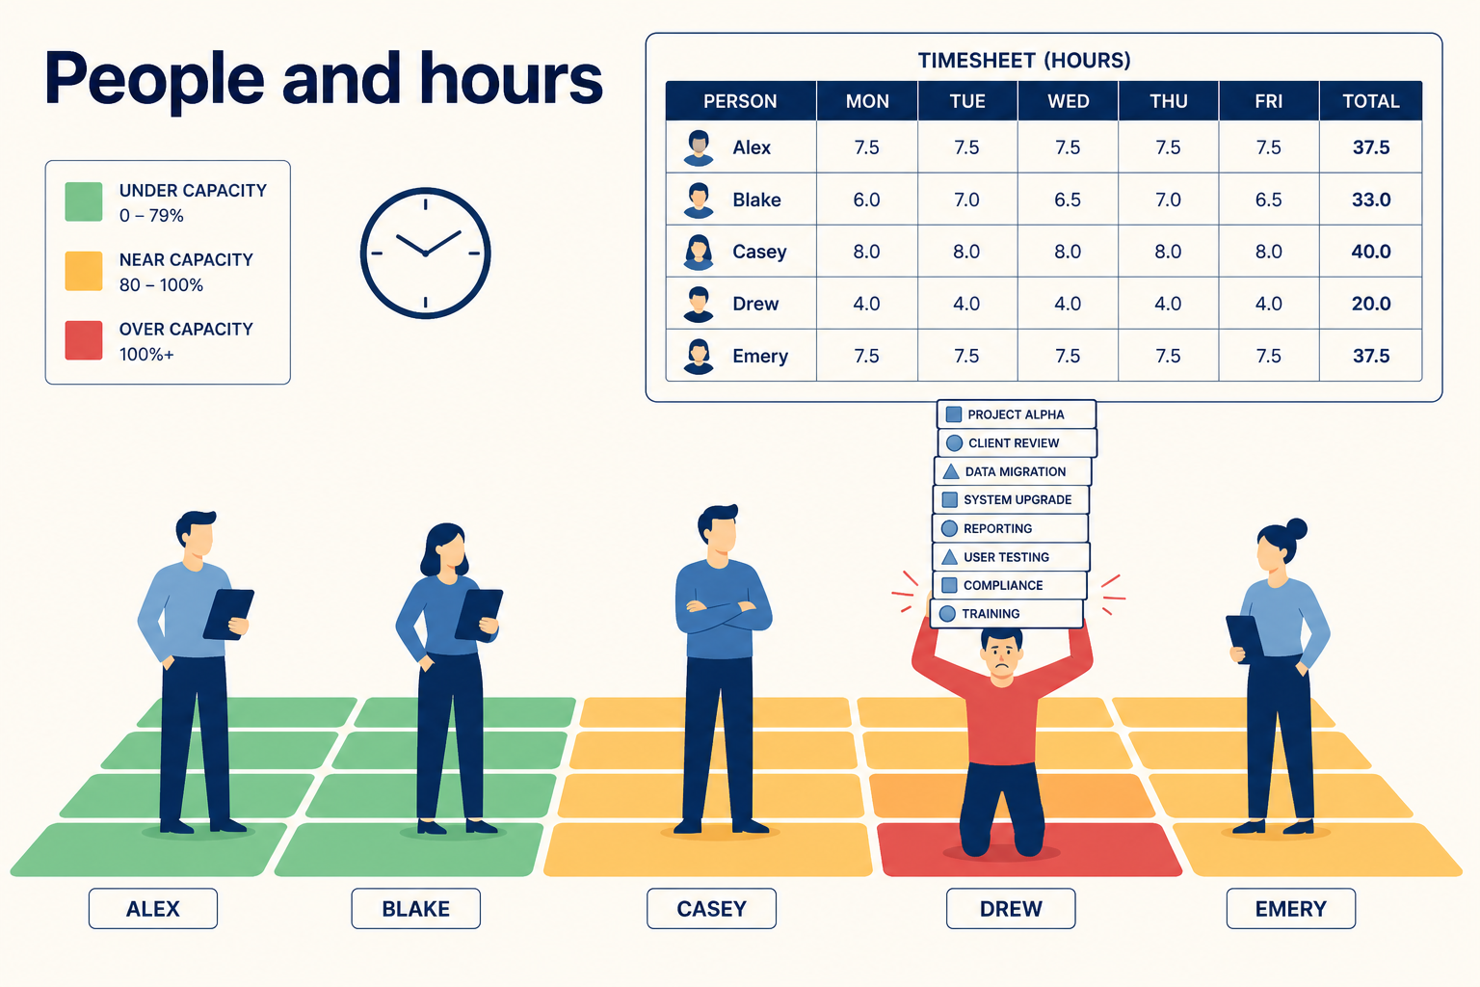
People are not a side spreadsheet. Hours hit the same picture as money.
iProjectX · Stop Flying Blind · Confidential
12 / 28
Notes:
Resources = plan vs actual, skill heat, utilisation. Health Engine treats 70–95% as the healthy band; >110% is overload. Timesheets: draft → PM → resource manager → approved. Calendar or grid. Billable and non-billable. Capacity gaps also appear in Executive Intelligence.

Slide 13
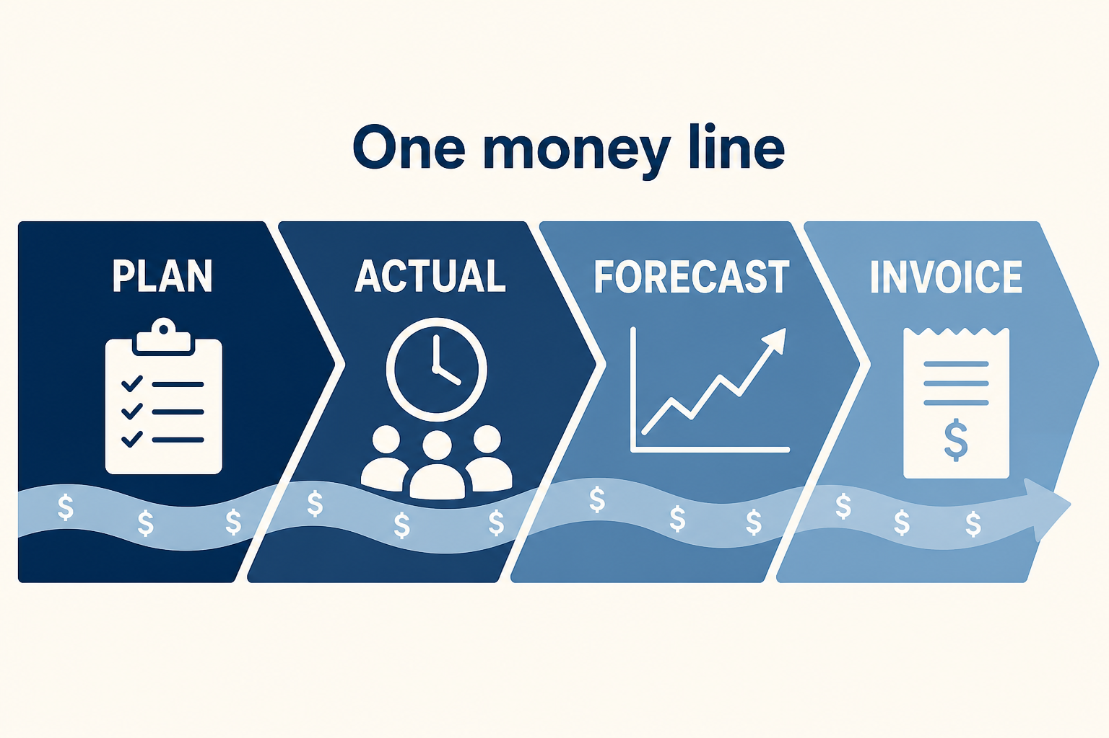
Plan, actual, forecast, invoice — one conversation. Not four files.
iProjectX · Stop Flying Blind · Confidential
13 / 28
Notes:
Financials = monthly CapEx/OpEx plan vs actual vs forecast. FY Allocation splits by financial year (default FY starts April). Phase Financials by stream. EVM: PV, EV, AC, SPI, CPI, EAC. Cost vs Benefit. Benefits Realisation feeds the 5% health weight. Org invoices use the live template — including already-issued bills.

Slide 14
THE STORY · MONEY
Every finance page the CFO can open
If it is about dollars, it sits on this line.
Financials
FY Allocation
Monthly plan / actual / forecast. Variance with Explain.
Split by financial year. Default FY start: April.
Phase Financials
Earned Value (EVM)
Spend by phase or stream — not only by project.
SPI = EV/PV. CPI = EV/AC. EAC from the engine.
Cost vs Benefit
Benefits Realisation
What it costs versus what it returns.
Target vs realised. 5% of the health score.
Billing & Invoices
Timesheets → $
Org subscription invoices. Live chrome/template.
Approved hours are not a separate product.
iProjectX · Stop Flying Blind · Confidential
14 / 28
Notes:
Open one project and stay there: plan, actual, forecast, an invoice. Do not hop tenants.

Slide 15
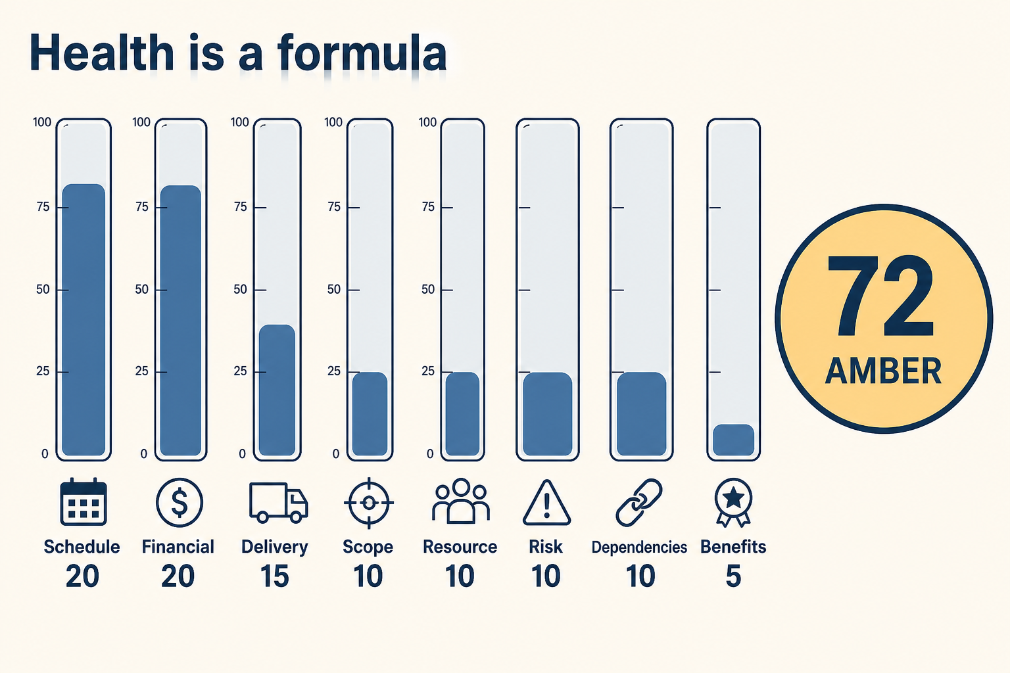
Health is a formula — eight weights. Not a colour someone typed.
iProjectX · Stop Flying Blind · Confidential
15 / 28
Notes:
Published weights: Schedule 20, Financial 20, Delivery 15, Scope 10, Resource 10, Risk 10, Dependencies 10, Benefits 5. Same engine on Infographic, Cockpit, and Pulse. Manual RAG still exists on the register; calculated health is what you defend.

Slide 16
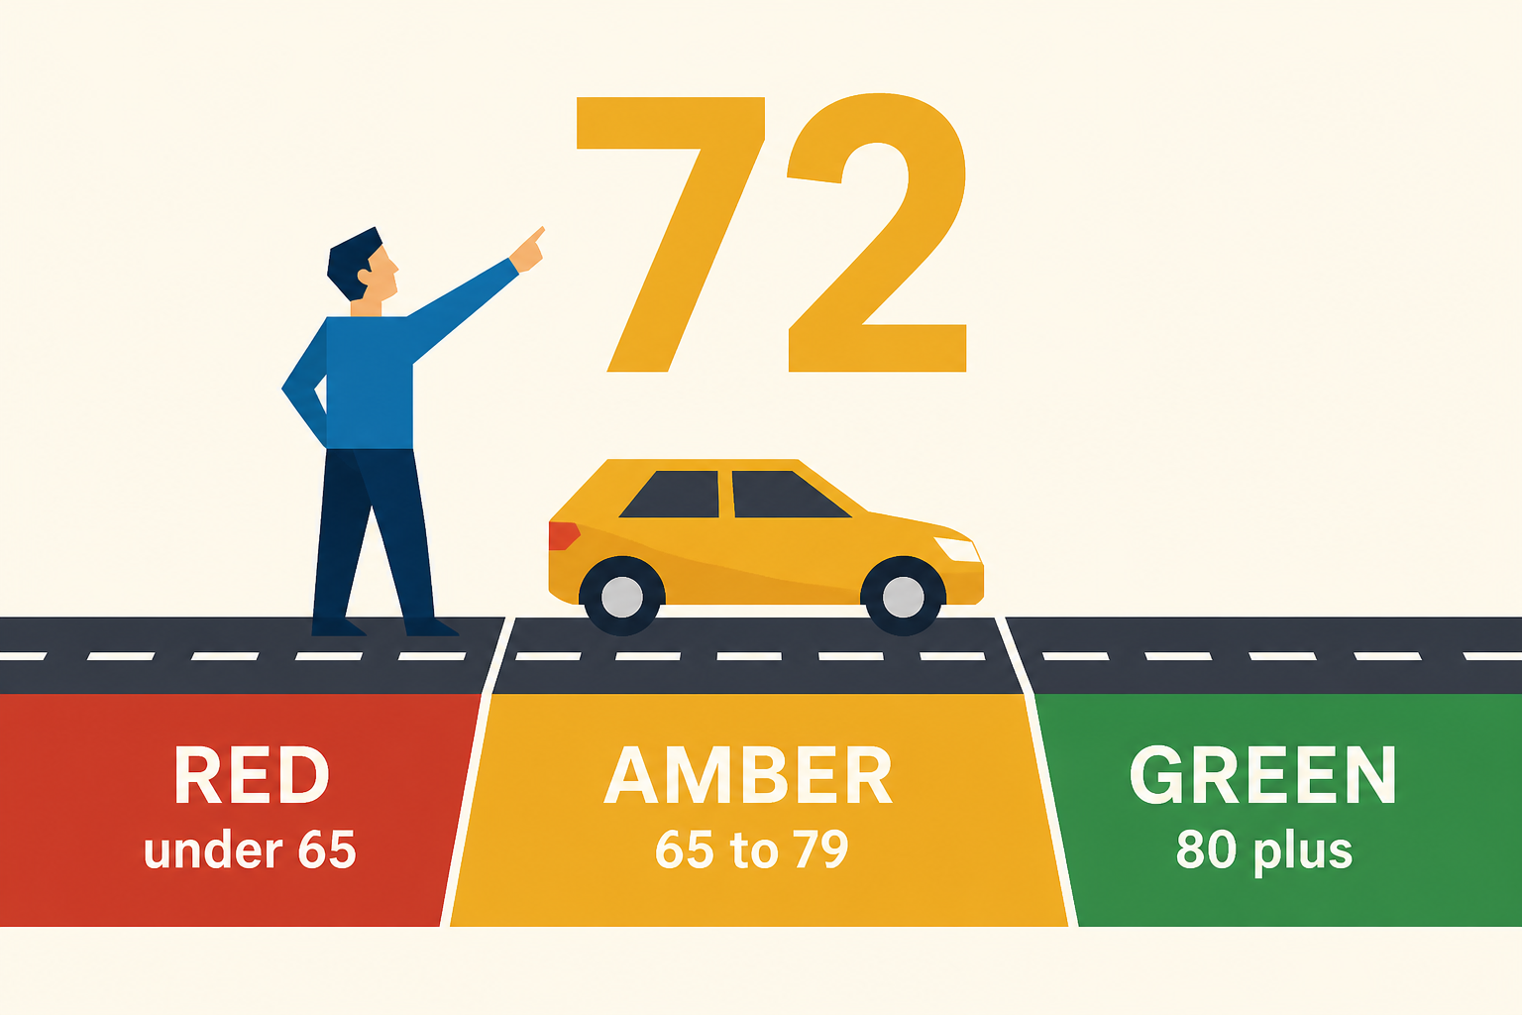
Green ≥ 80. Amber 65–79. Red < 65. Same bands in every tenant.
iProjectX · Stop Flying Blind · Confidential
16 / 28
Notes:
Click a RAG chip. Explain opens the drivers. Pulse uses six areas (Financial, Delivery, Resources, Risk, Benefits, Dependencies) and flags a move if the score shifts by 3 or more. Early warnings: FTE gap, slip, overrun, critical risks, util >110%, gates ≥15 days late. 30-day predictive health with confidence 50–92%.

Slide 17
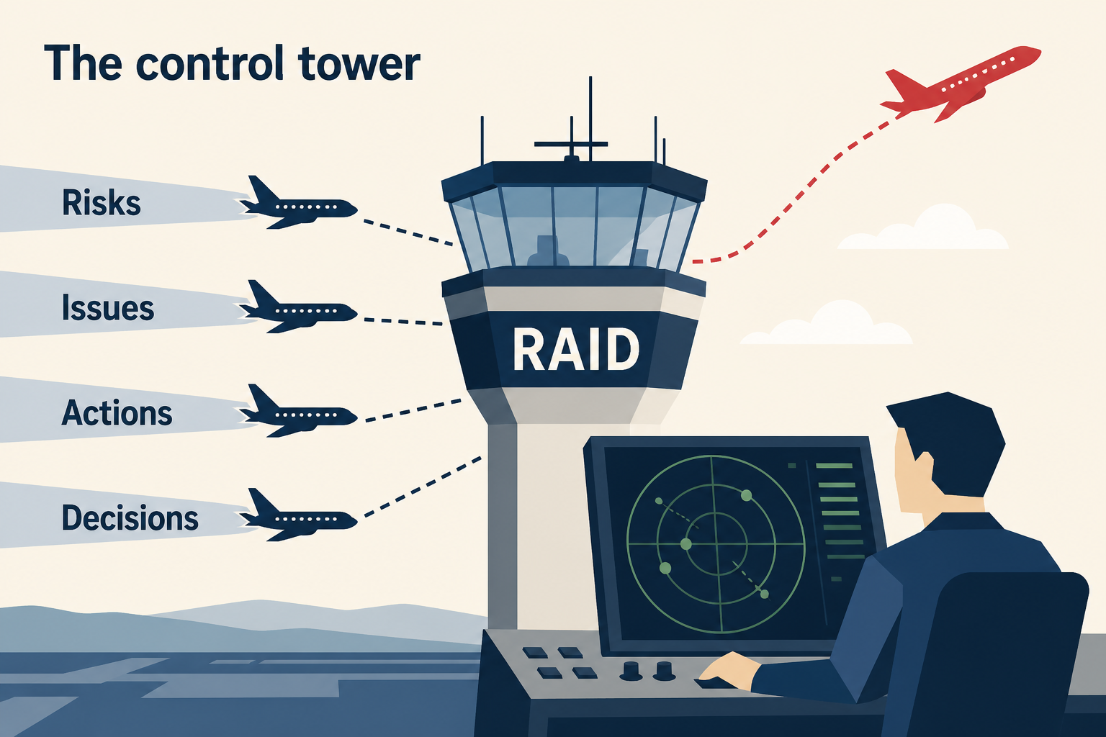
RAID is the control tower: Risks, Issues, Actions, Decisions — plus who owns them.
iProjectX · Stop Flying Blind · Confidential
17 / 28
Notes:
Severity = probability × impact. Critical ≥ 15. Auto-escalation fields. Decisions have an approval workflow (Pending / In Review / Approved / Rejected / On Hold). Actions have owners and dates. Stakeholders map influence. Lessons stay on the project. Release & Change Register is the change-request book. Alert emails: approvals, overdue RAID, escalation, pulse — when the platform has mail on.

Slide 18
THE STORY · GOVERN
Evidence, not folklore
If audit asked tomorrow, these pages are the replay.
Risks
Issues
Actions
P×I score. Critical ≥ 15. Escalation timestamp.
Blockers and defects on the same spine.
Owner, date, done or not. No inbox archaeology.
Decisions
Stakeholders
Lessons Learned
Log + approval. Awaiting my approval on My Work.
Influence / interest. Sponsor can be a login.
Kept on the project, not in a forgotten folder.
Release & Change
Stage Gates
Executive Reports
Change requests that move the baseline.
Hold / reject / pass. Checklist first.
The board pack: 7 tabs, Print/PDF, Excel.
Report Builder
Audit Log
Alert emails
Save your own metric snapshot.
Privileged actions. Excel pack ≤ 10,000 rows.
Digest and escalation — org can opt channels.
iProjectX · Stop Flying Blind · Confidential
18 / 28
Notes:
Executive Reports is the board pack. Do not call it a module that does not exist.

Slide 19
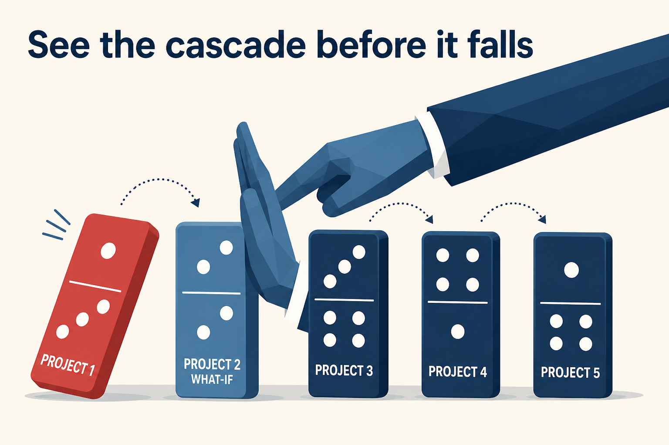
A delay is a row of dominoes. What-if lets you touch the first one on purpose.
iProjectX · Stop Flying Blind · Confidential
19 / 28
Notes:
Executive Intelligence: delay cascade through depends-on → dependent; resource capacity gaps (flag >0.5 FTE); resource optimisation; dependency criticality; change-control impact; investment ranking; funding what-if; decision backlog; benefits narrative; governance cadence tasks. This is See + Explain before the overrun.

Slide 20
THE STORY · COMMAND
What leaders open on Monday
Six Pulse areas. One cockpit. A dashboard. An intelligence bench. An in-house AI.
Portfolio Pulse
Executive Cockpit
Six areas + week-over-week. Snapshot ~every 6 days.
Live snapshot: money, delivery, benefits, health table.
Executive Dashboard
Executive Intelligence
Full cockpit + timelines + Generate PDF.
What-if, capacity, funding, decisions, benefits story.
In-house AI
Explain This
Ask the portfolio in English. Data stays in the tenant.
On RAG chips and money KPIs — drivers, not folklore.
Download page
Command palette
PDF / PPT / PNG of the page you are on.
⌘K / Ctrl+K to any page you are allowed to see.
iProjectX · Stop Flying Blind · Confidential
20 / 28
Notes:
Demo path: Pulse → one red → Explain → Intelligence what-if. Twelve minutes.

Slide 21
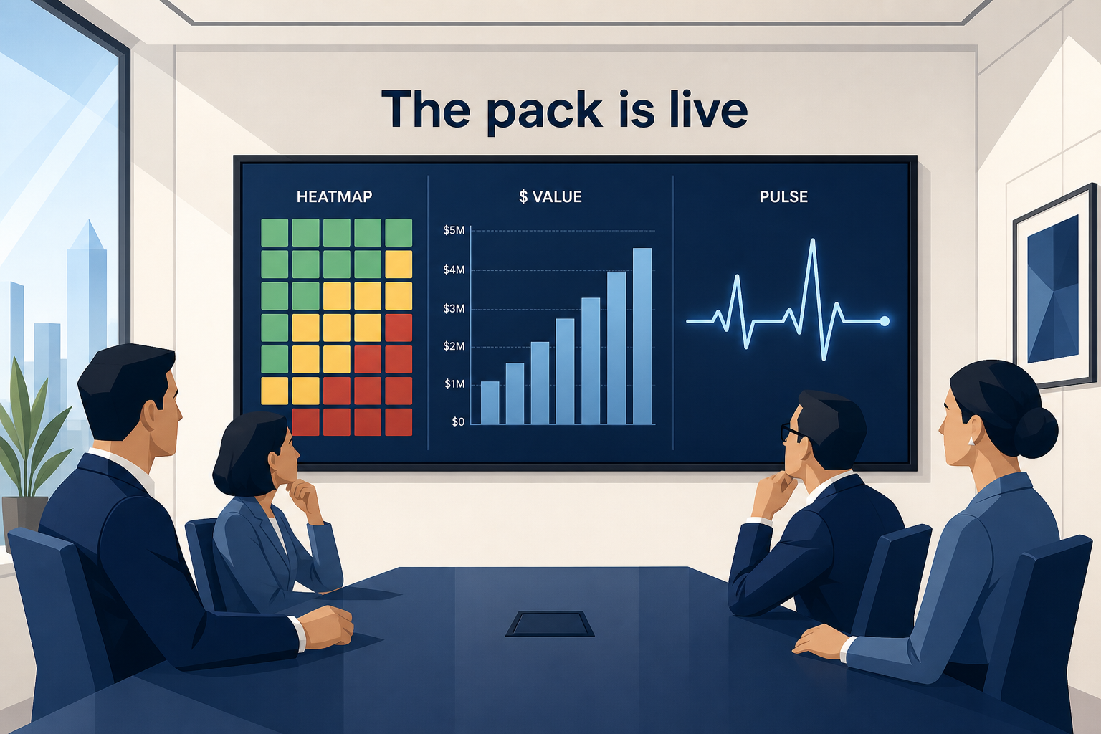
The pack is a live view. Seven tabs. Print, PDF, or Excel — not a Sunday rebuild.
iProjectX · Stop Flying Blind · Confidential
21 / 28
Notes:
Executive Reports tabs: Overview, Portfolio & RAG, Financials, Risks & Actions, Benefits, Stage Gates, Programs & BU. Project Infographic exports a one-project brief. Page Downloads policy decides which pages may export PDF/PPT/PNG.

Slide 22
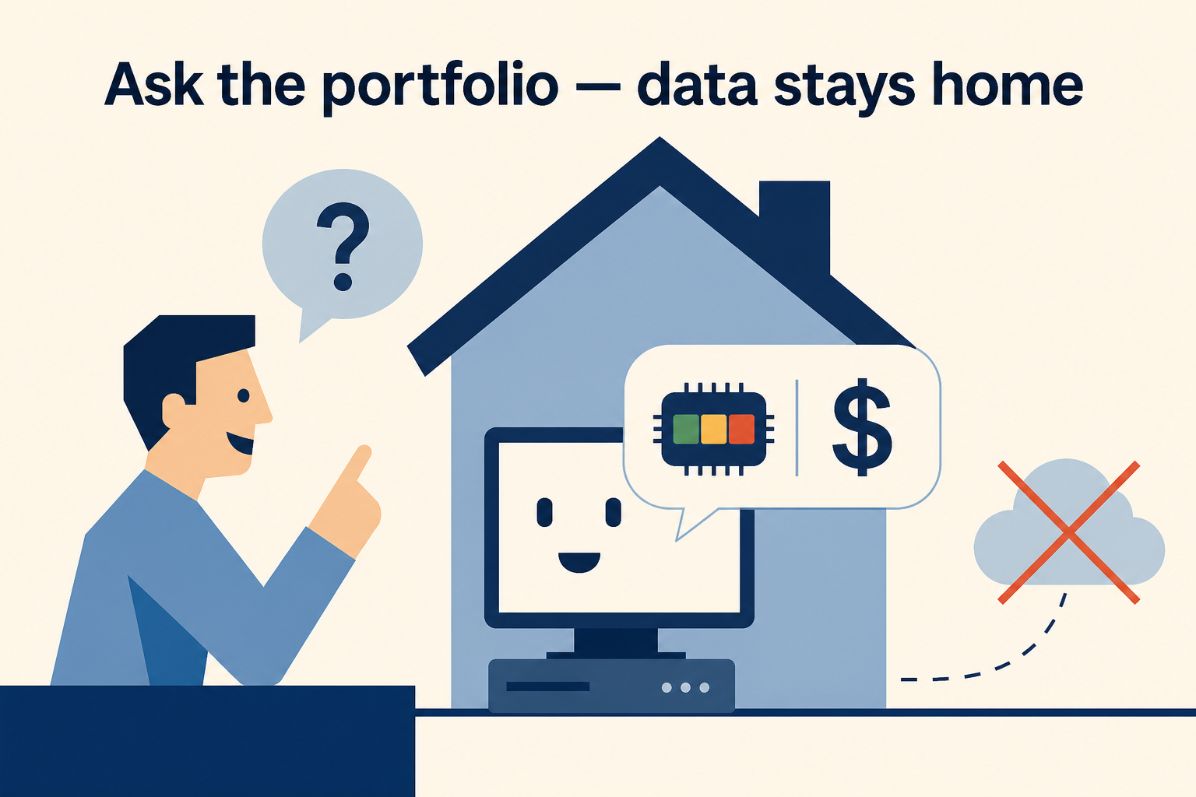
Ask the portfolio a question. The default answer never leaves the house.
iProjectX · Stop Flying Blind · Confidential
22 / 28
Notes:
In-house AI is the default — RLS-scoped, no external model. An approved Open AI model is optional, off unless the org asks. Do not demo a public chatbot. Show a question about this tenant’s red project.

Slide 23
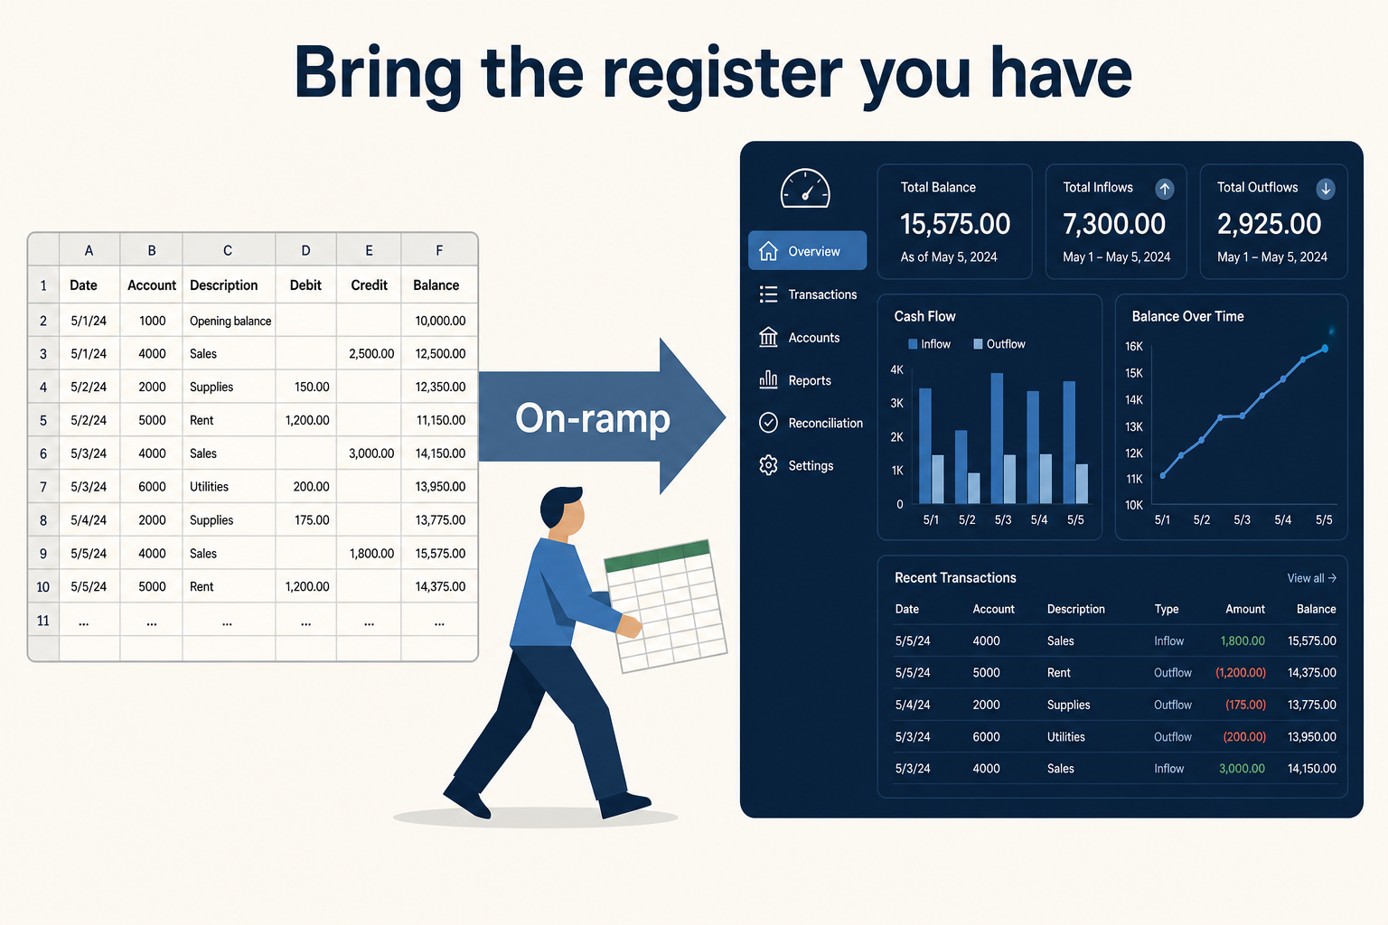
Bring the register you already have. Excel is the on-ramp, not the prison.
iProjectX · Stop Flying Blind · Confidential
23 / 28
Notes:
Data Editor: 29 tables, import upserts on project code, async export for large orgs. Needs data_editor / template_upload capability. Jira Cloud/DC imports issues into Work Items or Demand (test connection first; default 50 issues). Custom webhook → Demand. Azure DevOps and ServiceNow are listed, not shipped — do not sell them.

Slide 24
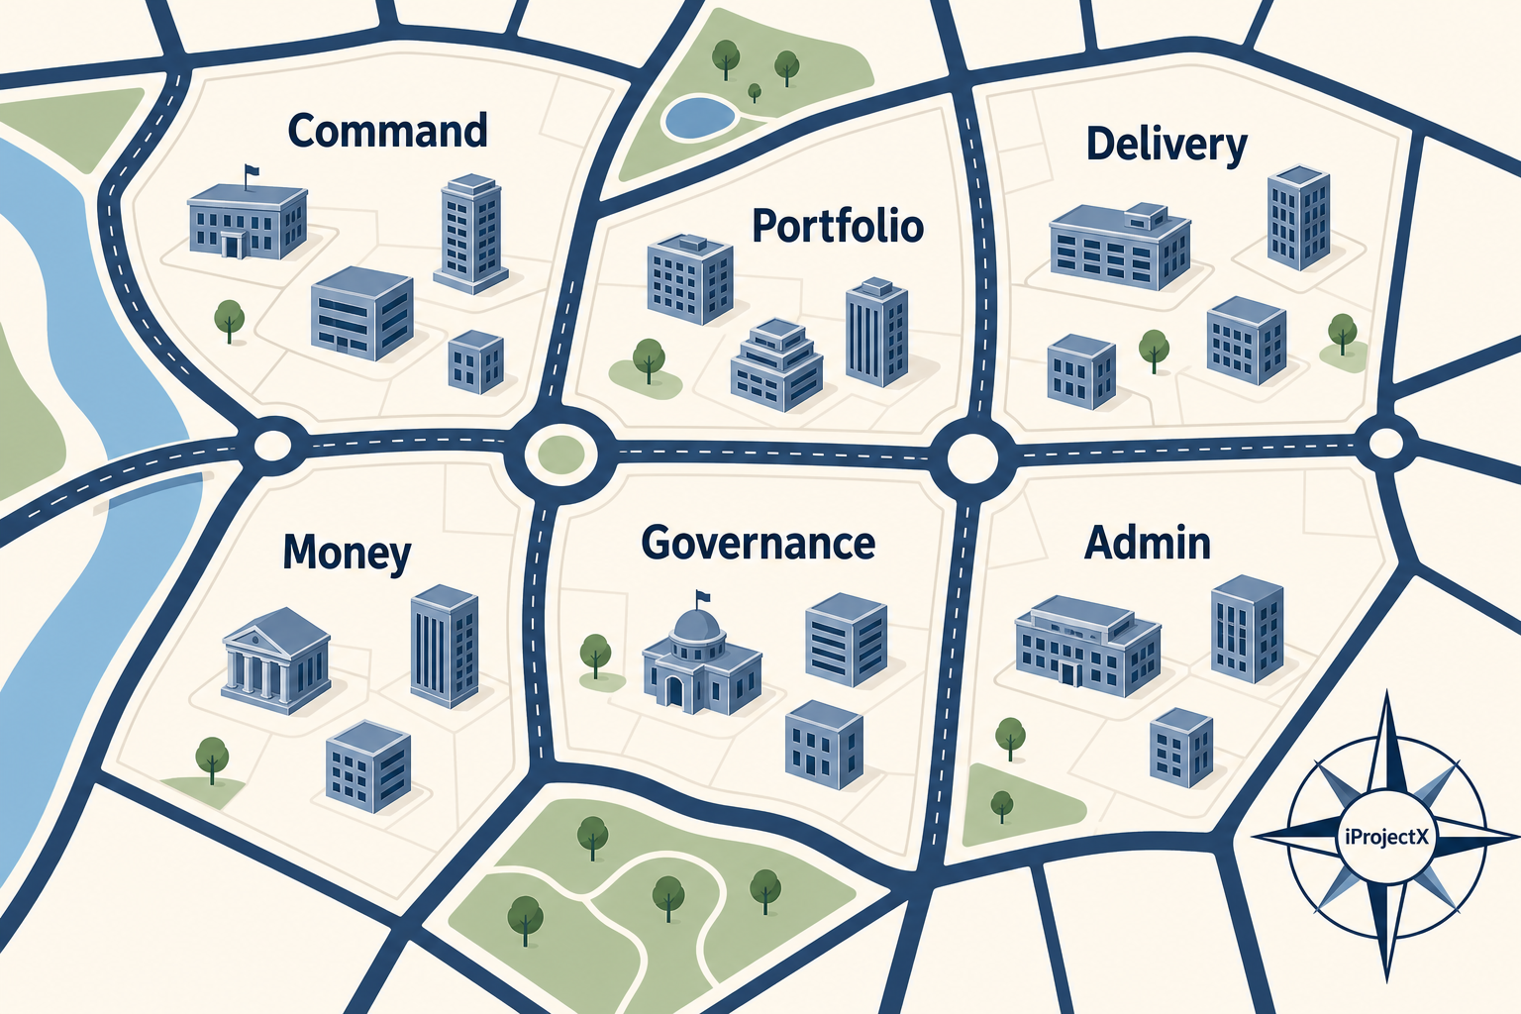
One product. Neighbourhoods: Command, Portfolio, Delivery, Money, Govern, Admin.
iProjectX · Stop Flying Blind · Confidential
24 / 28
Notes:
This image is the map. The next slide is the remaining admin and trust streets so nothing is missing from the pack.

Slide 25
THE STORY · OPERATE
Admin, integrations, and the rest of the streets
Still the same tenant. Nothing here is a second product.
Team & Users
Permissions
Project data access
Invite, roles, activate. admin / org_admin / bu_lead / pm / executive.
Page + table + capability matrix. Default deny.
Limit which projects a role or user can see.
Navigation sequence
Page downloads
Integrations
Reorder or hide sidebar items per org.
Allow or deny PDF / PPT / PNG per page.
Jira (shipped). Webhook (shipped). ADO / ServiceNow not shipped.
Data Editor
Chart Theme + styles
Organisation Settings
Excel workbook in and out. 29 tables.
Palette and chrome. Optional cartoons on Home.
FY start month, MFA status, notification prefs.
Alert emails
Licenses + Billing
Closed project purge
Org channel prefs. Users can opt out where allowed.
Certificates and subscription invoices for the org.
Completed / cancelled older than one year.
Support + Legal
Onboarding
Focus mode
Tickets to the platform. Published policies in-app.
First-run setup for a new organisation.
Denser chrome. Live sync when the database moves.
White-label login
/o/:slug/login — their name on the door.
iProjectX · Stop Flying Blind · Confidential
25 / 28
Notes:
Skip this slide in a 12-minute demo. Keep it in the leave-behind so procurement can see the streets.

Slide 26
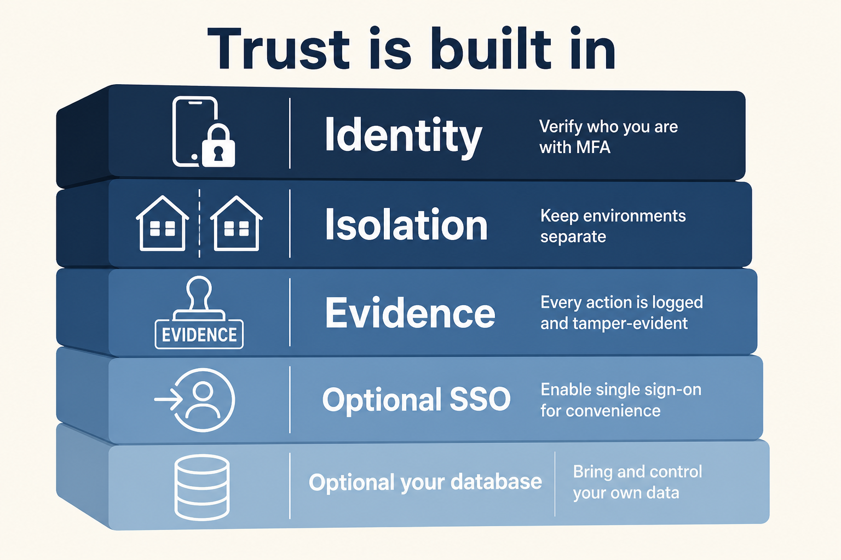
Trust is built in: MFA for everyone. Isolation. Evidence. Optional SSO and BYOD.
iProjectX · Stop Flying Blind · Confidential
26 / 28
Notes:
MFA (TOTP) is required for all users. Row-level tenancy. Optional SAML SSO, IP allowlist (max 50), BYOD on a customer PostgREST-compatible database. White-label name, logo, colours. In-house AI default. Audit + security Excel packs. Say readiness for SOC 2 / ISO — never “we are certified” unless Legal confirms.

Slide 27
THE WEEK, AFTER THE FOG LIFTS
A layperson can tell this story in six beats.
01 Monday
02 The chip
03 The line
Pulse shows what moved. One red is already named.
Explain opens the formula. Amber is 65–79 — not a feeling.
Plan, actual, forecast, invoice agree or they don’t — on one project.
04 The people
05 The gate
06 The pack
Resources and timesheets show who is over 110%.
A checklist blocks Approve. A decision is logged with evidence.
Executive Reports print from the tenant. Nobody rebuilt Sunday.
iProjectX · Stop Flying Blind · Confidential
27 / 28
Notes:
This is the close of the story before the ask. Read the six beats. Then the last image.

Slide 28

Put one red project on the wall.
If we cannot explain it, invoice it, and pack it from the same tenant — we have not earned the next meeting. · www.iprojectx.com · Expression of Interest
Notes:
Ask for an Expression of Interest and a scoped pilot on their extract. No list price. No invented ROI. No fake logos. No SOC 2 / ISO badge.

