Slide 1
Network Intrusion Detection System Using Machine Learning and Deep Learning for IoT Networks
Presented By:
Shailja Roy
Tech-295B
May 15, 2025
Committee:
Dr. Armin Moghadam(Chair)
Dr. Riti Gour
Prof. Bill Saichek

Slide 2
Personal Background
I did my bachelor's in Telecommunication Engineering from DSCE, Bengaluru, India in 2018.
I worked as a DevOps Engineer from July 2018 to November 2022.
Currently, I am doing a Master's in Engineering Technology and graduating this spring May 2025.
Motivation:- Securing the future of connected devices through intelligent intrusion detection.

Slide 3
Presentation outline
Introduction
Literature Review
Objective
Methodology
Results
Conclusion

Slide 4
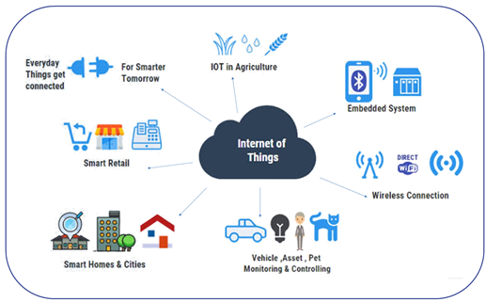
Introduction
IoT Definition: The Internet of Things (IoT) refers to interconnected devices that communicate and exchange data over the internet.
Applications: Smart homes, healthcare, industrial automation, smart cities, etc.
Significance: The rapid growth of IoT is transforming industries and daily life.

Slide 5
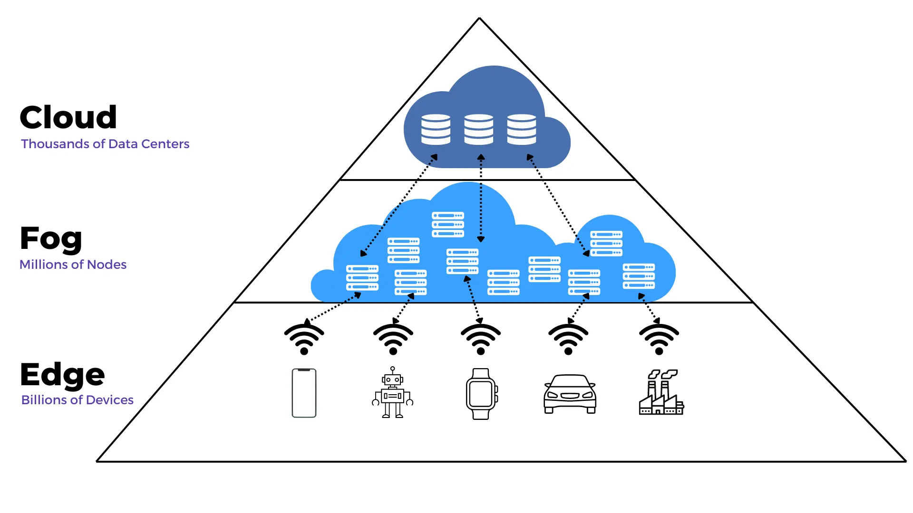
Technologies Used In IoT:
Edge Computing
Fog Computing
Cloud Computing
Networking Protocols

Slide 6
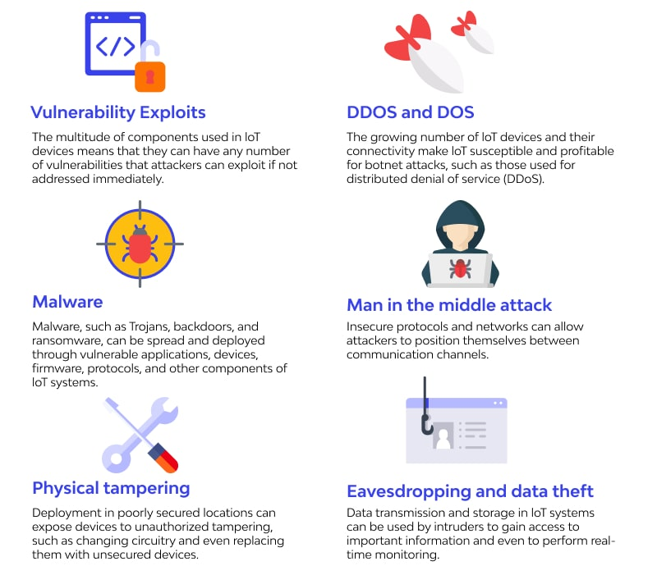
Challenges in IoT Security:
Limited computational and storage
resources in IoT devices.
Diverse and dynamic network topologies.
Vulnerability to attacks like DDoS,
malware, and zero-day threats.
Increasing volume of data requiring
real-time monitoring.

Slide 7
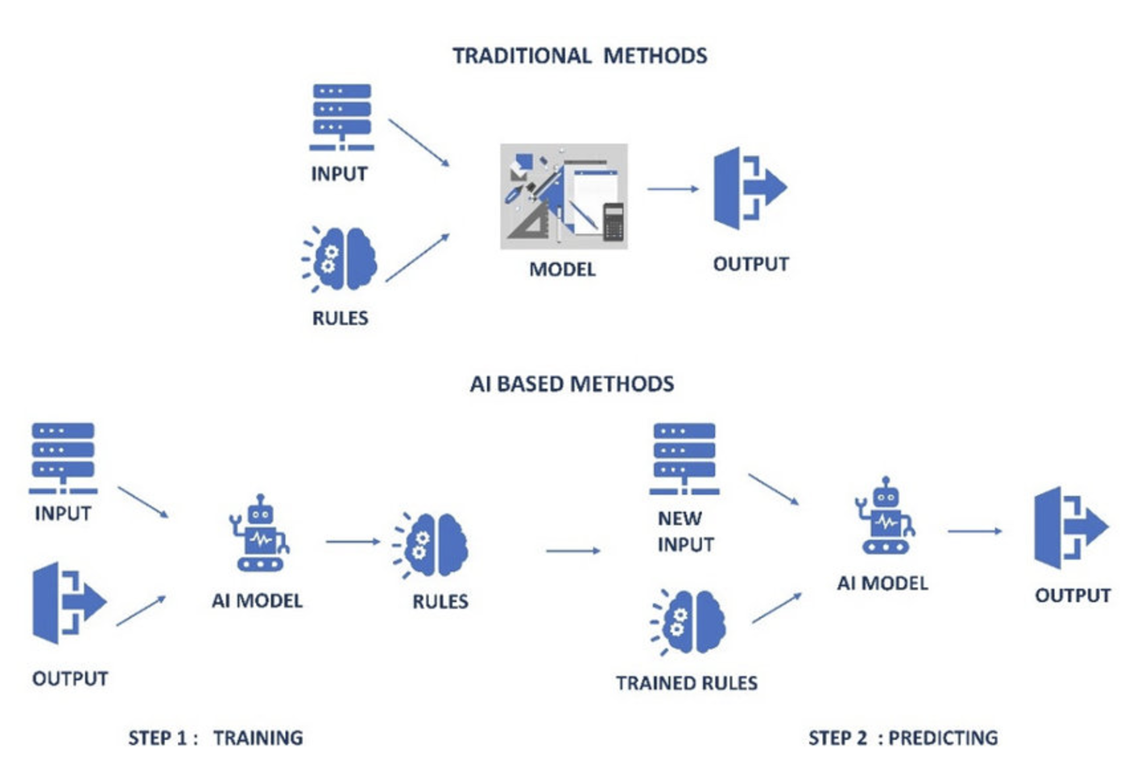
The Role of ML and DL in NIDS:
Why NIDS for IoT?
Detect malicious traffic in real time and prevent data breaches.
Traditional Limitations:
Rule-based systems struggle with new and evolving threats.

Slide 8
Literature Review
Title: Enhancing IoT Security: Machine Learning-Based Network Intrusion Detection
Authors: Sharma, Babbar
Objective: To propose a machine learning-based approach for IoT systems' network intrusion detection (NID) using various ML methods like Naive Bayes (NB), Decision Tree (DT), K-Nearest Neighbour (KNN), and Logistic Regression (LR) for effective detection and evaluation of intrusions.
Conclusion: The Decision Tree (DT) model achieved the highest accuracy of 99.47%, demonstrating superior performance in identifying network intrusions compared to other models.
Title: An Efficient Network Intrusion Detection System for Distributed Networks using Machine Learning Technique
Authors: Akhther, Maryposonia, Prasanth
Objective: To propose a Big Data-based Distributed Denial of Service Network Intrusion Detection System using Random Forest (RF) algorithm-based classification technique and Hadoop File System (HDFS).
Conclusion: The suggested detection algorithm achieved an Accuracy of 99.89%. The test results show strong accuracy, Precision, Recall and F1-Measure when compared to other methods currently used to identify DDoS attacks. Therefore, a more effective intrusion detection system may be developed on the basis of accurately identified attacks.

Slide 9
Title: CNN-IDS: Convolutional Neural Network for Network Intrusion Detection System
Authors: Halbouni, Assaig, Gunawan, Effendi, Halbouni, Ismail
Objective: To develop a convolutional neural network-based intrusion detection system and evaluate it using the CIC-IDS2017 dataset, aiming for a low false alarm rate, high accuracy, and a high detection rate.
Conclusion: The model achieved a 99.55 percent detection rate and a 0.12 FAR using the CIC-IDS2017 multiclass classification. The results indicate the efficacy of the CNN algorithm for intrusion detection. Increasing the number of layers and neurons enhances the model's performance. The model achieved 99.55% accuracy and 99.63% detection rate for multiclass classification, and 99.56% accuracy and 99.4% detection rate for binary classification.
Title: Comparison Analysis of Intrusion Detection using Deep Learning in IoT Networks
Authors: Ikhwan, Purwanto, Rochim
Objective: To compare several Deep Learning algorithms, including DNN, CNN, LSTM, and AE, to identify the most effective algorithm for solving network security problems using intrusion detection in IoT networks.
Conclusion: The Deep Neural Network (DNN) algorithm achieved the best performance, with an accuracy of 99.76% and a loss value of 0.006%. The results highlight the efficacy of the DNN algorithm in detecting and preventing network security breaches in IoT devices and networks. While the Autoencoder (AE) had the fastest training time, the DNN demonstrated superior accuracy.

Slide 10
Title: A Comprehensive Analysis of Intrusion Detection System using Machine Learning and Deep Learning Algorithms
Authors: Varaprasad, Chakkaravarthy, Veeresha
Objective: To analyze the strengths, relationships, and challenges of Machine Learning (ML) and Deep Learning (DL) based prediction approaches for Intrusion Detection Systems (IDS) in IoT networks.
Conclusion: The study provides a taxonomy of IDS, comparing various ML and DL techniques. It discusses the role of IDS in securing networks against vulnerabilities and threats, and it also analyzed intrusion attacks in IoT network. Both ML techniques, which detect attacks and identify vulnerabilities, and DL techniques, which detect anomalies and analyze behavior patterns, are analyzed for their effectiveness in intrusion detection.
Title: An Improved Intrusion Dectection System using BoT-IoT Dataset
Authors: Majhi, Prastavana
Objective: To propose a compact and efficient feed-forward artificial neural network with the eXtreme Gradient Boosting algorithm for intrusion detection in IoT. The study uses the BoT-IoT dataset, developed by the University of New South Wales (UNSW).
Conclusion: The proposed model combines a feed-forward artificial multi-layer neural network and an eXtreme Gradient-Boost (XGBoost) classifier. The neural network is used for feature extraction and reduction, and then the XGBoost algorithm is applied for classification. The results demonstrate that the model performs effectively for intrusion detection in IoT environments.

Slide 11
Objective
To identify a real-time intrusion detection system model using machine learning and deep learning that classifies network traffic as normal or malicious for the IoT environment.

Slide 12
Methodology
Collected Data
Data Processing
Train ML/DL models
Test ML/DL Models
Deploy

Slide 13
Dataset: UNSW-NB15
IoT-based network traffic dataset created by the Australian Centre for Cyber Security capturing both normal activities and malicious attack behaviours.
Attack categories: Fuzzers, Analysis, Backdoors, DoS, Exploits, Generic, Reconnaissance, Shellcode, Worms.
Created using IXIA PerfectStorm at Cyber Range Lab, Australian Centre for Cyber Security.
Key Features:
Training Data: 175,341 records
Testing Data: 82,332 records
Features: 44 input features
Labelling: attack_cat for category of attacks, label (attack(1) and normal(0)) for binary classification

Slide 14
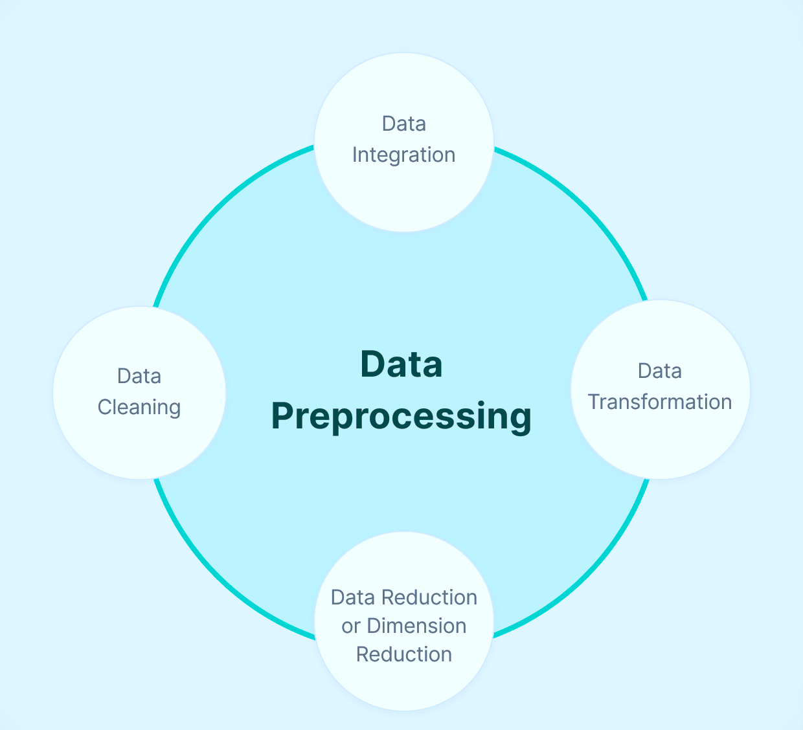
Data Preparation
Data Collection & Exploration
Data Cleaning
Handling Missing Values
Feature Encoding & Scaling
One-Hot Encoding for categorical variables (non-ordinal)
StandardScaler applied to numerical features for normalization
Transformation Pipeline
Combined steps using Pipeline and ColumnTransformer
Notes:
I began with Data Collection and Loading, followed by Data Cleaning, where I removed unnecessary columns, handled missing values, and corrected issues like invalid entries in the 'is_ftp_login' column. For Feature Encoding and Scaling, I applied One-Hot Encoding for categorical variables and StandardScaler for numerical ones to standardize their range. Finally, I built a Data Transformation Pipeline using Pipeline and ColumnTransformer to streamline preprocessing, making the data ready for model training and evaluation. One-Hot Encoding is a technique used to convert categorical data into a numerical format that machine learning models can understand. In this process, each category is represented as a binary vector, where only one element is "1" (hot) and all others are "0" (cold). StandardScaler is a data preprocessing technique used to standardize features by removing the mean and scaling to unit variance. This ensures that each feature contributes equally to the model's learning process, preventing features with larger scales from dominating those with smaller scales.
Data Transformation Pipeline: Automates the sequence of data preprocessing steps, like encoding and scaling, ensuring consistency and efficiency during model training and testing.

Slide 15
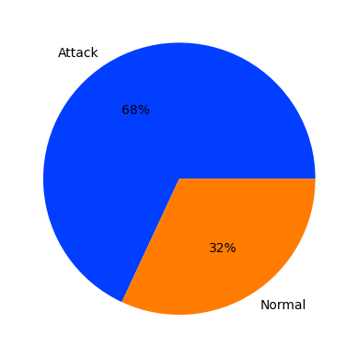
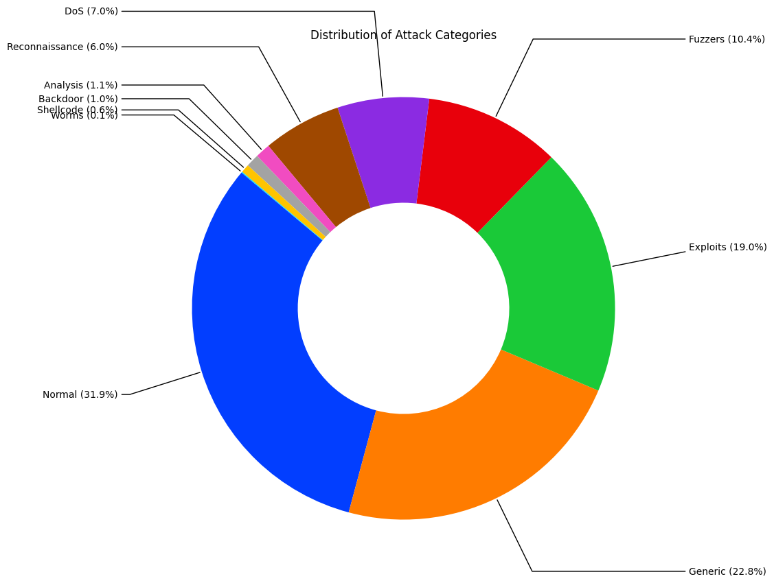
Data Visualization
Binary Classification Target Distribution:
Multi-class Target Distribution:

Slide 16
OVERVIEW OF ML METHODS – Decision Trees
Powerful ML algorithm for classification & regression
Fits complex datasets by recursive feature-based splitting
In this project, used to detect "Normal" vs "Attack" behaviour
Features selected based on correlation with the target variable
Root Node (Feature A)
/ \
Subset 1 Subset 2
(Feature B) (Feature C)
/ \ / \
Class 0 Class 1 Class 0 Class 1

Slide 17
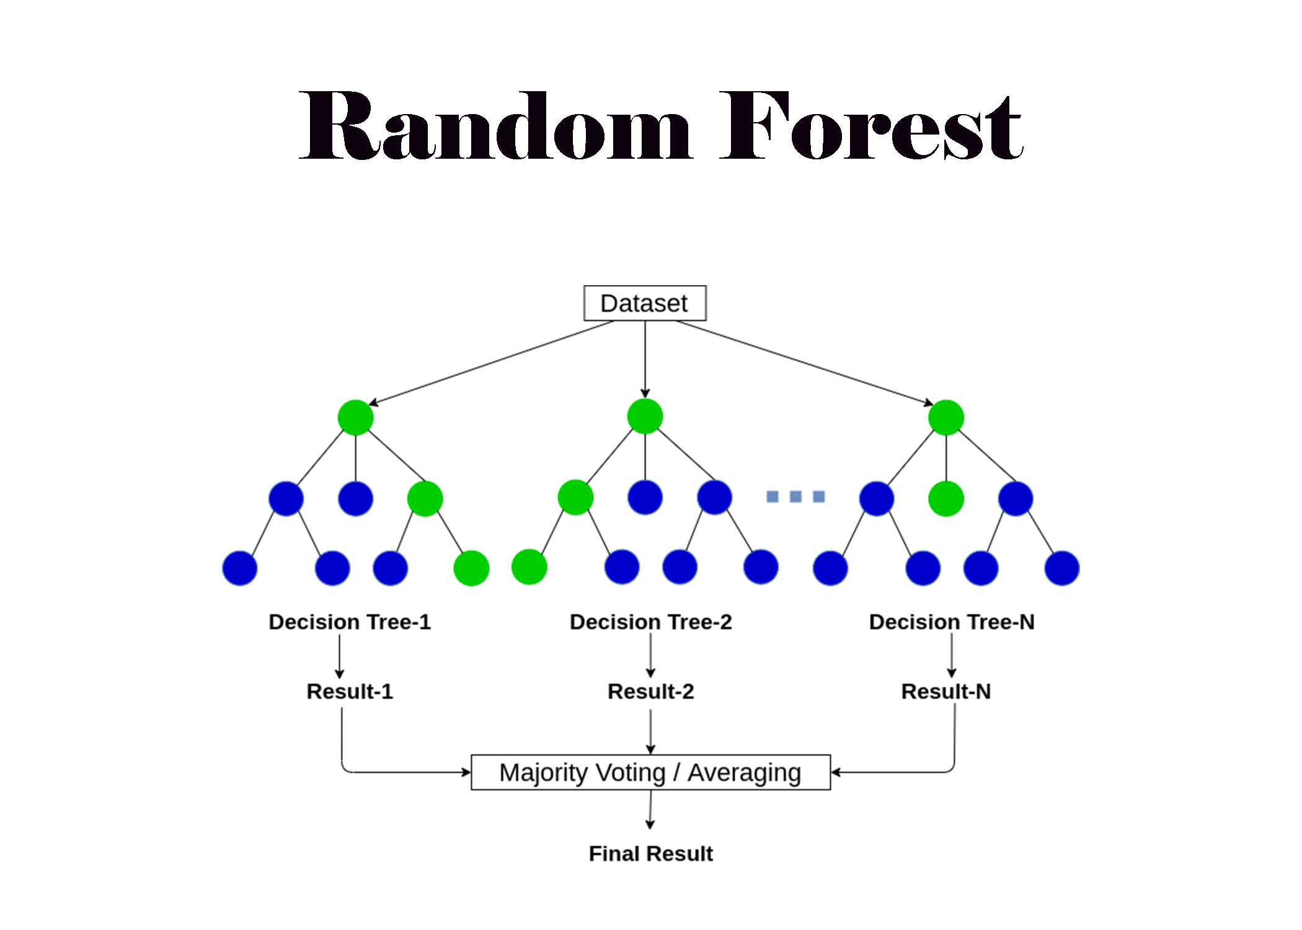
OVERVIEW OF ML METHODS – Random Forest
An ensemble learning method that builds multiple decision trees
Used for both classification and regression
Known for high accuracy, robustness, and feature importance analysis
Final output:
Classification: Majority vote
Regression: Mean of predictions
5. Core Concepts:
Bagging
Feature Subsampling
No pruning

Slide 18
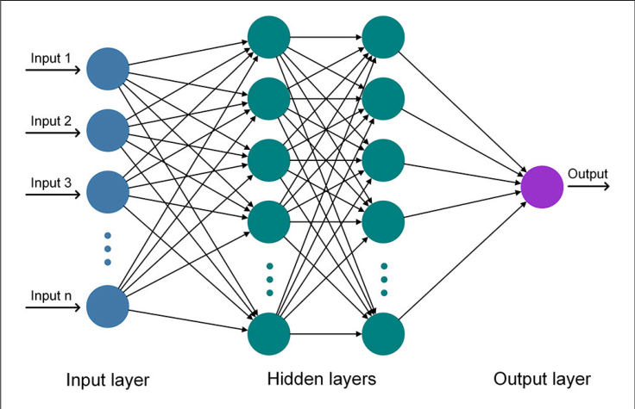
OVERVIEW OF DL METHODS - Artificial Neural Networks
Computational models inspired by biological neurons
Capable of learning non-linear, complex patterns from data
ANN Architecture
Input Layer
Hidden Layers
Output Layer
Training Process
Forward Propagation
Loss Calculation
Backpropagation

Slide 19
Deep Learning Models for Intrusion Detection
Model | Architecture | Optimizer | Learning Rate | Loss Function
Model 1 | 3 hidden layers × 64 neurons | Adam | 0.009 | Binary Cross-Entropy
Model 2 | 6 hidden layers × 32 neurons | SGD | 0.009 | Binary Cross-Entropy
Model 3 | 6 hidden layers × 96 neurons | SGD | 0.0012 | Binary Cross-Entropy

Slide 20
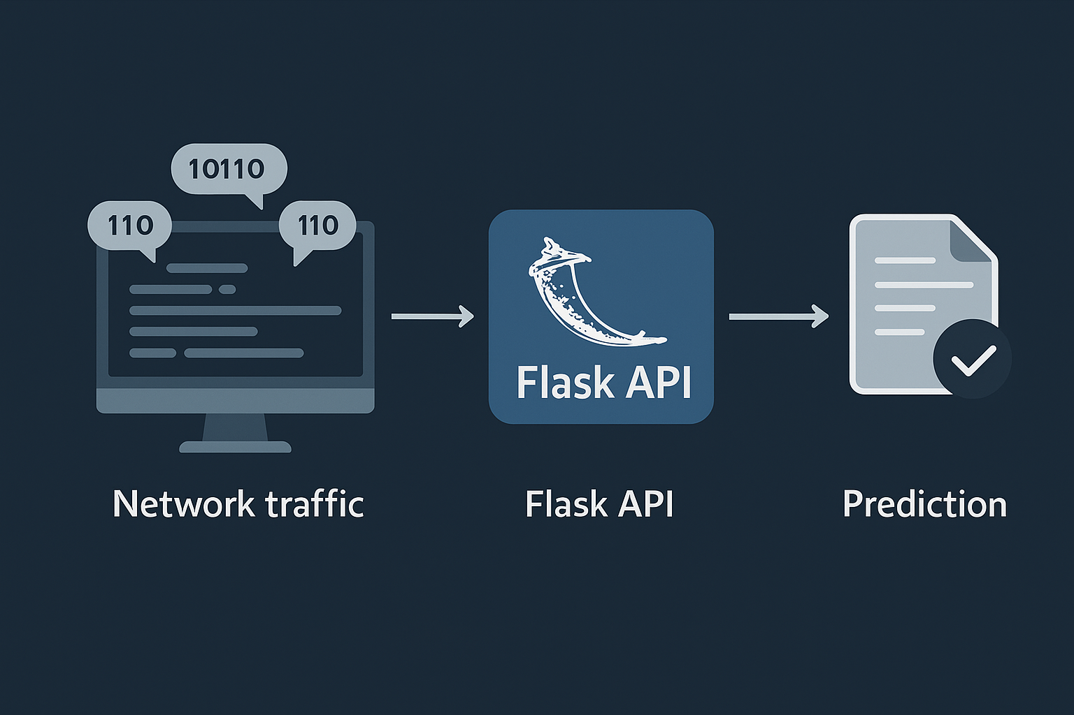
Flask API Development for NIDS Deployment
Lightweight Python framework for
building RESTful APIs
Supports fast, scalable web service
development
Enables real-time intrusion detection
via model deployment
Easily integrates with dashboards,
cloud platforms, and IoT systems

Slide 21
Development Workflow:
Environment Setup:
Created a requirements.txt to manage dependencies:
Flask
joblib
TensorFlow/Keras
NumPy, pandas, scikit-learn
Installed dependencies
Serialized models
2. Flask Application Structure:
Project Directory: nids_service/
app.py: Main application script
models/: Directory containing serialized models
utils/: Helper functions for data preprocessing
Implemented Flask routes to handle prediction requests

Slide 22
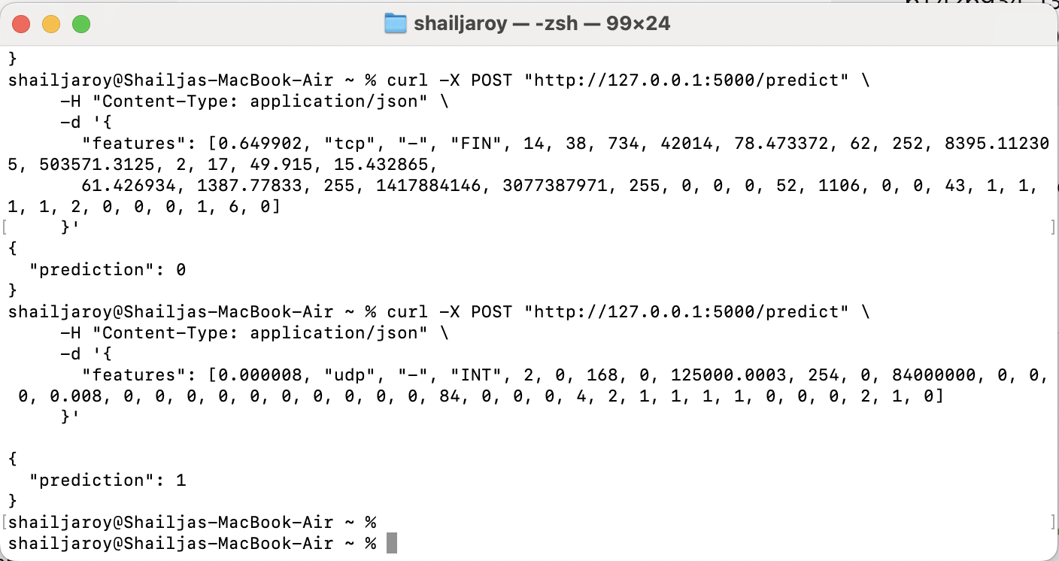
API Endpoint:
Route: /predict
Method: POST
Local Testing:
Utilised tools like curl to send test requests

Slide 23
Results
The table below shows UNSW-NB15 Training Set Results
Model | Accuracy | Recall | Precision
Decision Tree | 0.9275925 | 0.96(Class 0) 0.91(Class 1) | 0.84(Class 0) 0.98(Class 1)
Random Forest | 0.9485573 | 0.97(Class 0) 0.94(Class 1) | 0.88(Class 0) 0.98(Class 1)
Neural Network Model 1 | 0.9430 | 0.9760 | 0.9424
Neural Network Model 2 | 0.9433 | 0.9763 | 0.9426
Neural Network Model 3 | 0.9414 | 0.9796 | 0.9372

Slide 24
The table below shows UNSW-NB15 Validation Set Results
Model | Accuracy | Recall | Precision
Neural Network Model 1 | 0.9407 | 0.9677 | 0.9463
Neural Network Model 2 | 0.9390 | 0.9883 | 0.9268
Neural Network Model 3 | 0.9376 | 0.9772 | 0.9340

Slide 25
The table below shows UNSW-NB15 Test Set Results
Model | Accuracy | Recall | Precision
Decision Tree | 0.9122698 | 0.87(Class 0) 0.95(Class 1) | 0.93(Class 0) 0.90(Class 1)
Random Forest | 0.9166909 | 0.86(Class 0) 0.97(Class 1) | 0.95(Class 0) 0.89(Class 1)
Neural Network Model 1 | 0.9265 | 0.9368 | 0.9526
Neural Network Model 2 | 0.9524 | 0.9896 | 0.9403
Neural Network Model 3 | 0.9472 | 0.9803 | 0.9417

Slide 26
Conclusions
Successfully built and evaluated ML/DL-based NIDS
Artificial Neural Network Model 2 showed the highest effectiveness
API deployment supports real-time detection
Lays the foundation for advanced, real-time, scalable intrusion detection
Contributes to improved cybersecurity in IoT environments

Slide 27


