Slide 1
AI Search Algorithms
Dr. Shailesh S

Slide 2
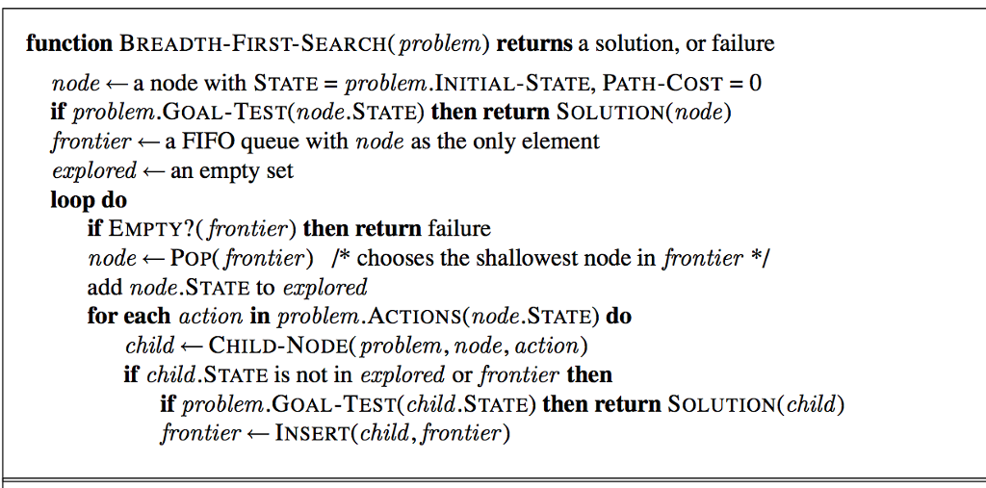
Breadth-First-Search

Slide 3
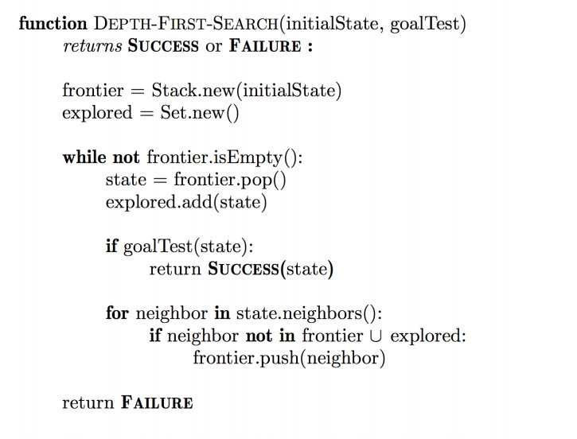
Depth-First-Search

Slide 4
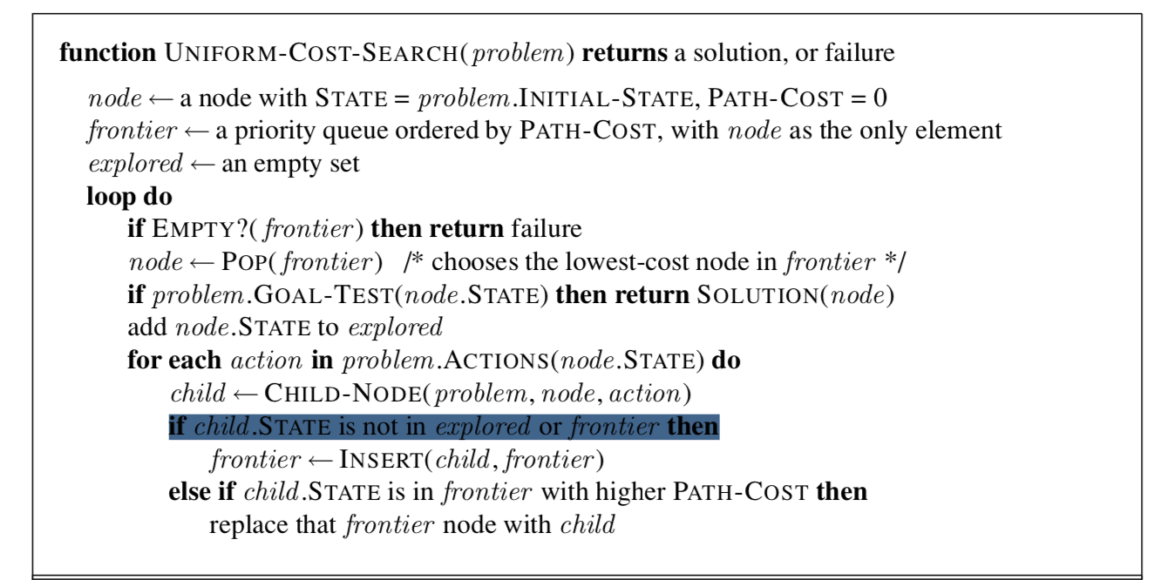
Uniform-Cost-Search

Slide 5
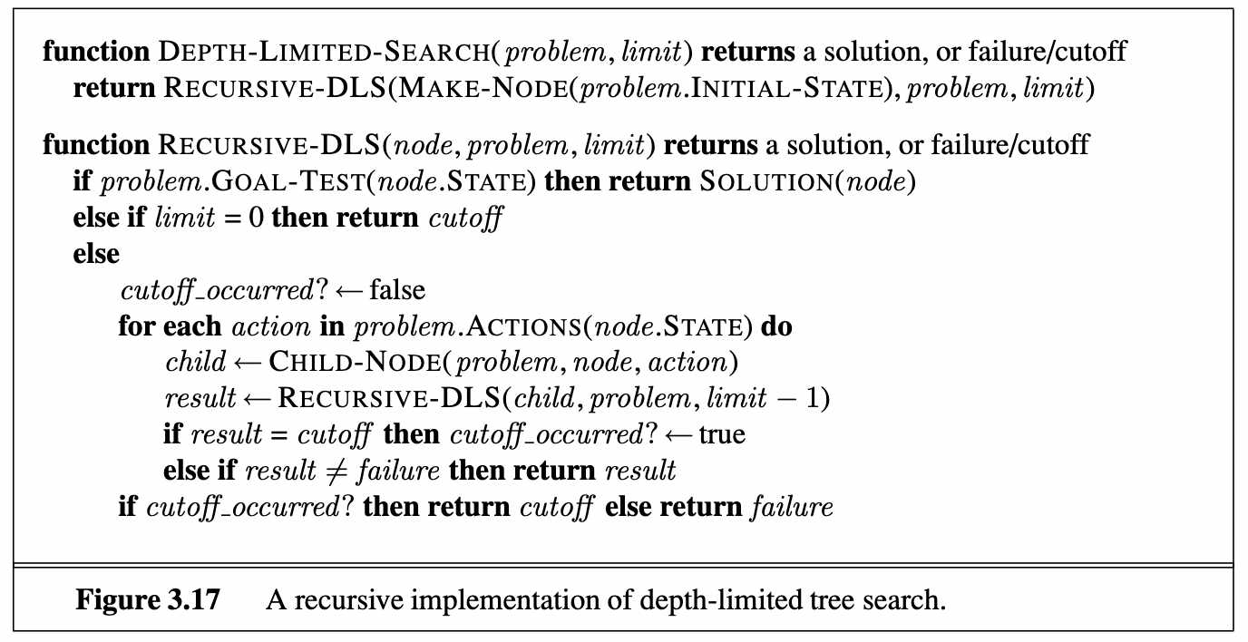
Depth-Limited-Search

Slide 6
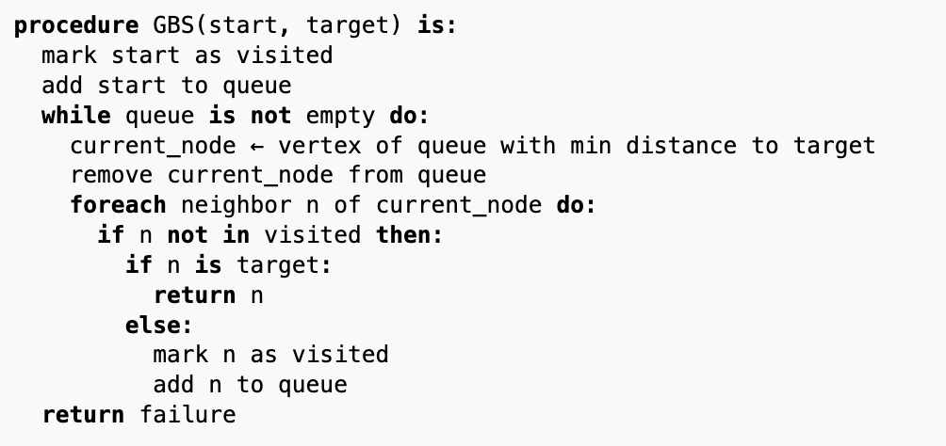
Greedy-Best-First Search

Slide 7
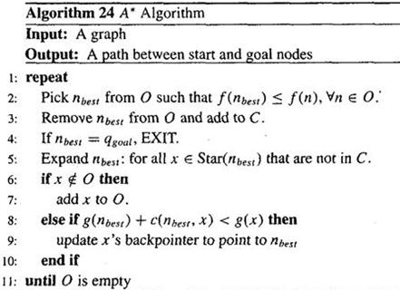
A* Search

