Slide 1
Deeplearning & Tensorflow
Shailesh S

Slide 2
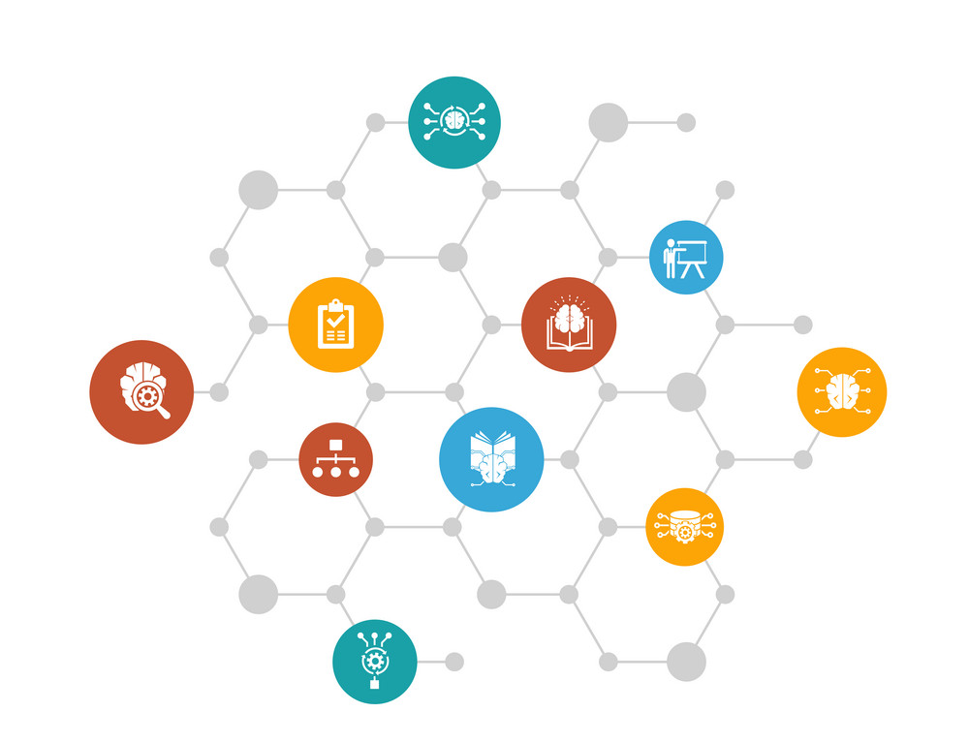
DEEP LEARNING

Slide 3
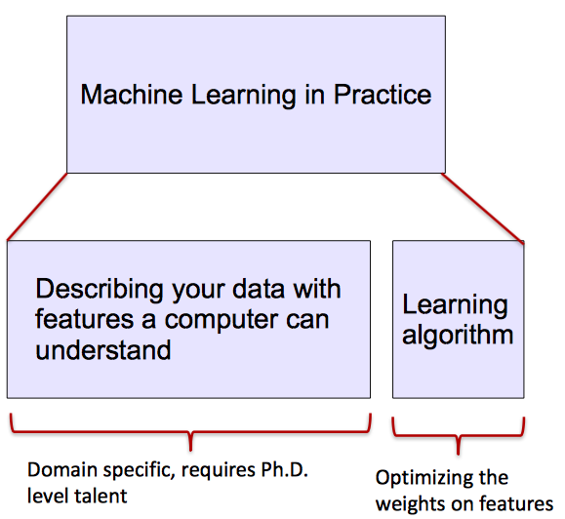
Machine vs Deep Learning
Most machine learning methods work well because of human-designed representations and input features
ML becomes just optimizing weights to best make a final prediction

Slide 4
Machine vs Deep Learning
A machine learning subfield of learning representations of data. Exceptional effective at learning patterns.
Deep learning algorithms attempt to learn (multiple levels of) representation by using a hierarchy of multiple layers
If you provide the system tons of information, it begins to understand it and respond in useful ways.

Slide 5
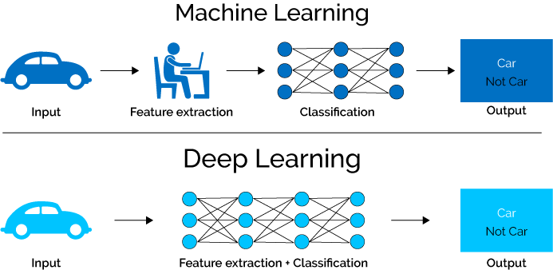
Machine vs Deep Learning

Slide 6
Why Deep Learning useful?
Manually designed features are often over-specified, incomplete and take a long time to design and validate
Learned Features are easy to adapt, fast to learn
Deep learning provides a very flexible, (almost?) universal, learnable framework for representing world, visual and linguistic information.
Can learn both unsupervised and supervised
Effective end-to-end joint system learning
Utilize large amounts of training data

Slide 7
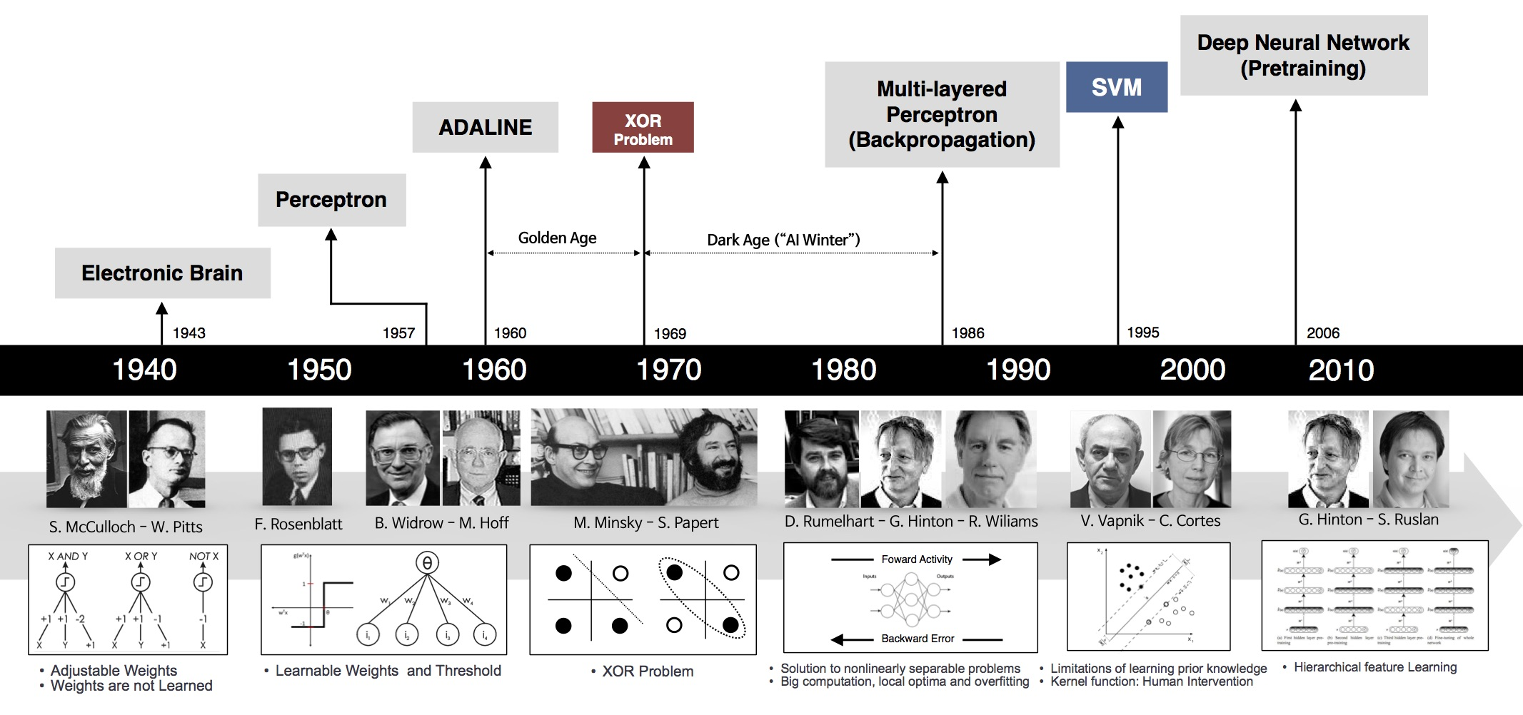
History of Deep Learning

Slide 8
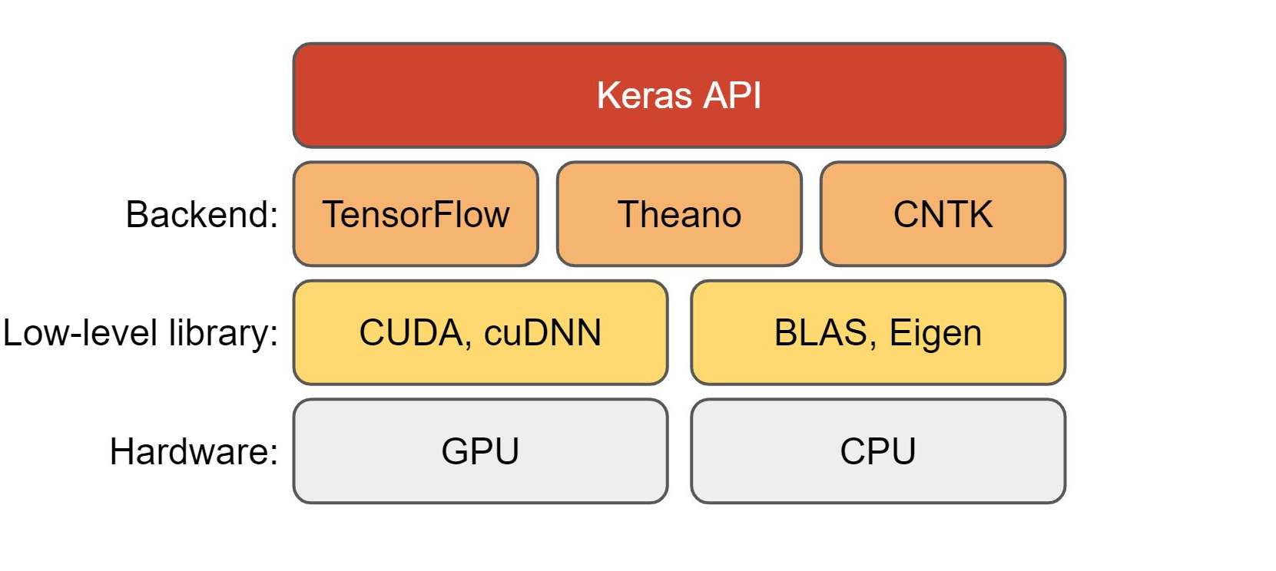
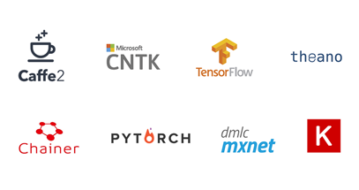
Deeplearning Technology Stack
Keras
Keras is an effective high-level neural network Application Programming Interface (API) written in Python
PyTorch
Tensorflow
Theano
Pytorch is a relatively new deep learning framework based on Torch.
Developed by Facebook’s AI research group
Pytorch has a reputation for simplicity, ease of use, flexibility, efficient memory usage, and dynamic computational graphs.
TensorFlow is an end-to-end open-source deep learning framework developed by Google
It is known for scalable production and deployment options, multiple abstraction levels, and support for different platforms, such as Android
Theano is popular deep learning libraries, an open-source project
Theano was developed by the Universite de Montreal
It lets programmers define, evaluate, and optimize mathematical expressions, including multi-dimensional arrays and matrix-valued expressions

Slide 9
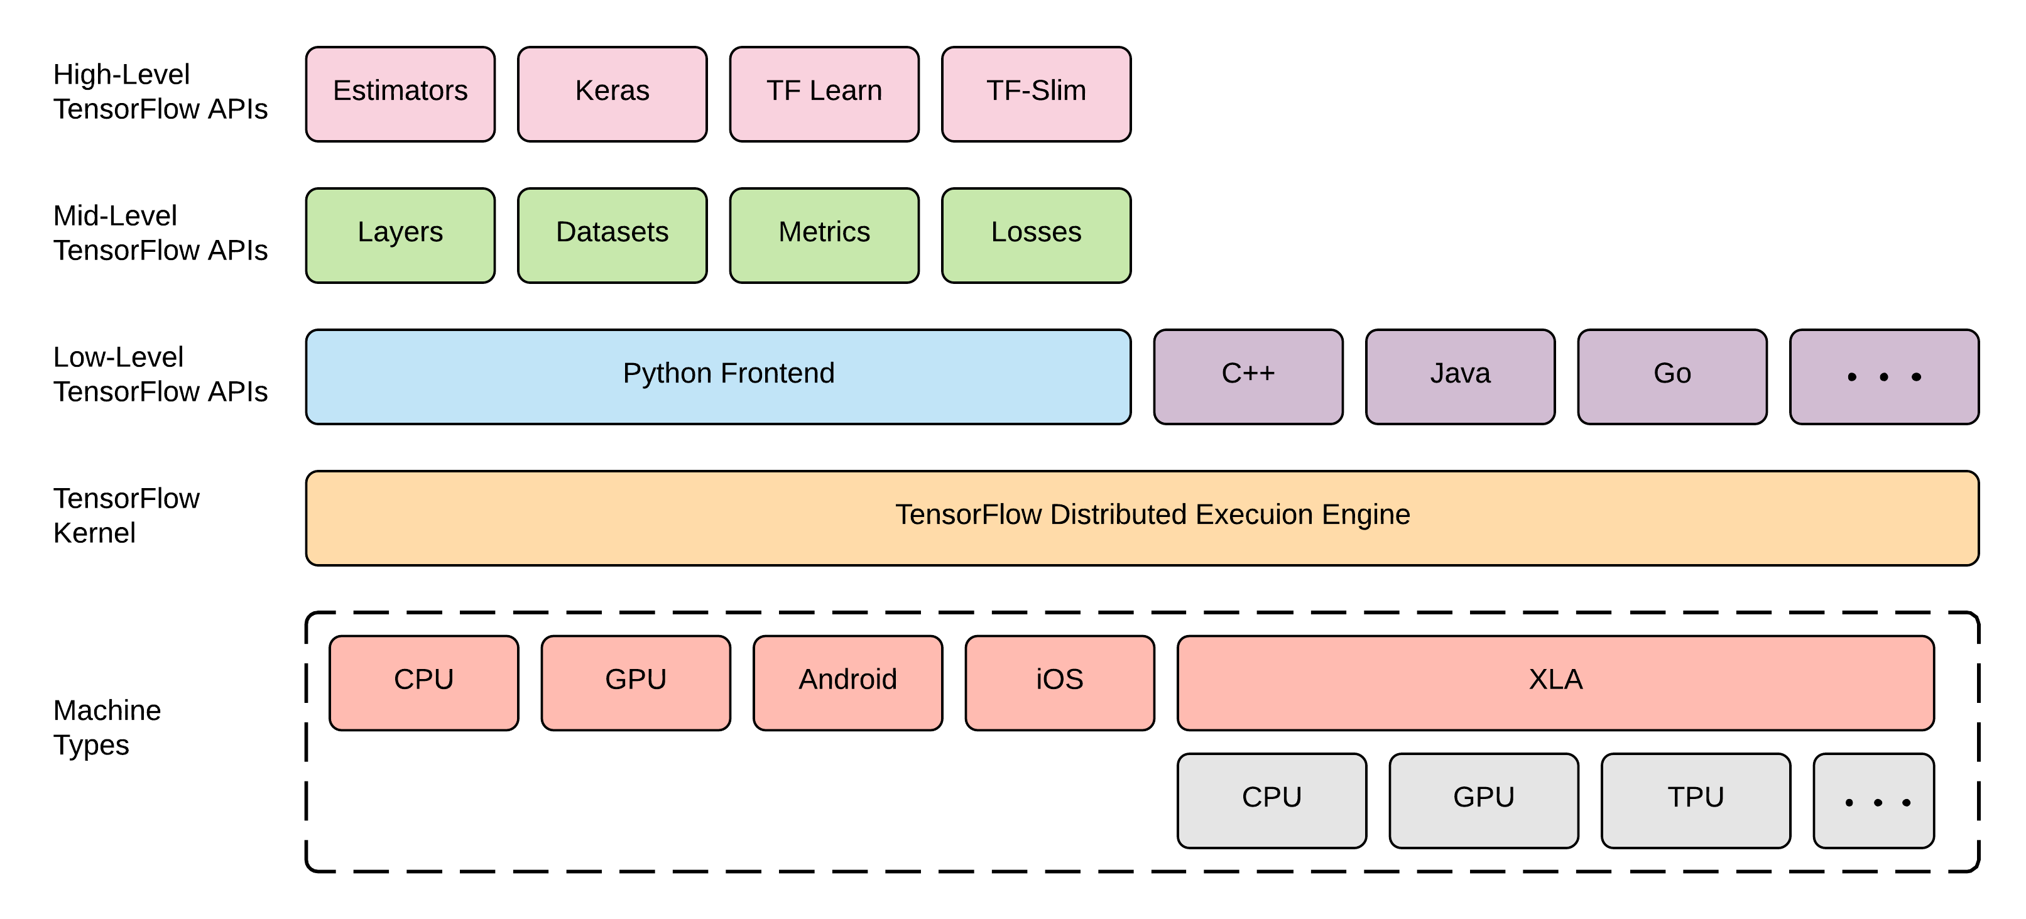
Tensorflow

Slide 10
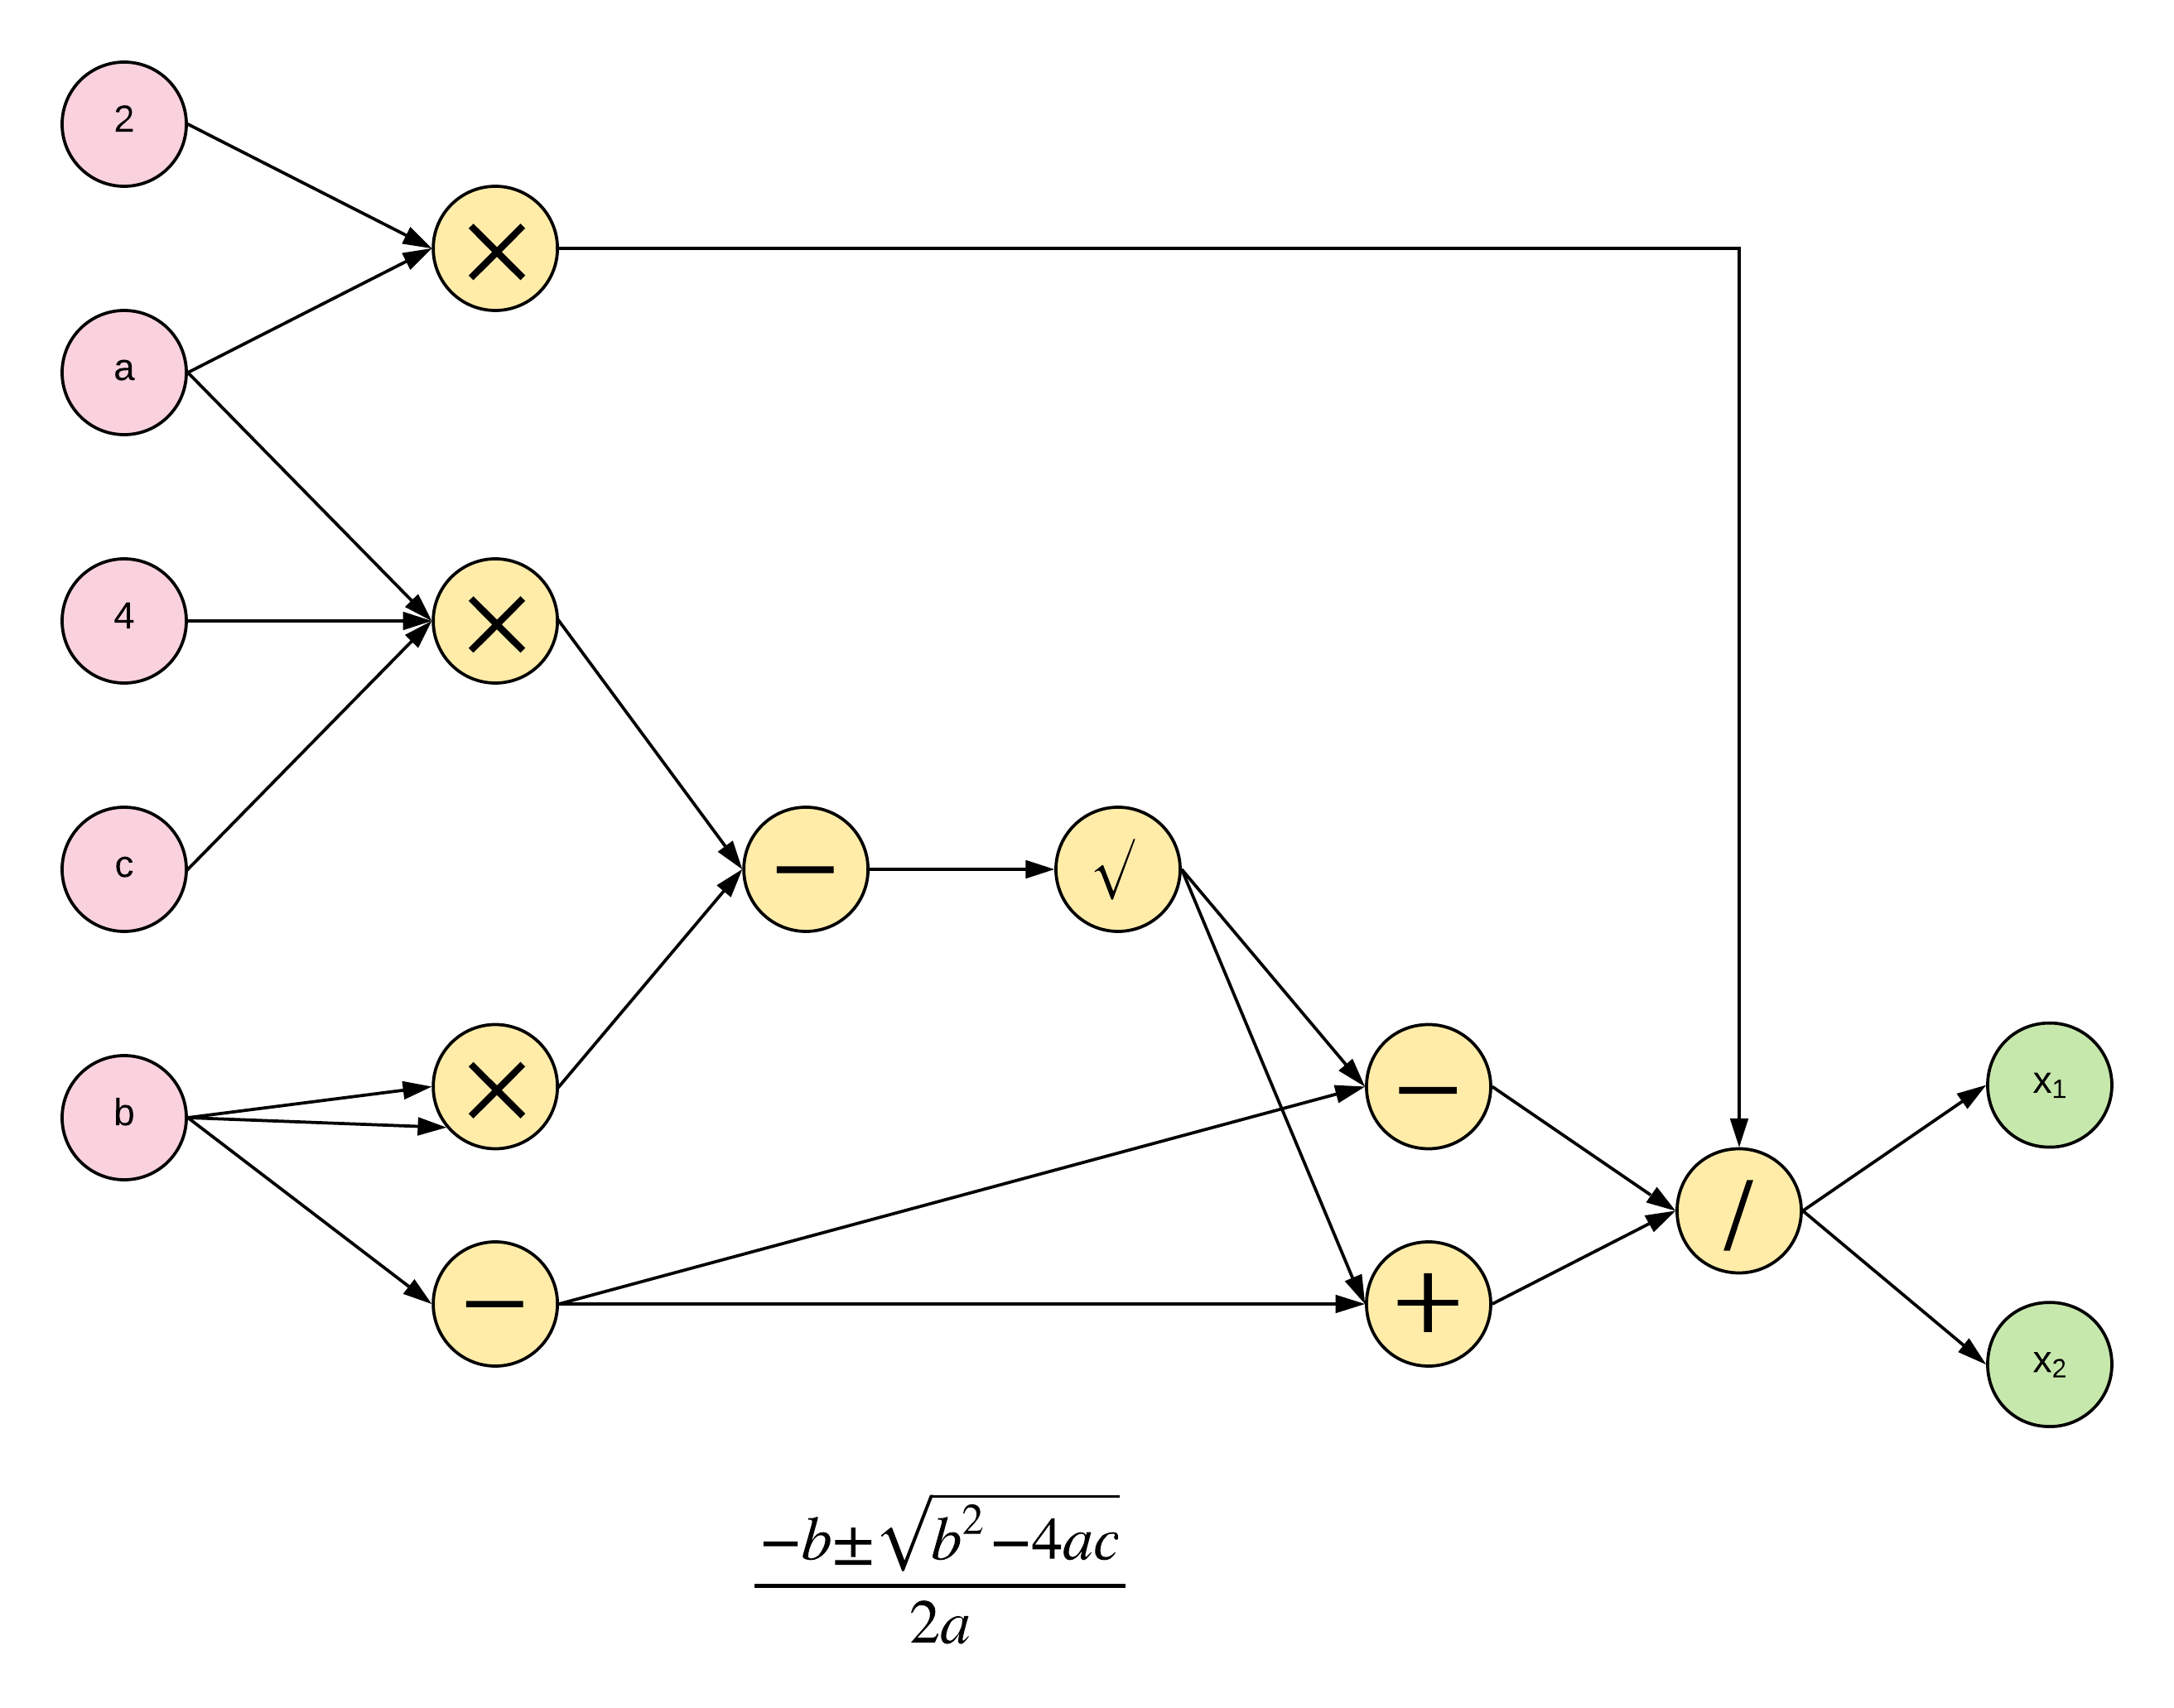
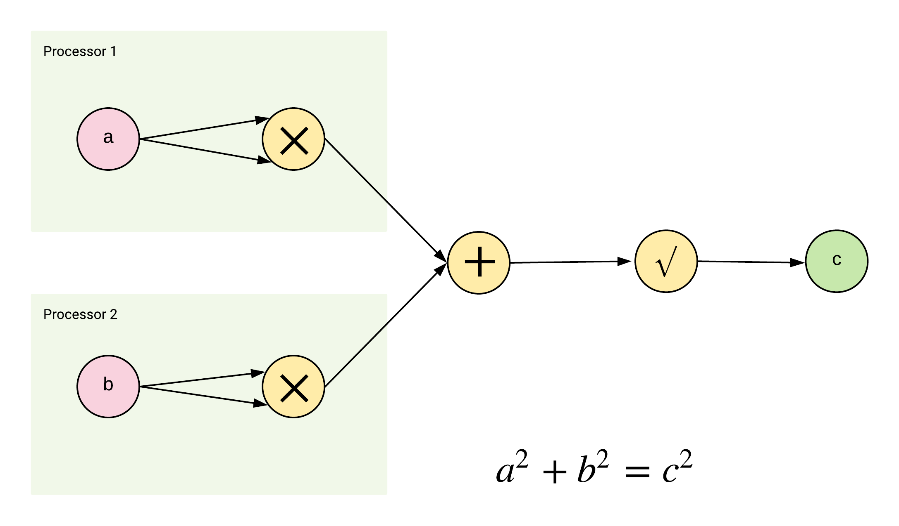
Tensorflow Computational Graphs

Slide 11
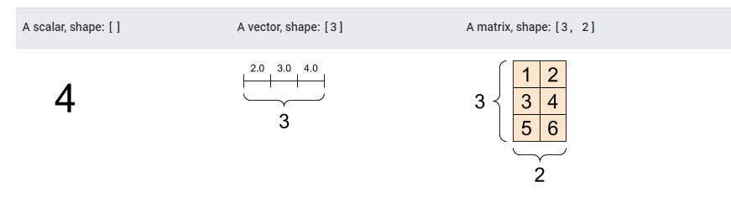
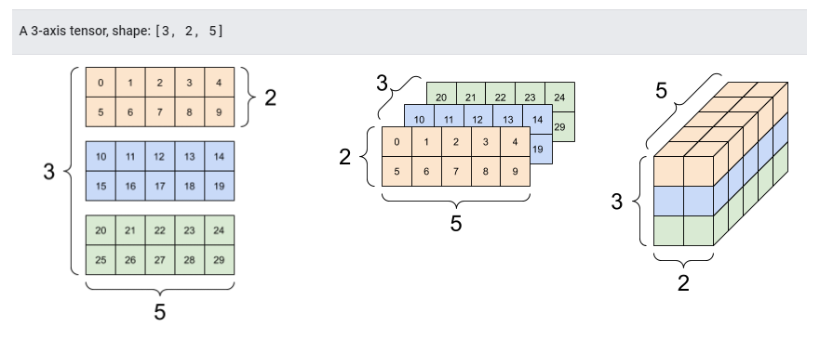
Tensors

Slide 12
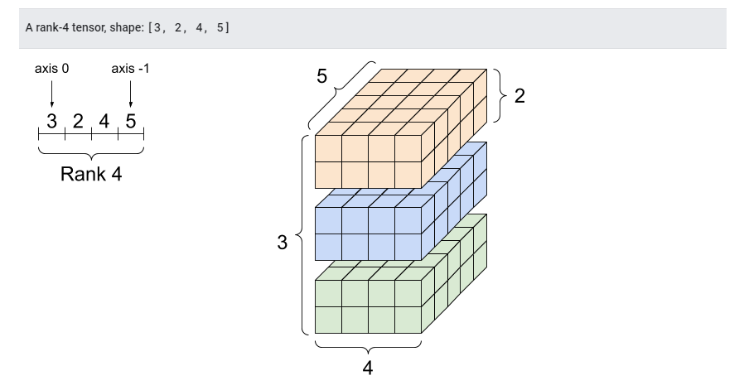
Tensors

Slide 13
Tensors
# This will be an int32 tensor by default; see "dtypes" below.
rank_0_tensor = tf.constant(4) print(rank_0_tensor)
# Let's make this a float tensor.
rank_1_tensor = tf.constant([2.0, 3.0, 4.0]) print(rank_1_tensor)
# If you want to be specific, you can set the dtype (see below) at creation time
rank_2_tensor = tf.constant([[1, 2], [3, 4], [5, 6]], dtype=tf.float16) print(rank_2_tensor)

Slide 14
Tensors
# There can be an arbitrary number of # axes (sometimes called "dimensions")
rank_3_tensor = tf.constant([ [[0, 1, 2, 3, 4], [5, 6, 7, 8, 9]], [[10, 11, 12, 13, 14], [15, 16, 17, 18, 19]], [[20, 21, 22, 23, 24], [25, 26, 27, 28, 29]],]) print(rank_3_tensor)
Variables
my_tensor = tf.constant([[1.0, 2.0], [3.0, 4.0]])
my_variable = tf.Variable(my_tensor) # Variables can be all kinds of types, just like tensors
bool_variable = tf.Variable([False, False, False, True])
complex_variable = tf.Variable([5 + 4j, 6 + 1j])

Slide 15
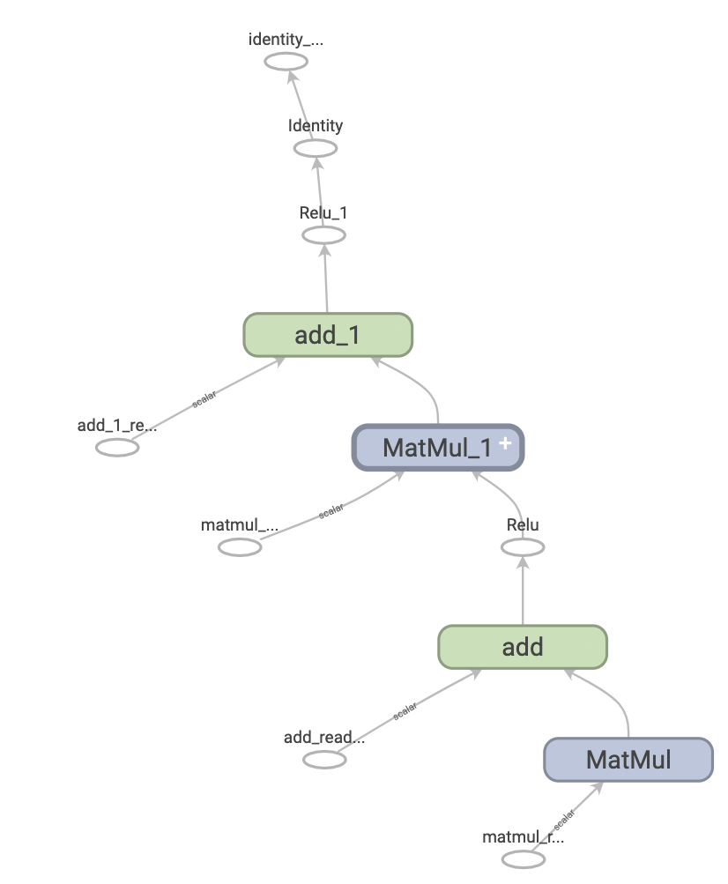
Tensorflow Graphs
Eagerly Execution means TensorFlow operations are executed by Python, operation by operation, and returning results back to Python.
Graph execution means that tensor computations are executed as a TensorFlow graph, sometimes referred to as a tf.Graph or simply a "graph."
While eager execution has several unique advantages, graph execution enables portability outside Python and tends to offer better performance
Graphs are data structures that contain a set of tf.Operation objects, which represent units of computation; and tf.Tensor objects, which represent the units of data that flow between operations. They are defined in a tf.Graph context.

Slide 16
THANK YOU

