Slide 1

Convolutional Neural Networks Shailesh S shaileshsivan@gmail.com

Slide 2
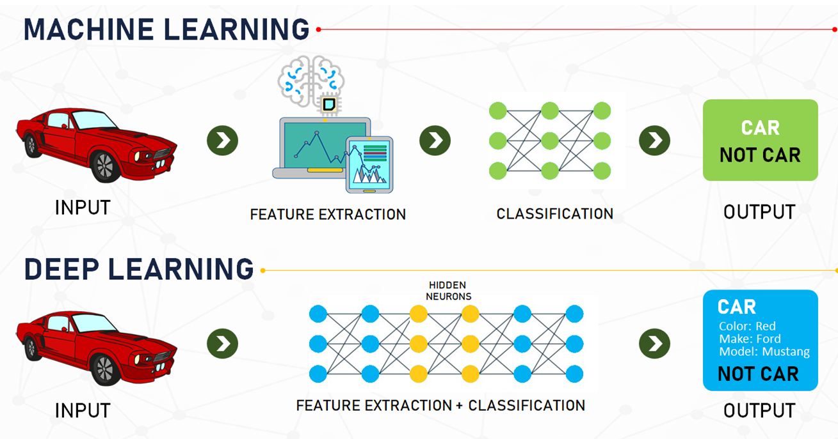
Deeplearning

Slide 3
Why Deep Learning useful?
Manually designed features are often over-specified, incomplete and take a long time to design and validate
Learned Features are easy to adapt, fast to learn
Deep learning provides a very flexible, (almost?) universal, learnable framework for representing world, visual and linguistic information.
Effective end-to-end joint system learning
Utilize large amounts of training data

Slide 4

Convolutional Neural Networks
A convolutional neural network (CNN, or ConvNet) is a class of artificial neural network, most commonly applied to analyze visual imagery
They are also known as shift invariant or space invariant artificial neural networks (SIANN)

Slide 5
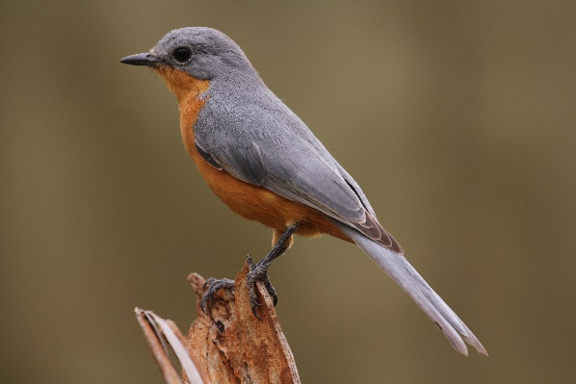
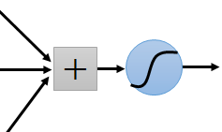
Consider learning an image:
Some patterns are much smaller than the whole image
Can represent a small region with fewer parameters
“beak” detector

Slide 6
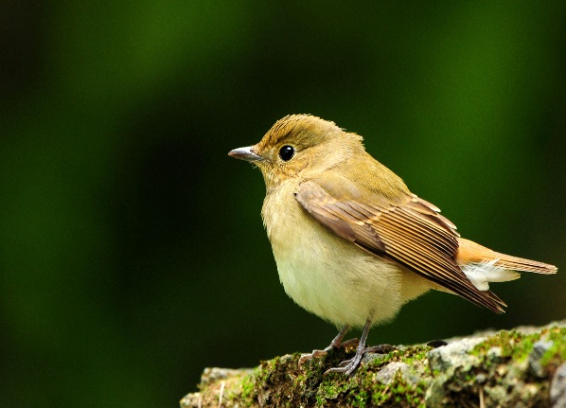
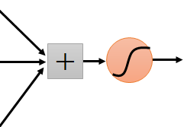
Same pattern appears in different places: They can be compressed! What about training a lot of such “small” detectors and each detector must “move around”.
“upper-left beak” detector
They can be compressed
to the same parameters.
“middle beak” detector

Slide 7
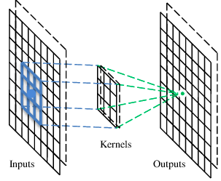
A convolutional layer
A CNN is a neural network with some convolutional layers
(and some other layers). A convolutional layer has a number
of filters that does convolutional operation.
Beak detector
A filter

Slide 8
Convolution
These are the network parameters to be learned.
1 | 0 | 0 | 0 | 0 | 1
0 | 1 | 0 | 0 | 1 | 0
0 | 0 | 1 | 1 | 0 | 0
1 | 0 | 0 | 0 | 1 | 0
0 | 1 | 0 | 0 | 1 | 0
0 | 0 | 1 | 0 | 1 | 0
-1 | 1 | -1
-1 | 1 | -1
-1 | 1 | -1
Filter 1
1 | -1 | -1
-1 | 1 | -1
-1 | -1 | 1
Filter 2
……
6 x 6 image
Each filter detects a small pattern (3 x 3).

Slide 9
Convolution
stride=1
1 | 0 | 0 | 0 | 0 | 1
0 | 1 | 0 | 0 | 1 | 0
0 | 0 | 1 | 1 | 0 | 0
1 | 0 | 0 | 0 | 1 | 0
0 | 1 | 0 | 0 | 1 | 0
0 | 0 | 1 | 0 | 1 | 0
Dot
product
3
-1
Filter 1
1 | -1 | -1
-1 | 1 | -1
-1 | -1 | 1
6 x 6 image

Slide 10
Convolution
If stride=2
1 | 0 | 0 | 0 | 0 | 1
0 | 1 | 0 | 0 | 1 | 0
0 | 0 | 1 | 1 | 0 | 0
1 | 0 | 0 | 0 | 1 | 0
0 | 1 | 0 | 0 | 1 | 0
0 | 0 | 1 | 0 | 1 | 0
3
-3
1 | -1 | -1
-1 | 1 | -1
-1 | -1 | 1
Filter 1
6 x 6 image

Slide 11
Convolution
1 | -1 | -1
-1 | 1 | -1
-1 | -1 | 1
Filter 1
stride=1
1 | 0 | 0 | 0 | 0 | 1
0 | 1 | 0 | 0 | 1 | 0
0 | 0 | 1 | 1 | 0 | 0
1 | 0 | 0 | 0 | 1 | 0
0 | 1 | 0 | 0 | 1 | 0
0 | 0 | 1 | 0 | 1 | 0
3
-1
-3
-1
-3
1
0
-3
-3
-3
0
1
3
-2
-2
-1
6 x 6 image

Slide 12
Convolution
-1 | 1 | -1
-1 | 1 | -1
-1 | 1 | -1
Filter 2
stride=1
Repeat this for each filter
3
-1
-3
-1
1 | 0 | 0 | 0 | 0 | 1
0 | 1 | 0 | 0 | 1 | 0
0 | 0 | 1 | 1 | 0 | 0
1 | 0 | 0 | 0 | 1 | 0
0 | 1 | 0 | 0 | 1 | 0
0 | 0 | 1 | 0 | 1 | 0
-1
-1
-1
-1
-3
1
0
-3
-1
-1
-2
1
-3
-3
0
1
-1
-1
-2
1
3
-2
-2
-1
-1
0
-4
3
6 x 6 image
Two 4 x 4 images
Forming 2 x 4 x 4 matrix
Feature
Map

Slide 13
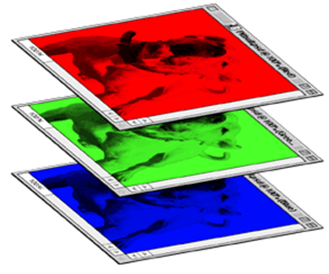
Color image: RGB 3 channels
Filter 1
Filter 2
1 | -1 | -1
-1 | 1 | -1
-1 | -1 | 1
-1 | 1 | -1
-1 | 1 | -1
-1 | 1 | -1
1 | -1 | -1
-1 | 1 | -1
-1 | -1 | 1
-1 | 1 | -1
-1 | 1 | -1
-1 | 1 | -1
1 | -1 | -1
-1 | 1 | -1
-1 | -1 | 1
-1 | 1 | -1
-1 | 1 | -1
-1 | 1 | -1
Color image
1 | 0 | 0 | 0 | 0 | 1
0 | 1 | 0 | 0 | 1 | 0
0 | 0 | 1 | 1 | 0 | 0
1 | 0 | 0 | 0 | 1 | 0
0 | 1 | 0 | 0 | 1 | 0
0 | 0 | 1 | 0 | 1 | 0
1 | 0 | 0 | 0 | 0 | 1
0 | 1 | 0 | 0 | 1 | 0
0 | 0 | 1 | 1 | 0 | 0
1 | 0 | 0 | 0 | 1 | 0
0 | 1 | 0 | 0 | 1 | 0
0 | 0 | 1 | 0 | 1 | 0
1 | 0 | 0 | 0 | 0 | 1
0 | 1 | 0 | 0 | 1 | 0
0 | 0 | 1 | 1 | 0 | 0
1 | 0 | 0 | 0 | 1 | 0
0 | 1 | 0 | 0 | 1 | 0
0 | 0 | 1 | 0 | 1 | 0

Slide 14
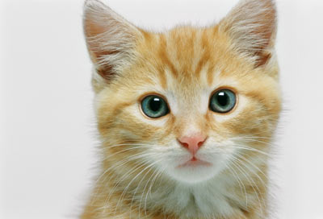
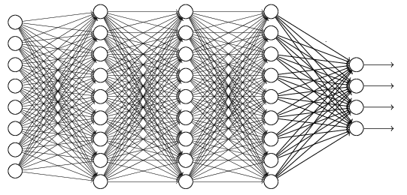
The whole CNN
cat dog ……
Convolution
Max Pooling
Can repeat many times
Fully Connected Feedforward network
Convolution
Max Pooling
Flattened

Slide 15
Max Pooling
1 | -1 | -1
-1 | 1 | -1
-1 | -1 | 1
-1 | 1 | -1
-1 | 1 | -1
-1 | 1 | -1
Filter 1
Filter 2
3
-1
-3
-1
-1
-1
-1
-1
-3
1
0
-3
-1
-1
-2
1
-3
-3
0
1
-1
-1
-2
1
3
-2
-2
-1
-1
0
-4
3

Slide 16
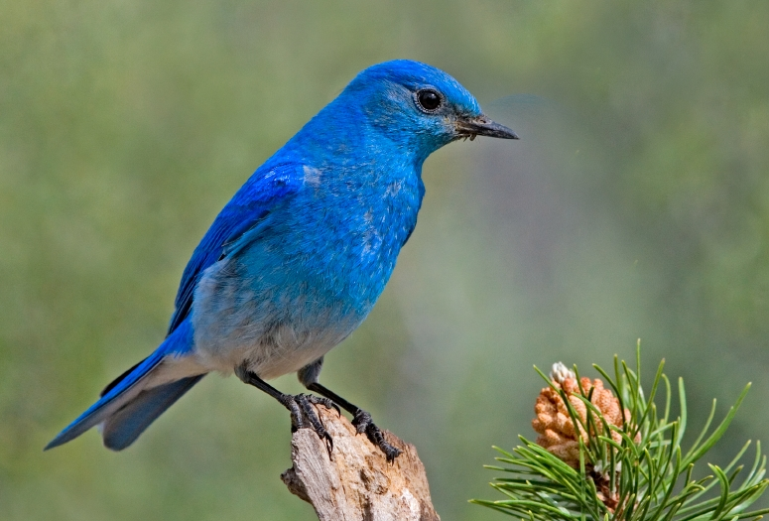

Why Pooling
Subsampling pixels will not change the object
bird
bird
Subsampling
We can subsample the pixels to make image smaller
fewer parameters to characterize the image

Slide 17
A CNN compresses a fully connected network in two ways:
Reducing number of connections
Shared weights on the edges
Max pooling further reduces the complexity

Slide 18
Max Pooling
New image
but smaller
1 | 0 | 0 | 0 | 0 | 1
0 | 1 | 0 | 0 | 1 | 0
0 | 0 | 1 | 1 | 0 | 0
1 | 0 | 0 | 0 | 1 | 0
0 | 1 | 0 | 0 | 1 | 0
0 | 0 | 1 | 0 | 1 | 0
Conv
3
0
-1
1
Max
Pooling
3
1
0
3
2 x 2 image
6 x 6 image
Each filter
is a channel

Slide 19
The whole CNN
3
0
-1
1
Convolution
3
1
0
3
Max Pooling
Can repeat many times
A new image
Convolution
Smaller than the original image
The number of channels is the number of filters
Max Pooling

Slide 20
The whole CNN
cat dog ……
Convolution
Max Pooling
Fully Connected Feedforward network
A new image
Convolution
Max Pooling
Flattened
A new image

Slide 21
Flattening
3
0
1
3
0
-1
1
3
3
1
-1
0
3
Flattened
1
Fully Connected Feedforward network
0
3

Slide 22
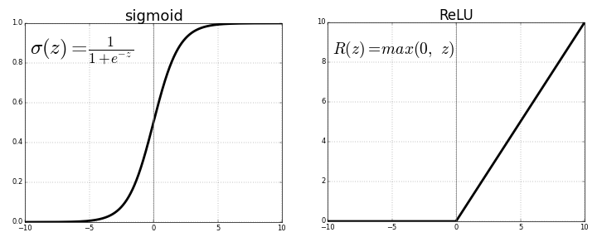
ReLU activation
Rectified Linear Unit
Computationally efficient
Non-linear
The sigmoid and hyperbolic tangent activation functions cannot be used in networks with many layers due to the vanishing gradient problem
The rectified linear activation function overcomes the vanishing gradient problem, allowing models to learn faster and perform better

Slide 23
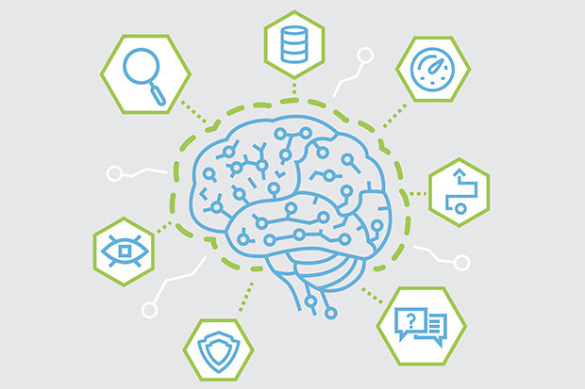
Thank You

