Slide 1




Python Programming
Dr. Shailesh Sivan

Slide 2
Top Programming Languages in 2022-Python is still No. 1 .
IEEE Spectrum - an award-winning technology magazine and the flagship publication of the IEEE.

Slide 3
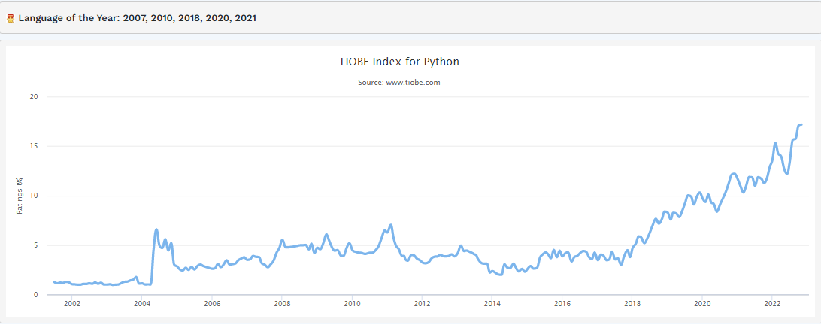
TIOBE Index
The TIOBE Programming Community index is an indicator of the popularity of programming languages. The index is updated once a month. The ratings are based on the number of skilled engineers world-wide, courses and third party vendors

Slide 4
Overview
Introduction to Python
Python Development Tools
Installation
Package Managers and Virtual Environments
Language Fundamentals
Basic Data Types
Operators
String Operations
Control Structures
Containers
Functions
Classes

Slide 5
Python Introduction
Python is a widely used general-purpose, high level programming language.
Initially designed by Guido van Rossum in 1991 and developed by
Python Software Foundation.
There are 2 major Python versions : Python 2 and Python 3
Three main popular applications for Python:
1. Web Development
2. Data Science-including machine learning, data analysis, and data visualization

Slide 6
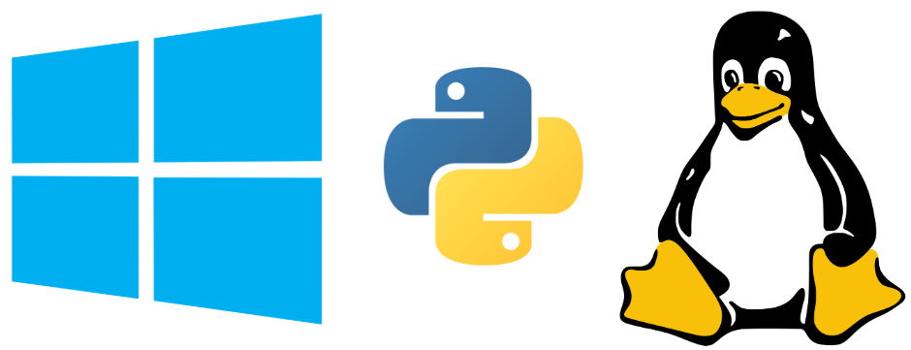

Python Development Tools
Installation
Windows - Download and Install the Python 3 Installer (https://www.python.org/downloads/windows/)
Linux(ubuntu) - There is a very good chance your Linux distribution has Python installed already; otherwise
$ sudo apt-get update
$ sudo apt-get install python3.X
For AI/ML- Install
Anaconda[about 3 GB to install over 720+ packages (many of the packages are never used)
(https://www.anaconda.com/distribution/)
Miniconda[Know what package(s) you need to install]
(https://docs.conda.io/en/latest/miniconda.html)

Slide 7
Python Development Tools
Python Package Managers - Python utility intended to simplify the tasks of locating, installing, upgrading and removing Python packages.
pip - pip is a package management system used to install and manage software packages along with its dependencies
$pip install < you package >
conda - is an open source package management system and environment management system that runs on Windows, macOS and Linux
$conda install < you package >

Slide 8
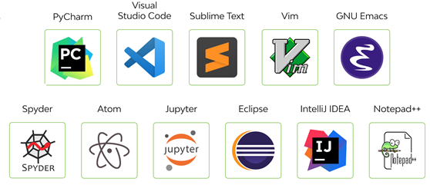
Python Fundamentals
Start with ‘Hello World’
print(‘Hello World’)
# Hello World

Slide 9
Google Colab

Slide 10
Python Fundamentals
Basic Data Types
a=5
print(a)
print(type(a))
# 5
# <class 'int'>
f=1.5
print(f)
print(type(f))
# 1.5
# <class 'float'>
s="hello"
print(s)
print(type(s))
# hello
# <class 'str'>
b=True
print(b)
print(type(b))
# True
# <class 'bool'>
t=5+3j
print(t)
print(type(t))
# (5+3j)
# <class 'complex'>

Slide 11
Python Fundamentals
Arithmetic Operators
a = 7
b = 3
ab_sum = a + b
print(ab_sum)
# 10
ab_dif = a - b
print(ab_dif)
# 4
ab_pro = a * b
print(ab_pro)
# 21
ab_quo = a / b
print(ab_quo)
# 2.3333333333333335
ab_iquo = a // b
print(ab_iquo)
# 2
ab_rem = a % b
print(ab_rem)
# 1
ab_pow = a ** b
print(ab_rem)
# 343

Slide 12
Python Fundamentals
Boolean Operations
T=True
F=False
print(T,F)
# True False
p = 5 > 3
print(p)
# True
q = -1 < -12.5
print(q)
# False
print(p and q)
# False
print(p or q)
# True
print(not q)
# True
Note
Python uses words instead of symbols like &&, ||, ! for Boolean
Note
Other relational opeators <=, >=, ==, !=

Slide 13
Python Fundamentals
Some String Operations
print(s3.upper())
# PYTHON WORLD
print(s3.capitalize())
# Python world
print(s3.lower())
# python world
print('hello world how are you'.split(' '))
# ['hello', 'world', 'how', 'are', 'you']
print('book'.replace('o','e'))
# beek
word = 'jewellery'
print(word.find('well'))
print(word.find('is'))
# 2
# -1
s = 'hello'
u = "hello"
print(s)
print(u)
# hello
# hello
s1 = "python"
s2 = 'world'
s3 = s1 + ' ' + s2
print(s3)
# python world
s3 = '%s %s %d' %(s1, s2, 1011)
print(s3)
# python world 1011
print(len(s3))
# 12

Slide 14
Control Structures
if - else
if number > 99 and number < 1000:
print('3 digit')
else:
print('Not 3 digit')
# Enter number : 123
# 3 digit
if – elif - else
response = input('Are you familiar with python : ')
if response.upper() == "YES":
print("You can skip this course :-|")
elif response.upper() == "NO":
print("You are at the right place :-)")
else:
print('Sorry wrong input :-(')
# Are you familiar with python : no
# You are at the right place :-)
Note
Take care of indentation !
Don’t forget to put ‘ : ’ at the end
Remember its elif not else if

Slide 15
Control Structures
for loop
for x in range(10):
print(x,end=' ')
# 0 1 2 3 4 5 6 7 8 9
limit = int(input('Enter a limit : '))
sum = 0
for i in range(1,limit + 1):
if i%2 != 0:
sum += i
print("Odd sum = "+str(sum))
# Enter a limit : 15
# Odd sum = 64
range()
print(list(range(10)))
# [0, 1, 2, 3, 4, 5, 6, 7, 8, 9]
print(list(range(1,10)))
# [1, 2, 3, 4, 5, 6, 7, 8, 9]
print(list(range(1,10,2)))
# [1, 3, 5, 7, 9]

Slide 16
Control Structures
While loop
Nested loops
number = int(input('Enter number : '))
s = 0
while number > 0 :
s += number%10
number = number//10
print(s)
# Enter number : 1254
# 12
limit = int(input('Enter number : '))
for num in range(2,limit+1):
is_divisible = False
k=2
while k <= num//2 :
if num % k == 0:
is_divisible=True
break;
k += 1
if not is_divisible:
print(num,end=' ')
# Enter number : 400
# 2 3 5 7 11 13 17 19 23 29 31 37

Slide 17
Containers
Containers - List
b = [1,2,3]
mylist.append(b)
print(mylist)
# ['a', 'b', 1, 1.2, True, [1, 2, 3]]
mylist.remove(b)
print(mylist)
# ['a', 'b', 1, 1.2, True]
mylist.extend(b)
print(mylist)
# ['a', 'b', 1, 1.2, True, 1, 2, 3]
a = [2,3,1,4,5]
a.sort()
print(a)
# [1, 2, 3, 4, 5]
print(list('hello'))
# ['h', 'e', 'l', 'l', 'o']
mylist = ['a','b', 1, 1.2, True]
print(mylist)
# ['a', 'b', 1, 1.2, True]
mylist.append('new')
print(mylist)
# ['a', 'b', 1, 1.2, True, 'new']
print(mylist.pop())
# new
mylist.insert(2,'new')
print(mylist)
# ['a', 'b', 'new', 1, 1.2, True]
mylist.remove('new')
print(mylist)
# ['a', 'b', 1, 1.2, True]
​

Slide 18
Containers
Containers – List Slicing
print(numbers[1],numbers[-1])
# 2 10
sliced = numbers[5:11]
print(sliced)
# [6, 7, 8, 9, 10]
sliced = numbers[5:]
print(sliced)
# [6, 7, 8, 9, 10]
sliced = numbers[:7]
print(sliced)
# [1, 2, 3, 4, 5, 6, 7]
sliced = numbers[-2:]
print(sliced)
# [9, 10]
Note
list_name[a:b] => where it slices out a subset from the index a to b-1

Slide 19
Containers
Containers – List comprehension
numbers = list(range(1, 8))
print(numbers)
# [1, 2, 3, 4, 5, 6, 7]
square = []
for i in numbers:
square.append(pow(i,2))
print(square)
# [1, 4, 9, 16, 25, 36, 49]
##List Comprehension
square = [x**2 for x in numbers]
print(square)
# [1, 4, 9, 16, 25, 36, 49]
## List comprehension with a filter
odd_square =[x**2 for x in numbers if x%2 != 0]
print(odd_square)
# [1, 9, 25, 49]
A = [4,6,8,9]
AxA = [(a,b) for a in A for b in A if a!=b]
print(AxA)
# [(4, 6), (4, 8), (4, 9), (6, 4), (6, 8), (6, 9), (8, 4), (8, 6), (8, 9), (9, 4), (9, 6), (9, 8)]

Slide 20
Containers
Containers – Dictionary
person = {'name' : 'Manu', 'age': 28}
print(person['name'])
# Manu
print('name' in person)
# True
print('sex' in person)
# False
person['sex'] = 'male'
print(person)
# {'name': 'Manu', 'age': 28, 'sex': 'male'}
for item in person:
print(item,person[item])
# name Manu
# age 28
# sex male
for (key,value) in person.items():
print(key.capitalize(),'\t:\t', value)
# Name : Manu
# Age : 28
# Sex : male
print(person.keys())
# dict_keys(['name', 'age', 'sex'])
Note
A dictionary is a collection which is unordered, changeable and indexed. In Python dictionaries are written with curly brackets, and they have keys and values.

Slide 21
Containers
Containers - Tuples
t1 = (1,2,3)
t2 = 4,5,6
print(t1,t2)
# (1, 2, 3) (4, 5, 6)
t3 = t1 +t2
print(t3)
# (1, 2, 3, 4, 5, 6)
lt = tuple(['a','b','c','d'])
print(lt)
# ('a', 'b', 'c', 'd')
lt[2] = 'x'
# ----> 1 lt[2] = 'x'
# TypeError: 'tuple' object does not support item assignment
Tuple with single element
s = (3)
print(type(s))
#<class 'int'>
s = (3,)
print(type(s))
#<class 'tuple'>

Slide 22
Containers
Containers – Sets
s = {1,2,3}
print(s,type(s))
# {1, 2, 3} <class 'set'>
fset = {"apple", "banana", "cherry"}
fset.remove("banana")
print(fset)
# {'apple', 'cherry'}
fset = {"apple", "banana", "cherry"}
fset.discard("banana")
print(fset)
# {'apple', 'cherry’}
fset = {"apple", "banana", "cherry"}
fset.clear()
print(fset)
# set()
set1 = {"a", "b" , "c"}
set2 = {1, 2, 3}
set3 = set1.union(set2)
print(set3)
# {1, 2, 3, 'b', 'c', 'a'}
x = {"apple", "banana", "cherry"}
y = {"google", "microsoft", "apple"}
z = x.intersection(y)
print(z)
# {'apple’}
lst = [1,2,3,4,5,5,5,7,6]
myset = list(set(lst))
print(myset)
# [1, 2, 3, 4, 5, 6, 7]

Slide 23
Functions
Functions
def twice(number):
return 2*number
t = twice(5)
print(t)
# 10
def isPrime(number):
for factor in range(2, (number//2)+1):
if number%factor == 0:
return False
return True
number = int(input('Enter the number '))
print(isPrime(number))
# Enter the number 10
# False

Slide 24
Functions
Functions
def printPrimes(llimit, ulimit):
for num in range(llimit, ulimit + 1):
if isPrime(num) == True:
print(num, end = ' ')
printPrimes(5,50)
# 5 7 11 13 17 19 23 29 31 37 41 43 47
def swap(x,y):
t = x
x = y
y = t
return x,y
a=5
b=7
a,b = swap(a,b)
print(a,b)
#7 5
Note
Python support function with default arguments
def calculatePayable(p, y = 1, r = 5):
return p*(1 + r* y/100)
print(calculatePayable(1000))
# 1050.0
print(calculatePayable(1000, y =3))
# 1150.0
print(calculatePayable(1000, r = 10, y=3))
# 1300.0
print(calculatePayable(5000, r = 3))
# 5150.0
Note
Python supports more than one return values

Slide 25
Classes
Note
In object-oriented programming, a class is a blueprint for creating objects (a particular data structure), providing initial values for state (member variables or attributes), and implementations of behavior (member functions or methods).
‘_’ symbol before the data member - protected member
‘__’ symbol before the data member - private member
Classes
class Adder:
#constructor
def __init__(self):
self.__x = 0
self.__y = 0
#setter
def setValues(self, x, y):
self.__x = x
self.__y = y
#self variable name can be anything
def calculate(self1):
self1.__sum = self1.__x + self1.__y
#getter
def getSum(self):
return self.__sum
adder = Adder()
adder.setValues(5,4)
adder.calculate()
print(adder.getSum())
#9

Slide 26
Thank You

