Slide 1
Pretrained Models and Transfer learning
Shailesh S

Slide 2
Why Stop At One Hidden Layer?
E.g., vision hierarchy for recognizing handprinted text
Word output layer
Character hidden layer 3
Stroke hidden layer 2
Edge hidden layer 1
Pixel input layer

Slide 3

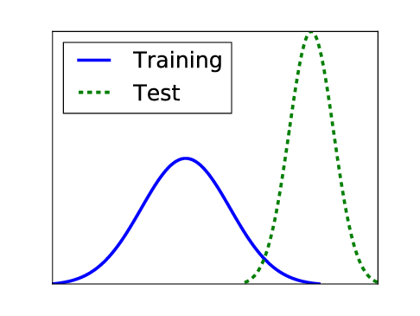
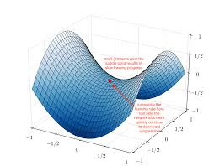
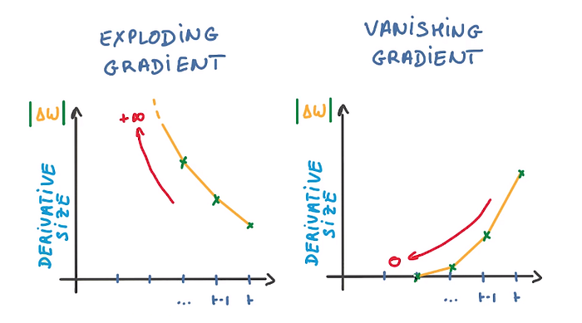
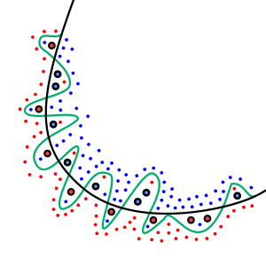
Challenges in Deep Learning
Requires Large dataset for Training
Overfitting or lack of generalization
Vanishing or Exploding Gradient Problem
Appropriate Learning rate
Covariate Shift
Effective Training

Slide 4
Why Deeply Layered Networks Fail
Credit assignment problem
How is a neuron in layer 2 supposed to know what it should output until all the neurons above it do something sensible?
How is a neuron in layer 4 supposed to know what it should output until all the neurons below it do something sensible?

Slide 5
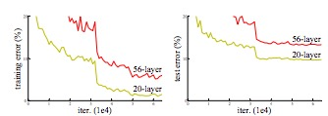
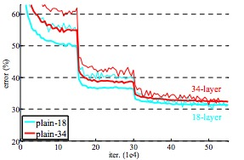
Deeper Vs. Shallower Nets
Deeper net can represent any mapping that shallower net can
Use identity mappings for the additional layers
Deeper net in principle is more likely to overfit
But in practice it often underfits on the training set
Degradation due to harder credit-assignment problem
Deeper isn’t always better!
CIFAR-10
ImageNet
thin=train,
thick=valid.
He, Zhang, Ren, and Sun (2015)

Slide 6




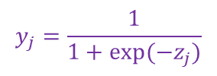

Why Deeply Layered Networks Fail
Vanishing gradient problem
With logistic or tanh units
Error gradients get squashed as they are passed back through a deep network
$$y_{j}=\frac{1}{1+exp⁡(−z_{j})}$$
$$\frac{∂y_{j}}{∂z_{j}}=y_{j}\left(1−y_{j}\right)$$
gradient
$$\frac{∂y_{j}}{∂z_{j}}=\left(1+y_{j}\right)\left(1−y_{j}\right)$$
$$y_{j}=\tanh\left(z_{j}\right)$$
$$n … 3 2 1$$
layer

Slide 7
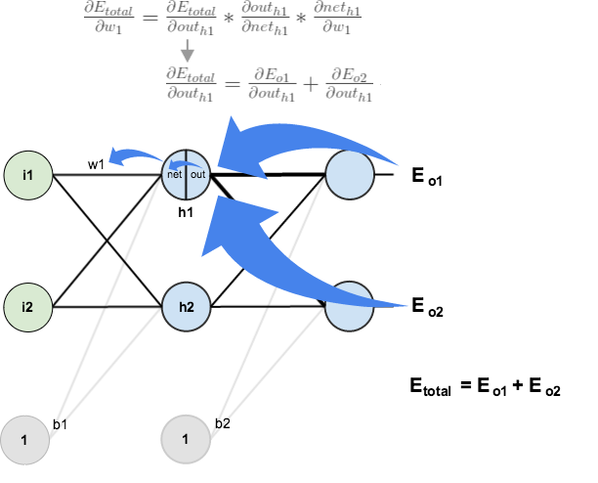
Why Deeply Layered Networks Fail

Slide 8


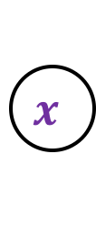
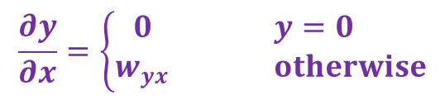

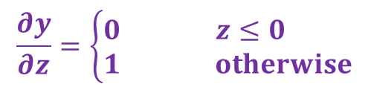

Why Deeply Layered Networks Fail
gradient
$$\frac{∂y}{∂z}=\left\{\begin{matrix}0 & z≤0 \\ 1 & otherwise\end{matrix}\right.$$
$$n … 3 2 1$$
layer
$$y=\text{max}(0,z)$$
$$\frac{∂y}{∂x}=\left\{\begin{matrix}0 & y=0 \\ w_{yx} & otherwise\end{matrix}\right.$$
Exploding gradient problem
with linear or ReLU units
can be a problem when $\left|\sum_{y}{\frac{∂y}{∂x}}\right|>1$
$$y$$
$$x$$

Slide 9
Trick From Long Ago To Avoid Local Optima
Add direct connections from input to output layer
Easy bits of the mapping are learned by the direct connections
Easy bit = linear or saturating-linear functions of the input
Often captures 80-90% of the variance in the outputs
Hidden units are reserved for learning the hard bits of the mapping
They don’t need to learn to copy activations forward for the linear portion of the mapping
Problem
Adds a lot of free parameters

Slide 10
Latest Tricks
Novel architectures that
skip layers
have linear connectivity between layers
Advantage over direct-connection architectures
no/few additional free parameters

Slide 11
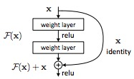
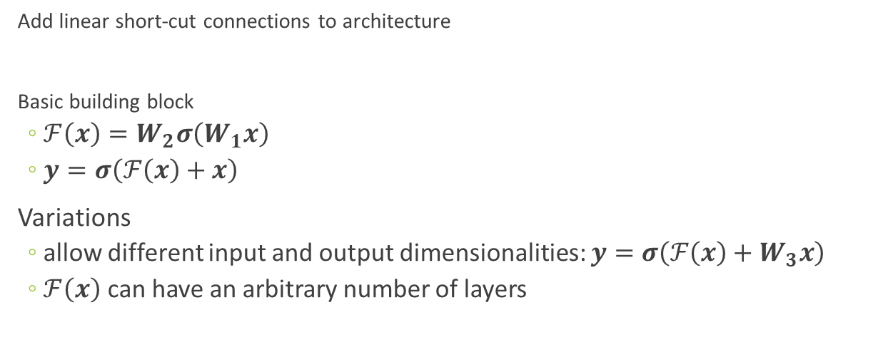
Deep Residual Networks (ResNet)
Add linear short-cut connections to architecture
Basic building block
$ℱ\left(x\right)=W_{2}σ\left(W_{1}x\right)$
$y=σ\left(ℱ\left(x\right)+x\right)$
Variations
allow different input and output dimensionalities: $y=σ\left(ℱ\left(x\right)+W_{3}x\right)$
$ℱ\left(x\right)$ can have an arbitrary number of layers
activation flow
He, Zhang, Ren, and Sun (2015)

Slide 12
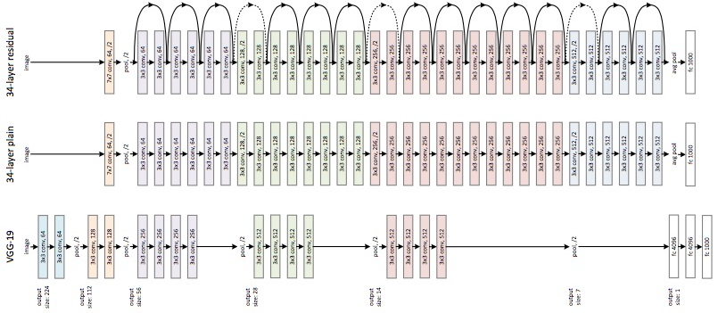
ResNet
kklk
He, Zhang, Ren, and Sun (2015)
Notes:
VGG net: imagenet competition winner
conv layers have 3x3 filters
multiple layers with same image size
number of features is the same for given image size
halving of spatial array and doubling of number of features›

Slide 13
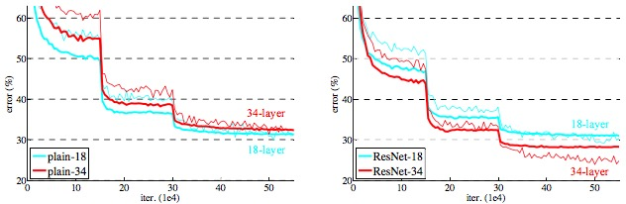

ResNet
Top-1 Error %
He, Zhang, Ren, and Sun (2015)

Slide 14
Inception Networks

Slide 15
Inception
traditional deep neural networks, which is well known for stacked convolutions
Inception networks are well known for parallel stacked convolutions
Inception block contains different size of convolutions and one max pooling layers which is arranged in a parallel manner.It is aggregated for the final output for the inception block
I.e, Computing 1*1,3*3, 5*5 convolutions with in the same module of the network which is arranged in a parallel manner

Slide 16
Inception
In every image, there is a huge variation in the location of information
Filter size should be chosen according to the information content

Slide 17


Slide 18
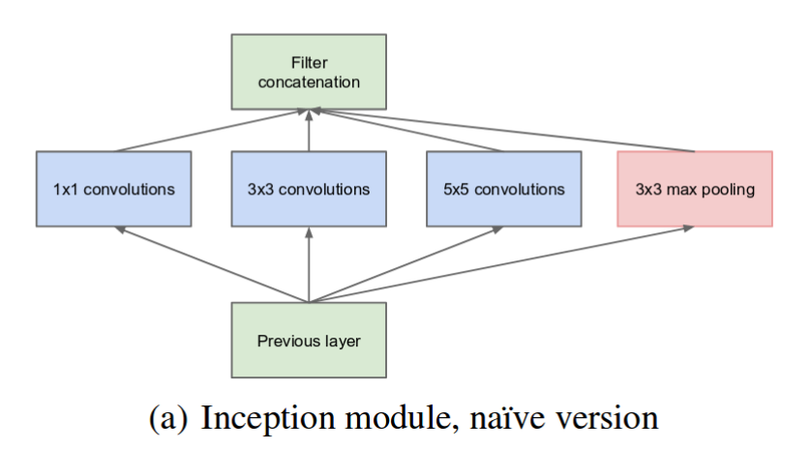
Google Net

Slide 19
Architecture based on Inception network
Inception v1(2014)
Inception v3(2015)
Inception v3(2015)
Inception v4(2016)
Inception ResNet(2016)
Adaptability of the different scales can be accommodated
Overfitting can be prevented

Slide 21
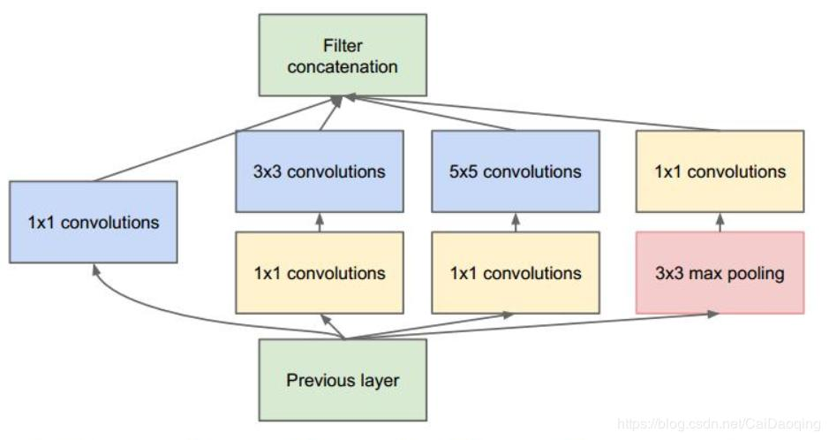
Deep neural networks are computationally expensive. To make it cheaper, the author limit the number of input channels by adding an extra 1*1 convolution before 5*5 and 3*3 convolutions

Slide 22
Transfer Learning

Slide 23
Transfer Learning
Transfer learning generally refers to a process where a model trained on one problem is used in some way on a second related problem.
The weights in re-used layers may be used as the starting point for the training process and adapted in response to the new problem.
This usage treats transfer learning as a type of weight initialization scheme.
This may be useful when the first related problem has a lot more labeled data than the problem of interest and the similarity in the structure of the problem may be useful in both contexts.
Transfer learning consists of taking features learned on one problem, and leveraging them on a new, similar problem.
Taking model learned on one problem , and update it for the new ,similar problem

Slide 24
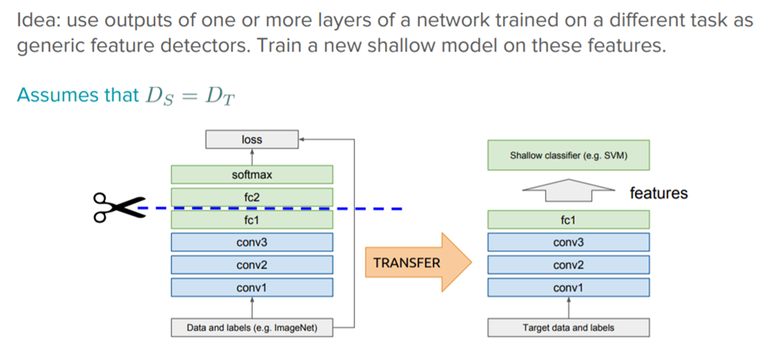
Feature Extraction
The pre-trained model can be used as a separate feature extraction program, in which case input can be pre-processed by the model or portion of the model to a given an output (e.g. vector of numbers) for each input image, that can then use as input when training a new model.

Slide 25
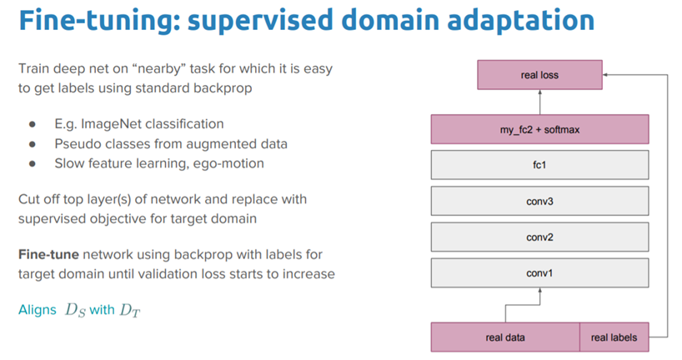
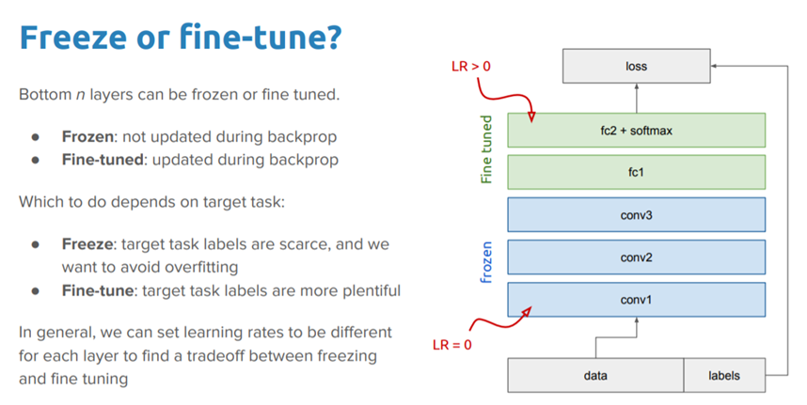
Freezing layers:
Take layers from previously trained model
Freezing them so as to avoid destroying any of the information during future training rounds
Add some new trainable layers on top of the frozen layers
Train the new layers on your dataset

