Slide 1
Recurrent Neural Networks
Shailesh S

Slide 2
Recurrent Nerural Networks
WHAT IS A RECURRENT NEURAL NETWORK (RNN)?
Recurrent neural networks (RNN) are a class of neural networks that are helpful in modeling sequence data. Derived from feedforward networks, RNNs exhibit similar behavior to how human brains function.
Simply put: recurrent neural networks produce predictive results in sequential data that other algorithms can’t.

Slide 3
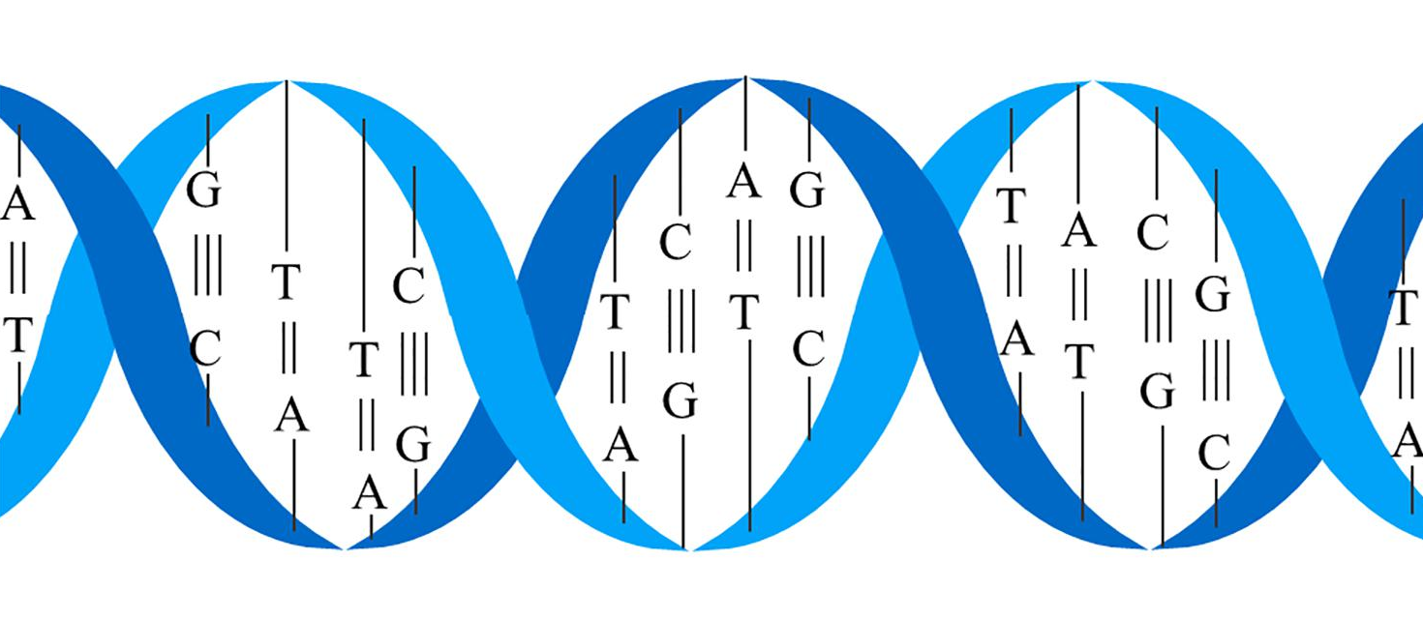
Recurrent Nerural Networks
Why or when to use reccurance ?
Whenever there is a sequence of data and that temporal dynamics that connects the data is more important than the spatial content of each individual frame.” – Lex Fridman (MIT)
Sequential data is basically just ordered data in which related things follow each other. Examples are financial data or the DNA sequence. The most popular type of sequential data is perhaps time series data, which is just a series of data points that are listed in time order.

Slide 4
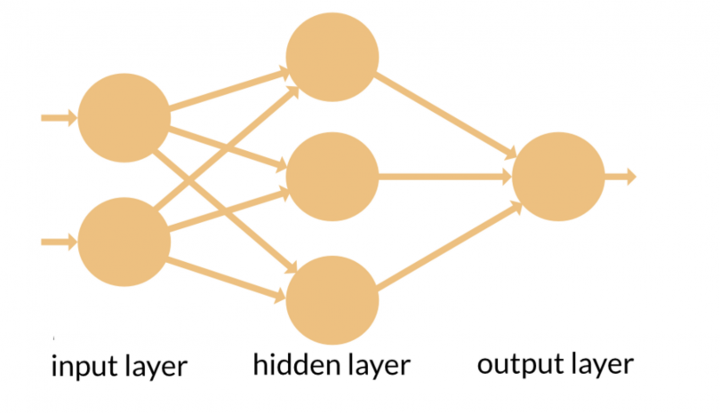
Recurrent Nerural Networks
RNN’s and feed-forward neural networks get their names from the way they channel information.
In a feed-forward neural network, the information only moves in one direction — from the input layer, through the hidden layers, to the output layer. The information moves straight through the network and never touches a node twice.

Slide 5
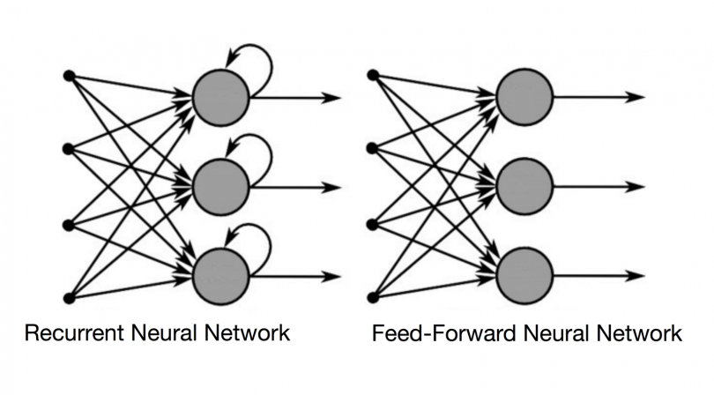
Recurrent Nerural Networks
RNN the information cycles through a loop. When it makes a decision, it considers the current input and also what it has learned from the inputs it received previously.
A recurrent neural network, however, is able to remember those characters because of its internal memory. It produces output, copies that output and loops it back into the network.
Simply put: recurrent neural networks add the immediate past to the present.

Slide 6
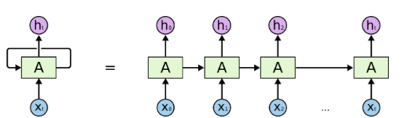
Recurrent Nerural Networks
RNN has two inputs: the present and the recent past. This is important because the sequence of data contains crucial information about what is coming next, which is why a RNN can do things other algorithms can’t.

Slide 7
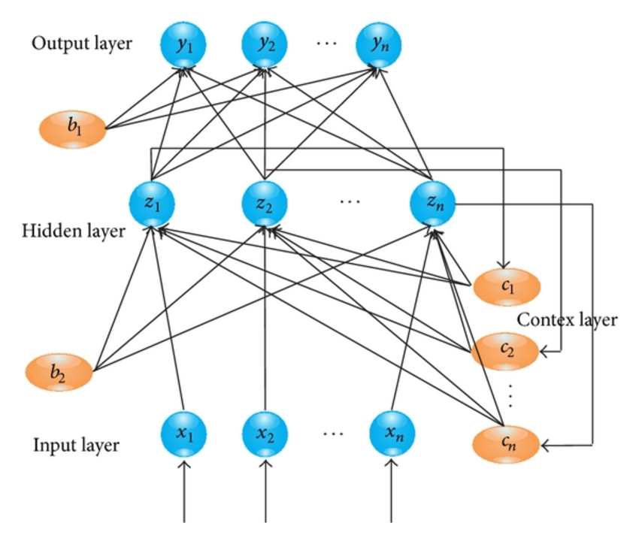
Recurrent Nerural Networks

Slide 8
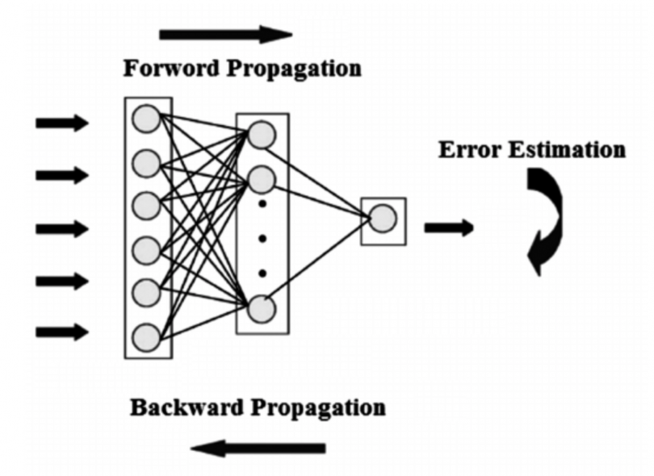
Recurrent Nerural Networks
BPTT is basically just a fancy buzz word for doing backpropagation on an unrolled RNN. Unrolling is a visualization and conceptual tool, which helps you understand what’s going on within the network
BACKPROPAGATION THROUGH TIME

Slide 9
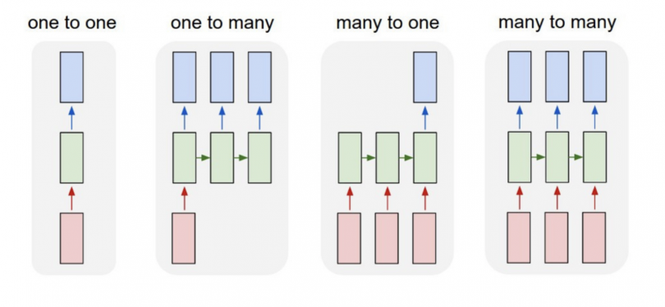
Recurrent Nerural Networks
Feed-forward neural networks map one input to one output, RNNs can map one to many, many to many (translation) and many to one (classifying a voice).

Slide 10
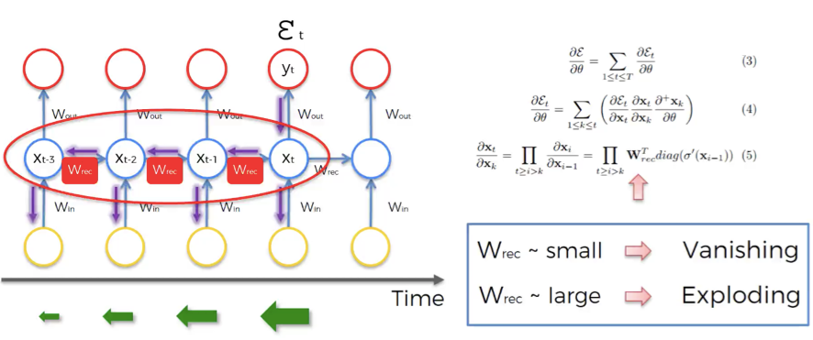
Reccurent Nerural Networks
EXPLODING GRADIENTS
Exploding gradients are when the algorithm, without much reason, assigns a stupidly high importance to the weights. Fortunately, this problem can be easily solved by truncating or squashing the gradients.
VANISHING GRADIENTS
Vanishing gradients occur when the values of a gradient are too small and the model stops learning or takes way too long as a result. This was a major problem in the 1990s and much harder to solve than the exploding gradients. Fortunately, it was solved through the concept of LSTM by Sepp Hochreiter and Juergen Schmidhuber.

Slide 11
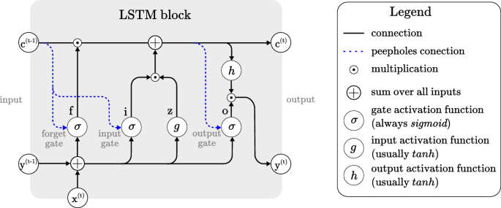
Long Short Term Memory
Long short-term memory networks are an extension for recurrent neural networks, which basically extends the memory. Therefore it is well suited to learn from important experiences that have very long time lags in between.
The units of an LSTM are used as building units for the layers of a RNN, often called an LSTM network

Slide 12
Long Short Term Memory

Slide 13
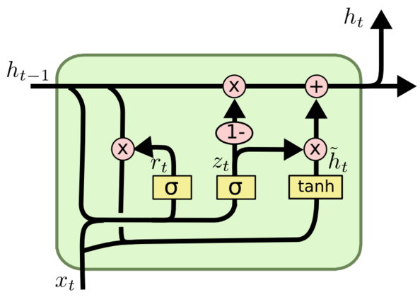
Gated Recurrent Units
To solve the vanishing gradient problem of a standard RNN, GRU uses, so-called, update gate and reset gate.
Basically, these are two vectors which decide what information should be passed to the output. T
he special thing about them is that they can be trained to keep information from long ago, without washing it through time or remove information which is irrelevant to the prediction.

Slide 14
Gated Recurrent Units

Slide 15
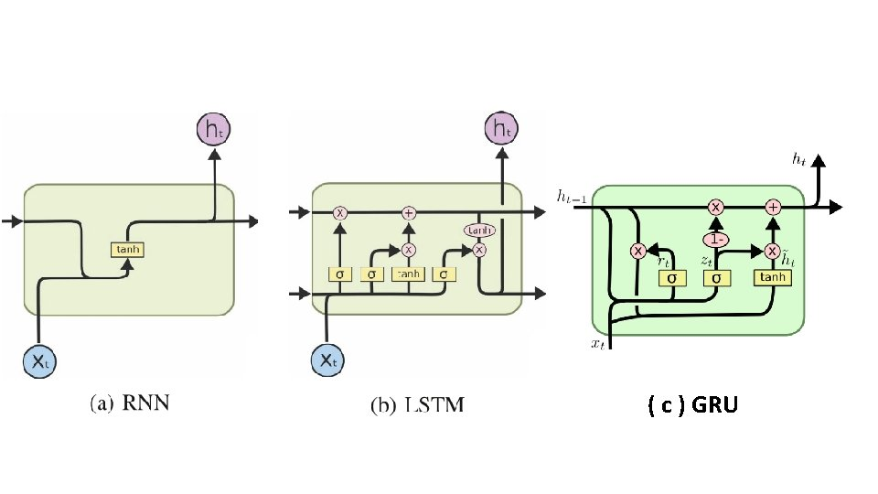
All Together

Slide 16
THANK YOU

