Slide 1
Regression
Dr. Shailesh S

Slide 2
Regression
For classification the output(s) is nominal
In regression the output is continuous
Function Approximation
Many models could be used – Simplest is linear regression
Fit data with the best hyper-plane which "goes through" the points
y
dependent
variable
(output)
x – independent variable (input)

Slide 3
Regression
For classification the output(s) is nominal
In regression the output is continuous
Function Approximation
Many models could be used – Simplest is linear regression
Fit data with the best hyper-plane which "goes through" the points
y
dependent
variable
(output)
x – independent variable (input)
Notes:
Show generalization

Slide 4
Regression
For classification the output(s) is nominal
In regression the output is continuous
Function Approximation
Many models could be used – Simplest is linear regression
Fit data with the best hyper-plane which "goes through" the points
For each point the differences between the predicted point and the actual observation is the residue
y
x

Slide 5
How do we "learn" parameters
For the 2-d problem (line) there are coefficients for the bias and the independent variable (y-intercept and slope)
To find the values for the coefficients which minimize the objective function

Slide 6
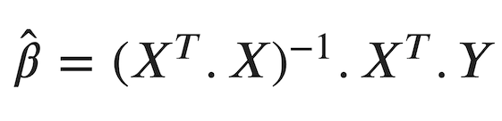
How do we "learn" parameters
Multivariate Linear Regression

Slide 7
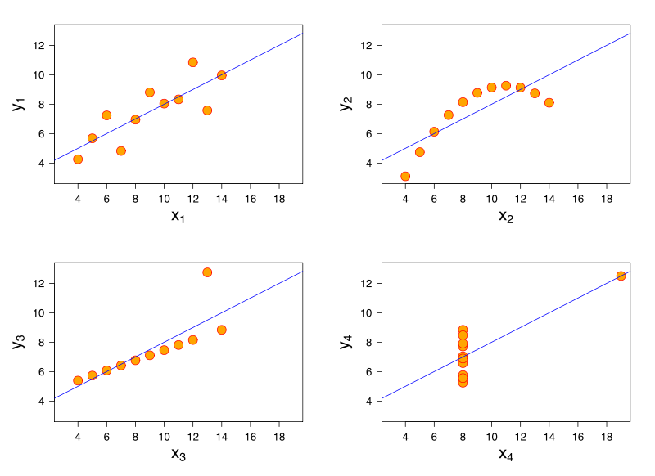
Examples
What lines "really" best fit each case? – different approaches
Notes:
Standard LR gives same line for each
If Gaussian error is #4 likely?, But in actual data set with human error, etc.?
Some approaches fit bottom two, but which is best? Noise vs exception

