Slide 1
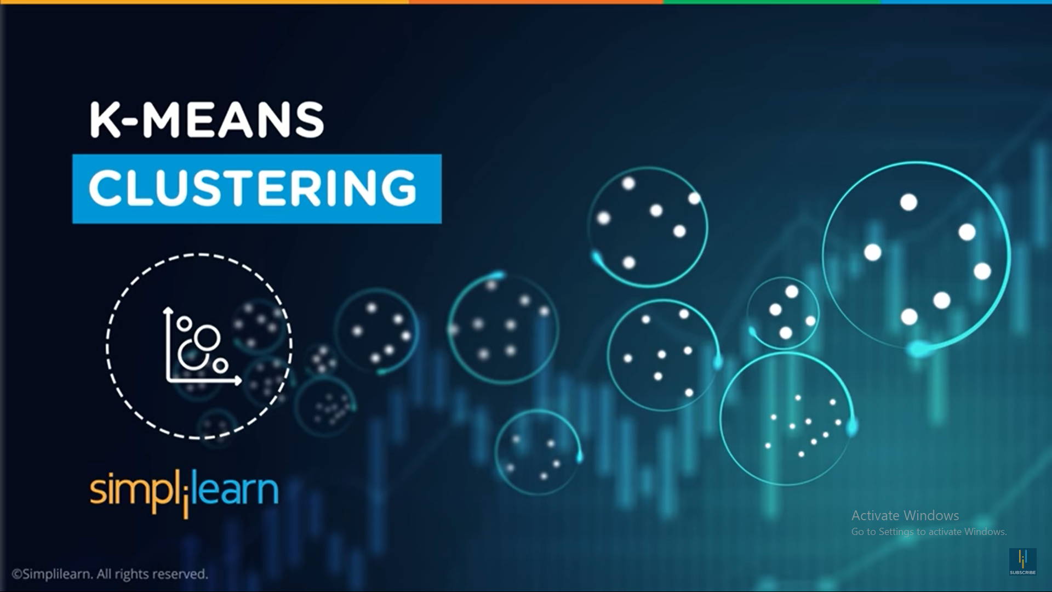

Dr. Shailesh S
DCS CUSAT

Slide 2
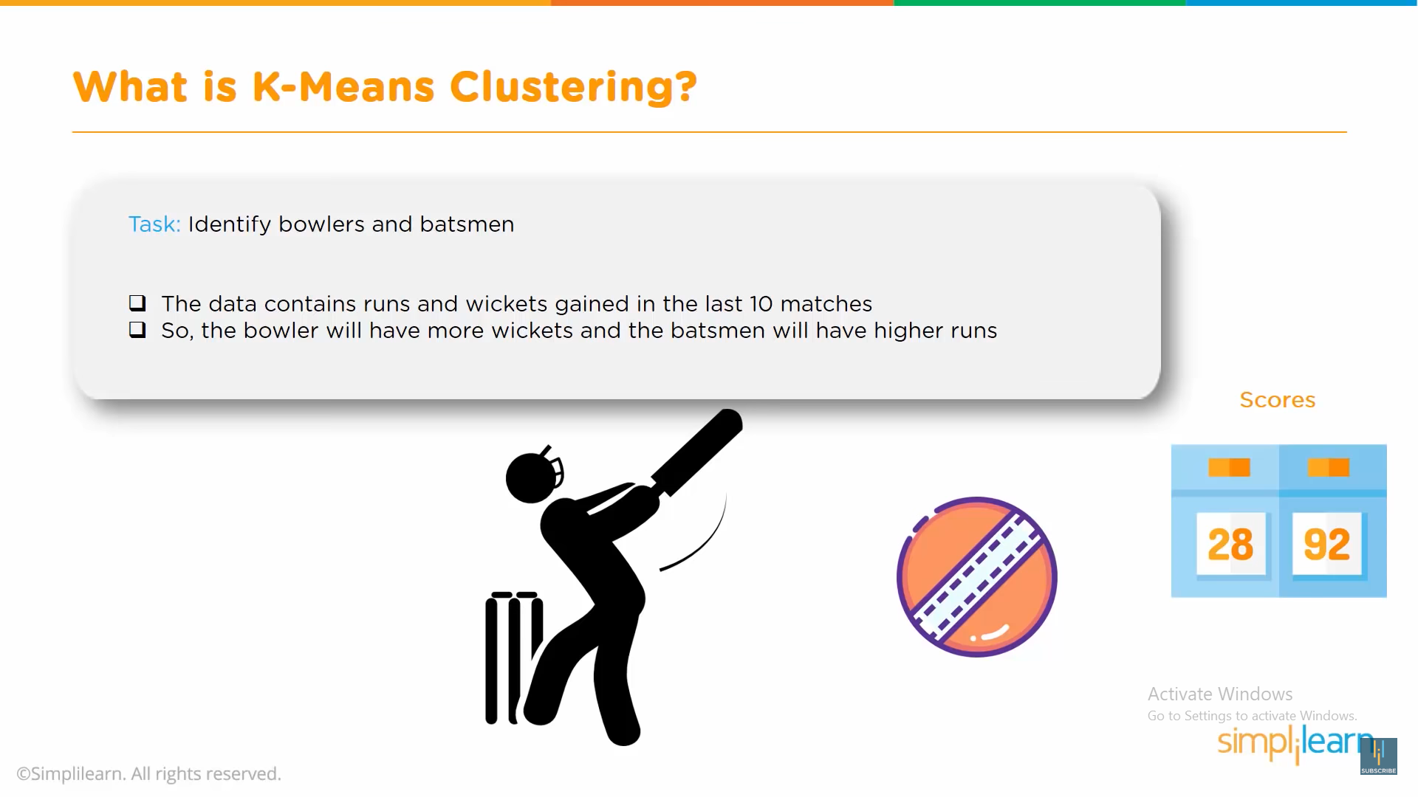

Slide 3
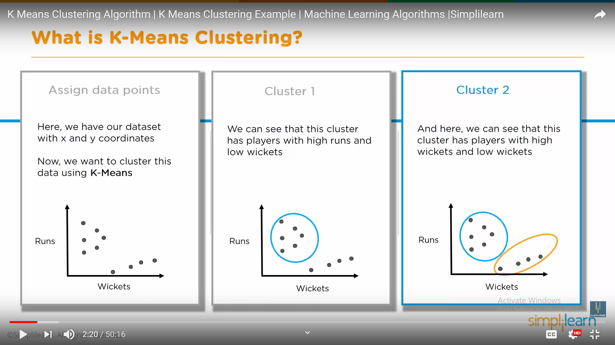

Slide 4
the process of grouping a set of objects into classes of similar object

Slide 5
Clustering
Clustering: the process of grouping a set of objects into classes of similar object
Documents within a cluster should be similar.
Documents from different clusters should be dissimilar.
Goal: maximize intra-cluster similarity and minimize inter-cluster similarity
Unsupervised learning = learning from raw data

Slide 6
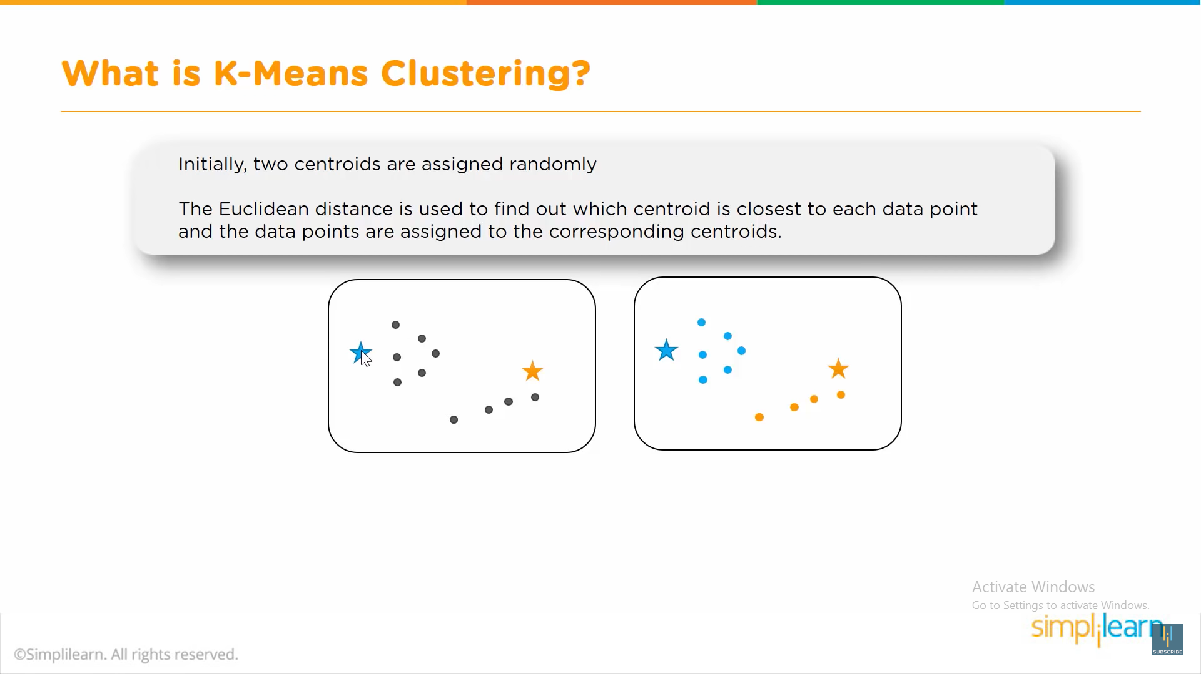

Slide 7
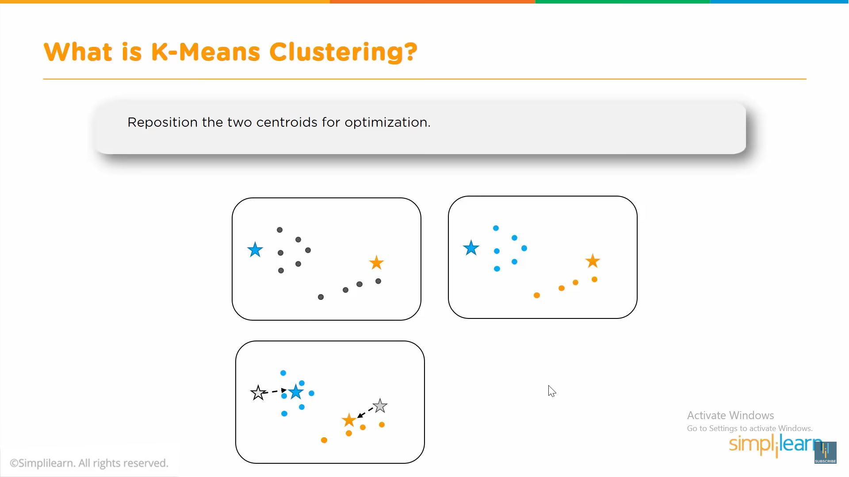

Slide 8
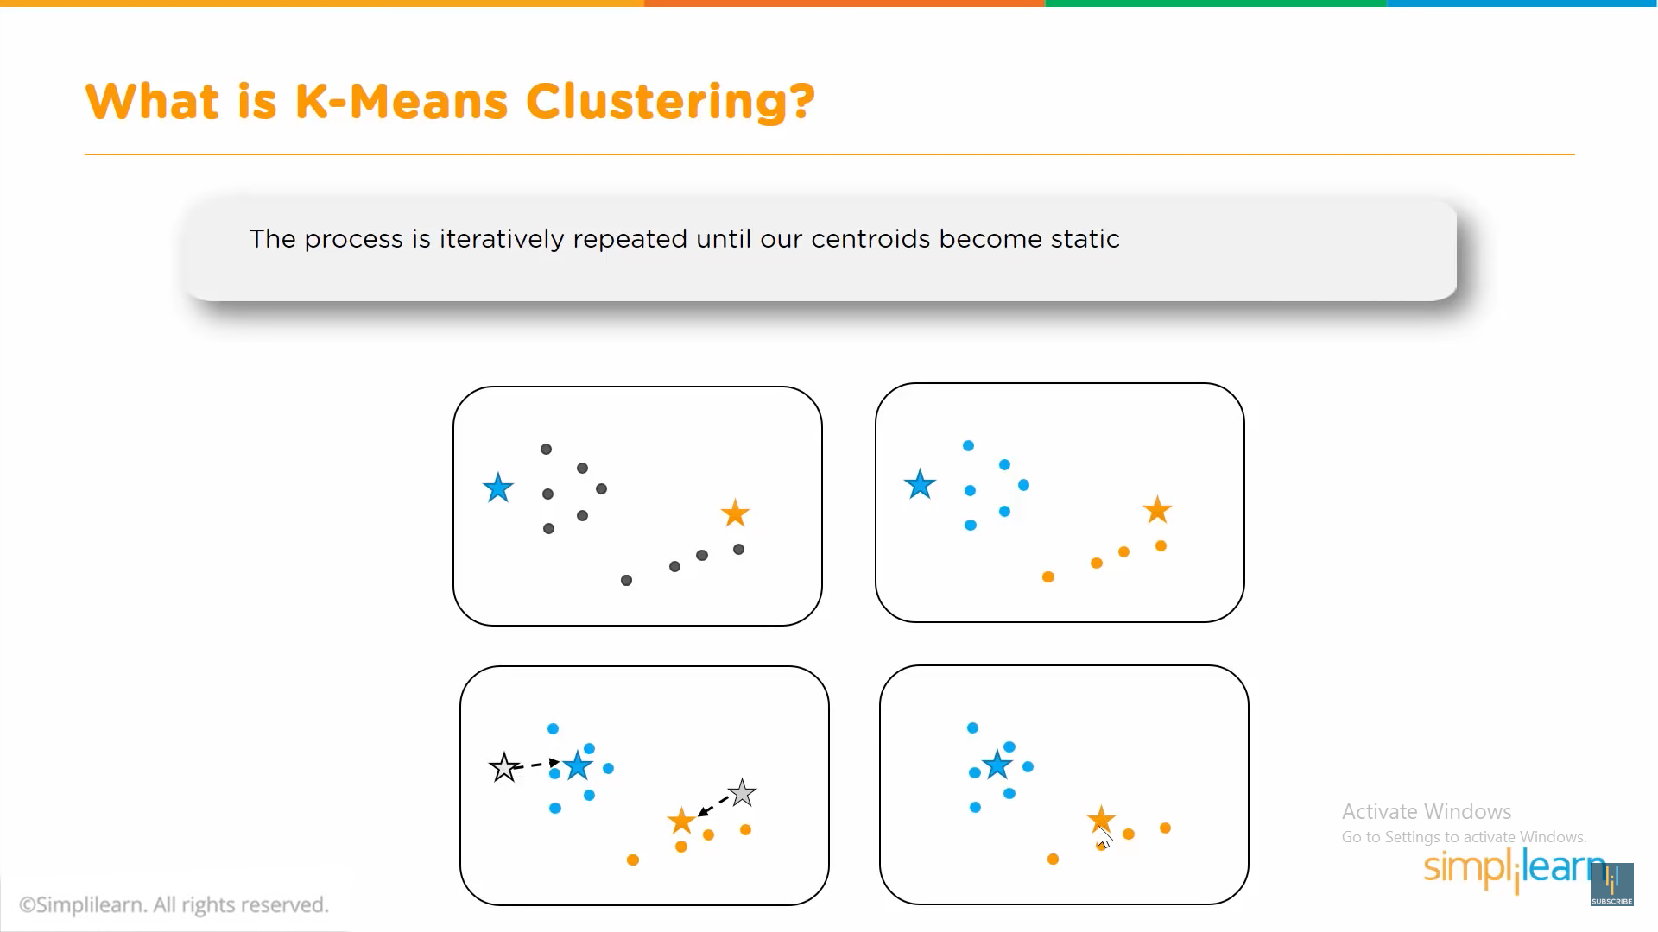

Slide 9
K-means algorithm(k=3)
Initial seeds

Slide 10
K-means algorithm
New centers

Slide 11
K-means algorithm
Final centers

Slide 12
Deviation detection
outlier

Slide 13
