Slide 1
K Means
DEMO

Slide 2
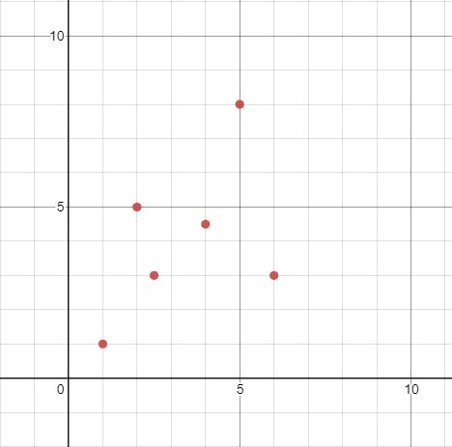

Slide 3
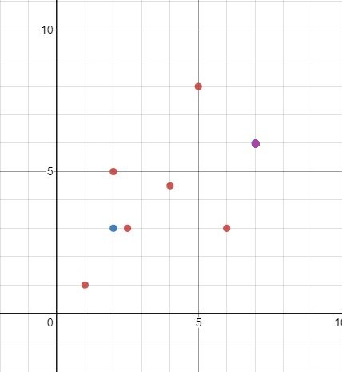
(7,6)
(2,3)

Slide 4
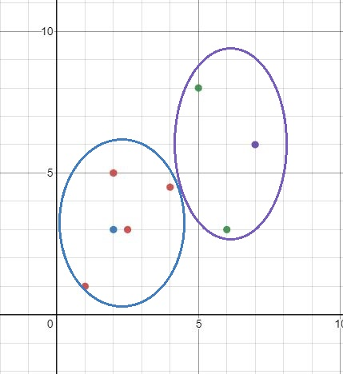
(7,6)
(2,3)

Slide 5
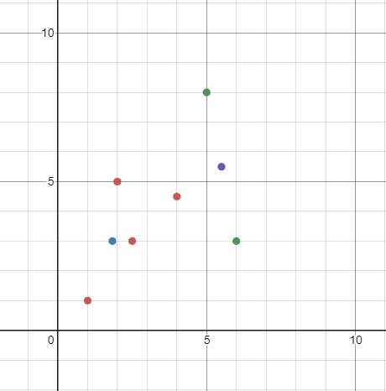
(5.5, 5.5)
(2.375,3.375)

Slide 6
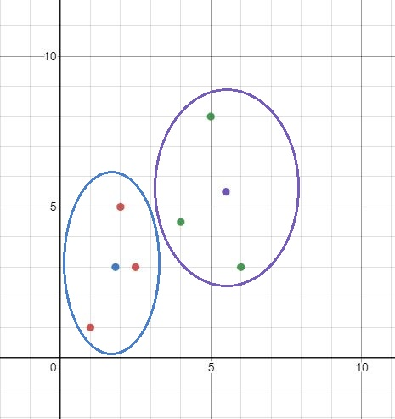
(5.5, 5.5)
(2.375,3.375)

Slide 7
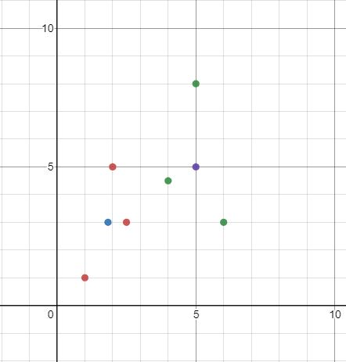
(5,5)
(1.833,3)

Slide 8
