Slide 1
Artificial Neural Networks
Dr.Shailesh S

Slide 2
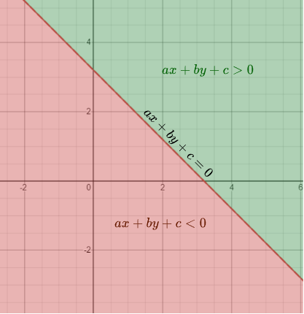
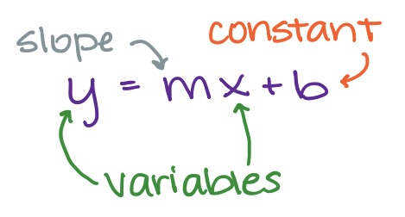
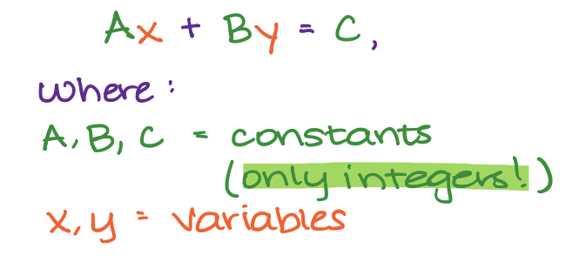
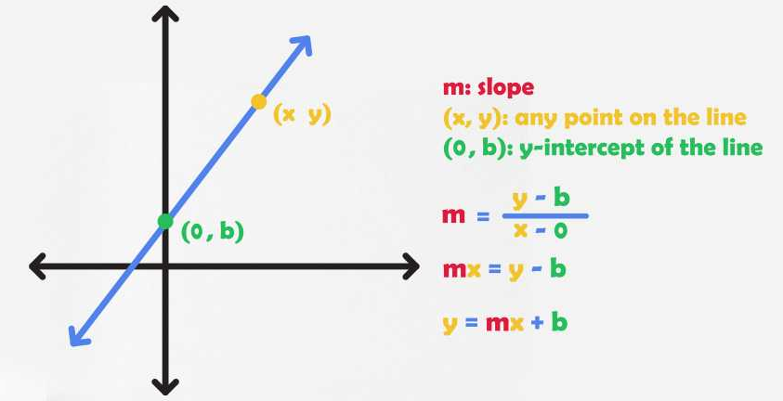
Equation of a LIne

Slide 3
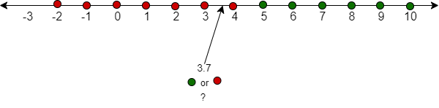

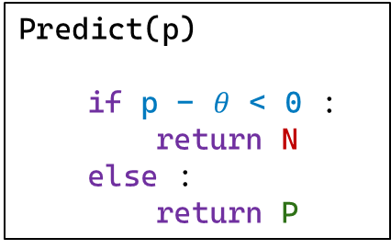
Classification : ReVISIT
Dataset
x | y
-2 | N
6 | P
7 | P
3 | N
2 | N
-1 | N
0 | N
5 | P
10 | P
4 | N
9 | P
8 | P
$θ$ = 4.5
Decision Boundry
Predict(p)
if p - $θ$ < 0 :
return N
else :
return P
Binary Classification

Slide 4
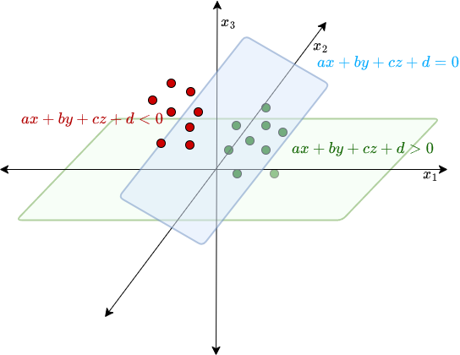
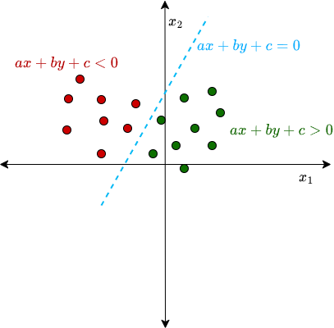
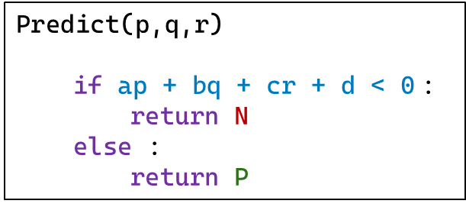
Classification : ReVISIT
2D - data
3D - data
Predict(p,q)
if ap + bq + c < 0:
return N
else :
return P
Predict(p,q,r)
if ap + bq + cr + d < 0 :
return N
else :
return P

Slide 5

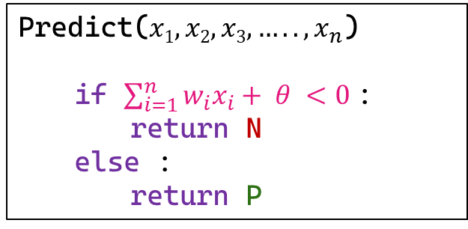
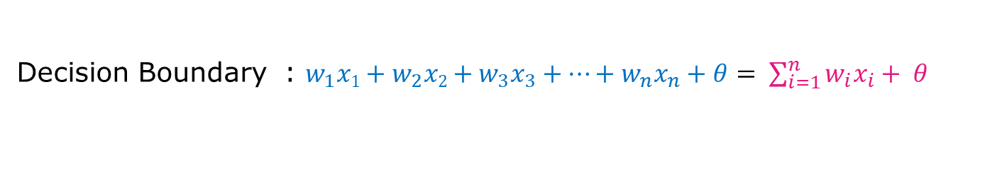
Classification : ReVISIT
Generalizing to n-dimensional space
Data : $X = <x1, x2, x3,….., x_{n}>$
Decision Boundary : $w_{1}x1+w_{2}x2+w_{3}x_{3}+…+w_{n}x_{n}+θ= \sum_{i=1}^{n}{w_{i}x_{i}+ θ }$
Predict($x1, x2, x3,….., x_{n}$)
if $\sum_{i=1}^{n}{w_{i}x_{i}+ θ }<0$:
return N
else :
return P

Slide 6
Perceptron
First neural network learning model in the 1960’s
Simple and limited (single layer models)
Basic concepts are similar for multi-layer models so this is a good learning tool
Still used in many current applications (modems, etc.)

Slide 7
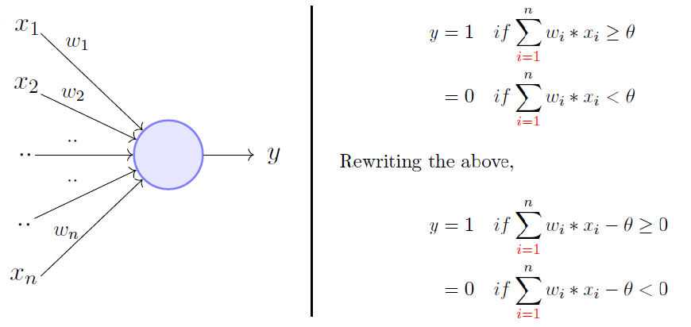
Perceptron Model

Slide 8
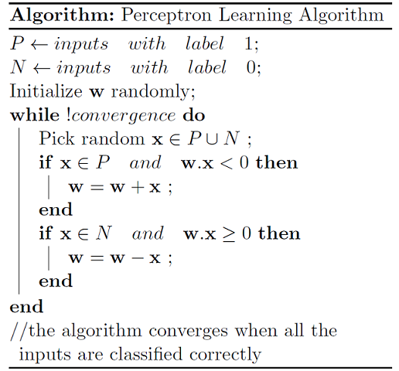
Perceptron Algorithm

Slide 9
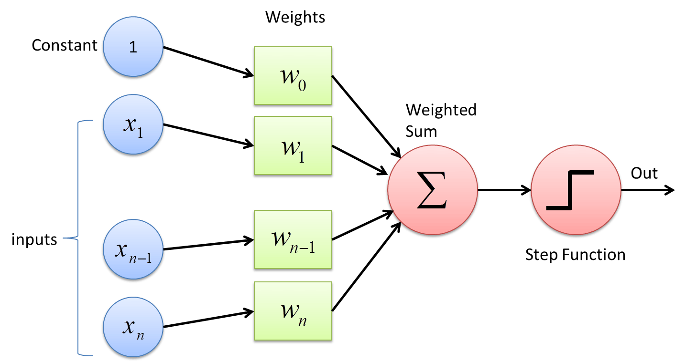
Perceptron Model

Slide 10
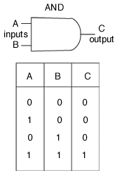
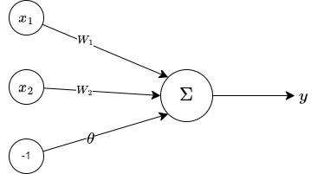
Learning AND gate

Slide 11
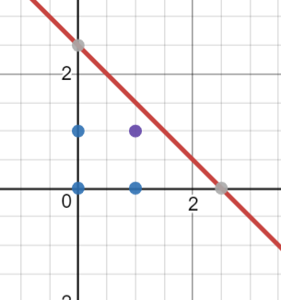
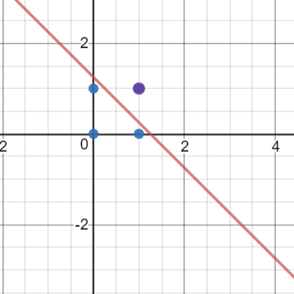
Learning AND gate
z = w₁.x₁ + w₂.x₂ – θ
w₁=1, w₂=1, θ= 2.5
1 x₁ + 1 x₂ – 2.5 = 0
w₁ | w₂ | -θ | (x₁,x₂) | z
1 | 1 | -2.5 | (0,1) - | 1x0 + 1x1 - 2.5 = -1.5
1 | 1 | -2.5 | (1,1) + | 1x1 + 1x1 - 2.5 = -0.5
2 | 2 | -2.5 | (0,0) - | 2x0 + 2x1 - 2.5 = -2.5
2 | 2 | -2.5 | (1,0) - | 2x1 + 2x0 - 2.5 = -0.5
2 | 2
2 x₁ + 2 x₂ – 2.5 = 0

Slide 12
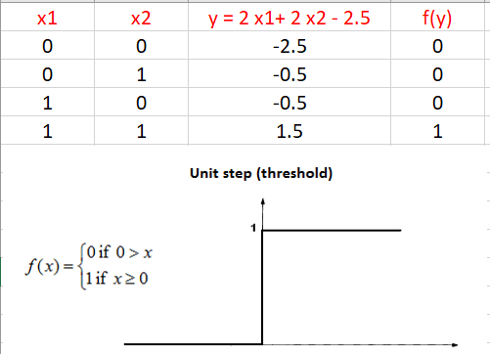
Learning AND gate

Slide 13
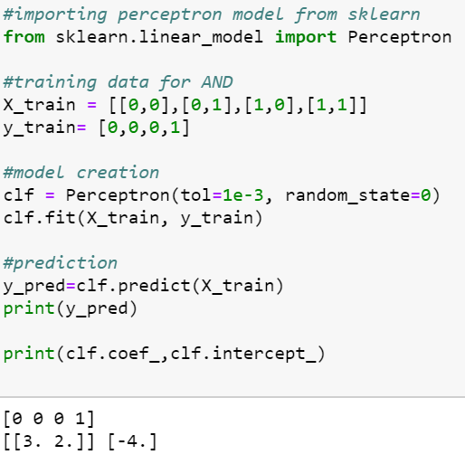
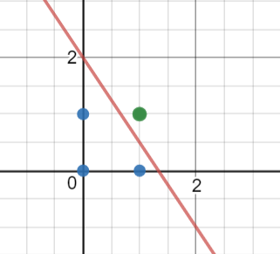
Implementing AND gate
Tools
Python
Sklearn
Try It For
OR, NAND, NOR, XOR

Slide 14
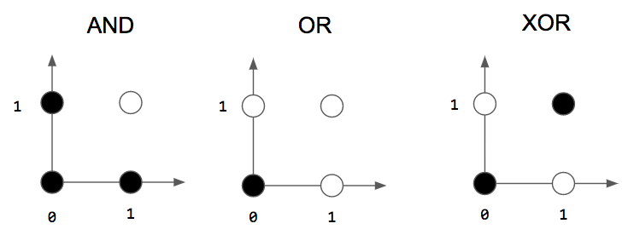
More Gates
?

Slide 15
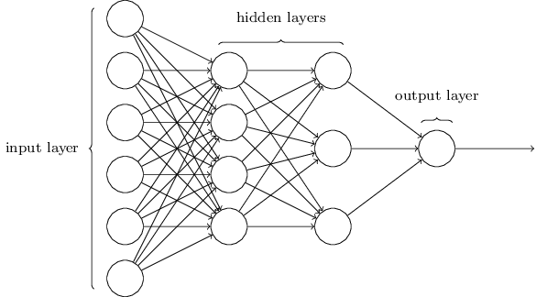
Multi Layer Perceptron(MLP)
Feedforward network: The neurons in each layer feed their output forward to the next layer until we get the final output from the neural network.
There can be any number of hidden layers within a feedforward network.
The number of neurons can be completely arbitrary.
MLP used to describe any general feedforward (no recurrent connections) network

Slide 16
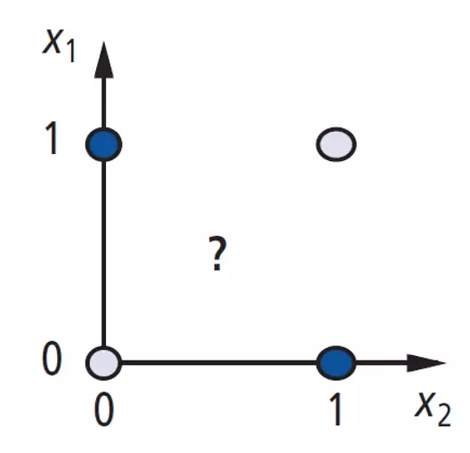
Again to XOR problem
A Perceptron cannot represent Exclusive XOR since it is not linearly separable.
PERCEPTRON -------→ MLP

Slide 17
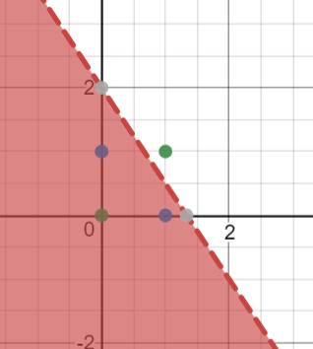
Solution XOR problem
x₁ | x₂ | y
0 | 0 | 0
0 | 1 | 1
1 | 0 | 1
1 | 1 | 0
4
x
-3
O₁
x | y | O₁
0 | 0 | 1
0 | 1 | 1
1 | 0 | 1
1 | 1 | 0
y
-2
Shade indicate 1 (+ve region )

Slide 18
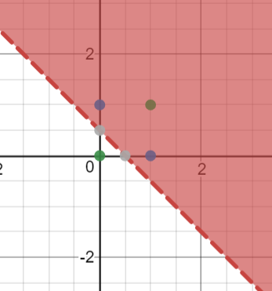
Solution XOR problem
Solution XOR problem
x
1
y
1
O₂
0.5
x₁ | x₂ | y
0 | 0 | 0
0 | 1 | 1
1 | 0 | 1
1 | 1 | 0
x | y | O₂
0 | 0 | 0
0 | 1 | 1
1 | 0 | 1
1 | 1 | 1
Shade indicate 1 (+ve region)

Slide 19
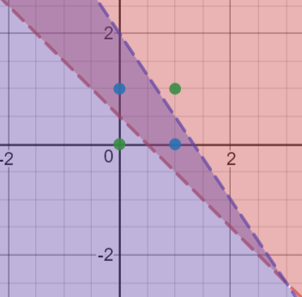
Solution XOR problem
4
-2
x
-3
O₁
1.5
z
1
-2
x₁ | x₂ | y
0 | 0 | 0
0 | 1 | 1
1 | 0 | 1
1 | 1 | 0
y
O₂
1
1
O₁ | O₂ | z
1 | 0 | 0
1 | 1 | 1
0 | 1 | 0
0.5
x | y | O₁
0 | 0 | 1
0 | 1 | 1
1 | 0 | 1
1 | 1 | 0
x | y | O₂
0 | 0 | 0
0 | 1 | 1
1 | 0 | 1
1 | 1 | 1

Slide 20
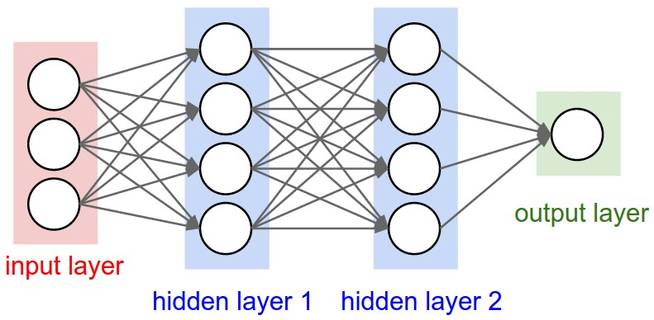
Three layer networks

Slide 21
Three layer networks
No connections within a layer
No direct connections between input and output layers
Fully connected between layers
Often more than 3 layers
Number of output units need not equal number of input units
Number of hidden units per layer can be more or less than input or output units

Slide 22
Three layer networks
No connections within a layer
No direct connections between input and output layers
Fully connected between layers
Often more than 3 layers
Number of output units need not equal number of input units
Number of hidden units per layer can be more or less than input or output units

Slide 23
What do each of these layer do ?
1st layer draws linear boundaries
2nd layer combines the boundaries
3rd layer can generate arbitrarily complex boundaries

Slide 24
What do each of these layer do ?
1st layer draws linear boundaries
2nd layer combines the boundaries
3rd layer can generate arbitrarily complex boundaries

Slide 25
Backpropagation learning algorithm ‘BP’
BP has two phases:
Forward pass phase: computes ‘functional signal’, feed forward
propagation of input pattern signals through network
Backward pass phase: computes ‘error signal’, propagates the error backwards through network starting at output units (where the error is the difference between actual and desired
output values)

Slide 26
Backpropagation learning algorithm ‘BP’

Slide 27
Backpropagation learning algorithm ‘BP’
● Error gradient along all connection weights were measured by propagating the error from output layer.
● First, a forward pass is performed - output of every neuron in every layer is computed.
● Output error is estimated.
● Then compute how much each neuron in last hidden layer contributed to output error.
● This is repeated backwards until input layer.
● Last step is Gradient Descent on all connection weights using error gradients estimated in previous steps.

Slide 28
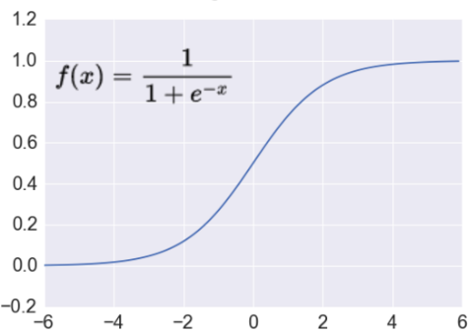

Activation: Sigmoid
Nice interpretation as the firing rate of a neuron
0 = not firing at all
1 = fully firing
Sigmoid neurons saturate and kill gradients, thus NN will barely learn
when the neuron’s activation are 0 or 1 (saturate)
gradient at these regions almost zero
almost no signal will flow to its weights
if initial weights are too large then most neurons would saturate
$$R^{n}→\left[0,1\right]$$
Takes a real-valued number and “squashes” it into range between 0 and 1.

Slide 29
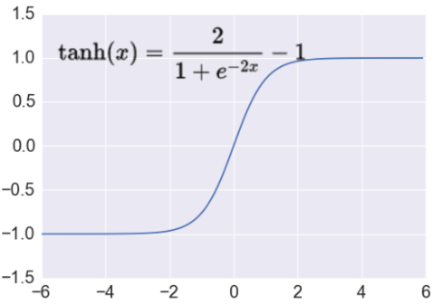
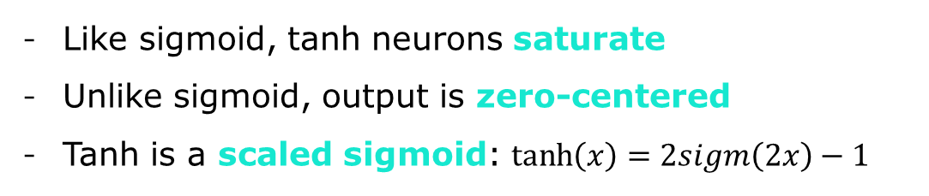

Activation: Tanh
Like sigmoid, tanh neurons saturate
Unlike sigmoid, output is zero-centered
Tanh is a scaled sigmoid: $\tanh\left(x\right)=2sigm\left(2x\right)−1$
$$R^{n}→\left[−1,1\right]$$
Takes a real-valued number and “squashes” it into range between -1 and 1.
Notes:
not zero-centered: later layers of processing would be receiving data that is not zero-centered.
if data coming into a neuron is always positive then the gradient on the weights will be either all be positive, or all negative (depending on the gradient of the whole expression). Could introduce undesirable zig-zagging dynamics in the gradient weight updates. However, once these gradients are added up across a data batch the final weight update can have variable signs, somewhat mitigating this issue.

Slide 30
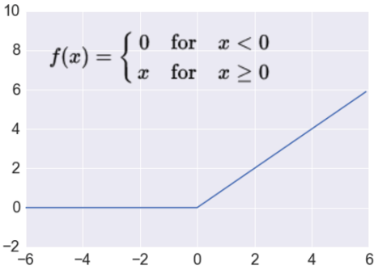


Activation: ReLU
Most Deep Networks use ReLU nowadays
Trains much faster
accelerates the convergence of SGD
due to linear, non-saturating form
Less expensive operations
compared to sigmoid/tanh (exponentials etc.)
implemented by simply thresholding a matrix at zero
More expressive
Prevents the gradient vanishing problem
$$f\left(x\right)= max⁡(0,x)$$
$$R^{n}→R_{+}^{n}$$
Takes a real-valued number and thresholds it at zero
Notes:
ReLU units can “die”
large gradient flowing through a ReLU could cause weights to update in such a way that the neuron will never activate on any datapoint again
gradient flowing through the unit will forever be zero from that point on
With a proper setting of the learning rate this is less frequently an issue

Slide 31
Activation: ReLU
Most Deep Networks use ReLU nowadays
Trains much faster
accelerates the convergence of SGD
due to linear, non-saturating form
Less expensive operations
compared to sigmoid/tanh (exponentials etc.)
implemented by simply thresholding a matrix at zero
More expressive
Prevents the gradient vanishing problem
$$f\left(x\right)= max⁡(0,x)$$
$$R^{n}→R_{+}^{n}$$
Takes a real-valued number and thresholds it at zero
Notes:
ReLU units can “die”
large gradient flowing through a ReLU could cause weights to update in such a way that the neuron will never activate on any datapoint again
gradient flowing through the unit will forever be zero from that point on
With a proper setting of the learning rate this is less frequently an issue

Slide 32
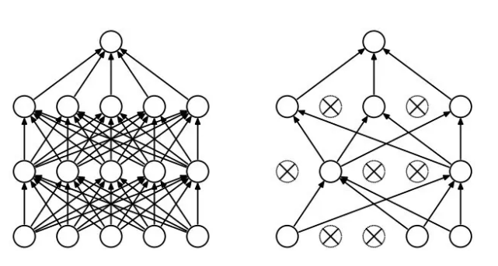
Regularization
Dropout
Randomly drop units (along with their connections) during training
Each unit retained with fixed probability p, independent of other units
Hyper-parameter p to be chosen (tuned)
L2 = weight decay
Regularization term that penalizes big weights
Weight decay value determines how dominant regularization is during gradient computation
Big weight decay coefficient → big penalty for big weights
Early-stopping
Use validation error to decide when to stop training
Stop when monitored quantity has not improved after n subsequent epochs
n is called patience

Slide 33
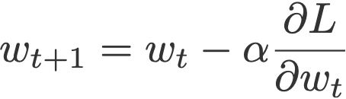
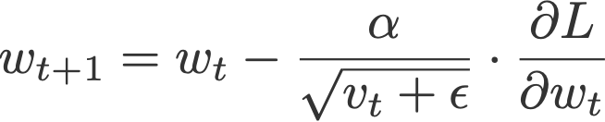
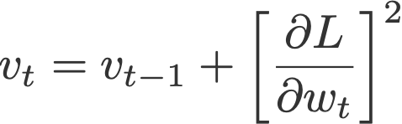
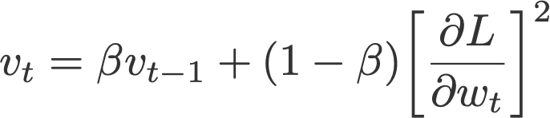
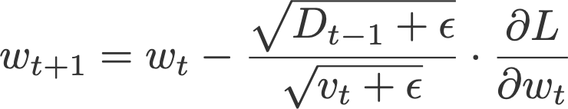
Optimization Methods
Gradient Descent
Stochastic Gradient Descent (SGD)
Mini Batch Stochastic Gradient Descent (MB-SGD)
SGD with momentum
Nesterov Accelerated Gradient (NAG)
Adaptive Gradient (AdaGrad)
AdaDelta
RMSprop
Adam
Gradient Descent
Adagrad
RMSprop
Adadelta

Slide 34
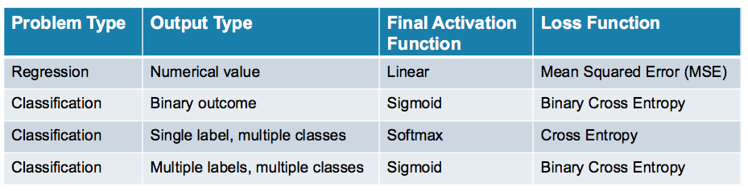
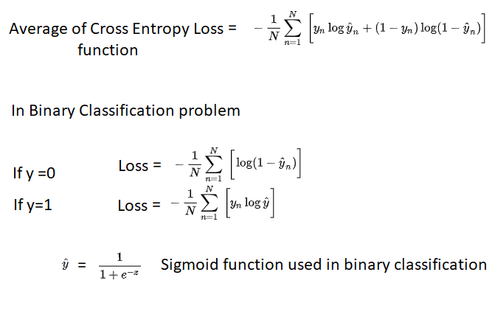
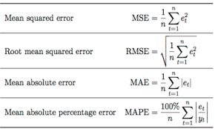
Loss Functions

Slide 35
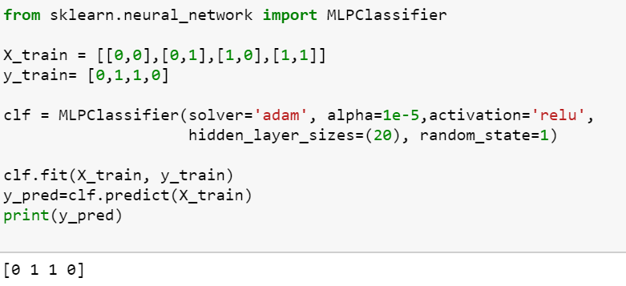
Implementation of XOR Gate MLP

Slide 36
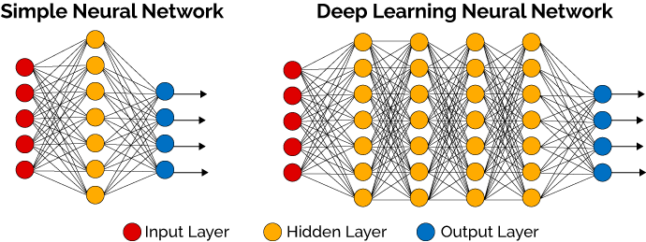
Deep Neural Networks

Slide 37
Thank You
ANY QUERIES ?

