Slide 1


INTRODUCTION TO
NATURAL LANGUAGE PROCESSING
Shilpa Shaju

Slide 2

What is NLP??
Natural language processing (NLP)- A branch of Artificial Intelligence that gives machines the ability to understand natural human langauge.
billions of text data being generated every day and most of them are unstructured.

Slide 3
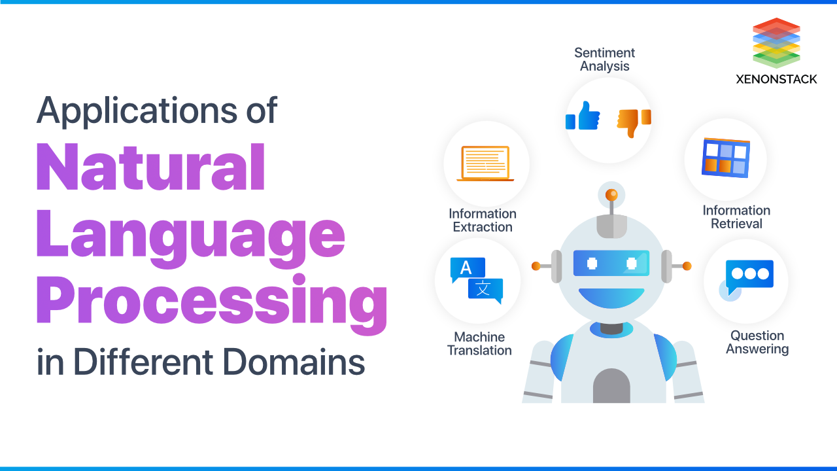

Slide 4

Python Libraries for NLP

Slide 5
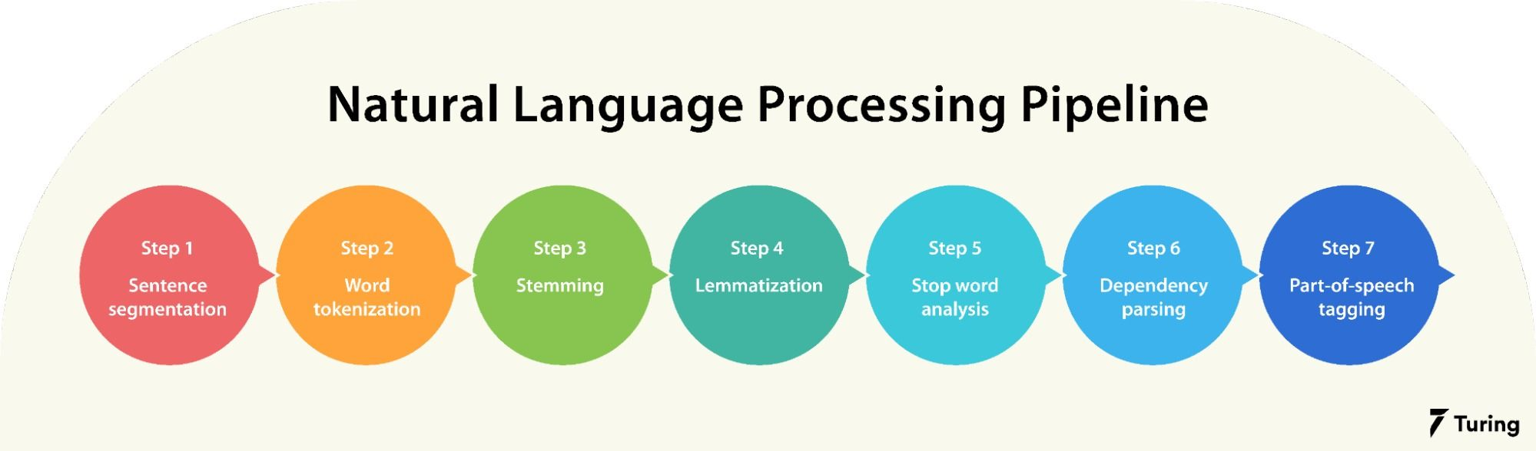
Common Terminologies
Source

Slide 6
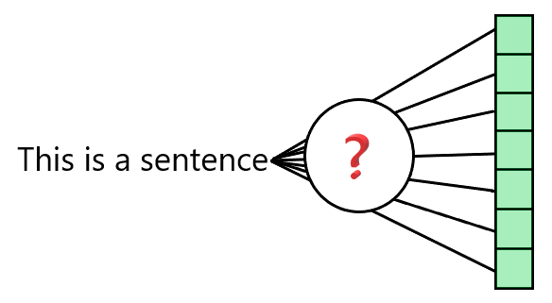
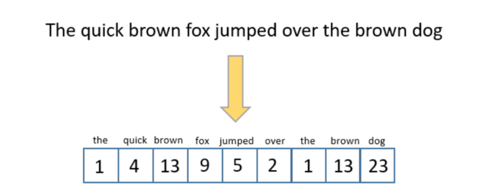
Text Features Extraction
Turning text into vectors that can be then fed to machine learning models in a classical way

Slide 7
Types
Machine learning algorithms cannot work with raw text directly; the text must be converted into numbers. Specifically, vectors of numbers.
N- Grams
Bag-of-Words
Term Frequency
(TF-IDF)
Word Embedding

Slide 8
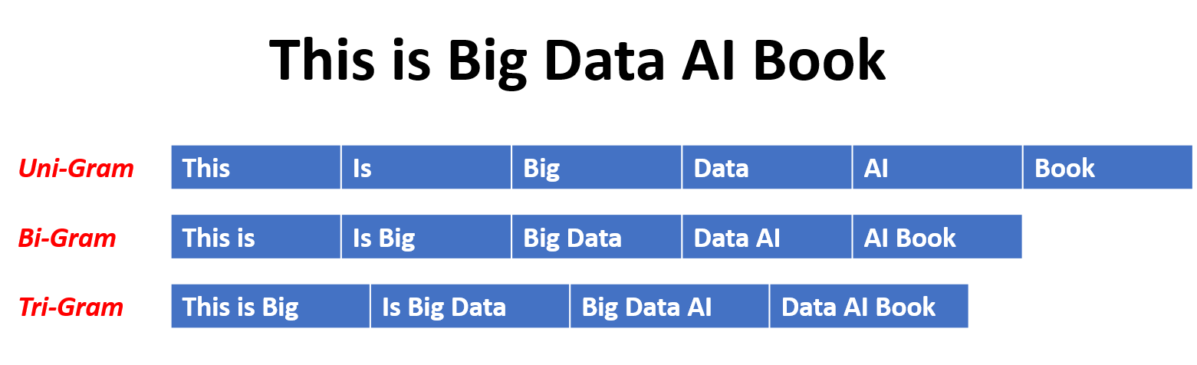
N-grams
N-grams are the combination of multiple words used together. Ngrams with N=1 are called unigrams. Similarly, bigrams (N=2), trigrams (N=3) and so on can also be used.

Slide 9
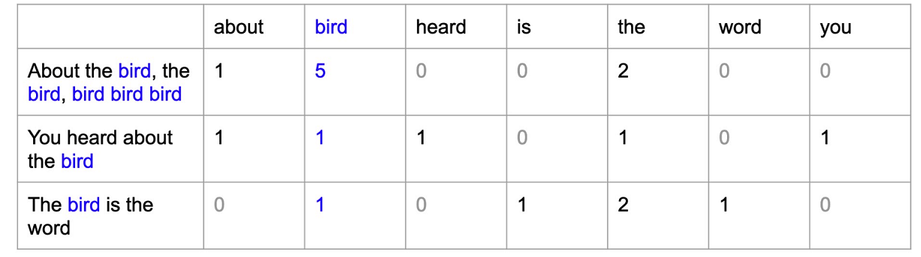
Bag of Words (BoW)
used to analyze text and documents based on word count.
model does not account for word order within a document.

Slide 10
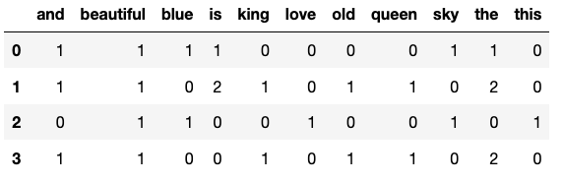
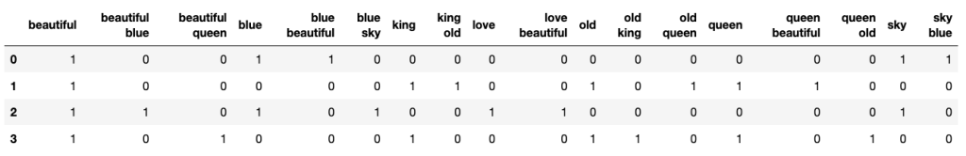
Bag of Words(BOW) Limitation
'The sky is blue and beautiful', 'The king is old and the queen is beautiful', 'Love this beautiful blue sky', 'The beautiful queen and the old king']

Slide 11
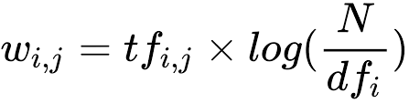
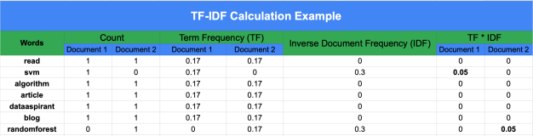
Term Document – Inverse Document Frequnecy Matrix
The document frequency of word i represents the number of documents in the corpus with word i in them
The term frequency is a ratio of the count of a word’s occurrence in a document and the number of words in the document
Let us show the count of word i in document j by
Let us represent document frequency for word i by . With N as the number of documents in the corpus, the tf-idf weight for word i in document j is computed by the following formula:

Slide 12
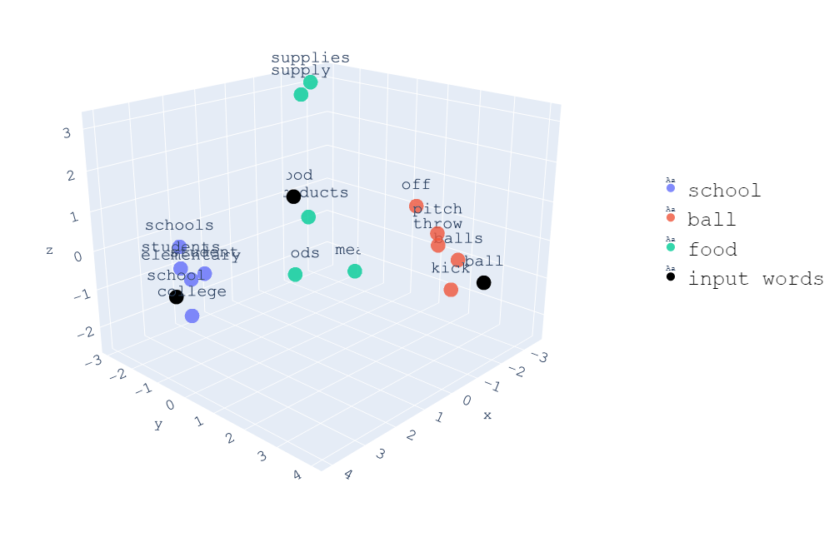
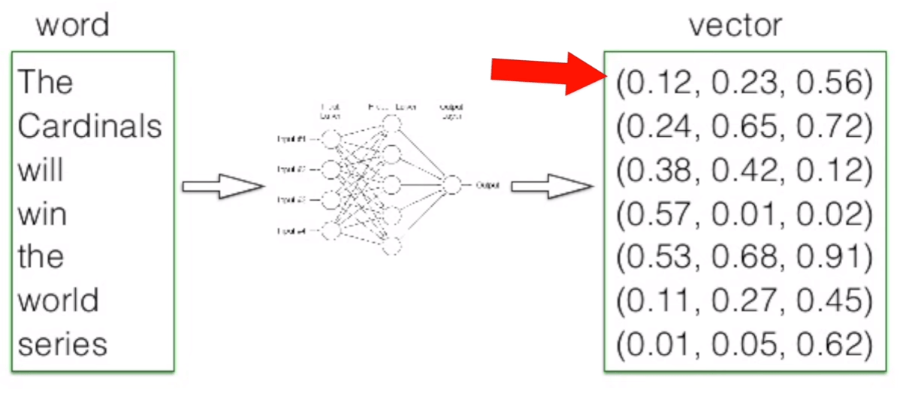
Text Embedding
Word Embedding is the representation of text in the form of vectors. The underlying idea here is that similar words will have a minimum distance between their vectors.
Word2Vec
Doc2Vec

Slide 13
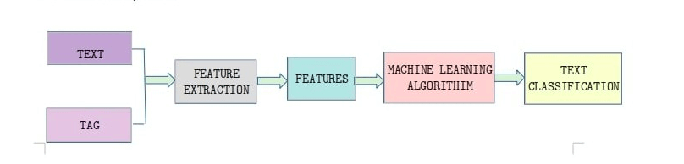
Text Classification -Pipeline

Slide 14
Assignment Question

Slide 15

Thank You

Slide 16

ANY QUESTION

