Slide 1

FDP on Machine Learning organized by SITTTR, Kalamaserry Shailesh S shaileshsivan@gmail.com

Slide 2
Overview
Dimensionality Reduction
Components of Dimensionality Reduction
Methods of Dimensionality Reduction
Feature Reduction Iris Dataset
Preprocessing

Slide 3
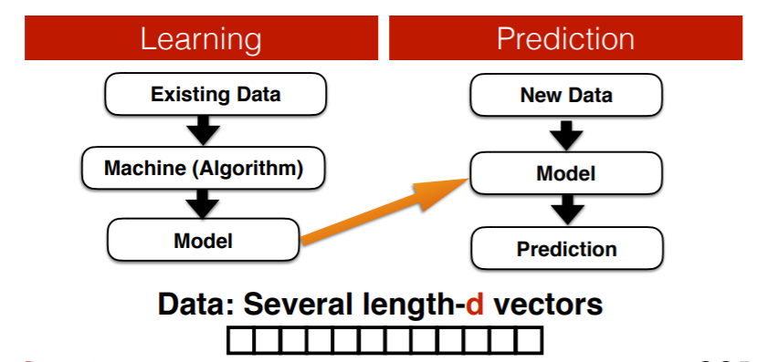
What machine learning does?

Slide 4
Some Facts
Expectation :
We have good enough data
Do focus on designing better algorithms
Reality :
We have large amount of data but not good enough
How to transform your data into learning compactable ?

Slide 5
What is a Feature in ML
A feature is a measurable property of the object you’re trying to analyze. In datasets, features appear as columns
Feature engineering is the process of transforming raw data into features that better represent the underlying problem to the predictive models, resulting in improved model accuracy on unseen data.
Feature engineering turn your inputs into things the algorithm can understand

Slide 6
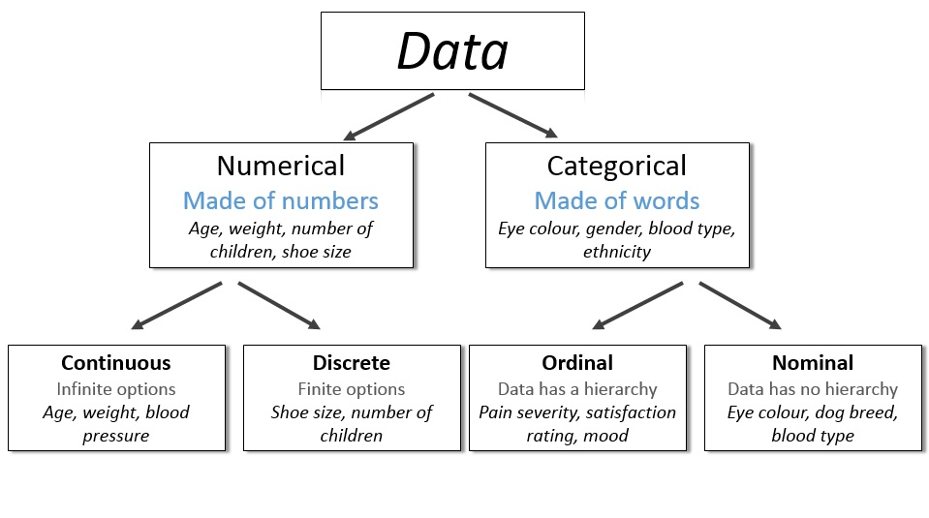
Types of Features
Features

Slide 7
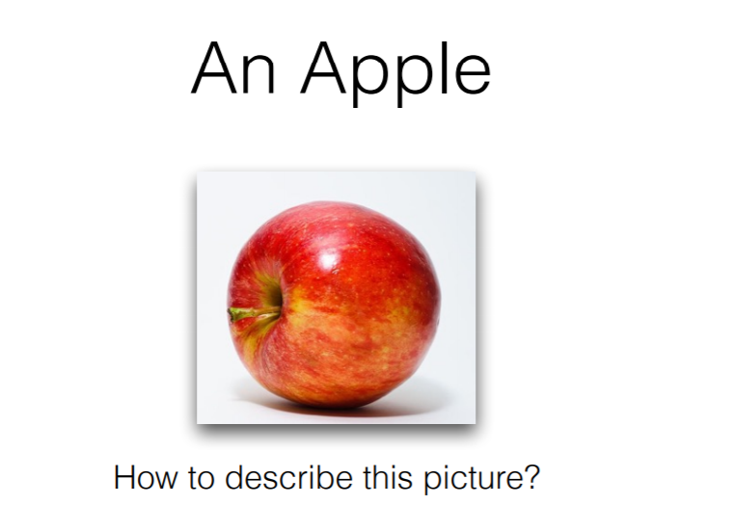
Features from observation

Slide 8
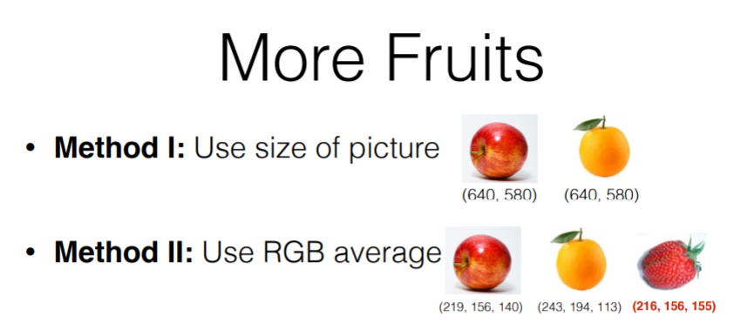
Features from observation

Slide 9
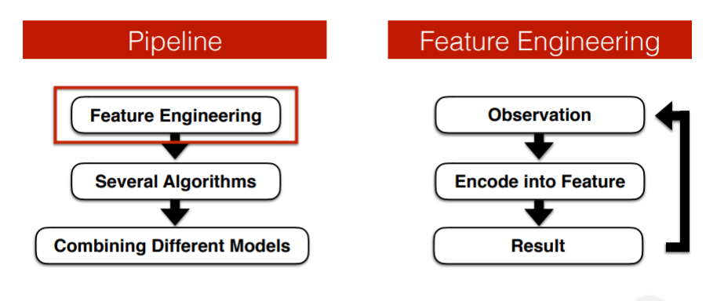
Feature Engineering

Slide 10
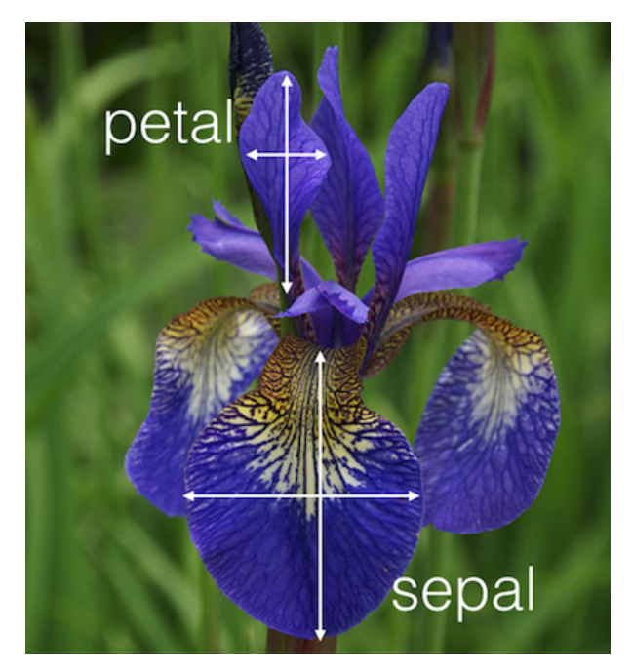
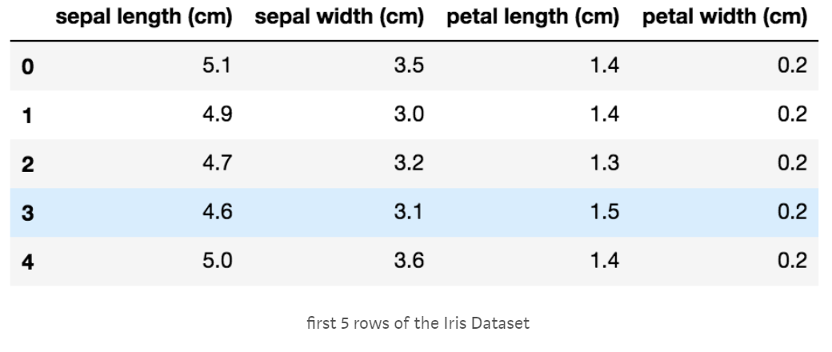
Features in iris data set
Source : Kaggle
https://www.kaggle.com/uciml/iris

Slide 11
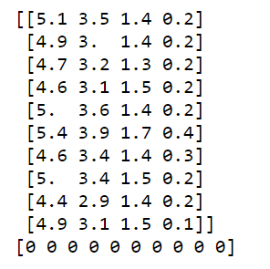
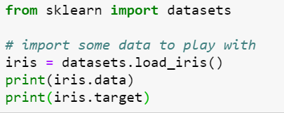
Iris dataset in scikit-learn
scikit-learn – machine learning in python
Simple and efficient tools for data mining and data analysis
several machine learning algorithms
Machine Learning in Python

Slide 12
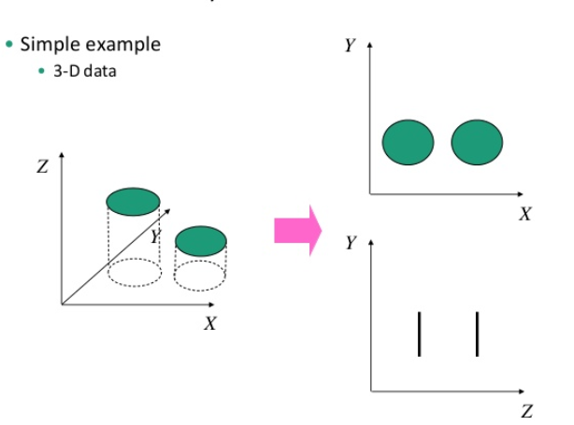
Dimensionality Reduction
Dimensionality reduction - Reducing the number of random variables to consider. Learning in Python

Slide 13
Dimensionality Reduction
‘Dimensionality’ - simply refers to the number of features (i.e. input variables) in your dataset.
When the number of features is very large relative to the number of observations in your dataset, certain algorithms struggle to train effective models.
This is called the “Curse of Dimensionality,”
It’s especially relevant for clustering algorithms that rely on distance calculations.

Slide 14
Components of Dimensionality Reduction
Feature selection: you select a subset of the original feature set.
Feature extraction: you build a new set of features from the original feature set.

Slide 15
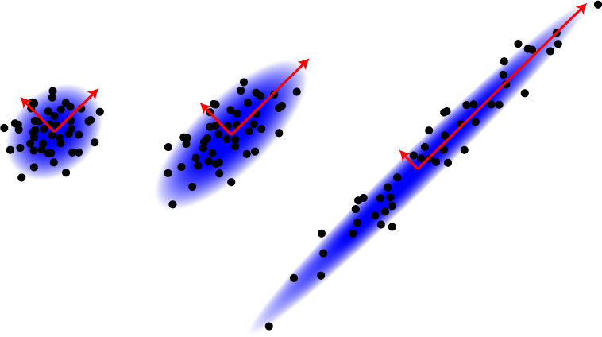
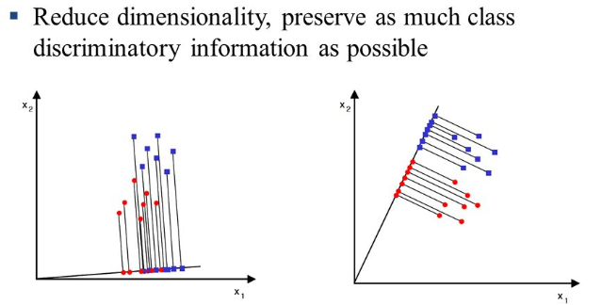
Methods of Dimensionality Reduction
Principal Component Analysis (PCA)
Linear Discriminant Analysis (LDA)

Slide 16
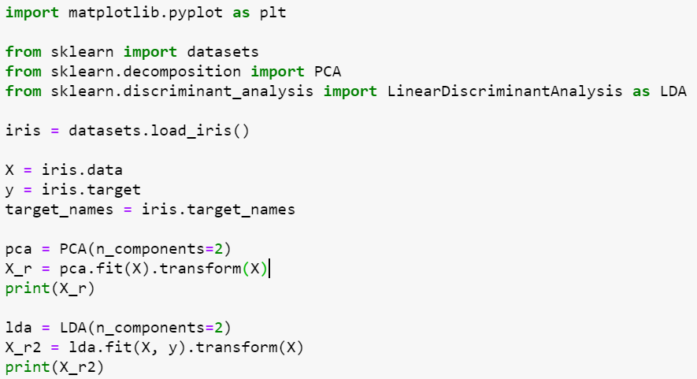
Feature Reduction Iris Dataset

Slide 17
Feature Reduction Iris Dataset
PCA OUTPUT
[[-2.68412563 0.31939725] [-2.71414169 -0.17700123] [-2.88899057 -0.14494943] [-2.74534286 -0.31829898] [-2.72871654 0.32675451] [-2.28085963 0.74133045] [-2.82053775 -0.08946138] [-2.62614497 0.16338496] [-2.88638273 -0.57831175] -------------------------------------------------------------------------------------------------------------------------------------------------------------------------------------------------------------------------------------------------------------------------------------------------------------------------------------------------------------[ 2.15943764 -0.21727758] [ 1.44416124 -0.14341341] [ 1.78129481 -0.49990168] [ 3.07649993 0.68808568] [ 2.14424331 0.1400642 ] [ 1.90509815 0.04930053] [ 1.16932634 -0.16499026] [ 2.10761114 0.37228787] [ 2.31415471 0.18365128] [ 1.9222678 0.40920347] [ 1.41523588 -0.57491635] [ 2.56301338 0.2778626 ] [ 2.41874618 0.3047982 ] [ 1.94410979 0.1875323 ] [ 1.52716661 -0.37531698] [ 1.76434572 0.07885885] [ 1.90094161 0.11662796] [ 1.39018886 -0.28266094]]
LDA OUTPUT
[[-8.06179978e+00 3.00420621e-01] [-7.12868772e+00 -7.86660426e-01] [-7.48982797e+00 -2.65384488e-01] [-6.81320057e+00 -6.70631068e-01] [-8.13230933e+00 5.14462530e-01] [-7.70194674e+00 1.46172097e+00] [-7.21261762e+00 3.55836209e-01] ------------------------------------------------------------------------------------------------------------------------------------------------------------------------------------------------------------------------------------------------[ 9.97610366e-01 -4.90530602e-01] [ 3.83525931e+00 -1.40595806e+00] [ 2.25741249e+00 -1.42679423e+00] [ 1.25571326e+00 -5.46424197e-01] [ 1.43755762e+00 -1.34424979e-01] [ 2.45906137e+00 -9.35277280e-01] [ 3.51848495e+00 1.60588866e-01] [ 2.58979871e+00 -1.74611728e-01] [-3.07487884e-01 -1.31887146e+00] [ 4.96774090e+00 8.21140550e-01] [ 5.88614539e+00 2.34509051e+00] [ 4.68315426e+00 3.32033811e-01]]

Slide 18
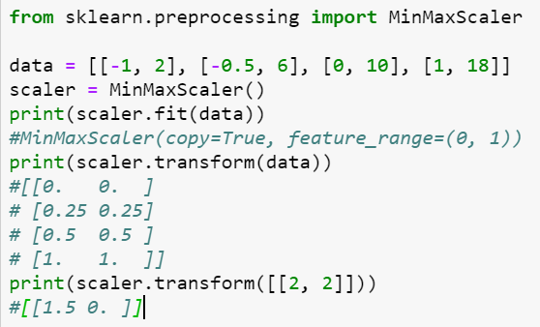

Preprocessing
Scaling
The MinMaxScaler is the probably the most famous scaling algorithm, and follows the following formula for each feature:
$\frac{xi–min⁡(x)}{max⁡(x)–min⁡(x) }$
Shrinks the range such that the range is now between 0 and 1 (or -1 to 1 if there are negative values).

Slide 19
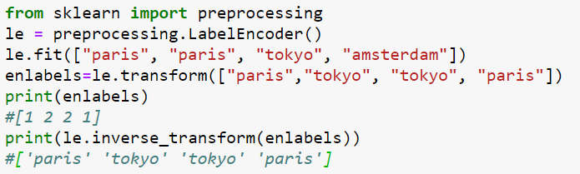
Preprocessing
Label Encoding
Used to transform non-numerical labels that is categorical values to numerical labels.

Slide 20

Thank You

