Slide 1
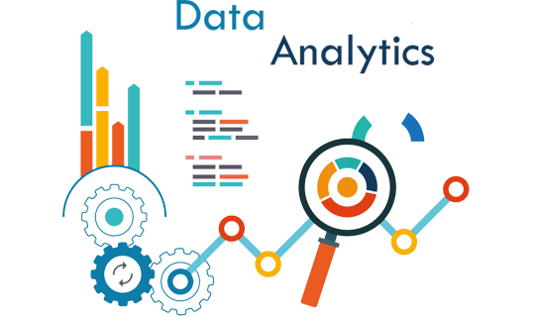
Data Processing & Visualization Using Python
SHILPA SHAJU
Research Scholar
DCS,CUSAT

Slide 2

Getting started…
open-source library specially designed for data analysis and data manipulation
built on the top of the NumPy package
hence it fundamentally relies on NumPy.

Slide 3
Import pandas library
In [ ]:
#Import pandas
import pandas as pd
Core components of pandas: Series and DataFrames
Series : A single column of data.Each value in the series has a label(or index)
DataFrame : An array that is heterogeneous and two-dimensional in format.[Table]

Slide 4
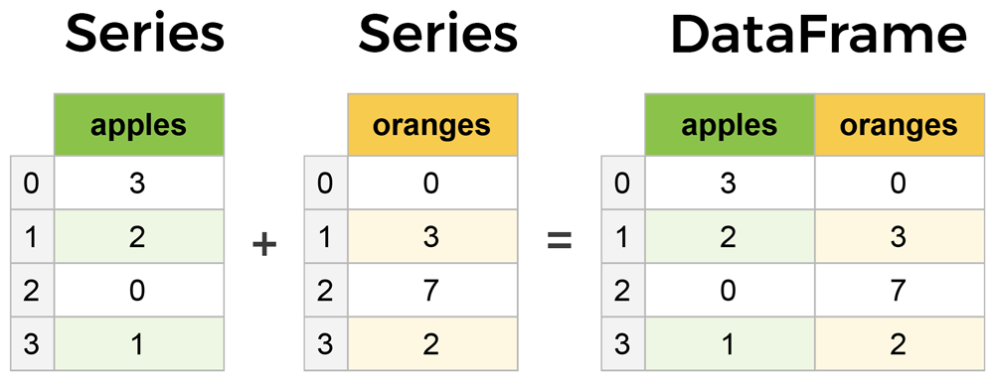

Slide 5
Reading data using pandas
In [ ]:
#Read csv file
df = pd.read_csv("Salaries.csv")
Note: The above command has many optional arguments to fine-tune the data import process.In my case I kept my .csv file
Mydrive—>Workshop_dataset—>Salaries.csv
There is a number of pandas commands to read other data formats:
pd.read_excel('myfile.xlsx',sheet_name='Sheet1', index_col=None, na_values=['NA'])
pd.read_stata('myfile.dta')
pd.read_sas('myfile.sas7bdat')
pd.read_hdf('myfile.h5','df')

Slide 6
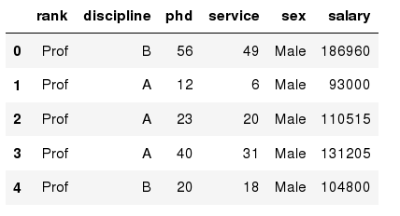
Exploring data frames
In [3]:
#List first 5 records
df.head()
Out[3]:

Slide 7
Dataframe data types
Pandas Type | Native Python Type | Description
object | string | The most general dtype. Will be assigned to your column if column has mixed types (numbers and strings).
int64 | int | Numeric characters. 64 refers to the memory allocated to hold this character.
float64 | float | Numeric characters with decimals. If a column contains numbers and NaNs(see below), pandas will default to float64, in case your missing value has a decimal.
datetime64, timedelta[ns] | N/A (but see the datetime module in Python’s standard library) | Values meant to hold time data. Look into these for time series experiments.

Slide 8
Data Frame data types
In [4]:
#Check a particular column type
df['salary'].dtype
Out[4]: dtype('int64')
In [5]:
#Check types for all the columns
df.dtypes
Out[4]:
object
object
int64
int64
object
int64
rank
discipline
phd
service
sex
salary
dtype: object

Slide 9
Data Frames attributes
Python objects have attributes and methods.
df.attribute | description
dtypes | list the types of the columns
columns | list the column names
axes | list the row labels and column names
ndim | number of dimensions
size | number of elements
shape | return a tuple representing the dimensionality
values | numpy representation of the data

Slide 10
Data Frames methods
Unlike attributes, python methods have parenthesis.
All attributes and methods can be listed with a dir() function: dir(df)
df.method() | description
head( [n] ), tail( [n] ) | first/last n rows
describe() | generate descriptive statistics (for numeric columns only)
max(), min() | return max/min values for all numeric columns
mean(), median() | return mean/median values for all numeric columns
std() | standard deviation
sample([n]) | returns a random sample of the data frame
dropna() | drop all the records with missing values

Slide 11
Selecting a column in a Data Frame
Method 1: Subset the data frame using column name:
df['sex']
Method 2: Use the column name as an attribute:
df.sex
Note: there is an attribute rank for pandas data frames, so to select a column with a name "rank" we should use method 1.

Slide 12
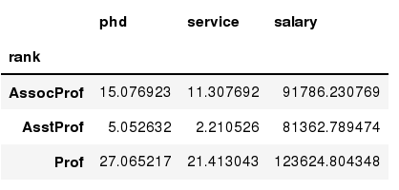
Data Frames groupby method
Using "group by" method we can:
Split the data into groups based on some criteria
Calculate statistics (or apply a function) to each group
Similar to dplyr() function in R
In [ ]:
#Group data using rank
df_rank = df.groupby(['rank'])
In [ ]:
#Calculate mean value for each numeric column per each group
df_rank.mean()

Slide 13
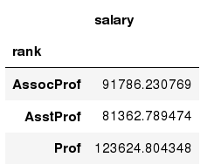
Data Frames groupby method
Once groupby object is create we can calculate various statistics for each group:
In [ ]:
#Calculate mean salary for each professor rank:
df.groupby('rank')[['salary']].mean()
Note: If single brackets are used to specify the column (e.g. salary), then the output is Pandas Series object. When double brackets are used the output is a Data Frame

Slide 14
Data Frames groupby method
groupby performance notes:
- no grouping/splitting occurs until it's needed. Creating the groupby object only verifies that you have passed a valid mapping
- by default the group keys are sorted during the groupby operation. You may want to pass sort=False for potential speedup:
In [ ]:
#Calculate mean salary for each professor rank:
df.groupby(['rank'], sort=False)[['salary']].mean()

Slide 15
Data Frame: filtering
To subset the data we can apply Boolean indexing. This indexing is commonly known as a filter. For example if we want to subset the rows in which the salary value is greater than $120K:
In [ ]:
#Calculate mean salary for each professor rank:
df_sub = df[ df['salary'] > 120000 ]
Any Boolean operator can be used to subset the data:
> greater; >= greater or equal;
< less; <= less or equal;
== equal; != not equal;
In [ ]:
#Select only those rows that contain female professors:
df_f = df[ df['sex'] == 'Female' ]

Slide 16
Data Frames: Slicing
There are a number of ways to subset the Data Frame:
one or more columns
one or more rows
a subset of rows and columns
Rows and columns can be selected by their position or label

Slide 17
Data Frames: Slicing
When selecting one column, it is possible to use single set of brackets, but the resulting object will be a Series (not a DataFrame):
In [ ]:
#Select column salary:
df['salary']
When we need to select more than one column and/or make the output to be a DataFrame, we should use double brackets:
In [ ]:
#Select column salary:
df[['rank','salary']]

Slide 18
Data Frames: Selecting rows
If we need to select a range of rows, we can specify the range using ":"
In [ ]:
#Select rows by their position:
df[10:20]
Notice that the first row has a position 0, and the last value in the range is omitted:
So for 0:10 range the first 10 rows are returned with the positions starting with 0 and ending with 9

Slide 19
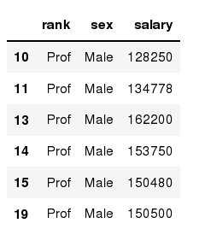
Data Frames: method loc
If we need to select a range of rows, using their labels we can use method loc:
In [ ]:
#Select rows by their labels:
df_sub.loc[10:20,['rank','sex','salary']]
Out[ ]:

Slide 20
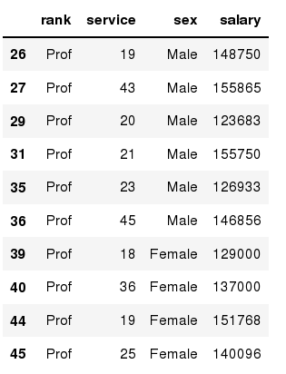
Data Frames: method iloc
If we need to select a range of rows and/or columns, using their positions we can use method iloc:
In [ ]:
#Select rows by their labels:
df_sub.iloc[10:20,[0, 3, 4, 5]]
Out[ ]:

Slide 21
Data Frames: method iloc (summary)
df.iloc[0] # First row of a data frame
df.iloc[i] #(i+1)th row
df.iloc[-1] # Last row
df.iloc[:, 0] # First column
df.iloc[:, -1] # Last column
df.iloc[0:7] #First 7 rows
df.iloc[:, 0:2] #First 2 columns
df.iloc[1:3, 0:2] #Second through third rows and first 2 columns
df.iloc[[0,5], [1,3]] #1st and 6th rows and 2nd and 4th columns

Slide 22
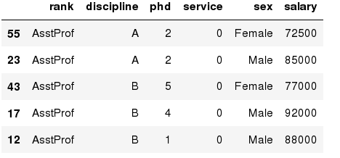
Data Frames: Sorting
We can sort the data by a value in the column. By default the sorting will occur in ascending order and a new data frame is return.
In [ ]:
# Create a new data frame from the original sorted by the column Salary
df_sorted = df.sort_values( by ='service')
df_sorted.head()
Out[ ]:

Slide 23
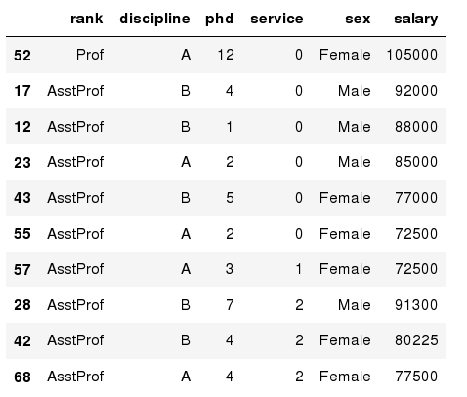
Data Frames: Sorting
We can sort the data using 2 or more columns:
In [ ]:
df_sorted = df.sort_values( by =['service', 'salary'], ascending = [True, False])
df_sorted.head(10)
Out[ ]:

Slide 24
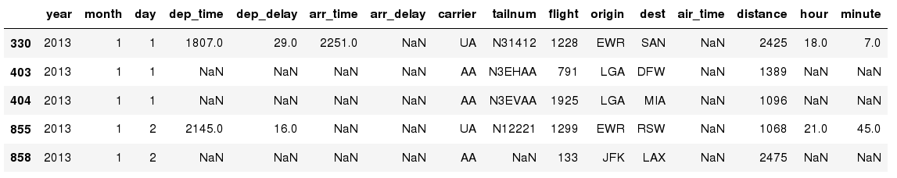
Missing Values
Missing values are marked as NaN
In [ ]:
# Read a dataset with missing values
flights = pd.read_csv("flights.csv")
In [ ]:
# Select the rows that have at least one missing value
flights[flights.isnull().any(axis=1)].head()
Out[ ]:

Slide 25
Missing Values
There are a number of methods to deal with missing values in the data frame:
df.method() | description
dropna() | Drop missing observations
dropna(how='all') | Drop observations where all cells is NA
dropna(axis=1, how='all') | Drop column if all the values are missing
dropna(thresh = 5) | Drop rows that contain less than 5 non-missing values
fillna(0) | Replace missing values with zeros
isnull() | returns True if the value is missing
notnull() | Returns True for non-missing values

Slide 26
Aggregation Functions in Pandas
Aggregation - computing a summary statistic about each group, i.e.
compute group sums or means
compute group sizes/counts
Common aggregation functions:
min, max
count, sum, prod
mean, median, mode, mad
std, var

Slide 27
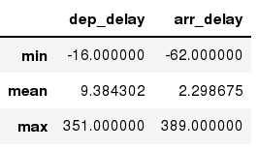
Aggregation Functions in Pandas
agg() method are useful when multiple statistics are computed per column:
In [ ]:
flights[['dep_delay','arr_delay']].agg(['min','mean','max'])
Out[ ]:

Slide 28
Basic Descriptive Statistics
df.method() | description
describe | Basic statistics (count, mean, std, min, quantiles, max)
min, max | Minimum and maximum values
mean, median, mode | Arithmetic average, median and mode
var, std | Variance and standard deviation
sem | Standard error of mean
skew | Sample skewness
kurt | kurtosis

Slide 29
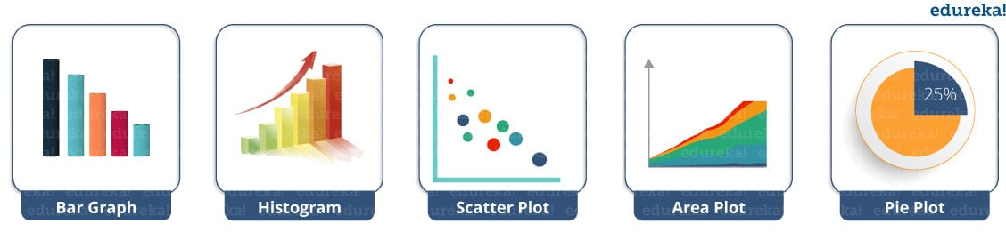
Matplotlib
A comprehensive library for creating static, animated, and interactive visualizations in Python.

Slide 30


Slide 31


