Slide 1
PROBLEM STATEMENT
a. Build a classifier to predict the outcome of a new patient with high accuracy. Also, remember
that as a data-scientist working on healthcare problems, your intent should also be to minimize
the number of false-negatives.
b. Build a regression model to predict the recurrence time for patients whose outcome is R.
MODELS USED
a: Support Vector Classifier with Ensemble Learning(Bagging)
b: Support Vector Regression

Slide 2
Support Vector Classifier with Bagging
Even the support vector machine (SVM) has been proposed to provide a good generalization performance, the classification result of the practically implemented SVM is often far from the theoretically expected level because their implementations are based on the approximated algorithms due to the high complexity of time and space. To improve the limited classification performance of the real SVM, we propose to use the SVM ensembles with bagging (bootstrap aggregating). Each individual SVM is trained independently using the randomly chosen training samples via a bootstrap technique. Then, they are aggregated into to make a collective decision

Slide 3
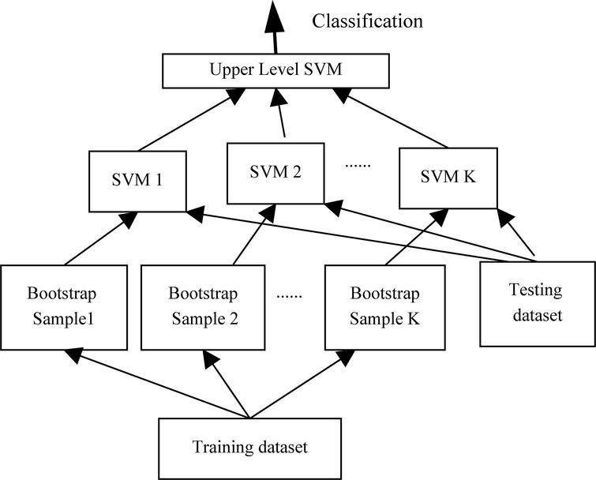
Execution Flow of Problem a

Slide 4
Support Vector Regression
the objective function of SVR is to minimize the coefficients — more specifically, the l2-norm of the coefficient vector — not the squared error. The error term is instead handled in the constraints, where we set the absolute error less than or equal to a specified margin, called the maximum error, ϵ (epsilon).

Slide 5
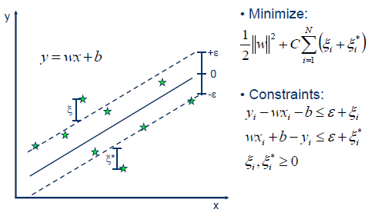
SVR (Diagrammatically)

