Slide 1

Capstone Project - Battle of Neighborhood
Recommend Toronto Neighborhood to open a Yoga Studio
Submitted By: Shailendra Dungarwal
Published on: Dec 26, 2020

Slide 2
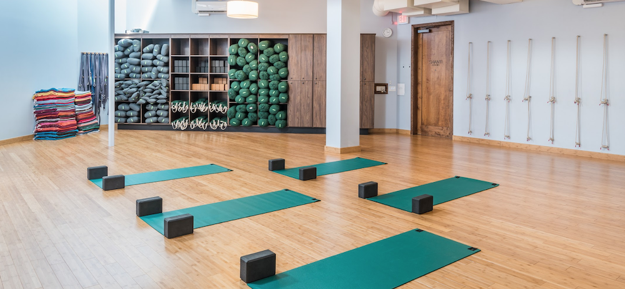
INTRODUCTION
With recent pandemic, there is an increased awareness about Yoga practices that focuses on overall wellness including physical and mental health. Yoga Studio is the best way to connect yoga teachers and students.
Toronto being most populous Canadian city along with its multicultural and cosmopolitan culture, makes it suitable city to start a new business. This project explores best neighborhood in Toronto to open a new Yoga Studio.

Slide 3
BUSINESS PROBLEM
Finding out a suitable location to open a business is very critical for the long term success. The purpose of the project is to use data science tools, methodology and machine learning algorithms to recommend most appropriate neighborhoods for opening a new Yoga Studio.

Slide 4
DATA
To perform my analysis, I need location data as well as Yoga Studio data in Toronto –
      List of Toronto neighborhoods
      Latitude and Longitude of these neighborhoods
      Venue data related to Yoga Studio

Slide 5
METHODOLOGY
Step 1 - Get Canada neighborhood and Postal Codes by scrapping Wikipedia page - https://en.wikipedia.org/wiki/List_of_postal_codes_of_Canada:_M
Step 2 – Append Latitude and Longitude to neighborhood data by using https://cocl.us/Geospatial_data. I visualized the Toronto map using Folium package to ensure that these are correct coordinates
Step 3 – Get Venue details around these neighborhoods – I created Foursquare developer account and used Foursquare API to get names, categories, latitude, and longitude of the venues. 150 popular spots for each neighborhood with a radius of 500 meters was chosen. Grouped the rows by neighborhood and taking the mean on the frequency of occurrence of each venue category. This is to prepare data for clustering.
Step 4 - Clustering using K-Means - Identified suitable K value and performed K-Means clustering. 3 clusters were created based on their frequency of occurrence for “Yoga Studio”. Based on the results, I will be able to recommend the ideal location to open a Yoga Studio.

Slide 6
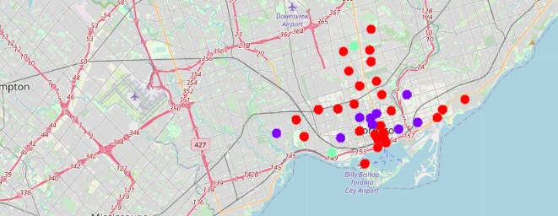
RESULT

Slide 7
RESULT CONTINUED..
K-Means clustering demonstrate that Toronto neighborhoods can be categorized into 3 clusters based on how many Yoga Studios are in each neighborhood:
  Cluster 0 has Toronto neighborhoods with the lesser number of Yoga Studios (Red color)
  Cluster 1 has Toronto neighborhoods with medium dense Yoga Studios (Indigo color)
  Cluster 2 has Toronto neighborhoods with highly dense Yoga Studios (Green color)
Results Summary –
  Church and Wellesley neighborhood has highest number of Yoga Studios.
  Cluster 0 neighborhoods have the least number of Yoga Studios.
  I will recommend opening Yoga Studio in Central Bay Street or Stn A PO Boxes as both these neighborhoods have least number of yoga studios currently.

Slide 8
RECOMMENDATIONS
With this project, I got exposure to how a real-life Data science project would looks like. I have used common Python libraries, visualize data by plotting graphs and exploratory data analysis. Foursquare API provided important information of Toronto venues. The analysis results depends on the accuracy of FourSquare data.
As a final conclusion, this project recommends the entrepreneur to open a Yoga Studio in Central Bay Street or Stn A PO Boxes neighborhoods of Toronto.

