Slide 1
Deterministic Finite Automaton (DFA) Regular Language
CSC3113: Theory of Computation
3
2
Summer 2023-2024
Prof. Dr. Afroza Nahar
Professor, Department of Computer Science,
Faculty of Science and Technology.
afroza@aiub.edu, room no: DN0113

Slide 2
Practice Problem with DFA.
Exercise solving from the book.
DFA design Issues.
Regular Language
Closure
Operations
Example: Regular Language closed under Union Operation

Slide 3
Understand, learn & practice with example
Practice designing DFA.
Learn Language, Regular Language & Regular Operations
Analyze Closure under regular Operation
Build one machine from 2 machine using closure under union

Slide 4
All outcome are represented with examples
Understand, learn & practice design of DFA.
Analyze and Design new machine model from one or more machine model(s) using closure rule of regular operation (example: Union).
In doing so, understand that, there are certain cases where DFA might not give a desired machine model.

Slide 5
Designing DFA – Example 1
0
Alphabet Σ={0,1,2}.
Language A₁ = {w : the sum of all the symbols in w is multiple of 3 }.
Can be represented as follows –
S= the sum of all the symbols in w.
If S modulo 3 = 0 then the sum is multiple of 3.
So the sum of all the symbols in w is 0 modulo 3.
We can model a_{i} as state representing S modulo 3 = i.
The finite state machine M₁= (Q₁, Σ, δ₁, q₁, F₁), where –
Q₁ = {a₀,a₁,a₂},
q₁ = a₀,
F₁ = {a₀},
δ₁
| 0 1 2 . a₀ | a₀ a₁ a₂
a₁ | a₁ a₂ a₀
a₂ | a₂ a₀ a₁
a₁
1
2
1
2
0
a₀
2
a₂
1
0
Input example: 01120101
Present State:
Input symbol:
Accepted
a₂
a₁
a₀
01120101
01120101
01120101
01120101
01120101
01120101
ε
01120101
01120101

Slide 6
Designing DFA – Example 2
Alphabet Σ={0,1,2}.
Language A₂ = {w : the sum of all the symbols in w is an even number }.
Can be represented as follows –
S= the sum of all the symbols in w.
If S modulo 2 = 0 then the sum is even.
Here, b_{i} is modeled as S modulo 2 = i.
The finite state machine M₂= (Q₂, Σ, δ₂, q₂, F₂), where –
Q₂ = {b₀,b₁},
q₂ = b₀,
F₂ = {b₀},
δ₂
| 0 1 2 . b₀ | b₀ b₁ b₀
b₁ | b₁ b₀ b₁
b₀
1
b₁
0,2
1
0,2
Input example: 01120101
Present State:
Input symbol:
Accepted
b₀
b₁
01120101
01120101
01120101
01120101
01120101
01120101
01120101
01120101
ε

Slide 7
DFA design issues
The key concept here is to understand the given language.
Type/pattern of input strings that the language gives.
Match the pattern from left to right with the states & transitions of the state diagram, one by one.
First match the necessary conditions with the transition then complete the diagram with rest of the transition maintaining the rules.
Maintain the rules –
From each state there must be exactly one transition for each input symbol.
Self-loop represents zero or more number of occurrences of the input symbol.
There can be one or more number of final states.
Make some of your own input strings based on the given language. Few that should be ACCEPTED and few that should be REJECTED. Test them on your state diagram after completing or while drawing the state diagram and update accordingly.
Let us practice some DFA in the following slides.

Slide 8
DFA: examples
Draw the state diagram of the DFA for the Language, L={w | w begins with a 0}, where alphabet is {0, 1}.
Draw the state diagram of the DFA for the Language, L={w | w begins with a 01}, where alphabet is {0, 1}.
Draw the state diagram of the DFA for the Language, L={w | w ends with a 01}, where alphabet is {0, 1}
Draw the state diagram of the DFA for the Language, L={w | w stars and ends with a 01}, where alphabet is {0, 1}
Draw the state diagram of the DFA for the Language, L={w | w ends with a 11}, where alphabet is {0, 1}

Slide 9
A5 ={w| w ends with a 0}.
A6 ={w| w begins with a 1}.
A7 ={w| w begins with a 1 and ends with a 0}.
∑ = {0,1}
1
1
q1
0
q2
0
A5
q3
0, 1
0
q1
1
q2
0, 1
A6
q4
1
0, 1
0
q1
1
q2
0
q3
0
A7
1

Slide 10
Draw the state diagram of the DFA for the Language over the alphabet {0, 1},
L = {w | length of w is divisible by 2/multiple of 2/even length/mode 2
Length of string is not divisible by 2 or not multiple of 2, odd length}
Draw the state diagram of the DFA for the Language over the alphabet is {0, 1}
L = {w | w binary number is divisible by 2}
L = {w | w binary number is divisible by 3}

Slide 11
Draw the state diagram of the DFA for the Language over the alphabet {0, 1},
L = {w | length of w is divisible by 2/multiple of 2/even length/mode 2
Length of string is not divisible by 2 or not multiple of 2, odd length}
Draw the state diagram of the DFA for the Language over the alphabet is {0, 1}
L = {w | w binary number is divisible by 2}
L = {w | w binary number is divisible by 3}

Slide 12
A3 ={w : w is a binary string containing an odd number of 1s}.
A4 ={w : w is a binary string containing an even number of 0s}.
∑ = {0,1}
0
0
1
q1
q2
A3
1
1
1
1
0
q1
0
q2
q3
A4
0

Slide 13
A8 ={w| w has at least two 1s}.
A9 ={w| w has at most two 1s}.
∑ = {0,1}
0
0
0, 1
1
1
A8
q1
q2
q3
0
0
0
1
1
1
A9
q1
q2
q3
q4
0, 1

Slide 14
A10 ={w| w has substring 101}.
A11 ={w| w has substring 011}.
∑ = {0,1}
0
1
A10
1
0
q10
1
q101
qs
q1
0, 1
0
1
0
0
1
q01
1
q011
A11
qs
q0
0, 1
0
What happens for the language, A11 ={w| w does not have substring 011}?

Slide 15
A12={w| each 1 in w is followed by at least one 0}.
A13 ={w | The length of w is at least three and have 0 in 2nd last position}
A14 ={w : The length of w is even and contains 1 in every odd position}
∑ = {0,1}
0
1
0
A12
1
q2
0
q3
q4
0,1
q3
1
1
A13
0, 1
0
0
q4
0
q1
q2
q3
1
1
0
q5
1
A14
1
q1
1
q2
0, 1
q3
0
q4
0,1
0

Slide 16
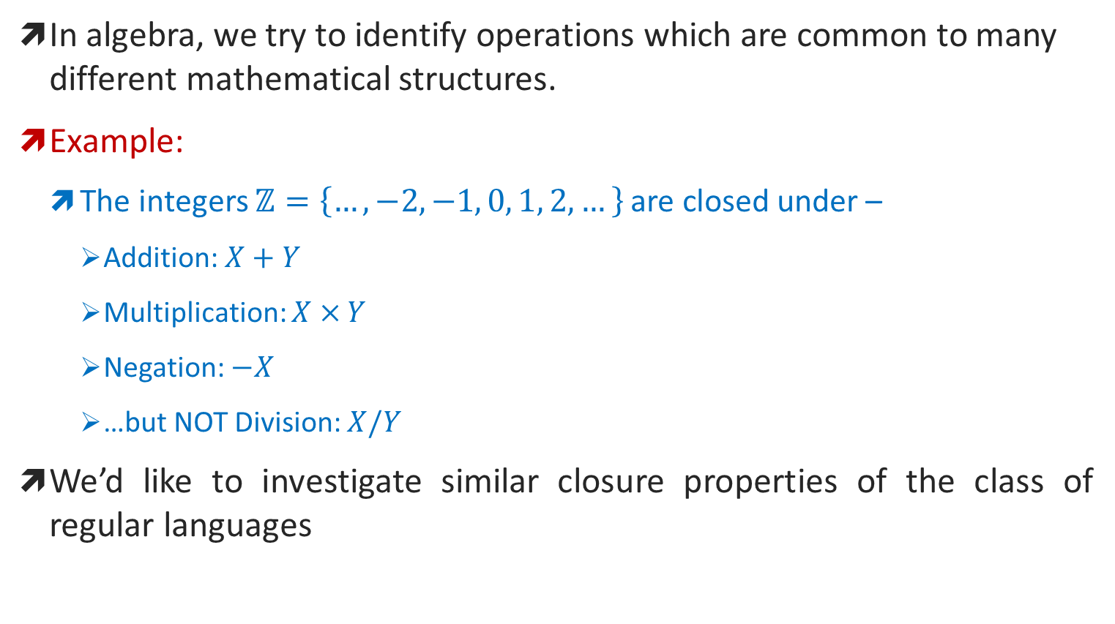
Regular Operations
An Analogy
In algebra, we try to identify operations which are common to many different mathematical structures.
Example:
The integers $ℤ=\left\{…,−2,−1, 0, 1, 2,…\right\}$are closed under –
Addition: $X+Y$
Multiplication: $X×Y$
Negation: $−X$
…but NOT Division: $X/Y$
We’d like to investigate similar closure properties of the class of regular languages

Slide 17
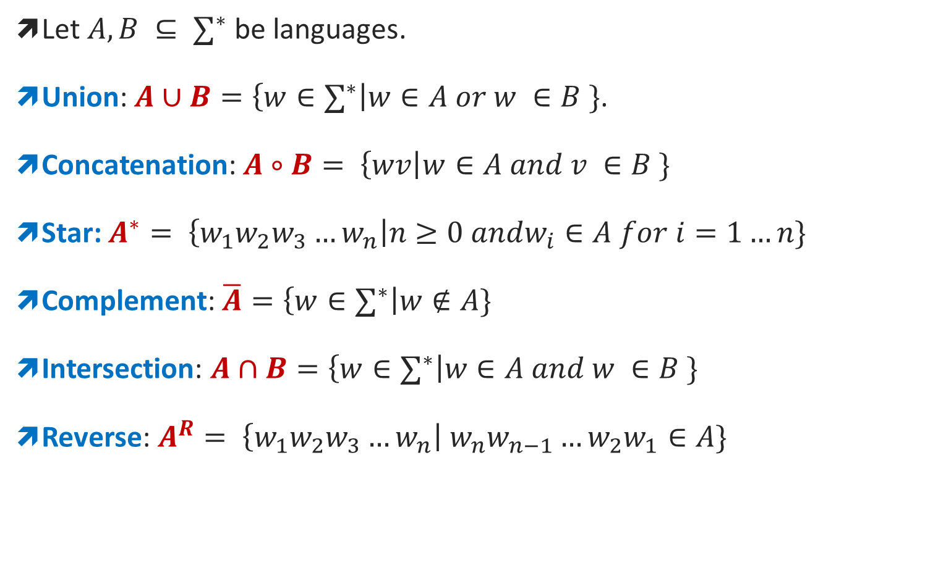
Regular operations on languages
Let $A, B ⊆ ∑^{∗}$ be languages.
Union: $A∪B=\left\{w∈∑^{∗}\right|w∈A or w ∈B \}$.
Concatenation: $A∘B= \left\{wv\right|w∈A and v ∈B \}$
Star: $A^{∗}= \left\{w_{1}w_{2}w_{3}…w_{n}\right|n≥0 andw_{i}∈A for i=1…n\}$
Complement: $\overline{A}=\left\{w∈∑^{∗}\right|w∉A\}$
Intersection: $A∩B=\left\{w∈∑^{∗}\right|w∈A and w ∈B \}$
Reverse: $A^{R}= \left\{w_{1}w_{2}w_{3}…w_{n}\right|{ w}_{n}w_{n−1}…{w_{2}w}_{1}∈A\}$

Slide 18
Regular Language
A language is called a regular language if some finite automaton recognizes it.
Regular Operations: Let A={good, bad}, B = {boy, girl}.
Basic 3 operations used to study the properties of the regular languages –
Union: A∪B = {x : x ∈ A or x ∈ B} = {good, bad, boy, girl}.
Takes all the strings in both A and B and lumps them together into one language.
Concatenation: A • B = {xy : x ∈ A and y ∈ B} = {goodboy, goodgirl, badboy, badgirl}.
Attaches a string from A in front of a string B in all possible ways to get the strings in the new language.
Star: A* = {x₁x₂…x_{k} : k ≥ 0 and each x_{i} ∈ A} = {ε, good, bad, goodgood, goodbad, badgood, badbad, goodgoodgood, goodgoodbad, …}.
Attaching any number of strings in A together to get a string in the new language. It is a unary operation, where ε is always a member of A* (as ‘any number’ also includes 0).

Slide 19
Closure
A collection of objects is closed under some operation, if applying that operation to the members of the collection returns an object still in the collection.
Theorem: The class of regular languages is closed under all three regular operations (union, concatenation, star), as well as under complement, intersection, and reverse.
i.e., if set A and B are regular, applying any of these operations on these sets yields a regular language.
Next, we will prove it for Union operation.

Slide 20
Regular Language closed under Union
We will prove it by construction.
Let M₁ recognize A₁, where M₁= (Q₁, Σ, δ₁, q₁, F₁), and M₂ recognize A₂, where M₂= (Q₂, Σ, δ₂, q₂, F₂).
Construct M to recognize A₁∪ A₂, where M = (Q, Σ, δ, q₀, F).
Q = {(r₁, r₂) : r₁ ∈ Q₁ and r₂ ∈ Q₂}.
Q = Q₁ × Q₂. (All combination of states of machine M₁ and M₂).
Σ = Σ₁ ∪ Σ₂.
But here, for simplicity, we have considered Σ₁ = Σ₂ to be same.
For each (r₁,r₂) ∈ Q and each a ∈ Σ, let δ((r₁,r₂), a) = (δ(r₁, a), δ(r₂, a)).
Hence δ gets a state of M (which actually is a pair of states from M₁ and M₂), together with an input symbol, and returns M’s next state.
q₀ is the pair (q₁, q₂).
F = { (r₁, r₂) : r₁ ∈ F₁ or r₂ ∈ F₂ }
F = (F₁ × Q₂) ∪ (Q₁ × F₂)

Slide 21
DFA Union Example
Let,
M₁= (Q₁, Σ, δ₁, q₁, F₁), where –
Q₁ = {a₀,a₁,a₂},
Σ = {0, 1, 2}
q₁ = a₀,
F₁ = {a₀},
δ₁
| 0 1 2 . a₀ | a₀ a₁ a₂ a₁ | a₁ a₂ a₀ a₂| a₂ a₀ a₁
M₂= (Q₂, Σ, δ₂, q₂, F₂), where –
Q₂ = {b₀,b₁},
Σ = {0, 1, 2}
q₂ = b₀,
F₂ = {b₀},
δ₂
| 0 1 2 . b₀ | b₀ b₁ b₀ b₁ | b₁ b₀ b₁
M= (Q, Σ, δ, q₀, F), where –
Q = {(r₁, r₂) : r₁ ∈ Q₁ and r₂ ∈ Q₂} = Q₁ × Q₂ Q = {(a₀,b₀), (a₀, b₁),(a₁, b₀), (a₁, b₁),(a₂, b₀), (a₂, b₁)},
Σ = Σ₁ ∪ Σ₂ = {0, 1, 2}
q₀ = (q₁,q₂) = (a₀, b₀)
F = { (r₁, r₂) : r₁ ∈ F₁ or r₂ ∈ F₂ } = (F₁ × Q₂) ∪ (Q₁ × F₂) F = {(a₀, b₀), (a₀, b₁), (a₁, b₀), (a₂, b₀)}
δ | 0 1 2 . (a₀, b₀) | (a₀, b₀) (a₁, b₁) (a₂, b₀) (a₀, b₁) | (a₀, b₁) (a₁, b₀) (a₂, b₁) (a₁, b₀) | (a₁, b₀) (a₂, b₁) (a₀, b₀) (a₁, b₁) | (a₁, b₁) (a₂, b₀) (a₀, b₁) (a₂, b₀) | (a₂, b₀) (a₀, b₁) (a₁, b₀) (a₂, b₁) | (a₂, b₁) (a₀, b₀) (a₁, b₁)
The above finite automata machine should give the same output for any given input to machine M₁ or M₂.
Here M₁ recognizes A₁ and M₂ recognizes A₂. So M should recognize A = A₁ ∪ A₂.
A₁= {w: sum of all the symbols in w is multiple of 3}.
A₂ = {w: sum of all the symbols in w is even}.
Machine 1
(a₀, b₀) (a₁, b₁) (a₂, b₀) (a₀, b₁) (a₁, b₀) (a₂, b₁) (a₁, b₀) (a₂, b₁) (a₀, b₀) (a₁, b₁) (a₂, b₀) (a₀, b₁) (a₂, b₀) (a₀, b₁) (a₁, b₀) (a₂, b₁) (a₀, b₀) (a₁, b₁)
Machine 2

Slide 22
DFA Union Simulation
2
0
(a₁,b₀)
(a₀,b₀)
(a₂,b₀)
2
2
0
0
1
1
1
1
(a₂,b₁)
(a₁,b₁)
2
2
2
0
0
1
(a₀,b₁)
1
0
Input example: 01120101
Input symbol:
Accepted

Slide 23
Closure under Concatenation
Let M₁ recognize A₁, where M₁= (Q₁, Σ, δ₁, q₁, F₁), and M₂ recognize A₂, where M₂= (Q₂, Σ, δ₂, q₂, F₂).
Construct M to recognize A_{1°}A₂, where M = (Q, Σ, δ, q₀, F).
M must accept if its input can be broken into two pieces where M₁ accepts the first piece and M₂ accepts the second piece.
Problem: M doesn’t know where to break its input. i.e., where the first part ends and the second begins.
To solve the problem we will learn a new technique called nondeterministic automaton.

Slide 24
Elements of the Theory of Computation, Papadimitriou (2nd ed), DFA + Exercise.
Introduction to Automata Theory, Languages, and Computation (3rd ed), DFA + Exercise.

