Slide 1
Non-deterministic Finite Automaton (NFA)
CSC3113: Theory of Computation
5
3
Summer 2023-2024
Prof. Dr. Afroza Nahar
Professor, Department of Computer Science,
Faculty of Science and Technology.
afroza@aiub.edu, room no: DN0113

Slide 2
Nondeterministic Finite Automata (NFA).
Running NFA, NFA Tree.
Formal Definition of NFA.
Practice, solve exercise of NFA.

Slide 3
Understand, learn & practice with example
Formal Definition of Nondeterministic Finite Automata (NFA)
Practice designing NFA.

Slide 4
All outcome are represented with examples
Understand, learn & formal definition of NFA.
Practice & Design of NFA

Slide 5
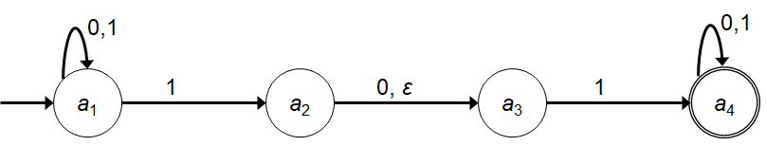
Nondeterministic Finite Automata (NFA)
State Diagram and the Properties of NFA
We already know DFA, so it would be sufficient to look into the differences of properties between the two.
In NFA a state may have –
Zero or more exiting arrows for each alphabet symbol.
Zero or more exiting arrows with the label ε.
So we can see that, not all steps of a computation follows in a unique way from the preceding step. There can be multiple choices to move from one state to another with a symbol. That’s the reason it’s computation is called nondeterministic.

Slide 6
Running an NFA
If we encounter a state with multiple ways to proceed –
The machine splits into multiple copies of itself and follows all the possibilities in parallel.
Each copy of the machine takes one of the possible ways to proceed and continues as before.
If there are subsequent choices, the machine splits again.
If a state with an ε symbol on an exiting arrow is encountered without reading any input, the machine splits into multiple copies,
one following each of the exiting ε-labeled arrows and
one staying in the current state.
If the next input symbol doesn’t appear on any of the arrows exiting the state occupied by a copy of the machine, that copy of the machine dies, along with the branch of the computation associated with it.
If any one of these copies of the machine is in an accept state at the end of the input, the NFA accepts the input strings.
So, nondeterminism may be viewed as a kind of parallel computation wherein several processes can be running concurrently.
If at least one of these processes accepts then the entire computation accepts.

Slide 7
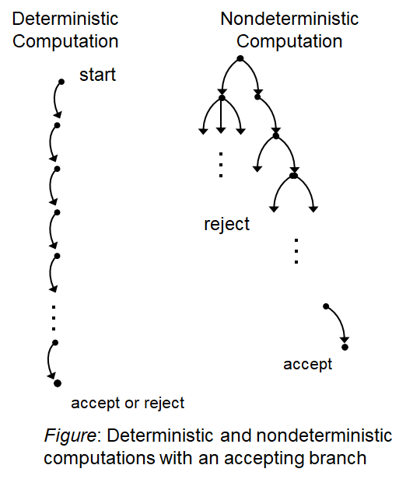
Running an NFA
Another way of viewing a nondeterministic computation is as a tree of possibilities.
The root corresponds to the start of the computation.
Every branching point in the tree corresponds to a point in the computation at which the machine has multiple choices.
The machine accepts if at least one of the computation branches ends in an accept state.
Tree representation

Slide 8
Simulation – NFA Tree
1
0,1
0,
010110
a₁
1
a₂
0,
ε
a₃
1
a₄
Symbol read
0 ----------------------------------------------------------------------------------
1 -----------------------------------------------------------------------
0 ----------------------------------------------------------------
1 ----------------------------------------------------------
1 ------------------------------------------------
0 ------------------------------------------
a₁
a₁
a₁
a₂
a₃
a₁
a₃
a₁
a₂
a₃
a₄
a₁
a₂
a₃
a₄
a₄
a₁
a₃
a₄
a₄
a₄
a₄

Slide 9
Formal Definition of NFA
NFA is a 5-tuple (Q, Σ, δ, q₀, F)
Q is a finite set of states.
Σ is a finite alphabet.
δ : Q × Σ_{ε} → P(Q).
The transition function takes a state and an input symbol or the empty string (Σ_{ε}=Σ ∪ ε) and produces the set of possible next states (P(Q) is the power set of Q).
q₀∈Q is the start state.
F ⊆ Q is the set of accepted states.

Slide 10
Nondeterministic Finite Automata (NFA)
Formal Definition
Let, the above NFA N₁ = (Q₁, Σ, δ₁, a₁, F₁).
Q₁ = {a₁, a₂, a₃, a₄}.
Σ = {0, 1}.
δ₁ | 0 1 ε
a₁ | {a₁} {a₁, a₂} φ
a₂ | {a₃} φ {a₃}
a₃ | φ {a₄} φ
a₄ | {a₄} {a₄} φ
a₁ is the start state.
F₁ = {a₄}.
δ₁ in form δ : Q × Σ_{ε} → P(Q)
δ₁(a₁, 0) = {a₁} δ₁(a₁, 1) = {a₁, a₂} δ₁(a₁, ε) = φ
δ₁(a₂, 0) = {a₃} δ₁(a₂, 1) = φ δ₁(a₂, ε) = {a₃}
δ₁(a₃, 0) = φ δ₁(a₃, 1) = {a₄} δ₁(a₃, ε) = φ
δ₁(a₄, 0) = {a₄} δ₁(a₄, 1) = {a₄} δ₁(a₄, ε) = φ
Q × Σ_{ε} = {(a₁, 0), (a₁, 1), (a₁, ε), (a₂, 0), (a₂, 1), (a₂, ε), (a₃, 0), (a₃, 1), (a₃, ε), (a₄, 0), (a₄, 1), (a₄, ε)}
P(Q) = {φ, {a₁}, {a₂}, {a₃}, {a₄}, {a₁,a₂}, {a₁,a₃}, {a₁,a₄}, {a₂,a₃}, {a₂,a₄}, {a₃,a₄}, {a₁,a₂,a₃}, {a₁,a₂,a₄}, {a₁,a₃,a₄}, {a₂,a₃,a₄}, {a₁,a₂,a₃, a₄}}

Slide 11
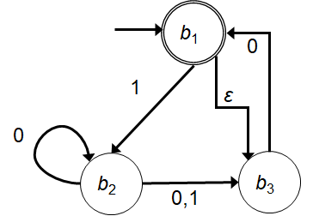
Nondeterministic Finite Automata (NFA)
Example
Let, the above NFA N₂ = (Q₂, Σ, δ₂, b₁, F₂).
Q₂ = {b₁, b₂, b₃}.
Σ = {0, 1}.
δ₂ is given as – | 0 1 ε b₁ | φ {b₂} {b₃} b₂ | {b₂, b₃} {b₃} φ b₃ | {b₁} φ φ
b₁ is the start state.
F₂ = {b₁}.

Slide 12
Practice NFA

Slide 13
Practice NFA
Draw the state diagram of the NFA for the following Languages over the alphabet is {0, 1}.
L={w | w begins/starts with a 0},
L={w | w begins/starts with a 1},
Draw the state diagram of the NFA for the following Languages over the alphabet is {a, b}.
L={w | w ends with a},
L={w | w ends with b},
L={w | w contains with b}
L={w | w contains with ab}

Slide 14
B1 ={w : w is a binary string containing an odd number of 1s}.
B2 ={w : w is a binary string containing an even number of 0s}.
∑ = {0,1}
0
0
1
q1
q2
B1
1
1
1
1
0
q1
0
q2
q3
B2
0

Slide 15
B3 ={w| w ends with a 0}.
B4 ={w| w begins with a 1}.
B5 ={w| w begins with a 1 and ends with a 0}.
∑ = {0,1}
0, 1
q1
0
q2
B3
q1
1
q2
0, 1
B4
0, 1
q1
1
q2
0
q3
B5

Slide 16
B₆ ={w| w has at least two 1s}.
B7 ={w| w has at most two 1s}.
∑ = {0,1}
0
0
0, 1
1
1
B₆
q1
q2
q3
0
0
0
1
1
B7
q1
q2
q3

Slide 17
B₈ ={w| w has substring 101}.
B9 ={w| w has substring 011}.
∑ = {0,1}
0,1
B₈
1
0
q10
1
q101
qs
q1
0, 1
0, 1
0
1
0
1
q01
1
q011
B9
qs
q0
0, 1
0
What happens for the language, A2 ={w| w does not have substring 011}?

Slide 18
B10 ={w| w starts with a 1 and has even length or w starts with a 0 and has odd length}.
∑ = {0,1}
0, 1
q2
0, 1
q3
1
B10
q1
0, 1
0
q4
0, 1
q5

Slide 19
Nondeterministic Finite Automata
Introduction to Theory of Computation, Sipser, (3rd ed), NFA.

