Slide 1
Spell Checker
Members:
Pranali Raval_131034
Rachana Solanki_131038
Shaily Mishra_131048
Course:
Data Structures and Algorithms
Institute:
Institute of Engineering and Technology

Slide 2
Project Description
Brief Description:
Implements simple spell checker of nearly 5000 words for English language
User enters a text containing some strings and this text is passed for spell checking.
If spelling of each word in the text matches with words in database exactly, program asks user if he wants to save the text he entered in the form of a text file otherwise asks if he wants to add those words to Trie and database or see list of suggestions and replace that word with one of the suggestions and then save the text in a file.
Goal:
To build a spell checker that shows whether input spelling is correct or not, gives suggestion list in case of non-matching input and let users add words to database. Also, user should be able to save whatever the text he gave as the input in a form of text file after spell checking of the text is done

Slide 3
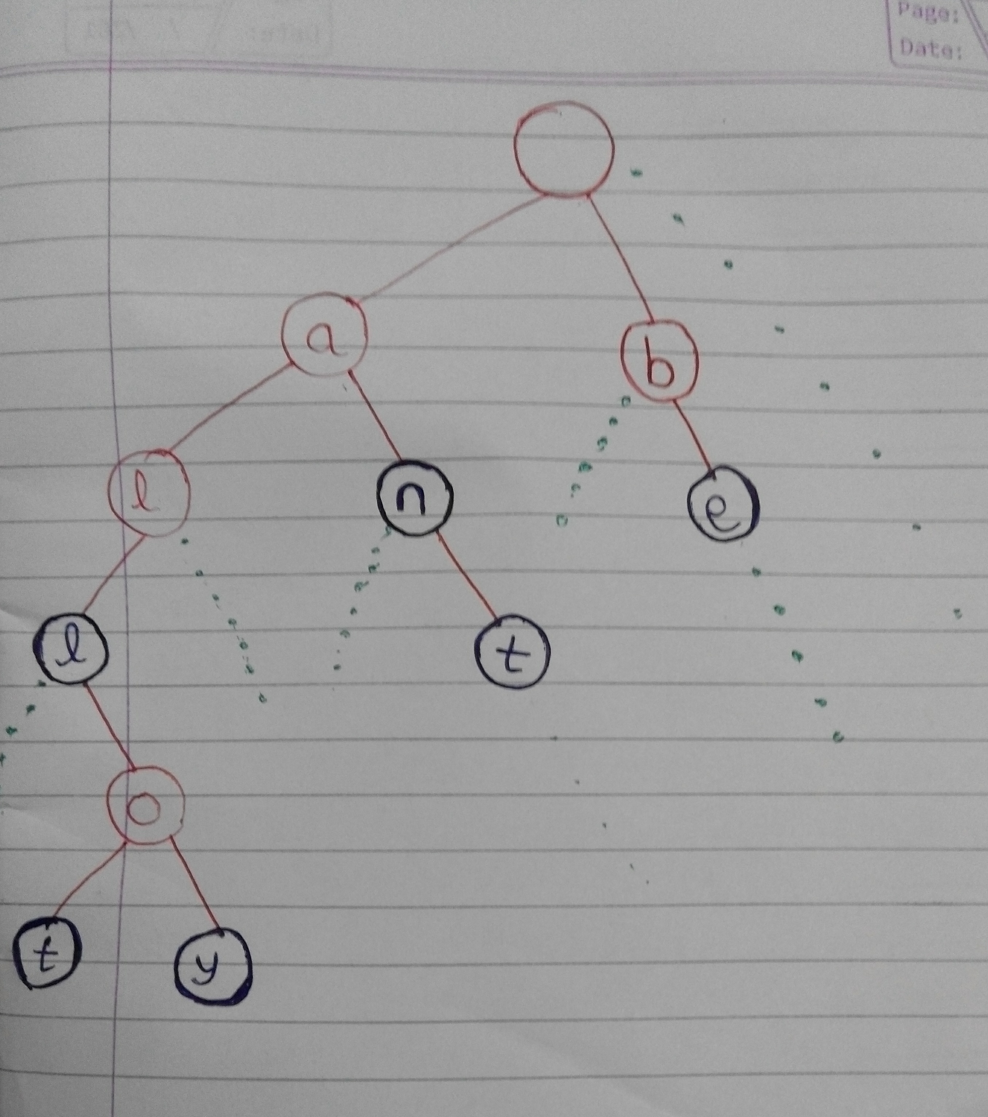
Logical Diagram

Slide 4
List of Data Structures:
Trie tree
Explanation of diagram:
Generalized trie tree
Root node empty and has 26 children (26 alphabets)
Each child contains an alphabet and 26 children
Black colored nodes show fullWord
Green dots show remaining children

Slide 5
List of Programs
TrieNode.java – Contains structure of a node in Trie
TrieTree.java – Contains methods to insert, find words in tree, print tree and suggest words to user
WriteFile.java – Contains method that writes text to a file
Read.java – Contains method to read word list from the database
Check.java – Contains methods that prompt user to enter a text, checks it for spelling and lets user save the text in a file
Main.java – Implements main method

Slide 6
Code Snippets
TrieNode.java
Structure of each node
Contain an alphabet and link to other 26 nodes
fullWord returns true when a word is completed in the tree
public class TrieNode
{
char letter;
TrieNode[] next;
boolean fullWord;
TrieNode(char letter, boolean fullWord)
{
this.letter = letter;
next = new TrieNode[26];
this.fullWord = fullWord;
}
}

Slide 7
Code Snippets
TrieTree.java
Method to insert word in the tree [1]
Current node initialized with root
For loop runs until word is completed
Offset is 97 as alphabets start from ASCII 97
If position is null letter is added there
After each insertion new node created
static void insertWord(TrieNode root, String word) {
int l = word.length();
char[] letters = word.toCharArray();
TrieNode current = root;
int position;
for (int i = 0; i < l; i++)
{
position = letters[i]-97;
if (current.next[position] == null) current.next[position] = new TrieNode(letters[i], i == l-1 ? true : false);
current = current.next[position];
}
}

Slide 8
Code Snippets
static boolean find(TrieNode root, String word) {
char[] letters = word.toCharArray();
int l = letters.length;
TrieNode current = root;
int i;
for (i = 0; i < l; i++) {
if (current == null)
return false;
current = current.next[letters[i]-97];
}
if (i == l && current == null)
return false;
if (current != null && !current.fullWord)
return false;
return true;
}
TrieTree.java
Method to find a word from trie [1]
Current node initialized with root
Returns true only when entered word is present in nodes of Trie

Slide 9
Code Snippets
static void Suggest( TrieNode root , String word) {
char[] letters = word.toCharArray();
int l = letters.length;
TrieNode curNode = root;
int i=0;
for ( i=0 ; i<l ; i++)
{
if (curNode != null)
curNode = curNode.next[letters[i]-97];
}
if (curNode == null)
System.out.println( " No suggestion for : " + word);
else {
System.out.println(" Suggested words for : " + word );
char[] branch = new char[50];
PrintSuggestions(curNode , 0 , branch, word );
}
}
TrieTree.java
Method to suggest words to users when input doesn’t matches with words in database
Prints subtree for the word with current node as root

Slide 10
Code Snippets
Check.java
Method to update Database and Trie tree by adding a new word
public static void AddToDataBase(String[] word) throws IOException {
WriteFile file2 = new WriteFile ("DataBase.txt" , true);
for(int i=0; i<word.length; i++)
{
file2.WriteToFile(word[i]);
tree.insertWord(rootNode,word[i]);
}
System.out.println("'" + word + "' added in database");
}

Slide 11
Input values
Any text
‘add’ if user wants to add any word to database and trie after checking the input text
‘suggest’ if user wants to see for suggestions list after checking the input text
‘replace’ if user wants to replace the word of input text by one of the suggestions
1 to write another text after a single cycle
0 to save the input text in a file
Filename by which the file containing input text is to be saved.

Slide 12
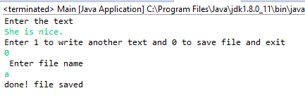
Outputs generated
Scenario 1:
All the words from the user input text are present in database.

Slide 13
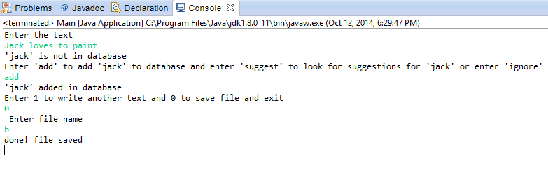
Outputs generated
Scenario 2:
Some words from the user input text are not present in database and user wants to add those words to DataBase.

Slide 14
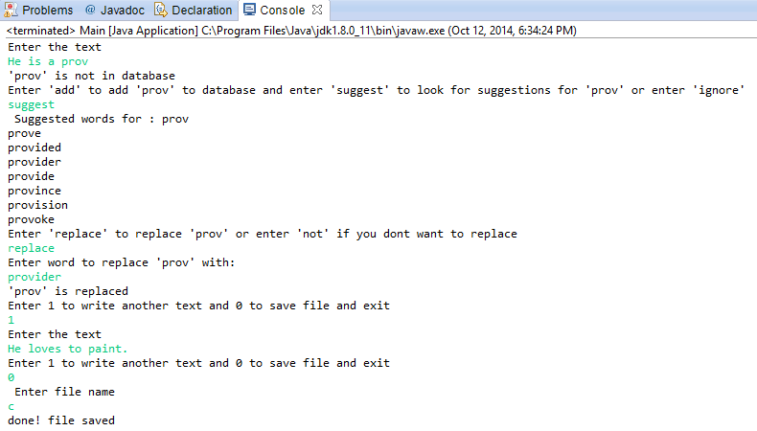
Outputs generated
Scenario 3:
Some words from user input text are not present in database and user wants to look for suggestions for those words and replace them with one of the suggestions.

Slide 15
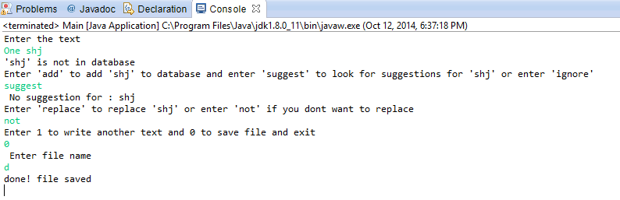
Outputs generated
Scenario 4:
User wants to look for suggestions but there is no suggestion for that word.

Slide 16
References
[1] - http://exceptional-code.blogspot.in/2011/07/coding-up-trie-prefix-tree.html
WriteFile.java and Read.java - http://www.homeandlearn.co.uk/java
DataBase ( word list ) - http://www.englishclub.com/vocabulary/common-words-5000.htm

