Slide 1
Data Mining Applications in The Healthcare field
AI-based Quantitative structure Activity relationship study (QSAR) for Alzheimer's disease
Data Mining Course –Ajman University

Slide 2
List of Content
Questions and comments
Data Mining & Drug discovery
Feature Engineering
Dataset Description
Data Mining
5
1
2
3
4
11.01.XX
09.05.XX
6
7
8
9
Problem Statement
EDA
Results and Evaluation
Preprocessing

Slide 3
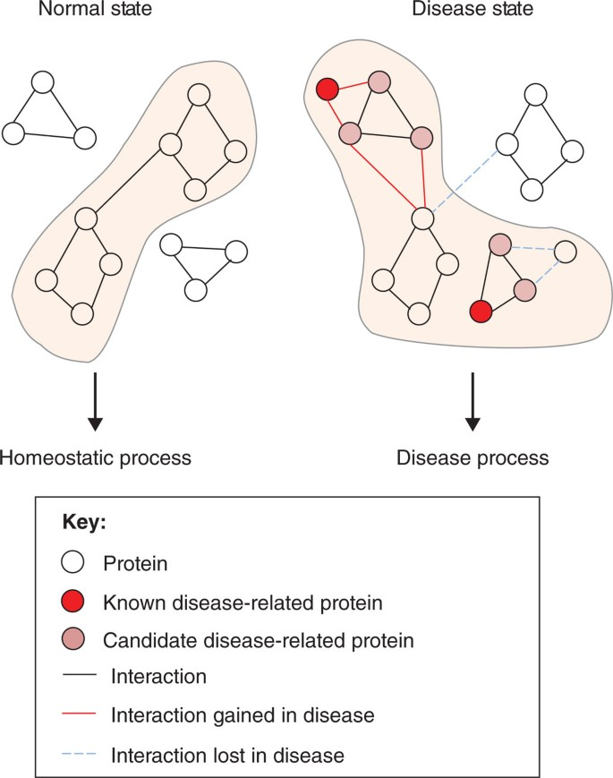
Drug Discovery & Data Mining :Story behind it
Also called Quantitative Structure Activity Relationship (QSAR)
Based on hypotheses at what is the targeted protein
search for the molecule that changes the functionality of target protein
Notes:
Data mining: turning large collection of data into knowledge, by discovering patterns in data
We wanna analyse the data of any disease to discover its cure
To have a better understanding , let's go back to our body, our body consists of proteins
When a disease attacks our bodies -> disrupt
The disease targets a protein :

Slide 4
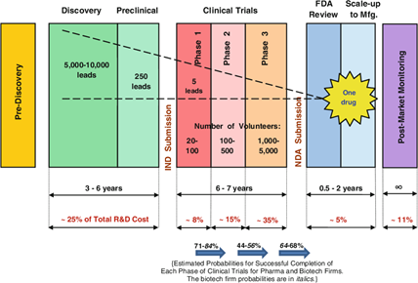
Drug Discovery Development Process
Notes:
Target discovery
Drug discovery
Number and background of vol
Healthy
Monitor sideeffects
Lengthy process, takes time, money and resources

Slide 5
Problem Statement
The process of drug discovery is a very long process that can take years of research, testing phases and getting the approval from Federal to be available to public for use. Utilizing Machine learning Algorithm, we aim to automate the routine work in the drug discovery laboratories of manually observing the activities of the target protein over the span of years and a load of biological calculations and analytical statistics.

Slide 6
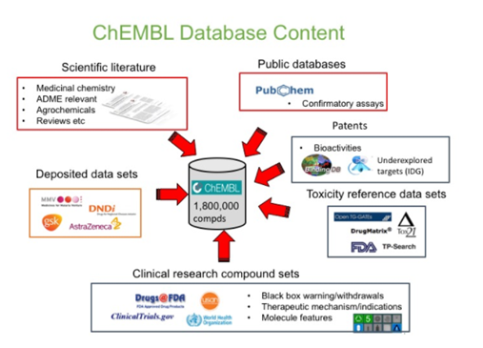
Database Description
Database : ChEMBL
Disease: Alzheimer
Target protein : Amyloid Beta A4 protein
Notes:
manually curated chemical database of bioactive molecules with drug-like properties

Slide 7
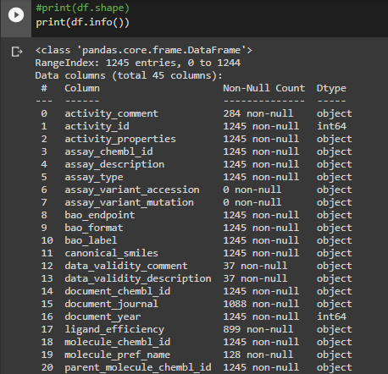
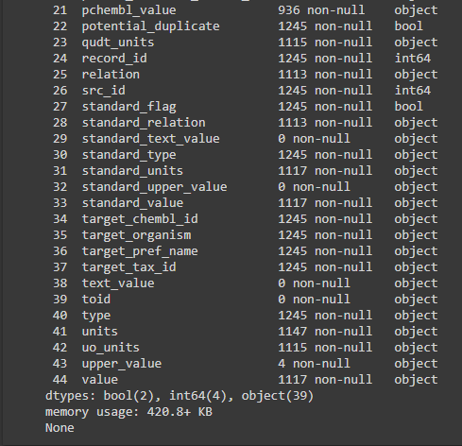
Dataset Description
Shape = (1245, 45)
2 important attributes: canonical_smiles (obj), standard_value(obj)

Slide 8
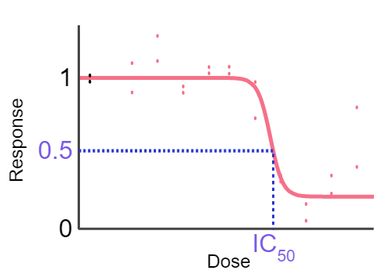
IC50 and pIC50
Half maximum inhibition concentration :a measure of the of a potency substance in inhibiting a specific biological or biochemical function.
pIC50 is negative log of IC50
Notes:
Since the nature of potency values is logarithmic, how the data is reported should also be log based

Slide 9
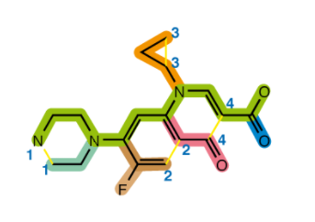
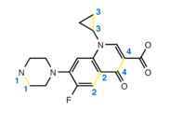
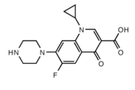

Smiles (Simplified Molecular input Line-Entry System)
Notes:
An additional type of bond is a "non-bond", indicated with ., to indicate that two parts are not bonded together
SMILES is in ASCII code

Slide 10
Data Preprocessing
DataFrame
Shape
Data Preprocessing
Converted standard_value to float
Drop rows that have canonical_smiles or\and standard_value as na (missing data)
Drop rows that have duplicate smiles notation (duplicated data)
Discritization: Create bioactivity class attribute and remove intermediate bioactive molecules (discritization)
Simplify the smiles notation and remove non-bonded elements (remove noise)
Normalize the standard value by taking the negative logarithmic value of IC50 == pIC50 (normalization)
Select The most meaningful features for our experiment [molecule_chembl_id, canonical_smiles] (feature selection)
Compute PaDEL from the selected features (feature engineering)
Eliminate non-variant features using VarianceThreshold method (dimension reduction)
(716, 45)
(716,2)
(716,881)
(716,557)
Notes:
I passed to padle the smiles and id and it returned
Why i skipped integration cuz this data set is an integration of many resources => many duplicates exists=> i need to remove the duplicates

Slide 11
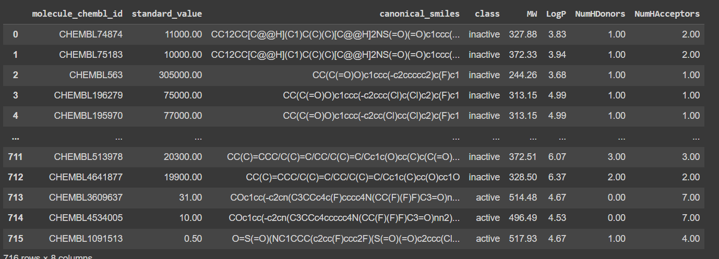
Feature Engineering and data splitting
Exploratory Data Analysis (EDA)
Compute Lipinski descriptor and analyze the dataset in terms of Lipinski criteria
Data is split into 67% training 33% testing

Slide 12
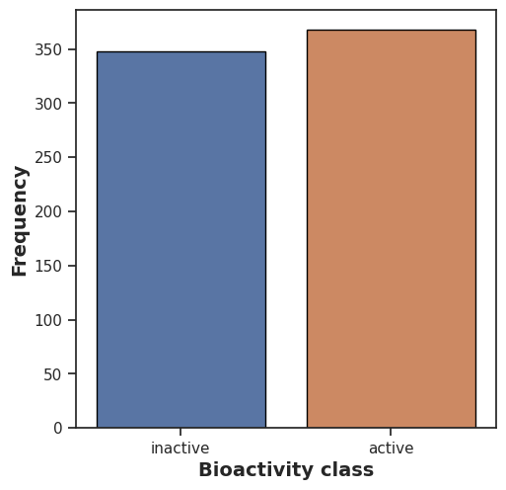
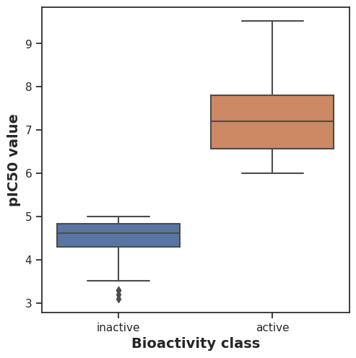
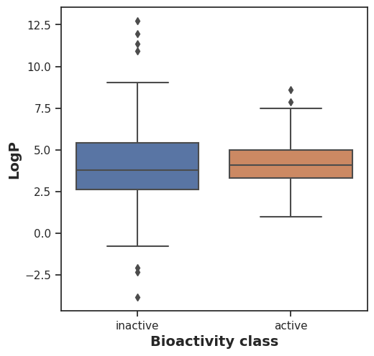
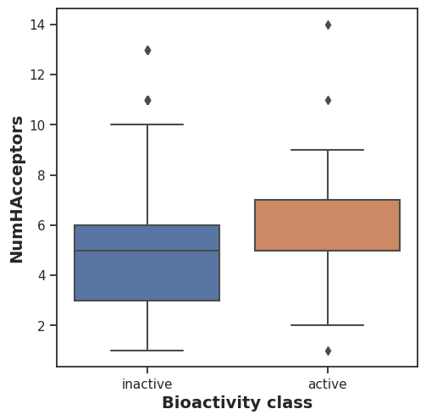
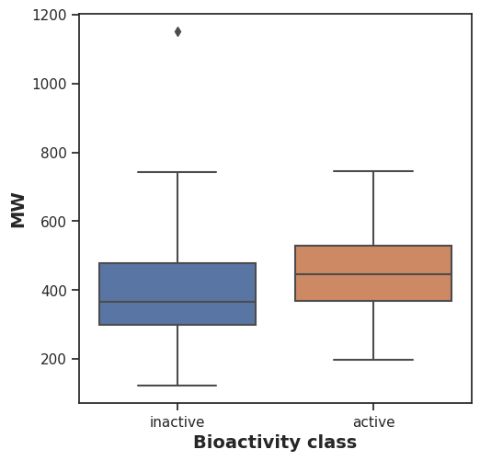
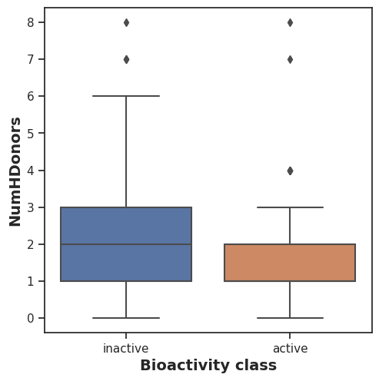
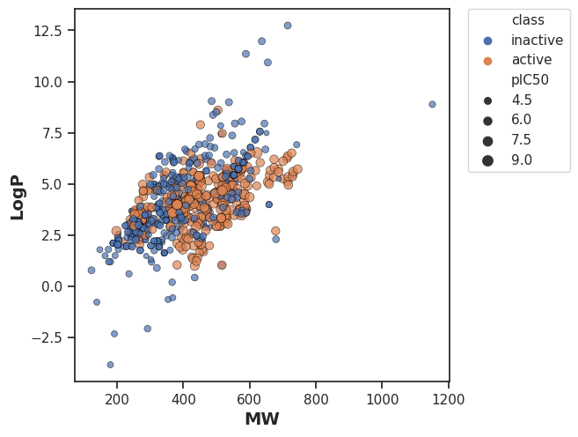
EDA
Data Exploration and Visualization using lipinski descriptors attributes

Slide 13
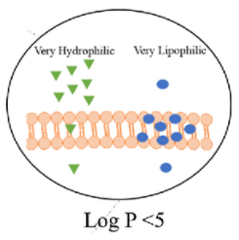
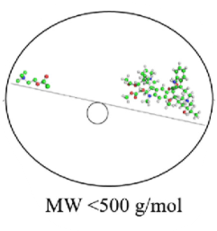
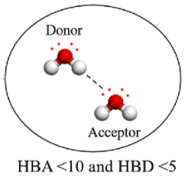
Lipinski Descriptors
Notes:
Log p whether a substance will be absorbed by plants, animals, humans, or other living tissue;

Slide 14
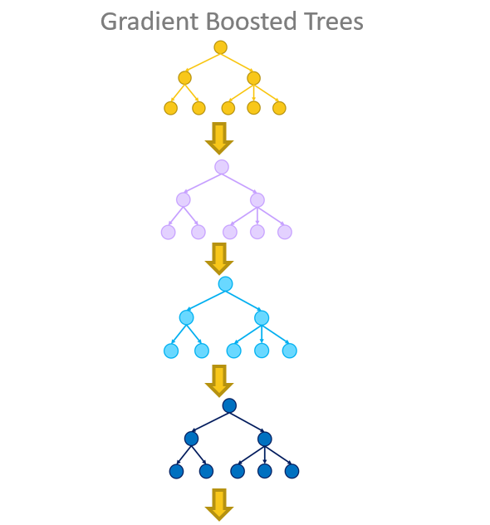
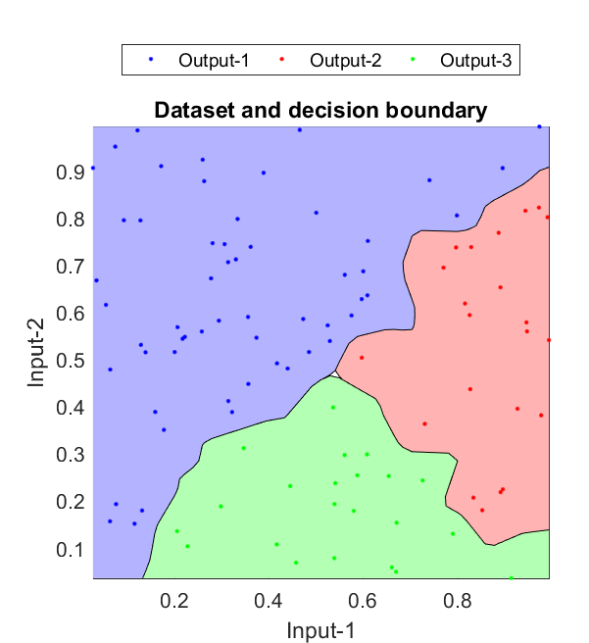
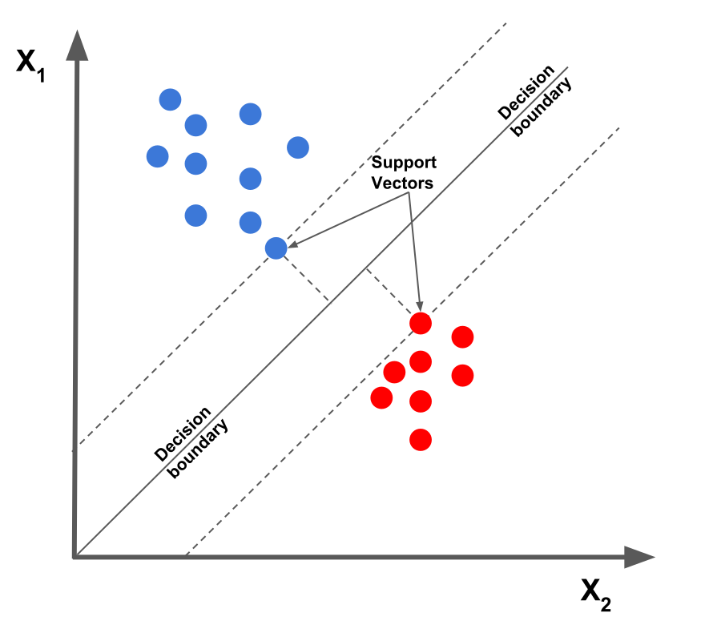
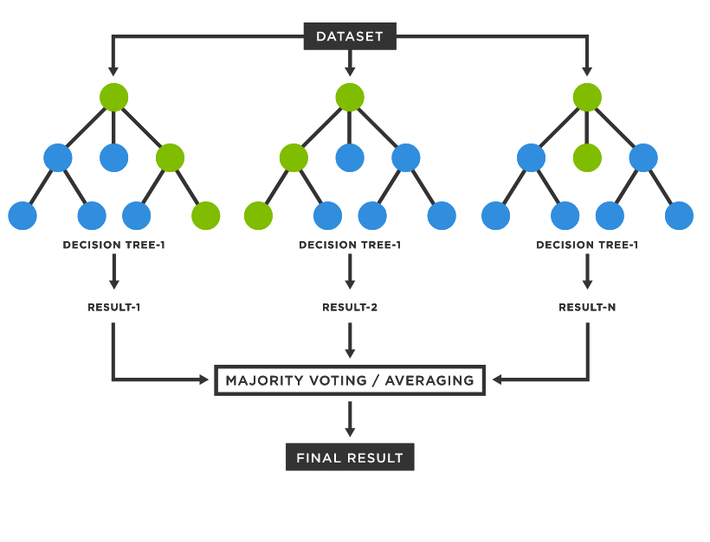
Data Mining : Regression Problem
Gradient Boosted
Regressor
K - Nearest Neighbor
Support Vector Machine
Random Forest

Slide 15
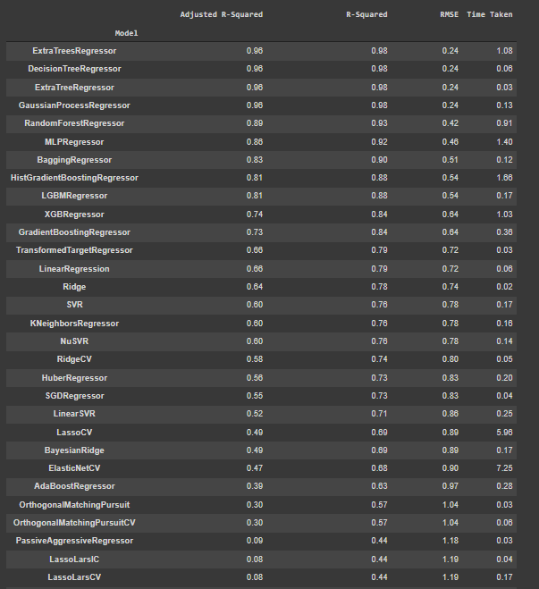
Evaluation of the
Lazy Predict Models

Slide 16
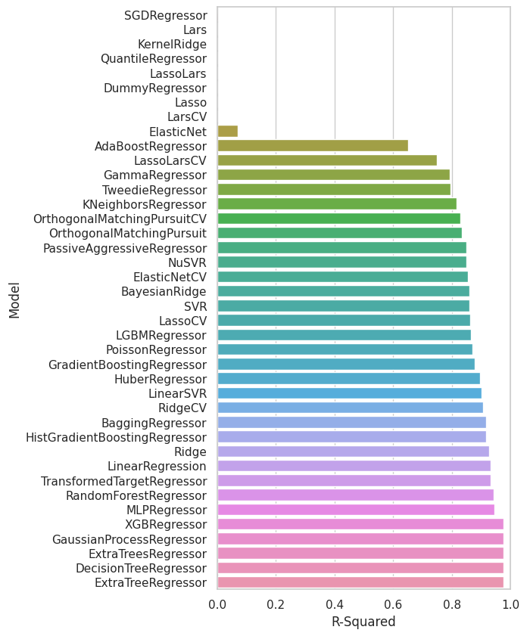
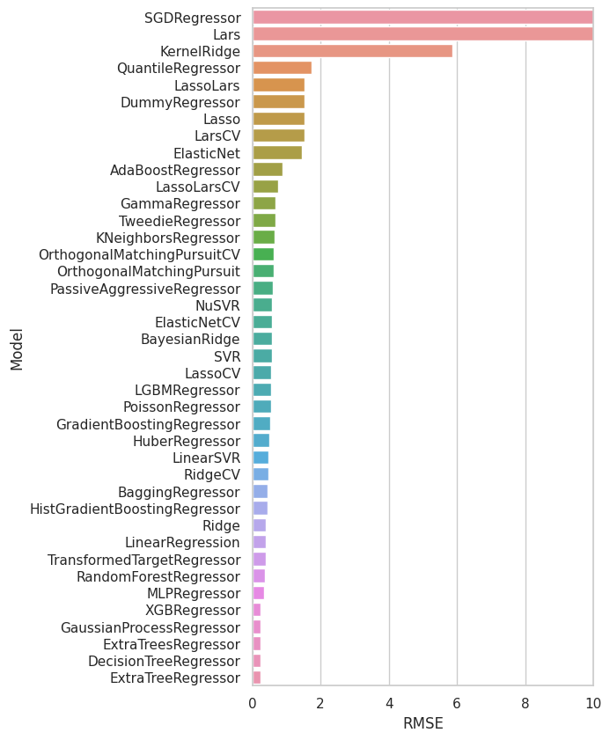
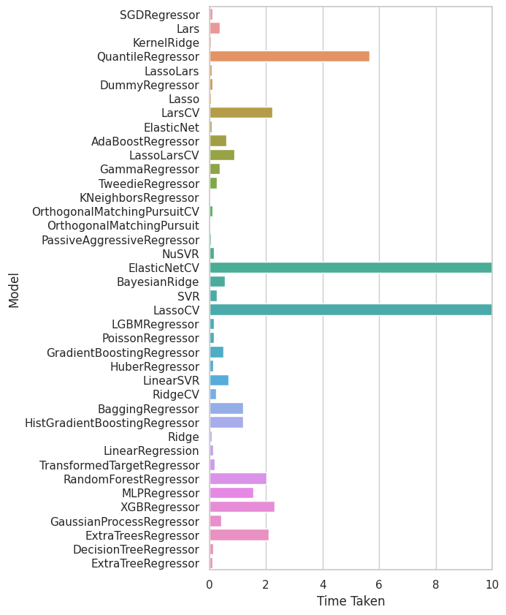
R-squared values
RMSE values
Computation Time

Slide 17
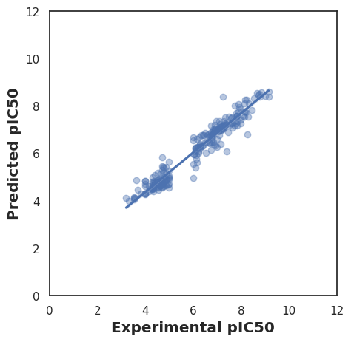
Hyperparameter Optimization
Search Grid for the best performing parameters
Number of estimators = 800
Tree Depth = 8
Cross Validation , cv = 3
Model | R2 Score | MAE | Execution time (Sec)
Random Forest | 0.7045 | 0.549 | 0.0091
Gradient Boosted regressor | 0.692 | 0.61 | 0.0015
K-nearest Neighbor | 0.68 | 0.61 | 0.0016
Support Vector Machine | 0.708 | 0.61 | 0.0018
Optimized Random Forest | 0.928 | 0.29 | 0.0702

Slide 18
Questions & Comments Thank you

