Slide 1
Human Computer Interaction Study Case: Voice Controlled Task Management Web App Tool
Done by :–
XXXXXX
Supervisor :XXXXXX

Slide 2
TABLE OF CONTENTS
01
03
Design Thinking Process
Live Demo
02
04
Development & Deployment
Conclusion & Future Work
Monday
20.12.2021

Slide 3
01
Design Thinking Process
How to approach problems creatively
Monday
20.12.2021

Slide 4





01-Design Thinking Process
Discover
Define
IDeate
Prototype
Deploy
Monday
20.12.2021

Slide 5
01.01
Discover stage
Find User Problems
Monday
20.12.2021

Slide 6



Interviews
Questions :
Do you write a todo list daily ?
How often do you use TMA?
Do you accomplish all tasks written in the list?
Analysis of answers :
Actual users do not have motivation to use it
Non-users do not use it efficiently
Interviewees :
Group Interview of
8 people of users/not users of TMA
Monday
20.12.2021

Slide 7
01.02
Define stage
Define requirements/ Goals of the design
Monday
20.12.2021

Slide 8
Main Strategy of the Design
Attract User and Non-Users of Time Management Apps
Simple and one-click Design
Keep in mind all types Users
Monday
20.12.2021

Slide 9
01.03
Ideate stage
Flare and Focus Method
Monday
20.12.2021

Slide 10
Final Applied Ideas
01
03
Use Voice Recognition to Control the App
Screen Reader Features
02
04
Minimalist & Modern Design
Make it Web App: accessible from all devices
Monday
20.12.2021

Slide 11
01.04
Design & Prototype stage
Using Latest Technologies
Monday
20.12.2021

Slide 12

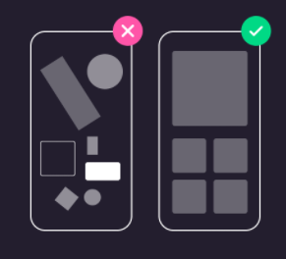
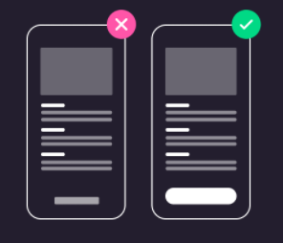
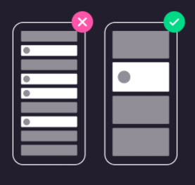
Designing a Prototype
Design Tool
Design Theories
Aesthetic-Usability Effect
Fitts’s Law
Hicks Law
Monday
20.12.2021

Slide 13
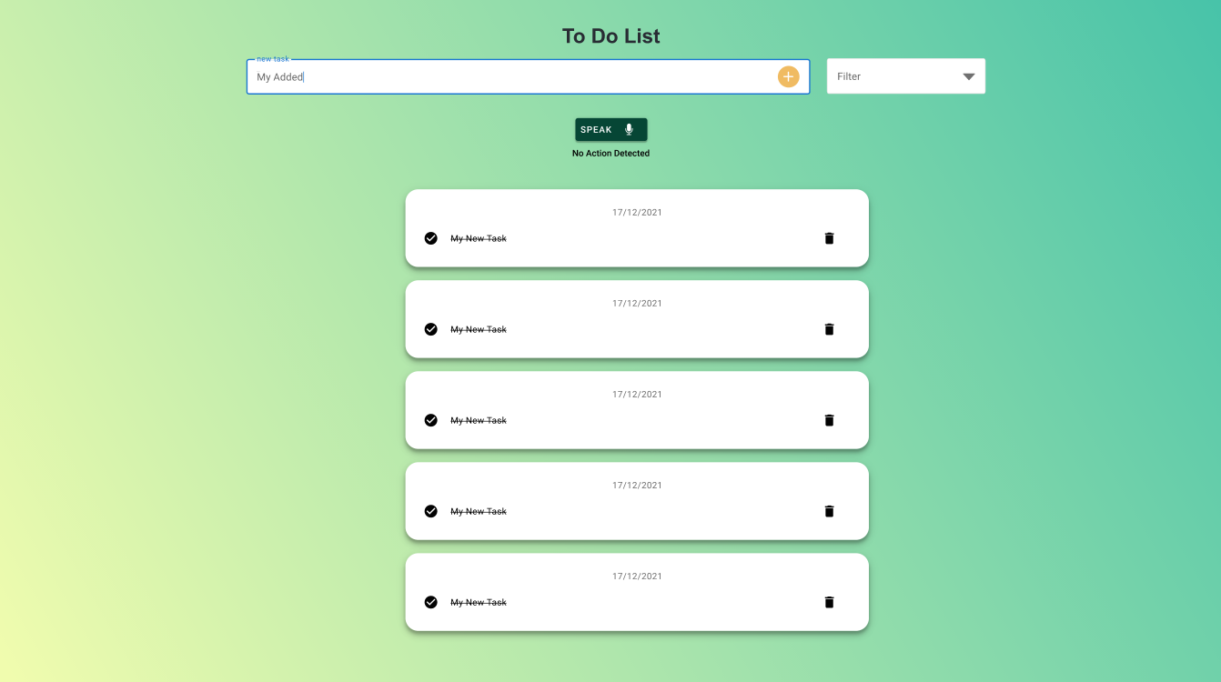

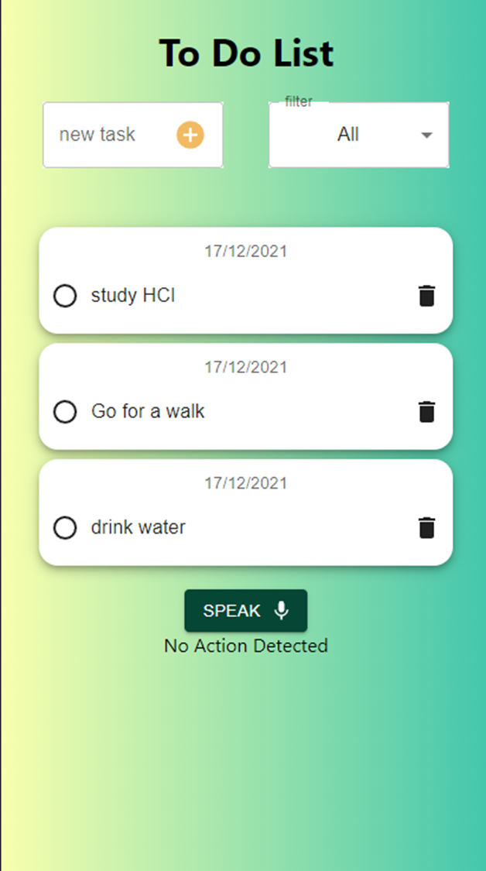
High Fidelity MOCKUPS
Adobe XD Design
Responsive Design for all types of Digital Devices regardless of Operating system or screen size or compatibility
Monday
20.12.2021

Slide 14
01.05
Test stage
UX and Functionality Testing
Monday
20.12.2021

Slide 15
Types of Tests Conducted
Usability
Responsiveness
Voice Recognition
Tested by 10 different People
Viewed from 4 different devices
Tested by 4 different People
Accessibility
Functionality
Deployment
Using web-based screen reader
Individual & combinations of functionality tested
Test if all previous test work on the deployed model
Monday
20.12.2021

Slide 16
03
Development & Deployment
Monday
20.12.2021

Slide 17
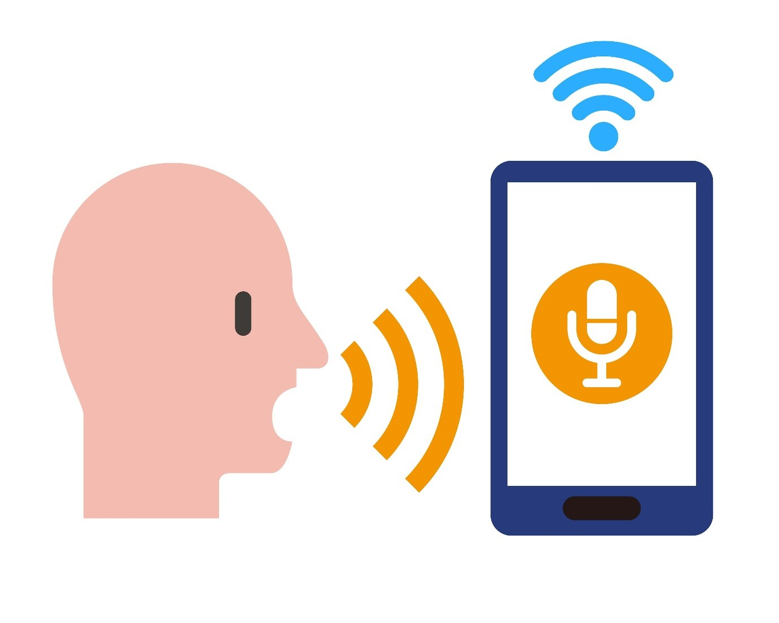
Voice Recognition Using TF model
01
Click on the speak button
02
Mic capture the command
03
Tensorflow model outputs“words”
04
Use REACt Hooks to control Webpage
Monday
20.12.2021

Slide 18










List of Used Libraries & Tools
AI Model
Backend & Frontend development
Tensorflow Speech Recognition Model
Monday
20.12.2021

Slide 19
03
Live Demo
Monday
20.12.2021

Slide 20
04
Conclusion and future work
Monday
20.12.2021

Slide 21
What The Future Holds
User Centered
Integrate
Stylus Experience
Generate unique features based on users demands
Integrate with other App for seamless transition and quicker access
Add stylus experience and its related features
Monday
20.12.2021

Slide 22
THANKS!
Do you have any questions?
Monday
20.12.2021

